Slide 1

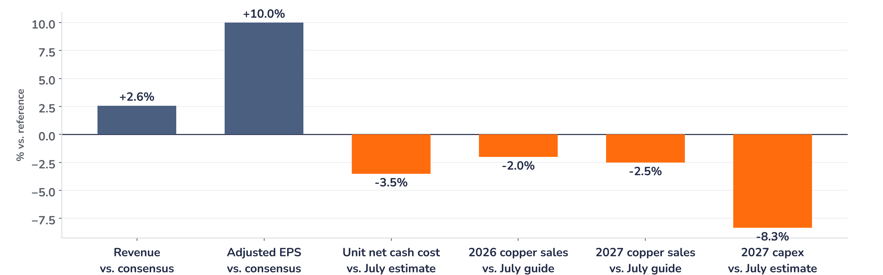
Earnings update
Freeport-McMoRan Q3 2026: price carries the beat, volumes carry the case
27 October 2026 · Syz Research
“The progress achieved during 2026 sets us up for growing volumes and improving financial performance as we look ahead to 2027 and 2028.”
Kathleen Quirk, President and Chief Executive Officer, Q3 2026 earnings call, 27 October 2026
Freeport-McMoRan mines copper, gold and molybdenum in the US, Peru, Chile and Indonesia (Grasberg). It expects about 3.0 billion pounds of copper sales in 2026. NYSE-listed, market value around USD 95bn.
Key takeaways
Beat
Adjusted EPS USD 0.88, 10% above consensus; revenue USD 7.55bn, up 8% on copper at USD 6.54/lb.
Reaction
Shares up 1.6% intraday on 27 October, muted: we read trimmed volumes and higher capex as the offset.
Watch
2026 copper sales trimmed about 2% to 3.0bn lb and 2027 about 2.5%; 2027 capex up USD 0.4bn.
Valuation
16.3x forward earnings, 12% below the 2021 to 2026 average, with consensus EPS up 19% since July.
Adjusted EPS
Revenue
Unit net cash cost
2026 copper sales guide
USD 0.88
USD 7.55bn
USD 2.07/lb
3.0bn lb
+10.0% vs. consensus
+2.6% vs. consensus
3.5% above July estimate
About 2% below July
What the quarter means for the investment case
Adjusted earnings per share beat consensus by 10% and revenue by 2.6%, and the shares rose 1.6% intraday on 27 October. The beat came from metal prices, not volumes: copper sales fell to 749 million pounds from 977 million a year ago, as Grasberg, the Indonesian mine recovering from a mud rush, ran at 67% of capacity.
Chart 1 · FCX: Q3 2026 vs. consensus and vs. the July guidance
Favourable (+) / unfavourable (-) in % · cost and capex unfavourable when above estimate · consensus EPS USD 0.80, revenue USD 7.36bn
Chart 1 splits the release in two. Everything measured against consensus beat; everything measured against the July plan moved the wrong way: unit cash costs 3.5% above estimate, 2026 and 2027 copper sales trimmed by about 2% and 2.5%, and 2027 capital spending raised by USD 0.4bn. Price flatters the quarter; execution sets the multiple.
Base case and implications
We are constructive on Freeport, while the fourth quarter and the short-term copper price are the key tests of the investment case. The fourth quarter must deliver 875 million pounds of copper sales, 29% of the 2026 guide, and keep the USD 1.90 per pound full-year cost guide intact. We underwrite volume-led earnings: copper sales up more than 20% in 2027 to about 3.7 billion pounds, with Grasberg at 80% of capacity by mid-2027. Each USD 0.10 per pound move in copper shifts annual EBITDA by about USD 390m.
What would strengthen our view
What would change our view
Fourth-quarter copper sales at or above 875 million pounds; Grasberg above 70% of capacity at the Q4 release; Bagdad approved at about USD 4.5bn; 2027 field results that support the 800 million pound leach aspiration.
Another cut to 2027 copper sales after today’s 2.5%; unit costs above USD 2.00 per pound into 2027; copper below USD 5.00, where EBITDA falls to about USD 12bn; delay to the Indonesian operating extension beyond 2041.
Syz Research · Earnings update · 27 October 2026
1 / 3

Slide 2
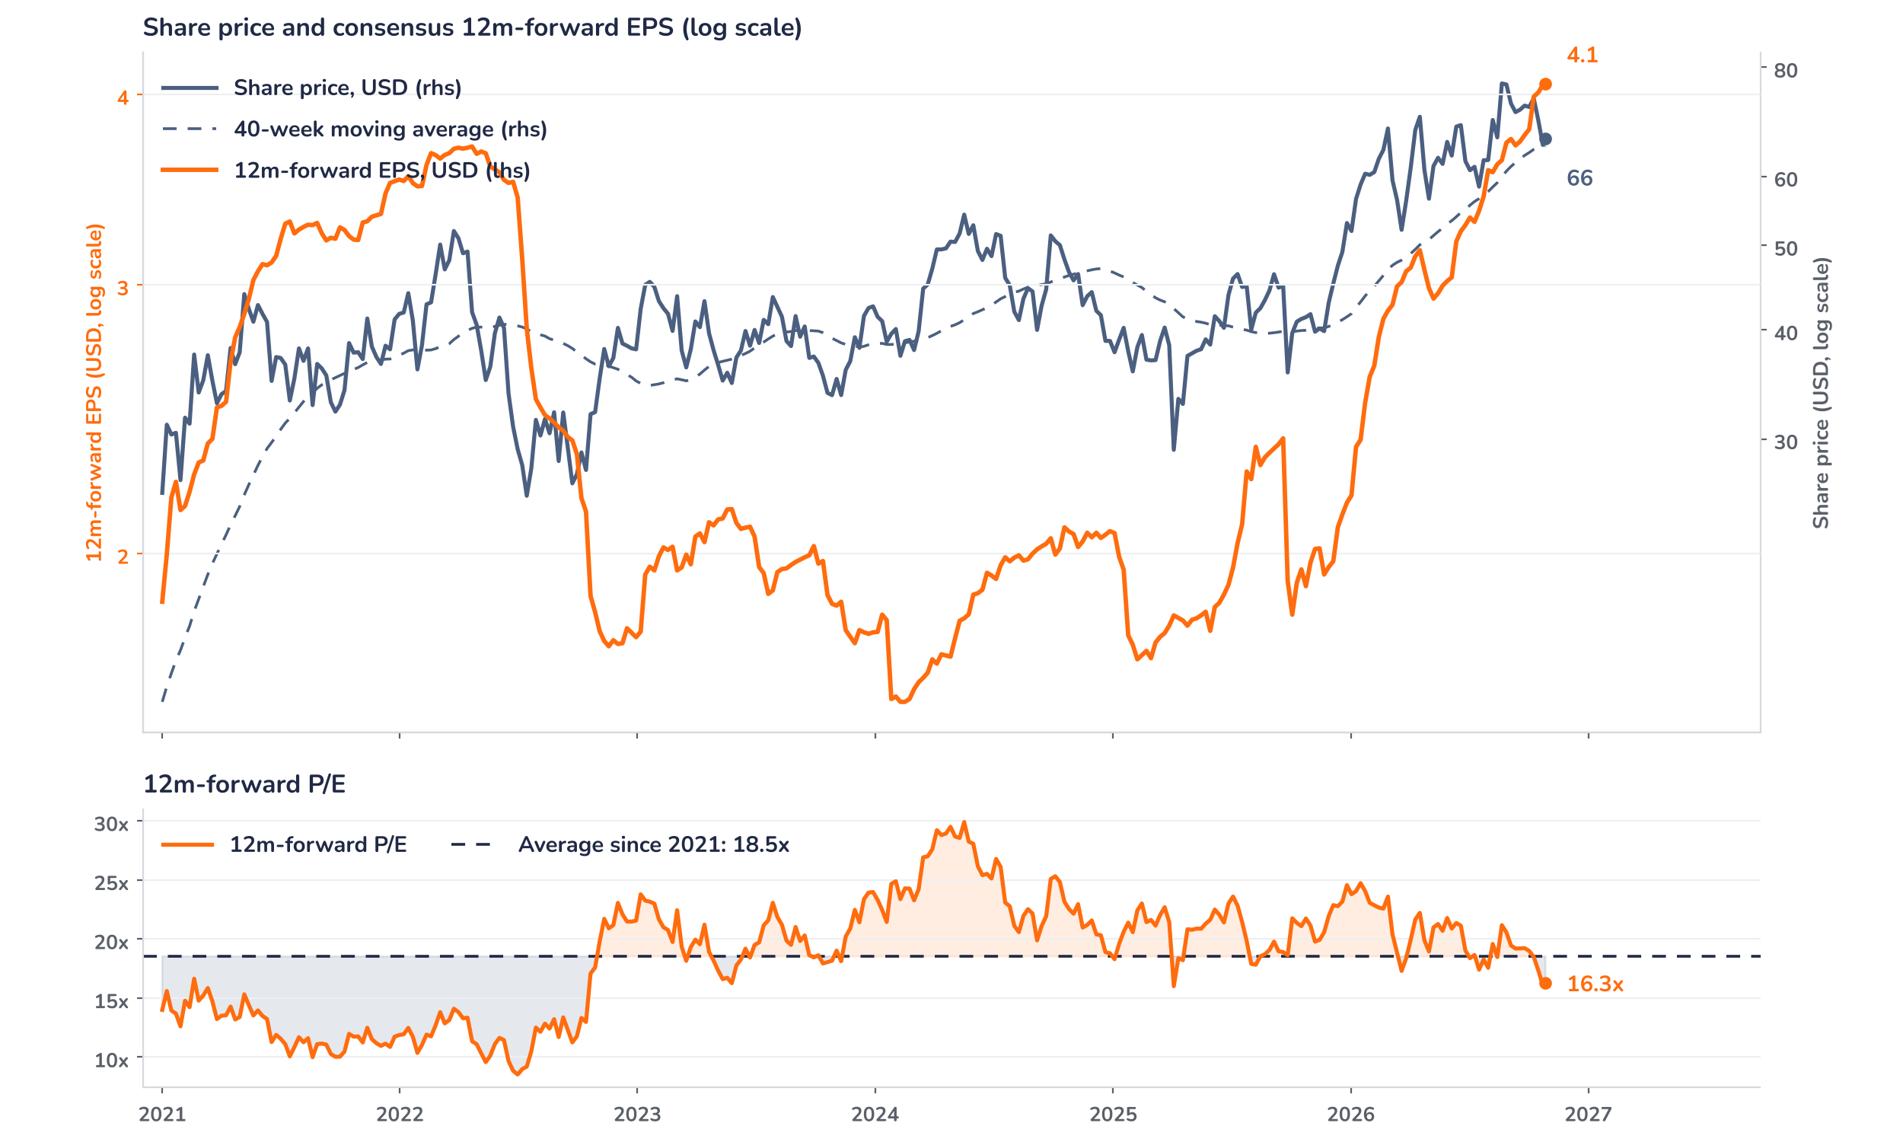
Beyond the key takeaways
Results: price did the work, volumes lagged
Revenue rose 8% to USD 7.55bn and adjusted EBITDA 14% to USD 3.2bn, while adjusted net income nearly doubled to USD 1.3bn, or USD 0.88 per share from USD 0.50. The driver was price: realised copper averaged USD 6.54 per pound and gold USD 4,273 per ounce, up from USD 3,539, which offset copper sales 23% lower at 749 million pounds and gold sales of only 105,000 ounces, as some shipments slipped into the fourth quarter. Unit net cash costs of USD 2.07 per pound reflect lower gold credits, diesel and sulphuric acid. Grasberg idle-facility charges of about USD 240m stay outside unit costs until 2027. Operating cash flow was USD 2.0bn.
A 10% earnings beat earned a 1.6% intraday rise on 27 October: aligned in sign, small in size. Confirmed drivers: 2026 copper sales were cut by about 2% on weather and grade shortfalls in the US and Chile, the 2027 plan by about 2.5% on mine-plan updates, and 2027 capital spending rose by USD 0.4bn. Volumes were previewed on 2 October. We think the market had largely priced the beat through spot copper, up 16% this year, and treated the guidance trims as the new information. The 11.5% fall in the two weeks before the release is consistent with that reading.
Outlook: 2027 growth intact on a lower base
Management sees the fourth quarter as the year’s strongest, with copper sales up 17% from the third quarter to 875 million pounds and gold sales nearly tripling. For 2027 it guides copper sales up more than 20% and gold more than 50%, then a further 10% and 20% in 2028; Grasberg copper rises from about 0.7 billion pounds this year to 1.2 billion. The 2026 unit cost guide of USD 1.90 per pound was kept. Capital spending rises to USD 4.4bn in 2026 and USD 5.2bn in 2027, excluding the USD 4.5bn Bagdad expansion, which would add 200 to 250 million pounds a year about 3.5 years after approval.
Valuation: earnings have outrun the price
Chart 2 · FCX: share price vs. consensus earnings and valuation
Weekly since Jan 2021 (earlier trough-earnings P/E above 100x) · Bloomberg 12m-forward consensus · 40-week MA · log scale · last price intraday 27 Oct
The share price is up 60% over 12 months, but consensus 12m-forward EPS has risen 114% to USD 4.07. Since the July results, EPS is up 19% and the price 6%. The multiple has compressed from 21.2x at the August peak to 16.3x, 12% below its 18.5x average since 2021 and below the one-year average of 20.5x. The price sits 1.8% above its 40-week moving average of USD 65.05. At today’s price, consensus EPS would have to fall 12% to take the multiple back to its average; our base case points the other way.
Syz Research · Earnings update · 27 October 2026
2 / 3

Slide 3
SYZ Source: Syz Research, Bloomberg, company filings, Freeport-McMoRan Q3 2026 results release and earnings call of 27 October 2026, analyst research notes of 2 October 2026
Disclaimer
This communication has been issued and made available to recipients for the purpose of advertising investment services and/or financial instruments. It has been sent for information purposes and cannot be considered as an offer or a personalised recommendation to buy or sell a financial instrument or any other investment or currency. This communication does not constitute investment research within the meaning of regulatory rules applicable in the European Economic Area, or research under the rules of the U.S. Self-Regulatory Organizations.
This information is made solely for professional and institutional clients as defined by the Swiss Financial Services Act, as well as qualified investors according to the Swiss Collective Investment Schemes Act. It is not intended for retail clients or non-qualified investors and consequently cannot be transmitted to any third party.
This communication is not directed to any person in any jurisdiction where, by reason of that person’s nationality, residence or otherwise, its dissemination or use is prohibited. It cannot be quoted, reproduced, disclosed, distributed or otherwise referred to, in whole or in part, to any third party without the Bank’s prior written consent.
This communication may contain information on past performances of a financial product, all kinds of economic and financial valuations and analyses, as well as opinions of the Bank or of third parties. Any market valuations, terms and calculation methods, yields and opinions expressed are subject to change without notice. The information and opinions contained herein have been compiled and provided in good faith, based on information obtained from sources believed to be trustworthy. However, such information has not been independently verified. No guarantee, representation, or warranty of any kind, whether express or implied, is provided by the Bank or by relevant data vendors and other sources with respect to the accuracy, reliability, currentness or exhaustiveness of the information communicated, the methodology employed or the prices contained herein.
Past performance is not a reliable indicator of current or future results. Any reference to the past performance of an investment does not guarantee its future performance. Fluctuations in exchange rates may adversely affect the value, price or income of any investment.
Nothing in the present communication constitutes investment, legal, accounting or tax advice. This information is purely objective since it does not take into consideration the personal situation (including financial knowledge and experience), the investment objectives and risk profile of any recipient. Moreover, certain financial instruments mentioned (in particular, but not exclusively, derivatives, options and futures) involve a high risk of loss and may not be suitable. Accordingly, recipients should consult their own advisors on such matters, including but not limited to the possible tax consequences of investing in any financial product mentioned herein, and make their own assessment of the suitability of such investment product.
Should a recipient make an investment on the basis of the present communication, the recipient alone shall bear the consequences thereof. In no event shall the Bank, its directors, employees, affiliates or agents be held responsible for damages of any kind arising out of the use of all or part of the information provided herein.
Syz Research · Earnings update · 27 October 2026
3 / 3

