Slide 1

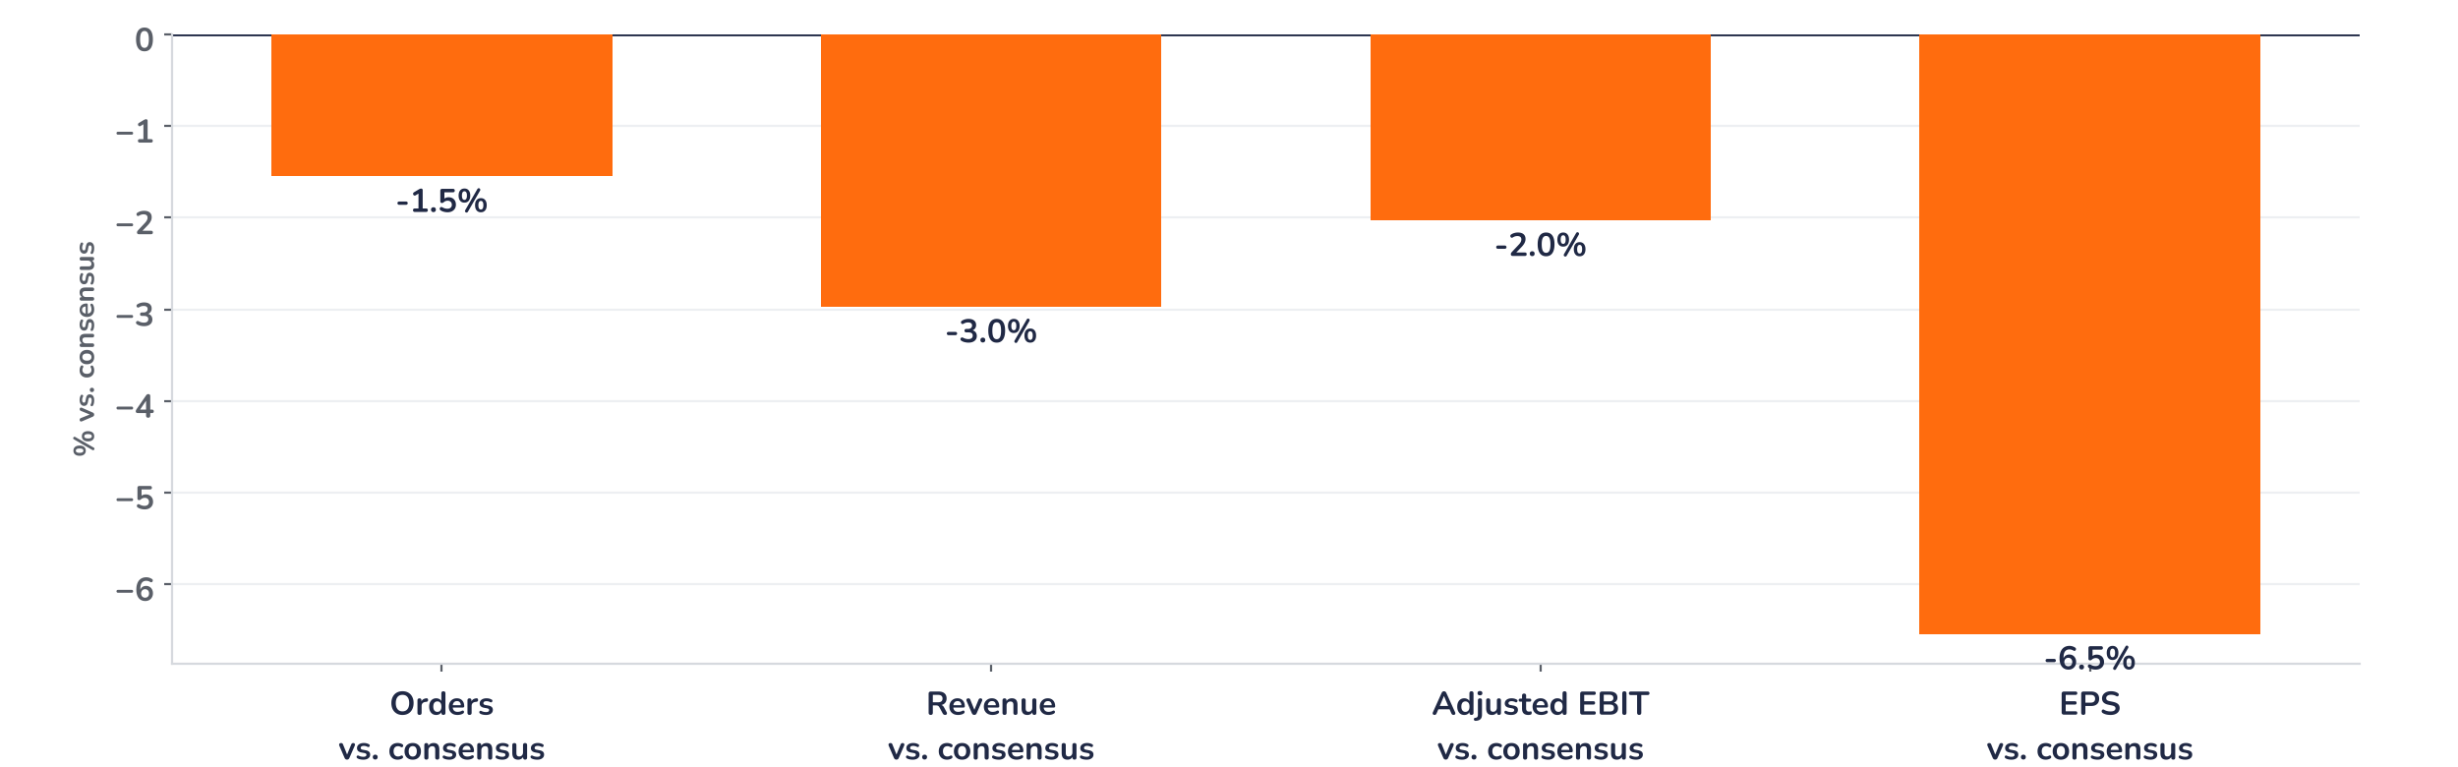
Earnings update
Epiroc Q3 2026: margins deliver, orders and cash do not
28 October 2026 · Syz Research
Epiroc makes drilling rigs, underground loaders, rock tools and attachments for mining and infrastructure customers, and services the installed fleet. Mining accounts for 83% of orders; quarterly revenue is SEK 16.8bn. Listed in Stockholm.
Key takeaways
Miss
Revenue SEK 16.8bn, 3.0% below consensus; EPS SEK 2.00, 6.5% below, despite a 20.4% margin.
Reaction
Shares down 5.1% on 28 October: equipment orders grew 16% organically, against about 26% expected.
Watch
Operating cash flow fell to SEK 1.4bn from 2.5bn on inventory; 12-month cash conversion 78%.
Valuation
24.8x forward earnings, in line with the average since the 2018 listing and down from 33.3x in February.
Revenue
Adjusted EBIT margin
EPS
Equipment orders, organic
SEK 16.8bn
20.4%
SEK 2.00
+16%
-3.0% vs. consensus
+20bp vs. consensus
-6.5% vs. consensus
About 26% expected
What the quarter means for the investment case
Revenue missed consensus by 3.0% and earnings per share by 6.5%, and the shares fell 5.1% by early afternoon on 28 October: miss and reaction are aligned. The margin was the bright spot at 20.4%, up from 19.0%, but equipment orders grew 16% organically against 30% in the second quarter, and cash conversion weakened sharply.
Chart 1 · EPI A: Q3 2026 vs. consensus
Surprise in % · orders consensus from analyst first takes · EPS: basic reported vs. adjusted consensus
Chart 1 shows a miss on every volume line, from orders to earnings per share, against a margin that beat by 20bp. Efficiency gains held the operating profit miss to 2.0%, which included a SEK 135m currency gain that management does not expect to repeat at that scale. Volume, not cost, is the real issue.
Base case and implications
We keep our position in Epiroc but would wait for the order rebound before adding. The earnings path we underwrite rests on backlog conversion: consensus expects fourth-quarter revenue of SEK 18.6bn and EPS of SEK 2.35, up 11% and 18% from the third quarter, which needs underground deliveries to accelerate. Margins look durable above 20%, carried by efficiency and pricing. The copper pipeline is the catalyst; the fourth-quarter report in early 2027, with equipment orders and cash conversion, is the next test.
What would strengthen our view
What would change our view
Equipment orders back above 20% organic growth in the fourth quarter as copper projects are booked; surface tenders converting into orders; cash conversion back above 90%; an Equipment & Service margin near 23.8% without currency gains.
A second quarter of equipment orders below 15% organic growth; copper decisions slipping into mid-2027 as negotiations drag; inventory rising further, with rolling cash conversion below 75%; infrastructure demand guided from stable to weaker.
Syz Research · Earnings update · 28 October 2026
1 / 3

Slide 2
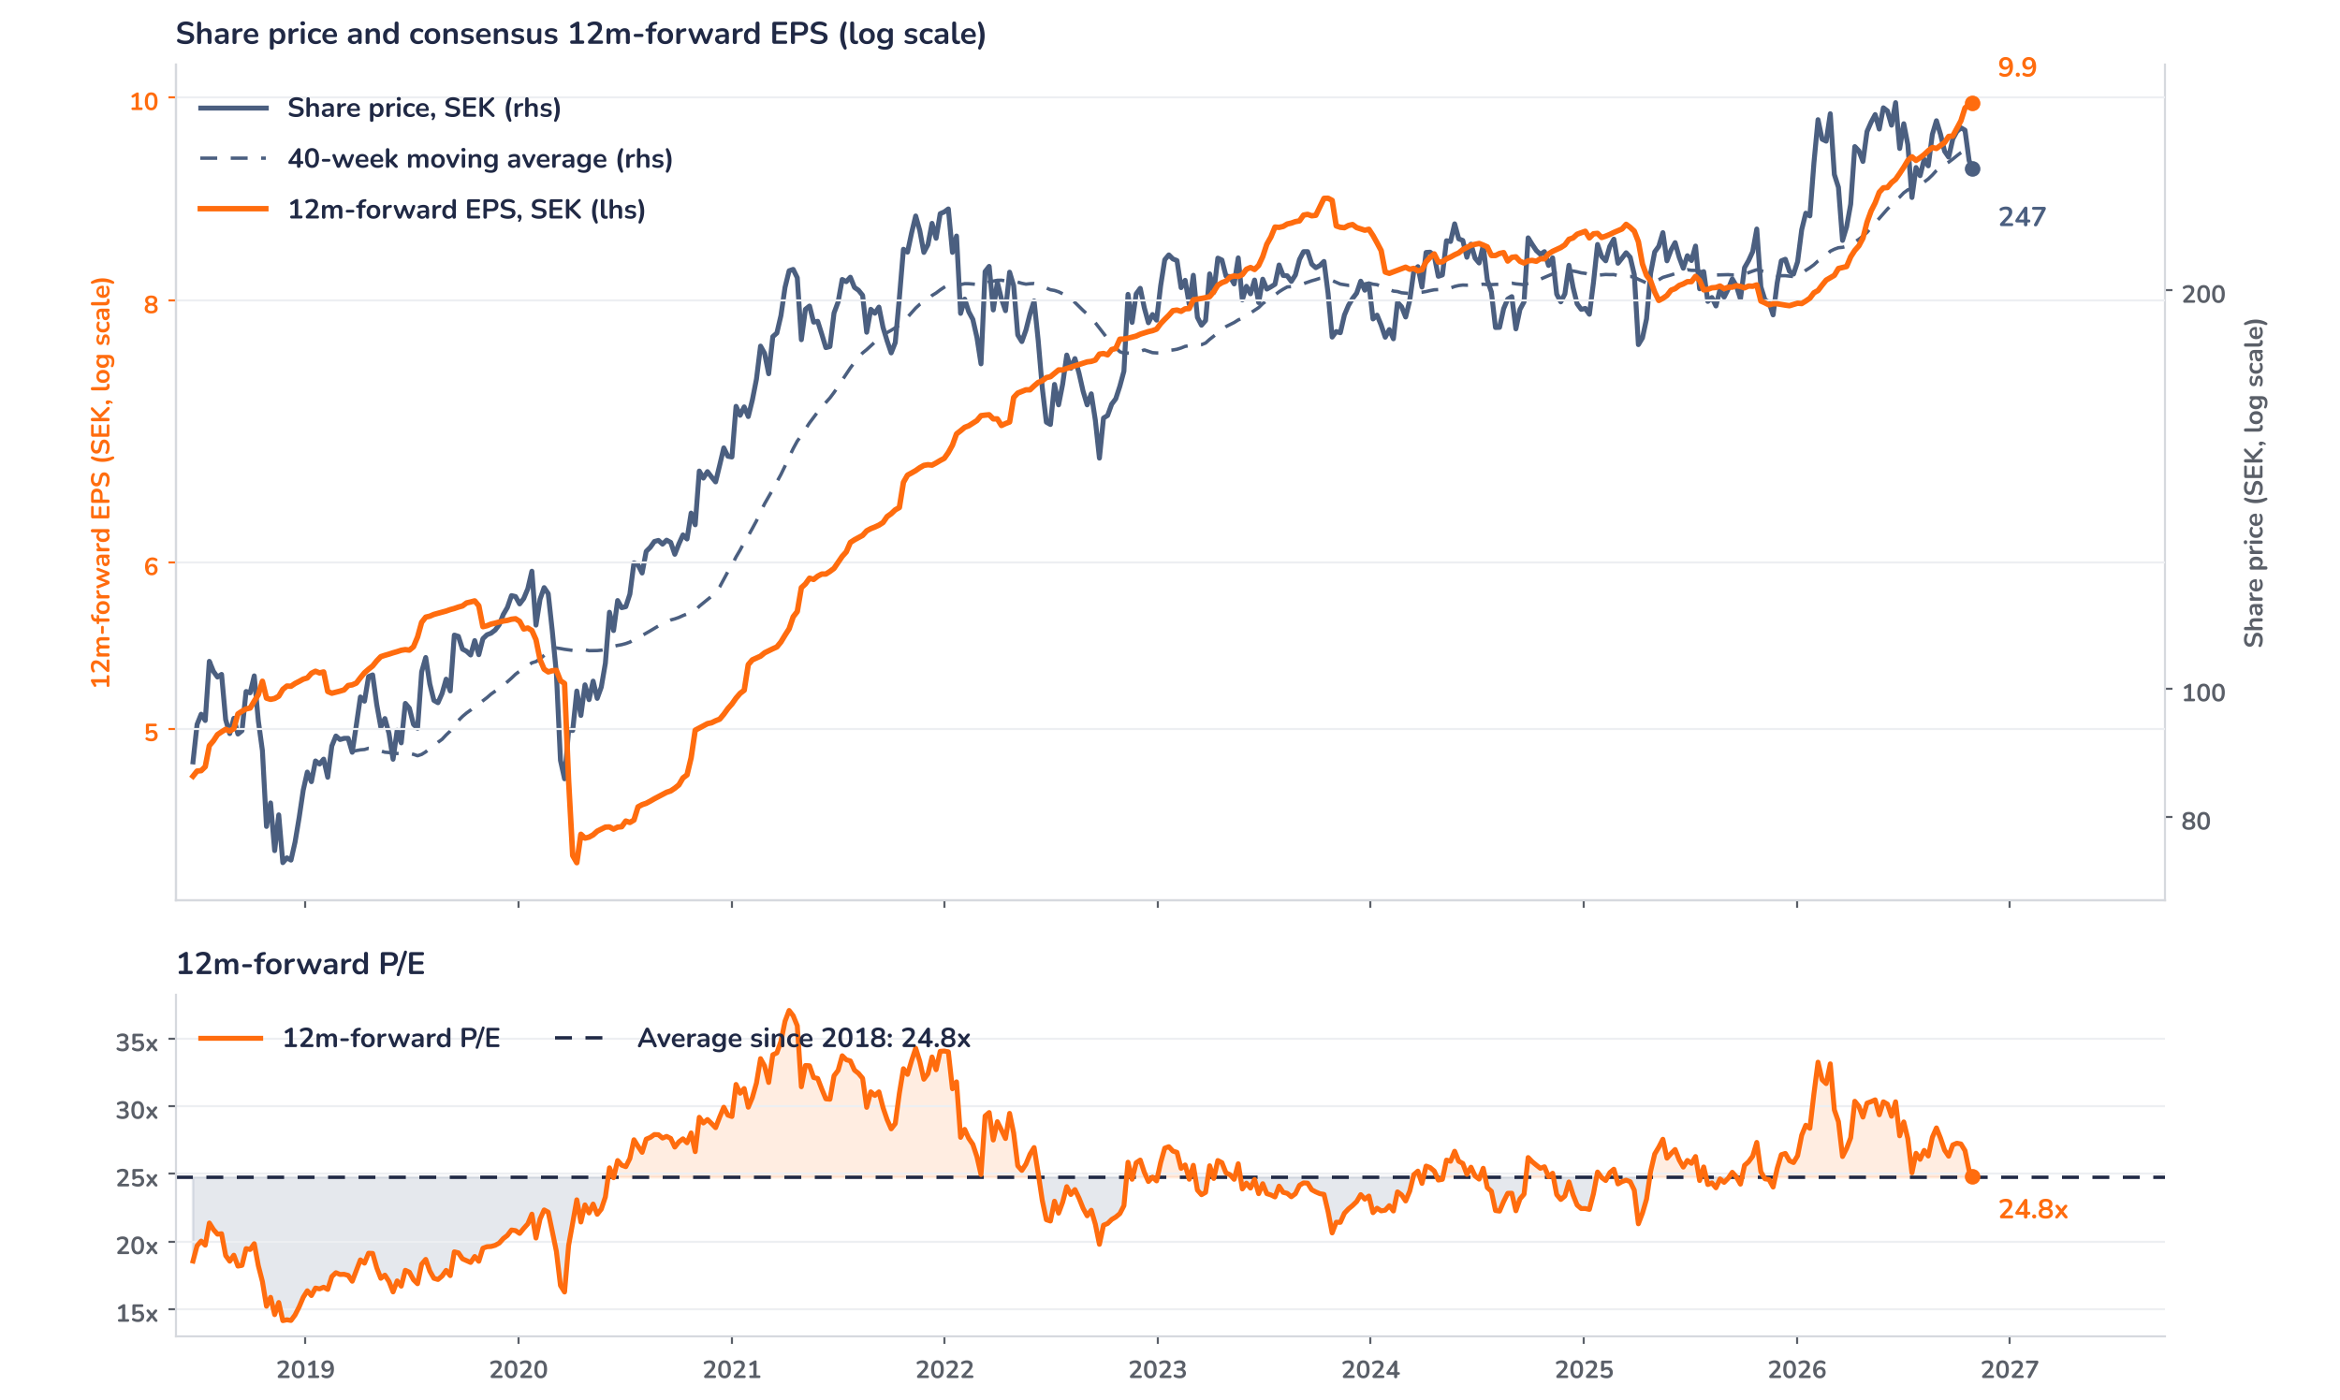
Beyond the key takeaways
Results: margins up, volumes short
Orders rose 12% organically to SEK 17.5bn, with equipment up 16% and service up 13%, against 30% and 6% in the second quarter; large orders reached SEK 790m, including a SEK 610m order for the Khoemacau copper mine. Revenue grew 7% organically to SEK 16.8bn: equipment only 5%, held back by long lead times on large surface rigs and a base that included more than SEK 300m of Roy Hill automation invoicing, service 10%. Equipment & Service lifted its adjusted margin to 23.8% from 21.9% on volume and efficiency; Tools & Attachments reached 13.2%, its best since early 2024. Currency added 3% to orders and revenue.
A miss on revenue, operating profit and earnings met a 5.1% fall by 13:27 GMT on 28 October: surprise and reaction are aligned. The confirmed drivers go beyond the headline: equipment orders grew 16% organically against analyst expectations of about 26%, surface tenders did not convert, the infrastructure outlook was trimmed from “increase somewhat” to “remain stable”, and operating cash flow fell to SEK 1.4bn from 2.5bn. Expectations were already easing, in our reading: the shares had fallen 6.5% in the two weeks before the release, which may have limited the move.
Outlook: copper pipeline strong, timing uncertain
Epiroc gives no numeric guidance. It expects mining demand to remain high and infrastructure demand to remain stable, where in July it expected infrastructure to increase somewhat; the weakness is in housing-related attachments. Management calls the copper pipeline for the fourth and first quarters very strong, but warns that investment decisions take months to become firm orders. Lead times are six to seven months for underground equipment and up to 12 months for large surface rigs, so the order book feeds revenue into 2027. Savings from moving tools production from Langley, Canada, to Matehuala, Mexico, are not yet in the numbers.
Valuation: back to the long-run average
Chart 2 · EPI A: share price vs. consensus earnings and valuation
Weekly since the June 2018 listing · Bloomberg 12m-forward consensus · 40-week MA · log scale · last price SEK 247.0, intraday 28 Oct
The share price is up 11% over 12 months while consensus 12m-forward EPS rose 22% to SEK 9.95, so earnings have outrun the price. Since the July results, EPS is up 6% and the price 5%. The forward P/E has fallen from 33.3x in February to 24.8x, in line with its average since the 2018 listing and well below the one-year average of 27.9x. The price sits 3.6% below its 40-week moving average of SEK 256 and 11% below the June high of SEK 278.2. The multiple no longer carries a premium; earnings delivery has to do the work.
Syz Research · Earnings update · 28 October 2026
2 / 3

Slide 3
SYZ Source: Syz Research, Bloomberg, company filings, Epiroc Q3 2026 interim report and results call of 28 October 2026, StreetAccount, analyst research notes of 28 October 2026
Disclaimer
This communication has been issued and made available to recipients for the purpose of advertising investment services and/or financial instruments. It has been sent for information purposes and cannot be considered as an offer or a personalised recommendation to buy or sell a financial instrument or any other investment or currency. This communication does not constitute investment research within the meaning of regulatory rules applicable in the European Economic Area, or research under the rules of the U.S. Self-Regulatory Organizations.
This information is made solely for professional and institutional clients as defined by the Swiss Financial Services Act, as well as qualified investors according to the Swiss Collective Investment Schemes Act. It is not intended for retail clients or non-qualified investors and consequently cannot be transmitted to any third party.
This communication is not directed to any person in any jurisdiction where, by reason of that person’s nationality, residence or otherwise, its dissemination or use is prohibited. It cannot be quoted, reproduced, disclosed, distributed or otherwise referred to, in whole or in part, to any third party without the Bank’s prior written consent.
This communication may contain information on past performances of a financial product, all kinds of economic and financial valuations and analyses, as well as opinions of the Bank or of third parties. Any market valuations, terms and calculation methods, yields and opinions expressed are subject to change without notice. The information and opinions contained herein have been compiled and provided in good faith, based on information obtained from sources believed to be trustworthy. However, such information has not been independently verified. No guarantee, representation, or warranty of any kind, whether express or implied, is provided by the Bank or by relevant data vendors and other sources with respect to the accuracy, reliability, currentness or exhaustiveness of the information communicated, the methodology employed or the prices contained herein.
Past performance is not a reliable indicator of current or future results. Any reference to the past performance of an investment does not guarantee its future performance. Fluctuations in exchange rates may adversely affect the value, price or income of any investment.
Nothing in the present communication constitutes investment, legal, accounting or tax advice. This information is purely objective since it does not take into consideration the personal situation (including financial knowledge and experience), the investment objectives and risk profile of any recipient. Moreover, certain financial instruments mentioned (in particular, but not exclusively, derivatives, options and futures) involve a high risk of loss and may not be suitable. Accordingly, recipients should consult their own advisors on such matters, including but not limited to the possible tax consequences of investing in any financial product mentioned herein, and make their own assessment of the suitability of such investment product.
Should a recipient make an investment on the basis of the present communication, the recipient alone shall bear the consequences thereof. In no event shall the Bank, its directors, employees, affiliates or agents be held responsible for damages of any kind arising out of the use of all or part of the information provided herein.
Syz Research · Earnings update · 28 October 2026
3 / 3

