Slide 1

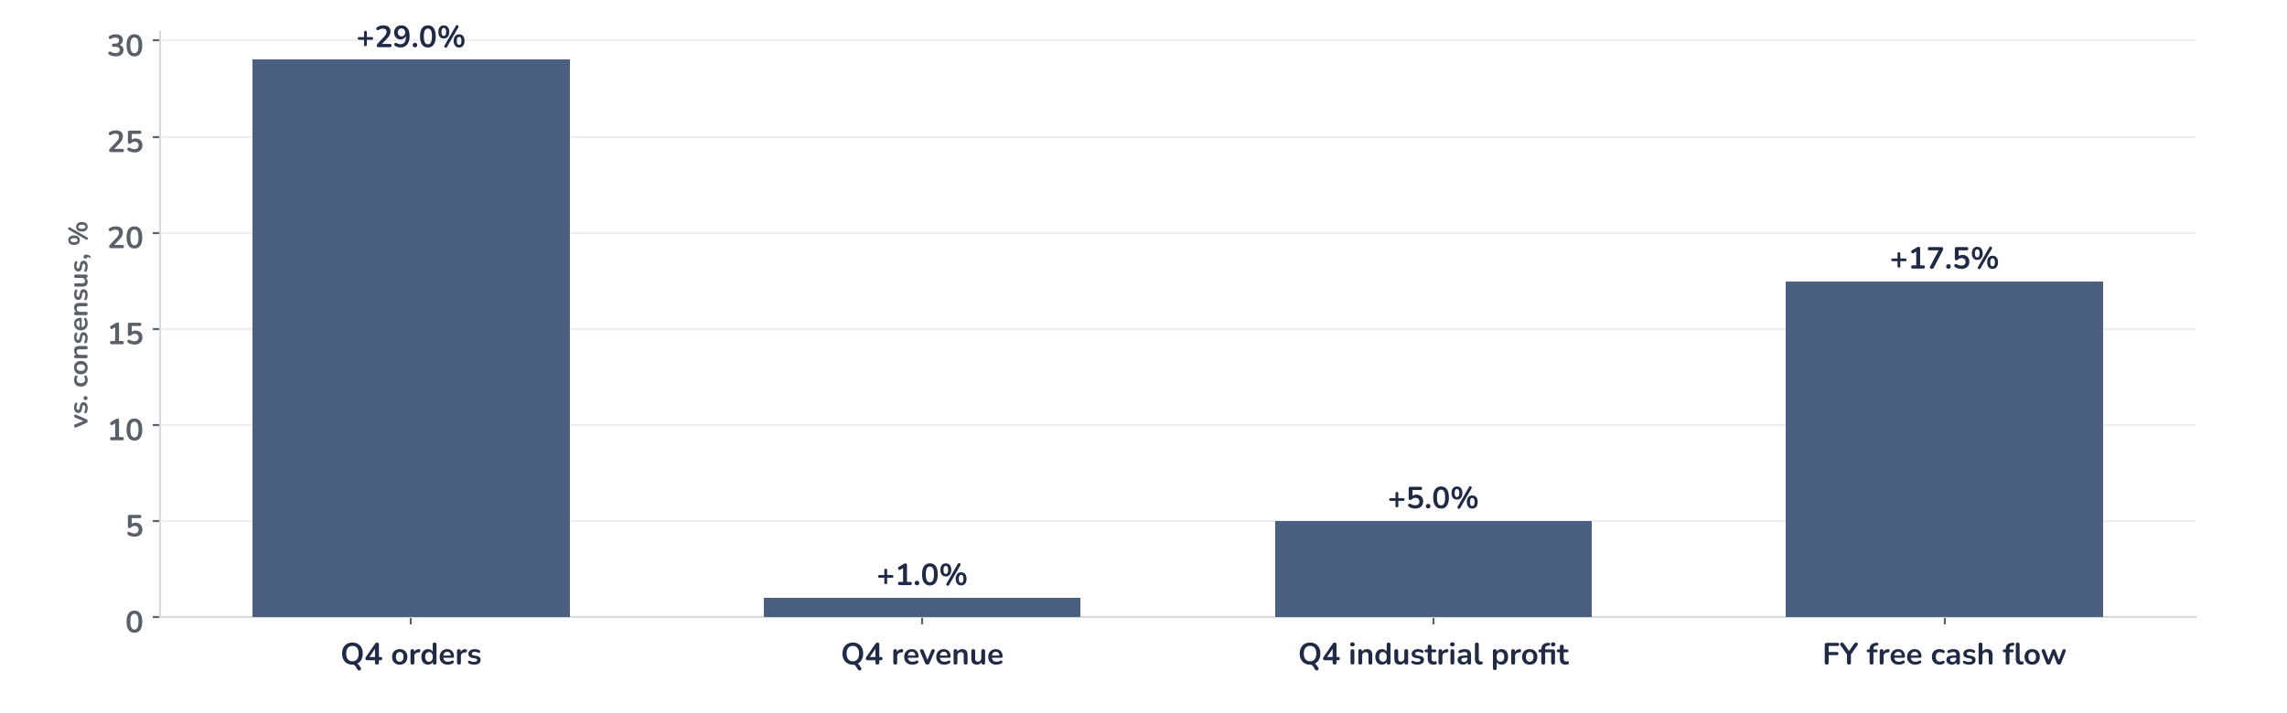
Earnings update
Siemens Q4 FY2026: record orders, higher targets, full price
12 November 2026 · Syz Research
“We see significant opportunities ahead. Driven by powerful secular growth trends and the strengths of our core markets, we are raising our mid-term targets.”
Roland Busch, CEO, Q4 FY2026 earnings call, 12 November 2026
Siemens supplies factory automation and software, electrification, building technology and rail systems, and controls Siemens Healthineers. Fiscal 2026 revenue EUR 83.4bn; Frankfurt-listed, market value about EUR 220bn.
Key takeaways
Beat
Q4 orders EUR 34.8bn, 29% above consensus; industrial profit EUR 3.9bn, 5% ahead, at a 16.8% margin.
Raised
Mid-term revenue growth target lifted to 7% to 11% from 6% to 9%; EPS growth now double digit.
Watch
Mobility’s record orders convert mostly after fiscal 2028; China automation orders softened in September.
Valuation
21.6x forward earnings, 43% above the 2015 to 2026 average of 15.1x: the quality is priced.
Q4 orders
Q4 revenue
Q4 industrial profit
FY27 EPS guide
EUR 34.8bn
EUR 23.7bn
EUR 3.9bn
EUR 10.20–10.80
+29% vs. consensus
+1% vs. consensus
+5% vs. consensus
+13% at midpoint, ex SHL
Orders reset the growth path, not the rating
Orders beat consensus by 29% and industrial profit by 5%, and the shares rose about 3% in early trading on 12 November, with the DAX higher. What changes is the growth path: management lifted the mid-term revenue target to 7% to 11% and EPS growth to double digit, backed by a data centre backlog above EUR 7bn and record free cash flow of EUR 12.1bn.
Chart 1 · SIE: Q4 FY2026 results vs. consensus
Reported vs. consensus, % · Consensus: analyst estimates before the release · Free cash flow: fiscal year; other lines: fiscal Q4
The orders beat is large but mixed in quality: Mobility booked more than EUR 10bn, much of it long-dated rolling stock and service contracts, while Smart Infrastructure orders rose 39% on data centres. Revenue was only 1% ahead, so the profit beat came from margins, led by Digital Industries at 21.9% before severance.
Base case and implications
Siemens has moved from a cyclical recovery story to a structural growth one, and the new targets make that explicit. We underwrite fiscal 2027 EPS of EUR 10.20 to 10.80 excluding Healthineers, up 13% at the midpoint, with upside if US and China automation keep their pace. The case remains constructive, but at 21.6x forward earnings the risk/reward is balanced: further gains need upgrades, not a higher multiple. The next tests are the spin-off report on 10 December and the February shareholder votes.
What would strengthen our view
What would change our view
Digital Industries Q1 growth inside its 8% to 12% range despite October pre-buying; data centre orders rising again in fiscal 2027; the EPS guide raised at the half year in May.
Data centre orders stalling for two quarters on power access or permits; China automation slowing once price-led pre-buying fades; the Healthineers spin-off slipping beyond the planned May 2027 date.
Syz Research · Earnings update · 12 November 2026
1 / 3

Slide 2
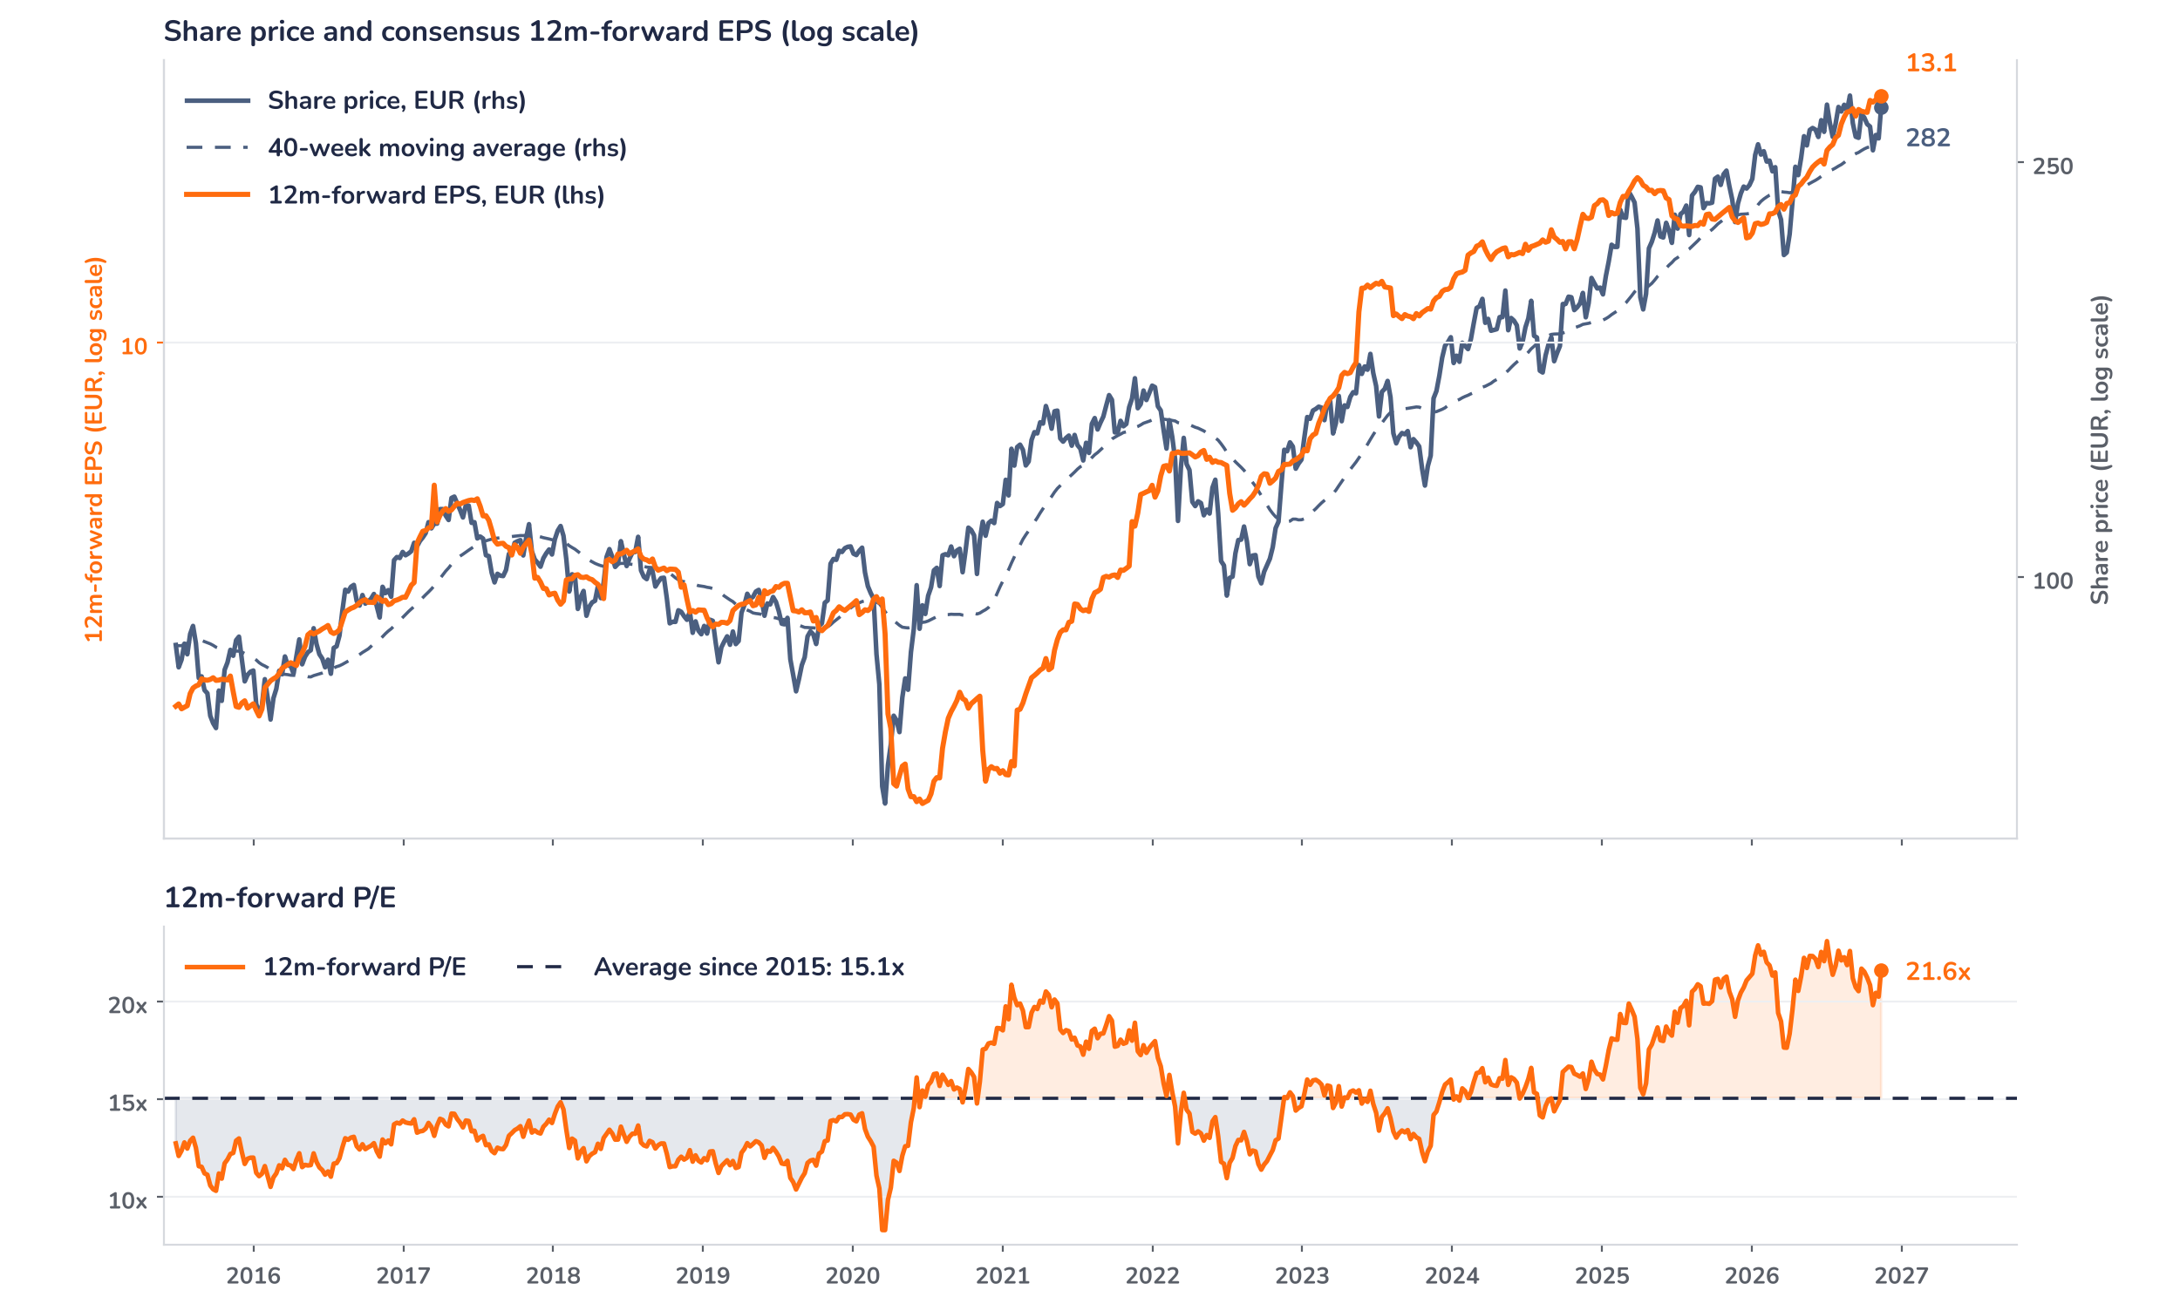
Beyond the key takeaways
Results: margins carried the profit beat
Comparable revenue rose 10% to EUR 23.7bn and industrial business profit 22% to EUR 3.9bn, a 16.8% margin, 150bp higher year on year. Digital Industries did most of the margin work: orders rose 15% and revenue 10%, and the margin before severance reached 21.9% on automation volumes, a better mix and some currency help, with software revenue and annual recurring revenue both up 12%. Smart Infrastructure grew revenue 15% at a 20.3% margin, of which 50bp came from US tariff refunds, a one-off we strip from the run rate. Mobility’s 9.5% margin reflected a favourable mix, and quarterly free cash flow reached EUR 5.6bn.
Surprise and reaction are aligned, but the move is modest for a 29% orders beat: the shares rose about 3% in early trading on 12 November, with the DAX also higher. Two confirmed facts temper the headline. Mobility’s record orders convert progressively, with many projects starting only beyond fiscal 2028, and China automation orders, up 8%, softened in September, while October was lifted by buying ahead of announced price increases. We think positioning also played a part: the shares traded at 20.2x forward earnings into the print, against a 15.1x average since 2015, so the beat confirms rather than changes the expected path.
Outlook: a 13% EPS step without Healthineers
For fiscal 2027, excluding Siemens Healthineers, Siemens guides comparable revenue growth of 9% to 11%, a book-to-bill above 1 and EPS before purchase price allocation of EUR 10.20 to 10.80, up 13% at the midpoint. Digital Industries 8% to 12% at a 20% to 22% margin, with moderate Q1 software growth before a renewal-heavy Q4; Smart Infrastructure 11% to 13% at 19.5% to 20.5%, carried by electrification; Mobility 6% to 8% at 8% to 10%, held back by Mermec integration costs. Management expects about 70% of the data centre backlog to convert in fiscal 2027. The 34.1% Healthineers stake is due to be spun off in late spring 2027.
Valuation: earnings must now do the work
Chart 2 · SIE: share price vs. consensus earnings and valuation
Weekly, Jun 2015 to 12 Nov 2026 · Bloomberg 12m-forward consensus EPS, includes Healthineers · 40-week MA · log scale · last price is a results-day level
Over 12 months the share price rose 19% against 13% for consensus EPS: the 12m-forward P/E stands at 21.6x, 43% above its 15.1x average since 2015 and close to the 23.1x peak of July 2026, with the price 9% above its 40-week moving average. Since early August, EPS rose 3% while the price was broadly flat, a mild derating. At the long-run average multiple the price would be about EUR 197, and a 10% upgrade at an unchanged price still leaves 19.6x. Consensus includes Healthineers, so the series will reset once the stake is reported as discontinued.
Syz Research · Earnings update · 12 November 2026
2 / 3

Slide 3
SYZ Source: Syz Research, Bloomberg, company filings, Siemens Q4 FY2026 earnings release and call of 12 November 2026, analyst research notes of 12 November 2026
Disclaimer
This communication has been issued and made available to recipients for the purpose of advertising investment services and/or financial instruments. It has been sent for information purposes and cannot be considered as an offer or a personalised recommendation to buy or sell a financial instrument or any other investment or currency. This communication does not constitute investment research within the meaning of regulatory rules applicable in the European Economic Area, or research under the rules of the U.S. Self-Regulatory Organizations.
This information is made solely for professional and institutional clients as defined by the Swiss Financial Services Act, as well as qualified investors according to the Swiss Collective Investment Schemes Act. It is not intended for retail clients or non-qualified investors and consequently cannot be transmitted to any third party.
This communication is not directed to any person in any jurisdiction where, by reason of that person’s nationality, residence or otherwise, its dissemination or use is prohibited. It cannot be quoted, reproduced, disclosed, distributed or otherwise referred to, in whole or in part, to any third party without the Bank’s prior written consent.
This communication may contain information on past performances of a financial product, all kinds of economic and financial valuations and analyses, as well as opinions of the Bank or of third parties. Any market valuations, terms and calculation methods, yields and opinions expressed are subject to change without notice. The information and opinions contained herein have been compiled and provided in good faith, based on information obtained from sources believed to be trustworthy. However, such information has not been independently verified. No guarantee, representation, or warranty of any kind, whether express or implied, is provided by the Bank or by relevant data vendors and other sources with respect to the accuracy, reliability, currentness or exhaustiveness of the information communicated, the methodology employed or the prices contained herein.
Past performance is not a reliable indicator of current or future results. Any reference to the past performance of an investment does not guarantee its future performance. Fluctuations in exchange rates may adversely affect the value, price or income of any investment.
Nothing in the present communication constitutes investment, legal, accounting or tax advice. This information is purely objective since it does not take into consideration the personal situation (including financial knowledge and experience), the investment objectives and risk profile of any recipient. Moreover, certain financial instruments mentioned (in particular, but not exclusively, derivatives, options and futures) involve a high risk of loss and may not be suitable. Accordingly, recipients should consult their own advisors on such matters, including but not limited to the possible tax consequences of investing in any financial product mentioned herein, and make their own assessment of the suitability of such investment product.
Should a recipient make an investment on the basis of the present communication, the recipient alone shall bear the consequences thereof. In no event shall the Bank, its directors, employees, affiliates or agents be held responsible for damages of any kind arising out of the use of all or part of the information provided herein.
Syz Research · Earnings update · 12 November 2026
3 / 3

