Slide 1

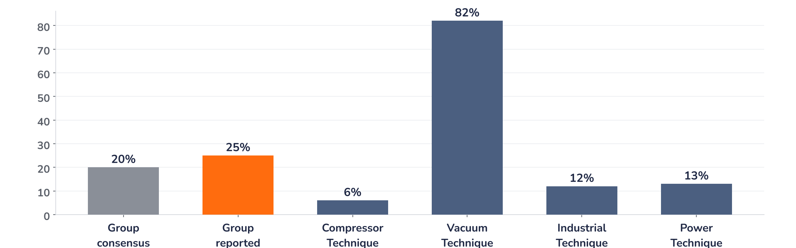
Earnings update · Industrial machinery
Atlas Copco Q3 2026: vacuum boom, compressor squeeze
22 October 2026 · Syz Research
“What we see now with the semi customers, the biggest priority now is that we focus on output. And I think the biggest discussions between ourselves and our customers is output, output.”
Vagner Rego, President and CEO, Q3 2026 earnings call, 22 October 2026
Key takeaways
Beat
Organic orders rose 25% against 20% expected, lifted by an 82% jump in vacuum for chipmakers.
Watch
The compressor margin fell to 23.6% from 25.3%: currency, mix and costlier components hit the core.
Outlook
Activity is seen stable, but chip orders after a record quarter are hard to call into Q4.
Valuation
The shares fell 7.1% to 29.2x forward earnings, below their one-year average of 31.0x.
Orders received
Revenue
Adj. operating margin
Compressor margin
SEK 52.3bn
SEK 47.9bn
21.3%
23.6%
+25% organic vs. 20% exp.
Record, +11% organic
Flat y/y, below expectations
-170bp y/y
What the quarter means for the investment case
Atlas Copco now runs at two speeds. Vacuum Technique is riding the semiconductor investment cycle: organic orders up 82%, revenue up 28% and the margin up to 22.2% despite ramp-up costs. Compressor Technique, the profit engine, grew orders by only 6% and gave up 1.7 points of margin. The shares fell 7.1% on the day: the beat rested on vacuum orders partly pulled forward, compressor prices will lag cost inflation, and a crowded stock close to its record needed more.
Chart 1 · ATCO: Q3 2026 organic order growth by business area
Organic growth in orders received, Q3 2026 vs. Q3 2025 · Group consensus: pre-results analyst expectations · Source: company, Bloomberg
Every region grew, with Asia and North America both up 39%, and three of the four business areas posted double-digit order growth. The beat is nonetheless concentrated in vacuum, where management acknowledged some pre-ordering by customers keen to secure capacity. Compressors, which carry the highest margin in the group, delivered the weakest growth, held back by a flat Europe.
Base case and implications
We stay positive on Atlas Copco and would add gradually on the results-day fall. The earnings path we underwrite rests on vacuum: lead times beyond the usual three to six months and a new US dry pump plant moving to full pump assembly in Q4 should carry double-digit revenue growth into 2027, while the compressor margin stabilises around 24% as price increases work through the order book. The debate has moved to compressor profitability. Crowded positioning means the de-rating can run further near term. The next test is the Q4 report in late January 2027.
What would strengthen our view
What would change our view
Compressor orders back above 10% organic growth, with the margin recovering towards 25% by mid-2027; vacuum orders holding close to the Q3 level in Q4 despite seasonality; clearly higher prices as semiconductor supply agreements come up for renewal in 2027.
A compressor margin below 23% in Q4, showing that price increases do not offset component inflation; vacuum orders falling more than seasonally as customers digest Q3 pre-orders; European weakness spreading to North American compressor demand in early 2027.
Syz Research · Earnings update · 22 October 2026
1 / 3

Slide 2
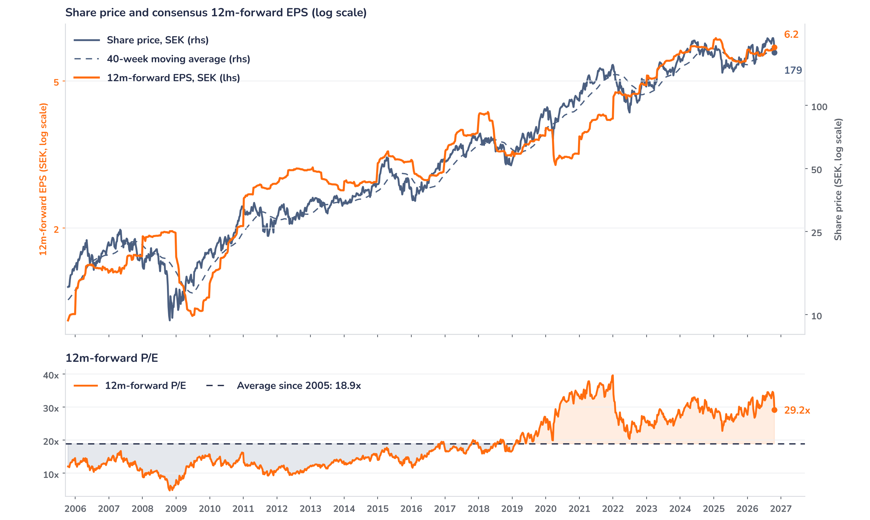
Beyond the key takeaways
Results: vacuum volume, compressor costs
Orders reached a record SEK 52.3bn, up 29% in total: 25% organic, 3% from acquisitions and a small currency tailwind. Revenue was also a record at SEK 47.9bn, up 11% organically. The reported operating margin of 20.8% includes a SEK 132m restructuring charge for German operations in Industrial Technique; the adjusted margin of 21.3% was flat year on year and slightly below analyst expectations. Volume and price drove a good organic drop-through, offset by currency, mainly a stronger Korean won, and mildly dilutive acquisitions. A 21% tax rate, helped by tax credits, lifted profit to SEK 7.7bn from SEK 6.7bn and basic EPS by 15% to SEK 1.58. Working capital absorbed only SEK 87m.
In Vacuum Technique, revenue rose 28% organically and the margin improved again to 22.2%, despite ramp-up costs and currency. Pricing gains are slow: customers are few and powerful, and supply agreements expire at staggered dates. Compressor Technique grew revenue 5% organically, but its margin slipped to 23.6% on the won, product and regional mix and dearer electronics, aluminium castings and oil. Long-cycle projects with up to a year of lead time were priced before the inflation. Industrial Technique orders rose 12%, revenue only 2%, with a 20.6% adjusted margin helped by lower tariff costs. Power Technique orders grew 13% and the margin rose to 18.3%.
Outlook: stable activity, a hard call on chips
The guidance is the usual sequential one: customer activity, excluding large orders, currency and seasonality, should remain at the current level for most segments. Management stressed the seasonal dip from Q3 to Q4 and declined to call semiconductor orders after a record intake, noting that customers now focus on output rather than new orders. Further vacuum margin expansion is expected, but at a slower pace than in the last two quarters. For compressors, price increases will reach the income statement only gradually and the new European cooling acquisition dilutes the margin. Currency should add about SEK 0.5bn to Q4 profit and the tax rate should rise to around 22.5%.
Valuation: the premium is being tested
Chart 2 · ATCO: share price vs. consensus earnings and valuation
Weekly, Oct 2005 to 22 Oct 2026 · Bloomberg BEst 12m-forward EPS · 40-week MA · Log scale · Last price: 22 October close, after the release
Over 12 months the share price rose 8.0% while consensus forward EPS rose 9.7%: earnings did the work. At 29.2x forward earnings the stock trades at a 54% premium to its 18.9x average since 2005, but it sits below its one-year average of 31.0x. The multiple has fallen from 35.2x at the record high of SEK 213.4 on 6 October, and the price is now below its 40-week average of SEK 190. A 5% EPS upgrade at an unchanged price would take the multiple to 27.8x. Analyst price targets set after the release range from SEK 235 to SEK 260.
Syz Research · Earnings update · 22 October 2026
2 / 3

Slide 3
SYZ Source: Syz Research, Bloomberg, Atlas Copco Q3 2026 interim report and earnings call of 22 October 2026, analyst research notes of 22 October 2026
Disclaimer
This communication has been issued and made available to recipients for the purpose of advertising investment services and/or financial instruments. It has been sent for information purposes and cannot be considered as an offer or a personalised recommendation to buy or sell a financial instrument or any other investment or currency. This communication does not constitute investment research within the meaning of regulatory rules applicable in the European Economic Area, or research under the rules of the U.S. Self-Regulatory Organizations.
This information is made solely for professional and institutional clients as defined by the Swiss Financial Services Act, as well as qualified investors according to the Swiss Collective Investment Schemes Act. It is not intended for retail clients or non-qualified investors and consequently cannot be transmitted to any third party.
This communication is not directed to any person in any jurisdiction where, by reason of that person’s nationality, residence or otherwise, its dissemination or use is prohibited. It cannot be quoted, reproduced, disclosed, distributed or otherwise referred to, in whole or in part, to any third party without the Bank’s prior written consent.
This communication may contain information on past performances of a financial product, all kinds of economic and financial valuations and analyses, as well as opinions of the Bank or of third parties. Any market valuations, terms and calculation methods, yields and opinions expressed are subject to change without notice. The information and opinions contained herein have been compiled and provided in good faith, based on information obtained from sources believed to be trustworthy. However, such information has not been independently verified. No guarantee, representation, or warranty of any kind, whether express or implied, is provided by the Bank or by relevant data vendors and other sources with respect to the accuracy, reliability, currentness or exhaustiveness of the information communicated, the methodology employed or the prices contained herein.
Past performance is not a reliable indicator of current or future results. Any reference to the past performance of an investment does not guarantee its future performance. Fluctuations in exchange rates may adversely affect the value, price or income of any investment.
Nothing in the present communication constitutes investment, legal, accounting or tax advice. This information is purely objective since it does not take into consideration the personal situation (including financial knowledge and experience), the investment objectives and risk profile of any recipient. Moreover, certain financial instruments mentioned (in particular, but not exclusively, derivatives, options and futures) involve a high risk of loss and may not be suitable. Accordingly, recipients should consult their own advisors on such matters, including but not limited to the possible tax consequences of investing in any financial product mentioned herein, and make their own assessment of the suitability of such investment product.
Should a recipient make an investment on the basis of the present communication, the recipient alone shall bear the consequences thereof. In no event shall the Bank, its directors, employees, affiliates or agents be held responsible for damages of any kind arising out of the use of all or part of the information provided herein.
Syz Research · Earnings update · 22 October 2026
3 / 3

