Slide 1

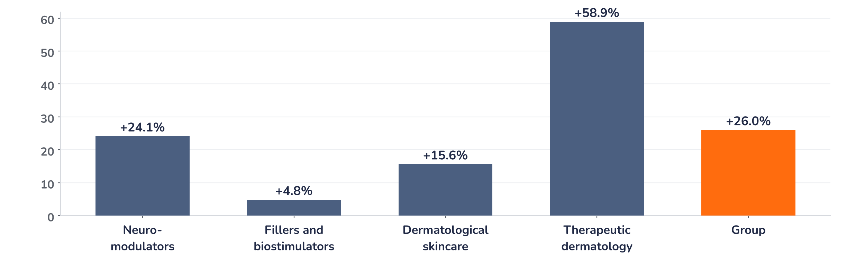
Earnings update · Dermatology
Galderma Q3 2026: beat and raise, upgrades to lower the P/E
22 October 2026 · Syz Research
“With a stronger-than-anticipated trajectory in the first nine months, especially in Therapeutic Dermatology, across both Nemluvio and the mature portfolio, as well as in Dermatological Skincare and Neuromodulators, Galderma is raising its full-year 2026 net sales growth guidance”
Galderma, Q3 2026 trading update, release of 22 October 2026 (company statement)
Key takeaways
Beat
Q3 sales USD 1,632m, up 26% at constant currency and 5.1% above consensus, with every category contributing.
Raised
2026 sales growth guide raised to 22.5–23.5% from 19–21%; core operating margin (EBITDA) held at about 26%.
Watch
Fillers grew only 4.8%, mature brands face generics, and the US Relfydess refiling waits until early 2027.
Valuation
46.1x this year’s consensus earnings with the shares 2% below their record: upgrades must now do the work.
Q3 net sales
Q3 growth, constant FX
Nemluvio Q3 sales
FY26 sales growth guide
USD 1,632m
+26.0%
USD 302m
+22.5–23.5%
+5.1% vs. consensus
Nine months: +25.1%
About +7% vs. consensus
Raised from +19–21%
What the quarter means for the investment case
This is the second beat and raise in a row, and the key message is breadth. Therapeutic dermatology grew 58.9%, but neuromodulators (+24.1%) and dermatological skincare (+15.6%) also ran well ahead of their markets: the quarter does not rest on Nemluvio alone. With the sales guide raised by more than three points and the margin target held, analysts expect 2026 sales and core EBITDA about 1.5% above prior consensus.
Chart 1 · GALD: Q3 2026 sales growth by category at constant currency
Year-on-year growth at constant currency, % · group sales USD 1,632m vs. consensus USD 1,552m (+5.1%) · Galderma product categories
Every category grew, three of four at a double-digit rate. Neuromodulators were helped by US shipments shifted from Q2, which flatters the quarter, but Dysport share gains and the Relfydess roll-out, approved in 37 markets, are structural. Fillers and biostimulators, at 4.8%, are the soft spot: the market is weak and last year included the Sculptra launch in China.
Base case and implications
We stay positive on Galderma and would add on weakness towards the 200-day moving average (CHF 162). Our base case is 2026 sales growth of about 23% at constant currency, a core EBITDA margin near 26% and consensus earnings per share of USD 4.80 edging higher after the raise. The debate has moved from whether Galderma can grow to whether it can hold the pace through generic erosion, the Relfydess delay and the ZO Skin Health integration. With the shares up 4.2% on the day and 2% below their June record, the easy re-rating is done. The next test is the full-year release in early 2027.
What would strengthen our view
What would change our view
Consensus 2026 earnings per share above USD 4.90; Nemluvio above USD 300m again in Q4, taking the year beyond USD 1bn; fillers growth back towards double digits in 2027; the US Relfydess refiling on time in Q1 2027.
Mature therapeutic brands falling faster than expected as generics arrive; a 2026 core EBITDA margin below 26% or a weak 2027 margin outlook once ZO Skin Health is consolidated; a further Relfydess delay; the shares breaking below CHF 162.
Syz Research · Earnings update · 22 October 2026
1 / 3

Slide 2
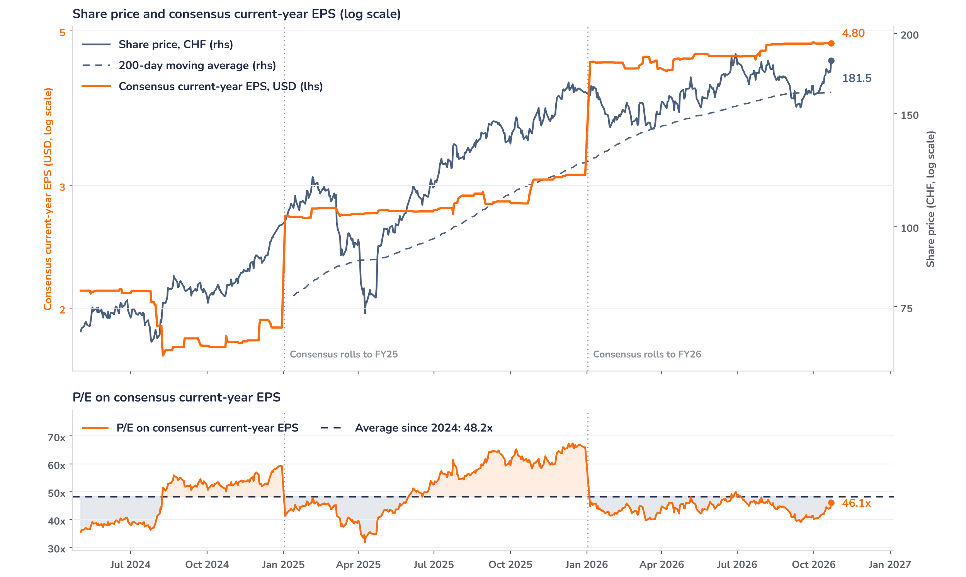
Beyond the key takeaways
Results: the beat came from every category
Injectable aesthetics, the largest category, delivered USD 736m (+15.4% at constant currency). Neuromodulators reached USD 433m (+24.1%) as unfavourable US shipment phasing from Q2 unwound on top of continued Dysport share gains and the international Relfydess launch; part of the 24.1% is therefore timing, not demand. Fillers and biostimulators grew 4.8% to USD 303m against a soft market and the prior-year Sculptra launch in China, but nine-month growth of 8.5% and double-digit Sculptra growth in the US and abroad point to continued share gains. Dermatological skincare added USD 396m (+15.6%), led by Cetaphil in Asia and by Alastin, with e-commerce the fastest-growing channel.
Therapeutic dermatology was the standout at USD 499m (+58.9%), about 8% above consensus. Nemluvio contributed USD 302m, some 7% ahead of expectations, taking nine-month sales to USD 735m and the USD 1bn full-year mark within reach. The mature portfolio, at USD 197m, benefited from generic entries arriving later than expected, a support the company expects to turn into negative growth pressure in the second half. The United States grew 39.3% to USD 755m, flattered by neuromodulator phasing, and international markets 17.1% to USD 876m. Volume led growth, helped by mix.
Outlook: the new guide still looks prudent
The full-year guide of 22.5 to 23.5% at constant currency compares with nine-month growth of 25.1%. By our arithmetic it implies Q4 growth of roughly 16 to 19%, well below the 26% of Q3, absorbing generic erosion, the fillers comparison and some consumer caution: we read it as prudent. The core EBITDA margin of about 26% compares with 25.6% in the first half. Post-release analyst estimates put 2026 sales near USD 6.5bn and core EBITDA near USD 1.69bn, about 1.5% above prior consensus. The new US Section 232 tariffs do not touch Nemluvio in 2026. ZO Skin Health (USD 1.5bn) is excluded: earnings-neutral in year one, slightly margin-dilutive in 2027.
Valuation: earnings must do the work
Chart 2 · GALD: share price vs. consensus earnings and valuation
GALD SW Equity, daily · consensus current-year EPS (USD), rolls each January · 200-day MA · log scale · last price after the release
The shares trade at 46.1x consensus 2026 earnings, 4% below the 48.2x average since May 2024 and close to the 44.0x average of 2026; the long-run figure is inflated by late-2025 readings on an ageing 2025 base. Consensus 2026 earnings per share has risen 6.4% since January and 4.3% since the H1 results, while the price was flat between the releases until today’s 4.2% gain: the stock de-rated from 46.4x to 44.0x before the print. The price sits 12% above its 200-day average. At about 33x 2027 analyst estimates, upgrades, not the multiple, drive the next leg.
Syz Research · Earnings update · 22 October 2026
2 / 3

Slide 3
SYZ Source: Syz Research, Bloomberg, company filings, Galderma Q3 2026 trading update of 22 October 2026, analyst research notes of October 2026
Disclaimer
This communication has been issued and made available to recipients for the purpose of advertising investment services and/or financial instruments. It has been sent for information purposes and cannot be considered as an offer or a personalised recommendation to buy or sell a financial instrument or any other investment or currency. This communication does not constitute investment research within the meaning of regulatory rules applicable in the European Economic Area, or research under the rules of the U.S. Self-Regulatory Organizations.
This information is made solely for professional and institutional clients as defined by the Swiss Financial Services Act, as well as qualified investors according to the Swiss Collective Investment Schemes Act. It is not intended for retail clients or non-qualified investors and consequently cannot be transmitted to any third party.
This communication is not directed to any person in any jurisdiction where, by reason of that person’s nationality, residence or otherwise, its dissemination or use is prohibited. It cannot be quoted, reproduced, disclosed, distributed or otherwise referred to, in whole or in part, to any third party without the Bank’s prior written consent.
This communication may contain information on past performances of a financial product, all kinds of economic and financial valuations and analyses, as well as opinions of the Bank or of third parties. Any market valuations, terms and calculation methods, yields and opinions expressed are subject to change without notice. The information and opinions contained herein have been compiled and provided in good faith, based on information obtained from sources believed to be trustworthy. However, such information has not been independently verified. No guarantee, representation, or warranty of any kind, whether express or implied, is provided by the Bank or by relevant data vendors and other sources with respect to the accuracy, reliability, currentness or exhaustiveness of the information communicated, the methodology employed or the prices contained herein.
Past performance is not a reliable indicator of current or future results. Any reference to the past performance of an investment does not guarantee its future performance. Fluctuations in exchange rates may adversely affect the value, price or income of any investment.
Nothing in the present communication constitutes investment, legal, accounting or tax advice. This information is purely objective since it does not take into consideration the personal situation (including financial knowledge and experience), the investment objectives and risk profile of any recipient. Moreover, certain financial instruments mentioned (in particular, but not exclusively, derivatives, options and futures) involve a high risk of loss and may not be suitable. Accordingly, recipients should consult their own advisors on such matters, including but not limited to the possible tax consequences of investing in any financial product mentioned herein, and make their own assessment of the suitability of such investment product.
Should a recipient make an investment on the basis of the present communication, the recipient alone shall bear the consequences thereof. In no event shall the Bank, its directors, employees, affiliates or agents be held responsible for damages of any kind arising out of the use of all or part of the information provided herein.
Syz Research · Earnings update · 22 October 2026
3 / 3

