Slide 1

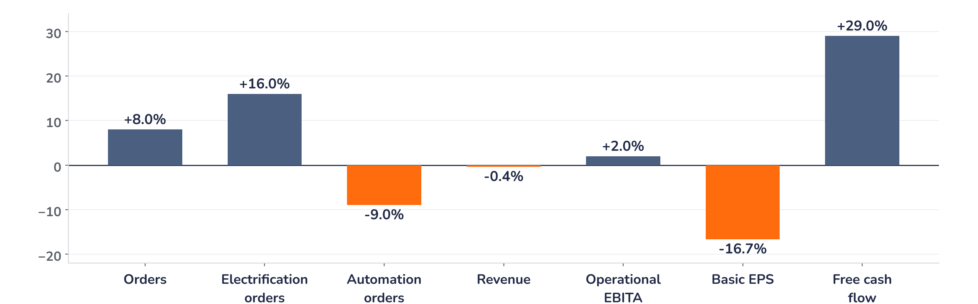
Earnings update · Industrials
ABB Q3 2026: record orders, but the premium needs broader growth
20 October 2026 · Syz Research
Key takeaways
Beat
Orders rose 40% to a record USD 12.1bn, 8% above consensus, led by data centres.
Miss
Basic EPS of USD 0.65 missed consensus by about 17%, partly on a USD 115m non-cash hedge charge.
Watch
Growth is narrow: Automation orders were flat at USD 2.1bn, 9% below consensus.
Valuation
At 25.6x consensus earnings, 36% above the 2006 to 2026 average, the shares need upgrades.
Orders
Operational EBITA
Basic EPS
Free cash flow
USD 12.1bn
USD 2.0bn
USD 0.65
USD 1.58bn
+8% vs. consensus
+2% vs. consensus
-17% vs. consensus
+29% vs. consensus
The case now rests on electrification
ABB is becoming an electrification company with an industrial tail. Electrification orders rose 70% on a comparable basis to USD 7.7bn and its order book reached a record USD 16bn, up 83% on the year, which secures growth into 2027 and 2028. Elsewhere momentum is thinner: Motion grew orders 12% but lost one percentage point of margin, and Automation orders were flat. The shares fell 5.5% on the day because investors had already paid for the strong part.
Chart 1 · ABBN: Q3 2026 results vs. consensus
Reported vs. pre-results consensus, % · EPS vs. the midpoint of USD 0.77 to 0.79 · operational EBITA and segment surprises approximate
The lines that point to future earnings beat; the line that prices the stock today missed. Orders and free cash flow, 29% above consensus, show strong demand and cash conversion. The USD 115m revaluation of a currency hedge linked to the Rotork acquisition is non-cash and explains about half of the EPS shortfall. The rest, and the 9% gap in Automation orders, are real.
Base case and implications
We stay constructive on ABB and hold, but would not add at current levels. We underwrite full-year revenue growth in the low teens and an operational EBITA margin up at least 270 basis points, knowing that about CHF 240m of Q4 property gains flatter it. Demand is not the debate any more; breadth and conversion are: can the USD 16bn Electrification backlog lift 2027 earnings while Automation and Motion lag? The catalyst would be 2027 upgrades, and consensus 2026 EPS has risen only 1% since the July results. With the shares 7% below their 40-week average, sentiment has reset. The next test is the Q4 release in early 2027.
What would strengthen our view
What would change our view
Q4 orders hold above USD 11bn with Electrification orders still well ahead of revenues; Automation orders return to growth as delayed large projects are booked; consensus 2027 EPS rises 5% or more before the Q4 results.
Data centre customers push out deliveries despite their deposits; the Electrification margin slips below 24% as large projects ramp up; the Q4 margin is flat only thanks to property gains; weakness in the Middle East spreads to other regions.
Syz Research · Earnings update · 20 October 2026
1 / 3

Slide 2
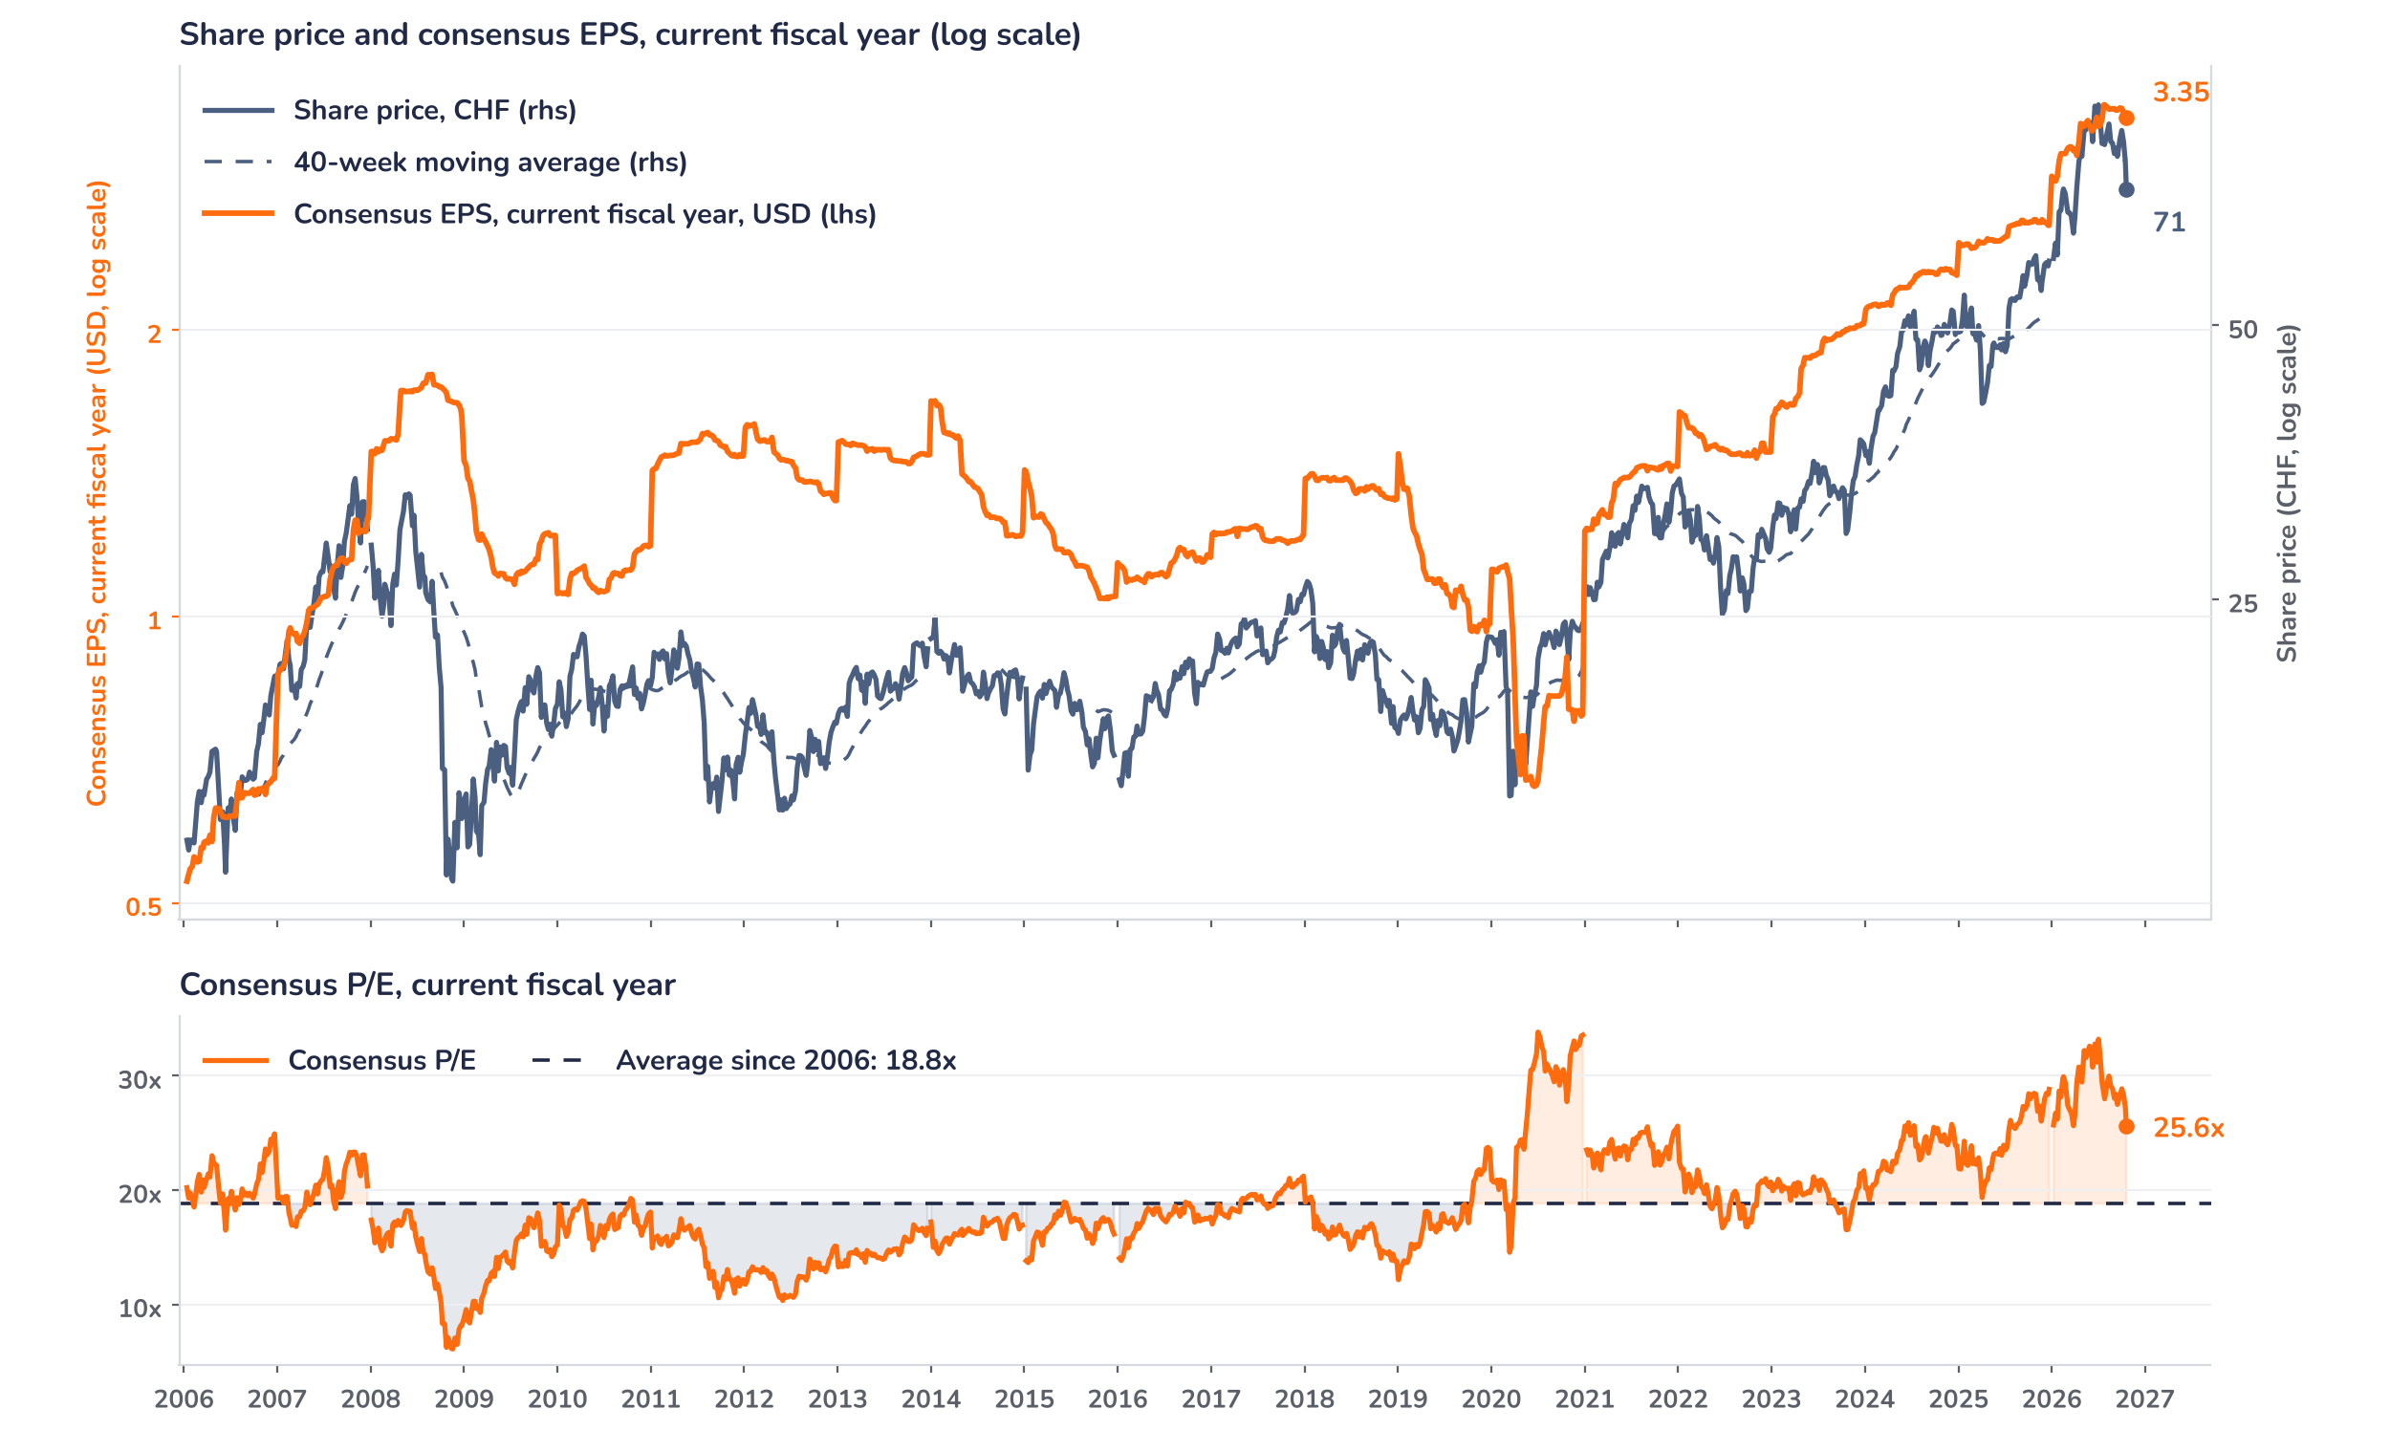
Beyond the key takeaways
Results: the beat was in orders, not earnings
Electrification carried the quarter. Orders rose 70% organically to USD 7.7bn, about 16% above consensus, with triple-digit growth in data centres and a 117% jump in the Americas; utilities, semiconductors and grid infrastructure also contributed. Revenues increased 21% to USD 5.4bn and operational EBITA 27% to USD 1.4bn, a 25.6% margin. On the call, management addressed the durability question directly: data centre orders are secured by large down payments and clear cancellation clauses, and each contract is tied to a specific site with permits and grid connections, which limits the risk of withdrawal. The 800-volt direct current Infinitus portfolio, with a solid-state transformer due in the second half of 2027, should support mix.
The rest of the group was weaker. Motion orders grew 12% organically, but its margin fell 100 basis points to 19.1%, partly due to the newly acquired Gamesa Electric. Automation orders were flat at USD 2.1bn, with the margin up 90 basis points to 14.8%; management attributes the sequential slowdown to the timing of large projects, but the Middle East has been subdued since Q1. At group level, gross margin fell 60 basis points to 40.6% on unrealised FX and commodity derivative effects, and pricing of just over 2% only offset cost inflation. Free cash flow of USD 1.58bn cut net debt to 0.2x EBITDA.
Outlook: a softer Q4 and a new Japan platform
Guidance rose less than orders. ABB expects full-year revenue growth in the low teens and an operational EBITA margin up at least 270 basis points, including about CHF 240m of Q4 property gains, so the underlying upgrade is modest. For Q4, management guides to low to mid single-digit revenue growth and a broadly stable margin. Robotics should be sold by late 2026 and Rotork closes by mid-2027. ABB will pay USD 495m for 51% of a joint venture with Mitsubishi Electric’s low-voltage business, valued at about EUR 890m on EUR 640m of revenue: a Japanese market leader targeting a margin of at least 20% within five years.
Valuation: the premium waits for 2027 upgrades
Chart 2 · ABBN: share price vs. consensus earnings and valuation
Weekly, Jan 2006 to 20 Oct 2026, resampled from daily · Bloomberg BEst EPS for the current fiscal year in USD (steps each January) vs. price in CHF and its 40-week MA · log scales · P/E vs. its 2006 to 2026 average · last price is the 20 October close, after the release
The price has run with earnings, not ahead of them, but the multiple is still rich. The shares are up 21% over 12 months and 20% this year, while consensus 2026 EPS has risen 15% since January. Since the July results, however, the price has fallen 10% and EPS has risen only 1%. The P/E of 25.6x is 36% above its 18.8x average since 2006, down from a 33.2x peak on 3 July 2026 and a one-year average of 28.9x. A 10% upgrade at an unchanged price would take the multiple to 23.3x, still 24% above the average.
Syz Research · Earnings update · 20 October 2026
2 / 3

Slide 3
SYZ Source: Syz Research, Bloomberg, company filings, analyst research notes of 20 October 2026
Disclaimer
This communication has been issued and made available to recipients for the purpose of advertising investment services and/or financial instruments. It has been sent for information purposes and cannot be considered as an offer or a personalised recommendation to buy or sell a financial instrument or any other investment or currency. This communication does not constitute investment research within the meaning of regulatory rules applicable in the European Economic Area, or research under the rules of the U.S. Self-Regulatory Organizations.
This information is made solely for professional and institutional clients as defined by the Swiss Financial Services Act, as well as qualified investors according to the Swiss Collective Investment Schemes Act. It is not intended for retail clients or non-qualified investors and consequently cannot be transmitted to any third party.
This communication is not directed to any person in any jurisdiction where, by reason of that person’s nationality, residence or otherwise, its dissemination or use is prohibited. It cannot be quoted, reproduced, disclosed, distributed or otherwise referred to, in whole or in part, to any third party without the Bank’s prior written consent.
This communication may contain information on past performances of a financial product, all kinds of economic and financial valuations and analyses, as well as opinions of the Bank or of third parties. Any market valuations, terms and calculation methods, yields and opinions expressed are subject to change without notice. The information and opinions contained herein have been compiled and provided in good faith, based on information obtained from sources believed to be trustworthy. However, such information has not been independently verified. No guarantee, representation, or warranty of any kind, whether express or implied, is provided by the Bank or by relevant data vendors and other sources with respect to the accuracy, reliability, currentness or exhaustiveness of the information communicated, the methodology employed or the prices contained herein.
Past performance is not a reliable indicator of current or future results. Any reference to the past performance of an investment does not guarantee its future performance. Fluctuations in exchange rates may adversely affect the value, price or income of any investment.
Nothing in the present communication constitutes investment, legal, accounting or tax advice. This information is purely objective since it does not take into consideration the personal situation (including financial knowledge and experience), the investment objectives and risk profile of any recipient. Moreover, certain financial instruments mentioned (in particular, but not exclusively, derivatives, options and futures) involve a high risk of loss and may not be suitable. Accordingly, recipients should consult their own advisors on such matters, including but not limited to the possible tax consequences of investing in any financial product mentioned herein, and make their own assessment of the suitability of such investment product.
Should a recipient make an investment on the basis of the present communication, the recipient alone shall bear the consequences thereof. In no event shall the Bank, its directors, employees, affiliates or agents be held responsible for damages of any kind arising out of the use of all or part of the information provided herein.
Syz Research · Earnings update · 20 October 2026
3 / 3

