Slide 1

“Revolutionizing the secondhand buying and selling experience;
for students, by students.”
J.B. Morris
01/23/2017

Slide 2
Product Description
A marketplace for college students
Familiar community
Rating system
Reverse the shopping process
Get alerted when relevant items are posted

Slide 3
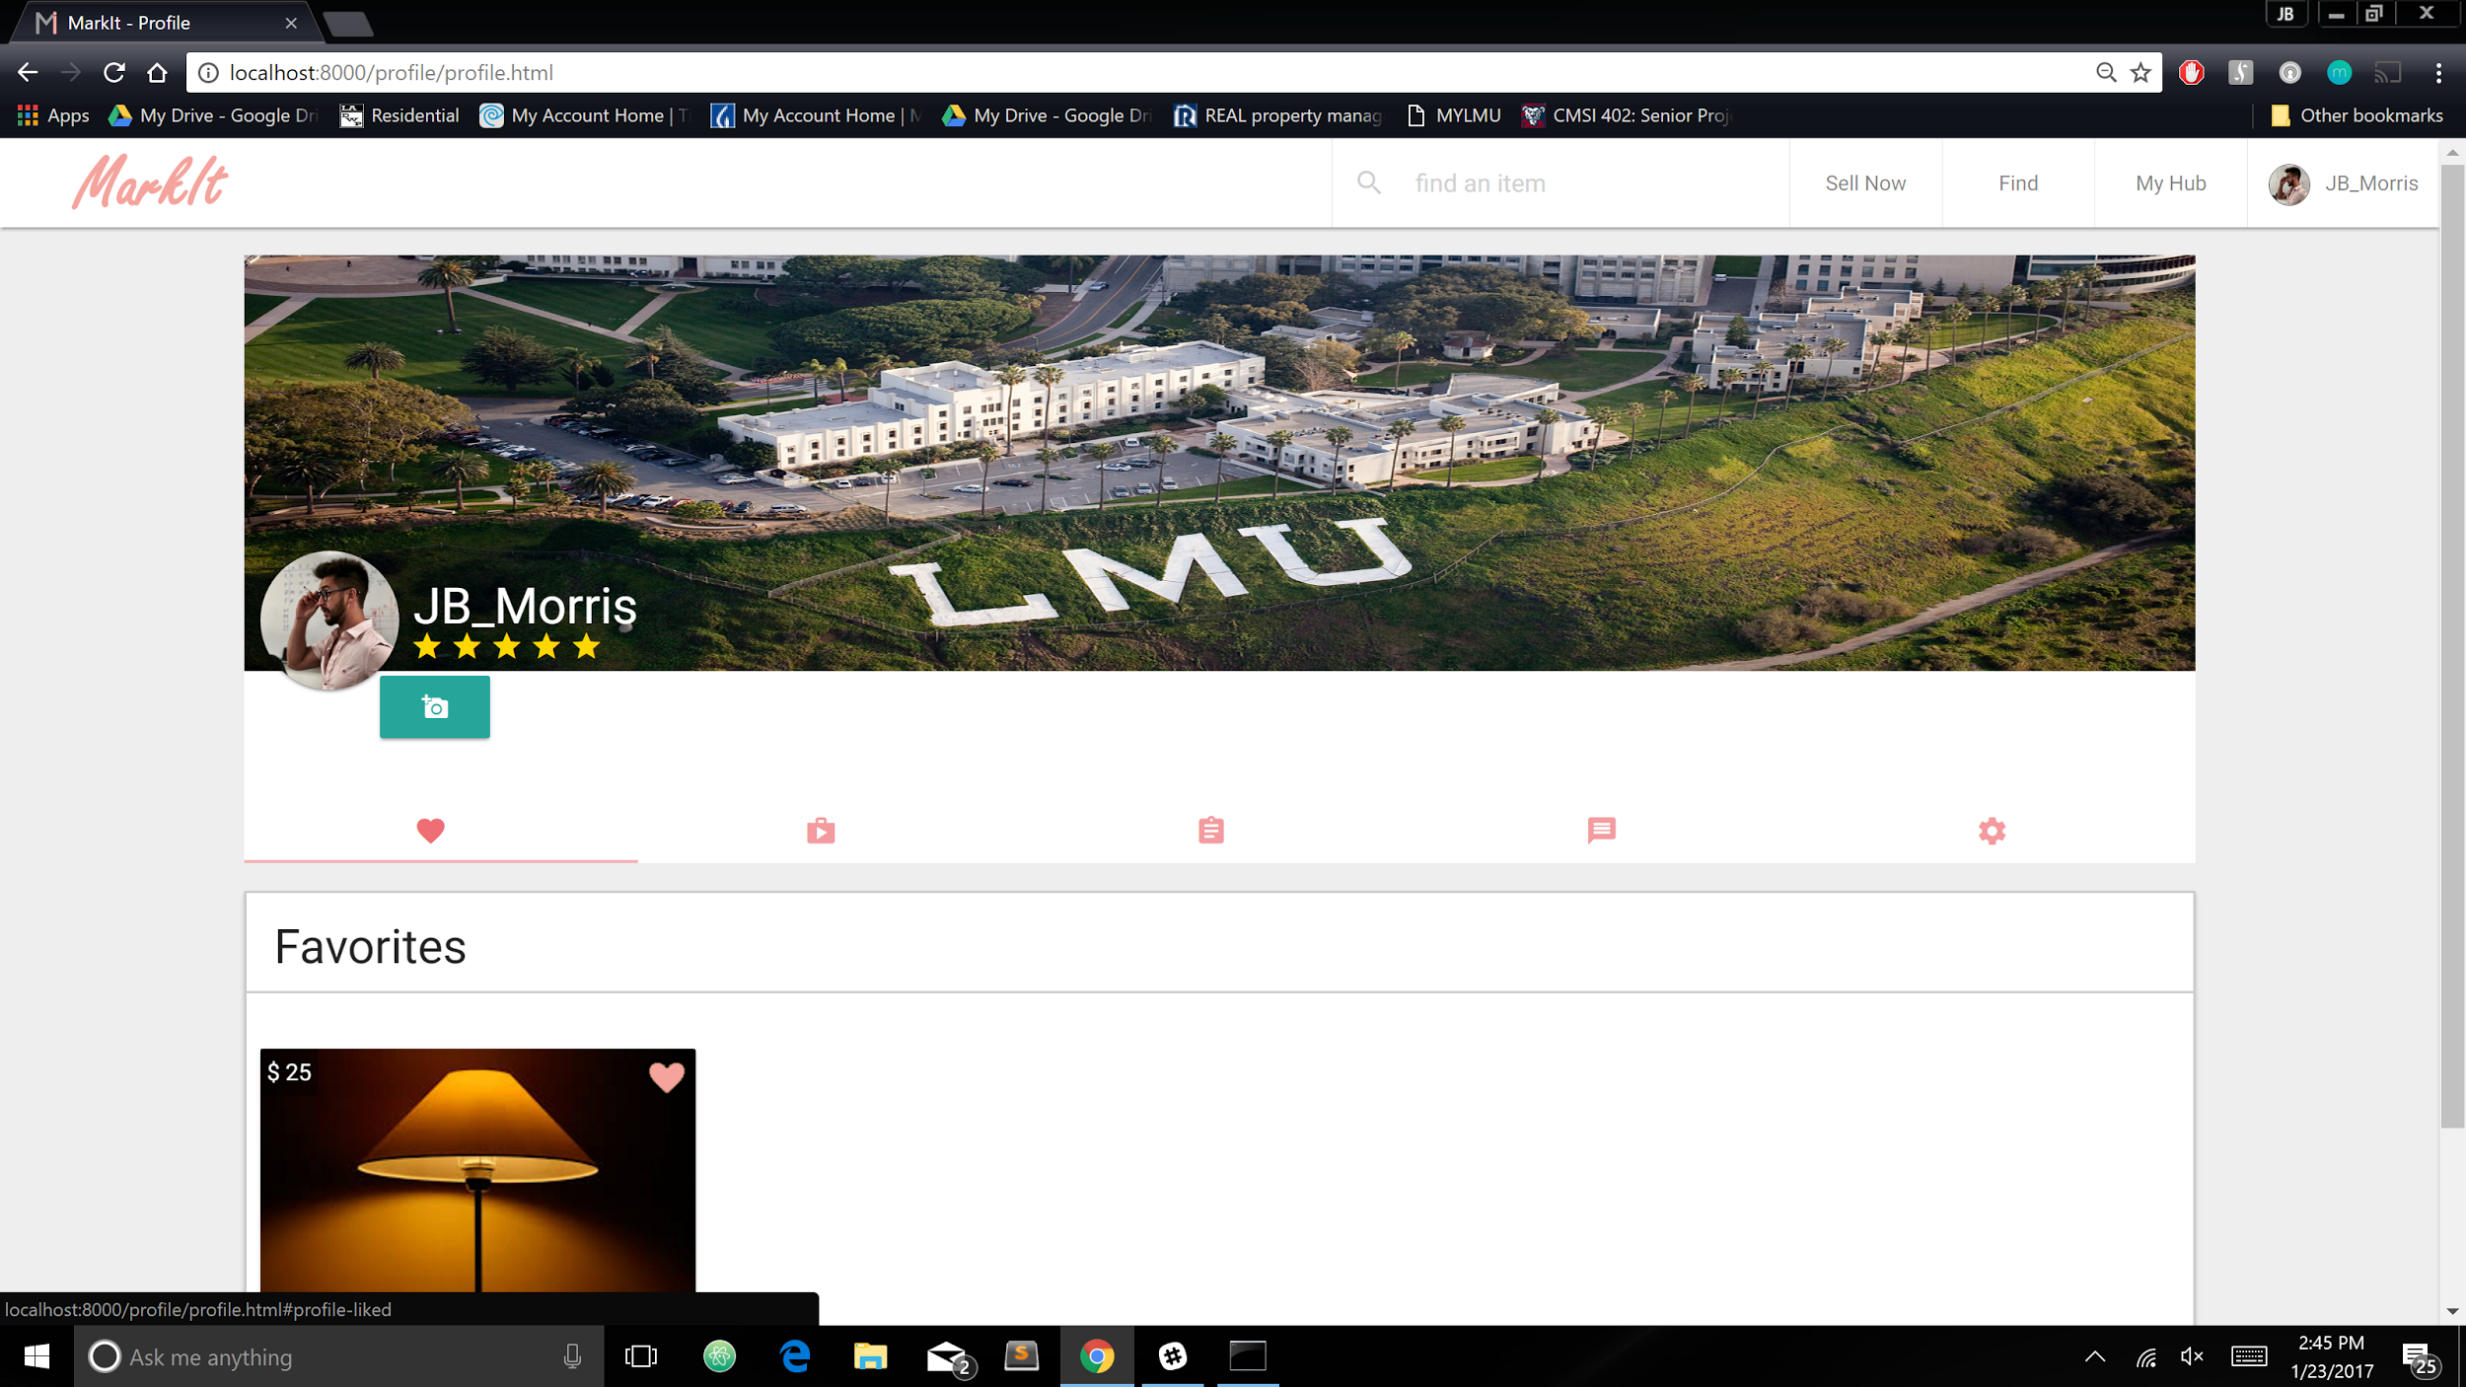
User Point of View

Slide 4
Operations and Technologies Description
Javascript, HTML, CSS
ReactJS, React Native (tentative)
Atom
Firebase

Slide 5
Preliminary Development Schedule
Weekly Cycle:
Monday: Development Scrum (402)
Tuesday: “Polish” weekly MVP
Wednesday: Meet with marketing team
Thursday: Begin addressing marketing team’s feedback
Friday: open
Saturday: Primary Development Day
Sunday: open

Slide 6
Questions?

