Slide 1

Predicting Credit Card Defaults
Benjamin Chen, Jason Brown

Slide 2
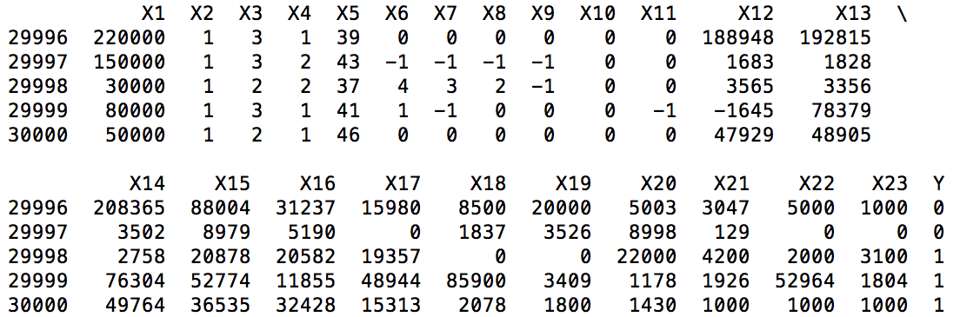
Description of the Data
n = 30,000 (source: Taiwanese bank) ; 22% defaulted (6,636 / 30,000)
X1 – X5: Credit given, gender, education level, marital status, age
X6 –X11: Monthly payment status
X12 – X17: Monthly bill amounts
X18 – X23: Monthly payments
In this small sample,
3 of 5 cardholders
defaulted

Slide 3
Baseline Methods
Data split into 2 groups, model training and validation
Techniques
K-nearest neighbor
Logistic regression
Discriminant analysis
Naïve Bayesian
Classification tree

Slide 4
Improvements Attempted
Feature selection
10-fold cross validation
PCA

Slide 5
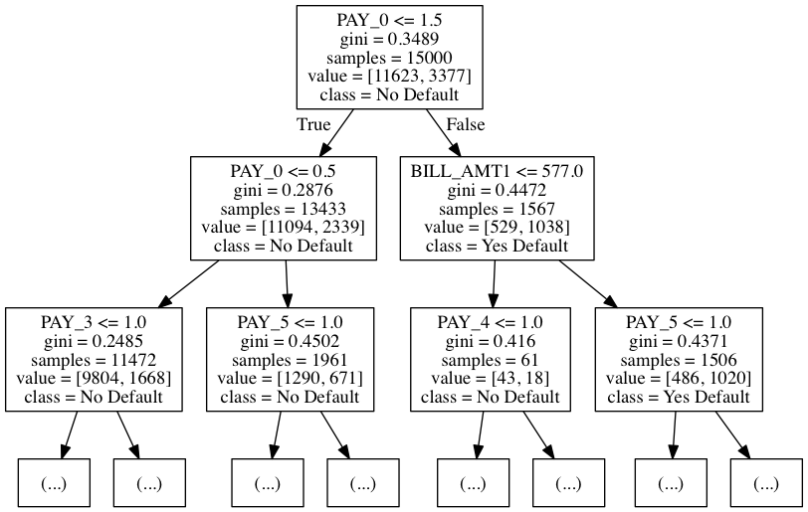
Experiment: Feature Selection (1 of 3)
Baseline Data
Decision Tree

Slide 6
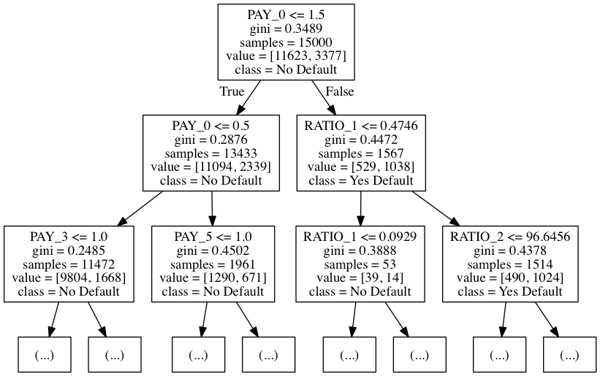
Experiment: Feature Selection (2 of 3)
Feature Selected Data
Decision Tree
credit_balance / max_credit (Sept)
credit_balance / max_credit (Aug)

Slide 7
Experiment: Feature Selection (3 of 3)
Model | 23 variables ROC_AUC | 25 variables ROC_AUC
Naïve Bayesian | 74.82% | 74.71%
Discriminant analysis | 73.04% | 72.89%
Logistic Regression | 66.58% | 66.76%
Classification tree | 61.08% | 61.11%
K-Nearest Neighbor | 61.12% | 61.12%
Mixed results – may be overfit; differences not statistically significant
Did not attempt to remove features (23 is a low cardinality already)
Changed tree (but didn’t drastically improve accuracy )

Slide 8
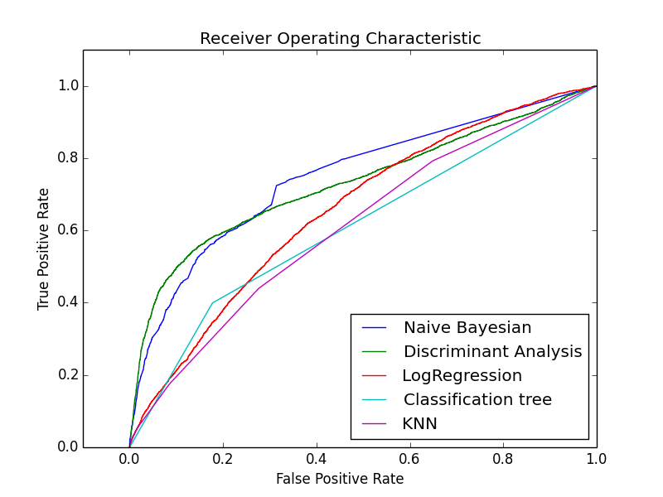
Model Accuracy
Only 22% of cardholders default, so {ŷ = 0} yields similar error rate to models
Better measures:
area ratio of lift chart / ROC area under curve
ROC_AUC 1 = Perfect fit; .5 = random guess
Model | Error_rate | ROC_AUC
Naïve Bayesian | 21.7% | 75%
Discriminant analysis | 18.2% | 73%
Logistic Regression | 21.7% | 66%
Classification tree | 27.3% | 61%
K-Nearest Neighbor | 24.6% | 61%
Better measure of model accuracy than error_rate ->

Slide 9
Not all Misclassifications are Equal
Predicted Class
*Error represents major loss
from default on debt
22,296 (model correctly predicted non-default) | 1,068 (false positive)
4,426 (false negative) | 2,210 (model correctly predicted default)
Actual Class
*Error represents minor lost revenue
Error rate of
K-Nearest Neighbor model
here was 18.3%

Slide 10
Experiment: 10-fold cross validation
Model | 50/50 split Error_rate | 10-fold cross Error_rate | 50/50 split ROC_AUC | 10-fold cross ROC_AUC
Naïve Bayesian | 21.7% | 21.7% | 75% | 74%
Discriminant analysis | 18.2% | 18.9% | 73% | 72%
Logistic Regression | 21.7% | 22.1% | 66% | 65%
Classification tree | 27.3% | 24.5% | 61% | 61%
K-Nearest Neighbor | 24.6% | 24.5% | 61% | 61%
10-fold cross validation average performance had mixed results
Some improvements, others did worse

Slide 11
Experiment: PCA
Model | No PCA ROC_AUC | Apply PCA ROC_AUC | No PCA Error_Rate | Apply PCA Error_Rate
Classification tree | 61% | 54% | 27.3% | 34.5%
K-Nearest Neighbor | 61% | 49% | 24.6% | 25.9%
Naïve Bayesian | 75% | 54% | 21.7% | 23%
Discriminant analysis | 73% | 58% | 18.2% | 22.5%
Logistic Regression | 66% | 58% | 21.7% | 23.1%
This approach yielded worse performance overall

Slide 12
Conclusion
Newly available (Jan-16) credit card data yielded opportunity to predict defaults
Consider the best measure for testing model accuracy (here: lift chart or ROC_AUC)
Experiments
Modest Improvement: Feature Selection, 10-fold Cross Validation
No improvement: PCA
Data and Code: https://github.com/jb08/credit_card_default_ML
Also analyzed data set:
I. Yeh, C. Lien, The comparisons of data mining techniques for the predictive accuracy of probability of default of credit card clients, Expert Systems with Applications 36 (2) (2008) 2473–2480.

