Slide 1

Predicting Credit Card Defaults
Benjamin Chen, Jason Brown

Slide 2
Description of the Data
n = 30,000 (source: Taiwanese bank)
22% defaulted (6,636 / 30,000)
Source of data: UC-Irvine Machine Learning Repository, Jan-16

Slide 3
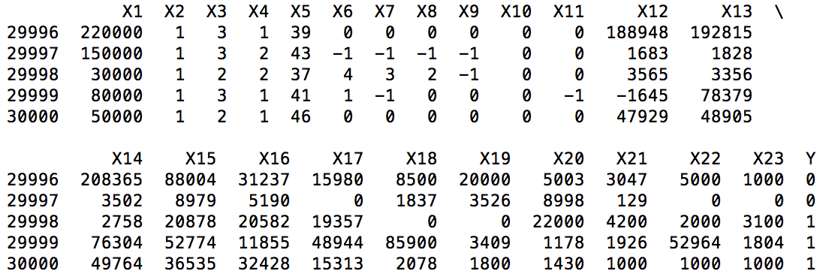
Data Sample (n=5)
X1 – X5: Credit given, gender, education level, marital status, age
X6 –X11: Monthly payment status
X12 – X17: Monthly bill amounts
X18 – X23: Monthly payments
In this small sample,
3 of 5 cardholders
defaulted

Slide 4
Not all Misclassifications are Equal
*Error represents major loss from default on debt
22,296 (model correctly predicted non-default) | 1,068 (false positive)
4,426 (false negative) | 2,210 (model correctly predicted default)
*Error represents minor lost revenue
Error rate of
K-Nearest Neighbor model
here was 18.3%
Why is Error rate not the best measure
of model accuracy here?

Slide 5
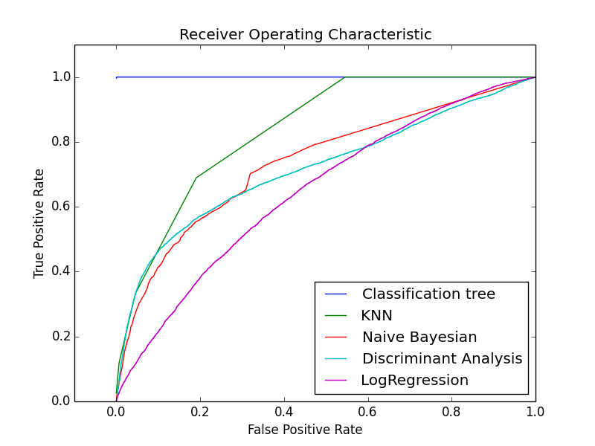
Model Accuracy
Only 22% of cardholders default, so {ŷ = 0} yields similar error rate to models
Better measures:
area ratio of lift chart / ROC area under curve
Sorting Smoothing Method
Model | Error_rate | ROC_AUC
Classification tree | 0% | 100%
K-Nearest Neighbor | 18.3% | 84%
Naïve Bayesian | 23.0% | 74%
Discriminant analysis | 18.8% | 72%
Logistic Regression | 22.1% | 65%
Better measure of model accuracy ->

Slide 6
Baseline Methods
Data split into 2 groups, model training and validation
Techniques
K-nearest neighbor
Logistic regression
Discriminant analysis
Naïve Bayesian
Neural networks
Classification tree

Slide 7
Improvements Attempted
Feature selection
10-fold cross validation
PCA w/ Random forest

Slide 8
Experiment: Feature Selection
Model | 23 variables ROC_AUC | 25 variables ROC_AUC
Classification tree | 100% | 100%
K-Nearest Neighbor | 84% | 84%
Naïve Bayesian | 74% | 74%
Discriminant analysis | 72% | 72%
Logistic Regression | 65% | 65%
A key credit-worthiness metric:
Current balance (X18) / total credit (X1)
Added this explanatory variable for two months as X24 and X25
However, this resulted in no improvement to accuracy of models
Did not attempt to remove features (23 is a low cardinality already)

Slide 9
Experiment: 10-fold cross validation
10-fold cross validation improved error rates by 200bp over 50/50 split
[]
[]
[]

Slide 10
Experiment: PCA with Random Forest
This approach yielded no improvement over the baseline methods
[]
[]
[]

Slide 11
Conclusion
Newly available (Jan-16) credit card data yielded opportunity to predict defaults
Consider the best measure for testing model accuracy (here: lift chart or ROC_AUC)
Experiments
Yielding improvement: 10-fold cross validation
No improvement: Feature Selection, PCA with Random Forest
Data and Code: https://github.com/jb08/credit_card_default_ML
References:
I. Yeh, C. Lien, The comparisons of data mining techniques for the predictive accuracy of probability of default of credit card clients, Expert Systems with Applications 36 (2) (2008) 2473–2480.

