Slide 1

Predicting Credit Card Defaults
Benjamin Chen, Jason Brown

Slide 2
Description of the Data
n = 30,000 (source: Taiwanese bank)
23 explanatory variables
1 Response variable
Y = 1 (yes defaulted) , Y = 0 (no)
22% defaulted (6636 / 30,000)
Source of data: UC-Irvine Machine Learning Repository, Jan-16

Slide 3
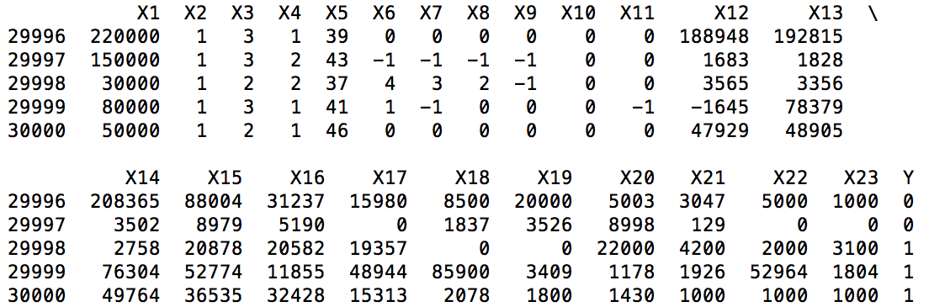
Data Sample (n=5)
X1 – X5: Credit given, gender, education level, marital status, age
X6 –X11: Monthly payment status
X12 – X17: Monthly bill amounts
X18 – X23: Monthly payments
In this small sample,
3 of 5 cardholders
defaulted

Slide 4
Sample Confusion Matrix
22,296 (model correctly predicted non-default) | 1,068 (false positive)
4,426 (false negative) | 2,210 (model correctly predicted default)
Error rate of
K-Nearest Neighbor model
was 18.3%
Why is Error rate not the best measure
of model accuracy here?

Slide 5
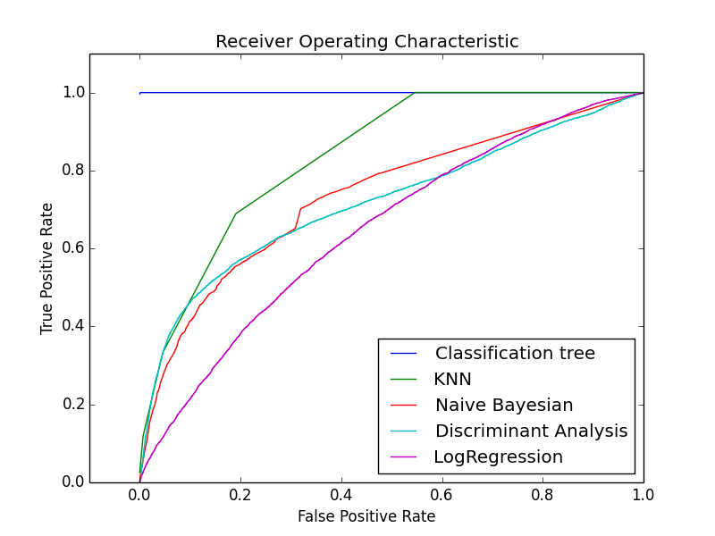
Model Accuracy
Only 22% of cardholders default, so {ŷ = 0} yields similar error rate to models
Better measures: area ratio of lift chart, area-under-curve of ROC chart
Model | Error_rate | ROC_AUC
Classification tree | 0% | 100%
K-Nearest Neighbor | 18.3% | 84%
Naïve Bayesian | 23.0% | 74%
Discriminant analysis | 18.8% | 72%
Logistic Regression | 22.1% | 65%
Better measure of model accuracy ->

Slide 6
Baseline Methods
Data split into 2 groups, model training and validation
Techniques
K-nearest neighbor
Logistic regression
Discriminant analysis
Naïve Bayesian
Neural networks
Classification tree

Slide 7
New Methods
Feature selection & addition
10-fold cross validation versus 50/50 split
[SVM?] , [PCA w/ Random forest?]
Evaluation Measure

Slide 8
Experiment Comparison Analysis
[]

Slide 9
Conclusion
[]
[]
[]
Supporting work
https://github.com/jb08/credit_card_default_ML
References:
I. Yeh, C. Lien, The comparisons of data mining techniques for the predictive accuracy of probability of default of credit card clients, Expert Systems with Applications 36 (2) (2008) 2473–2480.

