Slide 1
Final Software Project
Jenelle Brown
CST 499 Capstone for Computer Software Technology
University of Arizona Global Campus
Dr. Amjad Alkilani
January 29, 2024
Notes:
Hello, My name is Jenelle Brown and this is my project for student course enrollment. The purpose of this presentation to provide insight and explanation on the documentation produced from the software development life cycle to provide the software product to the user.

Slide 2
SRS Document
The document is reference material.
It provides the purpose, scope, intended audience, and requirements information to develop the software.
It also provides technical detailed information that is pertinent to the function, design, and implementation of the software product.
Provided to the development and testing team as a resource throughout the SDLC to determine whether the product works as expected. It is also used beyond in fixes, future enhancement, and as a general guide.
Notes:
The SRS document is presented in our requirements-gathering phase as we conduct interviews, surveys, and focus groups to obtain information about the desired function that stakeholders would like to see in the software product. This identifies the needs that we are required to meet in the function of the product and is also a reference material for the software development and testing team for insight on other factors such as constraints that the system may have for the software to run efficiently.

Slide 3
SRS Document
Product Scope
Product Description
Product Function
User Classes and Characteristics
Operation Environment
Design and Implementation Constraints
Interface Requirements
Non-Functional Requirements
Software Quality
Business Rules
Notes:
In my project, I provided key details that aim to support the function and the performance of the product in development for it to meet the high quality standards and customer satisfaction.

Slide 4
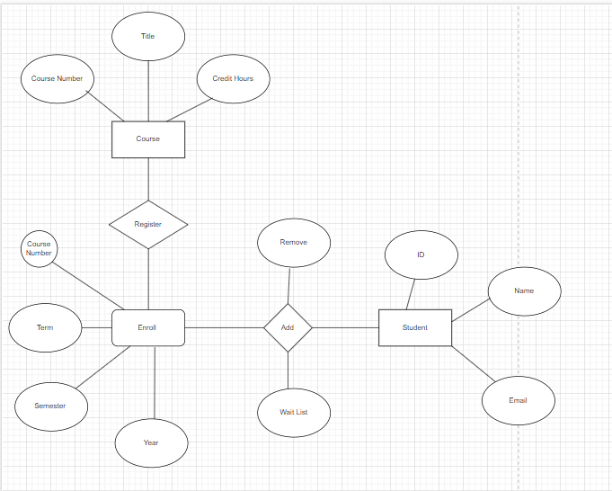
UML Design Model
Figure 1. Entity-Relationship Diagram
Notes:
The UML models, provide a clear and well explained process on function of the software and takes into consideration, users and stimuli that may interact within the system to make sure that the product is working as designed.

Slide 5
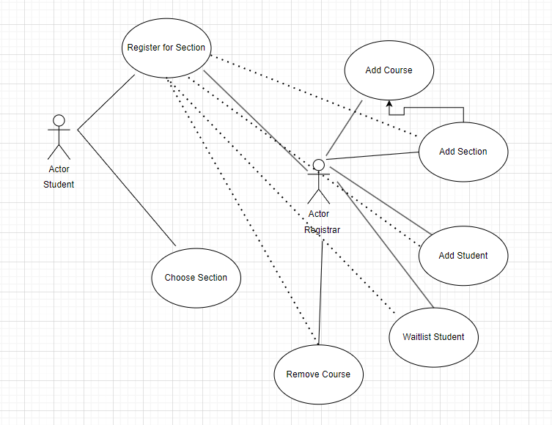
UML Design Model (cont’d)
Figure 2. Use Case Scenarios
Figure 2. Use Case Scenarios
Notes:
In use case scenarios, actors are used to determine whether the expected response is received from the software when the user interactions with the function.

Slide 6
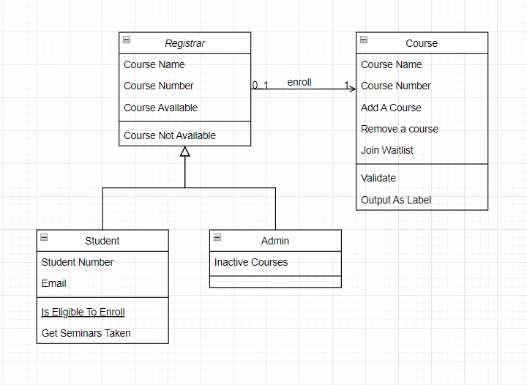
UML Design Model (cont’d)
Figure 3. Class Diagram
Figure 3. Class diagram
Notes:
Class Diagram provides the structure, attributes and operation of the product.

Slide 7
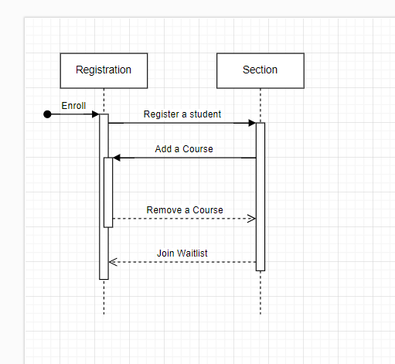
UML Design Model
Figure 4. Sequence Diagram
Notes:
Sequence Diagram shows the order of operation for the software product.

Slide 8
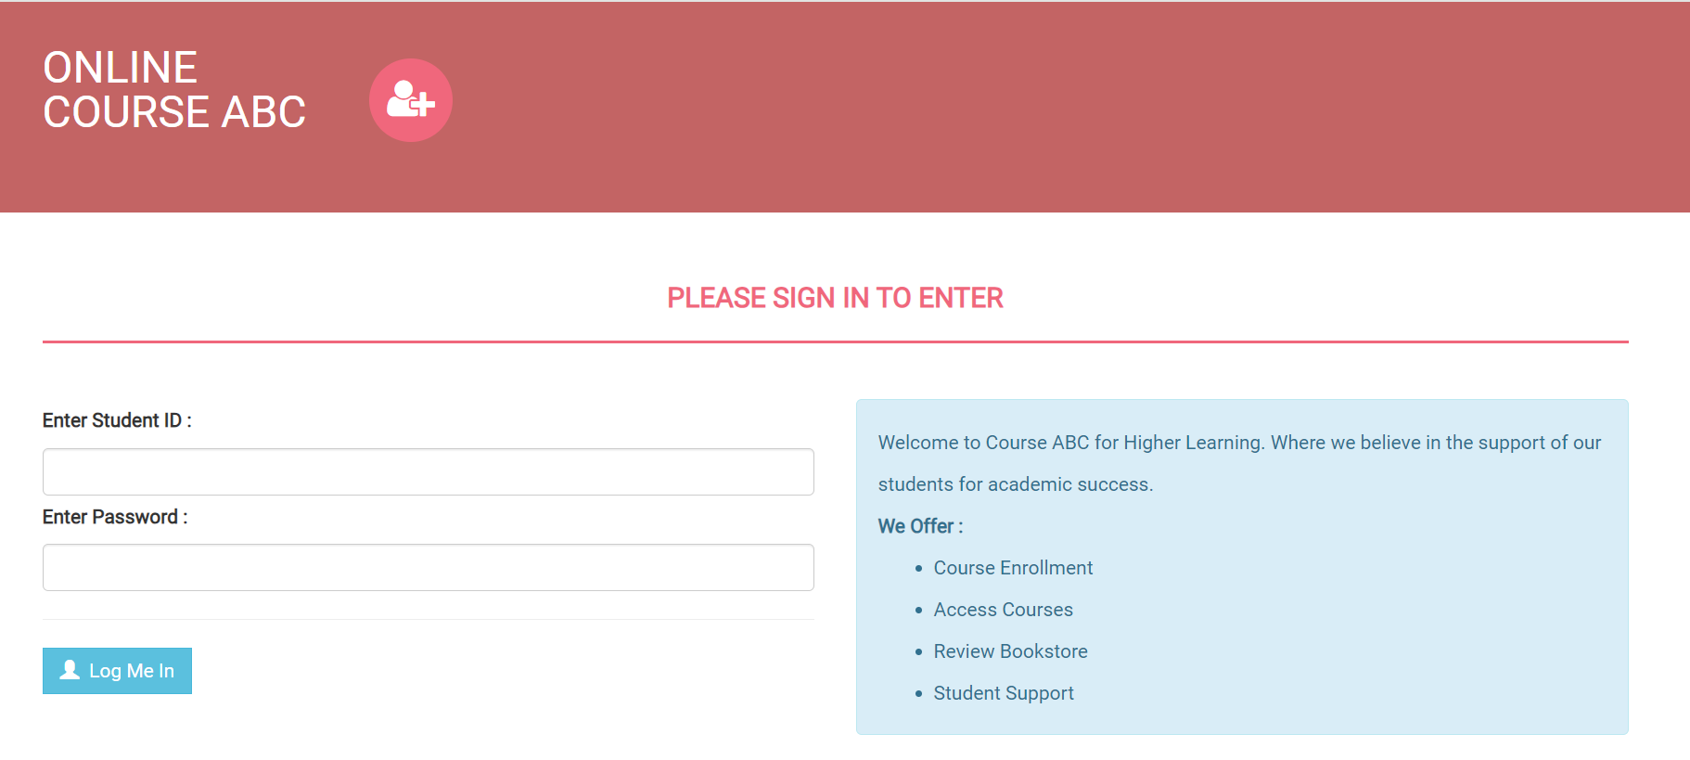
Design Details - Landing
Personalized for students and Admin for ease of visibility to access their respective portals.
Offers a brief overview of features and services that are available.
Connected to backend database management system for data collection, retrieval and modification.

Slide 9
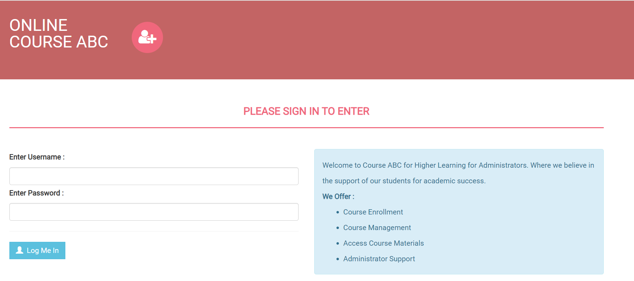
Design Details - Login

Slide 10
Design Details - Enrollment
Allows students to log in securely and register for their courses.
Add a course
View available course
Remove a course
Waitlist a course
Admins can display new courses for enrollment
Monitor available courses
Students amount assigned to a course
Monitor registration activity for courses

Slide 11
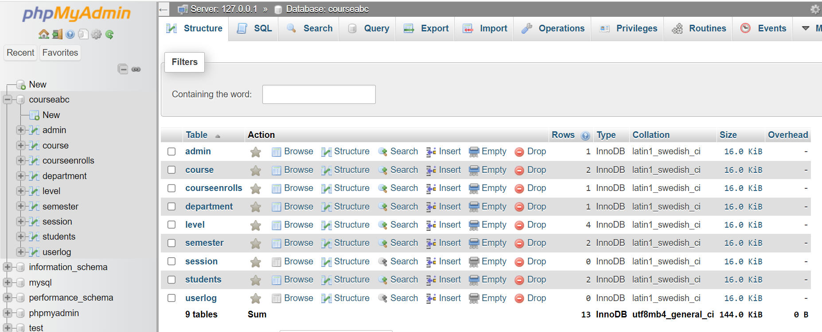
MySQL Database & Class Registration

Slide 12
MySQL Database & Class Registration (cont’d)
User Classes are listed as student and admin to provide available functions to the respective users to store information such as username, student ID, and password to allow secure access to complete actions per product functions.
Courses are registered by the student and monitored under the admin profile to determine whether the availability is within required amounts for the course.
The course details are held within the database for query based on the actions performed by the student and the admin while in the portal.

Slide 13
PHP Code Overview
PHP code is used for web development scripting and is an open-source general-purpose scripting language. It can be embedded in HTML.
The scripting allows for website visibility and database management for functions for the website and data.
Particularly for SQL, the script provides flexibility in using the function statements that allow web development and database management to be performed concurrently.
Through the programming language, the software product was developed to provide the user with an online website that provides ease and accessibility with personal identifiers created to allow for authorized use.

Slide 14
PHP Code Overview
Product Functions
Student Portal vs. Admin Portal – How they Differ?
Connection to Backend system
Enrollment
Monitoring – Admin’s Side

Slide 15
References
Tsui, F., Karam, O., & Bernal, B. (2018). Essentials of software engineering (4th ed.). Jones & Bartlett Learning.
Spillner, A., Linz, T., & Schaefer, H. (2014). Software testing foundations: A study guide for the certified tester exam (4th ed.). Rocky Nook.
El-Attar, M., & Miller, J. (2010). Developing comprehensive acceptance tests from use cases and robustness diagrams. Requirements Engineering, 15(3), 285–306. https://doi.org/10.1007/s00766-009-0088-6

Slide 16
The End

