Slide 1
Module 10: Network Management quiz https://pollev.com/juliusbarath742
Enterprise Networking, Security, and Automation v7.0
(ENSA)
Notes:
Cisco Networking Academy Program
Enterprise Networking, Security, and Automation v7.0 (ENSA)
Module 10: Network Management

Slide 2
Module Objectives
Module Title: Network Management
Module Objective: Implement protocols to manage the network.
Topic Title | Topic Objective
Device Discovery with CDP | Use CDP to map a network topology.
Device Discovery with LLDP | Use LLDP to map a network topology.
NTP | Implement NTP between an NTP client and NTP server.
SNMP | Explain how SNMP operates.
Syslog | Explain syslog operation.
Router and Switch File Maintenance | Use commands to back up and restore an IOS configuration file.
IOS Image Management | Implement protocols to manage the network.
Notes:
2
10.0- Introduction
10.0.2 – What will I learn to do in this module?

Slide 3
10.1 Device Discovery with CDP
Notes:
10 - Network Management
10.1 - Device Discovery with CDP

Slide 4

Device Discovery with CDP
CDP Overview
CDP is a Cisco proprietary Layer 2 protocol that is used to gather information about Cisco devices which share the same data link. CDP is media and protocol independent and runs on all Cisco devices, such as routers, switches, and access servers.
The device sends periodic CDP advertisements to connected devices. These advertisements share information about the type of device that is discovered, the name of the devices, and the number and type of the interfaces.
Notes:
10 - Network Management
10.1 - Device Discovery with CDP
10.1.1 - CDP Overview

Slide 5
Device Discovery with CDP
Configure and Verify CDP
For Cisco devices, CDP is enabled by default. To verify the status of CDP and display information about CDP, enter the show cdp command.
To disable CDP on a specific interface, enter no cdp enable in the interface configuration mode. CDP is still enabled on the device; however, no more CDP advertisements will be sent out that interface. To enable CDP on the specific interface again, enter cdp enable.
To enable CDP globally for all the supported interfaces on the device, enter cdp run in the global configuration mode. CDP can be disabled for all the interfaces on the device with the no cdp run command in the global configuration mode.
Use the show cdp interface command to display the interfaces that are CDP-enabled on a device. The status of each interface is also displayed.
Notes:
10 - Network Management
10.1 - Device Discovery with CDP
10.1.2 - Configure and Verify CDP

Slide 6
Device Discovery with CDP
Discover Devices by Using CDP
With CDP enabled on the network, the show cdp neighbors command can be used to determine the network layout, as shown in the output.
The output shows that there is another Cisco device, S1, connected to the G0/0/1 interface on R1. Furthermore, S1 is connected through its F0/5
R1# show cdp neighbors
Capability Codes: R - Router, T - Trans Bridge, B - Source Route Bridge
S - Switch, H - Host, I - IGMP, r - Repeater, P - Phone,
D - Remote, C - CVTA, M - Two-port Mac Relay
Device ID Local Intrfce Holdtme Capability Platform Port ID
S1 Gig 0/0/1 179 S I WS-C3560- Fas 0/5
IGMP - Internet Group Management Protocol
Notes:
10 - Network Management
10.1 - Device Discovery with CDP
10.1.3 - Discover Devices by Using CDP

Slide 7
Device Discovery with CDP
Discover Devices by Using CDP (Cont.)
The network administrator uses show cdp neighbors detail to discover the IP address for S1. As displayed in the output, the address for S1 is 192.168.1.2.
R1# show cdp neighbors detail
-------------------------
Device ID: S1
Entry address(es):
IP address: 192.168.1.2
Platform: cisco WS-C3560-24TS, Capabilities: Switch IGMP
Interface: GigabitEthernet0/0/1, Port ID (outgoing port): FastEthernet0/5
Holdtime : 136 sec
(output omitted)
Notes:
10 - Network Management
10.1 - Device Discovery with CDP
10.1.3 - Discover Devices by Using CDP (Cont.)
10.1.4 - Syntax Checker - Configure and Verify CDP

Slide 8
10.2 Device Discovery with LLDP
Notes:
10 - Network Management
10.2 - Device Discovery with LLDP

Slide 9

Device Discovery with LLDP
LLDP Overview
Link Layer Discovery Protocol (LLDP) is a vendor-neutral neighbor discovery protocol similar to CDP. LLDP works with network devices, such as routers, switches, and wireless LAN access points. This protocol advertises its identity and capabilities to other devices and receives the information from a physically-connected Layer 2 device.
Notes:
10 - Network Management
10.2 - Device Discovery with LLDP
10.2.1 - LLDP Overview

Slide 10
Device Discovery with LLDP
Configure and Verify LLDP
LLDP may be enabled by default. To enable LLDP globally on a Cisco network device, enter the lldp run command in the global config mode. To disable LLDP, enter the no lldp run command in the global config mode.
LLDP can be configured on specific interfaces. However, LLDP must be configured separately to transmit and receive LLDP packets.
To verify LLDP is enabled, enter the show lldp command in privileged EXEC mode.
Switch# conf t
Enter configuration commands, one per line. End with CNTL/Z.
Switch(config)# lldp run
Switch(config)# interface gigabitethernet 0/1
Switch(config-if)# lldp transmit
Switch(config-if)# lldp receive
Switch(config-if)# end
Switch# show lldp
Global LLDP Information:
Status: ACTIVE
LLDP advertisements are sent every 30 seconds
LLDP hold time advertised is 120 seconds
LLDP interface reinitialisation delay is 2 seconds
Notes:
10 - Network Management
10.2 - Device Discovery with LLDP
10.2.2 - Configure and Verify LLDP

Slide 11
Device Discovery with LLDP
Discover Devices by Using LLDP
With LLDP enabled, device neighbors can be discovered by using the show lldp neighbors command.
S1# show lldp neighbors
Capability codes:
(R) Router, (B) Bridge, (T) Telephone, (C) DOCSIS Cable Device
(W) WLAN Access Point, (P) Repeater, (S) Station, (O) Other
Device ID Local Intf Hold-time Capability Port ID
R1 Fa0/5 117 R Gi0/0/1
S2 Fa0/1 112 B Fa0/1
Total entries displayed: 2
Notes:
10 - Network Management
10.2 - Device Discovery with LLDP
10.2.3 - Discover Devices by Using LLDP

Slide 12
Device Discovery with LLDP
Discover Devices by Using LLDP (Cont.)
When more details about the neighbors are needed, the show lldp neighbors detail command can provide information, such as the neighbor IOS version, IP address, and device capability.
S1# show lldp neighbors detail
------------------------------------------------
Chassis id: 848a.8d44.49b0
Port id: Gi0/0/1
Port Description: GigabitEthernet0/0/1
System Name: R1
System Description: Cisco IOS Software [Fuji], ISR Software (X86_64_LINUX_.....,
RELEASE SOFTWARE (fc2)
Technical Support: http://www.cisco.com/techsupport
Copyright (c) 1986-2019 by Cisco Systems, Inc.
Compiled Thu 22-Aug-19 18:09 by mcpre
Time remaining: 111 seconds
System Capabilities: B,R
Enabled Capabilities: R
Management Addresses - not advertised
(output omitted)
Notes:
10 - Network Management
10.2 - Device Discovery with LLDP
10.2.3 - Discover Devices by Using LLDP (Cont.)
10.2.4 - Syntax Checker - Configure and Verify LLDP
10.2.5 - Check Your Understanding - Compare CDP and LLDP

Slide 13
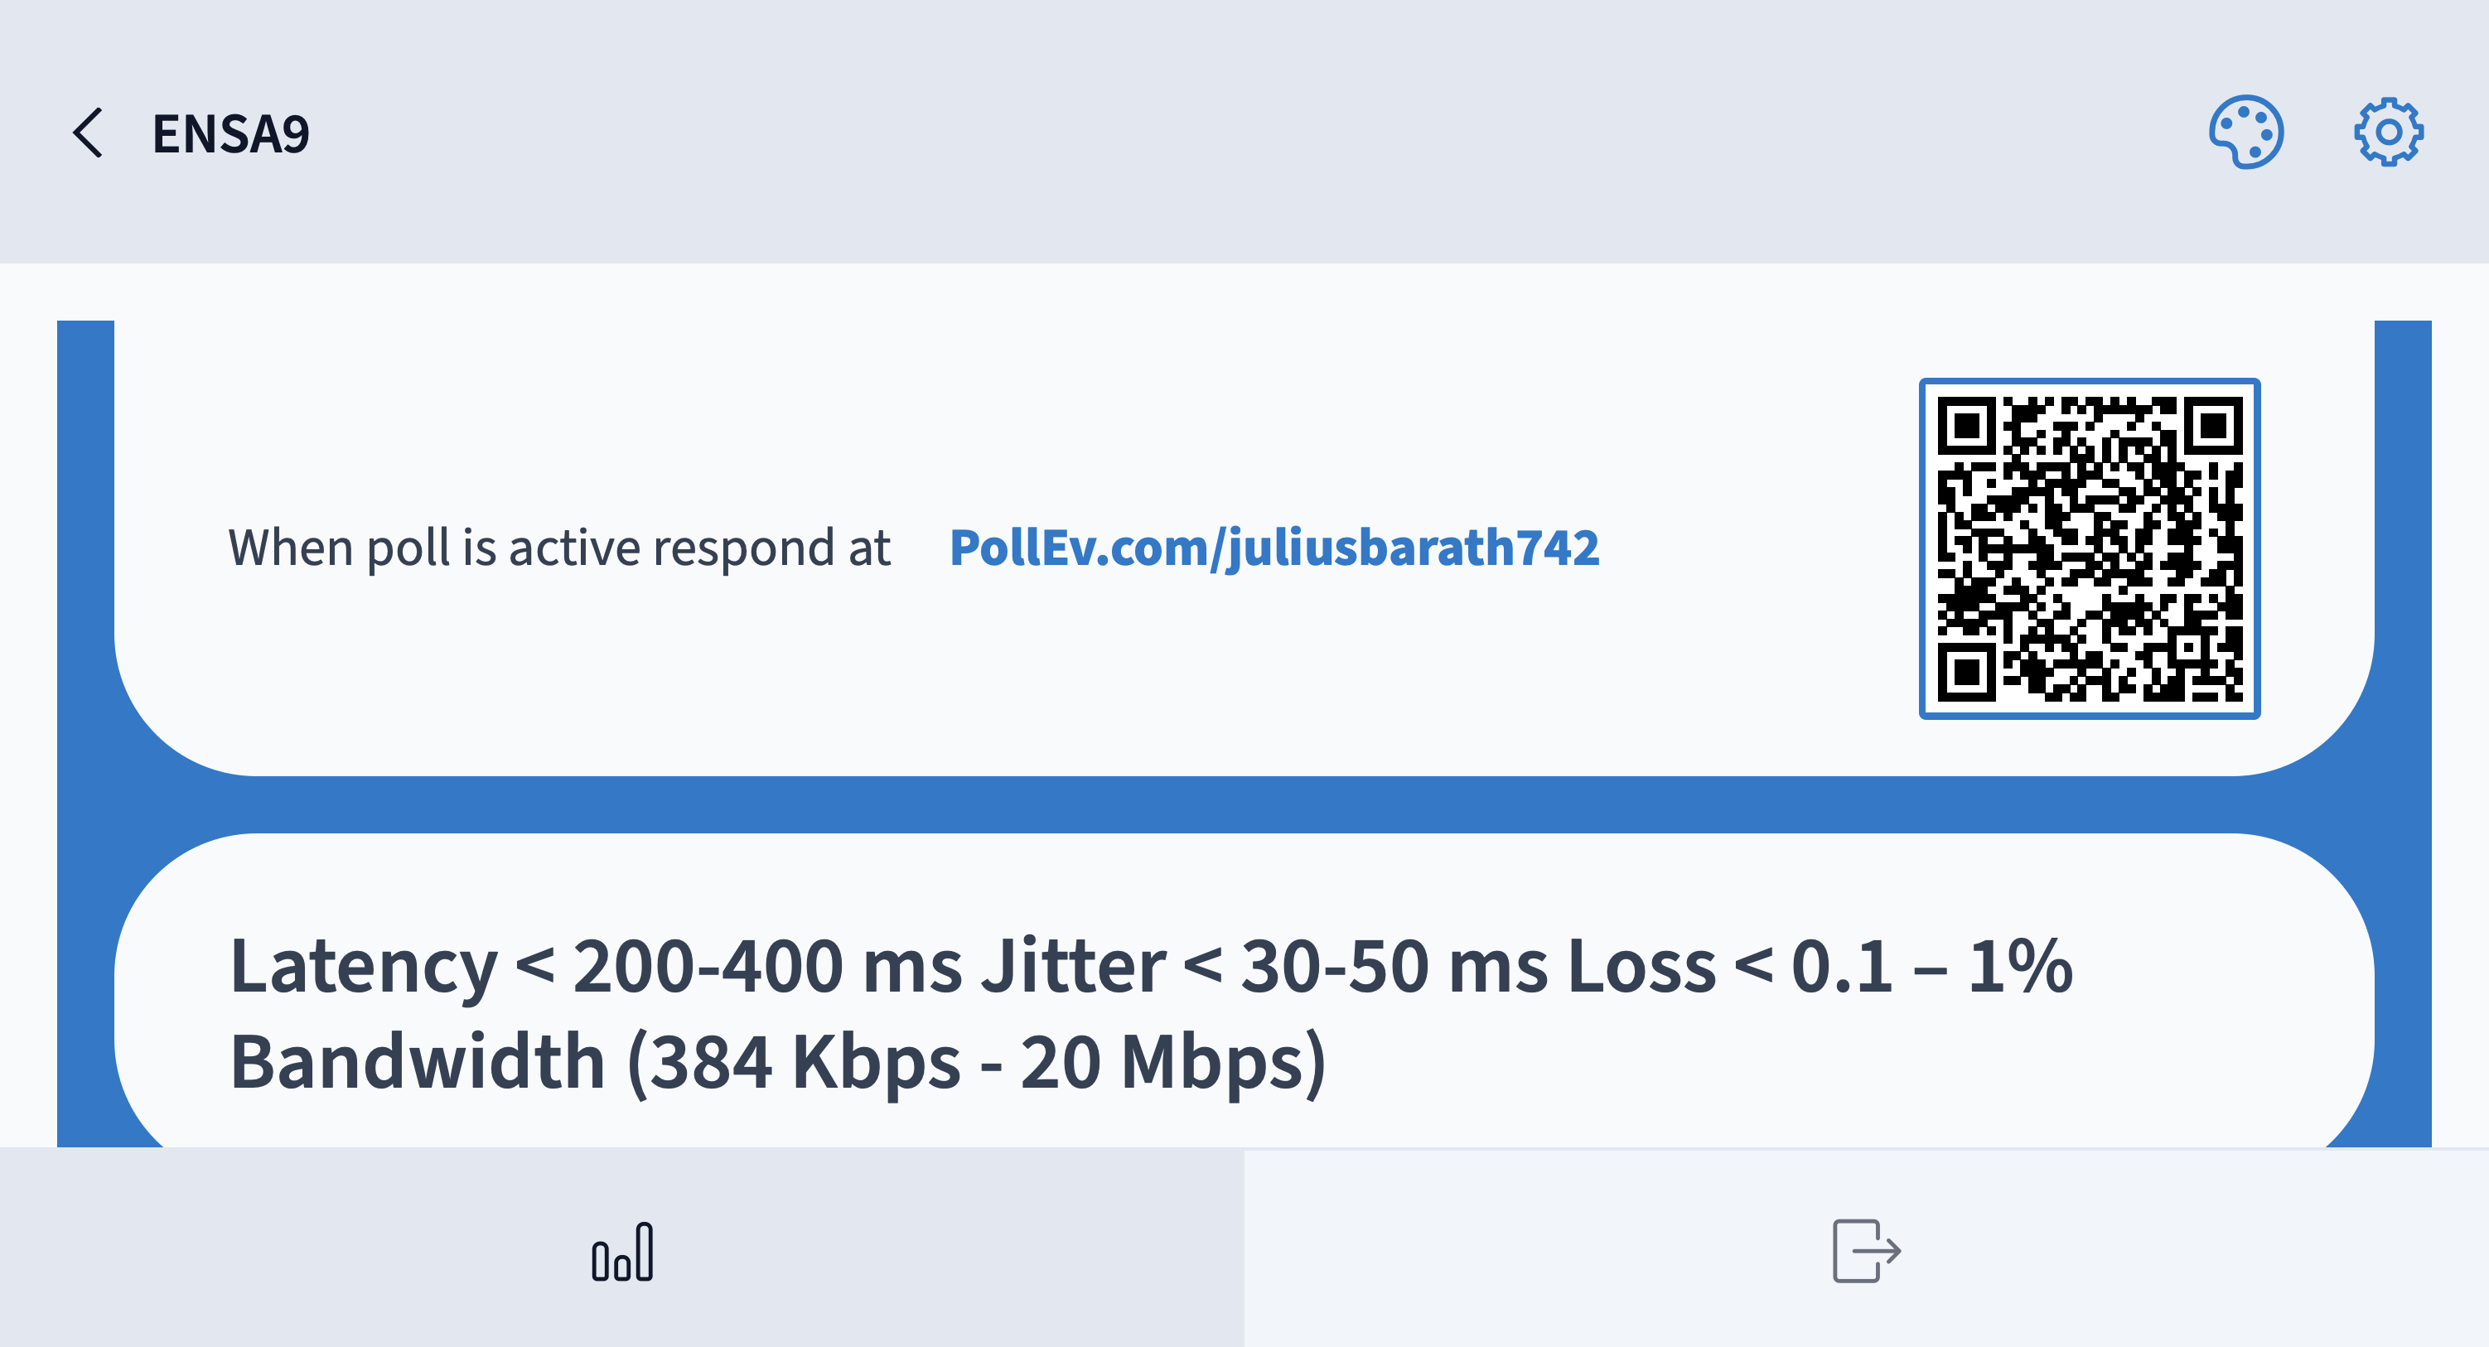

Slide 14
10.3 NTP
Notes:
10 - Network Management
10.3 - NTP

Slide 15
NTP
Time and Calendar Services
The software clock on a router or switch starts when the system boots. It is the primary source of time for the system. It is important to synchronize the time across all devices on the network. When the time is not synchronized between devices, it will be impossible to determine the order of the events and the cause of an event.
Typically, the date and time settings on a router or switch can be set by using one of two methods You can manually configure the date and time, as shown in the example, or configure the Network Time Protocol (NTP).
R1# clock set 09:36:00 oct 23 2024
R1#
*Oct 23 09:36:00.000: %SYS-6-CLOCKUPDATE: System clock has been updated from 21:32:31 UTC Fri Nov 15 2019 to 09:36:00 UTC Wed Oct 23 2024, configured from console by console.
Platí pre rok 2025
clock timezone CET
clock summer-time CEST recurring 30 Sun Mar 2:00 26 Sun Oct 2:00
Time Zone & Clock Changes in Bratislava, Slovakia (timeanddate.com)
Notes:
10 - Network Management
10.3 - NTP
10.3.1 - Time and Calendar Services

Slide 16
NTP
Time and Calendar Services (Cont.)
As a network grows, it becomes difficult to ensure that all infrastructure devices are operating with synchronized time using the manual method.
A better solution is to configure the NTP on the network. This protocol allows routers on the network to synchronize their time settings with an NTP server, which provides more consistent time settings. NTP can be set up to synchronize to a private master clock, or it can synchronize to a publicly available NTP server on the internet. NTP uses UDP port 123 and is documented in RFC 1305.
Notes:
10 - Network Management
10.3 - NTP
10.3.1 - Time and Calendar Services (Cont.)

Slide 17
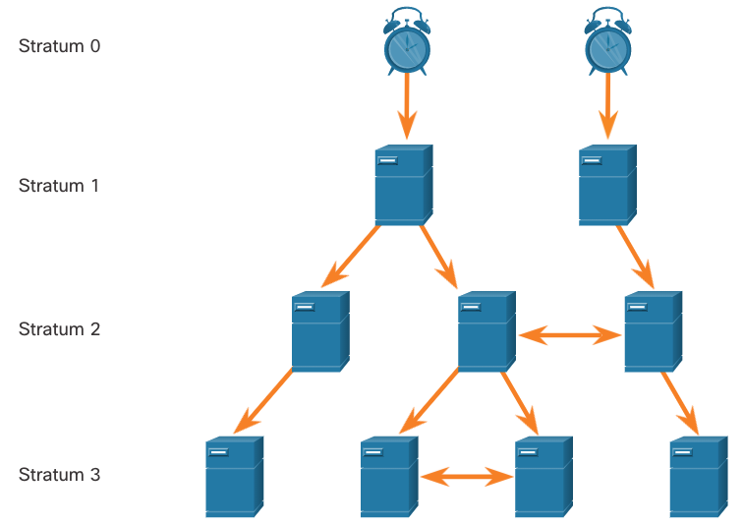
NTP
NTP Operation
NTP networks use a hierarchical system of time sources. Each level in this hierarchical system is called a stratum. The stratum level is defined as the number of hop counts from the authoritative source. The synchronized time is distributed across the network by using NTP.
The max hop count is 15. Stratum 16, the lowest stratum level, indicates that a device is unsynchronized.
Notes:
10 - Network Management
10.3 - NTP
10.3.2 - NTP Operation

Slide 18
NTP
NTP Operation (Cont.)
Stratum 0: These authoritative time sources are high-precision timekeeping devices assumed to be accurate and with little or no delay associated with them.
Stratum 1: Devices that are directly connected to the authoritative time sources. They act as the primary network time standard.
Stratum 2 and Lower: Stratum 2 servers are connected to stratum 1 devices through network connections. Stratum 2 devices, such as NTP clients, synchronize their time by using the NTP packets from stratum 1 servers. They could also act as servers for stratum 3 devices.
Time servers on the same stratum level can be configured to act as a peer with other time servers on the same stratum level for backup or verification of time.
Notes:
10 - Network Management
10.3 - NTP
10.3.2 - NTP Operation (Cont.)

Slide 19
NTP
Configure and Verify NTP
Before NTP is configured on the network, the show clock command displays the current time on the software clock. With the detail option, notice that the time source is user configuration. That means the time was manually configured with the clock command.
The ntp server ip-address command is issued in global configuration mode to configure 209.165.200.225 as the NTP server for R1. To verify the time source is set to NTP, use the show clock detail command. Notice that now the time source is NTP.
R1# show clock detail
20:55:10.207 UTC Fri Nov 15 2019
Time source is user configuration
R1# config t
R1(config)# ntp server 209.165.200.225
R1(config)# end
R1# show clock detail
21:01:34.563 UTC Fri Nov 15 2019
Time source is NTP
Notes:
10 - Network Management
10.3 - NTP
10.3.3 - Configure and Verify NTP

Slide 20
NTP
Configure and Verify NTP (Cont.)
The show ntp associations and show ntp status commands are used to verify that R1 is synchronized with the NTP server at 209.165.200.225. Notice that R1 is synchronized with a stratum 1 NTP server at 209.165.200.225, which is synchronized with a GPS clock. The show ntp status command displays that R1 is now a stratum 2 device that is synchronized with the NTP server at 209.165.220.225.
R1# show ntp associations
address ref clock st when poll each delay offset disp
*~209.165.200.225 .GPS. 1 61 64 377 0.481 7.480 4.261
sys.peer, # selected, + candidate, - outlyer, x falseticker, ~ configured
R1# show ntp status
Clock is synchronized, stratum 2, reference is 209.165.200.225
nominal freq is 250.0000 Hz, actual freq is 249.9995 Hz, precision is 2**19
(output omitted)
Notes:
10 - Network Management
10.3 - NTP
10.3.3 - Configure and Verify NTP (Cont.)

Slide 21
NTP
Configure and Verify NTP (Cont.)
The clock on S1 is configured to synchronize to R1 with the ntp server command and the configuration is verified with the show ntp associations command.
Output from the show ntp associations command verifies that the clock on S1 is now synchronized with R1 at 192.168.1.1 via NTP. R1 is a stratum 2 device, making S1 is a stratum 3 device that can provide NTP service to other devices in the network.
S1(config)# ntp server 192.168.1.1
S1(config)# end
S1# show ntp associations
address ref clock st when poll reach delay offset disp
*~192.168.1.1 209.165.200.225 2 12 64 377 1.066 13.616 3.840
sys.peer, # selected, + candidate, - outlyer, x falseticker, ~ configured
(output omitted)
S1# show ntp status
Clock is synchronized, stratum 3, reference is 192.168.1.1
nominal freq is 119.2092 Hz, actual freq is 119.2088 Hz, precision is 2**17
(output omitted
Notes:
10 - Network Management
10.3 - NTP
10.3.3 - Configure and Verify NTP (Cont.)

Slide 22
Router as NTP server
Router(config)#clock timezone CET
Router(config)#clock summer-time CEST recurring 27 Sun Mar 2:00 30 Sun Oct 2:00
Router(config)#clock calendar-valid
Router(config)#ntp master 8
Router(config)#end
Router#

Slide 23
10.4 SNMP
Notes:
10 - Network Management
10.4 - SNMP

Slide 24
SNMP
Introduction to SNMP
SNMP was developed to allow administrators to manage nodes on an IP network. It enables network administrators to monitor and manage network performance, find and solve network problems, and plan for network growth.
SNMP is an application layer protocol that provides a message format for communication between managers and agents. The SNMP system consists of three elements:
  SNMP manager
  SNMP agents (managed node)
  Management Information Base (MIB)
SNMP defines how management information is exchanged between network management applications and management agents. The SNMP manager polls the agents and queries the MIB for SNMP agents on UDP port 161. SNMP agents send any SNMP traps to the SNMP manager on UDP port 162.
Notes:
10 - Network Management
10.4 - SNMP
10.4.1 - Introduction to SNMP

Slide 25
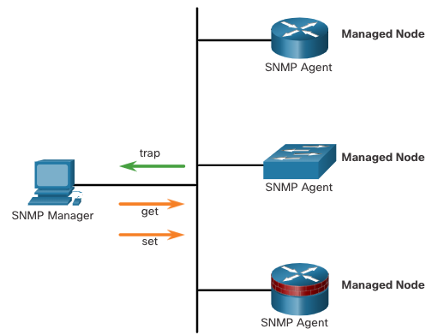
SNMP
Introduction to SNMP (Cont.)
The SNMP manager is part of a network management system (NMS). The SNMP manager can collect information from an SNMP agent by using the “get” action and can change configurations on an agent by using the “set” action. SNMP agents can forward information directly to a network manager by using “traps”.
The SNMP agent and MIB reside on SNMP client devices. MIBs store data about the device and operational statistics and are meant to be available to authenticated remote users. The SNMP agent is responsible for providing access to the local MIB.
Notes:
10 - Network Management
10.4 - SNMP
10.4.1 - Introduction to SNMP (Cont.)

Slide 26
SNMP
SNMP Operation
SNMP agents that reside on managed devices collect and store information about the device and its operation locally in the MIB. The SNMP manager then uses the SNMP agent to access information within the MIB.
There are two primary SNMP manager requests, get and set. In addition to configuration, a set can cause an action to occur, like restarting a router.
Operation | Description
get-request | Retrieves a value from a specific variable.
get-next-request | Retrieves a value from a variable within a table; the SNMP manager does not need to know the exact variable name. A sequential search is performed to find the needed variable from within a table.
get-bulk-request | Retrieves large blocks of data, such as multiple rows in a table, that would otherwise require the transmission of many small blocks of data. (Only works with SNMPv2 or later.)
get-response | Replies to a get-request, get-next-request, and set-request sent by an NMS.
set-request | Stores a value in a specific variable.
Notes:
10 - Network Management
10.4 - SNMP
10.4.2 - SNMP Operation

Slide 27
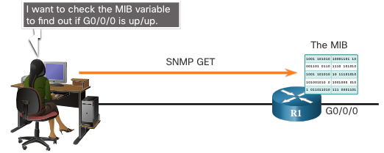
SNMP
SNMP Operation (Cont.)
The SNMP agent responds to SNMP manager requests as follows:
Get an MIB variable - The SNMP agent performs this function in response to a GetRequest-PDU from the network manager. The agent retrieves the value of the requested MIB variable and responds to the network manager with that value.
Set an MIB variable - The SNMP agent performs this function in response to a SetRequest-PDU from the network manager. The SNMP agent changes the value of the MIB variable to the value specified by the network manager. An SNMP agent reply to a set request includes the new settings in the device.
Notes:
10 - Network Management
10.4 - SNMP
10.4.2 - SNMP Operation (Cont.)

Slide 28
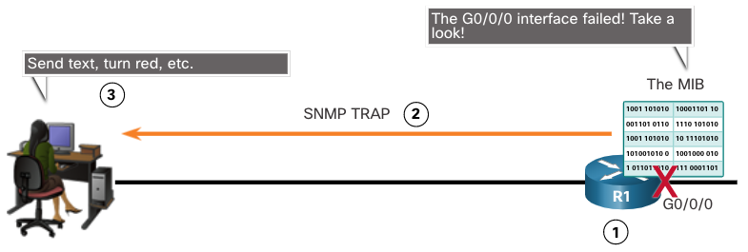
SNMP
SNMP Agent Traps
Traps are unsolicited messages alerting the SNMP manager to a condition or event on the network. Trap-directed notifications reduce network and agent resources by eliminating the need for some of SNMP polling requests.
The figure illustrates the use of an SNMP trap to alert the network administrator that interface G0/0/0 has failed. The NMS software can send the network administrator a text message, pop up a window on the NMS software, or turn the router icon red in the NMS GUI.
Notes:
10 - Network Management
10.4 - SNMP
10.4.3 - SNMP Agent Traps

Slide 29
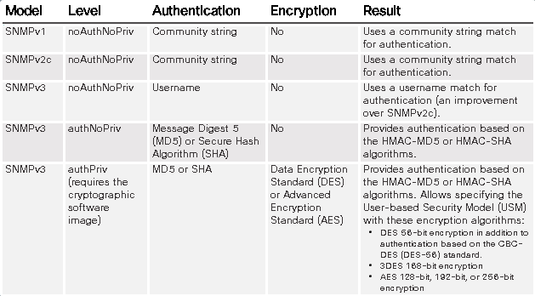
SNMP
SNMP Versions
SNMPv1 - Legacy standard defined in RFC 1157. Uses a simple community-string based authentication method. Should not be used due to security risks.
SNMPv2c - Defined in RFCs 1901-1908. Uses a simple community-string based authentication method. Provides for bulk retrieval options, as well as more detailed error messages.
SNMPv3 - Defined in RFCs 3410-3415. Uses username authentication, provides data protection using HMAC-MD5 or HMAC-SHA and encryption using DES, 3DES, or AES encryption.
Notes:
10 - Network Management
10.4 - SNMP
10.4.4 - SNMP Versions
10.4.5 - Check Your Understanding - SNMP Versions

Slide 30
SNMP
Community Strings
SNMPv1 and SNMPv2c use community strings that control access to the MIB. Community strings are plaintext passwords. SNMP community strings authenticate access to MIB objects.
There are two types of community strings:
  Read-only (ro) - This type provides access to the MIB variables, but does not allow these variables to be changed, only read. Because security is minimal in version 2c, many organizations use SNMPv2c in read-only mode.
  Read-write (rw) - This type provides read and write access to all objects in the MIB.
  To view or set MIB variables, the user must specify the appropriate community string for read or write access.
Notes:
10 - Network Management
10.4 - SNMP
10.4.6 - Community Strings

Slide 31
SNMP
MIB Object ID
The MIB organizes variables hierarchically. Formally, the MIB defines each variable as an object ID (OID). OIDs uniquely identify managed objects. The MIB organizes the OIDs based on RFC standards into a hierarchy of OIDs, usually shown as a tree.
The MIB tree for any given device includes some branches with variables common to many networking devices and some branches with variables specific to that device or vendor.
RFCs define some common public variables. Most devices implement these MIB variables. In addition, networking equipment vendors, like Cisco, can define their own private branches of the tree to accommodate new variables specific to their devices.
Notes:
10 - Network Management
10.4 - SNMP
10.4.7 - MIB Object ID

Slide 32
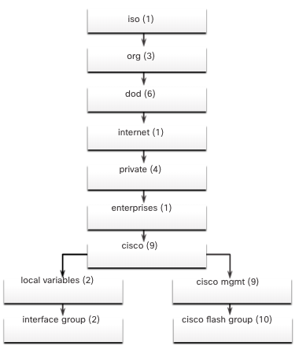
SNMP
MIB Object ID (Cont.)
The figure shows portions of the MIB structure defined by Cisco. Note how the OID can be described in words or numbers to help locate a particular variable in the tree.
OIDs belonging to Cisco, are numbered as follows: .iso (1).org (3).dod (6).internet (1).private (4).enterprises (1).cisco (9).
Therefore, the OID is 1.3.6.1.4.1.9.
Notes:
10 - Network Management
10.4 - SNMP
10.4.7 - MIB Object ID (Cont.)

Slide 33
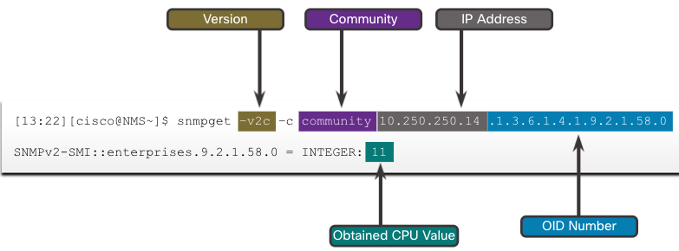
SNMP
SNMP Polling Scenario
SNMP can be used is to observe CPU utilization over a period of time by polling devices. CPU statistics can then be compiled on the NMS and graphed. This creates a baseline for the network administrator.
The data is retrieved via the snmpget utility, issued on the NMS. Using the snmpget utility, you can manually retrieve real-time data, or have the NMS run a report. This report would give you a period of time that you could use the data to get the average.
Notes:
10 - Network Management
10.4 - SNMP
10.4.8 - SNMP Polling Scenario

Slide 34
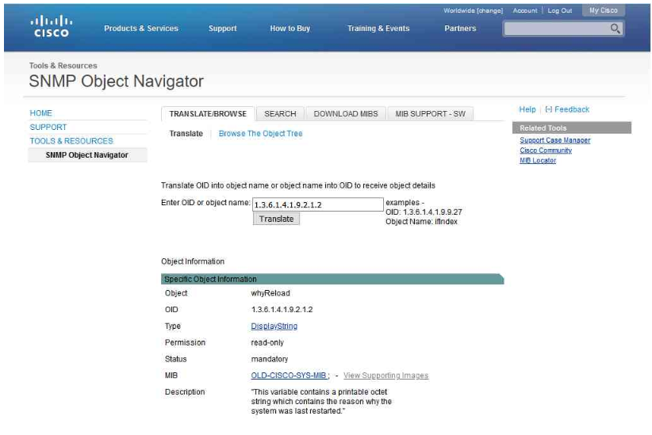
SNMP
SNMP Object Navigator
The snmpget utility gives some insight into the basic mechanics of how SNMP works. However, working with long MIB variable names like 1.3.6.1.4.1.9.2.1.58.0 can be problematic for the average user. More commonly, the network operations staff uses a network management product with an easy-to-use GUI, which makes the entire MIB data variable naming transparent to the user.
The Cisco SNMP Navigator on the http://tools.cisco.com/Support/SNMP/do/BrowseOID.do?local=en website allows a network administrator to research details about a particular OID.
Notes:
10 - Network Management
10.4 - SNMP
10.4.9 - SNMP Object Navigator

Slide 35
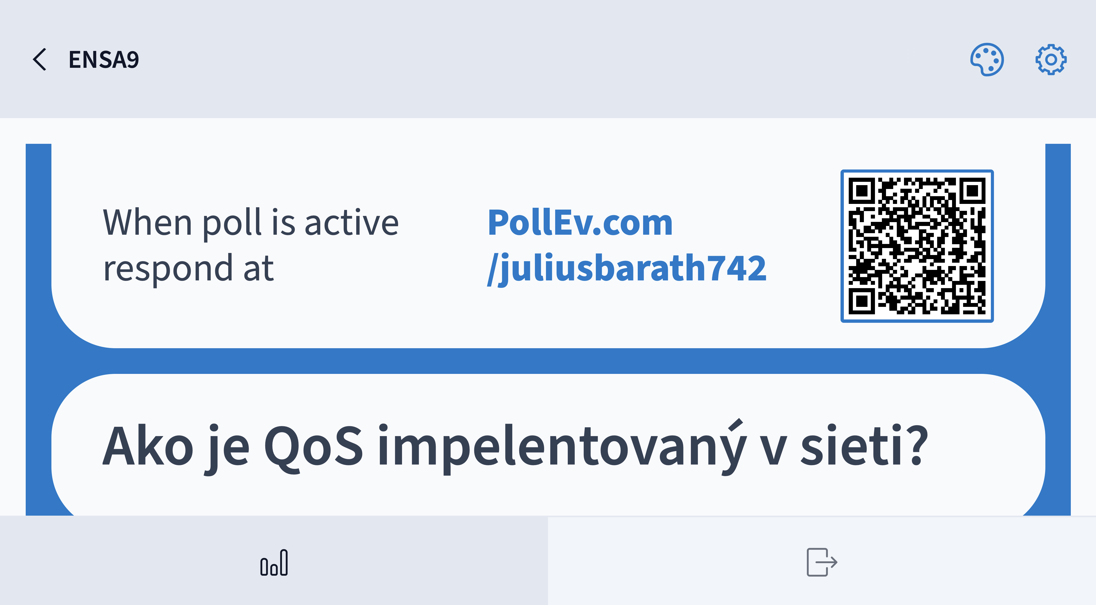

Slide 36
10.5 Syslog
Notes:
10 - Network Management
10.5 - Syslog

Slide 37
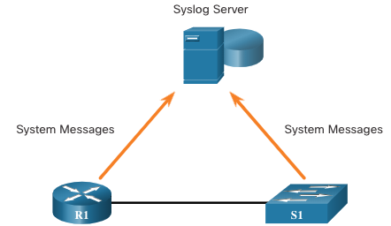
Syslog
Introduction to Syslog
Syslog uses UDP port 514 to send event notification messages across IP networks to event message collectors, as shown in the figure.
The syslog logging service provides three primary functions, as follows:
  The ability to gather logging information for monitoring and troubleshooting
  The ability to select the type of logging information that is captured
  The ability to specify the destinations of captured syslog messages
Secure Encrypted Port Number
TCP 6514 RFC 5425 Syslog over TLS
UDP 6514 RFC 6012 Syslog over DTLS
Used by unix too
Notes:
10 - Network Management
10.5 - Syslog
10.5.1 - Introduction to Syslog

Slide 38
Syslog
Syslog Operation
The syslog protocol starts by sending system messages and debug output to a local logging process. Syslog configuration may send these messages across the network to an external syslog server, where they can be retrieved without needing to access the actual device.
Alternatively, syslog messages may be sent to an internal buffer. Messages sent to the internal buffer are only viewable through the CLI of the device.
The network administrator may specify that only certain types of system messages be sent to various destinations. Popular destinations for syslog messages include the following:
  Logging buffer (RAM inside a router or switch)
  Console line
  Terminal line
  Syslog server
Notes:
10 - Network Management
10.5 - Syslog
10.5.2 - Syslog Operation

Slide 39
Syslog
Syslog Message Format
Cisco devices produce syslog messages as a result of network events. Every syslog message contains a severity level and a facility.
The smaller numerical levels are the more critical syslog alarms. The severity level of the messages can be set to control where each type of message is displayed (i.e. on the console or the other destinations). The complete list of syslog levels is shown in the table.
Severity Name | Severity Level | Explanation
Emergency | Level 0 | System Unusable
Alert | Level 1 | Immediate Action Needed
Critical | Level 2 | Critical Condition
Error | Level 3 | Error Condition
Warning | Level 4 | Warning Condition
Notification | Level 5 | Normal, but Significant Condition
Informational | Level 6 | Informational Message
Debugging | Level 7 | Debugging Message
Notes:
10 - Network Management
10.5 - Syslog
10.5.3 - Syslog Message Format

Slide 40
Syslog
Syslog Facilities
In addition to specifying the severity, syslog messages also contain information on the facility. Syslog facilities are service identifiers that identify and categorize system state data for error and event message reporting. The logging facility options that are available are specific to the networking device.
Some common syslog message facilities reported on Cisco IOS routers include:
  IP
  OSPF protocol
  SYS operating system
  IP security (IPsec)
  Interface IP (IF)
The following is a list of RFCs that define the Syslog protocol:
RFC 3195 Reliable Delivery for Syslog
RFC 5424 The Syslog Protocol
RFC 5425 TLS Transport Mapping for Syslog
RFC 5426 Transmission of Syslog Messages over UDP
RFC 5427 Textual Conventions for Syslog Management
RFC 5848 Signed Syslog Messages
RFC 6012 Datagram Transport Layer Security (DTLS) Transport Mapping for Syslog
Notes:
10 - Network Management
10.5 - Syslog
10.5.4 - Syslog Facilities

Slide 41
Syslog
Syslog Facilities (Cont.)
By default, the format of syslog messages on the Cisco IOS Software is as follows:
%facility-severity-MNEMONIC: description
For example, sample output on a Cisco switch for an EtherChannel link changing state to up is:
%LINK-3-UPDOWN: Interface Port-channel1, changed state to up
Here the facility is LINK and the severity level is 3, with a MNEMONIC of UPDOWN.
Router(config)#logging host 192.168.0.30
Router(config)#service timestamps debug datetime localtime show-timezone msec
Router(config)#service timestamps log datetime localtime show-timezone msec
Router(config)#logging trap warning
Router(config)#logging source-interface gi0/0/0
Nie je pevne stanovený maximálny počet syslog serverov, ale prakticky sa odporúča do 4 až 10 serverov, v závislosti od platformy a výkonu zariadenia.
Notes:
10 - Network Management
10.5 - Syslog
10.5.4 - Syslog Facilities (Cont.)

Slide 42
Syslog
Configure Syslog Timestamp
By default, log messages are not timestamped. Log messages should be timestamped so that when they are sent to another destination, such as a Syslog server, there is record of when the message was generated. Use the command service timestamps log datetime to force logged events to display the date and time.
R1# configure terminal
R1(config)# interface g0/0/0
R1(config-if)# shutdown
%LINK-5-CHANGED: Interface GigabitEthernet0/0/0, changed state to administratively down
%LINEPROTO-5-UPDOWN: Line protocol on Interface GigabitEthernet0/0/0, changed state to down R1(config-if)# exit
R1(config)# service timestamps log datetime
R1(config)# interface g0/0/0
R1(config-if)# no shutdown
*Mar 1 11:52:42: %LINK-3-UPDOWN: Interface GigabitEthernet0/0/0, changed state to down
*Mar 1 11:52:45: %LINK-3-UPDOWN: Interface GigabitEthernet0/0/0, changed state to up
*Mar 1 11:52:46: %LINEPROTO-5-UPDOWN: Line protocol on Interface GigabitEthernet0/0/0, changed state to up
R1(config-if)#
Notes:
10 - Network Management
10.5 - Syslog
10.5.5 - Configure Syslog Timestamp
10.5.6 - Check Your Understanding - Syslog Operation

Slide 43
10.6 Router and Switch File Maintenance
Notes:
10 - Network Management
10.6 - Router and Switch File Maintenance

Slide 44
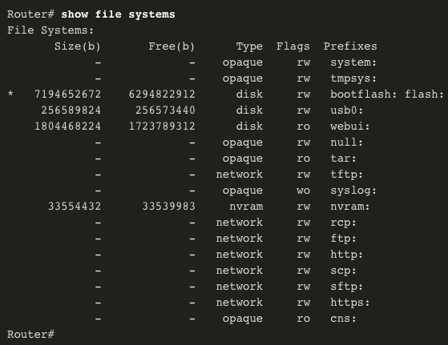
Router and Switch File Maintenance
Router File Systems
The Cisco IOS File System (IFS) allows the administrator to navigate to different directories and list the files in a directory. The administrator can also create subdirectories in flash memory or on a disk. The directories available depend on the device.
The example displays the output of the show file systems command, which lists all of the available file systems on a Cisco 4221 router.
The asterisk (*) indicates the current default file system. The pound sign (#) indicates a bootable disk. Both of these are assigned to the flash file system by default
Notes:
10 - Network Management
10.6 - Router and Switch File Maintenance
10.6.1 - Router File Systems

Slide 45
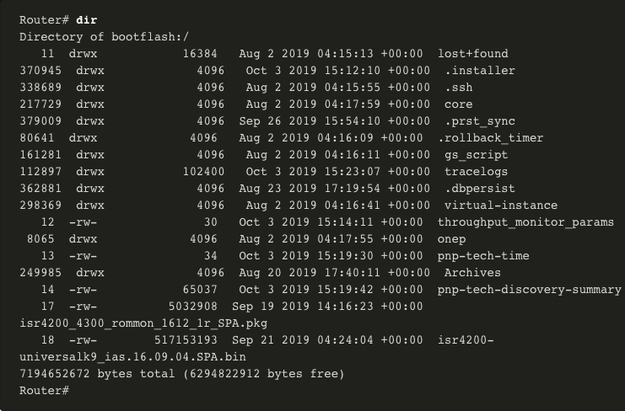
Router and Switch File Maintenance
Router File Systems (Cont.)
Because flash is the default file system, the dir command lists the contents of flash. Of specific interest is the last listing. This is the name of the current Cisco IOS file image that is running in RAM.
Notes:
10 - Network Management
10.6 - Router and Switch File Maintenance
10.6.1 - Router File Systems (Cont.)

Slide 46
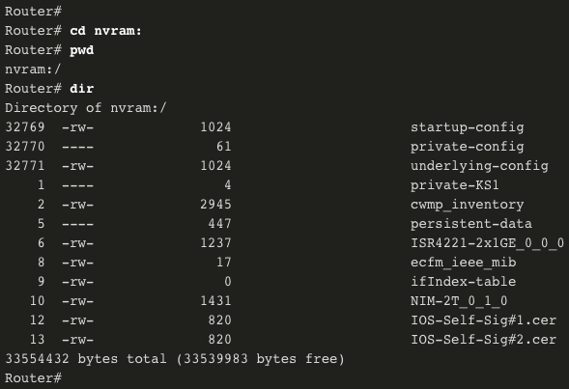
Router and Switch File Maintenance
Router File Systems (Cont.)
To view the contents of NVRAM, you must change the current default file system by using the cd (change directory) command, as shown in the example.
The present working directory command is pwd. This command verifies that we are viewing the NVRAM directory. Finally, the dir command lists the contents of NVRAM. Although there are several configuration files listed, of specific interest is the startup-configuration file.
Notes:
10 - Network Management
10.6 - Router and Switch File Maintenance
10.6.1 - Router File Systems (Cont.)

Slide 47
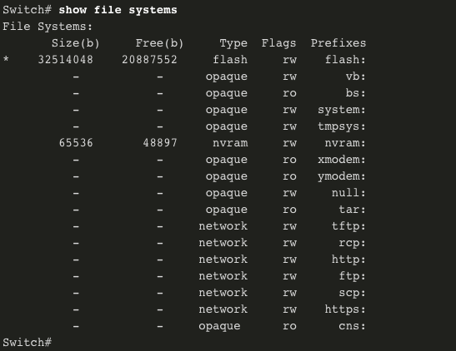
Router and Switch File Maintenance
Switch File Systems
With the Cisco 2960 switch flash file system, you can copy configuration files, and archive (upload and download) software images.
The command to view the file systems on a Catalyst switch is the same as on a Cisco router: show file systems.
Notes:
10 - Network Management
10.6 - Router and Switch File Maintenance
10.6.2 - Switch File Systems

Slide 48
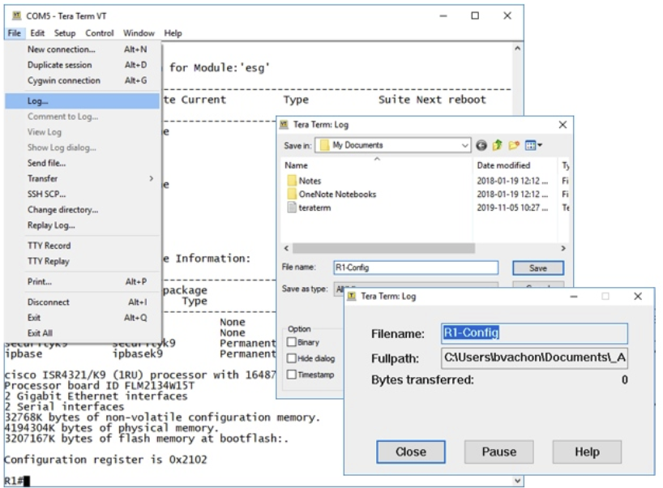
Router and Switch File Maintenance
Use a Text File to Back Up a Configuration
Configuration files can be saved to a text file by using Tera Term:
Step 1. On the File menu, click Log.
Step 2. Choose the location to save the file. Tera Term will begin capturing text.
Step 3. After capture has been started, execute the show running-config or show startup-config command at the privileged EXEC prompt. Text displayed in the terminal window will be directed to the chosen file.
Step 4. When the capture is complete, select Close in the Tera Term: Log window.
Step 5. View the file to verify that it was not corrupted.
Notes:
10 - Network Management
10.6 - Router and Switch File Maintenance
10.6.3 - Use a Text File to Back Up a Configuration

Slide 49
Router and Switch File Maintenance
Use a Text File to Restore a Configuration
A configuration can be copied from a file and then directly pasted to a device. The file will require editing to ensure that encrypted passwords are in plaintext, and that non-command text such as --More-- and IOS messages are removed.
Router# terminal length 0 odstráni riadkovanie ...
In addition, you may want to add enable and configure terminal to the beginning of the file or enter global configuration mode before pasting the configuration. Instead of copying and pasting, a configuration can be restored from a text file by using Tera Term. When using Tera Term, the steps are as follows:
    Step 1. On the File menu, click Send file.
    Step 2. Locate the file to be copied into the device and click Open.
    Step 3. Tera Term will paste the file into the device.
The text in the file will be applied as commands in the CLI and become the running configuration on the device.
Notes:
10 - Network Management
10.6 - Router and Switch File Maintenance
10.6.4 - Use a Text File to Restore a Configuration

Slide 50
Router and Switch File Maintenance
Using TFTP to Back Up and Restore a Configuration
Follow these steps to back up the running configuration to a TFTP server:
Step 1. Enter the copy running-config tftp command.
Step 2. Enter the IP address of the host where the configuration file will be stored.
Step 3. Enter the name to assign to the configuration file.
Step 4. Press Enter to confirm each choice.
Use the following steps to restore the running configuration from a TFTP server:
Step 1. Enter the copy tftp running-config command.
Step 2. Enter the IP address of the host where the configuration file is stored.
Step 3. Enter the name to assign to the configuration file.
Step 4. Press Enter to confirm each choice.
R1# copy running-config tftp
Remote host []?192.168.10.254
Name of the configuration file to write[R1-config]? R1-Jan-2019
Write file R1-Jan-2019 to 192.168.10.254? [confirm]
Writing R1-Jan-2019 !!!!!! [OK]
Notes:
10 - Network Management
10.6 - Router and Switch File Maintenance
10.6.5 - Using TFTP to Back Up and Restore a Configuration

Slide 51
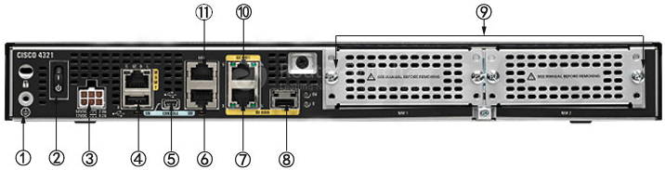
Router and Switch File Maintenance
USB Ports on a Cisco Router
The Universal Serial Bus (USB) storage feature enables certain models of Cisco routers to support USB flash drives. The USB flash feature provides an optional secondary storage capability and an additional boot device. The USB ports of a Cisco 4321 Router are shown in the figure. USB port (5) is console only!
Use the dir command to view the contents of the USB flash drive – connector (4).
Notes:
10 - Network Management
10.6 - Router and Switch File Maintenance
10.6.6 - USB Ports on a Cisco Router

Slide 52
Router and Switch File Maintenance
Using USB to Back Up and Restore a Configuration
Issue the show file systems command to verify that the USB drive is there and confirm its name. For this example, the USB file system is named usbflash0:.
Use the copy run usbflash0:/ command to copy the configuration file to the USB flash drive. Be sure to use the name of the flash drive, as indicated in the file system. The slash is optional but indicates the root directory of the USB flash drive.
The IOS will prompt for the filename. If the file already exists on the USB flash drive, the router will prompt to overwrite.
R1# copy running-config usbflash0:
Destination filename [running-config]? R1-Config
%Warning:There is a file already existing with this name
Do you want to over write? [confirm]
5024 bytes copied in 1.796 secs (2797 bytes/sec)
R1#
Notes:
10 - Network Management
10.6 - Router and Switch File Maintenance
10.6.7 - Using USB to Back Up and Restore a Configuration

Slide 53
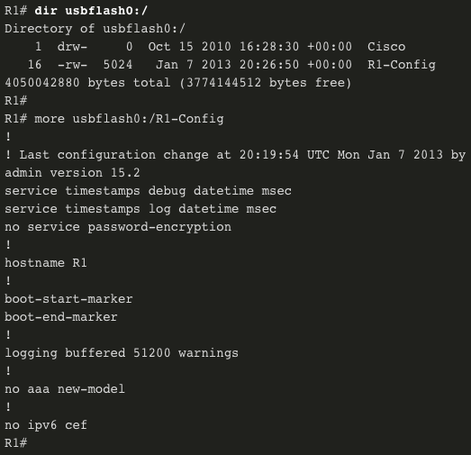
Router and Switch File Maintenance
Using USB to Back Up and Restore a Configuration (Cont.)
Use the dir command to see the file on the USB drive and use the more command to see the contents.
To Restore Configurations with a USB Flash Drive, it will be necessary to edit the USB R1-Config file with a text editor. Assuming the file name is R1-Config, use the command copy usbflash0:/R1-Config running-config to restore a running configuration.
Router# copy usbflash0:/R1-Config running-config
Notes:
10 - Network Management
10.6 - Router and Switch File Maintenance
10.6.7 - Using USB to Back Up and Restore a Configuration (Cont.)

Slide 54
Configuring Secure Copy
Configure the router for server-side SCP with local AAA:
Configure SSH
Configure at least one user with privilege level 15
Enable AAA
Specify that the local database is to be used for authentication
Configure command authorization
Enable SCP server-side functionality (ip scp server enable)
! AAA authentication and authorization
aaa new-model
aaa authentication login default local
aaa authorization exec default local username fero privilege 15 password 0 lab
Hostname x
ip domain-name xxx.sk
crypto key generate rsa
ip scp server enable
Router#copy startup-config scp
Address or name of remote host []? 20.20.0.2
Destination username [Router]? fero
Destination filename [Router-confg]? xxx.txt
Writing xxx.txt
Password:
!
840 bytes copied in 1.64552 secs (510 bytes/sec)
Router#
Notes:
2.3.1.4 Configuring Secure Copy

Slide 55
Router and Switch File Maintenance
Password Recovery Procedures
Passwords on devices are used to prevent unauthorized access. For encrypted passwords, such as the enable secret passwords, the passwords must be replaced after recovery. Depending on the device, the detailed procedure for password recovery varies.
However, all the password recovery procedures follow the same principle:
Step 1. Enter the ROMMON mode.
Step 2. Change the configuration register.
Step 3. Copy the startup-config to the running-config.
Step 4. Change the password.
Step 5. Change the configuration register.
Step 6. Save the running-config as the new startup-config.
Step 7. Reload the device.
Notes:
10 - Network Management
10.6 - Router and Switch File Maintenance
10.6.8 - Password Recovery Procedures

Slide 56
Router and Switch File Maintenance
Password Recovery Example
Step 1. Enter the ROMMON mode. With console access, a user can access the ROMMON mode by using a break sequence during the boot up process or removing the external flash memory when the device is powered off.
When successful, the rommon 1 > prompt displays, as shown in the example.
Readonly ROMMON initialized
monitor: command "boot" aborted due to user interrupt rommon 1 >
Notes:
10 - Network Management
10.6 - Router and Switch File Maintenance
10.6.9 - Password Recovery Example

Slide 57
Router and Switch File Maintenance
Password Recovery Example (Cont.)
Step 2. Change the configuration register. The confreg 0x2142 command allows the user to set the configuration register to 0x2142, which causes the device to ignore the startup config file during startup.
After setting the configuration register to 0x2142, type reset at the prompt to restart the device. Enter the break sequence while the device is rebooting and decompressing the IOS. The example displays the terminal output of a 1941 router in the ROMMON mode after using a break sequence during the boot up process.
rommon 1 > confreg 0x2142
rommon 2 > reset
System Bootstrap, Version 15.0(1r)M9, RELEASE SOFTWARE (fc1)
Technical Support: http://www.cisco.com/techsupport
Copyright (c) 2010 by cisco Systems, Inc.
(output omitted)
Notes:
10 - Network Management
10.6 - Router and Switch File Maintenance
10.6.9 - Password Recovery Example (Cont.)

Slide 58
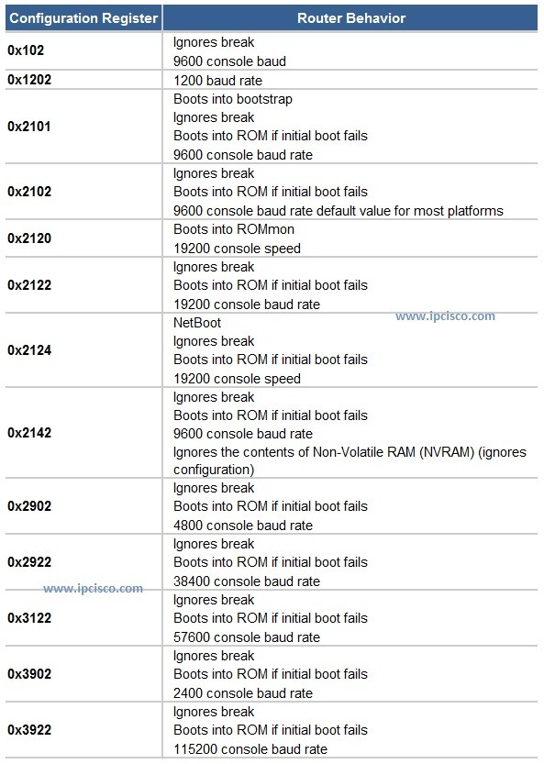

Slide 59
Router and Switch File Maintenance
Password Recovery Example (Cont.)
Enter privileged mode
Step 3. Copy the startup-config to the running-config. After the device has finished reloading, issue the copy startup-config running-config command.
CAUTION: Do not enter copy running-config startup-config. This command erases your original startup configuration.
Router> enable
Router# copy startup-config running-config
Destination filename [running-config]?
1450 bytes copied in 0.156 secs (9295 bytes/sec)
R1#
Notes:
10 - Network Management
10.6 - Router and Switch File Maintenance
10.6.9 - Password Recovery Example (Cont.)

Slide 60
Router and Switch File Maintenance
Password Recovery Example (Cont.)
Step 4. Change the password. Because you are in privileged EXEC mode, you can now configure all the necessary passwords.
Note: The password cisco is not a strong password and is used here only as an example
R1# configure terminal
Enter configuration commands, one per line. End with CNTL/Z.
R1(config)# enable secret cisco
Notes:
10 - Network Management
10.6 - Router and Switch File Maintenance
10.6.9 - Password Recovery Example (Cont.)

Slide 61
Router and Switch File Maintenance
Password Recovery Example (Cont.)
Steps 5 and 6. Save the running-config as the new startup-config. After the new passwords are configured, change the configuration register back to 0x2102 by using the config-register 0x2102 command in the global configuration mode. Save the running-config to startup-config.
R1(config)# config-register 0x2102
R1(config)# end
R1# copy running-config startup-config
Destination filename [startup-config]? Building configuration... [OK]
R1#
Notes:
10 - Network Management
10.6 - Router and Switch File Maintenance
10.6.9 - Password Recovery Example (Cont.)

Slide 62


Slide 63
10.7 IOS Image Management
Notes:
10 - Network Maintenance
10.7 - IOS Image Management

Slide 64
IOS Image Management
TFTP Servers as a Backup Location
As a network grows, Cisco IOS Software images and configuration files can be stored on a central TFTP server. This helps to control the number of IOS images and the revisions to those IOS images, as well as the configuration files that must be maintained.
Production internetworks usually span wide areas and contain multiple routers. For any network, it is good practice to keep a backup copy of the Cisco IOS Software image in case the system image on the router becomes corrupted or accidentally erased.
Widely distributed routers need a source or backup location for Cisco IOS Software images. Using a network TFTP server allows image and configuration uploads and downloads over the network. The network TFTP server can be another router, a workstation, or a host system.
Notes:
10 - Network Maintenance
10.7 - IOS Image Management
10.7.2 - TFTP Servers as a Backup Location

Slide 65
IOS Image Management
Backup IOS Image to TFTP Server Example
To maintain network operations with minimum down time, it is necessary to have procedures in place for backing up Cisco IOS images. This allows the network administrator to quickly copy an image back to a router in case of a corrupted or erased image. Use the following steps:
  Step 1. Ping the TFTP server. Ping the TFTP server to test connectivity.
  Step 2. Verify image size in flash. Verify that the TFTP server has sufficient disk space to accommodate the Cisco IOS Software image. Use the show flash0: command on the router to determine the size of the Cisco IOS image file.
  Step 3. Copy the image to the TFTP server. Copy the image to the TFTP server by using the copy source-url destination-url command. After issuing the command by using the specified source and destination URLs, the user is prompted for the source file name, IP address of the remote host, and destination file name. The transfer will then begin.
Notes:
10 - Network Maintenance
10.7 - IOS Image Management
10.7.3 - Backup IOS Image to TFTP Server Example

Slide 66
IOS Image Management
Copy an IOS Image to a Device Example
Step 1. Ping the TFTP server. Ping the TFTP server to test connectivity.
Step 2. Verify the amount of free flash. Ensure that there is sufficient flash space on the device being upgraded by using the show flash: command. Compare the free flash space with the new image file size.
Step 3. Copy the IOS image file from the TFTP server to the router by using the copy tftp: flash: command. After issuing this command, the user will be prompted for the IP address of the remote host, source file name, and destination file name.
R1# copy tftp: flash:
Address or name of remote host []? 2001:DB8:CAFE:100::99
Source filename []? isr4200-universalk9_ias.16.09.04.SPA.bin
Destination filename [isr4200-universalk9_ias.16.09.04.SPA.bin]?
Accessing tftp://2001:DB8:CAFE:100::99/ isr4200- universalk9_ias.16.09.04.SPA.bin... Loading isr4200-universalk9_ias.16.09.04.SPA.bin from 2001:DB8:CAFE:100::99 (via GigabitEthernet0/0/0): !!!!!!!!!!!!!!!!!!!!
[OK - 517153193 bytes]
517153193 bytes copied in 868.128 secs (265652 bytes/sec)
Notes:
10 - Network Maintenance
10.7 - IOS Image Management
10.7.4 - Copy an IOS Image to a Device Example

Slide 67
IOS Image Management
The boot system Command
During startup, the bootstrap code parses the startup configuration file in NVRAM for the boot system commands that specify the name and location of the Cisco IOS Software image to load. Several boot system commands can be entered in sequence to provide a fault-tolerant boot plan.
If there are no boot system commands in the configuration, the router defaults to loading the first valid Cisco IOS image in flash memory and runs it.
To upgrade to the copied IOS image after that image is saved on the flash memory of the router, configure the router to load the new image by using the boot system command. Save the configuration. Reload the router to boot the router with new image.
R1# configure terminal
R1(config)# boot system flash0:isr4200-universalk9_ias.16.09.04.SPA.bin
R1(config)# exit
R1# copy running-config startup-config
R1# reload
Notes:
10 - Network Maintenance
10.7 - IOS Image Management
10.7.5 -The boot system Command

