Slide 1
Module 8: VPN and IPsec Concepts
Enterprise Networking, Security, and Automation v7.0 (ENSA)
Notes:
Cisco Networking Academy Program
Enterprise Networking, Security, and Automation v7.0 (ENSA)
Module 8: VPN and IPsec Concepts

Slide 2
Module Objectives
Module Title: VPN and IPsec Concepts
Module Objective: Explain how VPNs and IPsec are used to secure site-to-site and remote access connectivity.
Topic Title | Topic Objective
VPN Technology | Describe the benefits of VPN technology.
Types of VPNs | Describe different types of VPNs.
IPsec | Explain how the IPsec framework is used to secure network traffic.
Notes:
2
8 – VPN and IPsec Concepts
8.0.2- What will I learn to do in this Module.

Slide 3
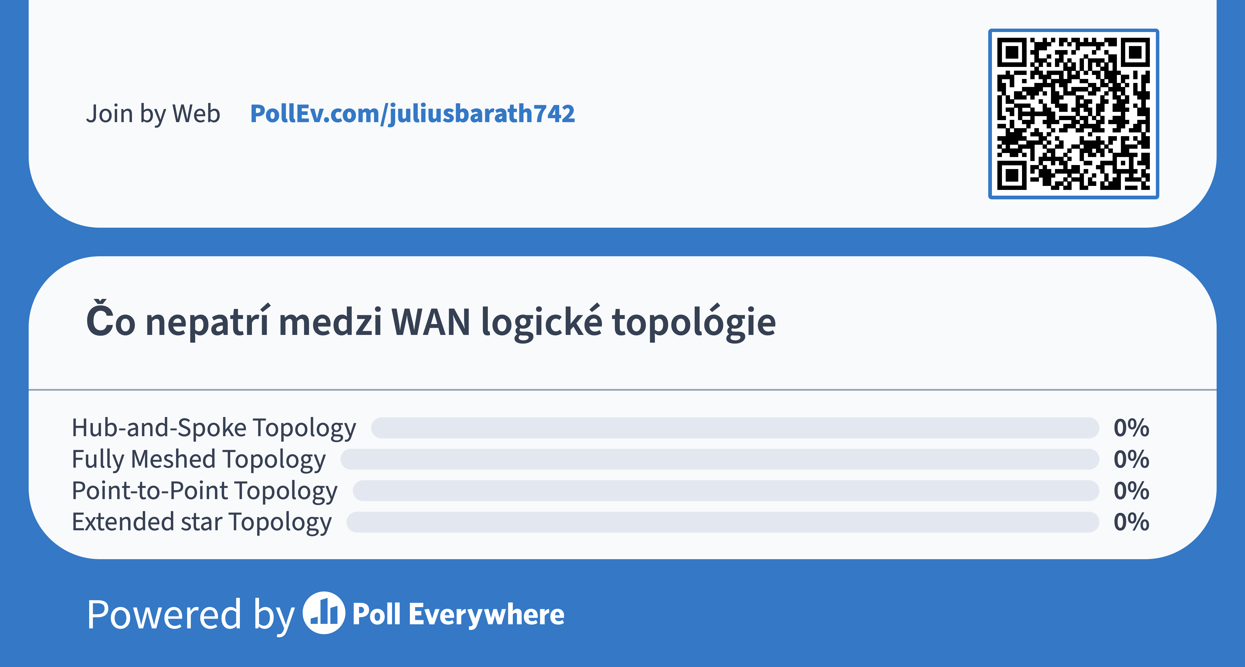

Slide 4
8.1 VPN Technology
Notes:
8 - VPN and IPsec Concepts
8.1 - VPN Technology

Slide 5
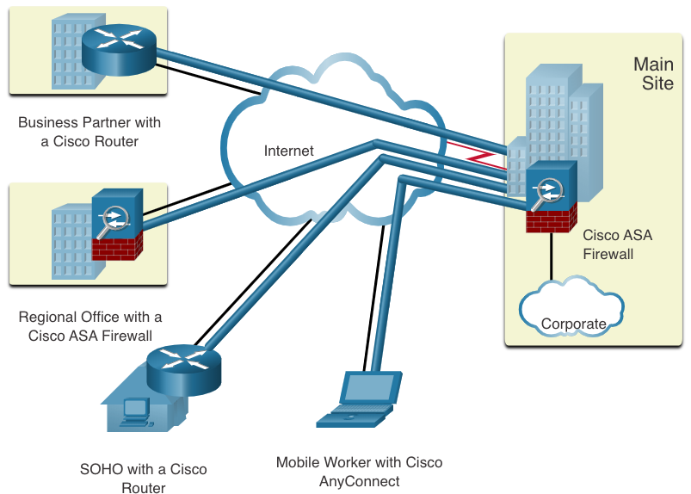
VPN Technology
Virtual Private Networks
Virtual private networks (VPNs) to create end-to-end private network connections.
A VPN is virtual in that it carries information within a private network, but that information is transported over a public network.
A VPN is private in that the traffic is encrypted to keep the data confidential while it is transported across the public network.
Notes:
8 – VPN and IPsec Concepts
8.1 – VPN Technology
8.1.1 – Virtual Private Networks

Slide 6
VPN Technology
VPN Benefits
Modern VPNs now support encryption features, such as Internet Protocol Security (IPsec) and Secure Sockets Layer (SSL) VPNs to secure network traffic between sites.
Major benefits of VPNs are shown in the table:
Benefit | Description
Cost Savings | Organizations can use VPNs to reduce their connectivity costs while simultaneously increasing remote connection bandwidth.
Security | Encryption and authentication protocols protect data from unauthorized access.
Scalability | VPNs allow organizations to use the internet, making it easy to add new users without adding significant infrastructure.
Compatibility | VPNs can be implemented across a wide variety of WAN link options including broadband technologies. Remote workers can use these high-speed connections to gain secure access to corporate networks.
Notes:
8 – VPN and IPsec Concepts
8.1 – VPN Technology
8.1.2 – VPN Benefits

Slide 7
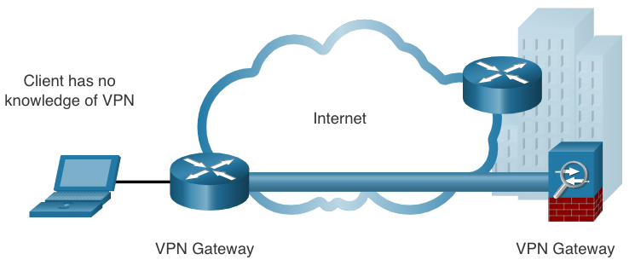
VPN Technology
Site-to-Site VPNs
A site-to-site VPN is terminated on VPN gateways. VPN traffic is only encrypted between the gateways. Internal hosts have no knowledge that a VPN is being used.
Notes:
8 – VPN and IPsec Concepts
8.1 – VPN Technology
8.1.3 – Site-to-Site and Remote Access VPNs

Slide 8
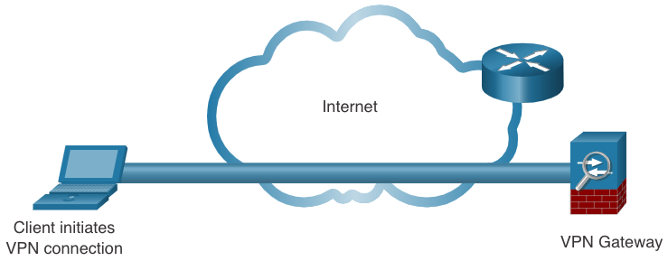
VPN Technology
Remote Access VPNs (Cont.)
A remote-access VPN is dynamically created to establish a secure connection between a client and a VPN terminating device.
Notes:
8 – VPN and IPsec Concepts
8.1 – VPN Technology
8.1.3 – Site-to-Site and Remote Access VPNs (Cont.)

Slide 9
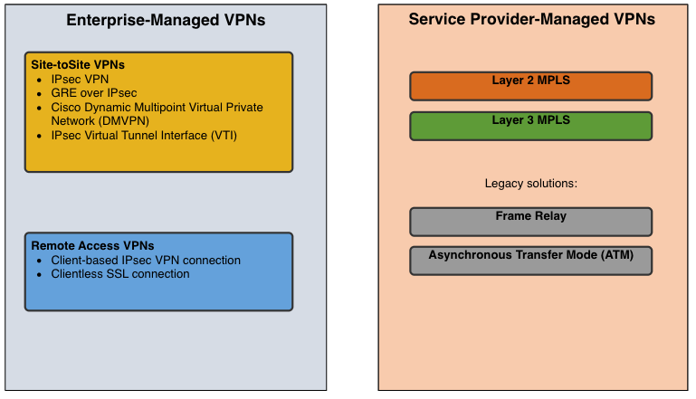
VPN Technology
Enterprise and Service Provider VPNs
VPNs can be managed and deployed as:
Enterprise VPNs - common solution for securing enterprise traffic across the internet. Site-to-site and remote access VPNs are created and managed by the enterprise using IPsec and SSL VPNs.
Service Provider VPNs - created and managed by the provider network. The provider uses Multiprotocol Label Switching (MPLS) at Layer 2 or Layer 3 to create secure channels between an enterprise’s sites, effectively segregating the traffic from other customer traffic.
MPLS itself does not provide encryption, but it is a virtual private network and, as such, is partitioned off from the public Internet. Therefore, MPLS is considered a secure transport mode.
Notes:
8 – VPN and IPsec Concepts
8.1 – VPN Technology
8.1.4 – Enterprise and Service Provider VPNs
8.1.5 – Check Your Understanding – VPN Technology

Slide 10
8.2 Types of VPNs
Notes:
8- VPN and IPsec Concepts
8.2 - VPN Types of VPNs

Slide 11
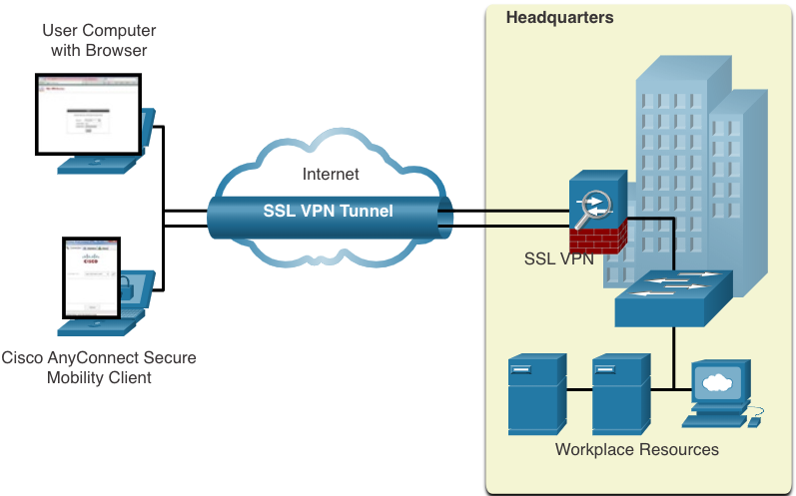
Types of VPNs
Remote-Access VPNs
Remote-access VPNs let remote and mobile users securely connect to the enterprise.
Remote-access VPNs are typically enabled dynamically by the user when required and can be created using either IPsec or SSL.
  Clientless VPN connection -The connection is secured using a web browser SSL connection.
  Client-based VPN connection - VPN client software such as Cisco AnyConnect Secure Mobility Client must be installed on the remote user’s end device.
You must disable support for SSLv2, SSLv3, and TLS 1.0 because they are outdated and vulnerable
You should disable TLS 1.1 if you can because there are known security vulnerabilities
You should enable TLS 1.2 and 1.3
Notes:
8 – VPN and IPsec Concepts
8.2 – Types of VPNs
8.2.1 – Remote-Access VPNs

Slide 12
Types of VPNs
SSL VPNs
SSL uses the public key infrastructure and digital certificates to authenticate peers. The type of VPN method implemented is based on the access requirements of the users and the organization’s IT processes. The table compares IPsec and SSL remote access deployments.
Feature | IPsec | SSL
Applications supported | Extensive – All IP-based applications | Limited – Only web-based applications and file sharing
Authentication strength | Strong – Two-way authentication with shared keys or digital certificates | Moderate – one-way or two-way authentication
Encryption strength | Strong – Key lengths 56 – 256 bits | Moderate to strong - Key lengths 40 – 256 bits
Connection complexity | Medium – Requires VPN client installed on a host | Low – Requires web browser on a host
Connection option | Limited – Only specific devices with specific configurations can connect | Extensive – Any device with a web browser can connect
Notes:
8 – VPN and IPsec Concepts
8.2 – Types of VPNs
8.2.2 – SSL VPNs

Slide 13
Types of VPNs
Site-to-Site IPsec VPNs
Site-to-site VPNs connect networks across an untrusted network such as the internet.
End hosts send and receive normal unencrypted TCP/IP traffic through a VPN gateway.
The VPN gateway encapsulates and encrypts outbound traffic from a site and sends the traffic through the VPN tunnel to the VPN gateway at the target site. The receiving VPN gateway strips the headers, decrypts the content, and relays the packet toward the target host inside its private network.
Notes:
8 – VPN and IPsec Concepts
8.2 – Types of VPNs
8.2.3 – Site-to-Site IPsec VPNs

Slide 14
Types of VPNs
GRE over IPsec
Generic Routing Encapsulation (GRE) is a non-secure site-to-site VPN tunneling protocol.
A GRE tunnel can encapsulate various network layer protocols as well as multicast and broadcast traffic.
GRE does not by default support encryption; and therefore, it does not provide a secure VPN tunnel.
A GRE packet can be encapsulated into an IPsec packet to forward it securely to the destination VPN gateway.
  Standard IPsec VPNs (non-GRE) can only create secure tunnels for unicast traffic.
  Encapsulating GRE into IPsec allows multicast routing protocol updates to be secured through a VPN.
Notes:
8 – VPN and IPsec Concepts
8.2 – Types of VPNs
8.2.4 – GRE over IPsec

Slide 15
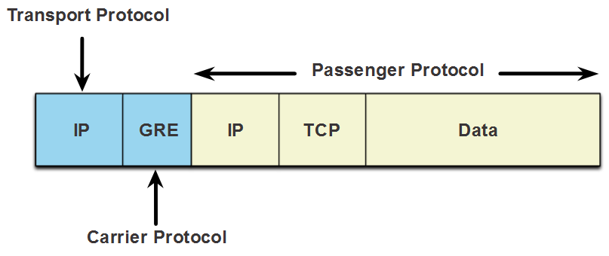
Types of VPNs
GRE over IPsec (Cont.)
The terms used to describe the encapsulation of GRE over IPsec tunnel are passenger protocol, carrier protocol, and transport protocol.
Passenger protocol – This is the original packet that is to be encapsulated by GRE. It could be an IPv4 or IPv6 packet, a routing update, and more.
Carrier protocol – GRE is the carrier protocol that encapsulates the original passenger packet.
Transport protocol – This is the protocol that will be used to forward the packet. This could be IPv4 or IPv6.
Notes:
8 – VPN and IPsec Concepts
8.2 – Types of VPNs
8.2.4 – GRE over IPsec (Cont.)

Slide 16
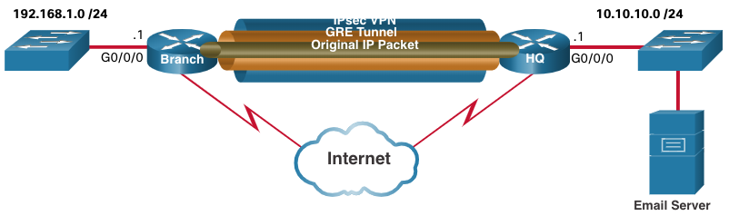
Types of VPNs
GRE over IPsec (Cont.)
For example, Branch and HQ need to exchange OSPF routing information over an IPsec VPN. GRE over IPsec is used to support the routing protocol traffic over the IPsec VPN. Specifically, the OSPF packets (i.e., passenger protocol) would be encapsulated by GRE (i.e., carrier protocol) and subsequently encapsulated in an IPsec VPN tunnel.
Notes:
8 – VPN and IPsec Concepts
8.2 – Types of VPNs
8.2.4 – GRE over IPsec (Cont.)

Slide 17
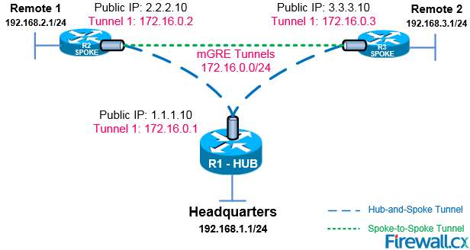

Types of VPNs
Dynamic Multipoint VPNs
Site-to-site IPsec VPNs and GRE over IPsec are not sufficient when the enterprise adds many more sites. Dynamic Multipoint VPN (DMVPN) is a Cisco software solution for building multiple VPNs in an easy, dynamic, and scalable manner.
  DMVPN simplifies the VPN tunnel configuration and provides a flexible option to connect a central site with branch sites.
  It uses a hub-and-spoke configuration to establish a full mesh topology.
  Spoke sites establish secure VPN tunnels with the hub site.
  Each site is configured using Multipoint Generic Routing Encapsulation (mGRE). The mGRE tunnel interface allows a single GRE interface to dynamically support multiple IPsec tunnels.
  Spoke sites can also obtain information about each other, and alternatively build direct tunnels between themselves (spoke-to-spoke tunnels).
Notes:
8 – VPN and IPsec Concepts
8.2 – Types of VPNs
8.2.5 – Dynamic Multipoint VPNs

Slide 18
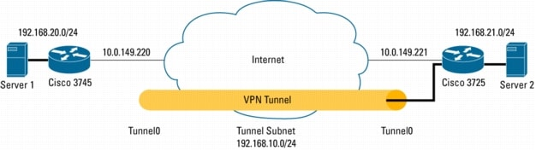

Types of VPNs
IPsec Virtual Tunnel Interface
policy-map FOO
class class-default
shape average 128000
!
crypto isakmp policy 1
encr 3des
authentication pre-share
group 2
crypto isakmp key MY_PASSWORD address 10.0.149.221
crypto isakmp keepalive 10
!
!
crypto ipsec transform-set TSET esp-3des esp-sha-hmac
!
crypto ipsec profile VTI
set transform-set TSET
!
interface Tunnel0
ip address 192.168.10.2 255.255.255.0
tunnel source 10.0.149.220
tunnel destination 10.0.149.221
tunnel mode ipsec ipv4
tunnel protection ipsec profile VTI
service-policy output FOO
!
ip route 192.168.21.0 255.255.255.0 tunel0
IPsec Virtual Tunnel Interface (VTI) simplifies the configuration process required to support multiple sites and remote access.
IPsec VTI configurations are applied to a virtual interface instead of static mapping the IPsec sessions to a physical interface.
IPsec VTI is capable of sending and receiving both IP unicast and multicast encrypted traffic. Therefore, routing protocols are automatically supported without having to configure GRE tunnels.
IPsec VTI can be configured between sites or in a hub-and-spoke topology.
Notes:
8 – VPN and IPsec Concepts
8.2 – Types of VPNs
8.2.6 – IPsec Virtual Tunnel Interface

Slide 19
Types of VPNs
Service Provider MPLS VPNs
Today, service providers use MPLS in their core network. Traffic is forwarded through the MPLS backbone using labels. Traffic is secure because service provider customers cannot see each other’s traffic.
MPLS can provide clients with managed VPN solutions; therefore, securing traffic between client sites is the responsibility of the service provider.
There are two types of MPLS VPN solutions supported by service providers:
  Layer 3 MPLS VPN - The service provider participates in customer routing by establishing a peering between the customer’s routers and the provider’s routers.
  Layer 2 MPLS VPN - The service provider is not involved in the customer routing. Instead, the provider deploys a Virtual Private LAN Service (VPLS) to emulate an Ethernet multiaccess LAN segment over the MPLS network. No routing is involved. The customer’s routers effectively belong to the same multiaccess network.
Notes:
8 – VPN and IPsec Concepts
8.2 – Types of VPNs
8.2.7 – Service Provider MPLS VPNs
8.2.8 – Check Your Understanding – Types of VPNs

Slide 20
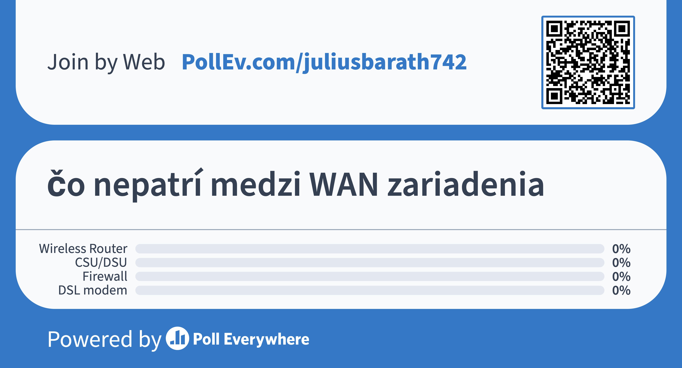

Slide 21
8.3 IPsec
Notes:
8 - VPN and IPsec Concepts
8.3 - IPsec

Slide 22
IPSec
IPsec Technologies
IPsec is an IETF standard that defines how a VPN can be secured across IP networks. IPsec protects and authenticates IP packets between source and destination and provides these essential security functions:
  Confidentiality - Uses encryption algorithms to prevent cybercriminals from reading the packet contents.
  Integrity - Uses hashing algorithms to ensure that packets have not been altered between source and destination.
  Origin authentication - Uses the Internet Key Exchange (IKE) protocol to authenticate source and destination.
  Diffie-Hellman – Used to secure key exchange.
Notes:
8 – VPN and IPsec Concepts
8.3 – IPsec
8.3.2 – IPsec Technologies

Slide 23
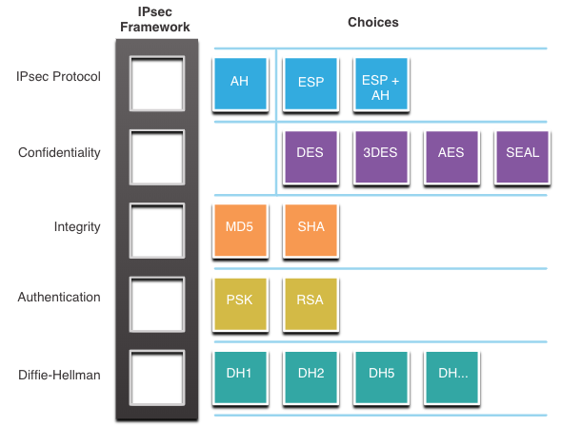
IPSec
IPsec Technologies (Cont.)
IPsec is not bound to any specific rules for secure communications.
IPsec can easily integrate new security technologies without updating existing IPsec standards.
The open slots in the IPsec framework shown in the figure can be filled with any of the choices that are available for that IPsec function to create a unique security association (SA).
Notes:
8 – VPN and IPsec Concepts
8.3 – IPsec
8.3.2 – IPsec Technologies (Cont.)

Slide 24
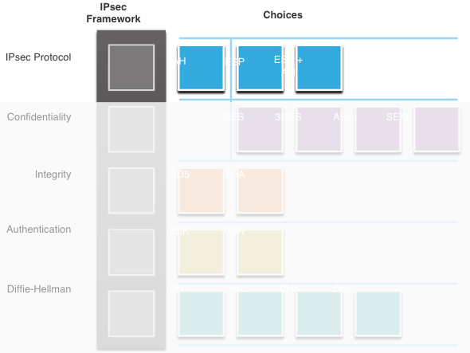
IPSec
IPsec Protocol Encapsulation
Choosing the IPsec protocol encapsulation is the first building block of the framework.
IPsec encapsulates packets using Authentication Header (AH) or Encapsulation Security Protocol (ESP).
The choice of AH or ESP establishes which other building blocks are available.
  AH provides authenticity and integrity.
  ESP provides both confidentiality and authentication.
Notes:
8 – VPN and IPsec Concepts
8.3 – IPsec
8.3.3 – IPsec Protocol Encapsulation

Slide 25
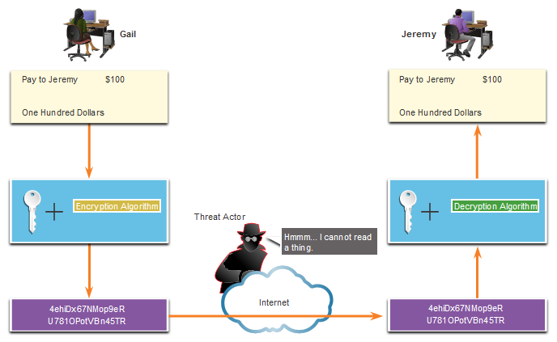
IPSec
Confidentiality
The degree of confidentiality depends on the encryption algorithm and the length of the key used in the encryption algorithm.
The number of possibilities to try to hack the key is a function of the length of the key - the shorter the key, the easier it is to break.
Notes:
8 – VPN and IPsec Concepts
8.3 – IPsec
8.3.4 – Confidentiality

Slide 26
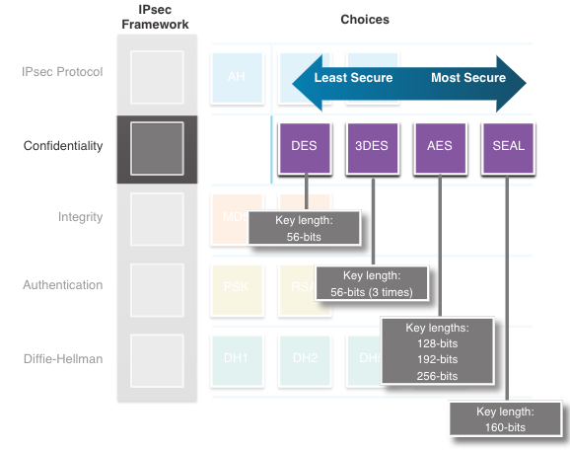
IPSec
Confidentiality (Cont.)
The encryption algorithms highlighted in the figure are all symmetric key cryptosystems:
    DES uses a 56-bit key.
    3DES uses three independent 56-bit encryption keys per 64-bit block.
    AES offers three different key lengths: 128 bits, 192 bits, and 256 bits.
    SEAL is a stream cipher, which means it encrypts data continuously rather than encrypting blocks of data. SEAL uses a 160-bit key.
Notes:
8 – VPN and IPsec Concepts
8.3 – IPsec
8.3.4 – Confidentiality (Cont.)

Slide 27
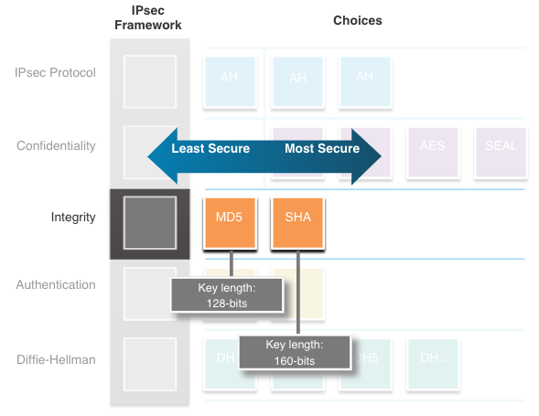
IPSec
Integrity
Data integrity means that the data has not changed in transit.
A method of proving data integrity is required.
The Hashed Message Authentication Code (HMAC) is a data integrity algorithm that guarantees the integrity of the message using a hash value.
  Message-Digest 5 (MD5) uses a 128-bit shared-secret key.
  The Secure Hash Algorithm (SHA) uses a 160-bit secret key.
Notes:
8 – VPN and IPsec Concepts
8.3 – IPsec
8.3.5 – Integrity

Slide 28
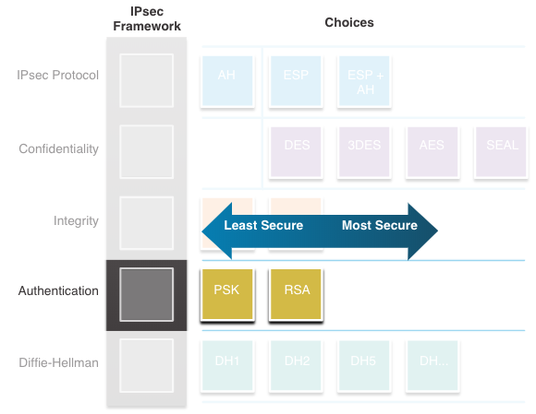
IPSec
Authentication
There are two IPsec peer authentication methods:
Pre-shared key (PSK) - (PSK) value is entered into each peer manually.
  Easy to configure manually
  Does not scale well
  Must be configured on every peer
Rivest, Shamir, and Adleman (RSA) - authentication uses digital certificates to authenticate the peers.
  Each peer must authenticate its opposite peer before the tunnel is considered secure.
Notes:
8 – VPN and IPsec Concepts
8.3 – IPsec
8.3.6 – Authentication

Slide 29
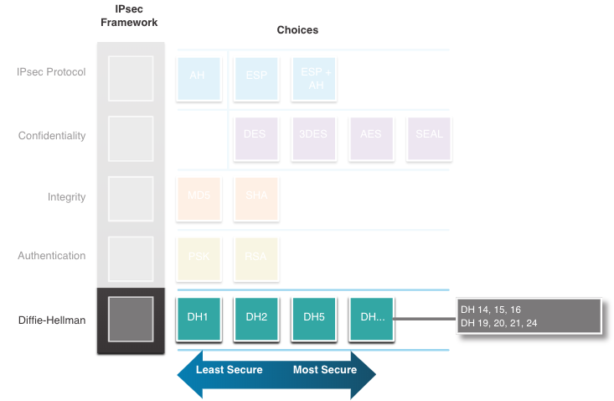
IPSec
Secure Key Exchange with Diffie - Hellman
DH provides allows two peers to establish a shared secret key over an insecure channel.
Variations of the DH key exchange are specified as DH groups:
  DH groups 1, 2, and 5 should no longer be used.
  DH groups 14, 15, and 16 use larger key sizes with 2048 bits, 3072 bits, and 4096 bits, respectively
  DH groups 19, 20, 21 and 24 with respective key sizes of 256 bits, 384 bits, 521 bits, and 2048 bits support Elliptical Curve Cryptography (ECC), which reduces the time needed to generate keys.
Notes:
8 – VPN and IPsec Concepts
8.3 – IPsec
8.3.7 – Secure Key Exchange with Diffie - Hellman

Slide 30
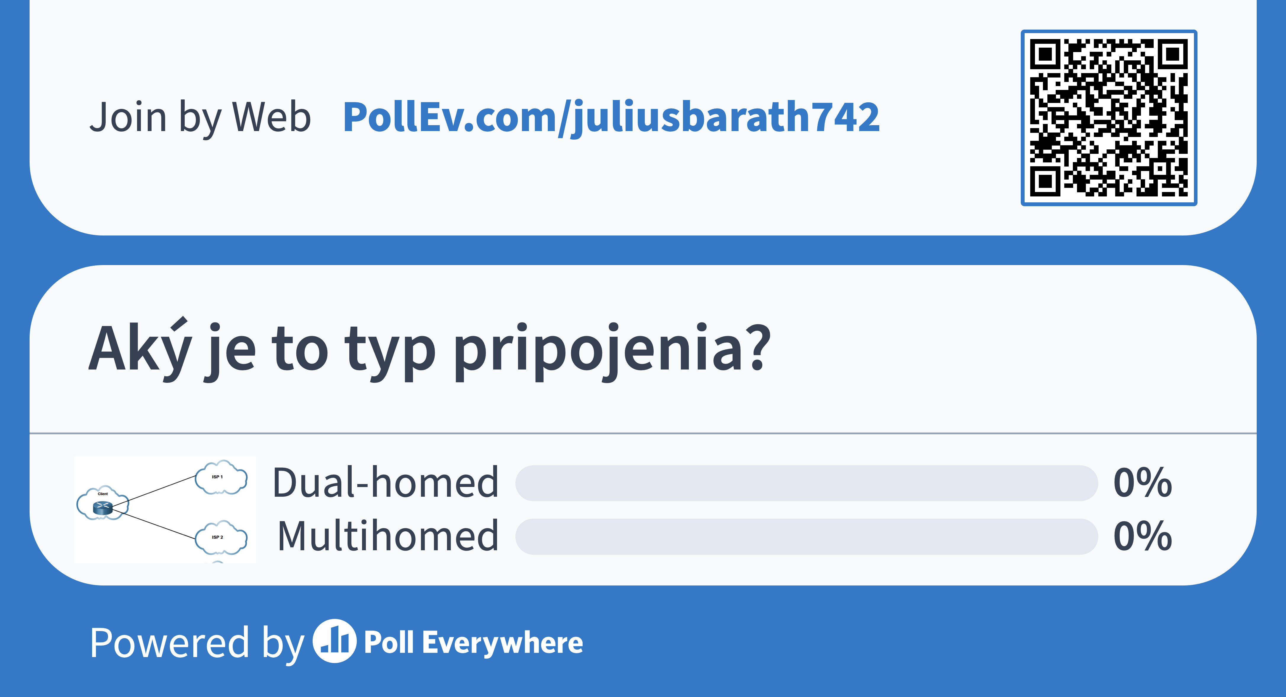

Slide 31
Alternatives
Open VPN https://openvpn.net/community-downloads/
Wireguard https://www.wireguard.com/
Wire https://wire.com/en/security/
ProtonVPN https://protonvpn.com/
TunnelBear https://www.tunnelbear.com/

