Slide 1

© 2006, Cisco Systems, Inc. All rights reserved.

Slide 2
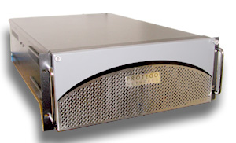
NPI Cisco Security
Monitoring, Analysis and Response System
CS MARS Release 4.2.2 Features and Enhancements
Azlina Ahmad
Effective. Efficient. Integrated

Slide 3
CS MARS Release 4.2.2 Features
1) FWSM 3.1 Device Support
- How to add FWSM module into MARS
- Understand the scope of this enhancement
- Understand how the Resource Monitoring is implemented
2) Multi-Threaded implementation for IDS/IPS/Windows events
pulling will provide better performance
- Why need multi-threaded
- Understand the backend enhancement made

Slide 4
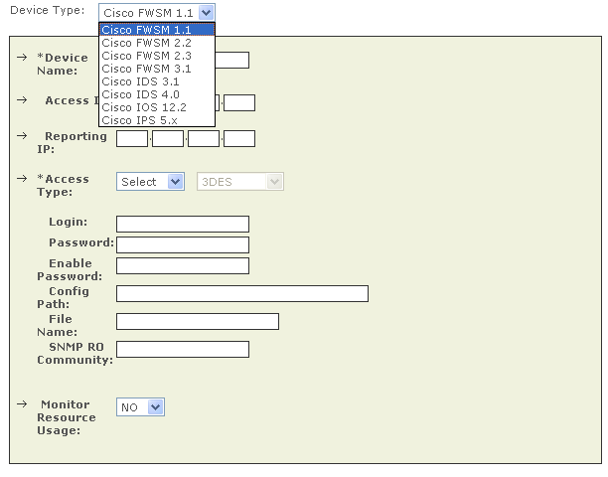
FWSM3.1 Device Support
Configuring FWSM3.1 into MARS is the same as previous FWSM2.3 supported device type.
In MARS release 4.2.2, the only change is a new Device Type, FWSM3.1 added to support this new version of FWSM module.

Slide 5
FWSM3.1 Device Support
Log on to CS-MARS GUI
From Admin tab->System Setup->Security & Monitor Device, select “Add” button to add the Catalyst Device.
(Switch-IOS or Switch-CatOS)
Hit Discover/Submit button. This will update the page with more options.
Adding CatOS/FWSM module is the same as previously supported FWSM2.3 module.
MARS is enhanced to parse and normalized 800 new events supported by FWSM3.1, in addition to previously supported events in FWSM2.3.
In this release, a “system” context will be created by MARS during the discovery of an “admin” context. This “system” context is used by Resource Monitoring feature and will be discussed in that section later.

Slide 6
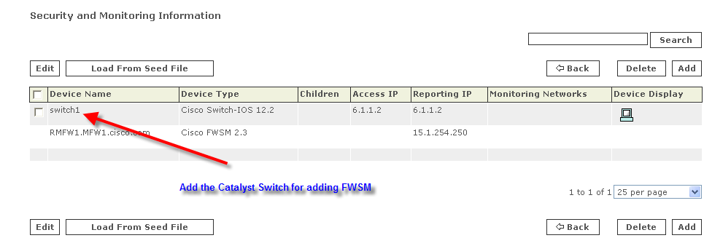
FWSM Context Discovery Support

Slide 7
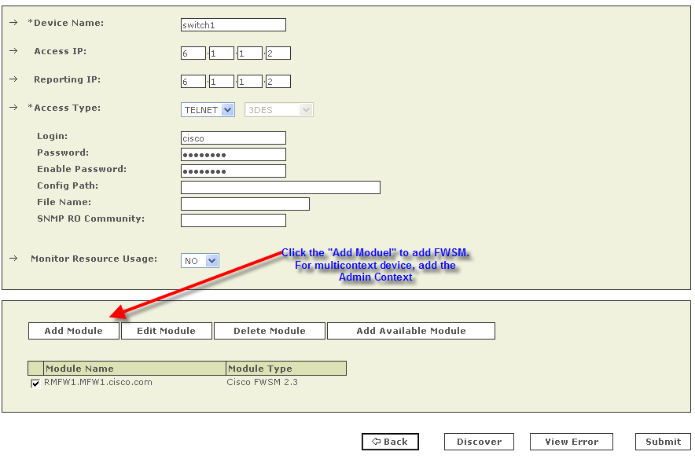
FWSM Context Discovery Support
Select “Add Module” to define FWSM.

Slide 8
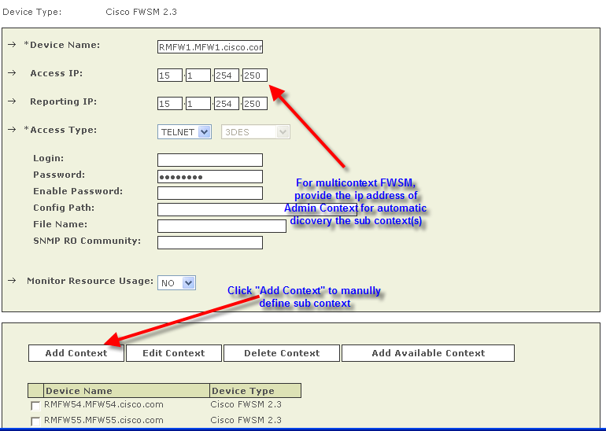
FWSM Context Discovery Support
For multi-context specify the Admin Context and discover.
Notes:
Can define context manually by selecting “Add Context”

Slide 9
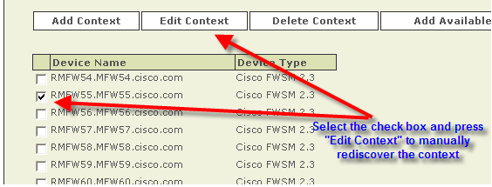
FWSM Context Discovery Support
Edit the context for manual discovery/update

Slide 10
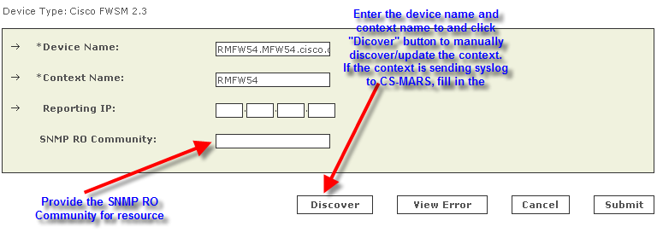
FWSM Context Discovery Support
Click the discover button for manually discovering/updating a context.

Slide 11
FWSM Caveat
CSCse82042
Release 4.2.1 implementation of “Change the Device Type Version” does not support version change for FWSM.
Customer needs to delete FWSM2.3 from MARS then re-configure FWSM3.1 into MARS.

Slide 12
Resource Monitoring for Multi Context Devices (FWSM 2.x/3.x, PIX 7.0, ASA 7.0)

Slide 13
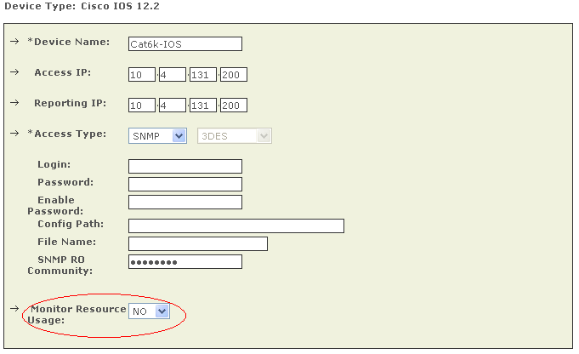
Previous Resource Monitoring Support
Prior to this MARS 4.2.2 release, Resource Monitoring (also known as Device Anomaly or Device Resource Utilization) is a feature that pulls resource information (such as CPU, Memory, Interface bytes/errors) from its monitoring devices.
Previously, Resource Monitoring is only supported on Cisco IOS, PIX and CheckPoint Device Type.
User could enabled this feature by toggling the Monitor Resource Usage when configuring the supported Device Type.

Slide 14
Resource Monitoring for FWSM and PIX/ASA
In 4.2.2 release, Resource Monitoring is enhanced to support additional device types, FWSM2.x, FWSM3.x as well as ASA7.x.
For FWSM device, Resource monitoring is enabled per module basis (also known as “system”) in addition to the device level (such as Cat6K chassis).
The module virtualized CPU, Memory and Firewall Connection usage on a per-context basis.
Chassis/Device
Cat6k Switch
Admin
context
FWSM
module
Context1
Context2
30%
Usage
35%
Usage
30%
Usage
System level CPU usage = 95%
Context
Module/System

Slide 15
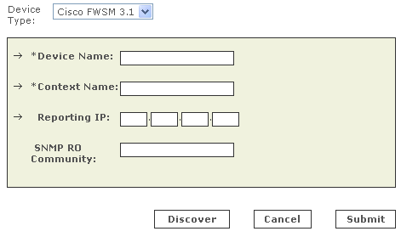
Resource Monitoring for FWSM and PIX/ASA
Per-context resource monitoring
  MARS uses SNMPv1 read-only access to poll each context every 5 minutes
  Note: Read-only SNMP community string and reporting IP must be configured for each context. User also MUST enabled SNMP RO access on the device level)
Enable SNMP per context

Slide 16
Resource Monitoring for FWSM and PIX/ASA
Per-context monitoring issues:
System Module may be in a state of high utilization even though individual contexts may report to have low utilization.
  Module/System level resource monitoring information is pulled using CLI since SNMP currently unsupported by FWSM nor PIX/ASA. Therefore Access IP, telnet/ssh access method and login credentials are required for MARS to pull the module/system level resources.

Slide 17
FWSM 2.x/3.x
Cat6k Switch
FWSM module
(System level CPU usage = 95%)
Admin
context
Context1
Context2
SNMP
30%
Usage
35%
Usage
30%
Usage
CLI
Example:
  Individual contexts are using 30-35% CPU therefore per Context MARS will not report any anomaly
  However the FWSM module is very busy which is only detected at the system context level with an anomaly event ‘CPU Utilization Higher Than 90%’
Similar argument applies to memory and firewall connection utilization
Interface utilization/error monitoring is not performed at the system level of an FWSM module. Interface Utilization and Errors are performed at the Chassis level which is the same as previously supported feature in MARS.

Slide 18
Context Discovery for Resource Monitoring
In order for MARS to poll the resource usage of the monitoring devices, user needs to discover the “admin” context.
A “dummy” System context will automatically be added by MARS during the discovery of an “admin” context as a placeholder of the Module/System Resource monitoring object.
This System context device in CS-MARS cannot be modified (edited/deleted) by the user.
Resource monitoring for Module/System level is performed via CLI with the telnet/ssh information of the ‘admin’ context’s device login credentials
MARS will not poll the System context resource monitoring information without the discovery of an “admin” context.

Slide 19
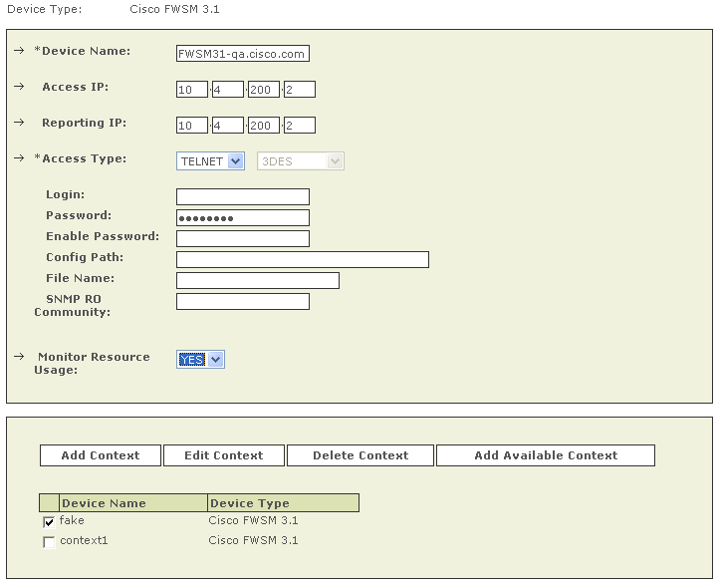
Enabling Resource Monitoring per System
User must select ‘YES’ for ‘Monitor Resource Usage’ for the admin context in order to enable this feature.
  Enabling this applies to all contexts discovered corresponding to the admin context.
Enable resource monitoring per context basis

Slide 20
Resource Monitoring for PIX/ASA7.0
MARS is enhanced to support Resource Monitoring for PIX/ASA 7.0 and previously supported FWSM2.x multi-context devices. They are also monitored in a similar manner to FWSM module.
Known Caveats
  CSCsf11651 (Device resource monitoring incorrectly samples 5 sec CPU instead of 5 min)
    CPU monitoring at system context uses 5 min CPU usage which is sampled every 5 minutes
  CSCsf26715 (Inaccuracy in per-context memory utilization for multi-context devices)

Slide 21
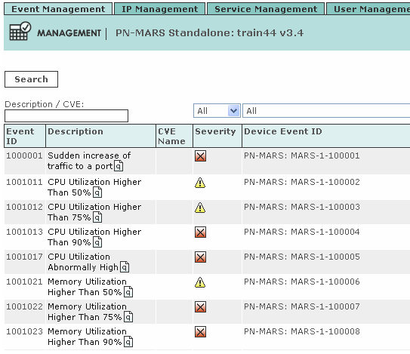
Resource Monitoring Event Type
There are multiple pre-defined Event Type relates to Resource Monitoring that were added in 4.1.1 release.
In 4.2.2 release, the same event type will be applicable to the FWSM system resource monitoring.
Notes:
Note:

Slide 22
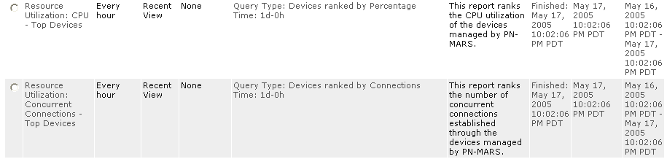
Resource Monitoring Reports
There are multiple Resource Utilization Reports built into CS-MARS in 4.1.1 release that are applicable to FWSM3.1 module.
Search for “Resource Utilization” keyword to identify all the related reports
Notes:
Note:

Slide 23
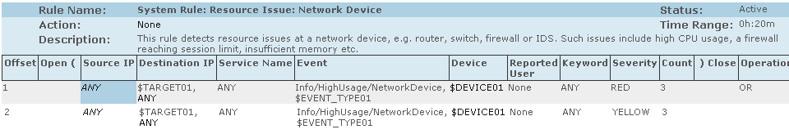
Resource Monitoring Rules
There is pre-defined Resource Utilization Rule built into CS-MARS in 4.1.1 which is applicable to FWSM3.1 module.
  e.g. System Rule: DoS: Network Device - Success Likely
  System Rule: DoS: Network - Success Likely
  System Rule: Resource Issue: Network Device
Notes:
Note:

Slide 24
Performance improvement with
Multi-Threaded for event pulling from IPS/IDS and Windows (CSCpn02938)

Slide 25
Multi-Threaded for Event Pulling
Current implementation of modules on CS-MARS that pull events from devices using a single threaded is inefficient and doesn’t scale in a large MARS IPS or reporting Hosts deployment.
Four existing modules that are enhanced for multi-threading in 4.2.2 release are:
  Module for pulling data from IOS devices with IPS module (IOS-IPS)
  Module for pulling data from IPS 5.x devices
  Module for pulling data from IDS 4.x devices
  Thread for pulling data from WINDOWS hosts

Slide 26
Previous Event Pulling Implementation
For pulling events, different modules on CS-MARS currently use a single threaded approach in which a single thread sequentially pulls information from a list of devices of the same “device type”.
Drawbacks of the current approach:
1) There is a delay in obtaining events from each device as at any given time only one device (of each device type) is being accessed while all devices are possibly producing events.

Slide 27
Previous Event Pulling Implementation
2) The current limit on CS-MARS is approximately 50 alerts per second from IDS/IPS appliances when a single sensor is configured in CS-MARS.
In multiple sensor deployments, this rate drops further to an observed 7 alerts per second when 60+ sensors are configured.
  If the alert rate was sustained at a rate higher than that processed by CS-MARS, then CS-MARS eventually lags behind and never catches up.
  In the extreme case, delayed polling coupled with limited on- device memory can cause loss of events (such as in the case of IOS IPS) where older alerts may be overwritten on the device if the alert generation rate is high.

Slide 28
Previous Event Pulling Implementation
3) Some module implementations also lack a separate thread (a watchdog) to test the connectivity to a device (as in the case of Windows). Thus, when faced with an unresponsive device, the only thread of execution is blocked for the duration of a TCP level timeout, exacerbating the problem.
4) Current implementations of modules on CS-MARS that pull data from devices using a single threaded model to a multi-threaded one is inefficient and doesn’t scale.

Slide 29
Multi-Threaded Enhancement in 4.2.2
Multi-thread processes to allow processing more than 1 device type at any one time.
Previous MARS processes pnids40_srv, pnids50_srv and pniosips_srv have been removed.
A new process “csips” is introduced in this release. It does the work for pnids40_srv and pnids50_srv which pulls events from IPS/IDS.
A new process “csiosips” now does the work for pniosips_srv which pulls events from IOS IPS.
A new process “cswin” has been added and will show up in the list of processes which pulls events from Windows.
Whenever possible, MARS ensure pulling is done using a non-blocking client with timeout values of approximately 30 seconds to a minute (instead of the TCP timeout default).
  On failure conditions due to timeouts, the process should try to increase the timeout to a maximum of 5 minutes (processed by a separate thread) to handle cases where the network latency is high.

Slide 30
Current Limitation in 4.2.2
Current implementation that remains the same:
For all devices, there is a limit for the number of events that can be pulled in 1 second. (e.g. 500 events per second for IDS/IPS/IOSIPS). If there is a device generating events at a sustained rate which is greater than this number, CS-MARS WILL lag behind.
There can be conditions where the process will pull more alerts than the particular CS-MARS model can handle. In such a case, the alert capacity of the model shall cause alerts to be dropped. (e.g. 12 threads pulling 500 events per second on a CS-MARS 100. This will cause a drop of 1000 events per second (assuming the event rates are sustained).)

Slide 31
Current Limitation in 4.2.2
The RDEP/ SDEE subscription shall be created to pull events from the IDS/IPS/IOSIPS from that point forward. In other words, CS-MARS shall NOT pull events that have occurred before the process was running (OR before the device was configured in MARS).
In case of errors such as HTTP session re-establishment, CS-MARS will try to reuse the existing subscription. However, if that fails, it shall create a new subscription as per the logic defined above.
The process shall use the timestamp present in the alert as the event time.

Slide 32


