Slide 1
Chapter 3: Authentication, Authorization, and Accounting
CCNA Security v2.0

Slide 2
Chapter Outline
3.0 Introduction
3.1 Purpose of the AAA
3.2 Local AAA Authentication
3.3 Server-Based AAA
3.4 Server-Based AAA Authentication
3.5 Server-Based Authorization and Accounting
3.6 Summary

Slide 3
Topic 3.1.1: AAA Overview

Slide 4
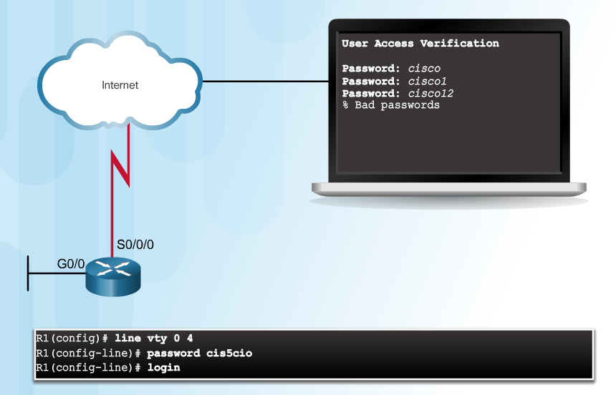
Authentication without AAA
Telnet is Vulnerable to Brute-Force Attacks
Notes:
3.1.1.1 Authentication without AAA

Slide 5
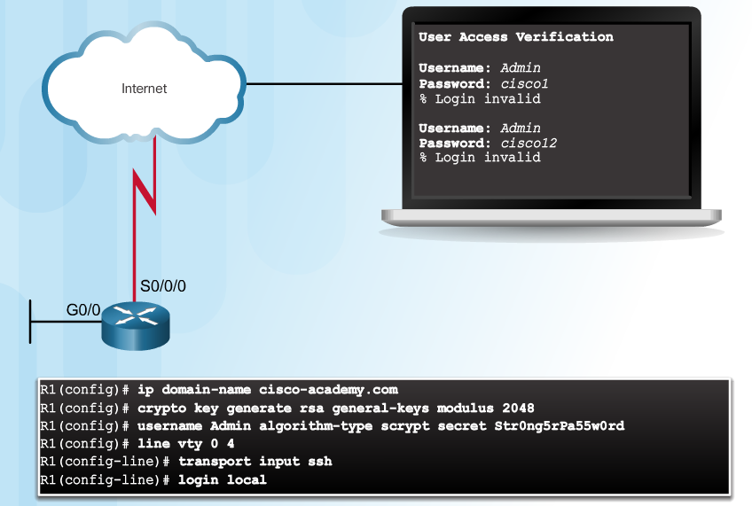
Authentication without AAA (Cont.)
SSH and Local Database Method
Notes:
3.1.1.1 Authentication without AAA

Slide 6
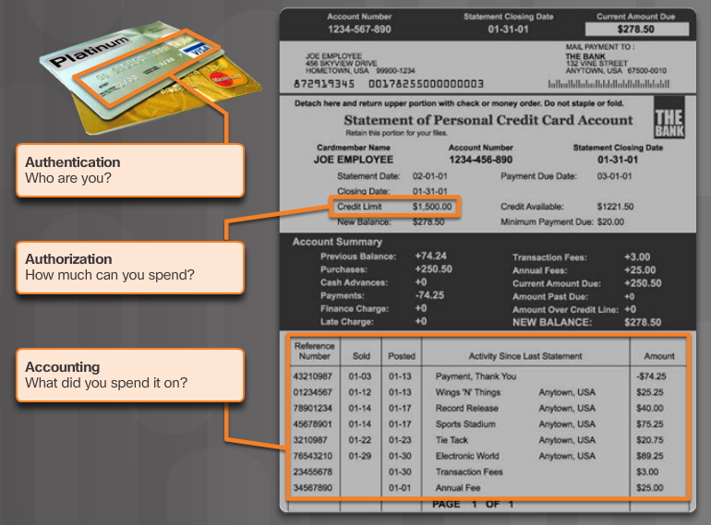
AAA Components
Notes:
3.1.1.2 AAA Components

Slide 7
Topic 3.1.2: AAA Characteristics

Slide 8
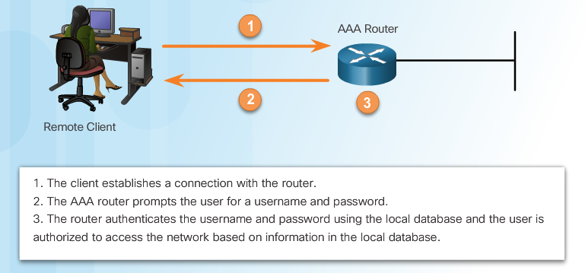
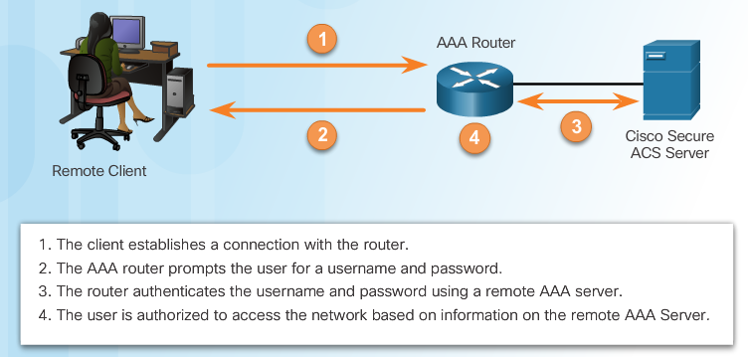
Authentication Modes
Local AAA Authentication
Server-Based AAA Authentication
Notes:
3.1.2.1 Authentication Modes

Slide 9
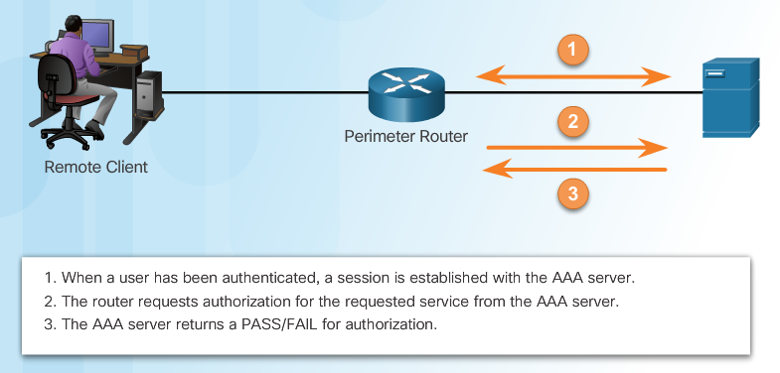
Authorization
AAA Authorization
Notes:
3.1.2.2 Authorization

Slide 10
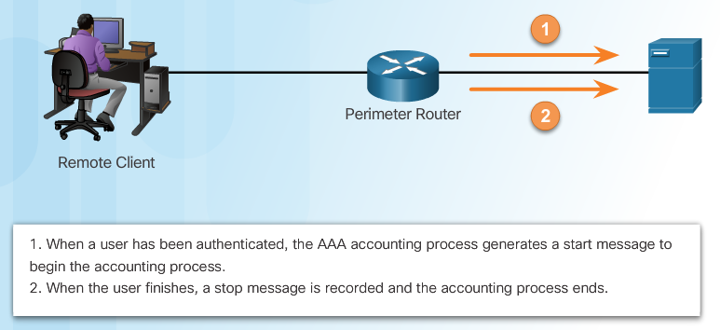
Accounting
Types of accounting information:
Network
Connection
EXEC
System
Command
Resource
AAA Accounting
Notes:
3.1.2.3 Accounting
3.1.2.4 Activity - Indentify the Characteristics of AAA

Slide 11
Section 3.2: Local AAA Authentication
Upon completion of this section, you should be able to:
Configure AAA authentication, using the CLI, to validate users against a local database.
Troubleshoot AAA authentication that validates users against a local database.

Slide 12
Topic 3.2.1: Configuring Local AAA Authentication with CLI

Slide 13
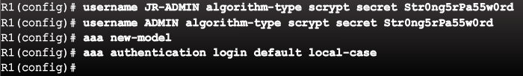
Authenticating Administrative Access
Add usernames and passwords to the local router database for users that need administrative access to the router.
Enable AAA globally on the router.
Configure AAA parameters on the router.
Confirm and troubleshoot the AAA configuration.
From this moment any access to router requires authentication (console, vty, ...)
Notes:
3.2.1.1 Authenticating Administrative Access

Slide 14
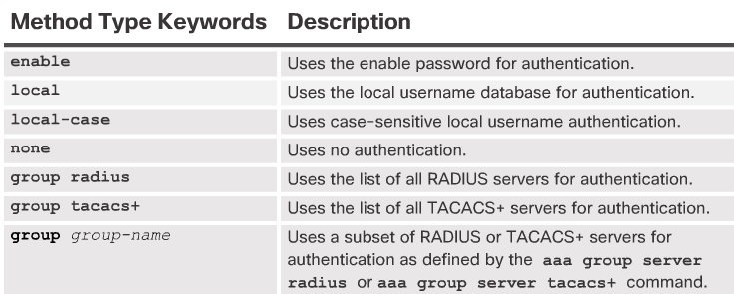
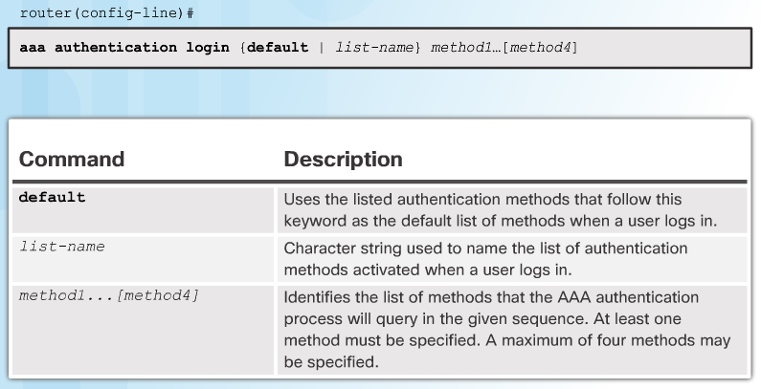
Authentication Methods
Notes:
3.2.1.2 Authentication Methods

Slide 15
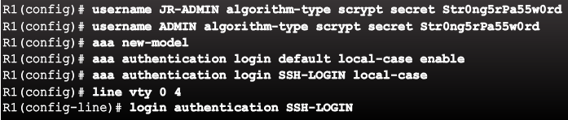
Default and Named Methods
Example Local AAA Authentication
...Local-case enable
Ak v konfigu nie je definovaný žiadny používateľ, prihlásenie je možné ľubovoľným menom a heslom na prechod do privilegovaného módu...
Notes:
3.2.1.3 Default and Named Methods

Slide 16
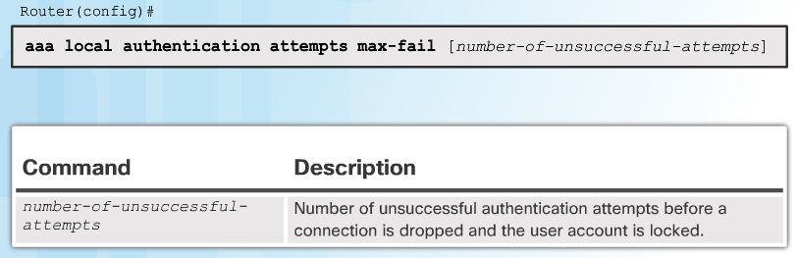

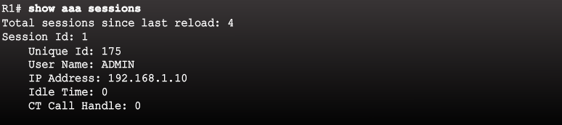
Fine-Tuning the Authentication Configuration
Command Syntax
Display Locked Out Users
clear aaa local user lockout {username username | all}
Show Unique ID of a Session
Notes:
3.2.1.4 Fine-Tuning the Authentication Configuration

Slide 17
Topic 3.2.2: Troubleshooting Local AAA Authentication

Slide 18
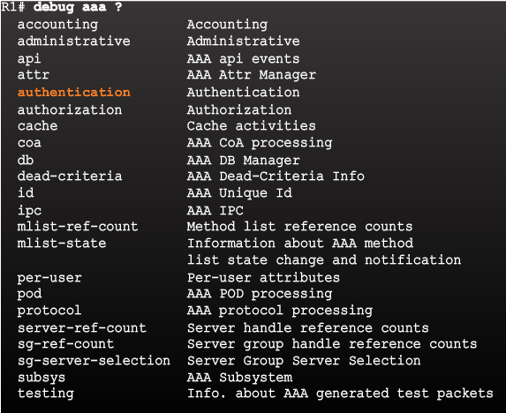
Debug Options
Debug Local AAA Authentication
Notes:
3.2.2.1 Debug Options

Slide 19
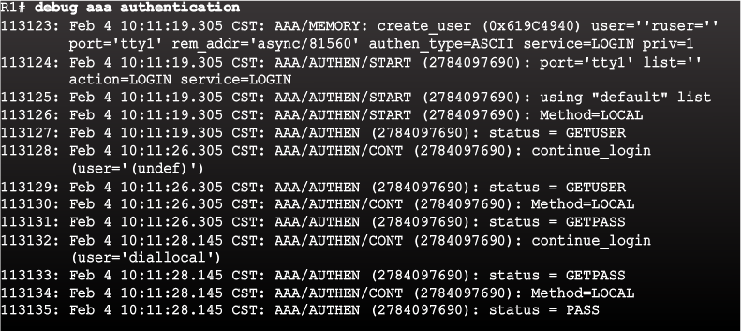
Debugging AAA Authentication
Understanding Debug Output
Notes:
3.2.2.2 Debugging AAA Authentication

Slide 20
Section 3.3: Server-Based AAA
Upon completion of this section, you should be able to:
Describe the benefits of server-based AAA.
Compare the TACACS+ and RADIUS authentication protocols.

Slide 21
Topic 3.3.1: Server-Based AAA Characteristics

Slide 22

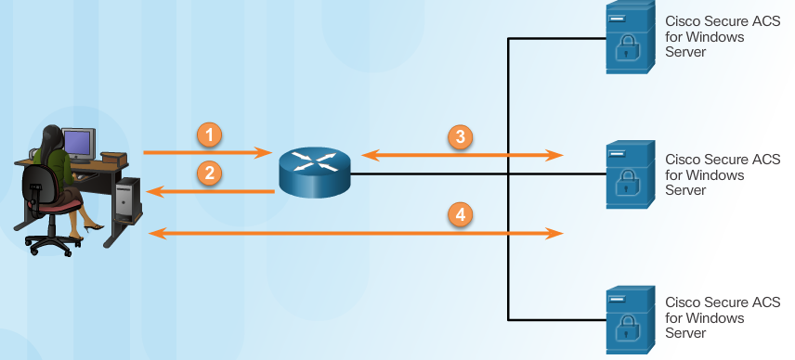
Comparing Local AAA and Server-Based AAA Implementations
Local authentication:
User establishes a connection with the router.
Router prompts the user for a username and password, authentication the user using a local database.
Server-based authentication:
User establishes a connection with the router.
Router prompts the user for a username and password.
Router passes the username and password to the Cisco Secure ACS (server or engine)
The Cisco Secure ACS authenticates the user.
Notes:
3.3.1.1 Comparing Local AAA and Server-Based AAA Implementations

Slide 23
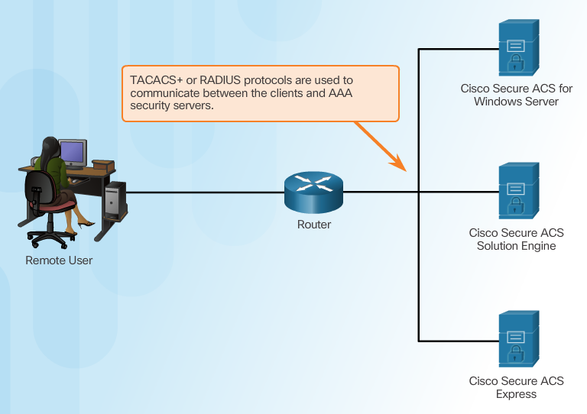
Introducing Cisco Secure Access Control System
Notes:
3.3.1.2 Introducing Cisco Secure Access Control System

Slide 24
Topic 3.3.2: Server-Based AAA Communication Protocols

Slide 25
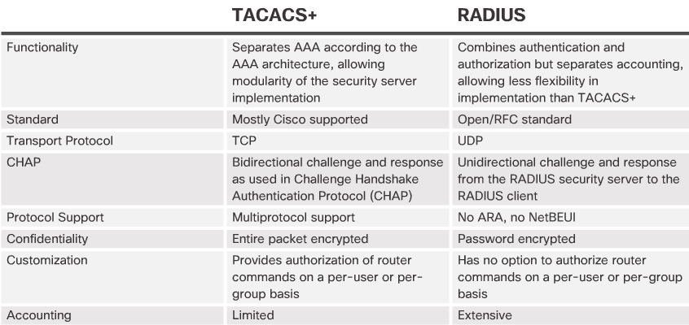
Introducing TACACS+ and RADIUS
Notes:
3.3.2.1 Introducing TACACS+ and RADIUS

Slide 26
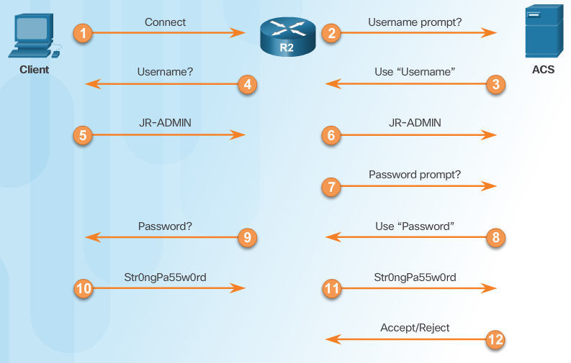
TACACS+ Authentication
TACACS+ Authentication Process
Notes:
3.3.2.2 TACACS+ Authentication

Slide 27
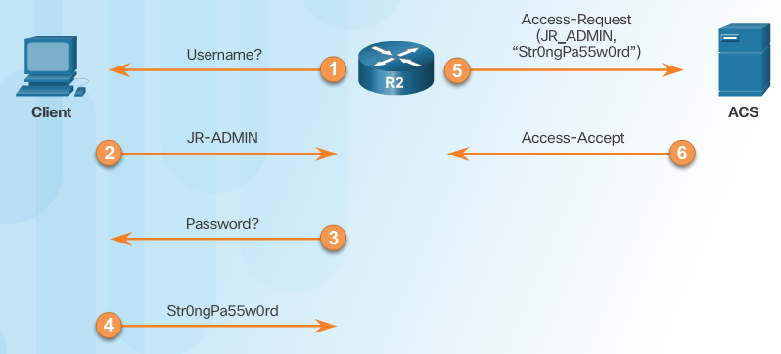
RADIUS Authentication
RADIUS Authentication Process
Notes:
3.3.2.3 RADIUS Authentication

Slide 28
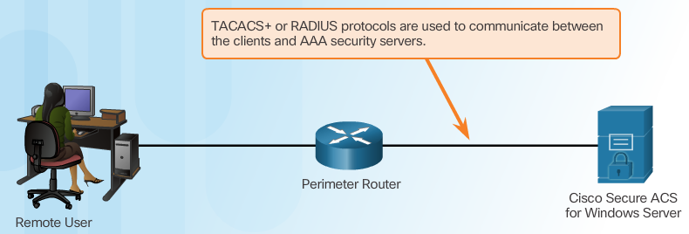
Integration of TACACS+ and ACS
Cisco Secure ACS
Notes:
3.3.2.4 Integration of TACACS+ and ACS

Slide 29
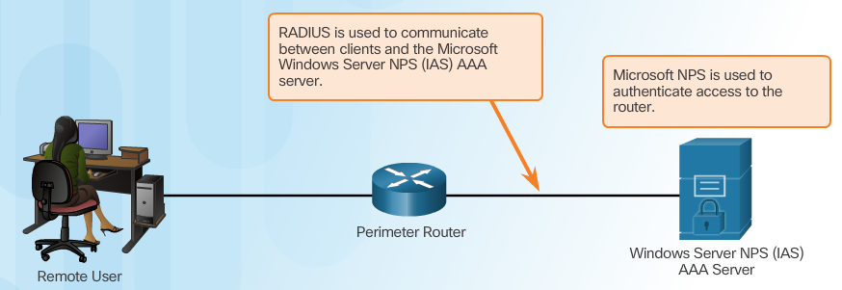
Integration of AAA with Active Directory
Notes:
3.3.2.5 Integration of AAA with Active Directory
3.3.2.6 Video - Integration of AAA with Identity Service Engine
3.3.2.7 Activity - Identify the AAA Communication Protocol

Slide 30
Section 3.4: Server-Based AAA Authentication
Upon completion of this section, you should be able to:
Configure server-based AAA authentication, using the CLI, on Cisco routers.
Troubleshoot server-based AAA authentication.

Slide 31
Topic 3.4.1: Configuring Server-Based Authentication with CLI

Slide 32
Steps for Configuring Server-Based AAA Authentication with CLI
Enable AAA.
Specify the IP address of the ACS server.
Configure the secret key.
Configure authentication to use either the RADIUS or TACACS+ server.
Notes:
3.4.1.1 Steps for Configuring Server-Based AAA Authentication with CLI

Slide 33
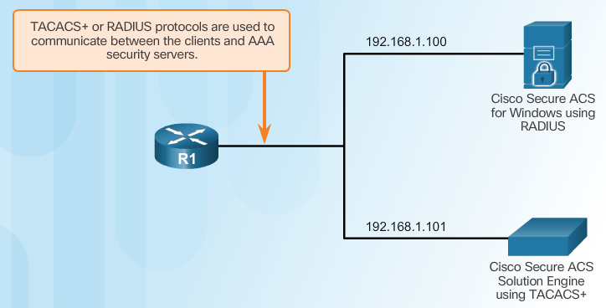
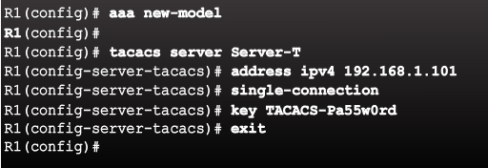
Configuring the CLI with TACACS+ Servers
Server-Based AAA Reference Topology
Configure a AAA TACACS+ Server
Notes:
3.4.1.2 Configuring the CLI for TACACS+ Servers

Slide 34
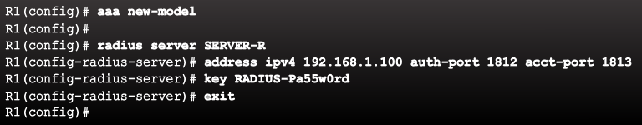
Configuring the CLI for RADIUS Servers
Configure a AAA RADIUS Server
RADIUS traffic is using User Datagram Protocol (UDP) ports 1812, 1813 or 1645, and 1646.
Notes:
3.4.1.3 Configuring the CLI for RADIUS Servers

Slide 35
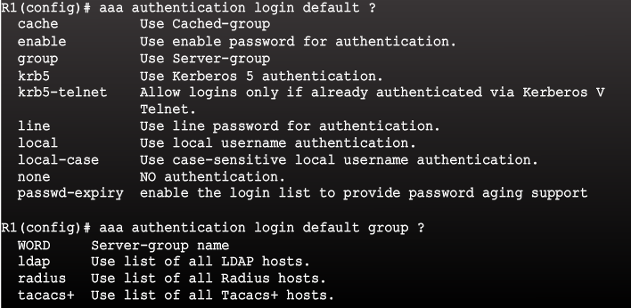
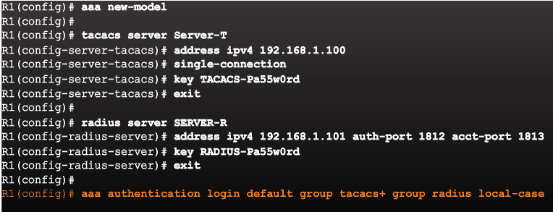
Configure Authentication to Use the AAA Server
Command Syntax
Configure Server-Based AAA Authentication
Notes:
3.4.1.4 Configure Authentication to Use the AAA Server
Syntax Checker - Configure Server-Based AAA Authentication

Slide 36
Topic 3.4.2: Troubleshooting Server-Based AAA Authentication

Slide 37
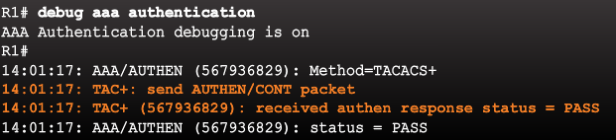
Monitoring Authentication Traffic
Troubleshooting Server-Based AAA Authentication
Notes:
3.4.2.1 Monitoring Authentication Traffic

Slide 38
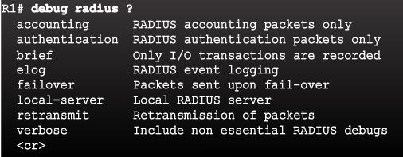
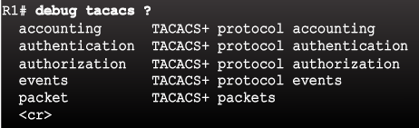
Debugging TACACS+ and RADIUS
Troubleshooting RADIUS
Troubleshooting TACACS+
Notes:
3.4.2.2 Debugging TACACS+ and RADIUS

Slide 39
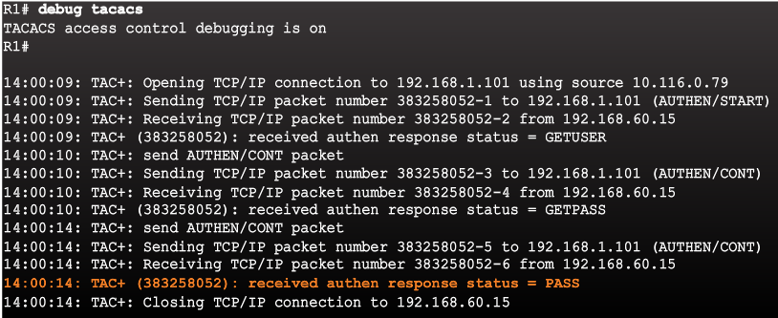
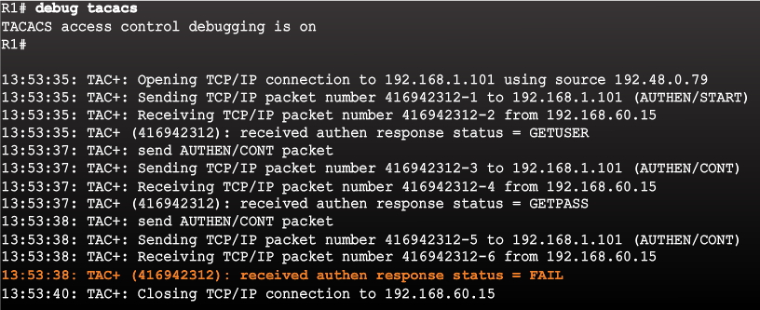
Debugging TACACS+ and RADIUS (Cont.)
AAA Server-Based Authentication Success
AAA Server-Based Authentication Failure
Notes:
3.4.2.2 Debugging TACACS+ and RADIUS (Cont.)
3.4.2.3 Video Demonstration: Configure a Cisco Router to Access a AAA RADIUS Server

Slide 40
Section 3.5: Server-Based AAA Authorization and Accounting
Upon completion of this section, you should be able to:
Configure server-based AAA authorization.
Configure server-based AAA accounting.
Explain the functions of 802.1x components.

Slide 41
Topic 3.5.1: Configuring Server-Based AAA Authorization

Slide 42
Introduction to Server-Based AAA Authorization
Authentication vs. Authorization
Authentication ensures a device or end-user is legitimate
Authorization allows or disallows authenticated users access to certain areas and programs on the network.
TACACS+ vs. RADIUS
TACACS+ separates authentication from authorization
RADIUS does not separate authentication from authorization
Commands--Applies to the EXEC mode commands a user issues. Command authorization attempts authorization for all EXEC mode commands (This allows you to authorize all commands associated with a specified command level from 0 to 15.)l.
EXEC--Applies to the attributes associated with a user EXEC terminal session.
Network--Applies to network connections. This can include a PPP, SLIP, or ARAP connection.
Notes:
3.5.1.1 Introduction to Server-Based AAA Authorization

Slide 43
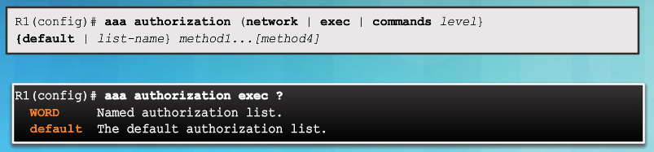
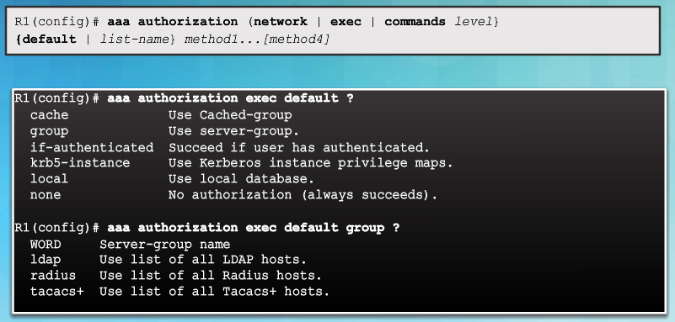
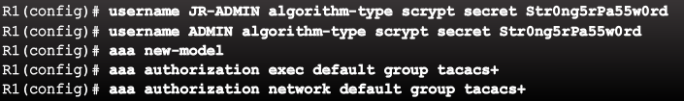
AAA Authorization Configuration with CLI
Command Syntax
Authorization Method Lists
Example AAA Authorization
Notes:
3.5.1.2 AAA Authorization Configuration with CLI

Slide 44
Topic 3.5.2: Configuring Server-Based AAA Accounting

Slide 45

Introduction to Server-Based AAA Accounting
Notes:
3.5.2.1 Introduction to Server-Based AAA Accounting

Slide 46
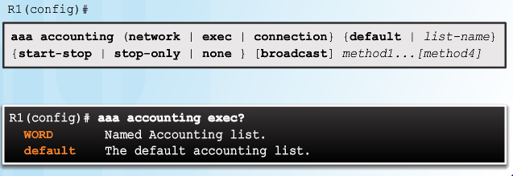
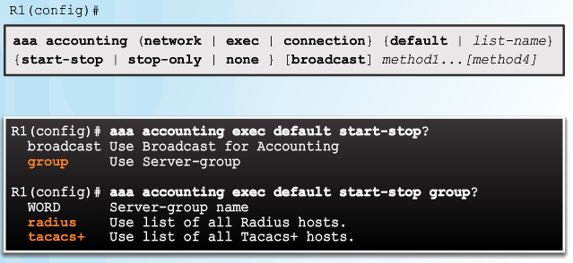
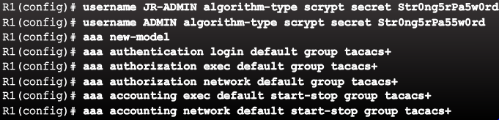
AAA Accounting Configuration with CLI
Command Syntax
Accounting Method Lists
Example AAA Accounting
Notes:
3.5.2.2 AAA Accounting Configuration with CLI
Syntax Checker - Configure AAA Accounting

Slide 47
Topic 3.5.3: 802.1X Authentication

Slide 48
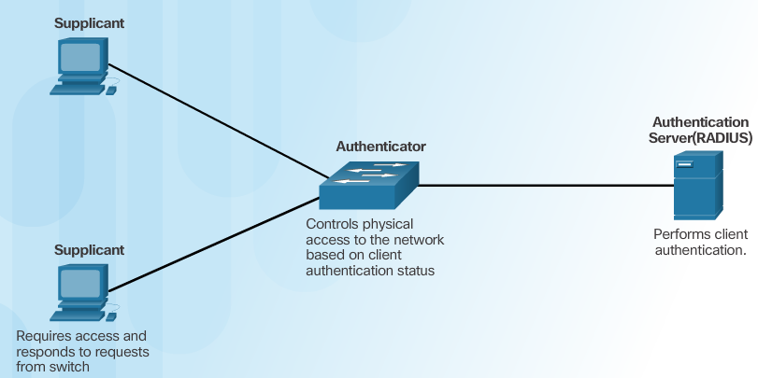
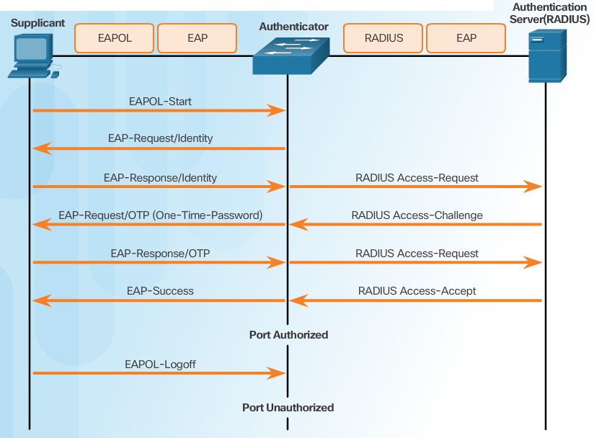
Security Using 802.1X Port-Based Authentication
802.1X Roles
802.1X Message Exchange
Notes:
3.5.3.1 Security Using 802.1X Port-Based Authentication

Slide 49
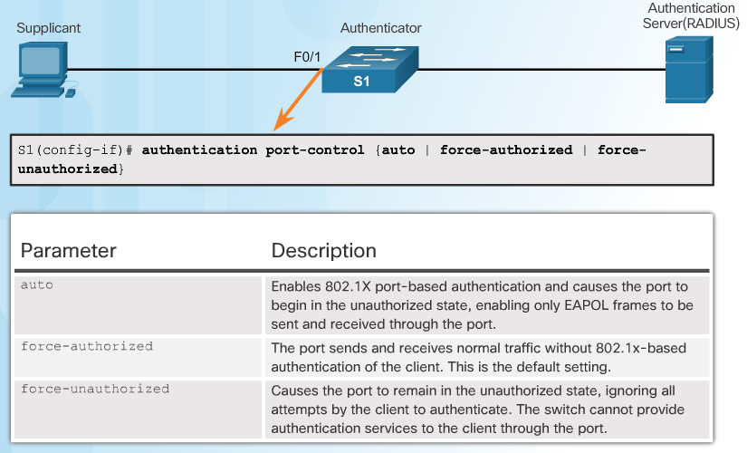
802.1X Port Authorization State
Command Syntax for dot1x port-control
Notes:
3.5.3.2 802.1X Port Authorization State

Slide 50
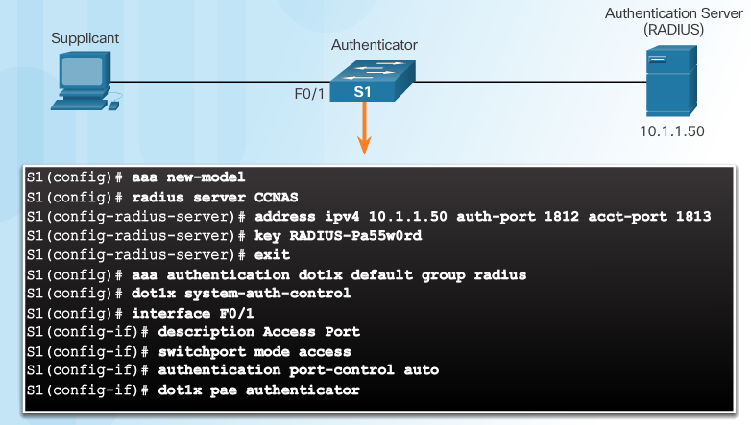
Configuring 802.1X
authentication host-mode multi-host
Notes:
3.5.3.3 Configuring 802.1X
Syntax Checker - Configure 802.1X Port-Authentication on a 2960 Switch
3.6.1.1 Packet Tracer - Configure Authentication on Cisco Routers
3.6.1.2 Lab - Securing Administrative Access Using AAA and RADIUS

Slide 51
802.1x extras
sh radius statistics
show dot1x all

Slide 52
Section 3.6: Summary
Chapter Objectives:
Explain how AAA is used to secure a network.
Implement AAA authentication that validates users against a local database.
Implement server-based AAA authentication using TACACS+ and RADIUS protocols.
Configure server-based AAA authorization and accounting.
Notes:
3.6.1.1 Packet Tracer - Configure Authentication on Cisco Routers
3.6.1.2 Lab - Securing Administrative Access Using AAA and RADIUS
3.6.1.3 Summary

Slide 54
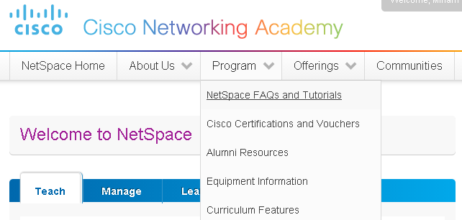
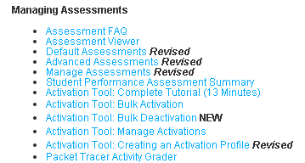
Instructor Resources
Remember, there are helpful tutorials and user guides available via your NetSpace home page. (https://www.netacad.com)
These resources cover a variety of topics including navigation, assessments, and assignments.
A screenshot has been provided here highlighting the tutorials related to activating exams, managing assessments, and creating quizzes.
1
2
Notes:
https://www.netacad.com

