Slide 1
Chapter 8: Implementing Virtual Private Networks
CCNA Security v2.0

Slide 2
Chapter Outline
8.0 Introduction
8.1 VPNs
8.2 IPsec VPN Components and Operations
8.3 Implementing Site-to-Site IPsec VPNs with CLI
8.4 Summary

Slide 3
Section 8.1: VPNs
Upon completion of this section, you should be able to:
Describe VPNs and their benefits.
Compare site-to-site and remote-access VPNs.

Slide 4
Topic 8.1.1: VPN Overview

Slide 5
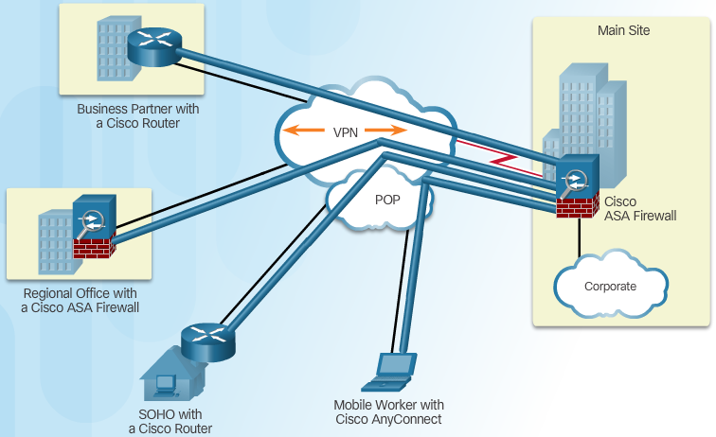
Introducing VPNs
VPN Benefits:
Cost Savings
Security
Scalability
Compatibility
Notes:
8.1.1.1 Introducing VPNs

Slide 6
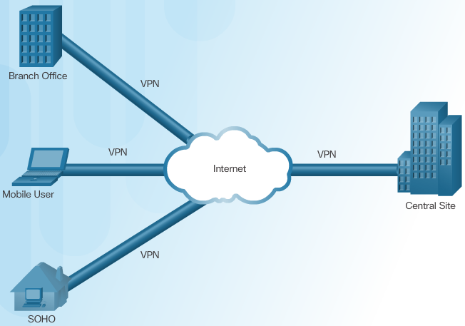
Layer 3 IPsec VPNs
Notes:
8.1.1.2 Layer 3 IPsec VPNs

Slide 7
Topic 8.1.2: VPN Technologies

Slide 8
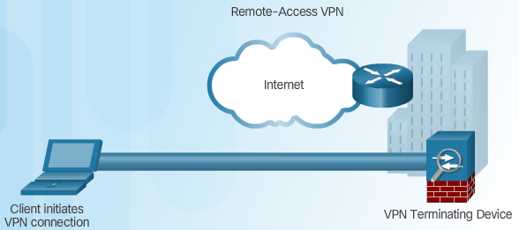
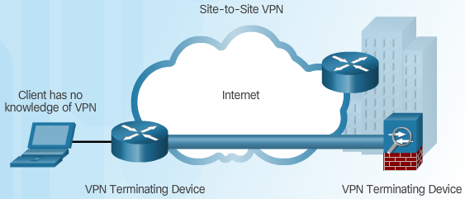
Two Types of VPNs
Remote-Access VPN
Site-to-Site VPN Access
Notes:
8.1.2.1 Two Types of VPNs

Slide 9
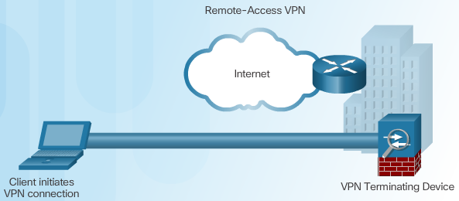
Components of Remote-Access VPNs
Client based
Clientless based
Notes:
8.1.2.2 Components of Remote-Access VPNs

Slide 10

Components of Site-to-Site VPNs
Notes:
8.1.2.3 Components of Site-to-Site VPNs
8.1.2.4 Activity – Compare Remote-Access and Site-to-Site VPNs

Slide 11
Section 8.2: IPsec VPN Components and Operation
Upon completion of this section, you should be able to:
Describe the IPsec protocol and its basic functions.
Compare AH and ESP protocols.
Describe the IKE protocol.

Slide 12
Topic 8.2.1: Introducing IPsec

Slide 13
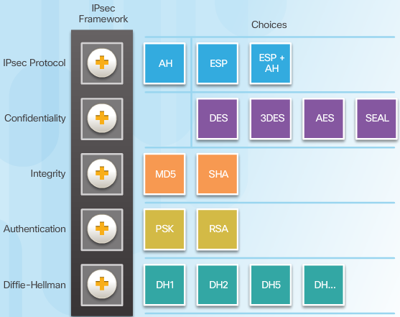
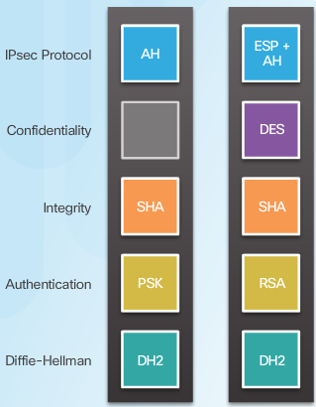
IPsec Technologies
IPsec Implementation Examples
IPsec Framework
Notes:
8.2.1.1 IPsec Technologies

Slide 14
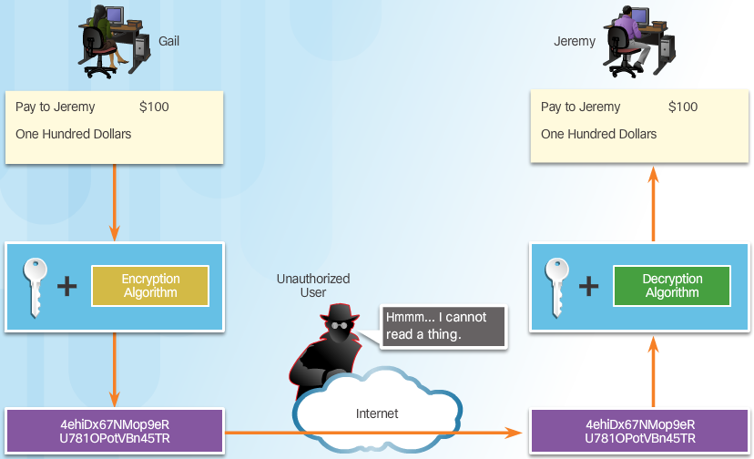
Confidentiality
Confidentiality with Encryption:
Notes:
8.2.1.2 Confidentiality

Slide 15
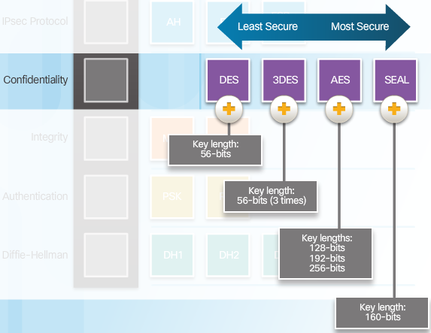
Confidentiality (Cont.)
Encryption Algorithms:
Notes:
8.2.1.2 Confidentiality (Cont.)

Slide 16
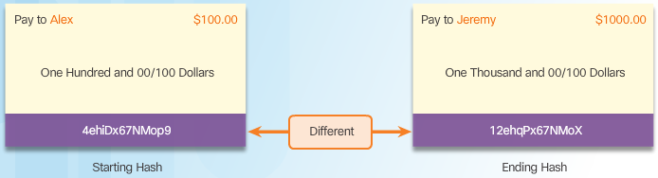
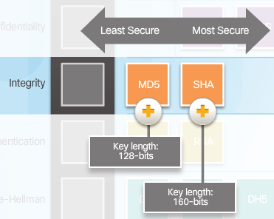
Integrity
Hash Algorithms
Security of Hash Algorithms
Notes:
8.2.1.3 Integrity

Slide 17
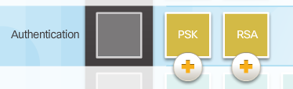
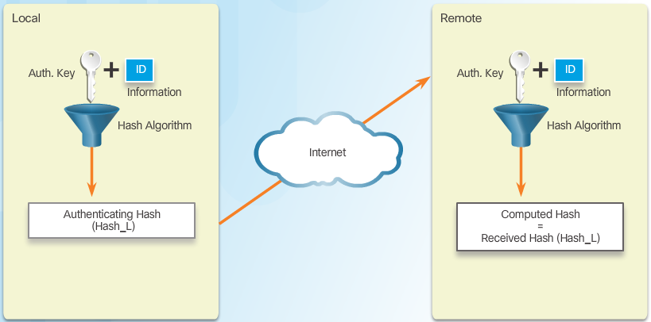
Authentication
Peer Authentication Methods
PSK
Notes:
8.2.1.4 Authentication

Slide 18
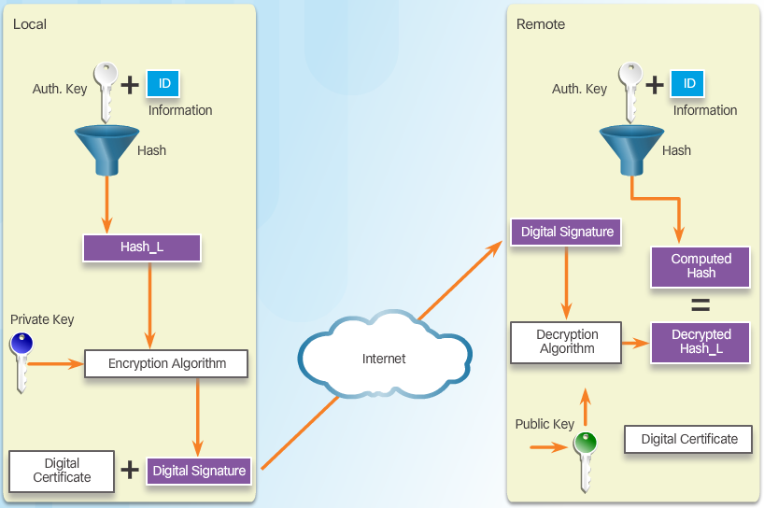
Authentication (Cont.)
RSA
Notes:
8.2.1.4 Authentication (Cont.)

Slide 19
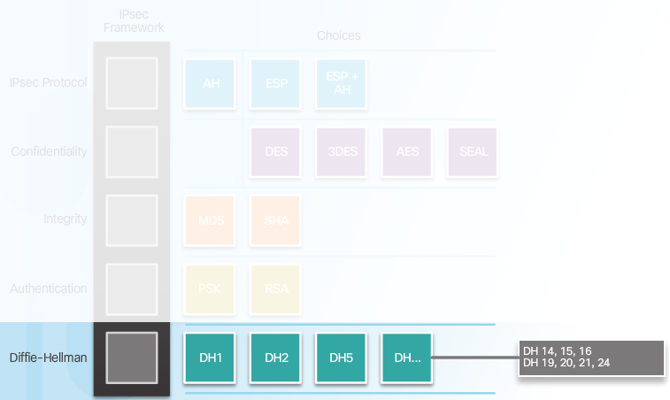
Secure Key Exchange
Diffie-Hellman Key Exchange
Notes:
8.2.1.5 Secure Key Exchange
8.2.1.6 Activity – Identify the Components fo the IPsec Framework

Slide 20
Topic 8.2.2: IPsec Protocols

Slide 21
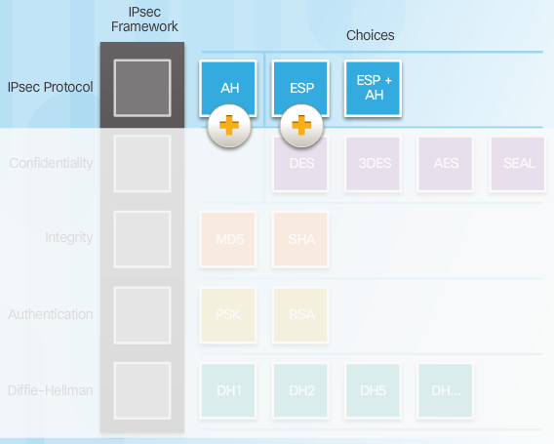
IPsec Protocol Overview
Notes:
8.2.2.1 IPsec Protocol Overview

Slide 22
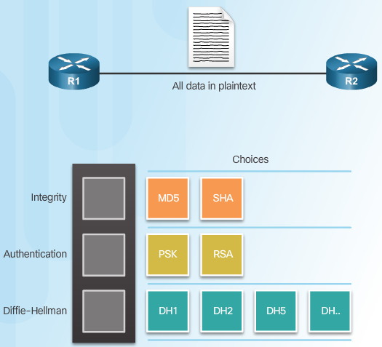
Authentication Header
AH Protocols / protocol 51
Notes:
8.2.2.2 Authentication Header

Slide 23
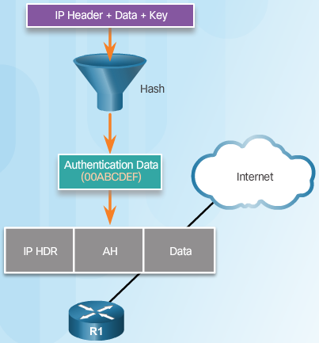
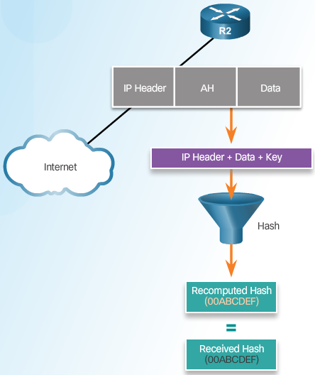
Authentication Header (Cont.)
Router Creates Hash and Transmits to Peer
Peer Router Compares Recomputed Hash to Received Hash
Notes:
8.2.2.2 Authentication Header (Cont.)

Slide 24
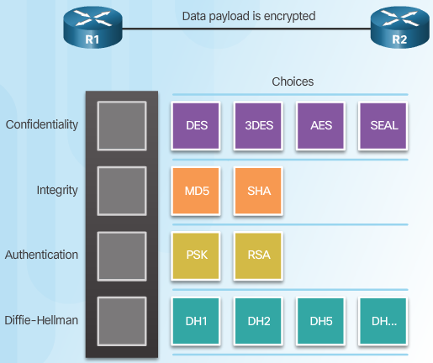
ESP protocol 50
Notes:
8.2.2.3 ESP

Slide 25
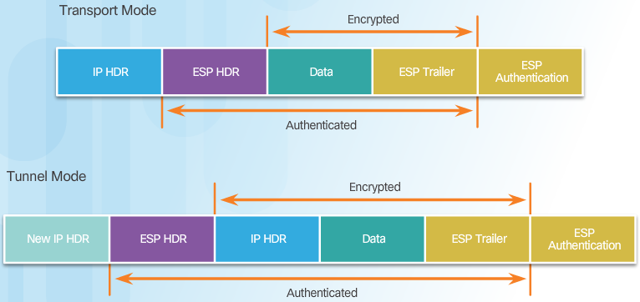
Transport and Tunnel Modes
Apply ESP and AH in Two Modes
Notes:
8.2.2.5 Transport and Tunnel Modes

Slide 26
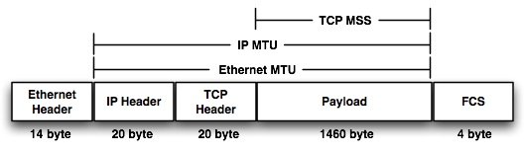
Transport and Tunnel Modes (Cont.)
Transport mode encrypts the payload and ESP trailer ONLY. IP header of the original packet is not encrypted.
Transport mode is implemented for client-to-site VPN scenarios.
NAT traversal IS NOT supported with the transport mode.
MSS is higher
Tunnel mode (default) protects any internal routing info by encrypting the IP header of the ENTIRE packet. The original packet is encapsulated by a another set of IP headers.
NAT traversal is supported with the tunnel mode.
Additional headers are added to the packet; so there is less payload MSS (maximum segment size)
Transport mode is usually used with other tunneling protocols (GRE, L2TP) which is used to first encapsulate the IP data packet, then IPsec is used to protect the GRE/L2TP tunnel packets.
Notes:
8.2.2.5 Transport and Tunnel Modes (Cont.)
8.2.2.6 Activity – Compare AH and ESP
https://security.stackexchange.com/questions/76308/when-do-i-use-ipsec-tunnel-mode-or-transport-mode

Slide 27
Topic 8.2.3: Internet Key Exchange

Slide 28
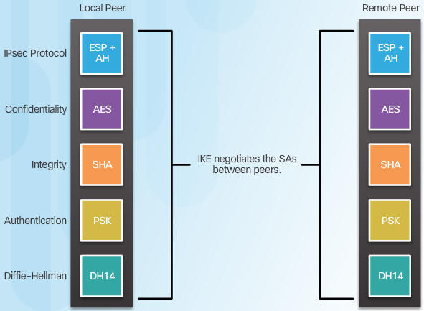
The IKE (Internet key exchange) Protocol
Notes:
8.2.3.1 The IKE Protocol

Slide 29
Difference Between IKEv2 and IKEv1
IKEv2 does not consume as much bandwidth as IKEv1.
IKEv2 supports EAP authentication while IKEv1 doesn’t.
IKEv2 supports MOBIKE while IKEv1 doesn’t.
IKEv2 has built-in NAT traversal while IKEv1 doesn’t.
IKEv2 can detect whether a tunnel is still alive while IKEv1 cannot. Read more: Difference Between IKEv1 and IKEv2 | Difference Between http://www.differencebetween.net/technology/protocols-formats/difference-between-ikev1-and-ikev2/#ixzz6FnW4yka8

Slide 30
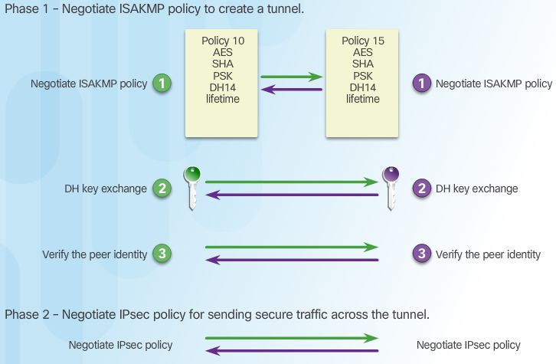
Phase 1 and 2 Key Negotiation
Notes:
8.2.3.2 Phase 1 and 2 Key Negotiation

Slide 31
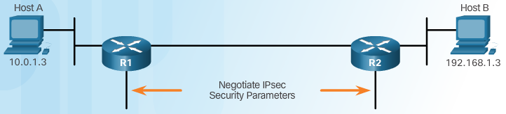
Phase 2: Negotiating SAs
Notes:
8.2.3.3 Phase 2: Negotiating Sas
8.2.3.4 Video Tutorial – IKE Phase 1 and Phase 2

Slide 32
Section 8.3: Implementing Site-to-Site IPsec VPNs with CLI
Upon completion of this section, you should be able to:
Describe IPsec negotiation and the five steps of IPsec configuration.
Configure the ISAKMP policy.
Configure the IPsec policy.
Configure and apply a crypto map.
Verify the IPsec VPN.

Slide 33
Topic 8.3.1: Configuring a Site-to-Site IPsec VPN

Slide 34
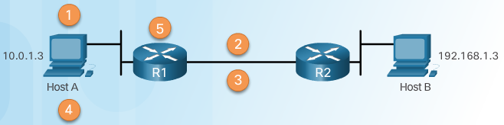
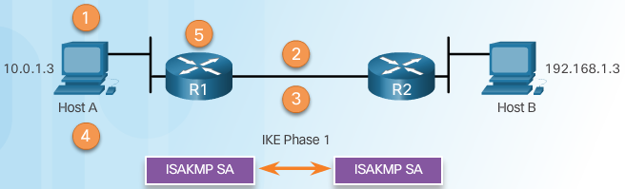
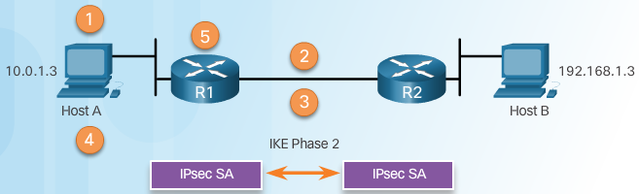
IPsec Negotiation
IPsec VPN Negotiation: Step 1 - Host A sends interesting traffic to Host B.
IPsec VPN Negotiation: Step 2 - R1 and R2 negotiate an IKE Phase 1 session.
IPsec VPN Negotiation: Step 3 - R1 and R2 negotiate an IKE Phase 2 session.
Notes:
8.3.1.1 IPsec Negotiation

Slide 35
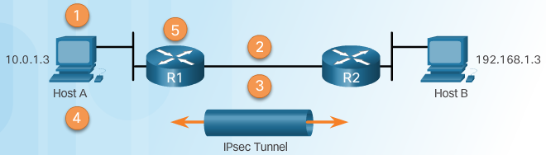
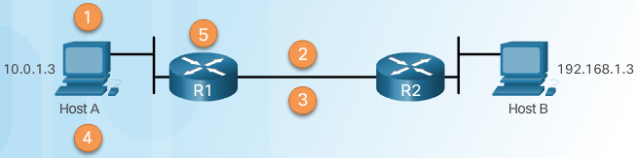
IPsec Negotiation (Cont.)
IPsec VPN Negotiation: Step 4 - Information is exchanged via IPsec tunnel.
IPsec VPN Negotiation: Step 5 - The IPsec tunnel is terminated.
Notes:
8.3.1.1 IPsec Negotiation (Cont.)

Slide 36
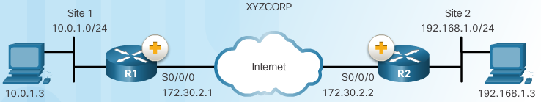
Site-to-Site IPsec VPN Topology
Notes:
8.3.1.2 Site-to-Site IPsec VPN Topology

Slide 37
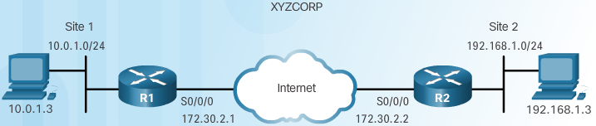
IPsec VPN Configuration Tasks
XYZCORP Security Policy | Configuration Tasks
Encrypt traffic with AES 256 and SHA | 1. Configure the ISAKMP policy for IKE Phase 1
Authentication with PSK | 2. Configure the IPsec policy for IKE Phase 2
Exchange keys with group 24 | 3. Configure the crypto map for IPsec policy
ISAKMP tunnel lifetime is 1 hour | 4. Apply the IPsec policy
IPsec tunnel uses ESP with a 15-min. lifetime | 5. Verify the IPsec tunnel is operational
Notes:
8.3.1.3 IPsec VPN Configuration Tasks

Slide 38
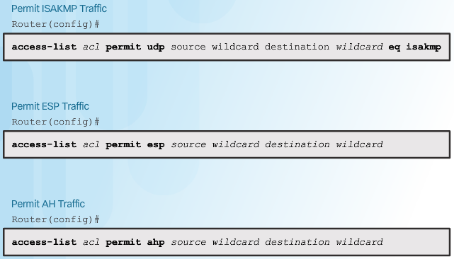
Existing ACL Configurations
Isakmp=500
Len ak sa používa čisté AHP bez ESP
Notes:
8.3.1.4 Existing ACL Configurations

Slide 39
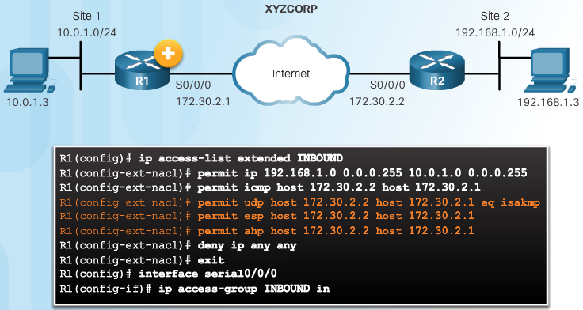
Existing ACL Configurations (Cont.)
Permitting Traffic for IPsec Negotiations
Notes:
8.3.1.4 Existing ACL Configurations (Cont.)

Slide 40
Topic 8.3.2: ISAKMP Policy

Slide 41
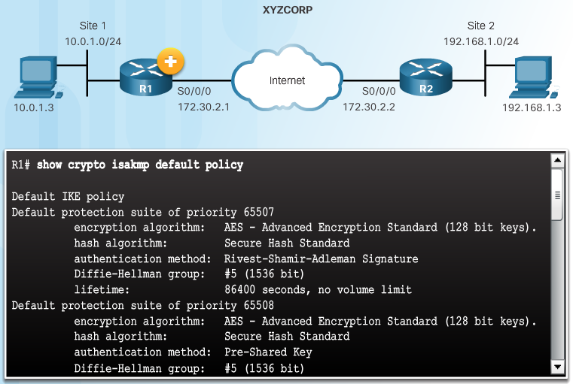
The Default ISAKMP Policies
Notes:
8.3.2.1 The Default ISAKMP Policies

Slide 42
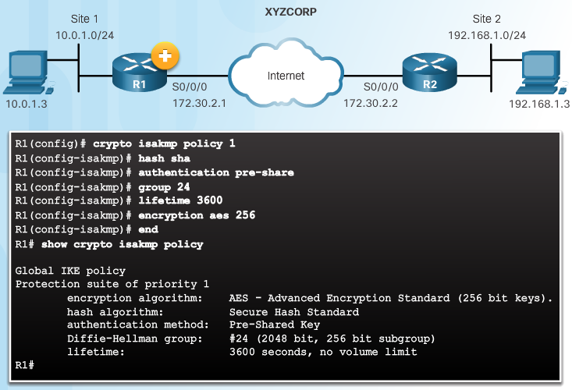
XYZCORP ISAKMP Policy Configuration
Notes:
8.3.2.3 XYZCORP ISAKMP Policy Configuration

Slide 43
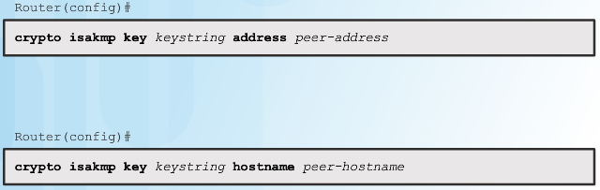
Configuring a Pre-Shared Key
The crypto isakmp key Command
Notes:
8.3.2.4 Configuring a Pre-Shared Key

Slide 44
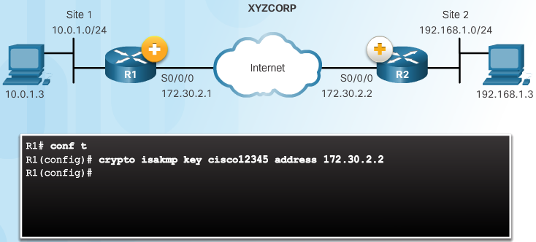
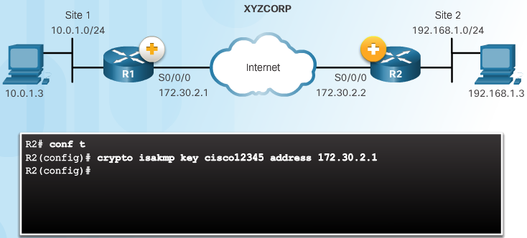
Configuring a Pre-Shared Key (Cont.)
Pre-Shared Key Configuration
Notes:
8.3.2.4 Configuring a Pre-shared Key (Cont.)

Slide 45
Topic 8.3.3: IPsec Policy

Slide 46
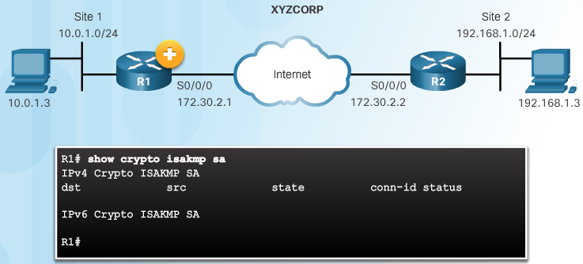
Define Interesting Traffic
The IKE Phase 1 Tunnel Does Not Exist Yet
Notes:
8.3.3.1 Define Interesting Traffic

Slide 47
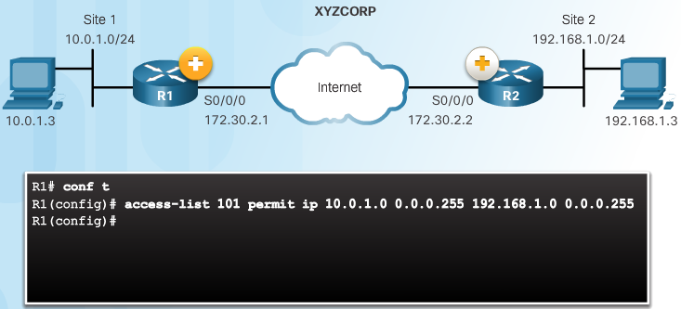
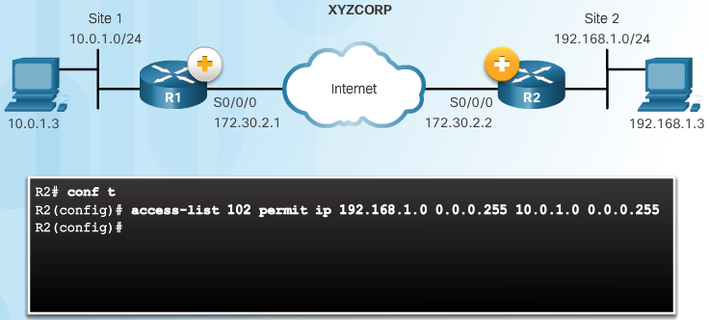
Define Interesting Traffic (Cont.)
Configure an ACL to Define Interesting Traffic
Notes:
8.3.3.1 Define Interesting Traffic (Cont.)

Slide 48
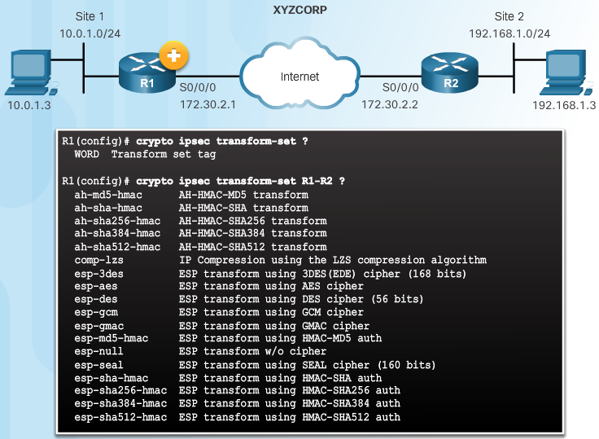
Configure IPsec Transform Set
The crypto ipsec transform-set Command
Notes:
8.3.3.2 Configure IPsec Transform Set

Slide 49
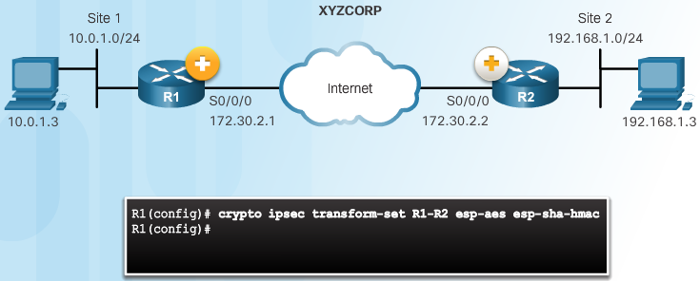
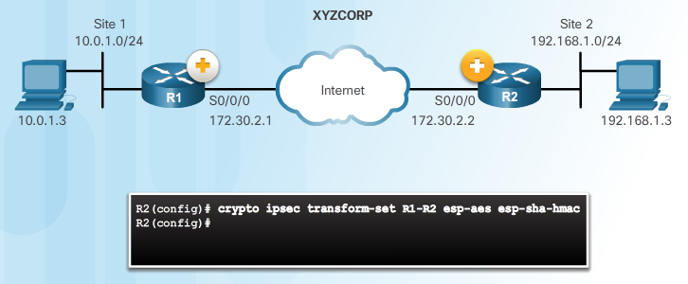
Configure IPsec Transform Set (Cont.)
The crypto ipsec transform-set Command
Notes:
8.3.3.2 Configure IPsec Transform Set (Cont.)

Slide 50
Topic 8.3.4: Crypto Map

Slide 51
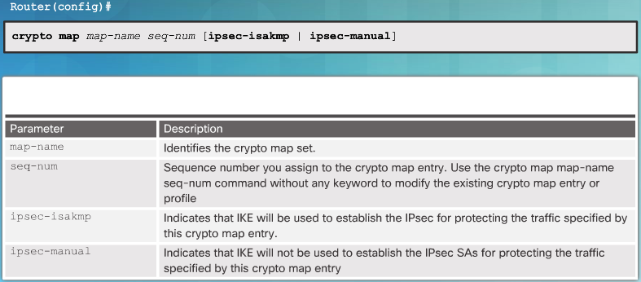
Syntax to Configure a Crypto Map
Notes:
8.3.4.1 Syntax to Configure a Crypto Map

Slide 52
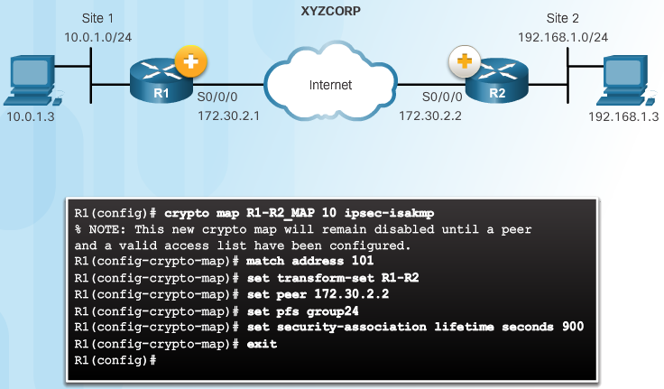

XYZCORP Crypto Map Configuration
Crypto Map Configuration:
Perfect Forward Secrecy (PFS) What is PFS?
PFS ensures that the same key will not be generated again, so forces a new diffie-hellman key exchange. This would ensure if a hacker\criminal wants to compromise a private key, he would be able to access data in transit which protected by that key and not any future data, as future data will not be associated with that compromised key.
Both sides of VPN should support PFS in order for PFS to work.Therefore using PFS provides a more secure VPN connection.
Set pfs group24
.
Notes:
8.3.4.2 XYZCORP Crypto Map Configuration

Slide 53
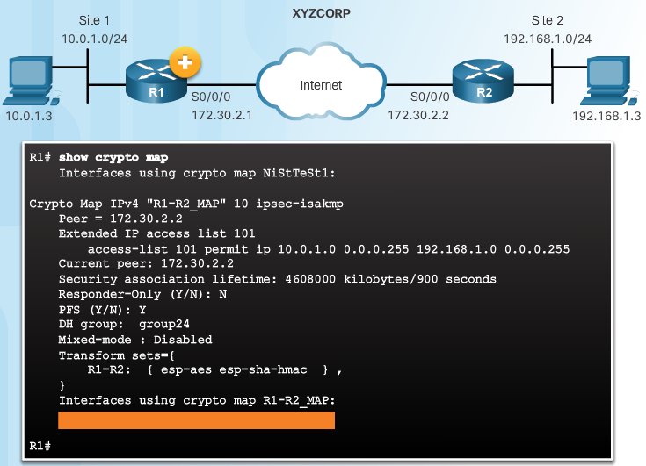
XYZCORP Crypto Map Configuration (Cont.)
Crypto Map Configuration:
Notes:
8.3.4.2 XYZCORP Crypto Map Configuration (Cont.)

Slide 54
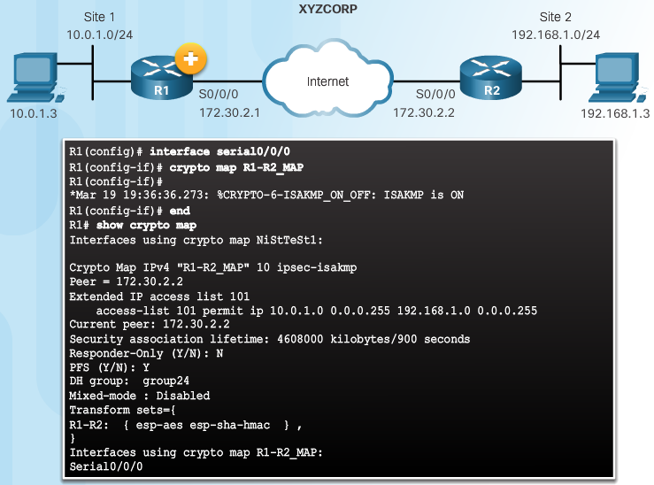
Apply the Crypto Map
Notes:
8.3.4.3 Apply the Crypto Map

Slide 55
Topic 8.3.5: IPsec VPN

Slide 56
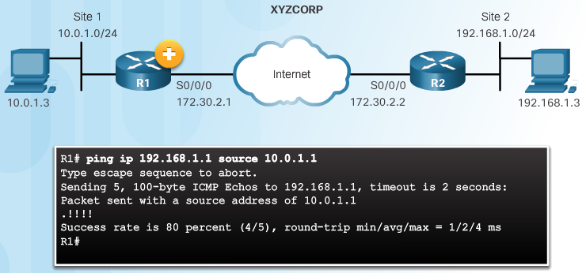
Send Interesting Traffic
Use Extended Ping to Send Interesting Traffic
Notes:
8.3.5.1 Send Interesting Traffic
8.3.5.2 Verify ISAKMP and IPsec Tunnels

Slide 57

Verify ISAKMP and IPsec Tunnels
Verify the ISAKMP Tunnel is Established
Notes:
8.3.5.2 Verify ISAKMP and IPsec Tunnels

Slide 58

Verify ISAKMP and IPsec Tunnels (Cont.)
Verify the IPsec Tunnel is Established
Notes:
8.3.5.2 Verify ISAKMP and IPsec Tunnels (Cont.)

Slide 59
Section 8.4: Summary
Chapter Objectives:
Explain the purpose of VPNs.
Explain how IPsec VPNs operate.
Configure a site-to-site IPsec VPN, with pre-shared key authentication, using the CLI.
Recomendations for IPSec parameters
https://www.ncsc.gov.uk/guidance/using-ipsec-protect-data
https://www.bsi.bund.de/SharedDocs/Downloads/EN/BSI/Publications/TechGuidelines/TG02102/BSI-TR-02102-3.html
Also look at:
Configure Transport mode IPSec Lab 13-3: Configuring GRE/IPSec Tunnel Mode, Transport Mode, and S-VTI > IPSec VPN | Cisco Press
Open VPN https://openvpn.net/
Wireguard https://www.wireguard.com/
Notes:
8.4.1.1 Video Demonstration – Site-to-Site IPsec VPN Configuration
8.4.1.2 Packet Tracer – Configure and Verify a Site-to-Site IPsec VPN
8.4.1.3 Lab – Configuring a Site-to-Site VPN
8.4.1.4 Chapter 8: Implementing Virtual Private Networks

Slide 61


Instructor Resources
Remember, there are helpful tutorials and user guides available via your NetSpace home page. (https://www.netacad.com)
These resources cover a variety of topics including navigation, assessments, and assignments.
A screenshot has been provided here highlighting the tutorials related to activating exams, managing assessments, and creating quizzes.
1
2
Notes:
https://www.netacad.com

