Slide 1
Archive Incubations: Experimental Design
Samples selected from sites with different land uses, depths, and length of time archived:
California (forest, top and subsoil, 9 y)
Tennessee (forest, topsoil, 14 y)
North Carolina (forest, topsoil and subsoil, 10 y)
Germany (grassland and forest, topsoil, 7 y)
Selection criteria: median ¹⁴C values from HR, carbonate containing samples excluded, only Hainich Exploratory
Massachusetts/Harvard Forest (topsoil, 19 y)
Lab replication was performed according to quantity of soil available (1 to 3 reps per sample)
Pre-incubation was not done for initial sample set, as exact duration and CO2 release unknown for most samples
A second experiment was performed with samples from two sites in Germany (Hainich and Schorfheide) where pre-incubation was done
CO₂ concentrations in the headspace were measured every 3 days during main incubation period until approximately the same amount of C was respired as during the t₁ incubations (g CO₂-C g soil ⁻¹)
Notes:
Sierra HR data

Slide 2
Archive Incubation Experiment: Questions and Hypotheses
Does length of time archived affect 14C signature of respiration?
H1:
Archiving will not alter the accessibility of SOM to microbes, thus the 14C signature of HR will not change between t₁ and t₂.
Does the rewetting pulse of CO2 release older carbon than the following basal respiration?
Rewetting dry soil has been shown to release a burst of CO2, even in the absence of microbes
H2:
CO₂-C released in response to rewetting will be older than CO₂-C respired by microbes following the pre-incubation period, as the rewetting process will mobilize C otherwise inaccessible to microbes.
H2A:
CO₂-C released in response to rewetting will be younger than CO₂-C respired by microbes following the pre-incubation period, as the rewetting process will rapidly mobilize large amounts of C, inducing a priming effect.
Does rewetting dried, archived soils lead to a difference in total CO₂-C evolved during the pre-incubation period at t₁ versus t₂?
H3:
More CO₂ will be released at t₂ as the rewetting effect will be stronger on completely dry soil versus field moist samples. This will in term lead to faster CO₂ respiration rates during the main incubation period for t₂ as a result of priming.
Notes:
Sierra HR data

Slide 3
Archive Incubation Round II: Questions and Hypotheses
Does the amount of CO₂ released during pre-incubation relative to the main incubation period affect the 14C signature during the main incubation period?
If more C is released during rewetting than was released during the initial incubation, this could change the energy balance of the system. If more energy is available, microbes could potentially be able to invest in the synthesis of enzymes to breakdown certain compounds that they would not have otherwise been able to afford.
H4:
Increased C mobilization (more CO₂ produced) during rewetting at t₂ will lead to an older 14C signature at t₂.
Is there an interaction between land use and ¹⁴C signature at t₁ versus t₂?
H5 (null):
There will be no interaction between land use and archiving/rewetting on the observed ¹⁴C signature of HR following pre-incubation, as the mechanisms of soil organic matter stabilization are the same, even if certain mechanisms are more important under specific land uses.
H5 (alternative):
Older ¹⁴C signatures will be observed in grasslands as compared to forests during the rewetting period as aggregates are a more important mechanism for soil carbon stabilization under this land use, and aggregates are susceptible to disruption from rewetting (Degens and Sparling, 1995).
Notes:
Sierra HR data

Slide 4
Archive Incubation Round II: Questions and Hypotheses
Potential issue:
Current experimental design makes it difficult to separate archiving effects from rewetting effects. Ideally I would test samples collected recently but were then dried and rewetted against those that had been both dried and archived before rewetting…
Maybe compare to literature studies of rewetting effect? cf. Fierer and Schimel, 2003; Pulleman and Tietema, 1999; Degens and Sparling, 1995; Van Gestel et al., 1991.
Question:
Unknown how pre-incubation respiration would differ from t1 to t2
Notes:
Sierra HR data

Slide 5
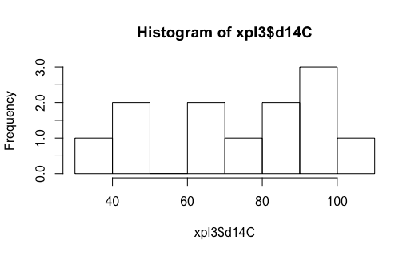
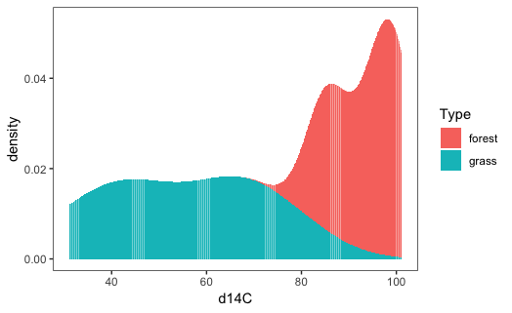
Archive Incubation Round II: Experimental Design
d14C
Samples selected to cover a range of ¹⁴C values (Fig. 1)
Three samples selected from each land use (forest, grassland) at two Exploratories (Hainich, Schorfheide)
Samples will be run as duplicates, i.e. two lab reps each with 20 g dry soil rewetted to 60% WHC
n_{samples} = 12, n_{reps}= 24
Pre-incubation will last for 4 days, which is the duration of the pre-incubation from the t₁ incubations
CO₂ concentrations in the headspace will be measured daily during the pre-incubation period and at least 3 times during the main incubation period
Following pre-incubation, headspace samples will be collected for ¹⁴C and ¹³C analysis, then jars will be flushed with CO₂-free synthetic air
Incubations will proceed until the same amount of C has been respired in the main incubation period as during t₁ incubations (g CO₂-C g soil ⁻¹)
d14C
Fig. 1 Histograms of ∆¹⁴C from Round II samples (t₁, n=12): ^{a)} (top) frequency, ^{b)} (bottom) density by land use.
Notes:
Sierra HR data

Slide 6
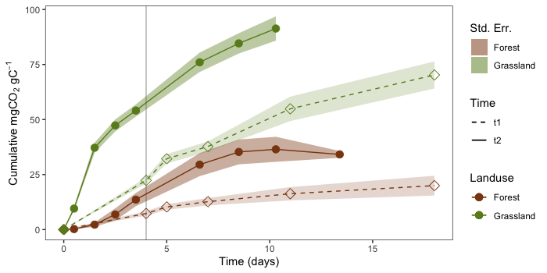
Archive Incubation Experiment Results: Round II of Exploratories Samples
T1 vs. t2 CO₂ accumulation
Pre-incubation = 4 d, for both t1 and t2; respiration rates measured daily for t2 pre-inc, but not t1 (only total CO2 accumulation measured for t1)
Main incubation duration for t1 = 14 d; t2 inc continued until the same amount of CO2 accumulated (per sample) as in t1 main incubation
Substantially more CO2 released during pre-incubation for t2 samples, particularly grasslands
n = 6
n = 12
Notes:
co2.p1 (ln 971, arc.inc.R) 29-01-2019; 700x350
Notes:
Forest samples slightly less CO2; grassland samples slightly more [appears to be function of relative resp rates---without daily measurements grassland samples overshot]
More soil used during t1 incubations (cf. 50g vs. 20g)
From t1 incubations:
Land use and exploratory affect respiration rates
Hainich grasslands respired much more C during both pre-incubation and main incubation period compared to Schorfheide grasslands, but this “Exploratory” effect is not apparent for forest samples.

Slide 7
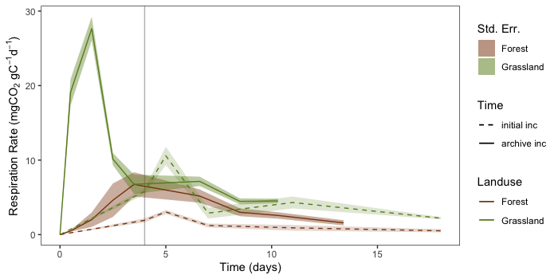
Archive Incubation Experiment Results: Round II of Exploratories Samples
Respiration rates:
Respiration during pre-incubation much greater for t2, especially grasslands
Peak respiration rate occurred later for t1 incubations
General shape of curve similar: initial peak followed by slow decline
However, respiration rates generally higher for t2 incubations—rewetting induced priming (H3)?
n = 6
n = 12
Notes:
resp.p2 (ln 933 arc.inc.R) 29-01-2019
- Calculated as first derivative of cumulative CO2 release over time, i.e. dCO2/dt

Slide 8
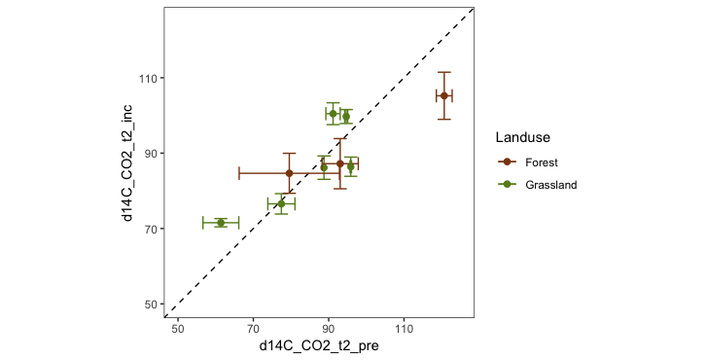
Archive Incubation Experiment Results: Round II of Exploratories Samples
14C: t2 pre vs main incubation period 14C
No trend (good)
NB: only 3 forest samples (of 6) accumulated enough CO2 during pre-inc for measuring 14C
Bars are min and max of duplicates, point is mean
Paired t.test:
mean dif = 0.52
95%CI = (-6.19, 7.23)
p = 0.86 on 8 df
Notes:
maybe add std error bar around 1:1 line

Slide 9
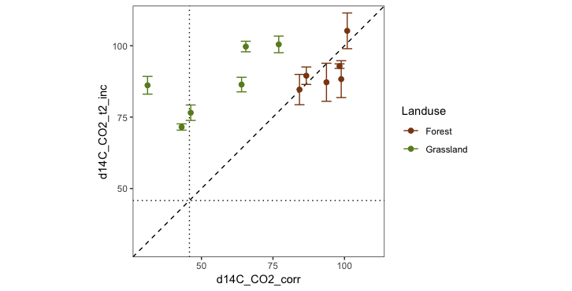
Archive Incubation Experiment Results: Round II of Exploratories Samples
14C: t1 vs t2 for main incubation period
Effect of land use apparent
Forests look great, grasslands diverge
slopes not significantly different from 1 (if HEG10 excluded---different soil, extreme point)
if kept in, G slope = 0.49, R²=0.44
dotted lines = atmosphere in mid 2009 (45.8)
Notes:
726x320
Extreme point is the vertisol (HEG10)
Perhaps the grassland sites that respired pre-bomb CO2 @ t1 did so in response to disturbance? vis. CO2 resp rates

Slide 10
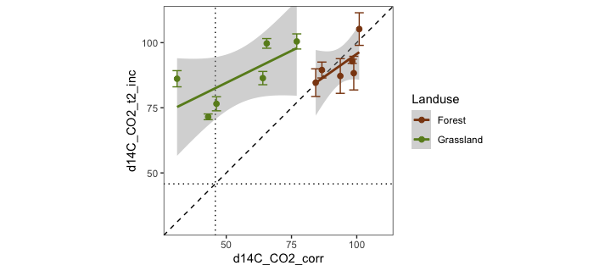
Archive Incubation Experiment Results: Round II of Exploratories Samples
14C: t1 vs t2 for main incubation period
Effect of land use apparent
Forests look great, grasslands diverge
slopes not significantly different from 1 (if HEG10 excluded---different soil, extreme point)
if kept in, G slope = 0.49, R²=0.44
dotted lines = atmosphere in mid 2009 (45.8)
Notes:
726x320
Extreme point is the vertisol (HEG10)
Perhaps the grassland sites that respired pre-bomb CO2 @ t1 did so in response to disturbance? vis. CO2 resp rates

Slide 11
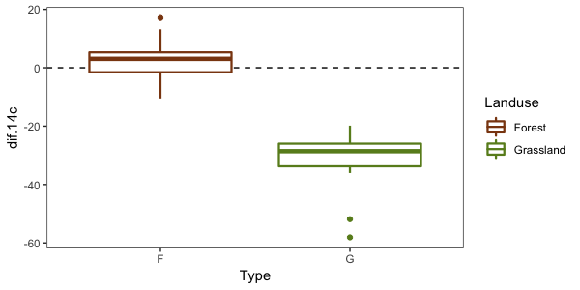
Archive Incubation Experiment Results: Round II of Exploratories Samples
14C: t1 vs t2 for main incubation period, Xpl R2 samples only
Significant effect of land use: grasslands 14C @t2 > t1, forest 14C @t2 < t1
Forests
t = 1.11, df = 11, p = 0.292
95% CI: (-2.47, 7.46)
mean dif: 2.50
Grasslands
t = --9.58, df = 11, p-value < 0.001
95% CI: (-39.72, -24.87)
mean dif: -32.30
Notes:
600x300
NB: made w/ age-corr d14C values on 16-May-2019

Slide 12
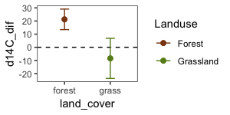
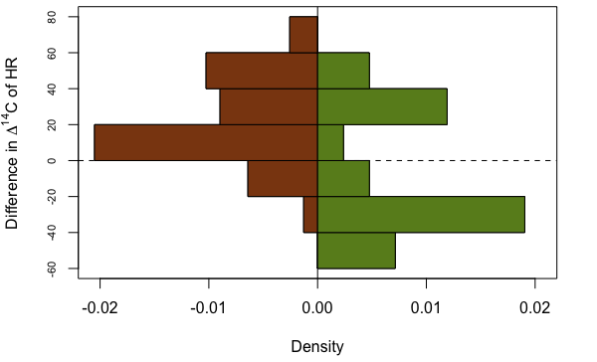
Archive Incubation Experiment Results
14C: t1 vs t2 for main incubation period
Histograms of raw difference (t1-t2) for all data
Shows trend in forest data is for t2 < t1, while grasslands show t2 > t1 (but strongly bimodal)
95% CI plot

Slide 13
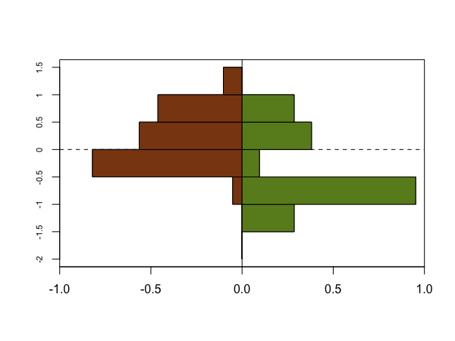
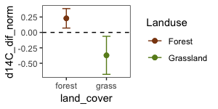
Archive Incubation Experiment Results
14C: t1 vs t2 for main incubation period
Histograms of normalized difference [((t1-t2)-mean(t1-t2))/sd(t1-t2)] for all data (does this make sense at all? I guess for showing the F/G difference?)
Shows trend in forest data is for t2 < t1, while grasslands show t2 > t1 (but bimodal)
95% CI plot
(note different scale)
Forests
t = 2.93, df = 38, p-value = 0.006
95% CI: (0.07, 0.39)
mean dif: 0.23
Grasslands
t = -2.51, df = 20, p-value = 0.021
95% CI: (-0.68, -0.06)
mean dif: -0.37
Notes:
600x450

Slide 14
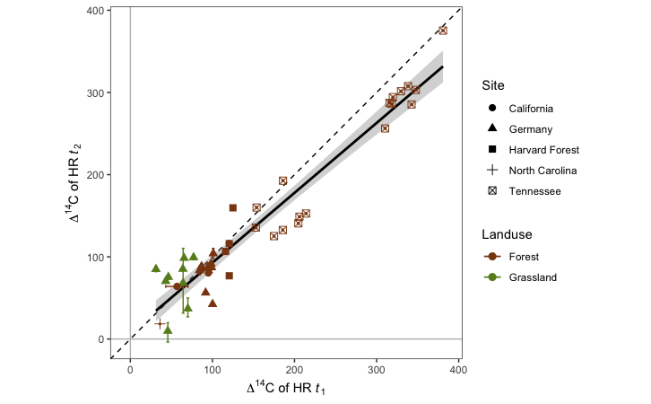
Archive Incubation Experiment Results
14C: t1 vs t2 for main incubation period, all samples
Reps only possible for Germany and CA samples, owing to limited sample
y = 7.88 + 0.85x
R² = 0.93, p < 0.001
Notes:
726x450
most recent C is more enriched in TN samples, most recent C is less enriched in other sample [slight old bias, i.e. loss of most recent C]
remove lines (14C too non-linear w/ bomb + enrichment effects)
consider putting error bands around 1:1 line

Slide 15
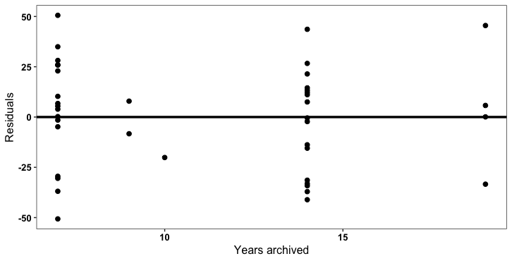
Archive Incubation Experiment
Residuals of (t2 – t1 d14C-CO₂) vs. years archived (all samples, reps averaged)
No significant effect overall, nor for landuse (grassland vs. forest) or site
7 to 19 years
p = 0.71, R² = 0 (n=40)
Notes:
consider the absolute difference (t2-t1) against time archive
consider adding conceptual trend (i.e. more noise as time goes on?)
group points (whatever grouping makes the most sense)

Slide 16
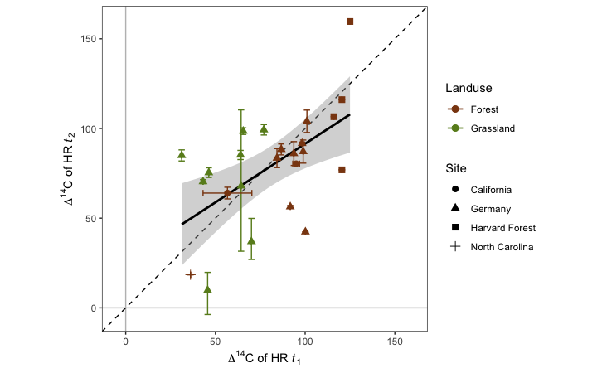
Archive Incubation Experiment Results
14C: t1 vs t2 for main incubation period
TN samples excluded
y = 26.12 + 0.65x
R² = 0.31, p = 0.003
Notes:
726x450

Slide 17
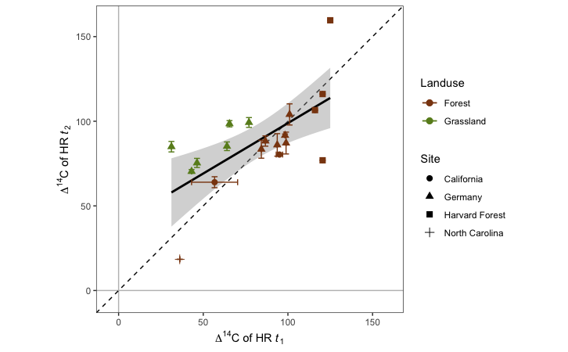
Archive Incubation Experiment Results
14C: t1 vs t2 for main incubation period
TN and Germany Round 1 samples excluded
y = 39.36 + 0.60x
R² = 0.41, p = 0.002
Notes:
726x450

Slide 18
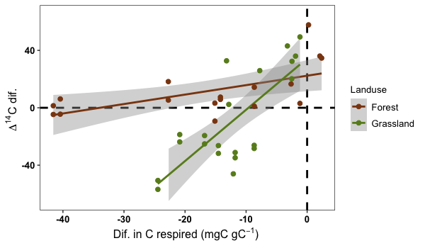
Archive Incubation Experiment Results: Round 2 of Exploratories Samples
Difference of t2 ¹⁴CO₂ - t1 ¹⁴CO₂ plotted against difference in C respired per gram of soil C during main incubation period
This is despite trying to control for this...
Grassland
y = 34.35 + 3.57x
R² = 0.57, p < 0.001
Forest
y = 22.35 + 0.66x
R² = 0.32, p = 0.01
Notes:
600x300
I prefer showing the relationship of d14_dif against HR rate dif

Slide 19
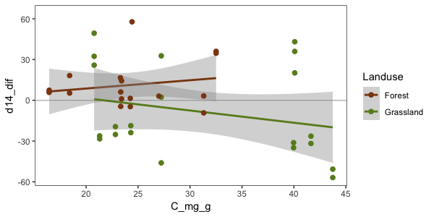
Archive Incubation Experiment Results: Round 2 of Exploratories Samples
Difference in ∆14C of HR vs. C content
No relationship
Notes:
600x300

Slide 20
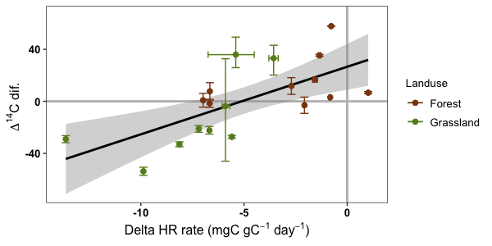
Archive Incubation Experiment Results: Round 2 of Exploratories Samples
Difference of t1 ¹⁴CO₂ – t2 ¹⁴CO₂ plotted against difference in HR respiration rate during main incubation period
y = 26.6+5.2x
R² = 0.43
p = 0.001
Notes:
land cover not a significant effect on this relationship

Slide 21
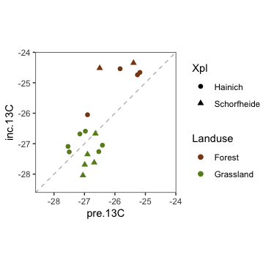
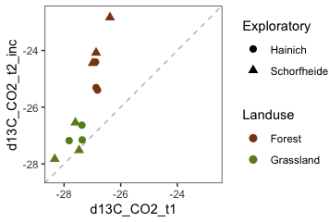
Archive Incubation Experiment Results: Round 2 of Exploratories Samples
13C of CO2:
T2 13C consistently more enriched than t1 13C, for both pre and main incubation (left)
No real trend in grassland pre vs. main incubation 13C for t2 incubations (right)
Appears to be a soil texture pattern here, e.g. sandy Schorfheide site less enriched in main incubation compared to clayey Hainich sites where no difference is seen
Notes:
resp.p2 (ln 933 arc.inc.R) 29-01-2019
size = 370x370

Slide 22
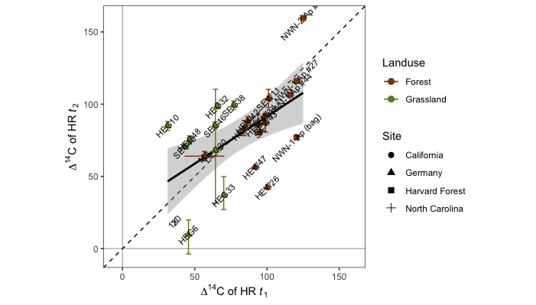

Slide 23
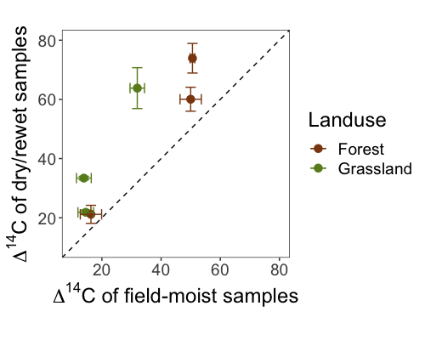
Drying/Rewetting results

Slide 24
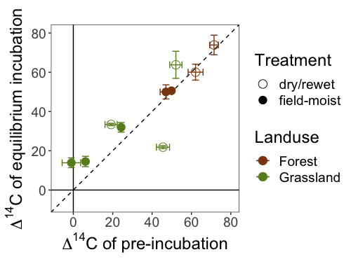
Drying/Rewetting results
Notes:
Outlier excluded
ns (p = 0.3221)
mean dif = -3.7
95% CI: -11.7, 4.3

Slide 25
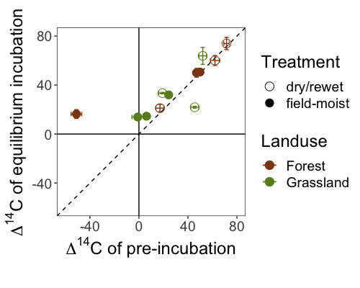
Drying/Rewetting results
Notes:
ns (p = 0.1635)
mean dif = -9.0
95% CI: -22.4, 4.3

Slide 26
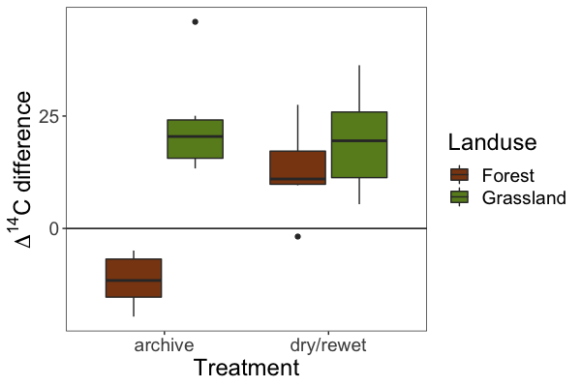
Summary of results
All differences significant (p < 0.05)
land use significant for both treatments: difference > for grassland samples
Notes:
600x400

Slide 27
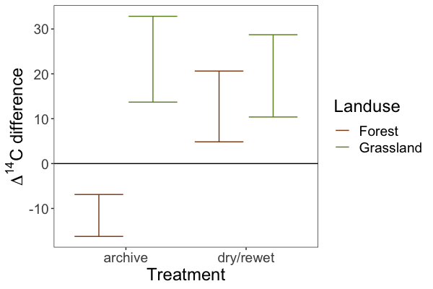
Summary of results (95% CIs)
Notes:
600x400
n = 12 for both experiments

Slide 28
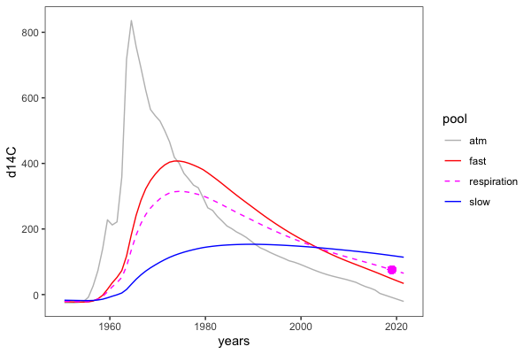
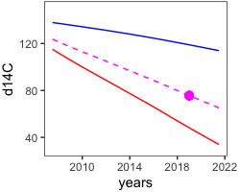
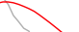
Conceptual plot
Inset shows potential shifts in ¹⁴C-CO₂ in response to treatment (relative to control)
Direction of shift implies changes in the relative contribution of soil C pools with different intrinsic cycling rates (“fast” or “slow”) to respiration
respiration (measured)
•
control
°
°
enrichment (more slow C)
*
depletion (more fast C)
*
pool (modeled)
Notes:
600x400

Slide 29
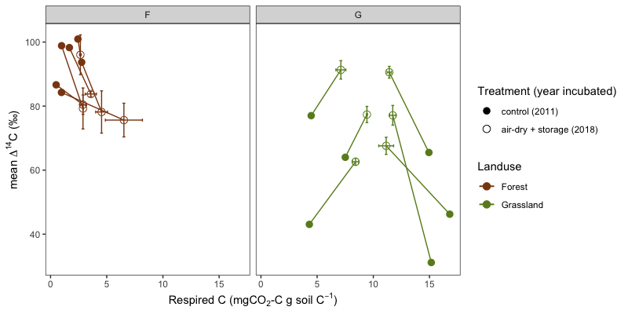
∆¹⁴C-CO₂ by fraction (‰) of soil C pool respired (2011 samples)
Shown as absolute measurements, rather than differences
Lines show theoretical trend
Notes:
800x400

Slide 30
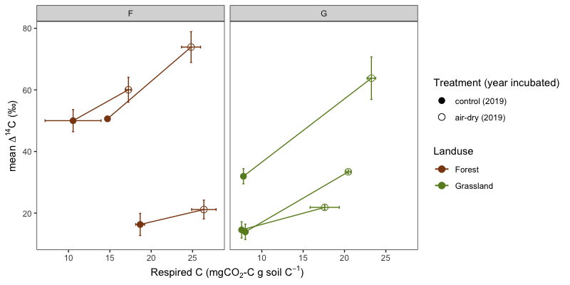
∆¹⁴C-CO₂ by fraction (‰) of soil C pool respired (2019samples)
Shown as absolute measurements, rather than differences
Lines show theoretical trend
Notes:
800x400

Slide 31
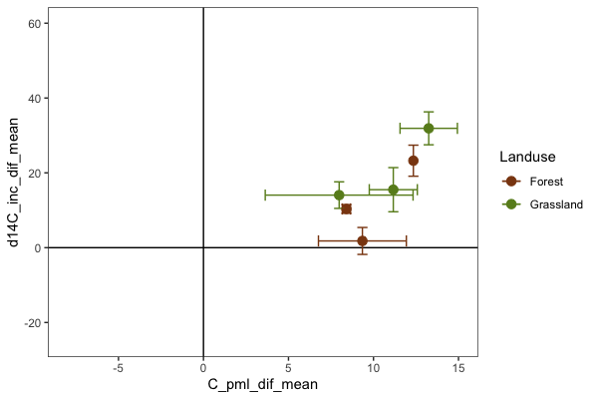
Fraction of total C respired against 14C dif
Treatment: “air-dry”
¹⁴C difference (y-axis): equilibrium respiration only
difference in ‰ soil C respired (x-axis): entire incubation, i.e. pre + equilibrium
Notes:
600x400

Slide 32
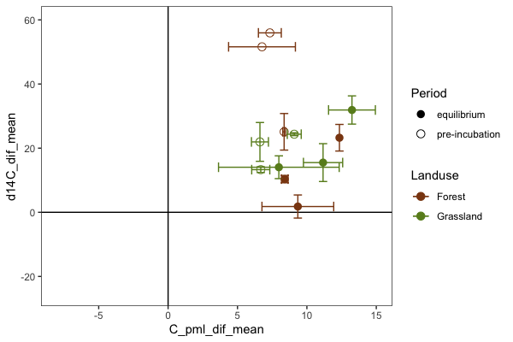
Fraction of total C respired against 14C dif
Treatment: “air-dry”
both pre-incubation and equilibrium respiration data shown
Notes:
600x400

Slide 33
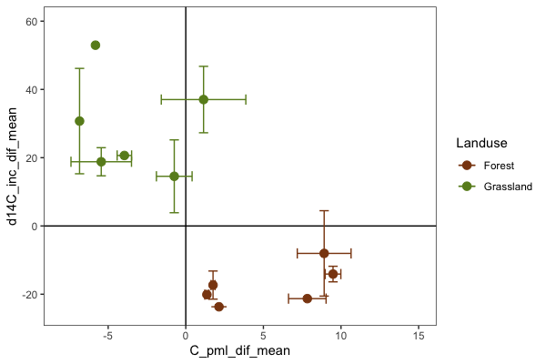
Fraction of total C respired against 14C dif
Treatment: “air-dry + storage”
¹⁴C difference (y-axis): equilibrium respiration only
difference in ‰ soil C respired (x-axis): entire incubation, i.e. pre + equilibrium
Notes:
600x400

Slide 34
Conceptual plot (1)
Illustration of the importance in having multiple time points to improve model constraints
Fit a model with one time point and show multiple solutions; compare to the solution found with two time points
Notes:
600x400
inset: 250x200
show pre-cross trends
use ctl pch 16; open for treatment
add 2nd conceptual figure for archive inc rationale (fig 1)

Slide 35
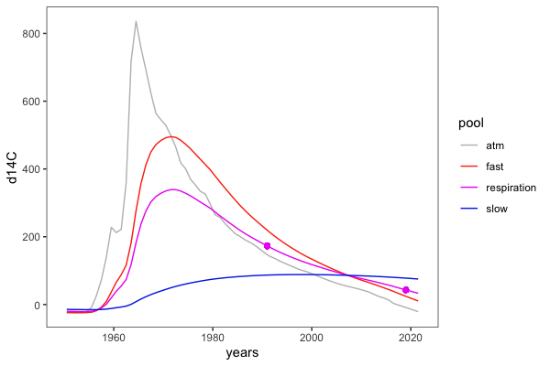
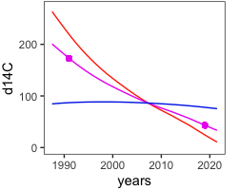
Conceptual plot (2)
Inset shows potential shifts in ¹⁴C-CO₂ in response to treatment (relative to control)
Direction of shift implies changes in the relative contribution of soil C pools with different intrinsic cycling rates (e.g. “fast” or “slow”) to respiration
respiration (measured)
•
control
+
greater slow C contribution
+
greater fast C contribution
+
pool (modeled)
Notes:
600x400
inset: 250x200
add additional conceptual figure for archive inc rationale (fig 1), i.e. two time points
make HR curve solid and purple
E50000, B700D2, 0030BF

Slide 36
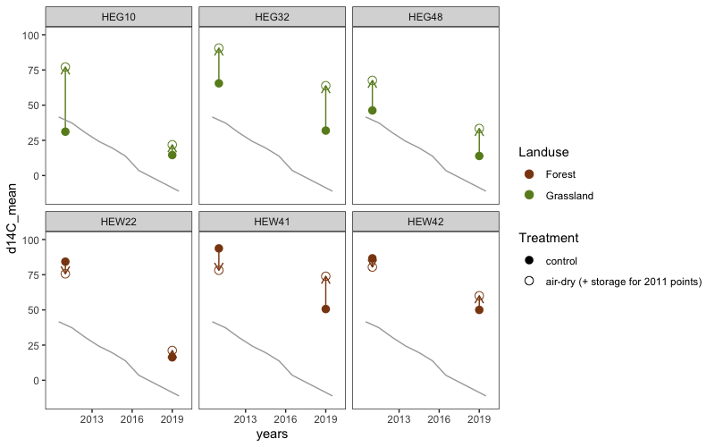
Change in ∆¹⁴C-CO₂ over time
(both control and treatment samples, from 2011 and 2019)
Notes:
narrative themes:
drying/rewetting; + storage; pre-inc; C-respired; interactions...
context: F/G, archive incubations

Slide 37
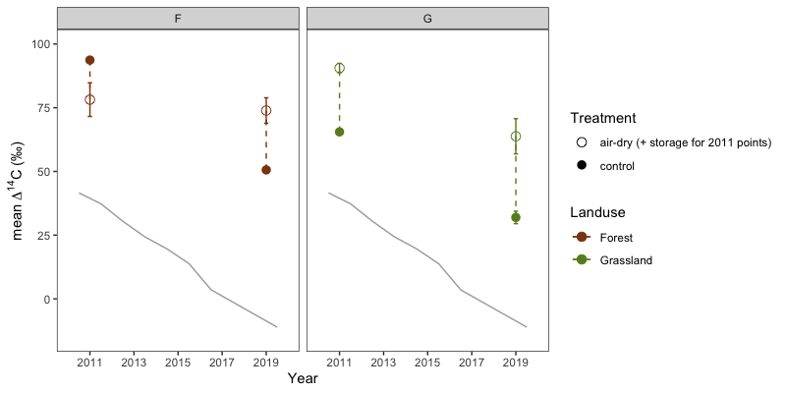
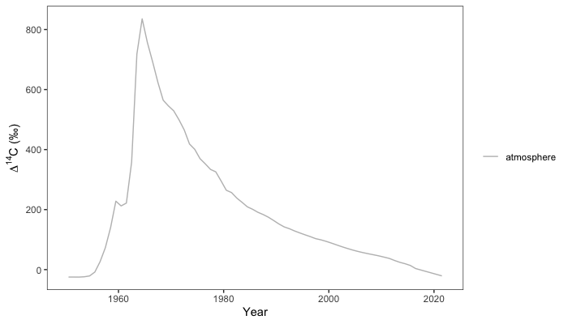
Treatment effects on ∆¹⁴C-CO₂ (selected 2011 and 2019 samples)
Only data from representative samples HEG32 and HEW41 shown to avoid over-plotting
Grassland samples show enrichment with treatment, relative to control
Forest samples show depletion for 2011 samples (treatment = air-dry + storage), but enrichment for 2019 samples (treatment = air-dry)—maybe slow/fast curves crossed between 2011 and 2019 for the forest samples?
Notes:
unite this w/ concept plot 2

Slide 38
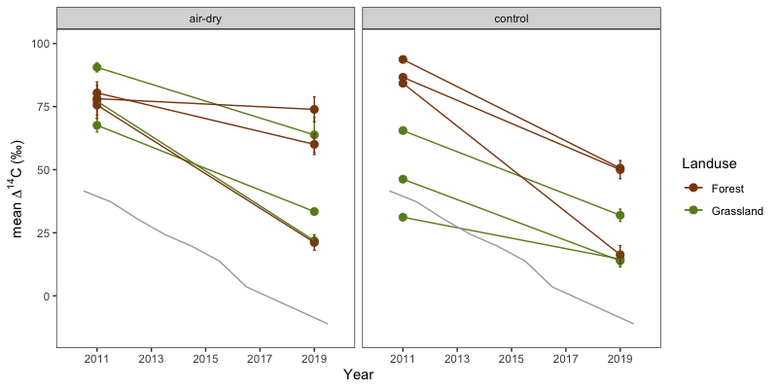
Change in ∆¹⁴C-CO₂ over time
(both control and treatment samples, from 2011 and 2019)
* note that the treatment for the 2011 “air-dry” samples is actually “air-dry + storage”
*
Notes:
narrative themes:
drying/rewetting; + storage; pre-inc; C-respired; interactions...
context: F/G, archive incubations

Slide 39
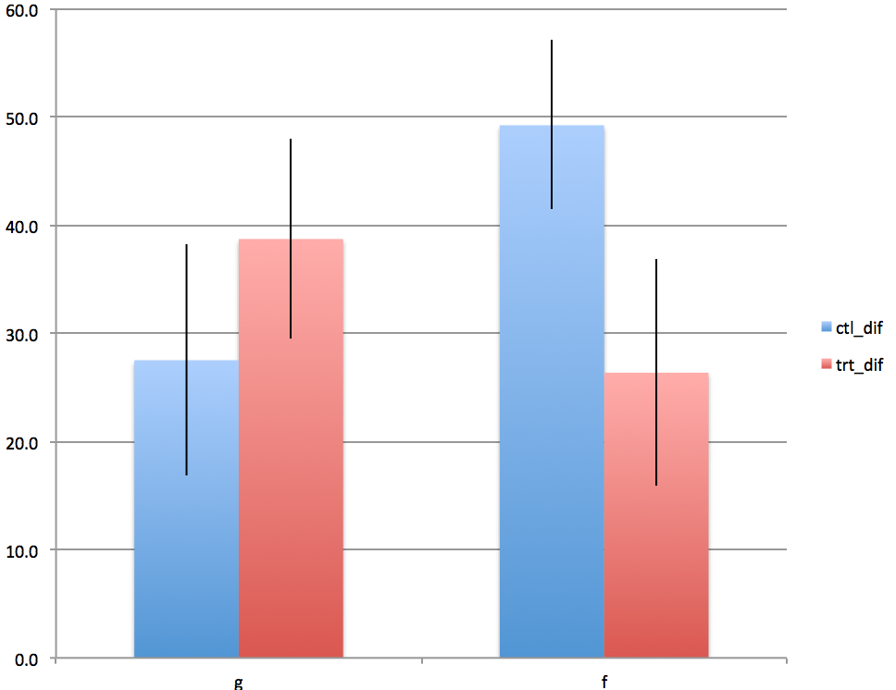
Notes:
narrative themes:
drying/rewetting; + storage; pre-inc; C-respired; interactions...
context: F/G, archive incubations

Slide 40
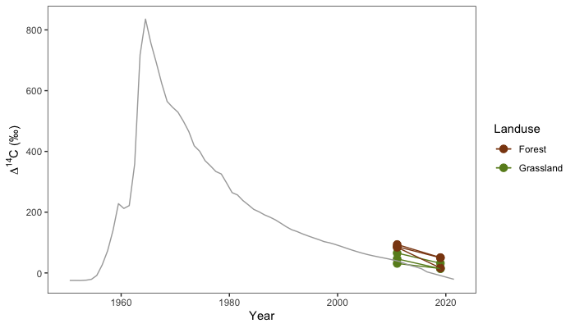
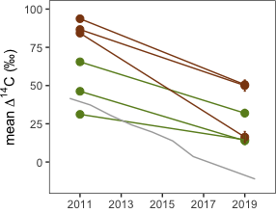
Change in ∆¹⁴C-CO₂ over time
(control samples only, 2011 and 2019 samples)
Notes:
700x400
inset: 300x300

Slide 41
Air-dry + storage effects on ∆¹⁴C-CO₂
(by fraction (‰) of soil C pool respired, 2011 samples)
Hainich samples respired more during the initial control incubations in 2011 than during the treatment incubations in 2018, while the opposite was true for the Schorfheide samples
However, the exploratory had no impact on the treatment effect on ∆¹⁴C-CO₂
Hainich samples (other grassland samples from Schorfheide)
Notes:
800x400

Slide 42
Air-dry + storage effects on ∆¹⁴C-CO₂
(by fraction (‰) of soil C pool respired, 2011 samples)
Forest samples show a trend with decreasing ∆¹⁴C-CO₂ with increasing respiration; grasslands do not
Higher amount of C respired for forest samples during treatment incubations may confound treatment effect
Notes:
800x400
NB: circles = equilibrium resp; triangles = pre-incubation; open = treatment, filled = control; squares = theoretical treatment response (open and w/ ‘x’)

Slide 43
Air-dry effects on ∆¹⁴C-CO₂
(by fraction (‰) of soil C pool respired, 2019 samples)
Both grassland and forest samples show a trend of increasing ∆¹⁴C-CO₂ with increasing respiration
Higher amount of C respired during treatment incubations may confound treatment effect
Notes:
800x400

Slide 44
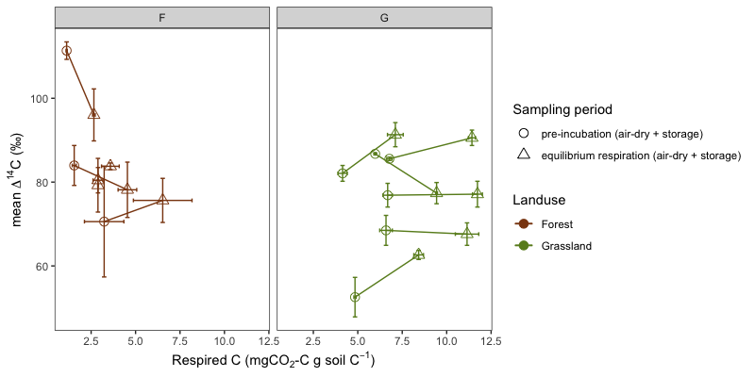
Rewetting pulse versus equilibrium respiration ∆¹⁴C-CO₂
(by fraction (‰) of soil C pool respired, 2011 samples)
No trend in ∆¹⁴C-CO₂ with increasing respiration for either forests or grasslands
Notes:
800x400

Slide 45
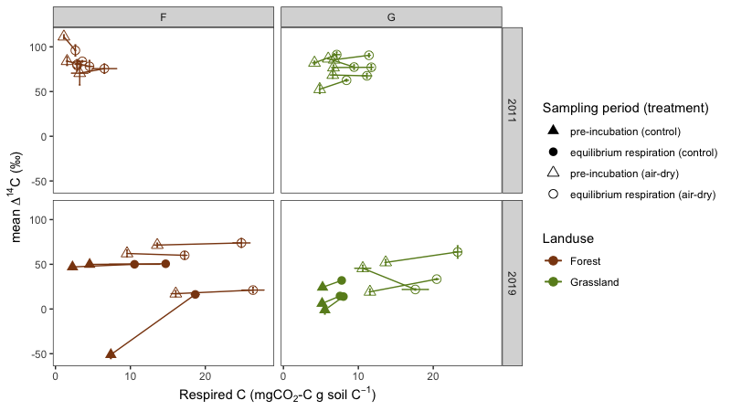
Rewetting pulse versus equilibrium respiration ∆¹⁴C-CO₂
(by fraction (‰) of soil C pool respired)
No trend in ∆¹⁴C-CO₂ with increasing respiration for forests or grasslands in 2011, nor forests in 2019; increasing trend for grassland 2019 except HEG10 (decline---slower C dyn)
Notes:
800x400

Slide 46
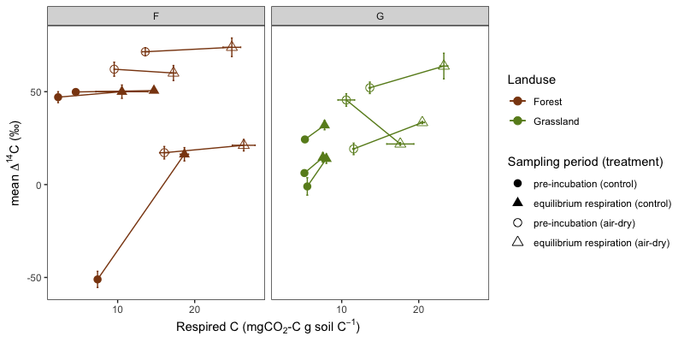
Rewetting pulse versus equilibrium respiration ∆¹⁴C-CO₂
(by fraction (‰) of soil C pool respired, 2019 samples)
Forest samples: no trend in ∆¹⁴C-CO₂ with increasing respiration for either treatment or control incubations
Grassland samples: control samples show slight increase in ∆¹⁴C-CO₂ with increasing respiration, no trend for treatment samples
HEG10 (slow)
Seems to be an outlier
Notes:
800x400
- NB: divergent grassland sample is HEG10 (i.e. odd sample)

Slide 47
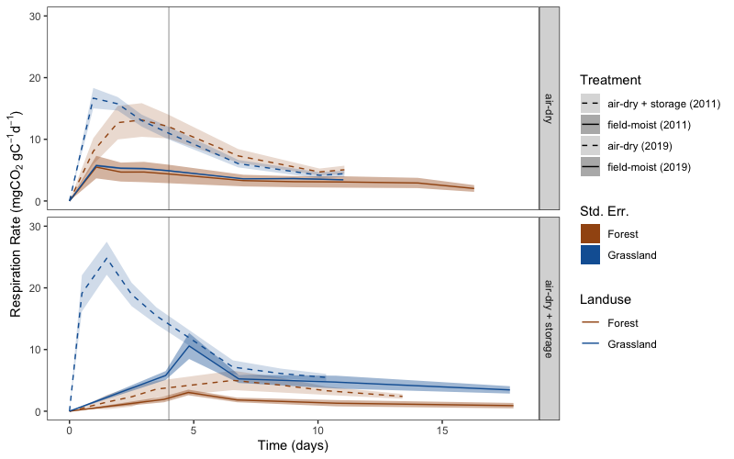
Treatment effect on respiration rate
Notes:
800x500
consider pairing with pre vs. main inc iso plots
maybe split by exploratory, e.g. just hainich here and facet by exploratory in SI plots

Slide 48
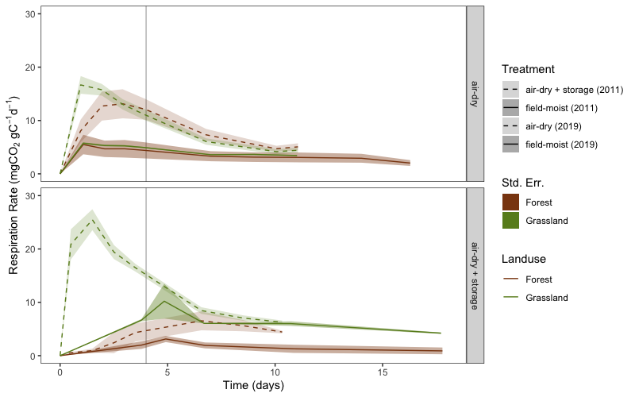
Treatment effect on respiration rate
Notes:
800x500
Just hainich (not really any different)

Slide 49
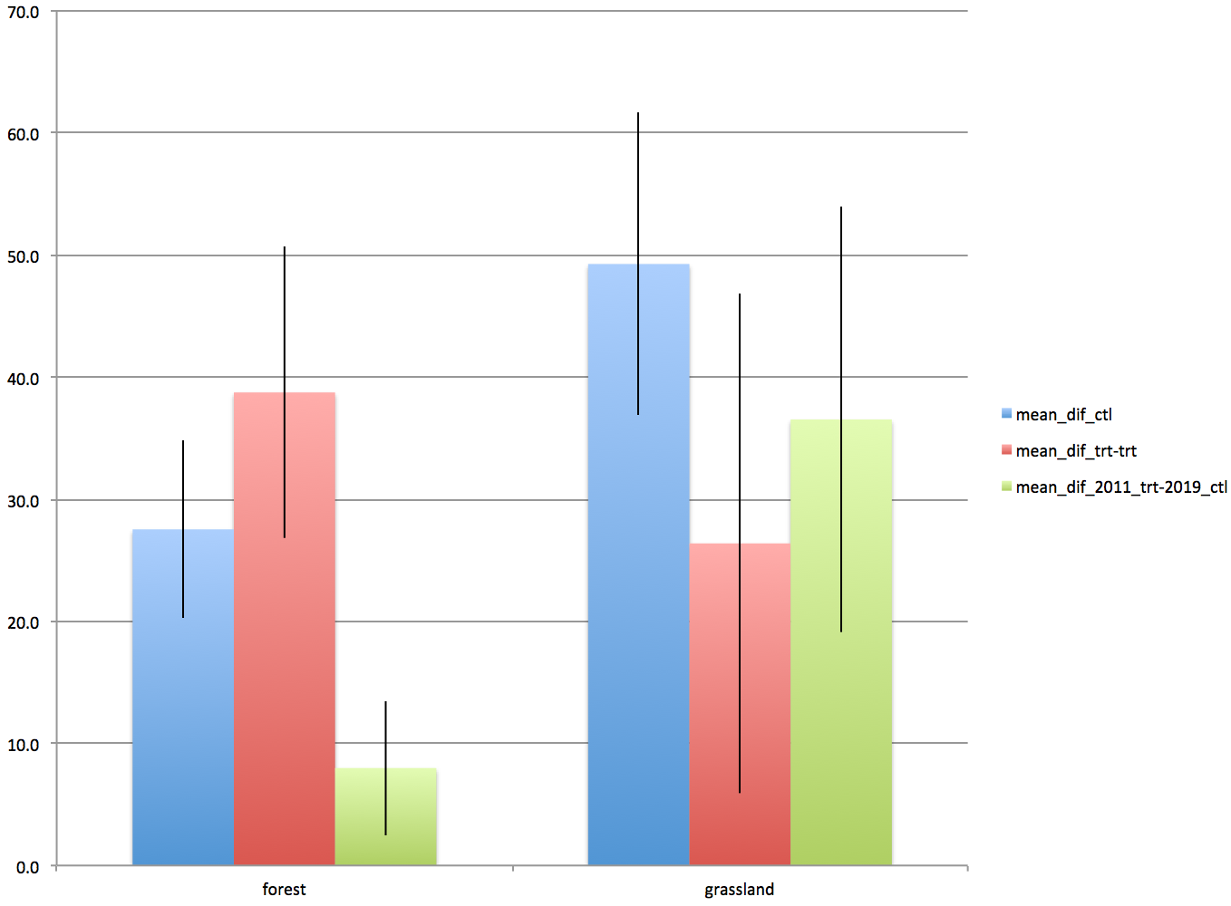
Assessing treatment effects on estimating change over time in 14C-CO2
Blue bars show differences in control samples between 2011 and 2019, red bars show differences in treatment samples between 2011 and 2019, and green bars show the difference between 2011 values measured in 2018 after undergoing air-drying + storage treatment and 2019 control samples (i.e. field-moist samples rewetted to 60% WHC prior to incubation).
Notes:
800x500
Just hainich (not really any different)

