Slide 1
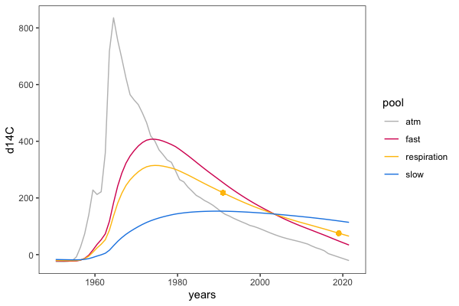
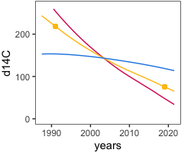
Conceptual plot (2)
Inset shows potential shifts in ¹⁴C-CO₂ in response to treatment (relative to control)
Direction of shift implies changes in the relative contribution of soil C pools with different intrinsic cycling rates (e.g. “fast” or “slow”) to respiration
respiration (measured)
•
+
control
+
greater slow C contribution
greater fast C contribution
+
pool (modeled)
Notes:
600x400
inset: 250x200
add additional conceptual figure for archive inc rationale (fig 1), i.e. two time points
make HR curve solid and purple
E50000, B700D2, 0030BF

Slide 2
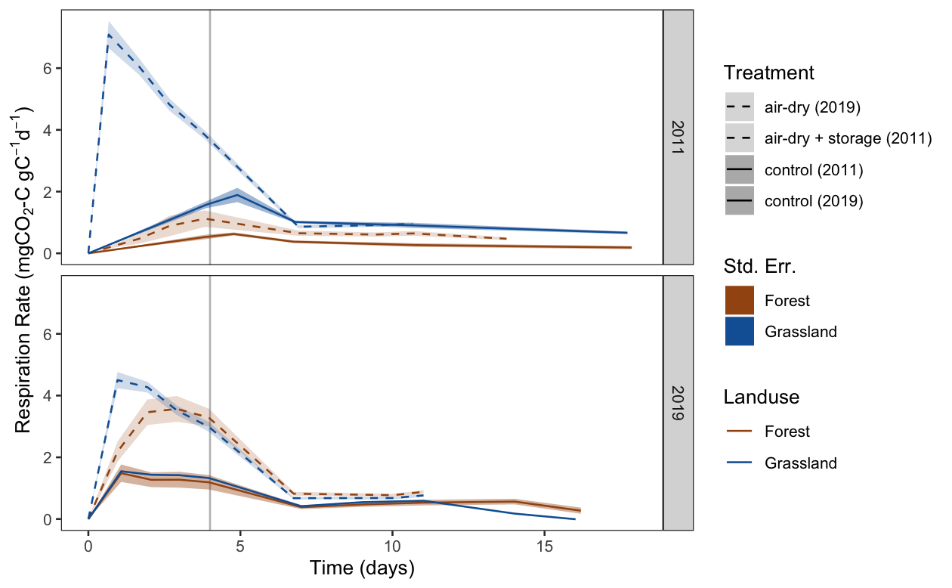
Treatment effect on respiration rate
Notes:
800x500
updated 22-Apr-2020

Slide 3
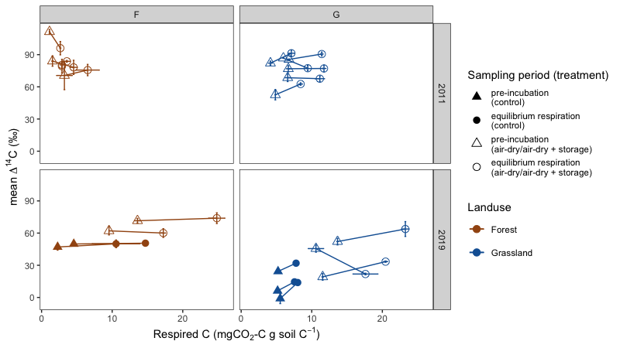
Rewetting pulse versus equilibrium respiration ∆¹⁴C-CO₂
(by fraction (‰) of soil C pool respired)
No trend in ∆¹⁴C-CO₂ with increasing respiration for forests or grasslands in 2011, nor forests in 2019; increasing trend for grassland 2019 except HEG10 (decline---slower C dyn)
Notes:
800x450

Slide 4
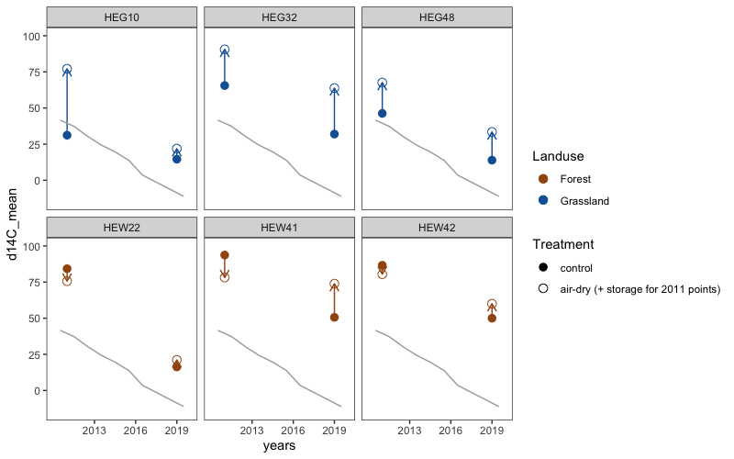
Shift in ∆¹⁴C-CO₂ due to treatment, over time
(both control and treatment samples, equilibrium respiration period from 2011 and 2019)
Notes:
narrative themes:
drying/rewetting; + storage; pre-inc; C-respired; interactions...
context: F/G, archive incubations

