Slide 1

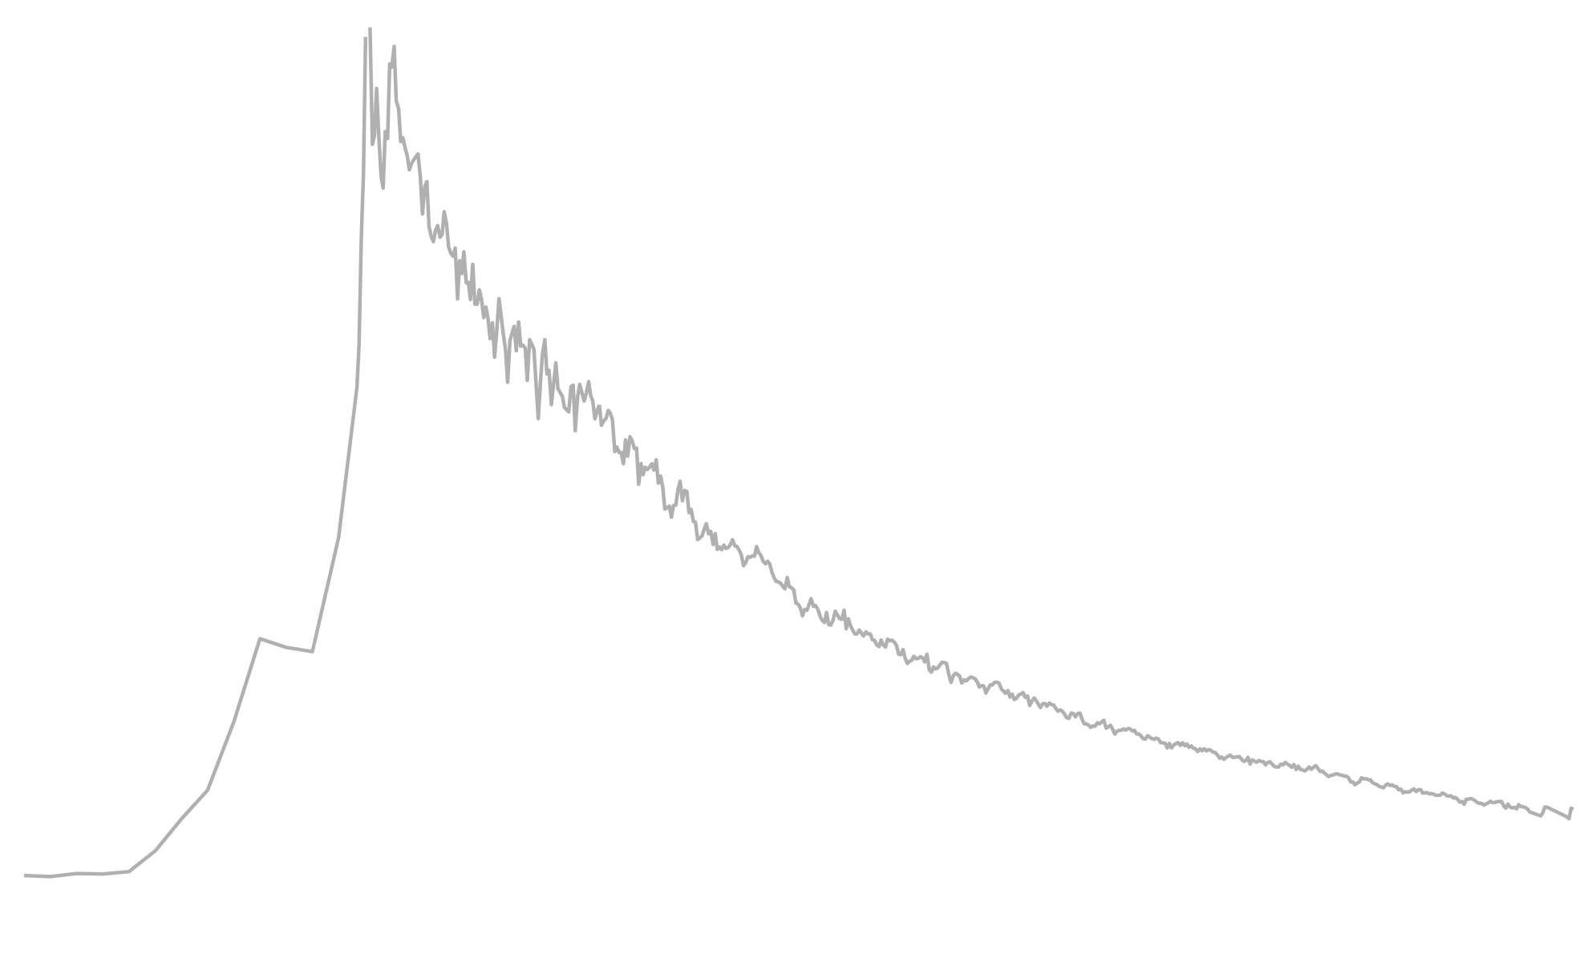
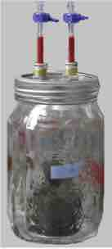



Radiocarbon incubations of archived soils
Jeffrey Beem-Miller¹
Marion Schrumpf¹
Georg Guggenberger²
Alison Hoyt^{1,3}
Susan Trumbore^{1,4}
Max Planck Institute for Biogeochemistry
Leibniz Universität Hannover
Berkeley National Lab
University of California, Irvine
Insights into drying/rewetting effects and constraining soil C models
Notes:
How does archiving affect the radiocarbon signature of respired CO2?
archiving = air-drying and rewetting as well as storage
The radiocarbon carbon of respired CO2 tells us how long the carbon that microbes are eating has been in the soil

Slide 2
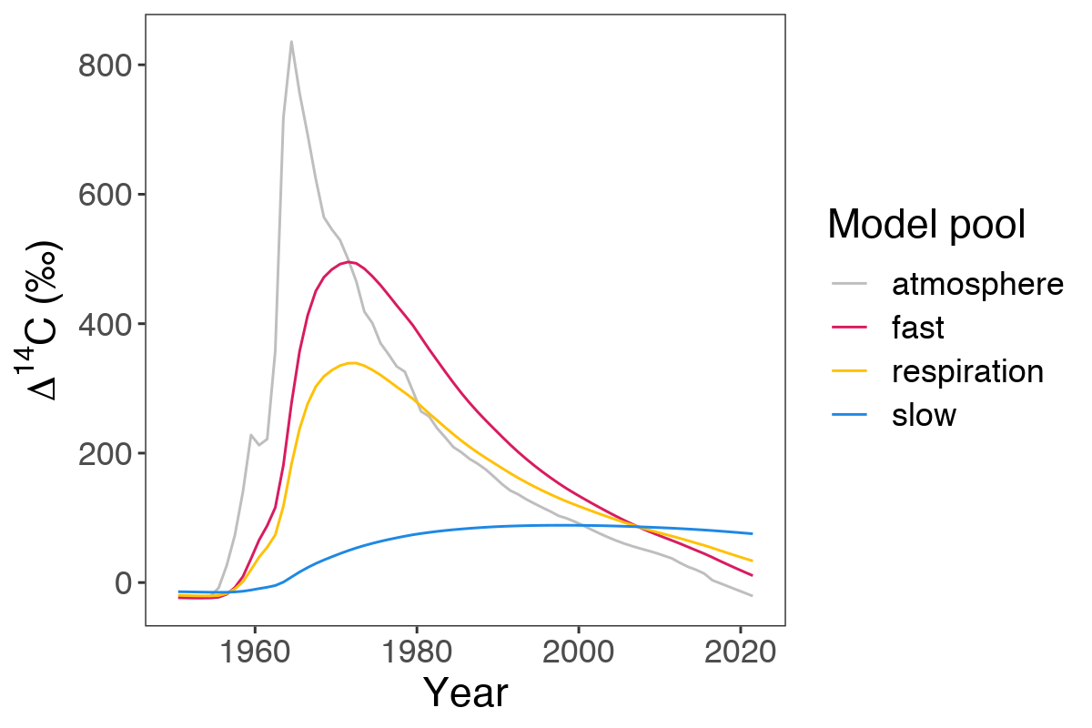
Bomb-C as a decadal tracer
“Bomb-C” from mid-20th century nuclear weapons testing (gray line, Fig. 1) provides a decadal-scale tracer for soil C dynamics
The rate of bomb-C incorporation in different pools of soil C (blue and magenta lines, Fig. 1) depends on intrinsic decomposition rates and transfers between pools
Observations at multiple time points key for constraining models
Fig. 1 Incorporation of bomb-C in soil over time in a theoretical 2-pool system.
Notes:
Bomb-C peak shifted to the right in soil---a few years in fast pool, decades in slow pool
Observations at a single point in time lead to multiple model solutions (symmetry of the bomb-C curve)
Past radiocarbon signature higher and therefore more informative
taus = 6, 100

Slide 3

Radiocarbon incubations
Incubations are a “natural” means of fractionating soil C
Heterotrophically respired CO₂ integrates fluxes from soil C pools with different intrinsic decomposition rates
Perturbation of the soil system in laboratory soil incubations (e.g. air-drying and rewetting, long-term storage) may alter the relative contribution of different soil C pools to respiration
¹⁴C_{HR} = γ(¹⁴C fast)+ (1-γ)(¹⁴C slow)
where γ is the flux partitioning coefficient
CO₂
fast
slow
Fig. 2 Conceptual model (2-pool, parallel)
Notes:
bulk soil 14C as estimate of mean age (decades to centuries)
bulk 14C not whole story
14C of heterotrophic respiration typically far younger (heterogeneity)
If you put more carbon in, will it stick around?
If the temperature increases, will more C be respired?
empirical definitions of “slow” and “fast” problematic
14C facilitates partitioning

Slide 4
Radiocarbon incubations
Incubations are a “natural” means of fractionating soil C
Heterotrophically respired CO₂ integrates fluxes from soil C pools with different intrinsic decomposition rates
Perturbation of the soil system in laboratory soil incubations (e.g. air-drying and rewetting, long-term storage) may alter the relative contribution of different soil C pools to respiration
¹⁴C_{HR} = γ(¹⁴C fast)+ (1-γ)(¹⁴C slow)
where γ is the flux partitioning coefficient
CO₂
DISTURBANCE
fast
slow
Fig. 2 Conceptual model (2-pool, parallel)
Notes:
disturbances to the system, such as air-drying and rewetting, may shift the relative contribution of the pools to respiration

Slide 5
Radiocarbon incubations
Incubations are a “natural” means of fractionating soil C
Heterotrophically respired CO₂ integrates fluxes from soil C pools with different intrinsic decomposition rates
Perturbation of the soil system in laboratory soil incubations (e.g. air-drying and rewetting, long-term storage) may alter the relative contribution of different soil C pools to respiration
¹⁴C_{HR} = γ(¹⁴C fast)+ (1-γ)(¹⁴C slow)
where γ is the flux partitioning coefficient
CO₂
fast
slow
Fig. 2 Conceptual model (2-pool, parallel)

Slide 6
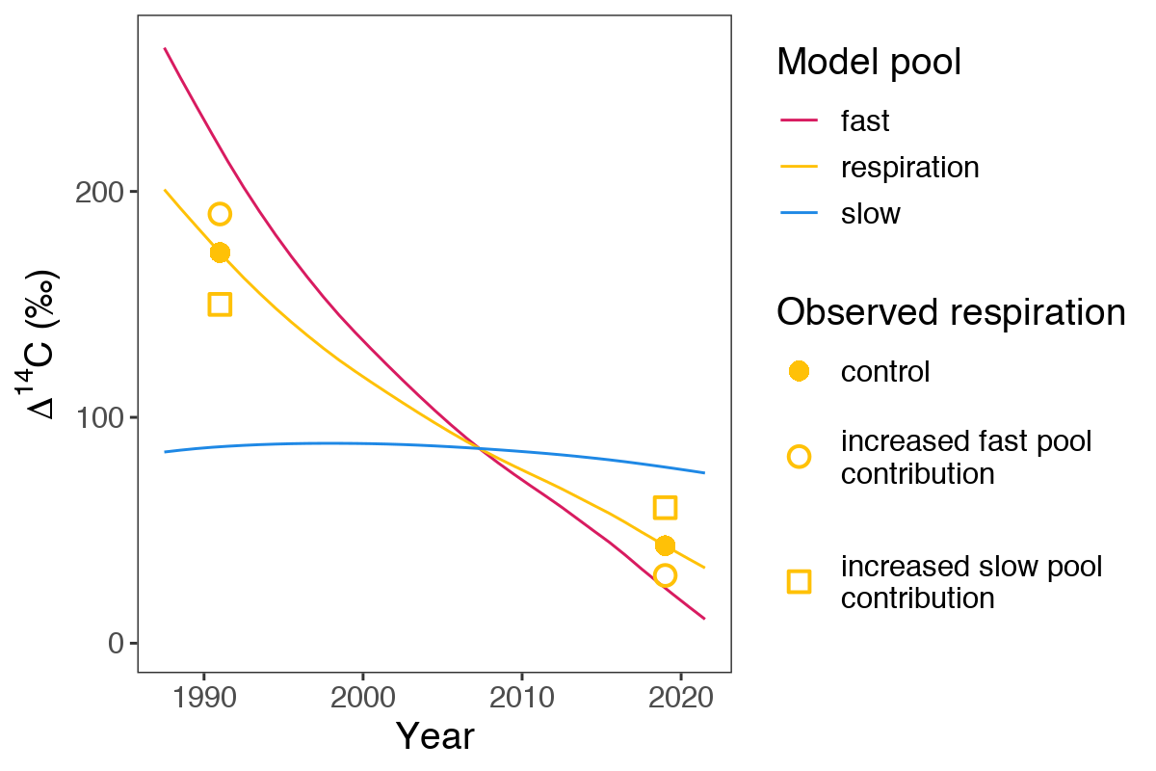
Treatment effects on ∆¹⁴C-CO₂
Potential shifts in the contribution of different soil C pools to respired CO₂ following disturbance can be visualized using the model from figures 1 and 2 (previous slides)
Direction and magnitude of the shift in ∆¹⁴C-CO₂ depends on:
Year when soil C pool ¹⁴C curves cross
Year of sample collection
Fig. 3 Potential treatment effects on ∆¹⁴C of respired CO₂
Notes:
Use model to visualize how treatment effects might lead to shifts in the contribution of different soil carbon pools to the respiration flux and effect on 14C
not simple to interpret because of “crossing” of curves

Slide 7
Treatment effects on ∆¹⁴C-CO₂
Potential shifts in the contribution of different soil C pools to respired CO₂ following disturbance can be visualized using the model from figures 1 and 2 (previous slides)
Direction and magnitude of the shift in ∆¹⁴C-CO₂ depends on:
Year when soil C pool ¹⁴C curves cross
Year of sample collection
Fig. 3 Potential treatment effects on ∆¹⁴C of respired CO₂ ➔Increased slow pool contribution (open squares) results in depletion relative to the controls (solid circles) in 1991
Notes:
increased slow pool contribution: depletion in 1991

Slide 8
Treatment effects on ∆¹⁴C-CO₂
Potential shifts in the contribution of different soil C pools to respired CO₂ following disturbance can be visualized using the model from figures 1 and 2 (previous slides)
Direction and magnitude of the shift in ∆¹⁴C-CO₂ depends on:
Year when soil C pool ¹⁴C curves cross
Year of sample collection
Fig. 3 Potential treatment effects on ∆¹⁴C of respired CO₂. ➔Increased slow pool contribution (open squares) results in depletion relative to the controls (solid circles) in 1991, but enrichment in 2019
Notes:
increased slow pool contribution: enrichment in 2019

Slide 9
Treatment effects on ∆¹⁴C-CO₂
Potential shifts in the contribution of different soil C pools to respired CO₂ following disturbance can be visualized using the model from figures 1 and 2 (previous slides)
Direction and magnitude of the shift in ∆¹⁴C-CO₂ depends on:
Year when soil C pool ¹⁴C curves cross
Year of sample collection
Fig. 3 Potential treatment effects on ∆¹⁴C of respired CO₂. ➔Increased fast pool contribution (open circles) results in enrichment relative to the controls (solid circles) in 1991, but depletion in 2019
Notes:
opposite effects for increased fast pool contribution

Slide 10
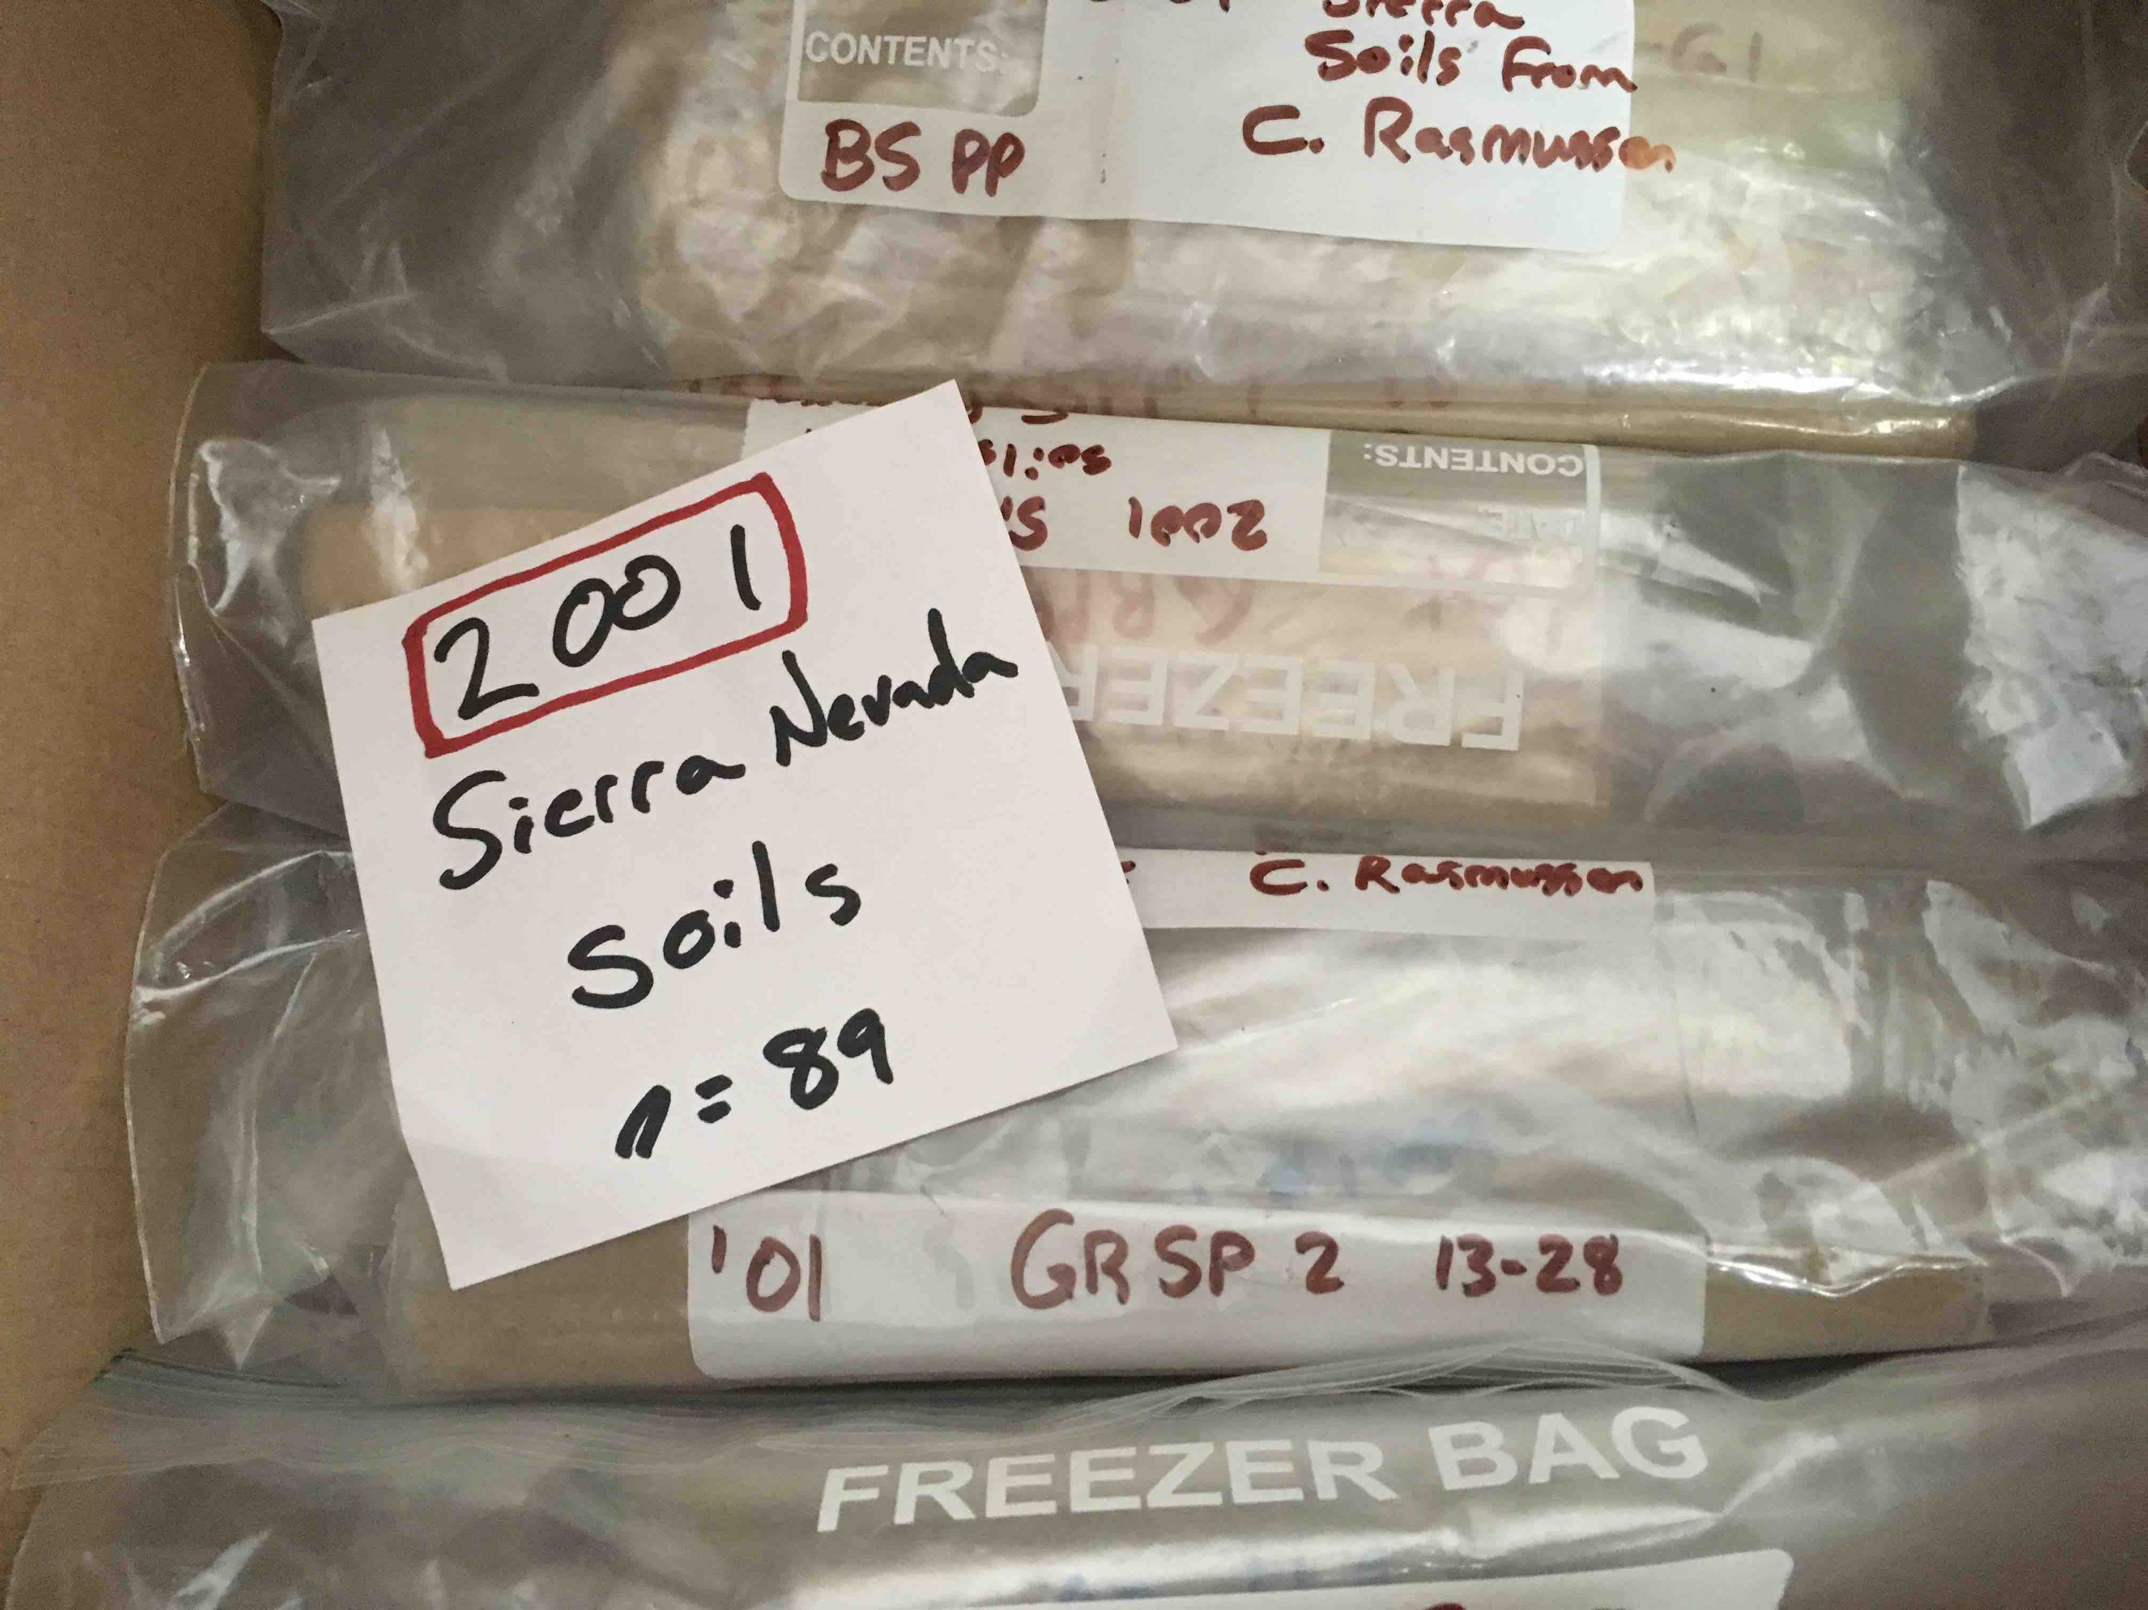
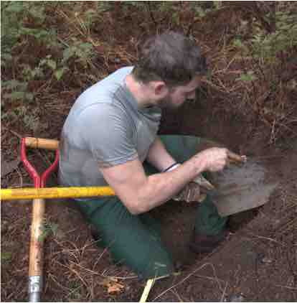
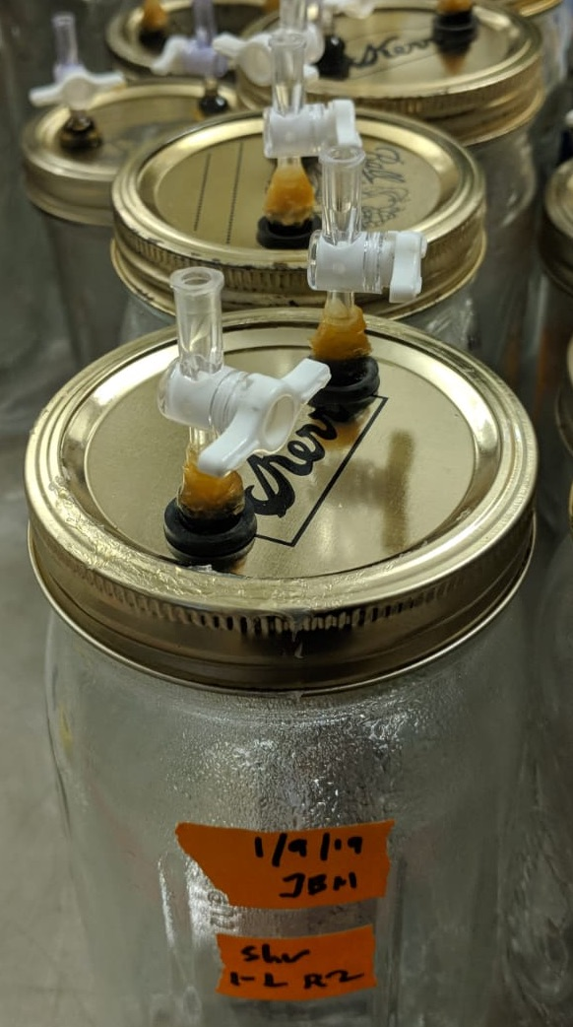
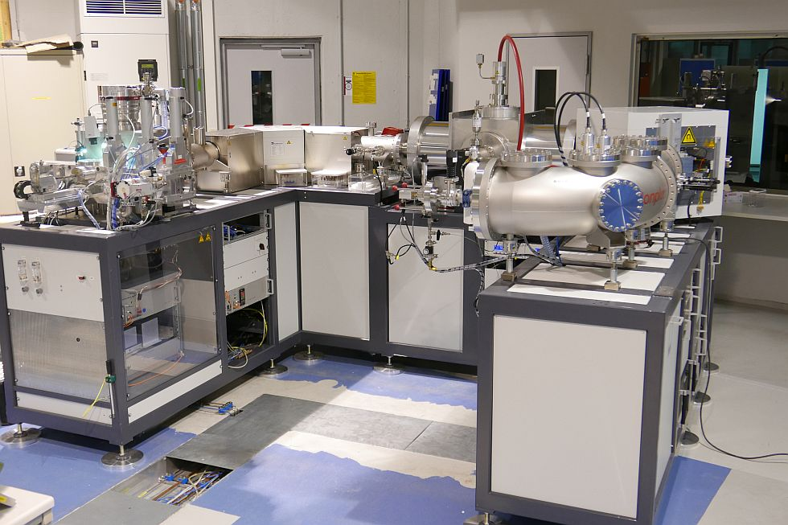
Research questions
Can we use ∆¹⁴C of respired CO₂ measured in incubations of archived soils to constrain soil C models?
Notes:
The central question of this study is this:
Can we successfully measure the radiocarbon signature of heterotrophic respiration in incubations of archived soils?
To answer this question, we identified two primary mechanisms that might affect the observed radiocarbon signature of heterotrophic respiration, air-drying and rewetting, and the duration of storage, and designed a series of experiments to test them.

Slide 11
Research questions
How does air-drying and subsequent rewetting affect ∆¹⁴C-CO₂?
Can we use ∆¹⁴C of respired CO₂ measured in incubations of archived soils to constrain soil C models?
Notes:
mechanism 1

Slide 12
Research questions
How does air-drying and subsequent rewetting affect ∆¹⁴C-CO₂?
Can we use ∆¹⁴C of respired CO₂ measured in incubations of archived soils to constrain soil C models?
What is the effect of storage duration on ∆¹⁴C-CO₂?
Notes:
mechanism 2

Slide 13
Experimental design
Pre-incubation ∆¹⁴C
Equilibrium respiration ∆¹⁴C
adjust moisture (60% WHC*)
Ctl
Experiment 1: air-dry + storage
Samples from Central Germany
Control incubation in 2011 prior to air-drying
Treatment incubation in 2019 after air-drying + storage
Trt
air-dry
storage
rewet (60% WHC)
* WHC = water holding capacity
Notes:
The first experiment looks at the effect of air-drying in combination with storage
The samples for this experiment were collected in 2011 from two sites in central Germany.

Slide 14
Experimental design
Experiment 1: air-dry + storage
Samples from Central Germany
Control incubation in 2011 prior to air-drying
Treatment incubation in 2019 after air-drying + storage
Pre-incubation ∆¹⁴C
Equilibrium respiration ∆¹⁴C
adjust moisture (60% WHC)
Ctl
Experiment 2: air-dry only
Samples from Central Germany
Control incubation in 2019 prior to air-drying
Treatment incubation in 2019 after air-drying
Trt
air-dry
rewet (60% WHC)
* WHC = water holding capacity
Notes:
The second experiment was conducted on samples collected from a subset of the same sites in 2019.
The same air-drying treatment was imposed, but treatment samples were rewetted immediately after air-drying
no storage effect.

Slide 15
Experimental design
Experiment 1: air-dry + storage
Samples from Central Germany
Control incubation in 2011 prior to air-drying
Treatment incubation in 2019 after air-drying + storage
Experiment 2: air-dry only
Samples from Central Germany
Control incubation in 2019 prior to air-drying
Treatment incubation in 2019 after air-drying
Equilibrium respiration ∆¹⁴C
adjust moisture (60% WHC)
Experiment 3: air-dry + storage (no pre-inc)
Samples from all over the world
Control incubations prior to air-drying
Treatment incubation in 2019 after air-drying + storage
Ctl
Trt
air-dry
storage
rewet (60% WHC)
* WHC = water holding capacity
Notes:
third experiment: storage duration
Samples were acquired from collaborators that had been initially incubated between 7 and 14 years earlier.
Treatment incubations were then conducted on remoistened samples hewing as closely as possible to the control incubation conditions.
For experiments 1 and 2 we incubated samples from an equal number of forest and grassland sites, as we hypothesized that the soil carbon stabilization mechanisms, and therefore the treatment response, may vary between these ecosystems. Unfortunately we could not find any previously incubated grassland samples for experiment 3.

Slide 16
Hypotheses
H1) Rewetting pulse: in air-dried soils the pulse of CO₂ released immediately following rewetting will be older than the CO₂ released during the equilibrium respiration period

Slide 17
Hypotheses
H1) Rewetting pulse: in air-dried soils the pulse of CO₂ released immediately following rewetting will be older than the CO₂ released during the equilibrium respiration period
H2) Equilibrium respiration: ∆¹⁴C-CO₂ released after the initial rewetting pulse will not differ between air-dried soils and non air-dried soils
Notes:
The central question of this study is this:
Can we successfully measure the radiocarbon signature of heterotrophic respiration in incubations of archived soils?
To answer this question, we identified two primary mechanisms that might affect the observed radiocarbon signature of heterotrophic respiration, air-drying and rewetting, and the duration of storage, and designed a series of experiments to test them.

Slide 18
Hypotheses
H1) Rewetting pulse: in air-dried soils the pulse of CO₂ released immediately following rewetting will be older than the CO₂ released during the equilibrium respiration period
H2) Equilibrium respiration: CO₂ released after the initial rewetting pulse will not differ between air-dried soils and non air-dried soils
H3) Storage duration: duration of storage will not affect ∆¹⁴C-CO₂ observed in incubations of archived soils.
Notes:
The central question of this study is this:
Can we successfully measure the radiocarbon signature of heterotrophic respiration in incubations of archived soils?
To answer this question, we identified two primary mechanisms that might affect the observed radiocarbon signature of heterotrophic respiration, air-drying and rewetting, and the duration of storage, and designed a series of experiments to test them.

Slide 19
Results

Slide 20
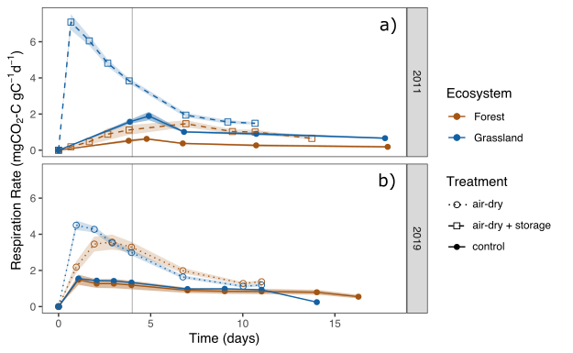
Respiration rates
Pre-incubation
Equilibrium respiration
Both treatments (dashed/dotted lines, Fig. 4) increased respiration rates compared to control samples (solid lines)
The air-dry + storage effect (2011 samples, top panel) was stronger in grasslands than in forests
Note: the duration of the treatment sample equilibrium period was determined by the amount of C released over the same period by the paired control sample
Fig. 6 Respiration rates for experiments 1 and 2.
Vertical gray bar separates pre-incubation period (immediately following rewetting) and equilibrium respiration period (duration varied).
Notes:
Now for some results. In figure 4 we can see that respiration rates in experiments 1 and 2 responded strongly to both air-drying and air-drying + storage.
In the top panel we can see that the air-drying and rewetting plus storage treatment was stronger in grassland samples than in forests, but this was not the case in 2019 for the air-drying and rewetting alone.
These results match what has been observed in many other incubation studies: a large burst in respiration for air-dried soils immediately following rewetting, before a return to similar basal respiration rates as in control samples that did not undergo air-drying.

Slide 21
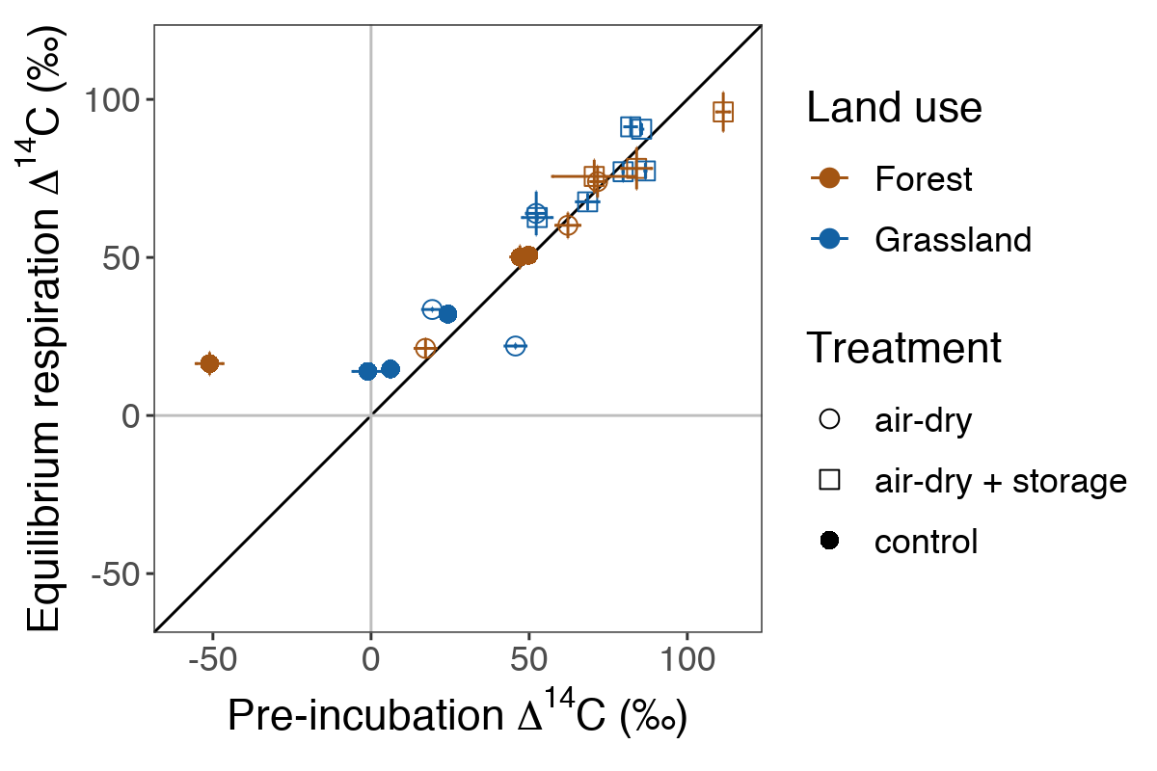
∆¹⁴C of pre-incubation vs. equilibrium respiration
No significant difference (p > 0.05) was found between pre-incubation and equilibrium respiration period ∆¹⁴C-CO₂
Pre-incubation ∆¹⁴C-CO₂ was more variable across samples than equilibrium respiration ∆¹⁴C-CO₂
No effect of ecosystem
Ecosystem
Fig. 7 Pre vs. equilibrium period ∆¹⁴C-CO₂.
Error bars are 2x standard error.
Notes:
Despite the strong effect of treatment on respiration rates in the pre-incubation period, the radiocarbon signature of the pre-incubation period was not significantly different from that of the equilibrium respiration period. Neither treatment nor land use affected this relationship.
As you can see by the greater spread of data along the x-axis, pre-incubation 14C was more variable across samples than was equilibrium respiration 14C.

Slide 22
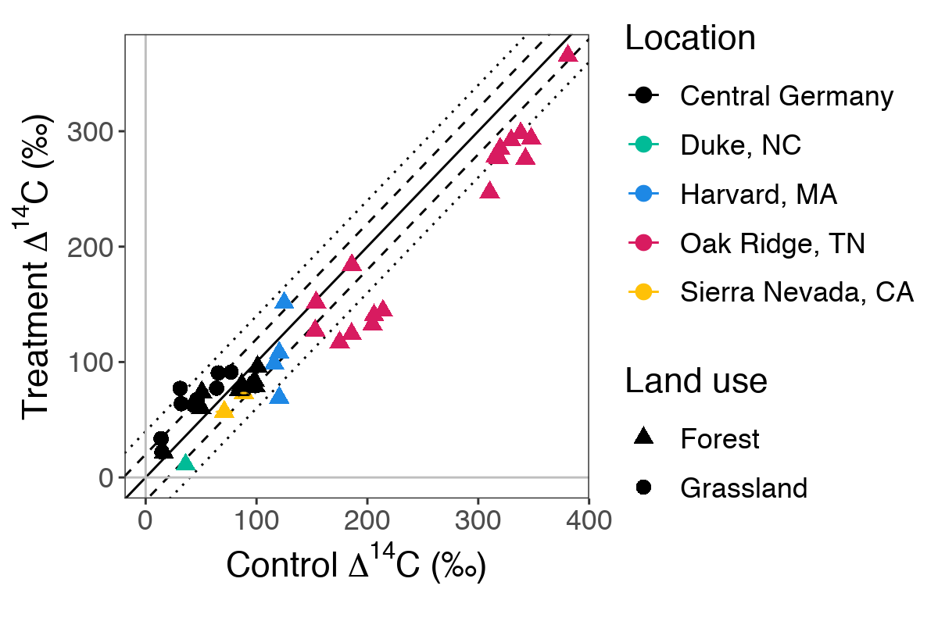
Treatment effects: all samples
Data from all three experiments show that the difference between control and treatment sample ∆¹⁴C-CO₂ is within 20‰ (dashed lines) for the majority of samples
The samples from Oak Ridge (magenta triangles) are an exception to the ±20‰ trend—but they came from a labeling experiment
Mean differences for grassland samples were greater than for forests
Ecosystem
Fig. 4 Control vs. treatment ∆¹⁴C-CO₂ for all samples.
Solid line shows 1:1, dashed and dotted lines show10‰ and 20‰ offsets respectively (equivalent to ±5 and ±10 years).
Notes:
Here we see the results from experiement 3. Note that the black points in this plot are data from experiments 1 and 2.
∆14C of equilibrium respiration from treatment samples is on the y-axis, while that of control samples is on the x-axis.
The solid line shows a 1:1 relationship, while the dashed and dotted lines represent differences of 20 and 40 per mille, respectively. For the period 2000 to the present, atmospheric ∆14C has decreased at a nearly linear rate of 4 per mille per year, meaning that 20 and 40 per mille represent a difference of approximately 5 and 10 years, respectively.
Treatment differences for forest samples are within 20 per mille for the majority of samples, while differences are within 40 per mille for grassland samples.
The Oak Ridge samples—magenta triangles—are an exception. These samples were part of a labeling experiment, and thus represent an extreme case where almost all of the label is stored entirely in the fastest cycling soil C pool. In line with our interpretation of the natural abundance samples, an increase in the contribution of the slow pool to respiration following air-drying and rewetting would lead to a correspondingly greater drop in the radiocarbon signature of respired CO2 for these samples, which is what we observe.

Slide 23
Duration of storage
Duration of storage does not appear to have a strong effect for samples with the bomb-C label
Oak Ridge samples (magenta triangles) do seem to show a trend
However, owing to a limited range of storage duration and experimental constraints the significance of the duration of storage effect cannot be tested conclusively here
Ecosystem
Fig. 5 Duration of storage effect on treatment differences.
Solid line shows unity, dashed and dotted lines show 10‰ and 20‰ differences respectively (equivalent to ±5 and ±10 years). Error bars are 2x standard error
Notes:
Here we see the duration of storage plotted on the x-axis, and the difference in delta 14C between control and treatment samples on the y-axis.
The labeled Oak Ridge samples in magenta do appear to show a slight increasing trend, suggesting losses of highly enriched recently fixed carbon over the duration of storage.
However, the remaining natural abundance do not appear to show a trend in with increasing storage duration, but this relatively sparse dataset does not really allow for conclusive testing of the storage duration effect.

Slide 24
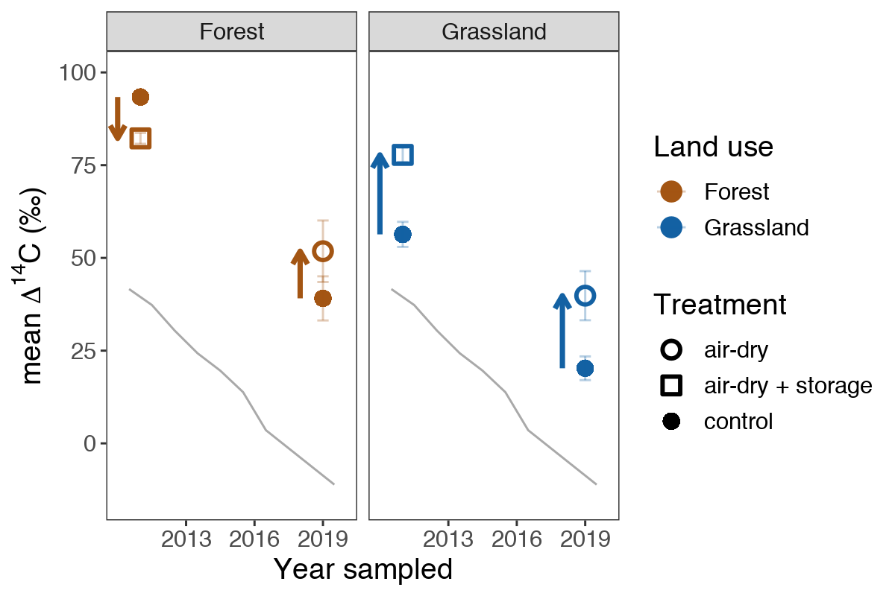
Treatment effects over time: ∆¹⁴C-CO₂
In 2011, the air-dry + storage treatment led to depletion in forest samples, but enrichment in grassland samples
In 2019, the air-dry only treatment led to enrichment in both forest and grassland samples
atmosphere
Ecosystem
Fig. 8 Treatment effect on ∆¹⁴C-CO₂ over time.
Error bars are 2x standard error.
Notes:
Now let’s look at the treatment effect on equilibrium respiration 14C over time. As you can see, the respiration signature is 14C enriched in both control and treatment samples relative to the atmosphere, reflecting the contribution of older, bomb-C-enriched carbon to the respiration flux.
For samples collected in 2011, the air-dry + storage treatment led to depletion in 14C relative to the controls for forest samples, but had the opposite effect in grassland samples.
In contrast, the air-dry treatment alone led to enrichment in both forest and grassland soils for the samples collected in 2019.
We hypothesize that the switch in the direction of trend for the forest samples between 2011 and 2019 is due to a crossing of the slow and fast soil carbon pool curves (as we saw earlier in figure 2). In contrast, the slow and fast curves had likely already crossed by 2011 for the grassland samples. This makes sense, since respired C in grassland control samples is closer to the atmosphere, suggesting a faster transit time in this system. If this interpretation is correct, both the air-drying and air-drying + storage treatments lead to slight increases in the contribution of the more slowly cycling soil carbon pool to respiration, as compared to control samples.

Slide 25
Treatment effects on ∆¹⁴C-CO₂
Potential shifts in the contribution of different soil C pools to respired CO₂ following disturbance can be visualized using the model from figures 1 and 2 (previous slides)
Direction and magnitude of the shift in ∆¹⁴C-CO₂ depends on:
Year when soil C pool ¹⁴C curves cross
Year of sample collection
Fig. 3 Potential treatment effects on ∆¹⁴C of respired CO₂. ➔Increased slow pool contribution (open squares) results in depletion relative to the controls (solid circles) in 1991, but enrichment in 2019
Notes:
Using the model from Figure 2 on the previous slide, we can visualize how treatment effects might lead to shifts in the contribution of different soil carbon pools to the respiration flux and how these shifts could potentially alter the observed radiocarbon signature.
Figure 3 shows the same 2-pool model curves shown in full on Figure 1. Delta 14C is on the y-axis, and time is on the x-axis. The filled yellow circles are observations of the radiocarbon signature of respiration, while the open symbols represent two possible responses to the air-drying and rewetting treatment: increased contribution from either the “fast” or “slow” carbon pools. Interestingly, for this scenario, we can see from the open square symbols that increased contribution from the slow pool leads to apparent depletion in the radiocarbon signature of respiration for samples collected in 1991, but apparent enrichment in 2019, while the opposite is observed for increased fast pool contribution.

Slide 26
Treatment effects over time: δ¹³C-CO₂
Both forest and grassland soils in both 2011 and in 2019 exhibited enrichment in δ¹³C-CO₂ following treatment
Enrichment was stronger in forest soils, possibly due to a greater role of microbial recycling
(‰)
Fig. 9 Treatment effect on δ¹³C-CO₂ over time.
Error bars are 2x standard error.
Notes:
Now let’s look at the treatment effect on equilibrium respiration 14C over time. As you can see, the respiration signature is 14C enriched in both control and treatment samples relative to the atmosphere, reflecting the contribution of older, bomb-C-enriched carbon to the respiration flux.
For samples collected in 2011, the air-dry + storage treatment led to depletion in 14C relative to the controls for forest samples, but had the opposite effect in grassland samples.
In contrast, the air-dry treatment alone led to enrichment in both forest and grassland soils for the samples collected in 2019.
We hypothesize that the switch in the direction of trend for the forest samples between 2011 and 2019 is due to a crossing of the slow and fast soil carbon pool curves (as we saw earlier in figure 2). In contrast, the slow and fast curves had likely already crossed by 2011 for the grassland samples. This makes sense, since respired C in grassland control samples is closer to the atmosphere, suggesting a faster transit time in this system. If this interpretation is correct, both the air-drying and air-drying + storage treatments lead to slight increases in the contribution of the more slowly cycling soil carbon pool to respiration, as compared to control samples.

Slide 27
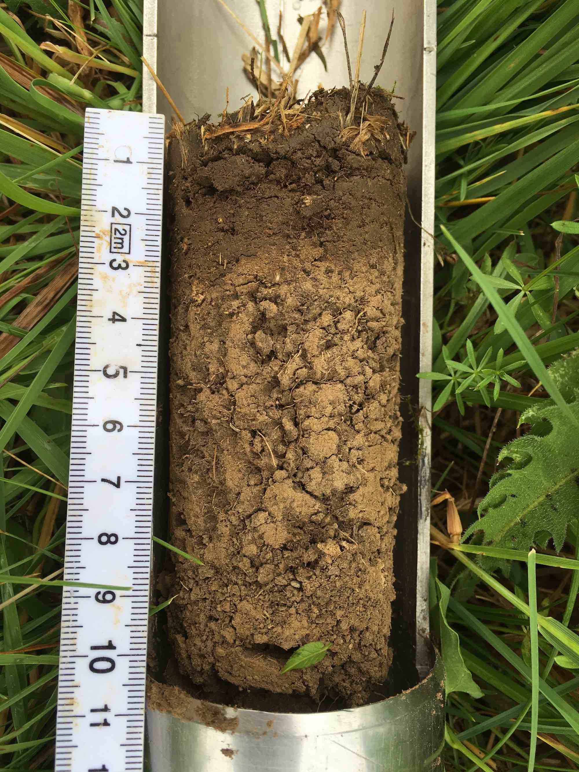
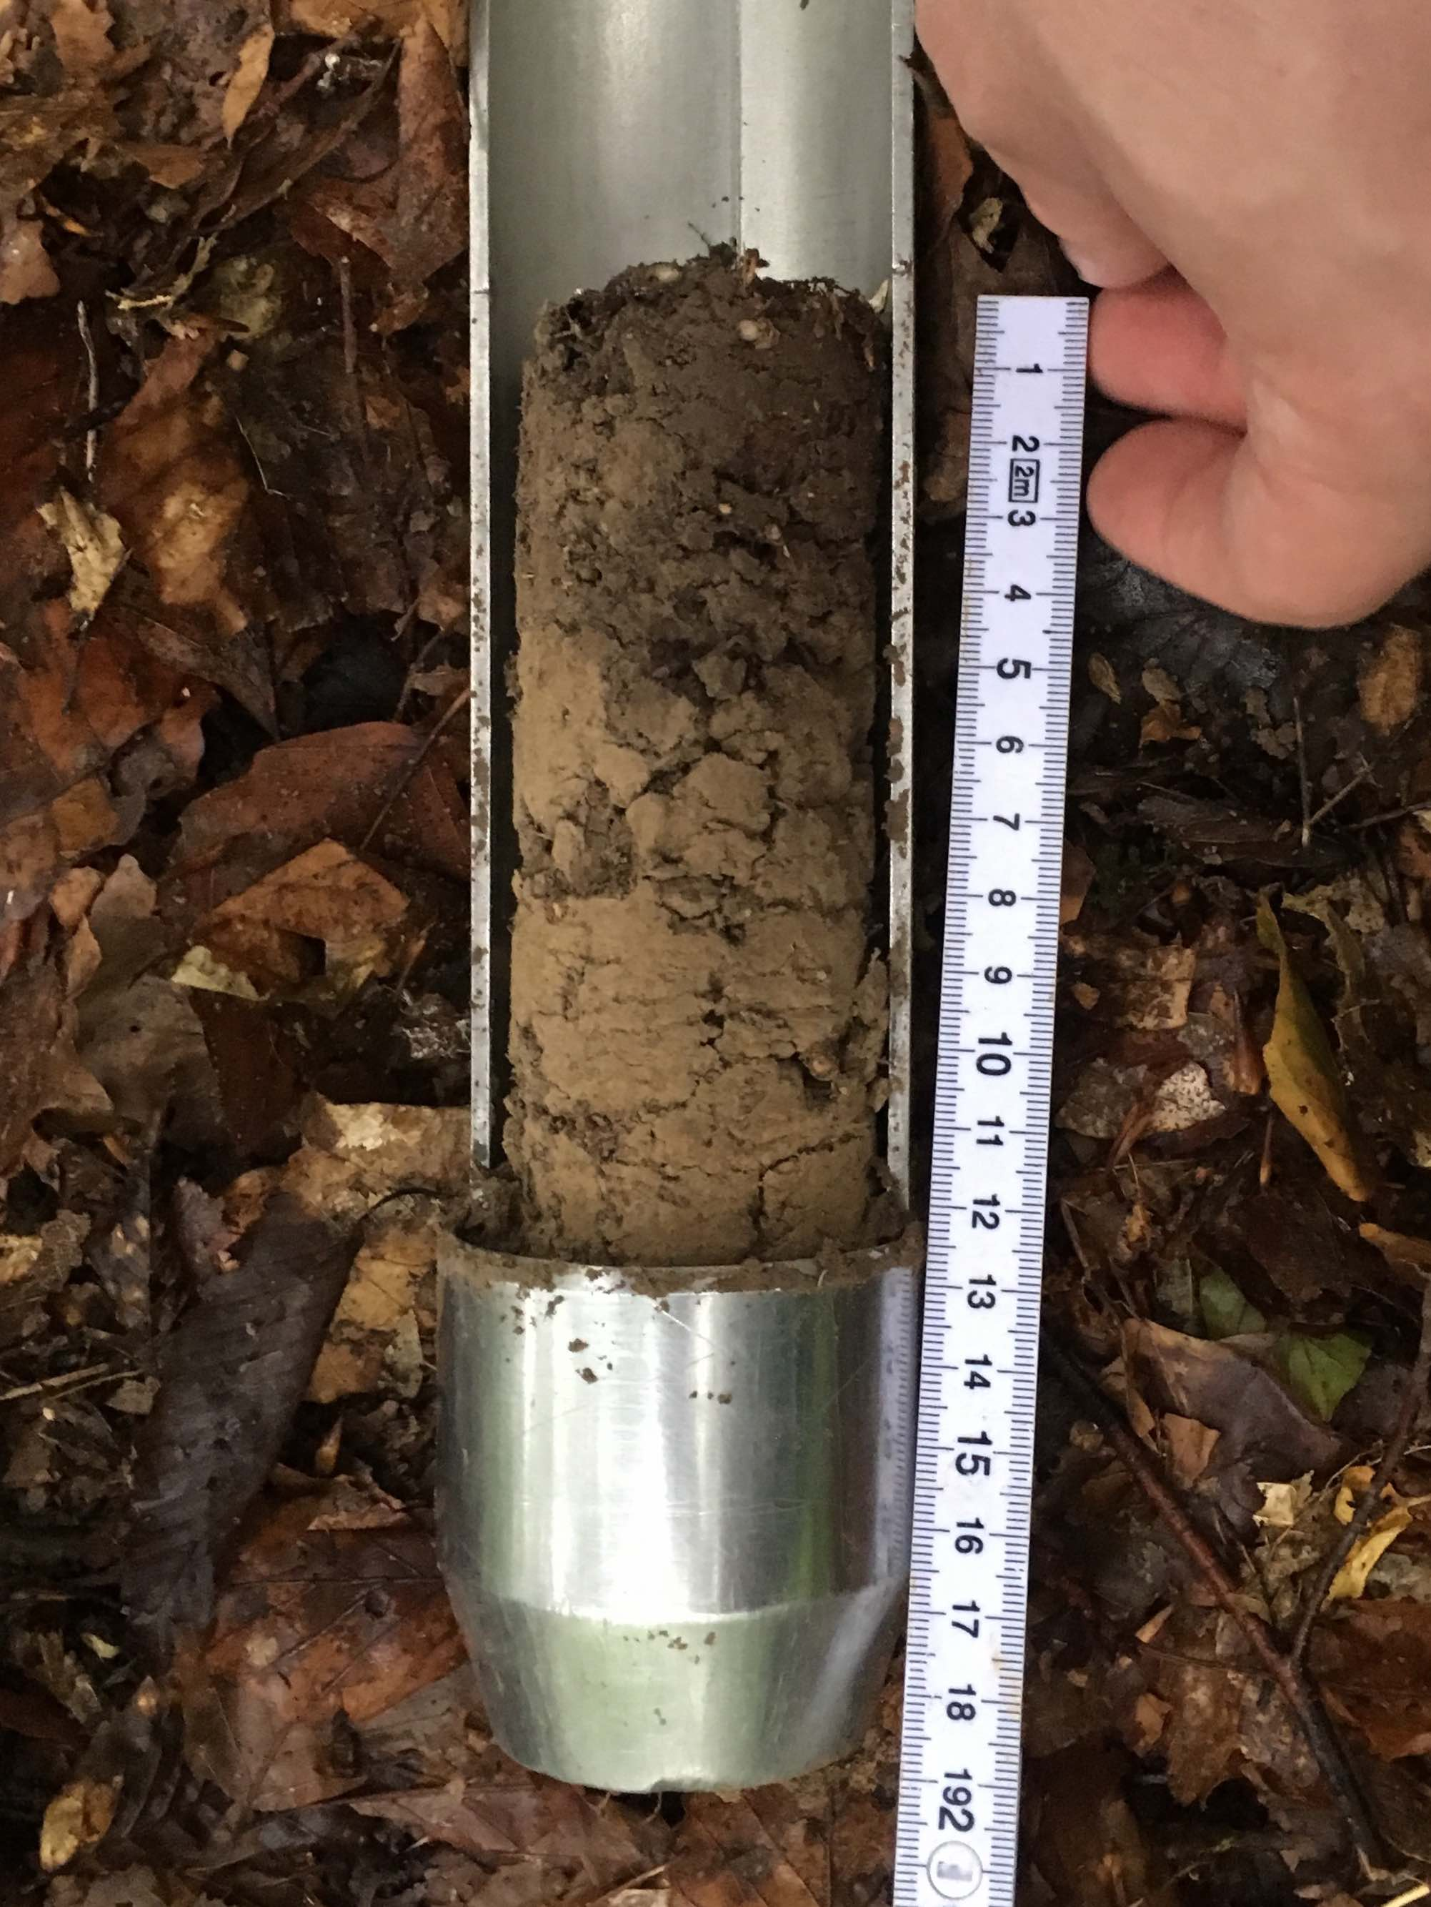
Summary
Air-drying and rewetting significantly affects ∆¹⁴C-CO₂ of laboratory incubations, and the effect is stronger in grasslands than in forests
Although we observed the characteristic pulse of CO₂ following rewetting, the ∆¹⁴C-CO₂ of pre-incubation was not significantly different than ∆¹⁴C-CO₂ of equilibrium respiration
In line with point 2, the amount of C respired was not significantly related to the difference in ∆¹⁴C-CO₂ between control and treatment samples
Duration of storage does not seem to have a substantial effect on ∆¹⁴C-CO₂
Notes:
Air-drying and rewetting significantly affects 14C of respired CO2 in laboratory incubations, and the effect is stronger in grasslands than in forests
Although we observed the characteristic pulse of CO₂ following rewetting, the 14C of respired CO2 in the pre-incubation period was not significantly different than the 14C of respired CO2 in the equilibrium respiration period.
In line with point 2, the amount of C respired was not significantly related to the difference in 14C of respired CO2 between control and treatment samples
Duration of storage does not seem to have a substantial effect on the 14C of respired CO2, but more data are needed to prove this conclusively.

Slide 28
Conclusions
Incubation of soils following air-drying and rewetting mobilizes a different fraction of soil C than would otherwise be accessible to the microbial community, affecting the relative contribution of older versus younger carbon pools to observed heterotrophic respiration
Differences in ∆¹⁴C-CO₂ observed in this study suggest that incubations of air-dried and rewet soils shift the apparent transit time of soil C by 3 to 5 years relative to estimates from incubations of soils that have not undergone air-drying
Overall, we believe the radiocarbon incubation technique for archived soils is promising approach for improving soil C models
Notes:
Incubation of soils following air-drying and rewetting mobilizes a different fraction of soil carbon than would otherwise be accessible to the microbial community, affecting the relative contribution of older versus younger carbon pools to observed heterotrophic respiration
Differences in 14C of respired CO2 observed in this study suggest that incubations of air-dried and rewet soils can shift the apparent transit time of soil carbon by 5 to 10 years relative to estimates from incubations of soils that have not undergone air-drying
Overall, we believe the radiocarbon incubation technique for archived soils is promising approach for improving soil carbon models

Slide 29
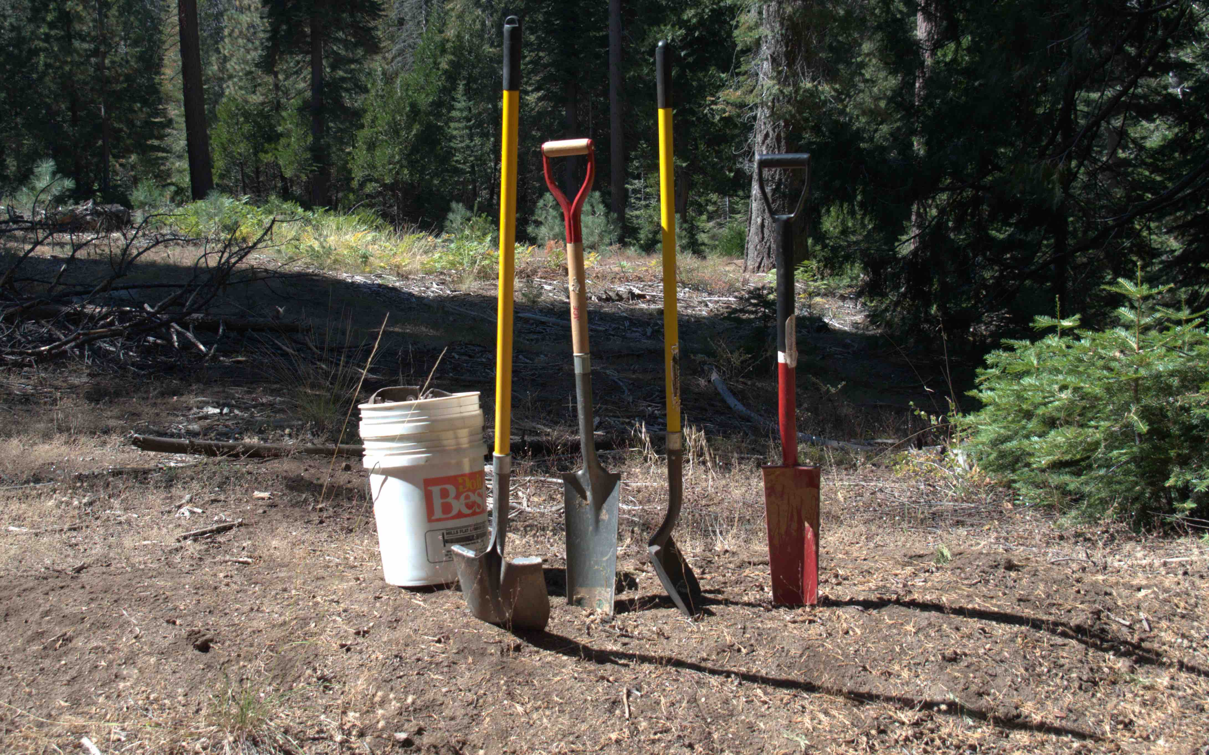
Thanks!
Acknowledgements and thanks to:
Manuel Rost for laboratory and field assistance
M. Cisneros, J. Koarashi, F. Hopkins, I. Schoening, C. Lawrence, and S. Trumbore for archived soil/data
ERC Horizon 2020 Research and Innovation Programme for funding
Axel Steinhof and the Jena AMS team
Co-authors and colleagues for valuable input
photo by S. von Fromm

Slide 30
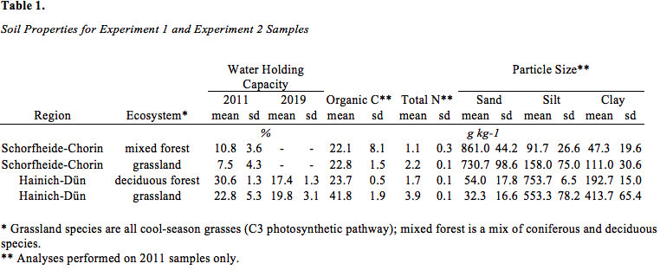
Soil properties for Exploratories samples

Slide 31
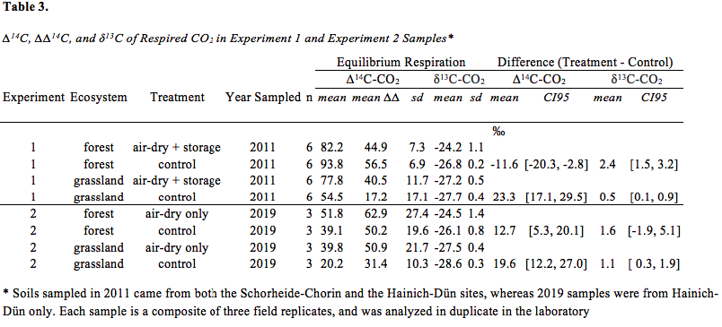
Summary of respiration isotope data

