Slide 1

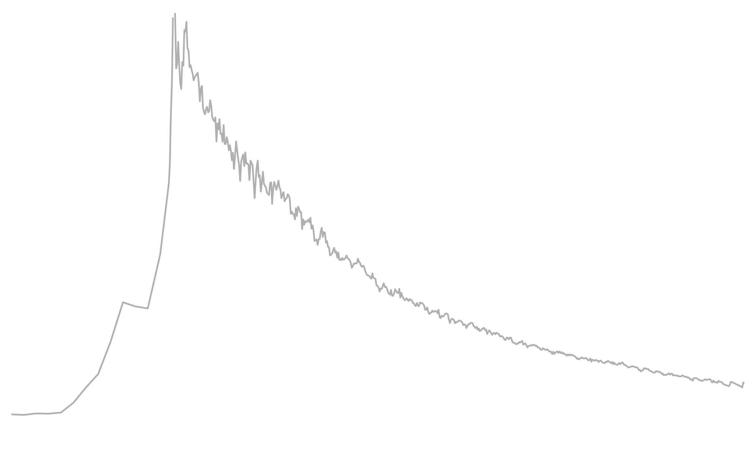
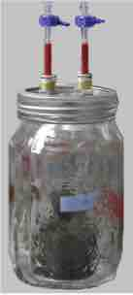



Radiocarbon incubations of archived soils
Jeffrey Beem-Miller¹
Marion Schrumpf¹
Georg Guggenberger²
Alison Hoyt^{1,3}
Susan Trumbore^{1,4}
Max Planck Institute for Biogeochemistry
Leibniz Universität Hannover
Berkeley National Lab
University of California, Irvine
Insights into drying/rewetting effects and constraining soil C models
Notes:
How does archiving affect the radiocarbon signature of respired CO2?
archiving = air-drying and rewetting as well as storage
The radiocarbon carbon of respired CO2 tells us how long the carbon that microbes are eating has been in the soil

Slide 2
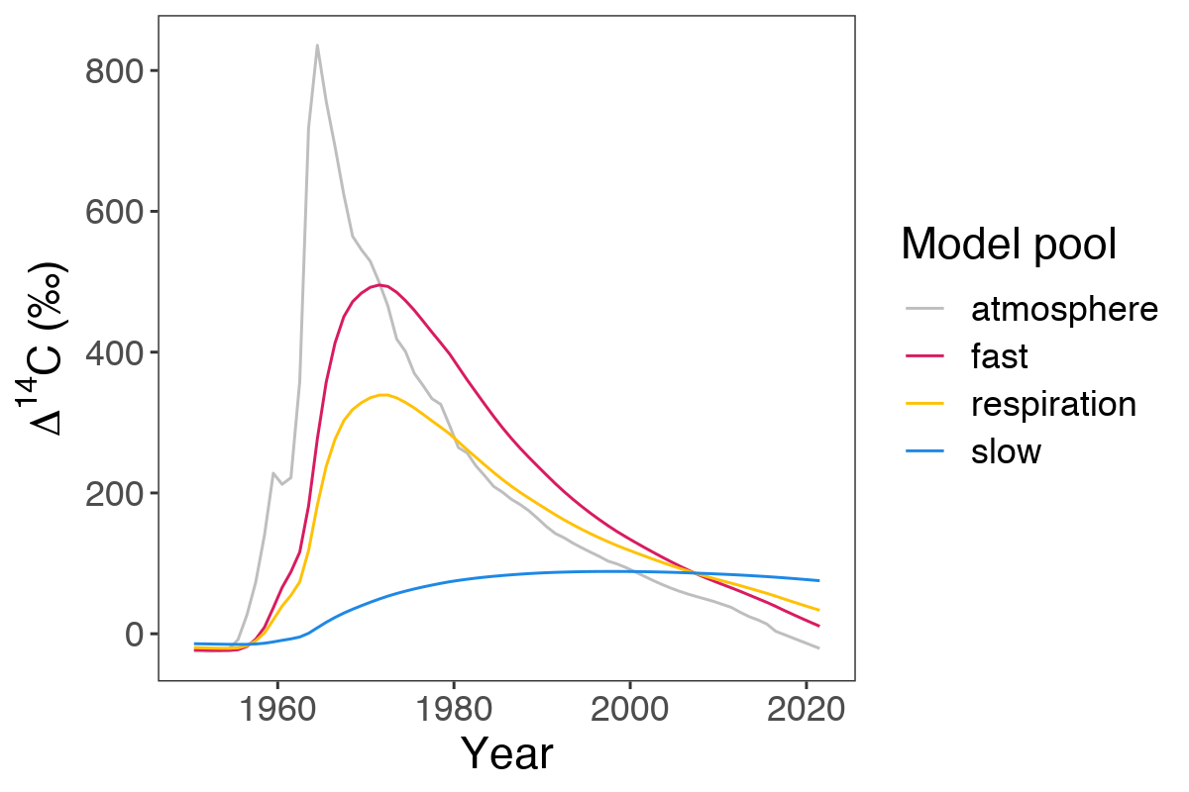
Incubating archived soils: a decadal tracer?
“Bomb-C” incorporation in different pools of soil C (blue and magenta lines, Fig. 1) depends on intrinsic decomposition rates and transfers between pools
∆¹⁴C of respired CO₂ (gold line, Fig. 1) is a powerful system constraint, integrating fluxes from soil C pools with different intrinsic decomposition rates
Observations at multiple time points key for constraining models
Can we measure ¹⁴C-CO₂ in incubations of archived soils?
Fig. 1 Incorporation of bomb-C in soil over time in a theoretical 2-pool system.
Notes:
Observations at a single point in time lead to multiple model solutions (symmetry of the bomb-C curve)
Past radiocarbon signature higher and therefore more informative
Technical advances in 14C analysis
taus = 6, 100

Slide 3
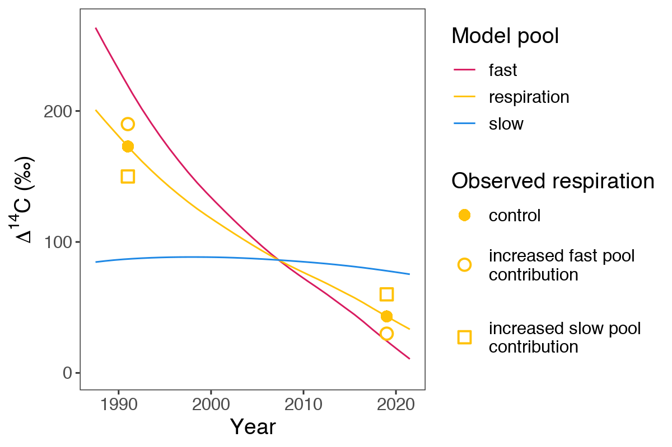
Archiving effects on ∆¹⁴C-CO₂
Perturbation of the soil system in laboratory soil incubations (e.g. air-drying and rewetting, long-term storage) may alter the relative contribution of different soil C pools to respiration
Direction and magnitude of the shift in ∆¹⁴C-CO₂ depends on:
Year when soil C pool ¹⁴C curves cross
Year of sample collection
Fig. 2 Potential treatment effects on ∆¹⁴C of respired CO₂
Notes:
Use model to visualize how treatment effects might lead to shifts in the contribution of different soil carbon pools to the respiration flux and effect on 14C
not simple to interpret because of “crossing” of curves

Slide 4
Archiving effects on ∆¹⁴C-CO₂
Perturbation of the soil system in laboratory soil incubations (e.g. air-drying and rewetting, long-term storage) may alter the relative contribution of different soil C pools to respiration
Direction and magnitude of the shift in ∆¹⁴C-CO₂ depends on:
Year when soil C pool ¹⁴C curves cross
Year of sample collection
Fig. 2 Potential treatment effects on ∆¹⁴C of respired CO₂ ➔Increased slow pool contribution (open squares) results in depletion relative to the controls (solid circles) in 1991
Notes:
increased slow pool contribution: depletion in 1991

Slide 5
Archiving effects on ∆¹⁴C-CO₂
Perturbation of the soil system in laboratory soil incubations (e.g. air-drying and rewetting, long-term storage) may alter the relative contribution of different soil C pools to respiration
Direction and magnitude of the shift in ∆¹⁴C-CO₂ depends on:
Year when soil C pool ¹⁴C curves cross
Year of sample collection
Fig. 2 Potential treatment effects on ∆¹⁴C of respired CO₂. ➔Increased slow pool contribution (open squares) results in depletion relative to the controls (solid circles) in 1991, but enrichment in 2019
Notes:
increased slow pool contribution: enrichment in 2019

Slide 6
Archiving effects on ∆¹⁴C-CO₂
Perturbation of the soil system in laboratory soil incubations (e.g. air-drying and rewetting, long-term storage) may alter the relative contribution of different soil C pools to respiration
Direction and magnitude of the shift in ∆¹⁴C-CO₂ depends on:
Year when soil C pool ¹⁴C curves cross
Year of sample collection
Fig. 2 Potential treatment effects on ∆¹⁴C of respired CO₂. ➔Increased fast pool contribution (open circles) results in enrichment relative to the controls (solid circles) in 1991, but depletion in 2019
Notes:
opposite effects for increased fast pool contribution

Slide 7
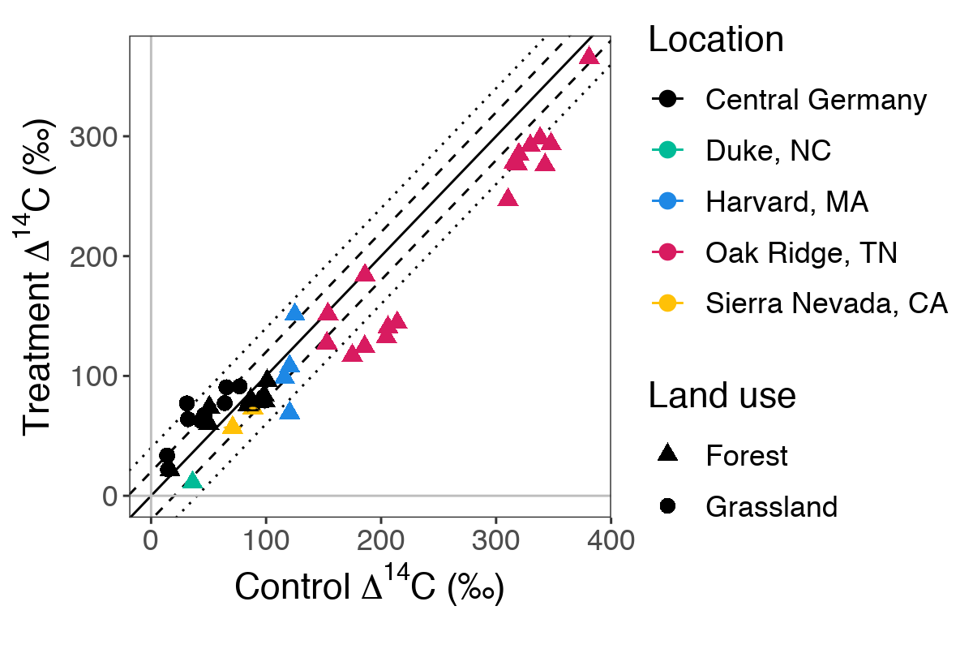
Drying/rewetting significant, not storage
The difference between initial and post-archiving ∆¹⁴C-CO₂ is within 20‰ (dashed lines) for the majority of samples
Mean differences for grassland samples were greater than for forests (natural abundance)
The samples from Oak Ridge (magenta triangles) are an informative exception as they came from a labeling experiment
Ecosystem
Fig. 3 Control vs. treatment ∆¹⁴C-CO₂ for all samples.
Solid line shows 1:1, dashed and dotted lines show10‰ and 20‰ offsets respectively (equivalent to ±5 and ±10 years).
Notes:
∆14C of equilibrium respiration from treatment samples is on the y-axis, while that of control samples is on the x-axis.
The solid line shows a 1:1 relationship, while the dashed and dotted lines represent differences of 20 and 40 per mille, respectively. For the period 2000 to the present, atmospheric ∆14C has decreased at a nearly linear rate of 4 per mille per year, meaning that 20 and 40 per mille represent a difference of approximately 5 and 10 years, respectively.
Treatment differences for forest samples are within 20 per mille for the majority of samples, while differences are within 40 per mille for grassland samples.
The Oak Ridge samples—magenta triangles—are an exception. These samples were part of a labeling experiment, and thus represent an extreme case where almost all of the label is stored entirely in the fastest cycling soil C pool. In line with our interpretation of the natural abundance samples, an increase in the contribution of the slow pool to respiration following air-drying and rewetting would lead to a correspondingly greater drop in the radiocarbon signature of respired CO2 for these samples, which is what we observe.

Slide 8
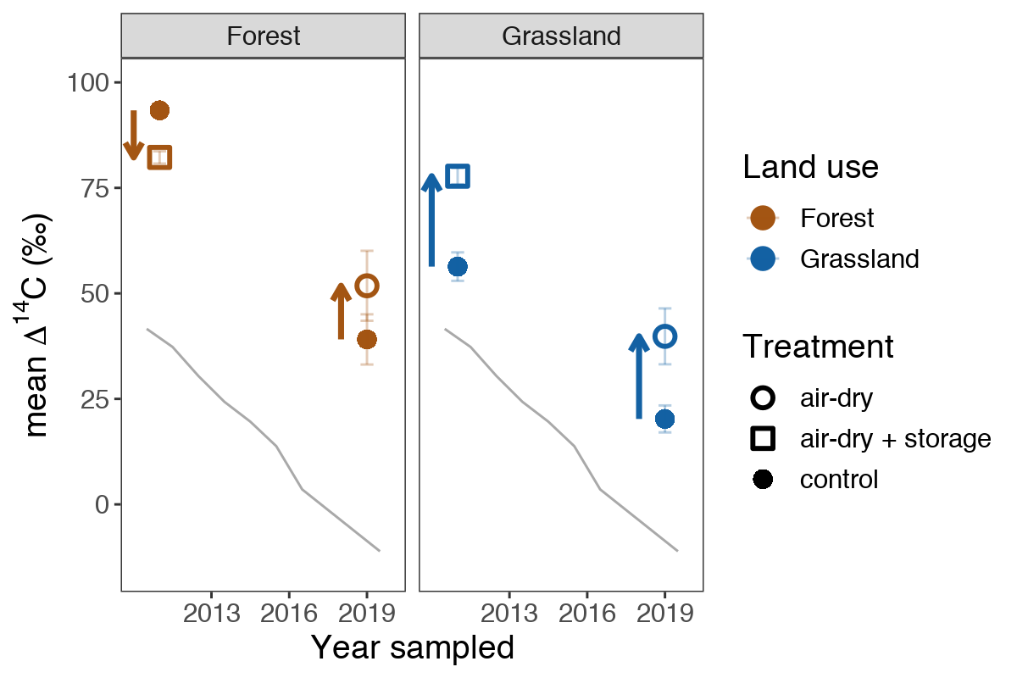
Distinct forest and grassland C dynamics
Grassland ∆¹⁴C-CO₂ tracks bomb curve in both 2011 and 2019, for both control and archived samples
Relative to the control, we see depletion in forest archived samples in 2011, but enrichment in 2019 (vis. Fig. 2)
Time series reveals key trends in system dynamics
atmosphere
Ecosystem
Fig. 4 Treatment effect on ∆¹⁴C-CO₂ over time.
Error bars are 2x standard error.
Notes:
Now let’s look at the treatment effect on equilibrium respiration 14C over time. As you can see, the respiration signature is 14C enriched in both control and treatment samples relative to the atmosphere, reflecting the contribution of older, bomb-C-enriched carbon to the respiration flux.
For samples collected in 2011, the air-dry + storage treatment led to depletion in 14C relative to the controls for forest samples, but had the opposite effect in grassland samples.
In contrast, the air-dry treatment alone led to enrichment in both forest and grassland soils for the samples collected in 2019.
We hypothesize that the switch in the direction of trend for the forest samples between 2011 and 2019 is due to a crossing of the slow and fast soil carbon pool curves (as we saw earlier in figure 2). In contrast, the slow and fast curves had likely already crossed by 2011 for the grassland samples. This makes sense, since respired C in grassland control samples is closer to the atmosphere, suggesting a faster transit time in this system. If this interpretation is correct, both the air-drying and air-drying + storage treatments lead to slight increases in the contribution of the more slowly cycling soil carbon pool to respiration, as compared to control samples.

Slide 9
Archiving effects on ∆¹⁴C-CO₂
Perturbation of the soil system in laboratory soil incubations (e.g. air-drying and rewetting, long-term storage) may alter the relative contribution of different soil C pools to respiration
Direction and magnitude of the shift in ∆¹⁴C-CO₂ depends on:
Year when soil C pool ¹⁴C curves cross
Year of sample collection
Fig. 2 Potential treatment effects on ∆¹⁴C of respired CO₂. ➔Increased slow pool contribution (open squares) results in depletion relative to the controls (solid circles) in 1991, but enrichment in 2019
Notes:
increased slow pool contribution: enrichment in 2019

