Slide 1
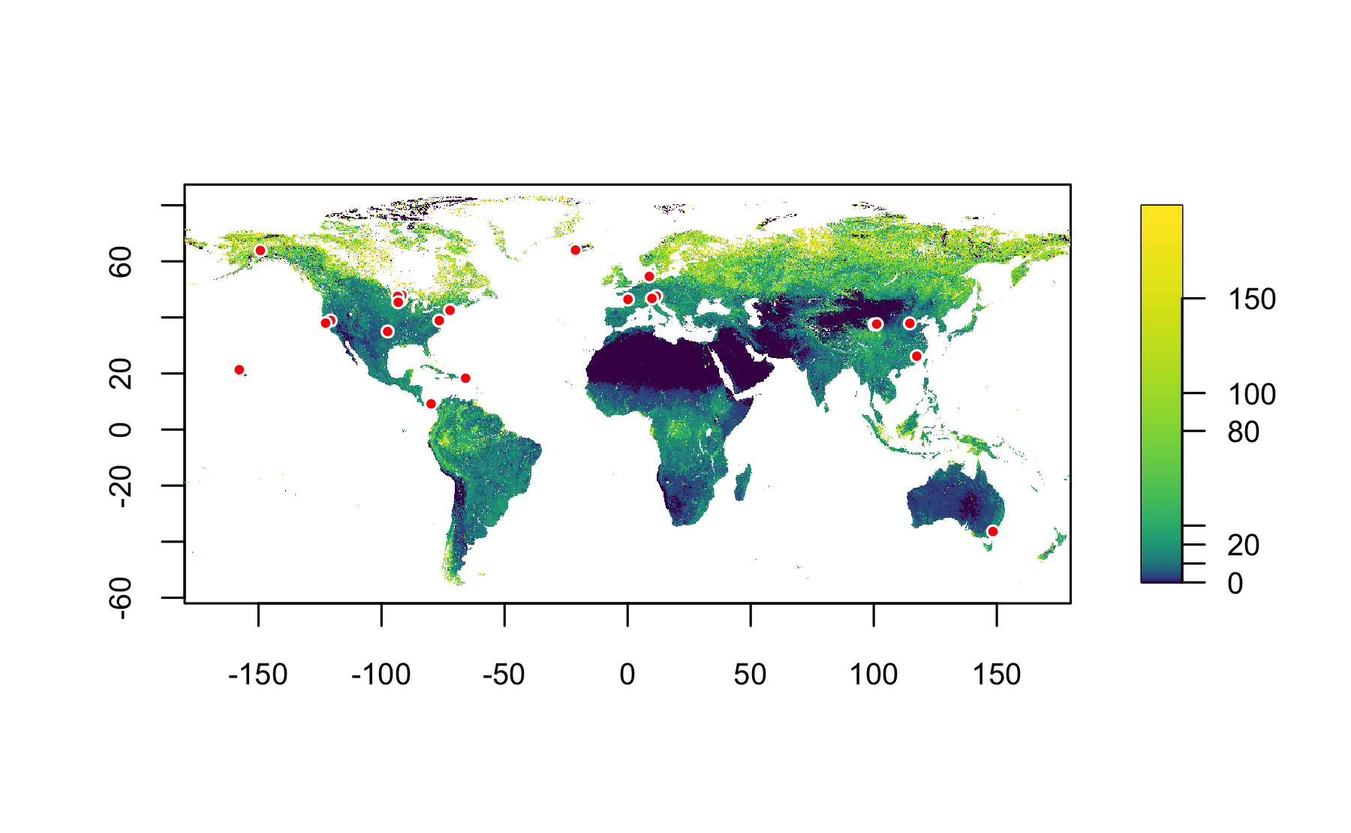
16
6
12
5
4
3
9
1
2
23
21
18
13
8
17
11
15
20
14
10
22
19
SOC, 0–0.2 m
[kg m⁻²]
80
150
7
30
0
^{Deep Soil Warming Experiments}
1
One85 Experiment Station, arable
^{ACBB, grassland & arable}
Achenkirch, temperate montane forest
B4WarmED, temperate & boreal forest
^{Blodgett, temperate forest}
^{CiPEHR, permafrost}
^{ForHot, subarctic grassland}
FutureClim, temperate montane grassland
^{GENX, temperate salt marsh}
Harvard Forest, temperate forest
^{Hawaii, tropical forest}
^{KAEFS, temperate grassland}
13
^{MERIT, temperate salt marsh}
Point Reyes, temperate grassland
^{Sanming, subtropical forest}
^{SMARTX, temperate saltmarsh}
^{SPRUCE, boreal peat bog}
^{Stillberg, subalpine forest}
^{SWAMP, permafrost}
^{SWELTR, moist tropical forest}
^{TEAM, alpine grassland}
^{TeRaCON, temperate grassland}
^{TRACE, moist tropical forest}
2
14
3
15
4
16
5
17
6
18
7
19
8
20
9
21
10
22
11
23
12

Slide 2
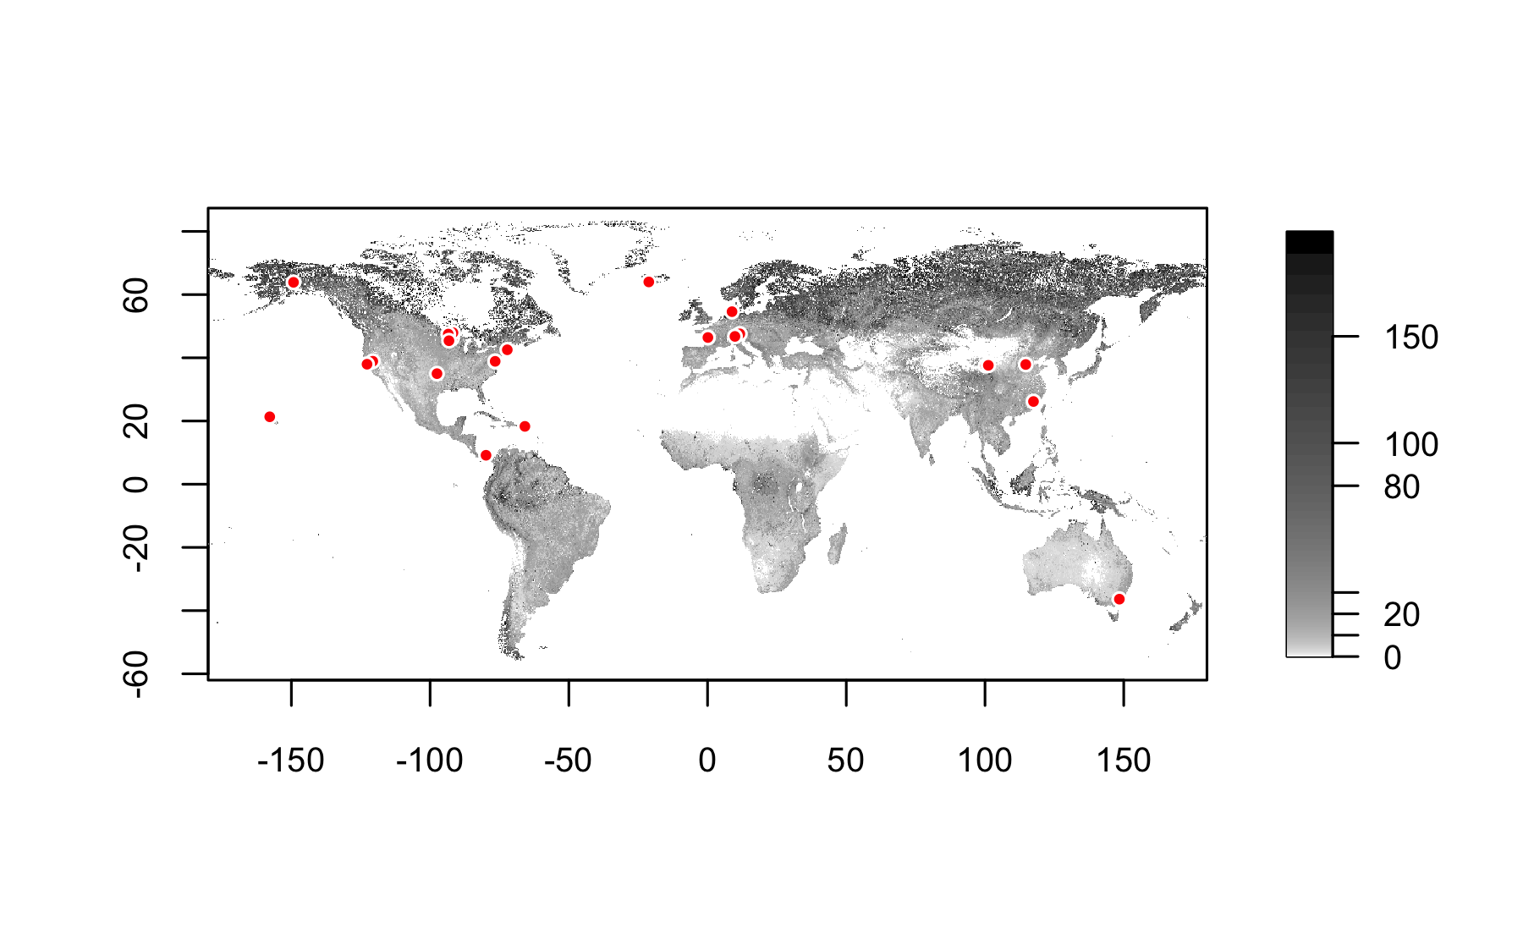
16
6
12
5
4
3
9
1
2
23
21
18
13
8
17
11
15
20
14
10
22
19
SOC, 0–0.2 m
[kg m⁻²]
0
80
150
7
30
^{SWEDDIE Warming Experiments}
1
^{ACBB, grassland & arable}
Achenkirch, temperate montane forest
B4WarmED, temperate & boreal forest
^{Blodgett, temperate forest}
^{CiPEHR, permafrost}
^{ForHot, subarctic grassland}
FutureClim, temperate montane grassland
^{GENX, temperate salt marsh}
Harvard Forest, temperate forest
^{Hawaii, tropical forest}
^{KAEFS, temperate grassland}
^{MERIT, temperate salt marsh}
13
Point Reyes, temperate grassland
^{Sanming, subtropical forest}
^{SMARTX, temperate salt marsh}
^{SPRUCE, boreal peat bog}
^{Stillberg, subalpine forest}
^{SWAMP, permafrost}
^{SWELTR, moist tropical forest}
^{TEAM, alpine grassland}
^{TeRaCON, temperate grassland}
^{TRACE, moist tropical forest}
^{185 Experiment Station, arable}
2
14
3
15
4
16
5
17
6
18
7
19
8
20
9
21
10
22
11
23
12

