Slide 1
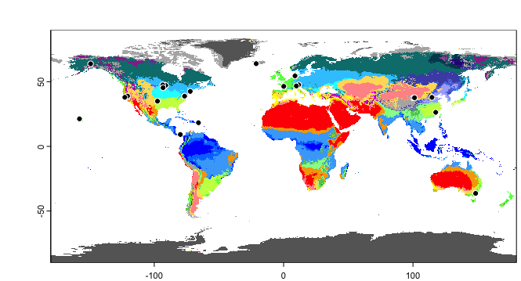
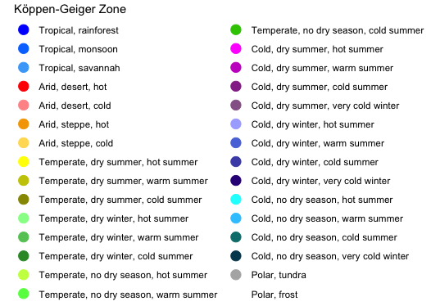
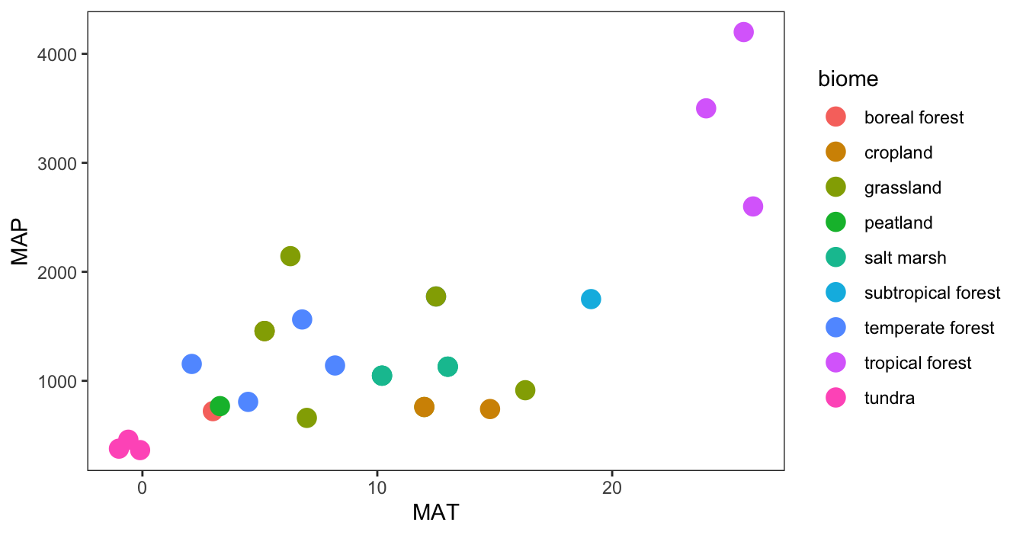
DeepSoil2100 sites (n = 23)
Notes:
The experiments in SWEDDIE cover a wide range of mean annual temperatures (MAT), mean annual precipitation (MAP), and biomes (fig. map; fig. MAT x MAP). The best represented ecosystems in SWEDDIE are temperate grassland and forests (n = 5 and 4, respectively), followed by temperate salt marsh, tropical forest, and tundra ecosystems (n = 3 each). The remaining ecosystems are only represented by a single site each. NB: two of the salt marsh warming experiments (SMARTX, GENX) are located adjacent to one another, so plot as a single point on the MAT x MAP figure.

Slide 2
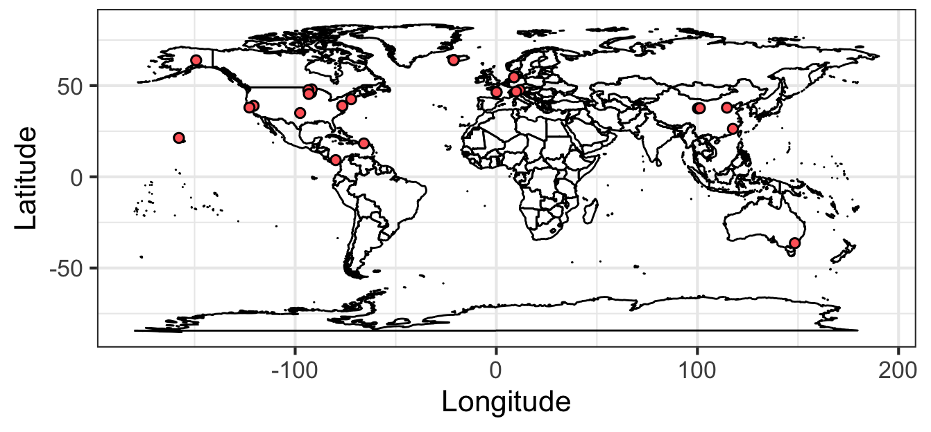
DeepSoil2100 sites (n = 23)
Notes:
Volumetric water content means for partial year heating only include heating period.

Slide 3
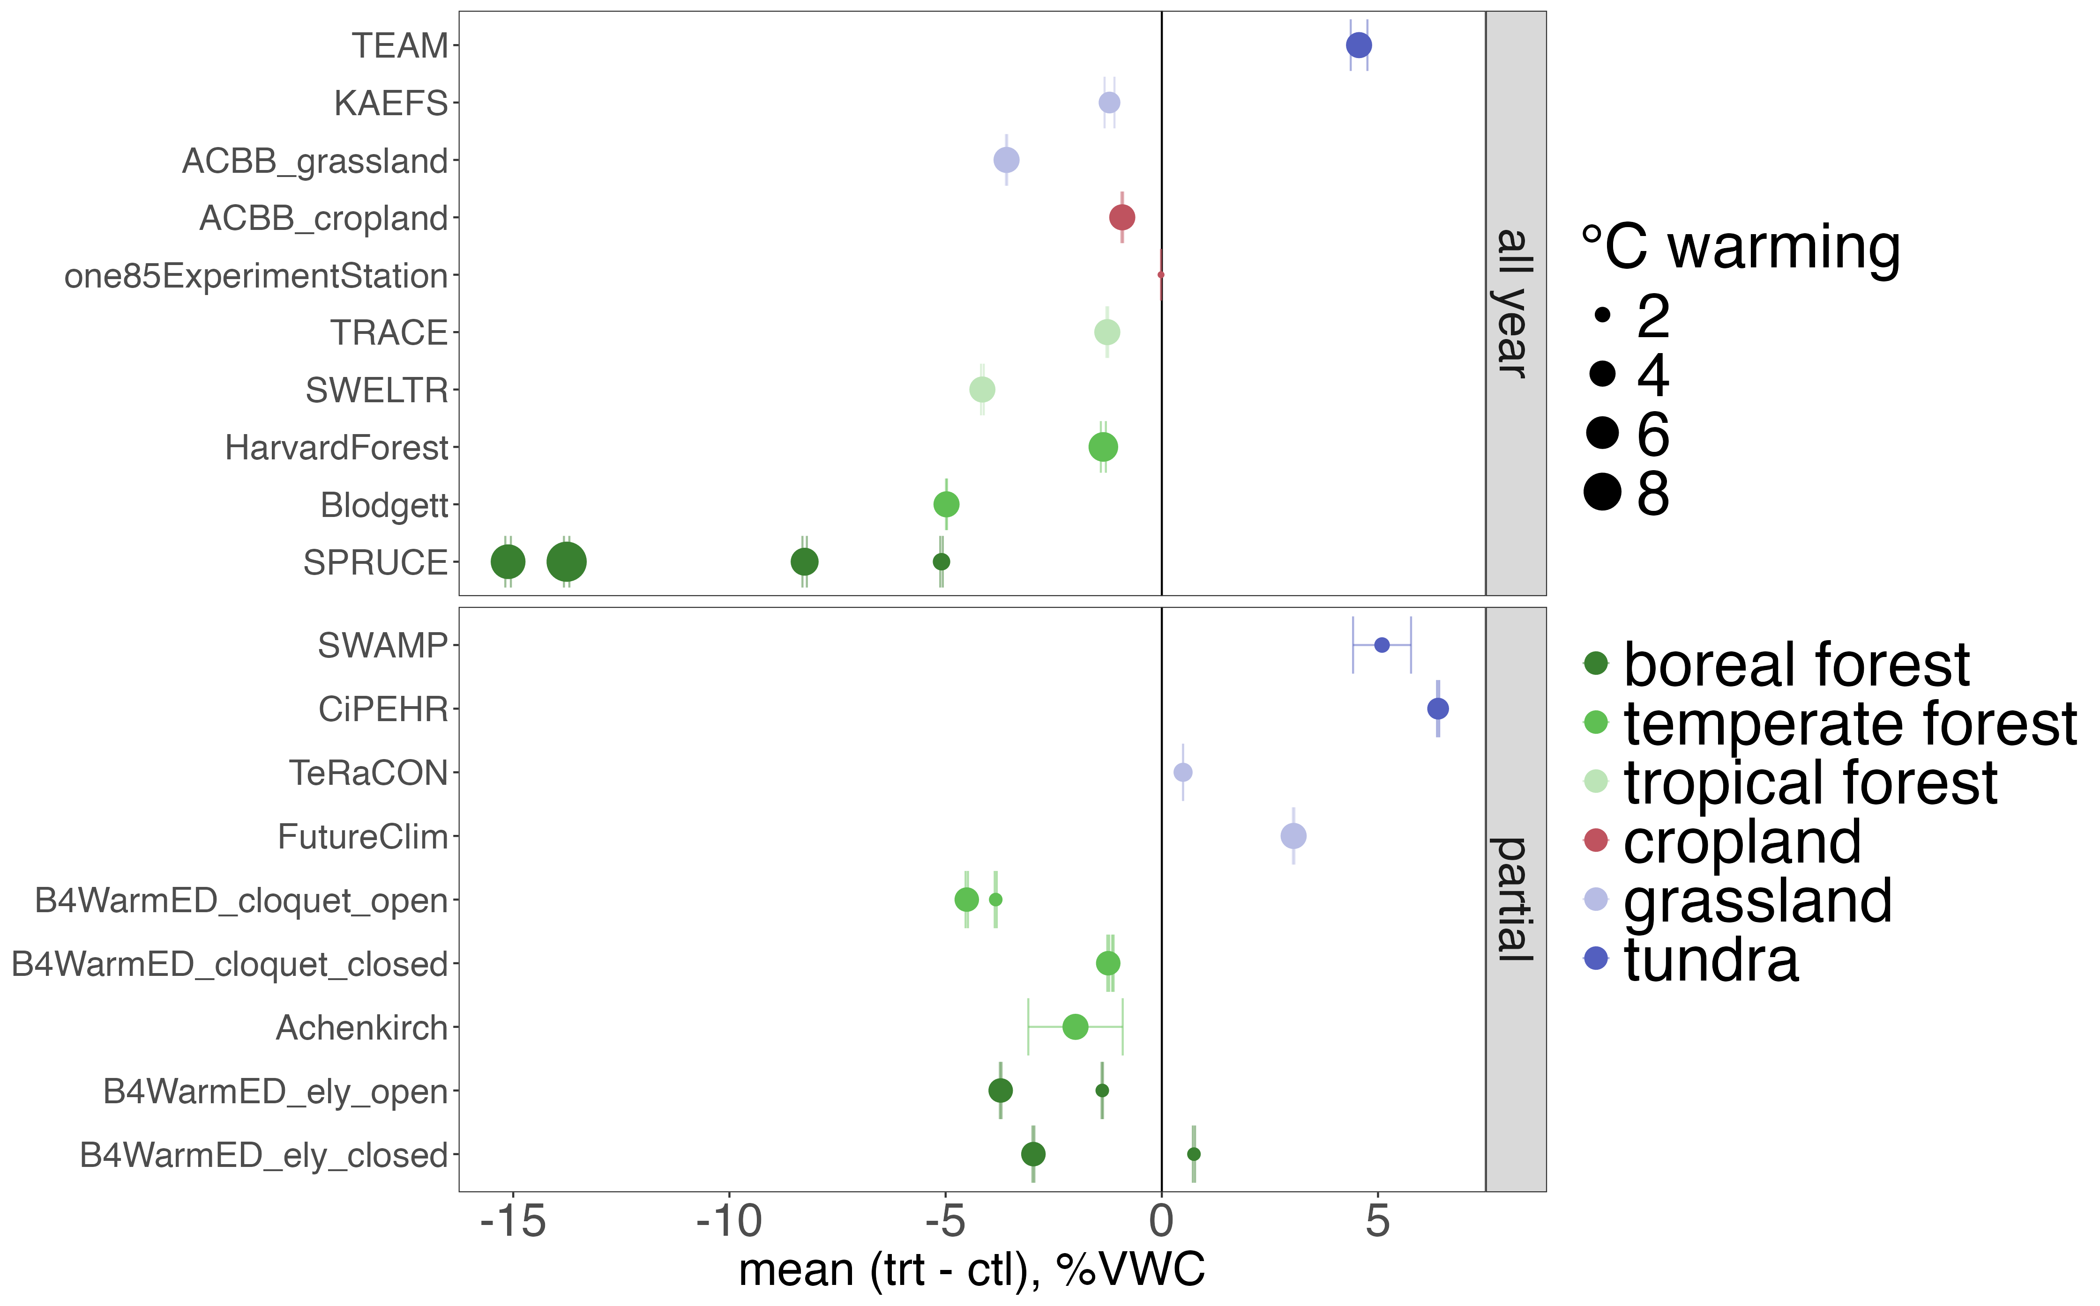
Impact of warming on soil moisture by ecosystem. Top panel shows experiments with all year heating, bottom panel partial year heating¹. Points are overall means; error bars are 95% CIs.
¹ VWC means for partial year heating only include heating period.
Notes:
NB: points are averages across all depths and time points, except for the partial year heating experiments for which only the heating period is considered.
Warming led to drier soils on average when considered across all sites, and observed soil drying was positively correlated with degrees of warming for those sites where warming led to drying. The drying effect varied by ecosystem, with forest soils tending to dry more per degree of warming than non-forest soils. The sites for which we either did not observe drying with warming or observed increased soil moisture with warming were non-forest soils in cold climates (CiPEHR, SWAMP, TEAM, FutureClim, TeRaCON). The tundra sites (CiPEHR, SWAMP, and TEAM) showed the strongest wetting effect. This is consistent with previous studies demonstrating that winter warming in permafrost soils leads to deepening of the active layer, resulting in wetter soils upon spring thaw.
In general, the effect of warming on soil moisture at sites with year-round heating was similar to that for which warming was active for only part of the year. However, the two grassland sites that were warmed all year long (KAEFS, ACBB) exhibited a clear drying effect of warming, while the two that were only warmed for part of the year (TeRaCON, FutureClim) exhibited an opposite wetting effect from warming.

Slide 4
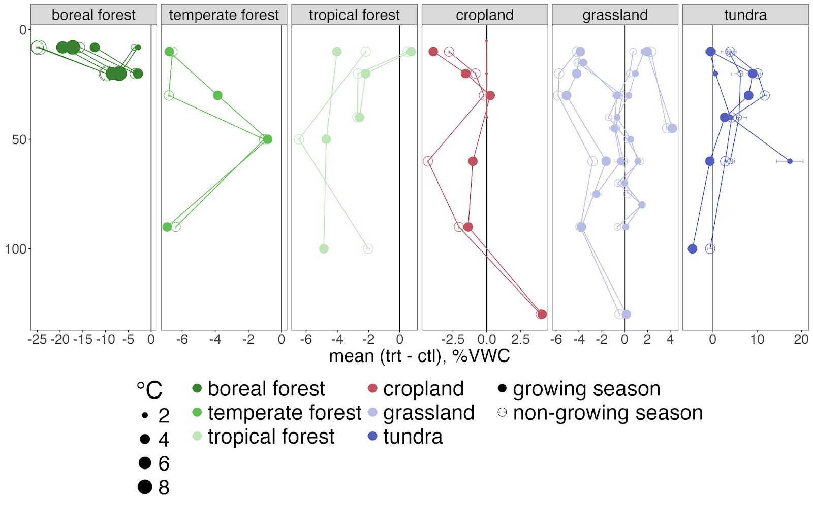
Warming effect on soil moisture by depth and seasonality. Points show means, error bars show 95% confidence intervals. Only terrestrial sites with measurements at multiple depths shown (n = 13). Point size corresponds to target degrees of warming. VWC: volumetric water content.
Notes:
We did not observe consistent depth trends for the effect of warming on soil moisture across sites. However, we observed notable site-specific relationships between depth and soil drying or wetting in response to warming. For example, the surface soil layer at the tropical moist forest site, TRACE, exhibited slight (+1% VWC) wetting with warming, while drying with warming was observed below 10 cm. The SPRUCE site, which was the only one with forced air above ground heating, showed a dramatic increase in drying at the upper depth (8 cm) compared to the lower depth (20 cm). The cropland and grassland sites for the warming experiment in Lusignan, France (ACBB) showed wetting or no effect of warming on soil moisture at depth, but significant drying in the surface soil layers. At the only temperate forest warming site for which we had depth resolved data (Blodgett), we observed strong drying at the surface, little effect at 50 cm, and then drying again at the 80 cm. The tundra sites with depth resolved data (SWAMP, TEAM) both showed an increase in wetting with depth initially, but drying below 50 cm.
Soil moisture differences between warmed and control plots also varied between the growing season and non-growing season. The drying effect was slightly enhanced during the non-growing season at the boreal forest sites, while the wetting effect at the tundra sites was enhanced during the non-growing season. The tundra sites showed the most variation in soil moisture differences with depth between the growing season and non-growing season, with increased wetting observed throughout the soil profile during the non-growing season at the TEAM site, while the opposite was observed at the SWAMP site, i.e., increased wetting during the growing season, particularly at depth. The grassland sites tended to show more drying with warming during the non-growing season, but the growing season effect was least notable in this ecosystem.

