Slide 1
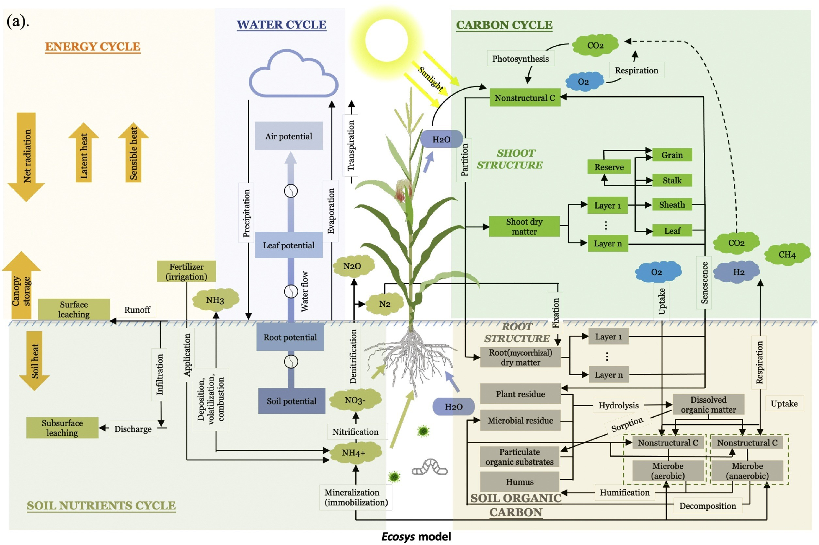
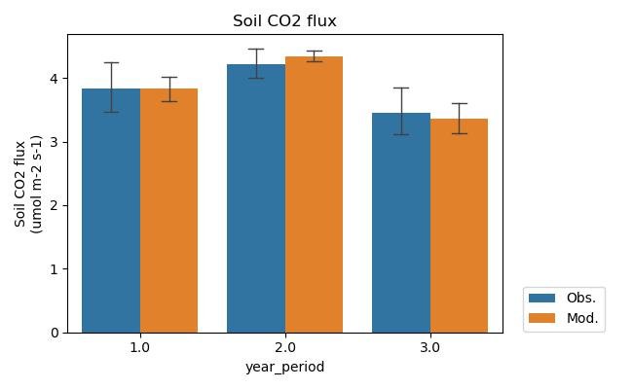
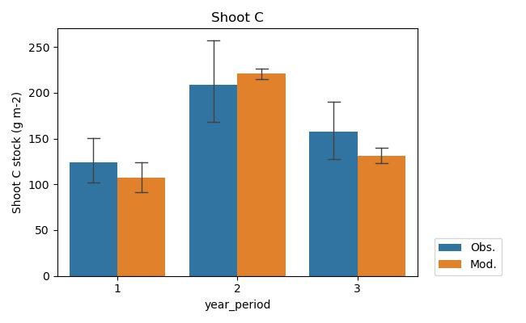
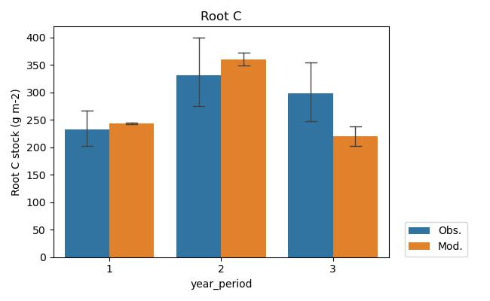
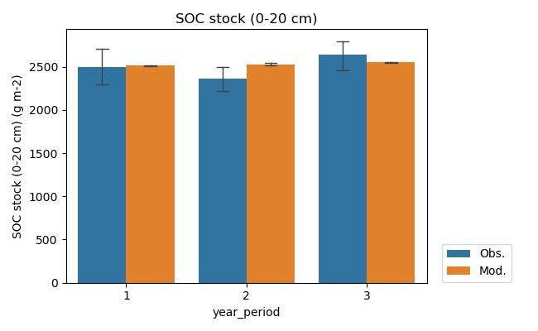
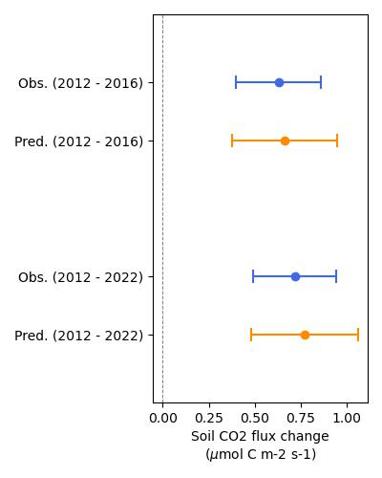
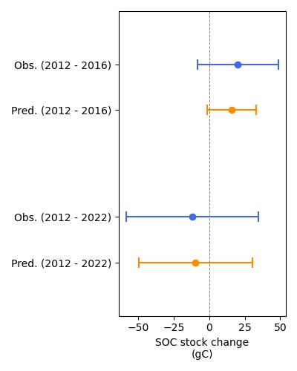
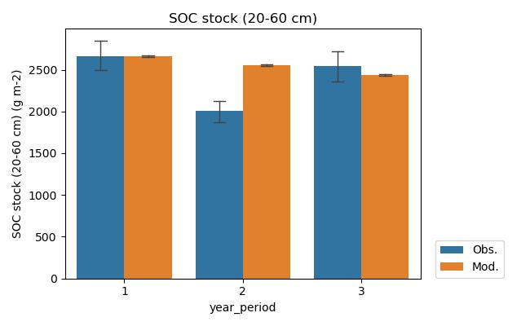
Using a process-rich (Ecosys) model to reproduce the observations at a site (TeRaCON) with soil warming experiment
Capture the yearly changes
Capture the differences between ambient and warming plots
A sub-hourly time-step mechanistic model fully coupled plant-microbe-soil carbon and nutrient cycling
Lei Zhang, William Riley, Peter Reich, Jinyun Tang, Margaret Torn, et al. (In prep).

