Slide 1
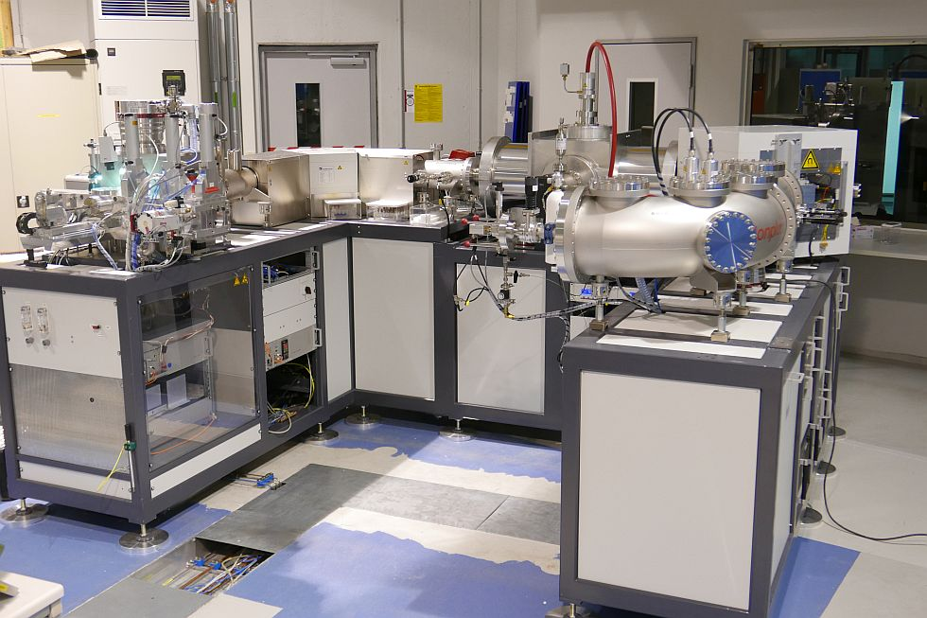
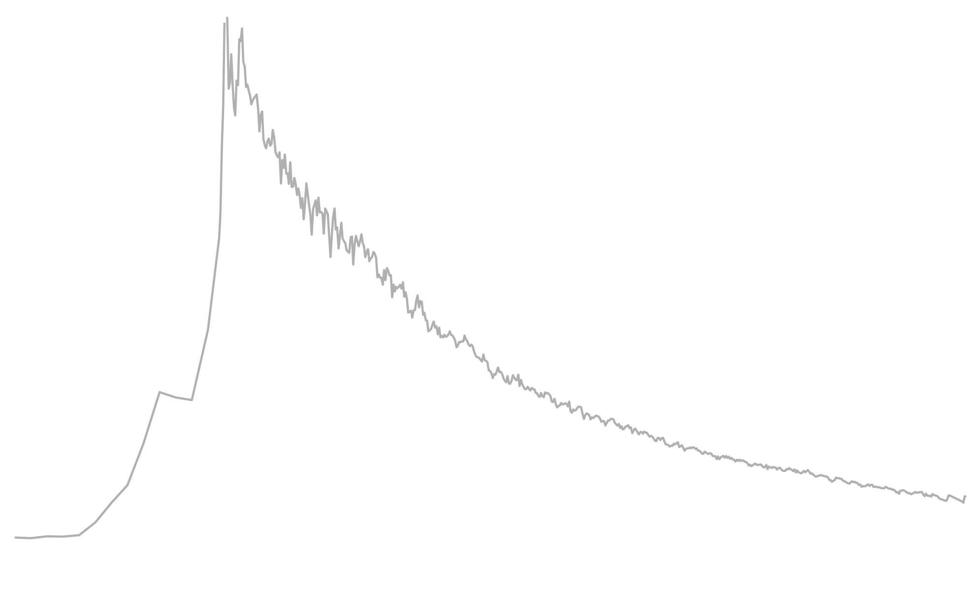
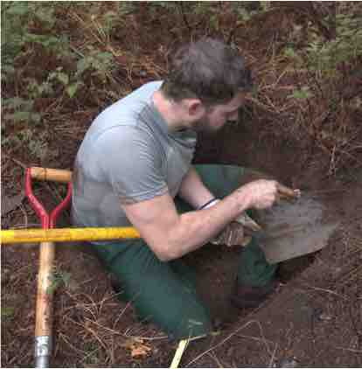
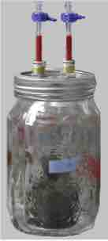



Mineralogical and climatic controls on decadal soil carbon dynamics
Tracing transiently cycling C with radiocarbon incubations of archived soils
Jeffrey BEEM-MILLER^{1,2}
¹ Max Planck Institute for Biogeochemistry, Germany
² Leibnitz University Hannover, Germany
jbeem@bgc-jena.mpg.de
SCIENTIFIC ADVISORY BOARD MEETING April 2021
Notes:
Brief overview of thesis work: Mineralogical and climatic controls on decadal soil carbon dynamics
A key technique...
Soil carbon is not a single homogenous pool
Incubations provide insight into faster cycling carbon pools
This of particular interest as we try to predict the near-term effects of environmental change

Slide 2
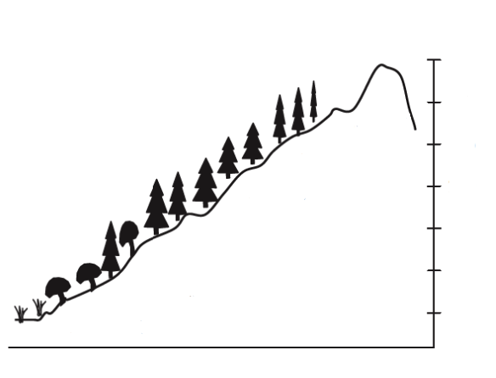
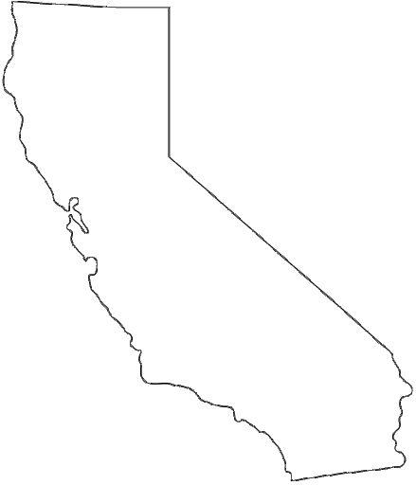
I. Minerals vs. climate
Research question:
How do mineralogy and climate interact to control soil carbon dynamics?
Sampling:
2001, 2009, 2019
Methods:
radiocarbon incubations, bulk soil ¹⁴C, density and thermal fractions
SoilR models
Basalt (3x)
Andesite (3x)
Elevation (1000 m)
Granite (3x)
3.5
3.0
2.5
cold
2.0
cool
temp gradient
1.5
warm
1.0
0.5
Experimental design of parent material by climate study (Sierra Nevadas, CA)
J. Beem-Miller
Notes:
overview of main study site
PM x climate gradient in Sierras
Granite -> Andesite -> Basalt heading north; elevation = MAT gradient; no change in MAP
time series: look at how bomb spike moves through soils over 20 years
density + thermal fractionations to dig into mineral-associated carbon dynamics
compare model structures and turnover rates with SoilR

Slide 3
II. ∆¹⁴C time series: bulk soil
Key result:
times series reveals both parent material and climate affect bulk soil ¹⁴C
Time series of bulk soil ∆¹⁴C (10-20 cm)
atmosphere
∆¹⁴C (‰)
2000
2005
2010
2015
2020
J. Beem-Miller
Notes:
[Describe graph]
Andesite less enriched than granite and basalt at both warm and cool sites
almost all bulk points remain below atmosphere curve for cool site, but cross atmosphere curve for warm site
overall dynamics faster with higher MAT, regardless of parent material
error bars are spatial reps (3x pits per site)

Slide 4
III. ∆¹⁴C time series: bulk + inc
Key result:
difference in ¹⁴C between respired (inc) and bulk soil (bulk) is a function of parent material
Paired bulk soil ∆¹⁴C and incubation ∆¹⁴C-CO₂
(10-20 cm)
∆¹⁴C (‰)
atmosphere
2000
2020
Year
2000
2020
J. Beem-Miller
Notes:
Same bulk data, + incubation
Key finding: difference between bulk and respired CO2 greatest in andesites, then basalts---almost no difference in granite soils
Tells us about the relative contribution of soil carbon pools with different intrinsic decomposition rates to respiration
For example, bulk 14C indistinguishable between BS and GR in 2019
difference in respiration curves tells us mean age BS > GR

Slide 5
IV. ∆¹⁴C profiles: bulk + inc
Paired bulk soil ∆¹⁴C and incubation ∆¹⁴C-CO₂: Depth profiles (2019)
atmosphere
J. Beem-Miller

Slide 6
III. ∆¹⁴C time series: bulk + inc
(Bulk - respired) ∆¹⁴C vs. extractable minerals
Climate
Parent material
J. Beem-Miller

Slide 7
III. ∆¹⁴C time series: bulk + inc
(Bulk - respired) ∆¹⁴C vs. extractable minerals
Climate
Parent material
J. Beem-Miller

Slide 8
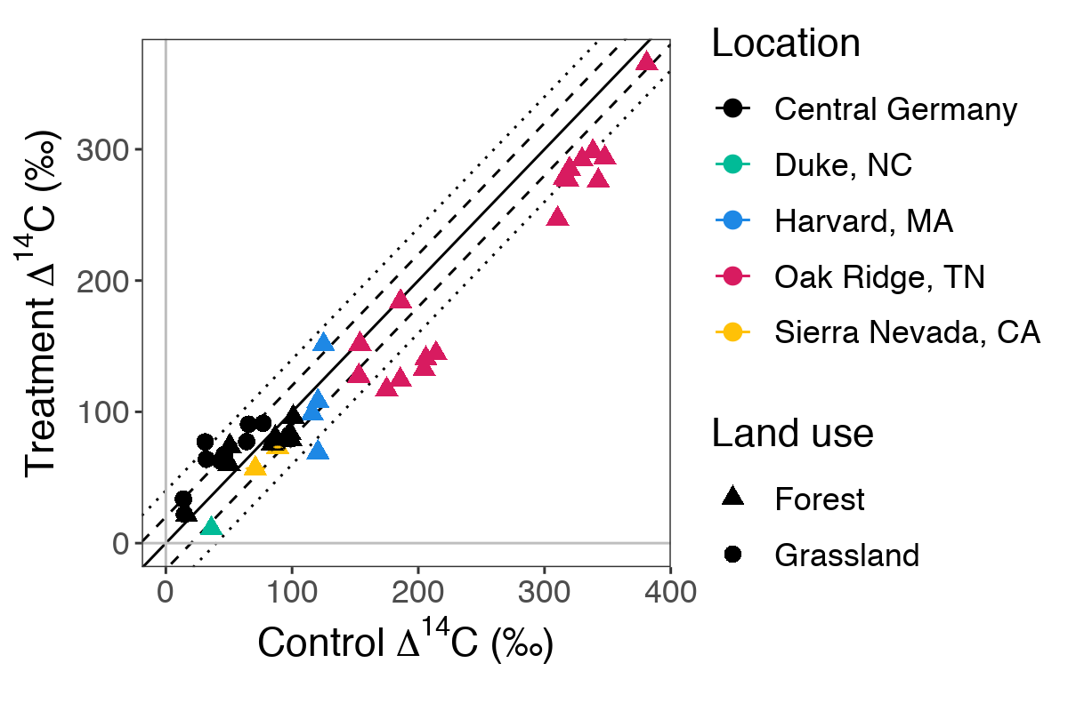
IV. Archiving effect on ∆¹⁴C-CO₂
Research question:
Does archiving soil affect ∆¹⁴C-CO₂ observed in laboratory incubations?
Results:
yes, but...technique works!
minor, but significant effect of air-drying and rewetting, but not storage
after archiving treatment
∆¹⁴C (‰)
∆¹⁴C-CO₂ (
∆¹⁴C (‰)
before archiving treatment
Solid line shows 1:1, dashed and dotted lines show ±10‰ and ±20‰ offsets respectively
J. Beem-Miller
Notes:
Before we can construct time series of 14C-CO2...
Samples from all over the US and Germany, forest and grasslands
Previously incubated soils, then I incubated splits that had been air-dried and stored for 7 to 14 years before I rewet and incubated them
Bottom line: technique works
significant difference due to air-drying, especially in grasslands, but five to ten per mille, so minor
Since only air-drying and rewetting had impact, can compare on air-dry and rewet basis over time

