Slide 1
Document Storage and Search with SQL Server
JOE BRUNO

Slide 2
About Me
Database Administrator with Foundation Software in Strongsville, OH
BA Ohio University / MIS University of Phoenix
Microsoft Certified Solutions Associate (MCSA) – SQL 2012/2014
Over 15 Years of experience with SQL Server and other RDBMS technologies
Report Writer -> Reporting Systems Developer -> BI Developer -> Database Administrator
joegbruno@gmail.com

Slide 3
Document Storage Use Cases
Insurance Company – store quotes, policies, and claims documents
Accounting Software – store billing sent to clients and Accounts Payable invoices /receipts
Personal Interest / Research

Slide 4
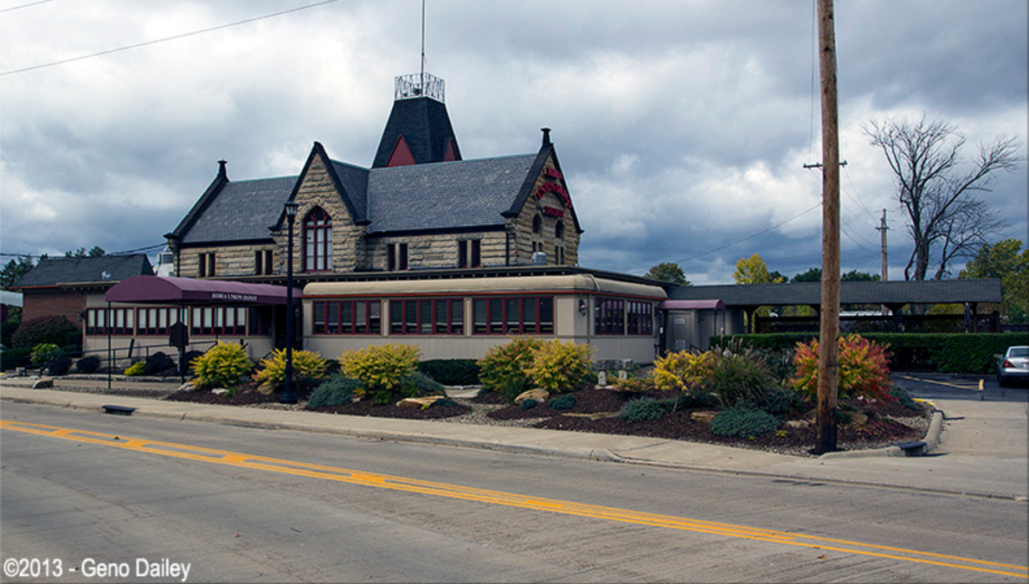
Anyone know this?

Slide 5
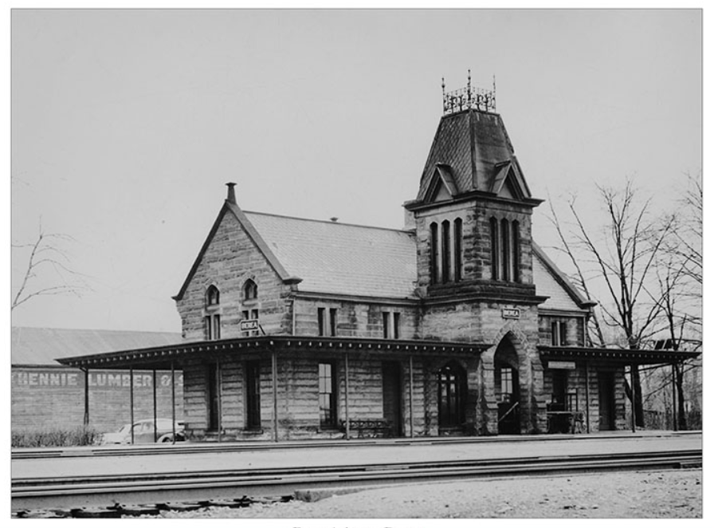
Berea Union Depot – The first stop on a Historical Walking Tour of Berea, Ohio

Slide 6
Facts
Dedicated on May 3, 1876, The Plain Dealer called it "the finest facility outside the big cities.“
Served as a Union Station for the Big Four railway companies at the time
Gothic Revival Structure built with sandstone from Berea’s quarries approximately 1 mile south
Tracks were built to transport sandstone from the Berea Quarries which were the world’s largest at the time
It ceased to serve as a railway depot in 1954
In 1980, it was added to the National Register of Historical Places
It is currently home to Berea Depot Bar and Restaurant, offering Upscale Pub Fare

Slide 7
Document Storage and Search to help me write the historical tour
Create a database in SQL Server
Pick a storage method for documents
Scan in several historical books on Berea Ohio
Save web HTML and PDF files
Create a Windows Form app that retrieves the documents using Full-Text Search
Create tables that link search items to document records
Also, can save video and audio files

Slide 8
Video and Audio Files?
As far as SQL Server is concerned, this is all Unstructured Data
Three types of data that can be stored in SQL Server
Structured Data – data with data types in columns, rows and tables. We have metadata that tells us what it is.
Semi-Structured Data – The structure of the data can change. Data in a semi-usable form to the SQL Server Engine – XML, JSON files
Unstructured Data – File System Binary Data that is not in a form “usable” by the SQL Server Engine. Images, Documents, music, videos, multi-media files.

Slide 9
Methods to Manage Unstructured Data
Simple pointer from relational data to to file system locations
Store unstructured data in VARBINARY(MAX) field
Store unstructured data using SQL Server Filestream technology
Store unstructured data with SQL Server File Table technology

Slide 10
Demo…

Slide 11
Pros
Simple pointer.
Simplicity – Only file path and file name is stored in SQL
Performance – unstructured data is not stored in SQL 8k pages
Store unstructured data in VARBINARY(MAX) field.
Only a single backup file would be required
Store unstructured data using SQL Server Filestream technology.
Highly controlled interaction via T-SQL only
Only a single backup file would be required
Store unstructured data with SQL Server File Table technology
Intuitive interaction with files via Windows File System

Slide 12
Cons
Simple pointer.
Maintenance of pointer integrity.
Unable to have a single backup file.
Store unstructured data in VARBINARY(MAX) field.
Sub-optimal performance rolling data out to buffer pool.
Store unstructured data using SQL Server Filestream technology.
Only T-SQL interaction
Proprietary File System Storage that is not intuitive
Store unstructured data with SQL Server File Table technology
Extra overhead and slower performance considerations using File Table versus Filestream

Slide 13
References
https://www.sqlskills.com/blogs/paul/files-and-filegroups-survey-results/
https://www.sqlskills.com/blogs/paul/misconceptions-around-filestream-storage/
https://www.red-gate.com/simple-talk/sql/learn-sql-server/an-introduction-to-sql-server-filestream/
https://www.mssqltips.com/sqlservertip/2667/filetable-feature-in-sql-server-2012/

