Slide 1

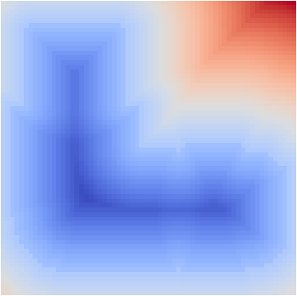
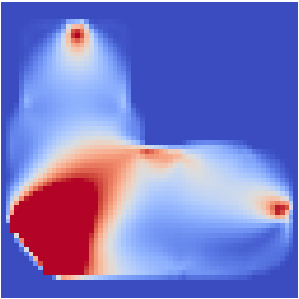
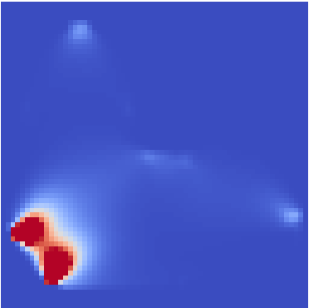
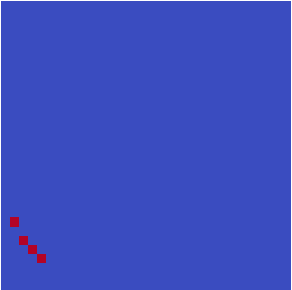
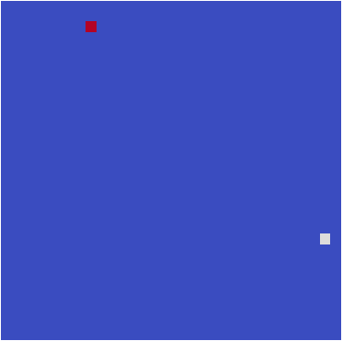
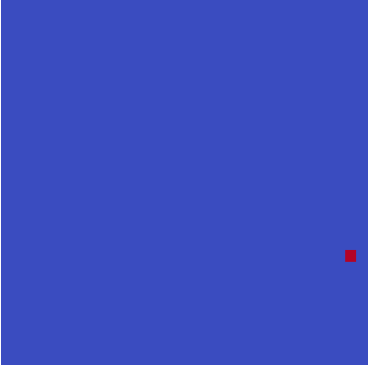

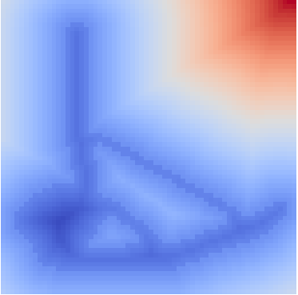
Domain-net
Physics-net
Design Domain
Physical Fields
Condition
Encoder
Decoder
GT
SDF
Output
Structure
Points Coordinates

Slide 2
Physics-net
Physical Fields
Condition
Encoder
Decoder
Concatenate
GT
SDF
Output
Structure
Points Coordinates
Points Property
Design Domain

Slide 4
Load(x-direction)
Load(y-direction)
Fixed
Strain field
Stress field

Slide 5


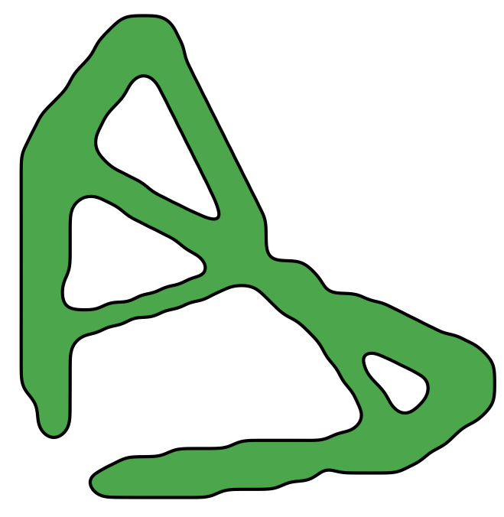



Topology Optimization
Post Processing
Load points
Fixed points
Volume constrain=36%
Continuous representation

Slide 6

Topology Optimization
Post Processing
Load points
Fixed points
Volume constrain=36%
Continuous representation

Slide 8


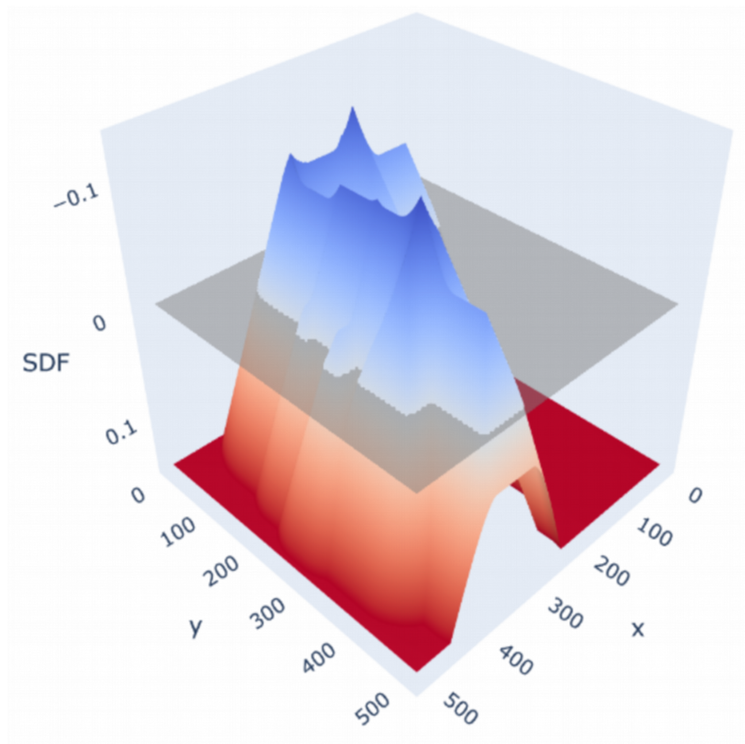
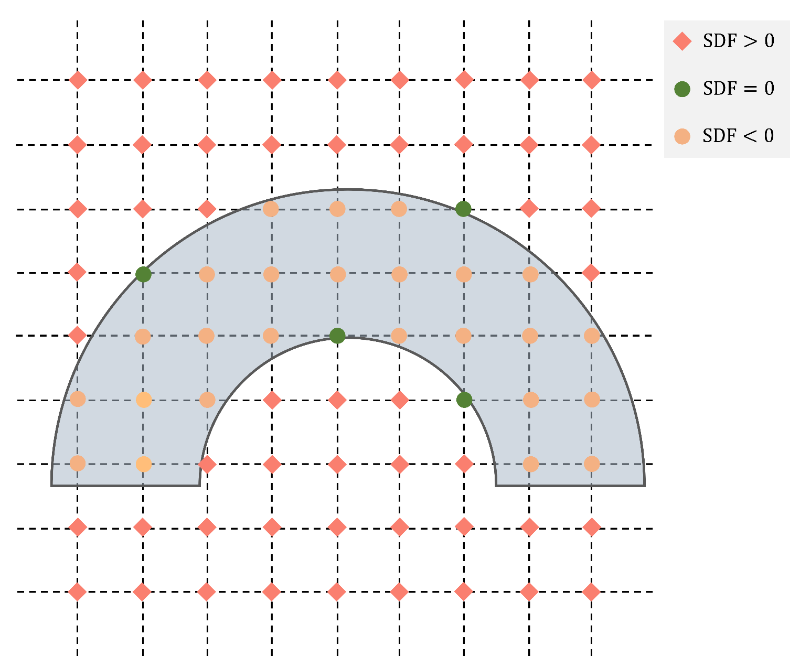


Resolution:32x32
Resolution:64x64
Resolution:128x128
Resolution:512x512

Slide 9
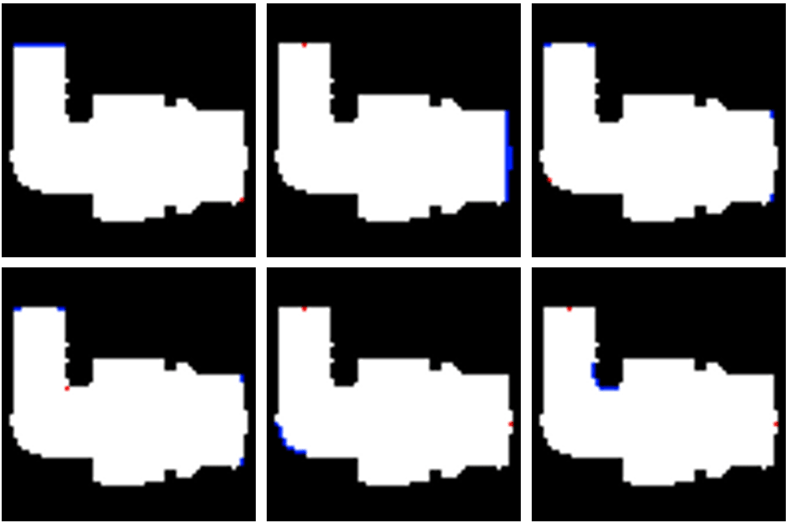

Slide 10
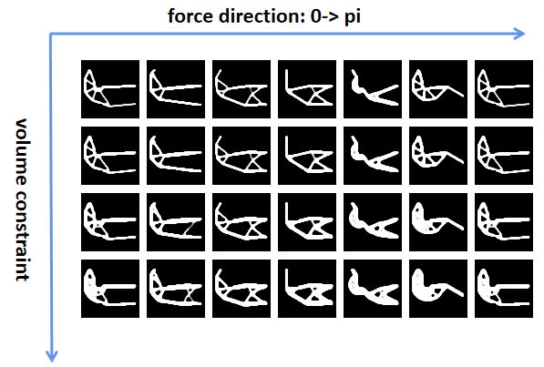
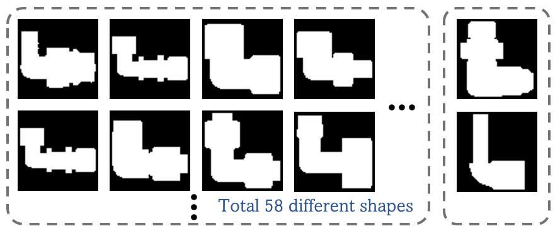
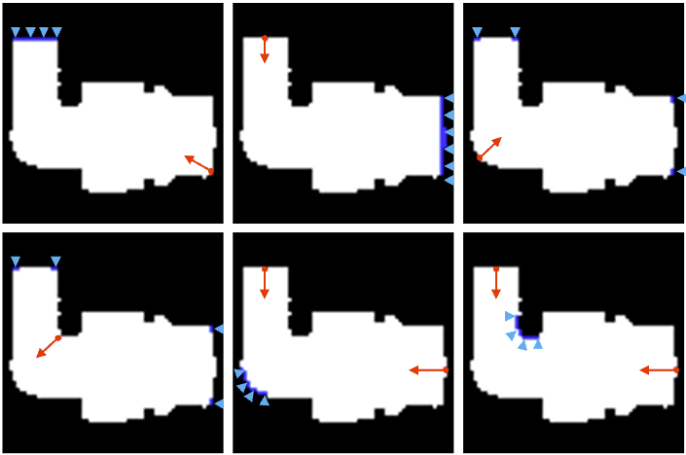
Domains for train set
test set

Slide 11

Load direction:
$$0→π$$

Slide 12
Transfer
Transfer
Optimal Structure
SDF
Design Domain
SDF
Load (x-direction)
Load (y-direction)
Displacement constraint
Stress field
Strain field

Slide 13




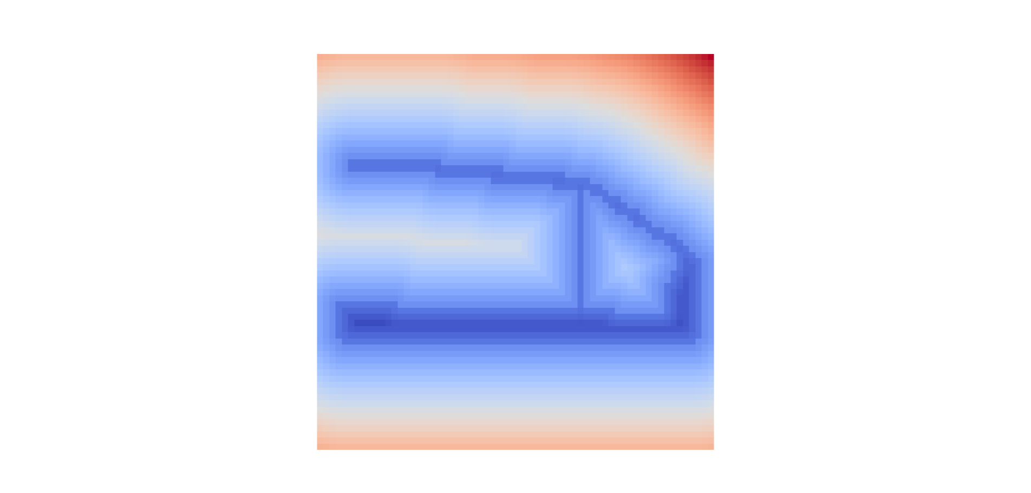
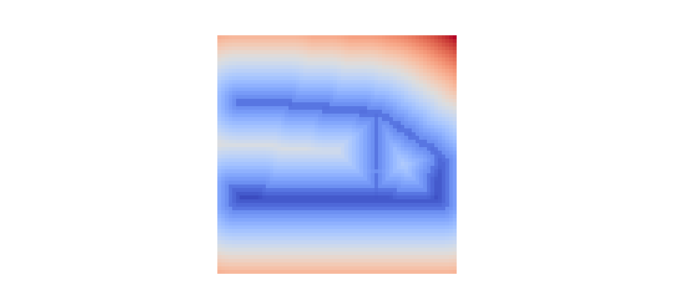



Slide 14
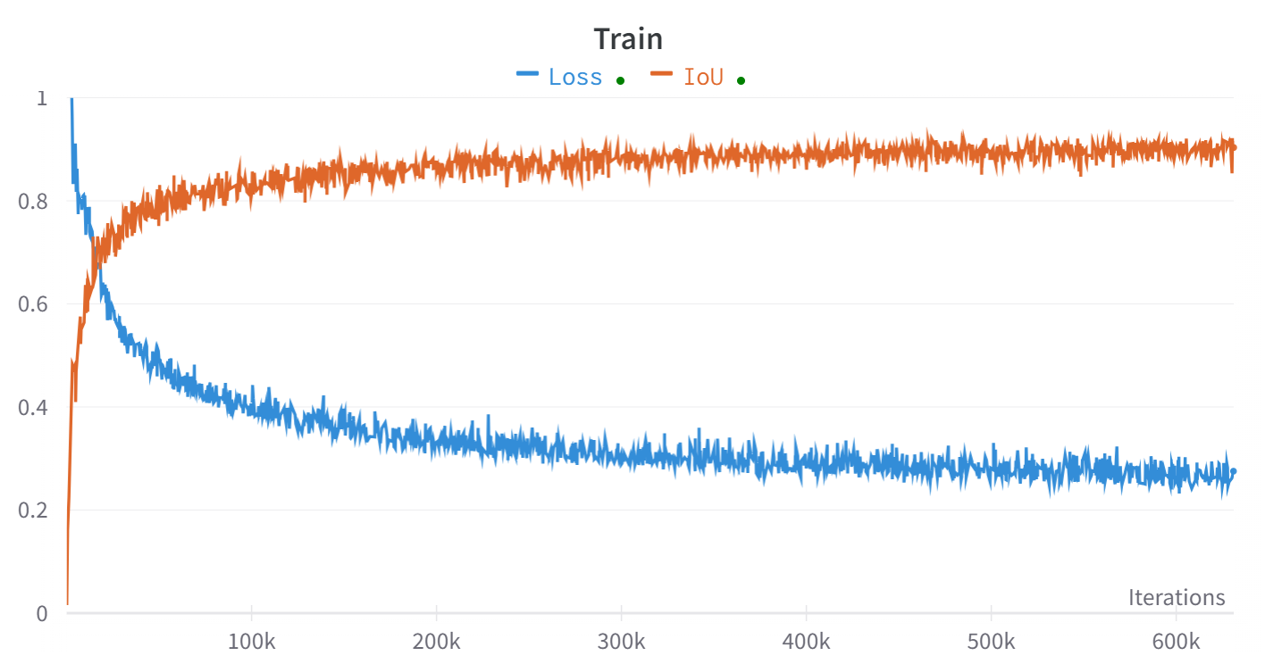
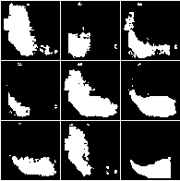
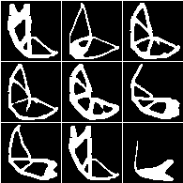
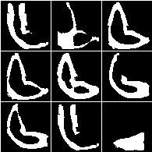
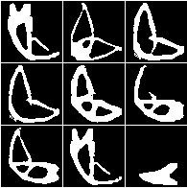

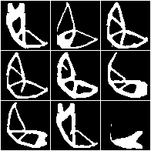

Slide 15
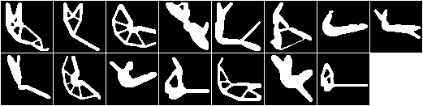

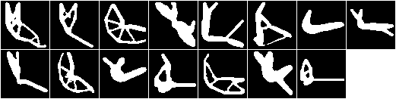

Ground Truth
Without Topological Loss
With Topological Loss

Slide 17

















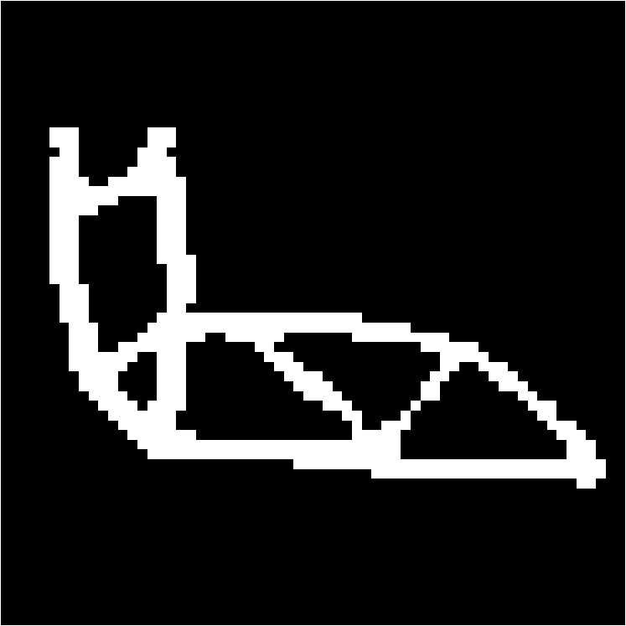












$$\overline{V}=38\%$$
GT
$ε^{comp}=1.53\%, ε^{vol}=3.35\%$
$$\overline{V}=38\%$$
GT
$ε^{comp}=0.30\%, ε^{vol}=0.75\%$
$$\overline{V}=46\%$$
GT
$ε^{comp}=0.78\%, ε^{vol}=0.77\%$
$$\overline{V}=36\%$$
GT
$ε^{comp}=0.39\%, ε^{vol}=3.29\%$
$$\overline{V}=34\%$$
GT
$ε^{comp}=19.92\%, ε^{vol}=4.54\%$
$$\overline{V}=32\%$$
GT
$ε^{comp}=0.38\%, ε^{vol}=4.05\%$
Train set

Slide 18


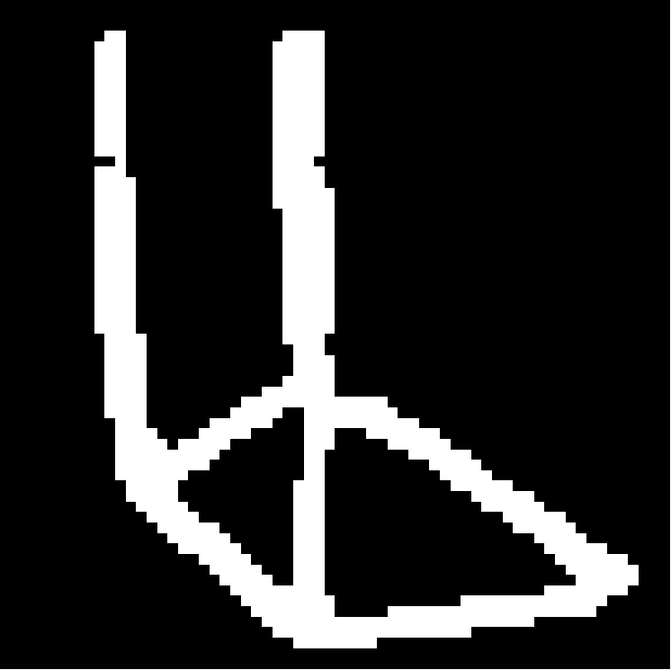





















$$\overline{V}=34\%$$
GT
$ε^{comp}=12.00\%, ε^{vol}=2.93\%$
$$\overline{V}=44\%$$
GT
$ε^{comp}=0.15\%, ε^{vol}=2.23\%$
$$\overline{V}=46\%$$
GT
$ε^{comp}=38.91\%, ε^{vol}=1.36\%$
$$\overline{V}=30\%$$
GT
$ε^{comp}=1.40\%, ε^{vol}=0.82 \%$
$$\overline{V}=46\%$$
GT
$ε^{comp}=65.43\%, ε^{vol}=6.20\%$
$$\overline{V}=32\%$$
GT
$ε^{comp}=1.72\%, ε^{vol}=18.00\%$
Test set

Slide 19





















GT
TopologyGAN
TopoDiff
IF-TONIR
$$ε^{comp}=2421\%$$
$$ε^{comp}=0.1\%$$
$$ε^{comp}=0.6\%$$
$$ε^{comp}=27.9 \%$$
$$ε^{comp}=21.2 \%$$
$$ε^{comp}=24.6 \%$$
$$ε^{comp}=20.7\%$$
$$ε^{comp}=0.6\%$$
$$ε^{comp}=1.5\%$$

Slide 20














GT
TopologyGAN
TopoDiff
IF-TONIR
$$ε^{comp}=2421\%$$
$$ε^{comp}=0.1\%$$
$$ε^{comp}=0.6\%$$
$$ε^{comp}=1.0\%$$
$$ε^{comp}=1.0\%$$
$$ε^{comp}=71.0\%$$
$$ε^{comp}=2.8 \%$$
$$ε^{comp}=0.5\%$$
$$ε^{comp}=6.5\%$$

Slide 21
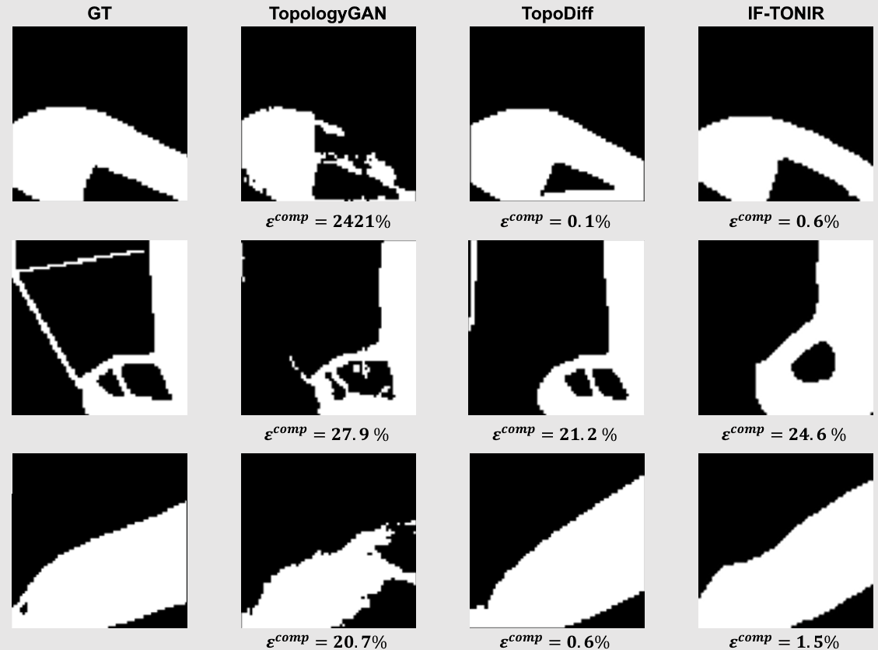
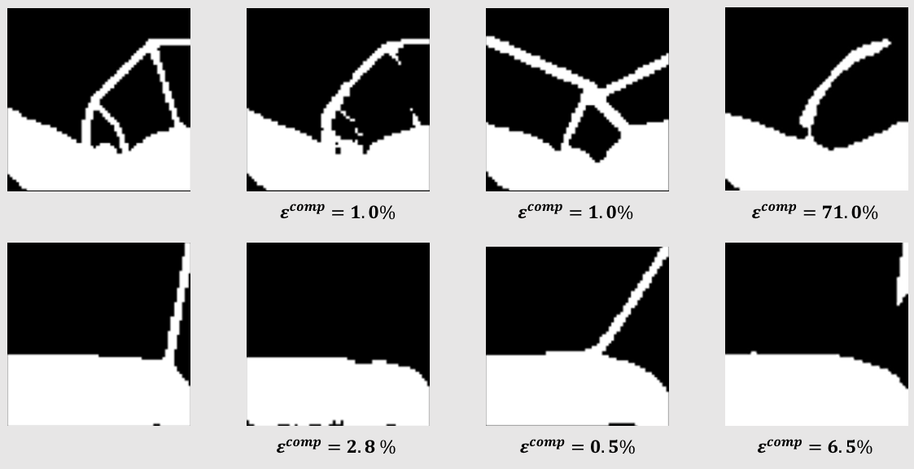
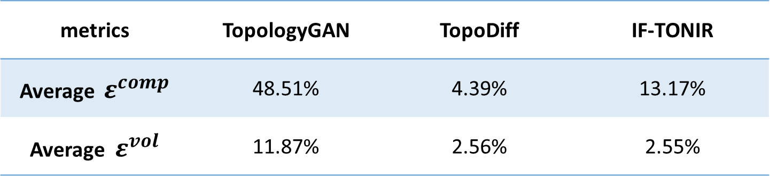
metrics | TopologyGAN | TopoDiff | IF-TONIR
Average $ε^{comp}$ | 48.51% | 4.39% | 13.17%
Average $ε^{vol}$ | 11.87% | 2.56% | 2.55%

