Slide 1
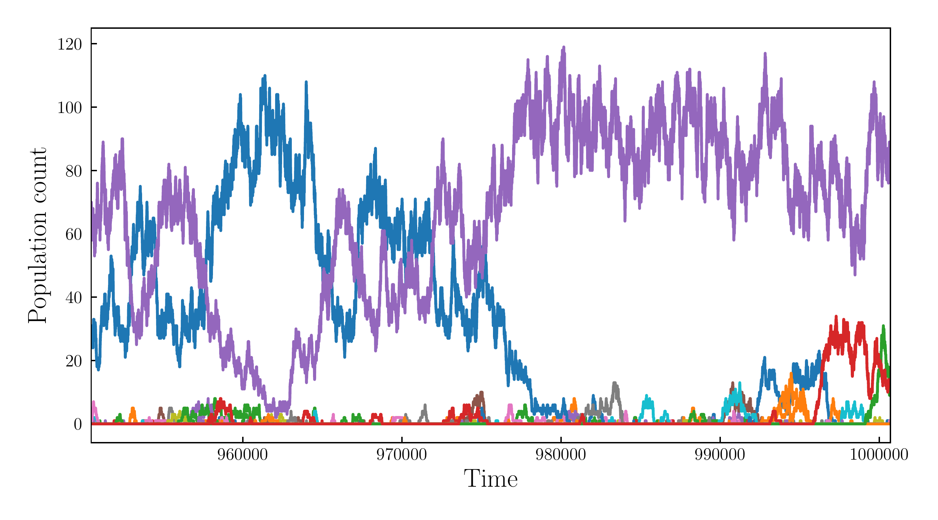
Multispecies Lotka-Voltera models in neutral and competitive regimes
Jeremy Rothschild

Slide 2
Old paradigm in ecology: Diversity ensures stability in an ecosystem
Changed in light of the work by many in the mid 1900s
Study stability in ecological communities in many scenarios
For example the perturbed stability of the microbiome in the lung is thought to be an important factor in the progression of Cystic Fibrosis
Notes:
Math

Slide 3
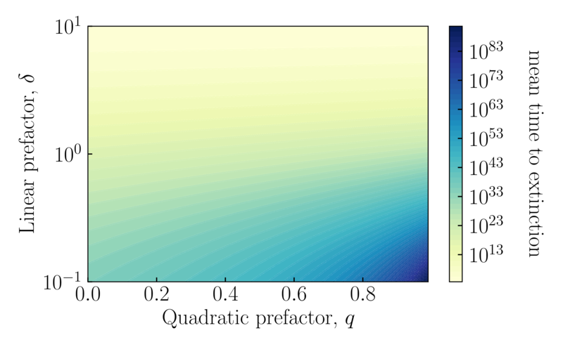
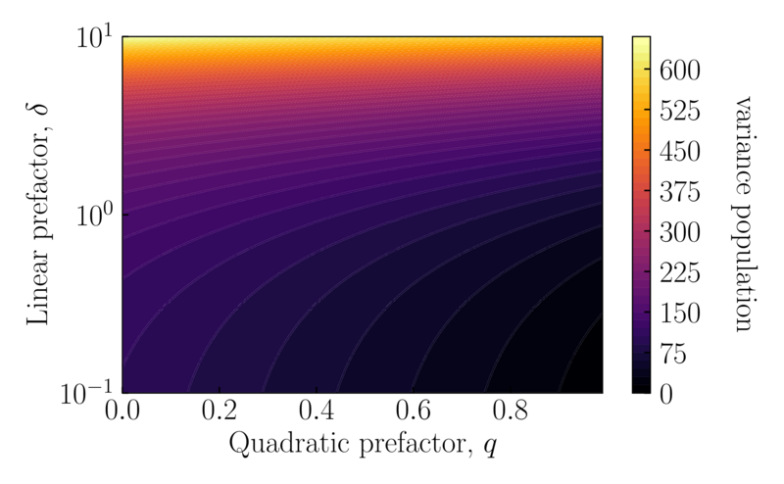


Previously we’ve looked at 1 species and evaluated the mean time to extinction, quasi-stationary probability distribution and the relaxation times
Why are we interested in this?
Would like to formally understand the diversity of species in Lotka-Voltera

Slide 4
Program for today
Deterministic Lotka-Volterra with immigration
Moran (neutral) Model
Abundance Distribution approximation
First passage time

Slide 5

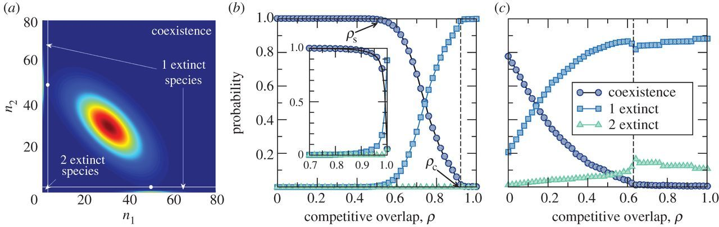
Symmetric species interactions in which competition affects the death rate. (S: number of species)
Capitan et al. 2015

Slide 6
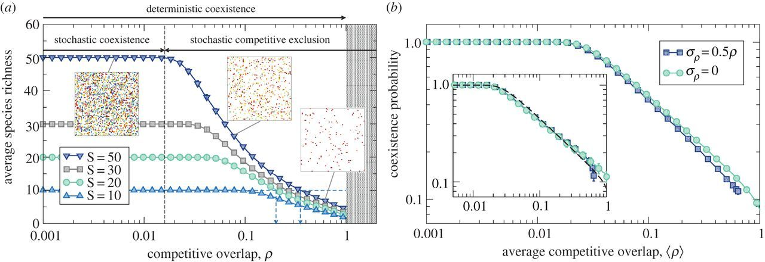
The abundance distribution is the number of species that have individuals.
Species richness is the amount of species that are present in the system.
Capitan et al. 2015

Slide 7

Classic multispecies Lotka-Volterra

Slide 8

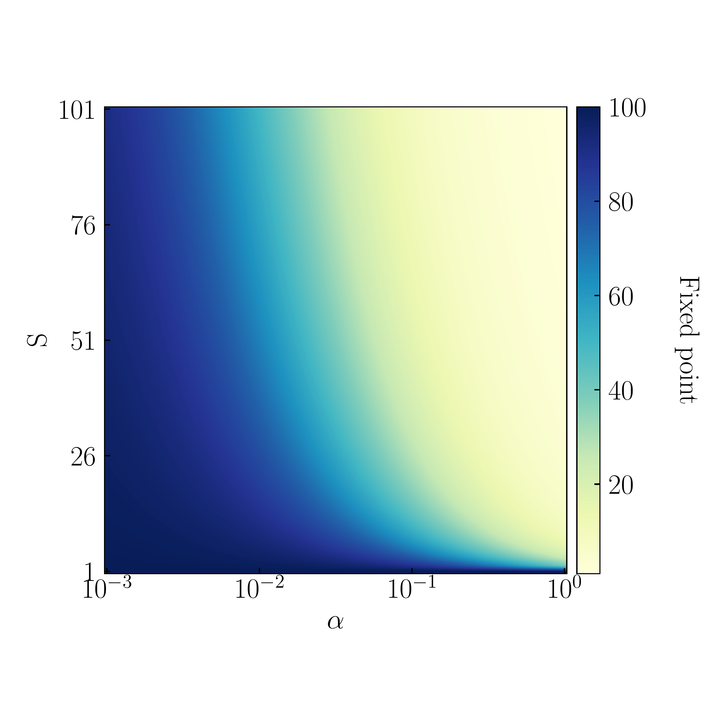
Multispecies Lotka-Volterra with immigration

Slide 9

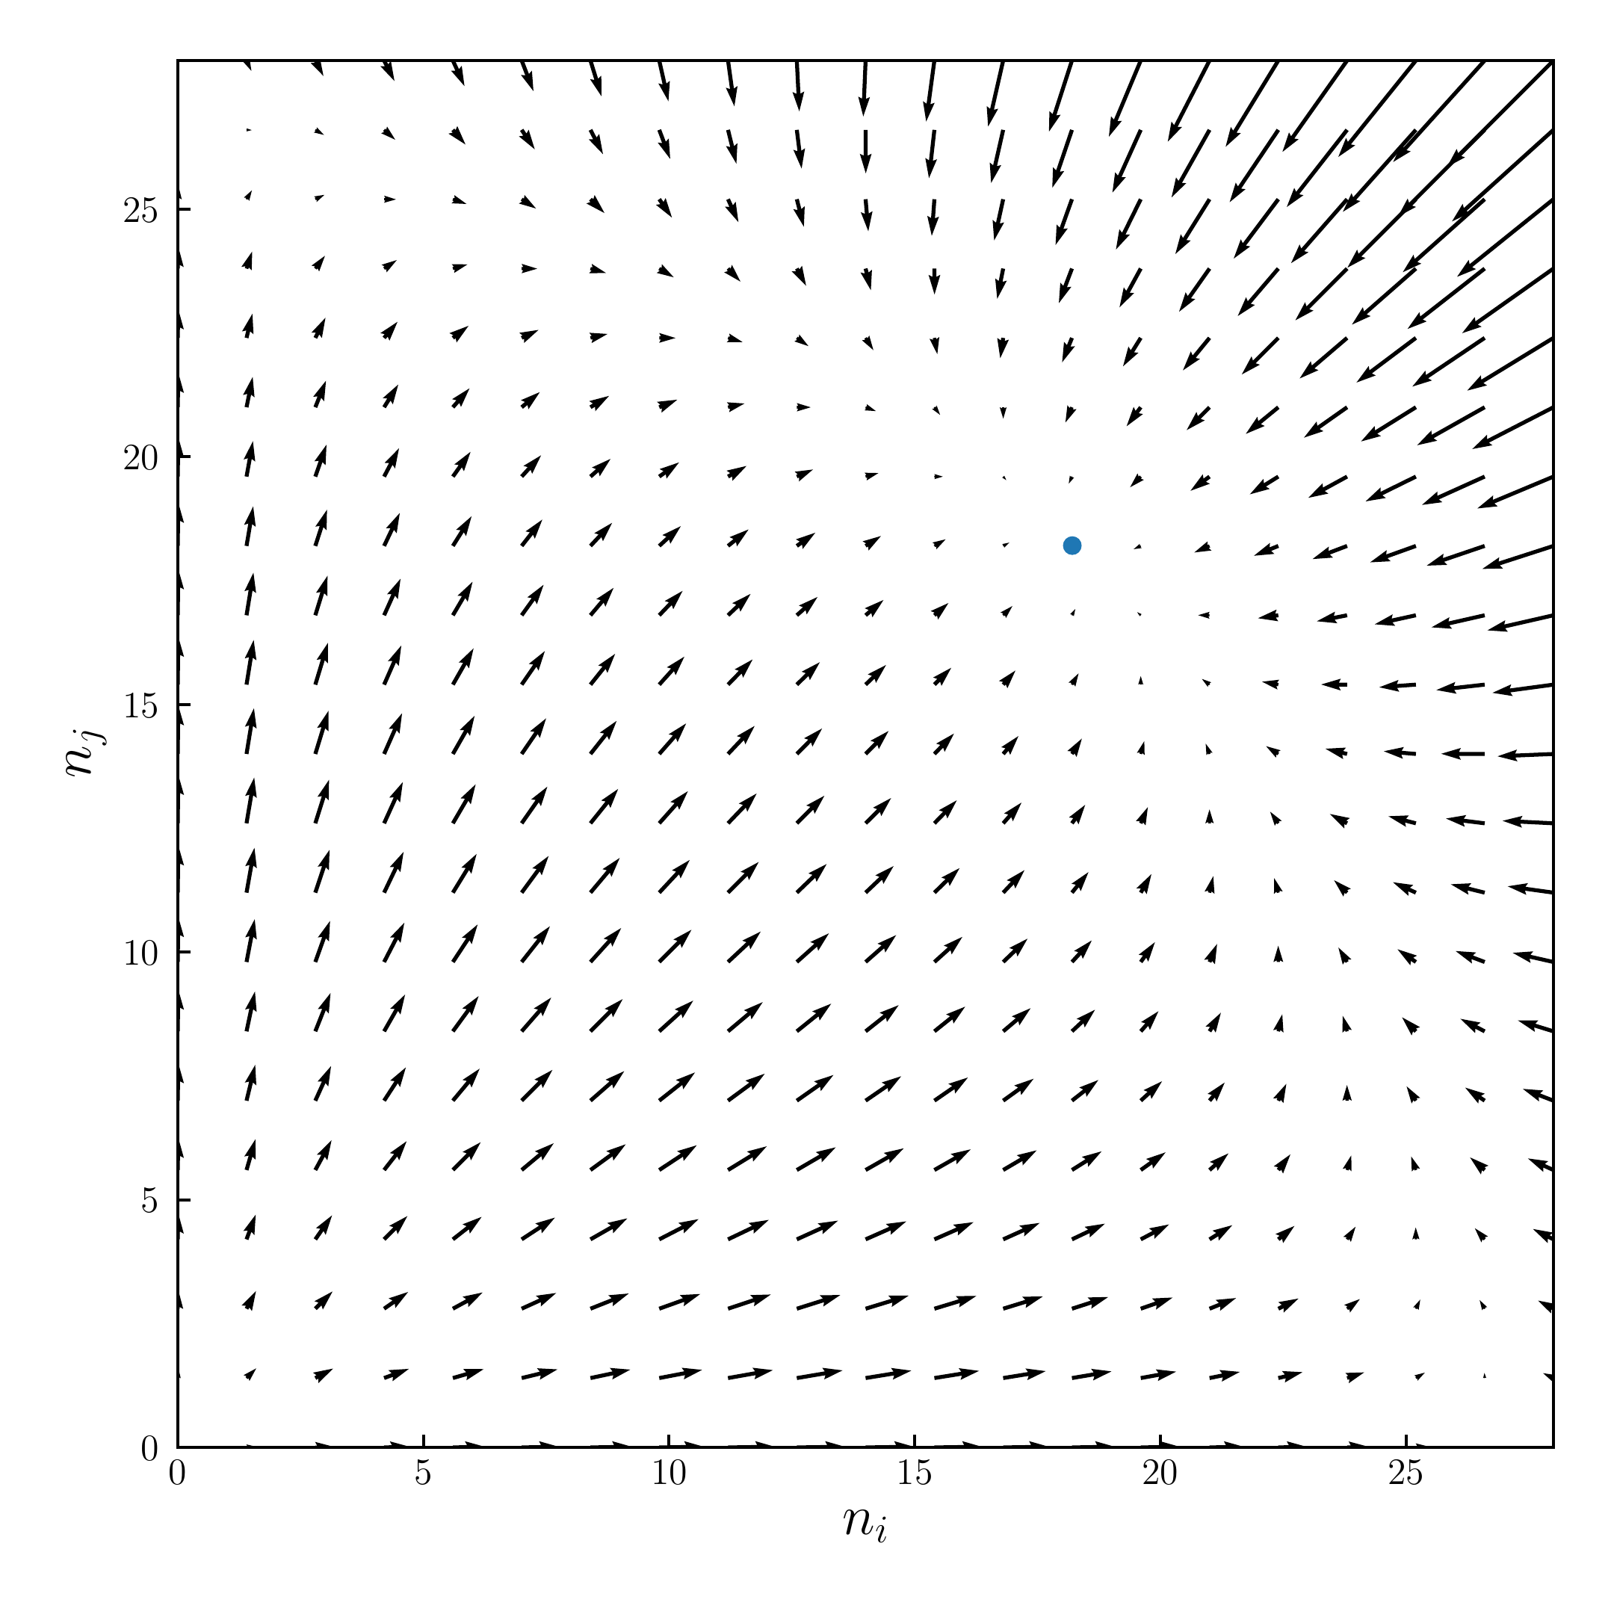

Slide 10
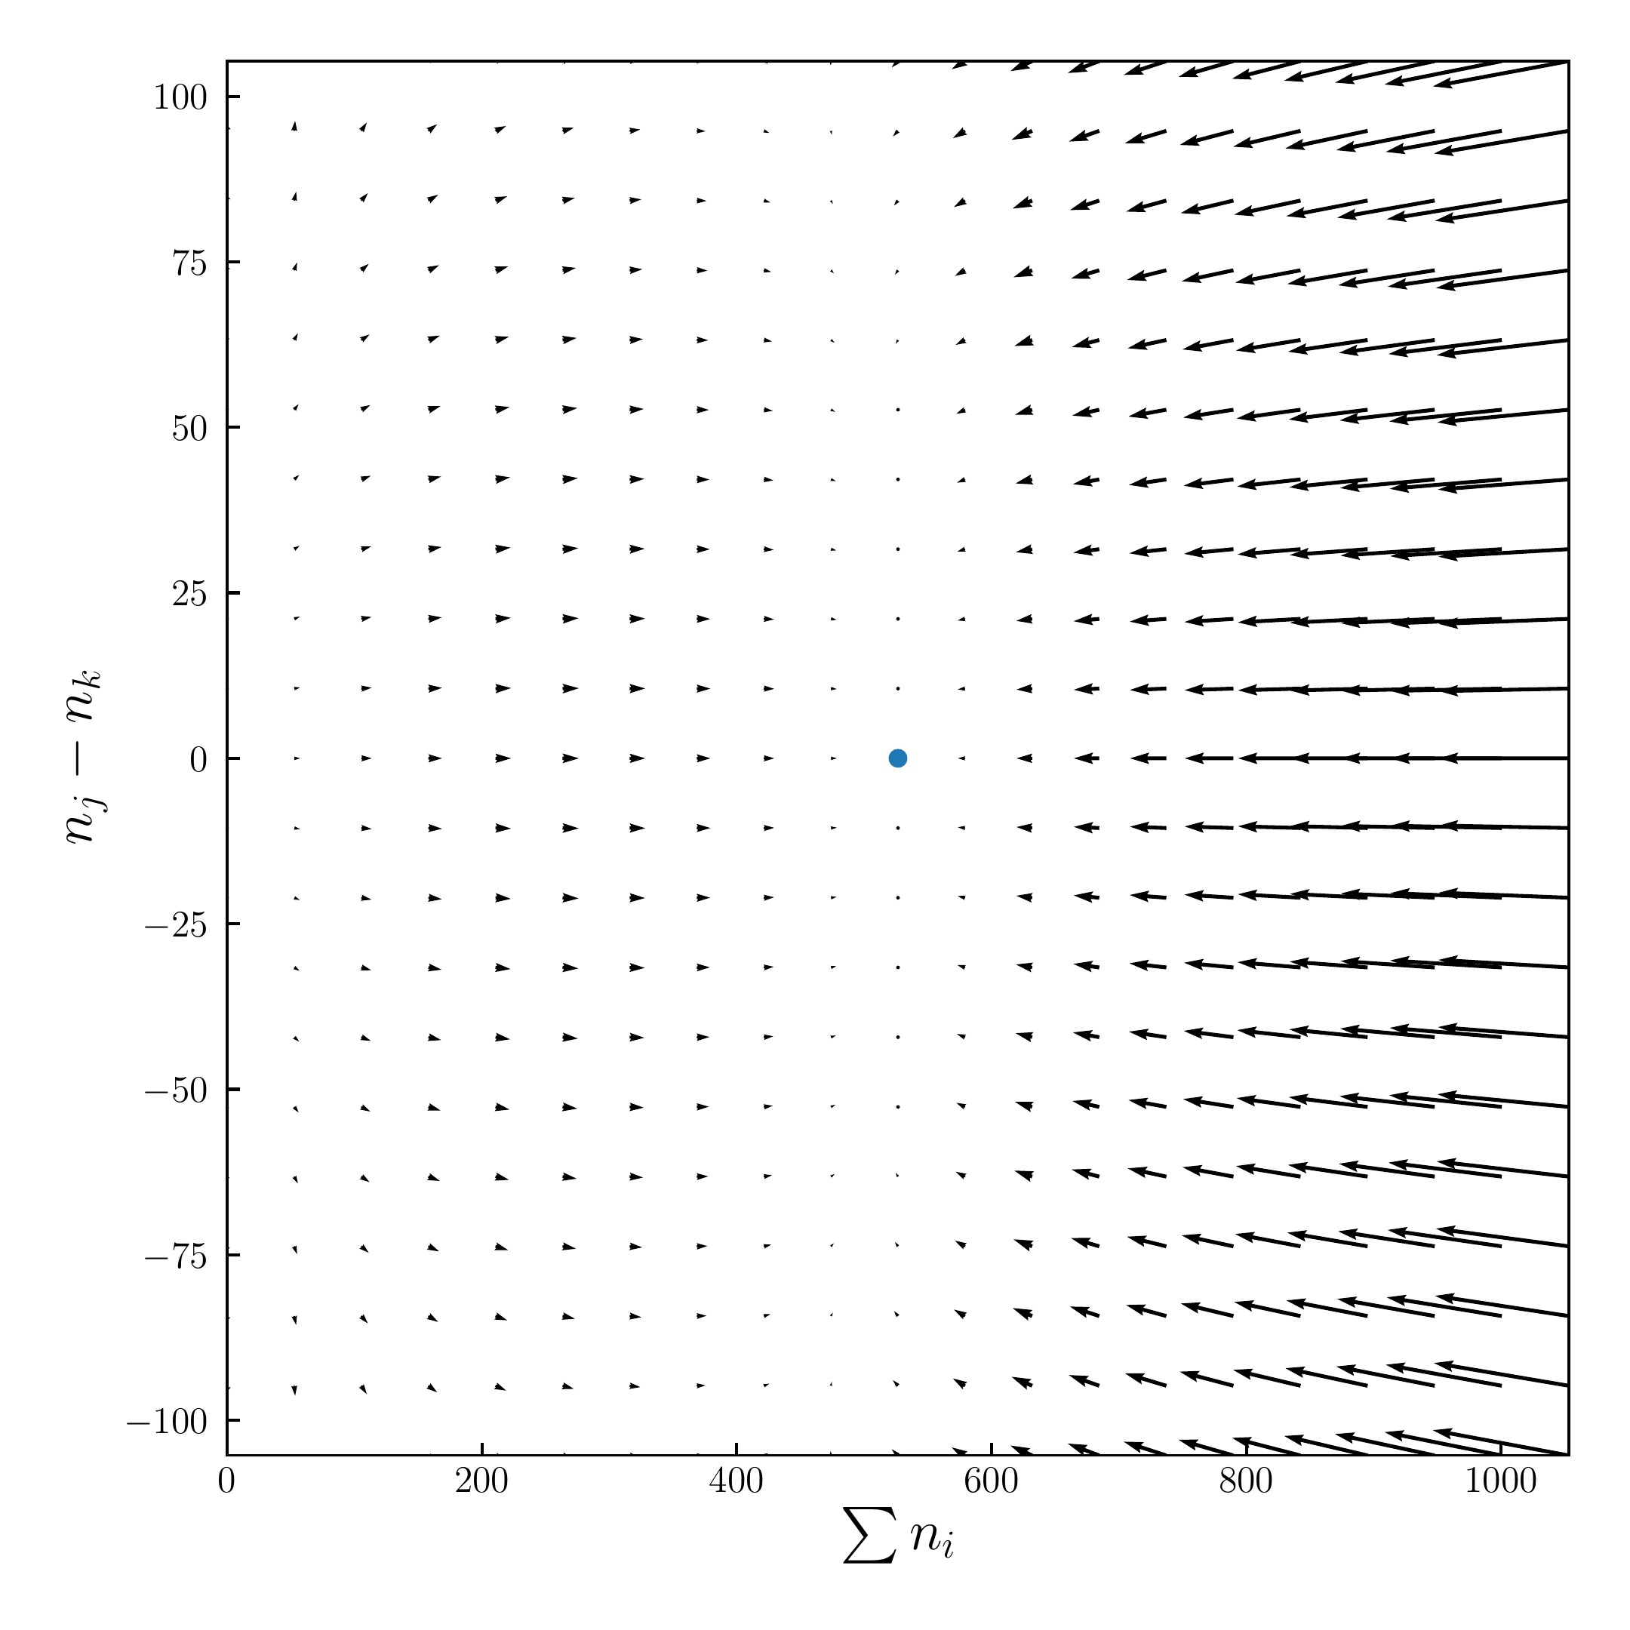
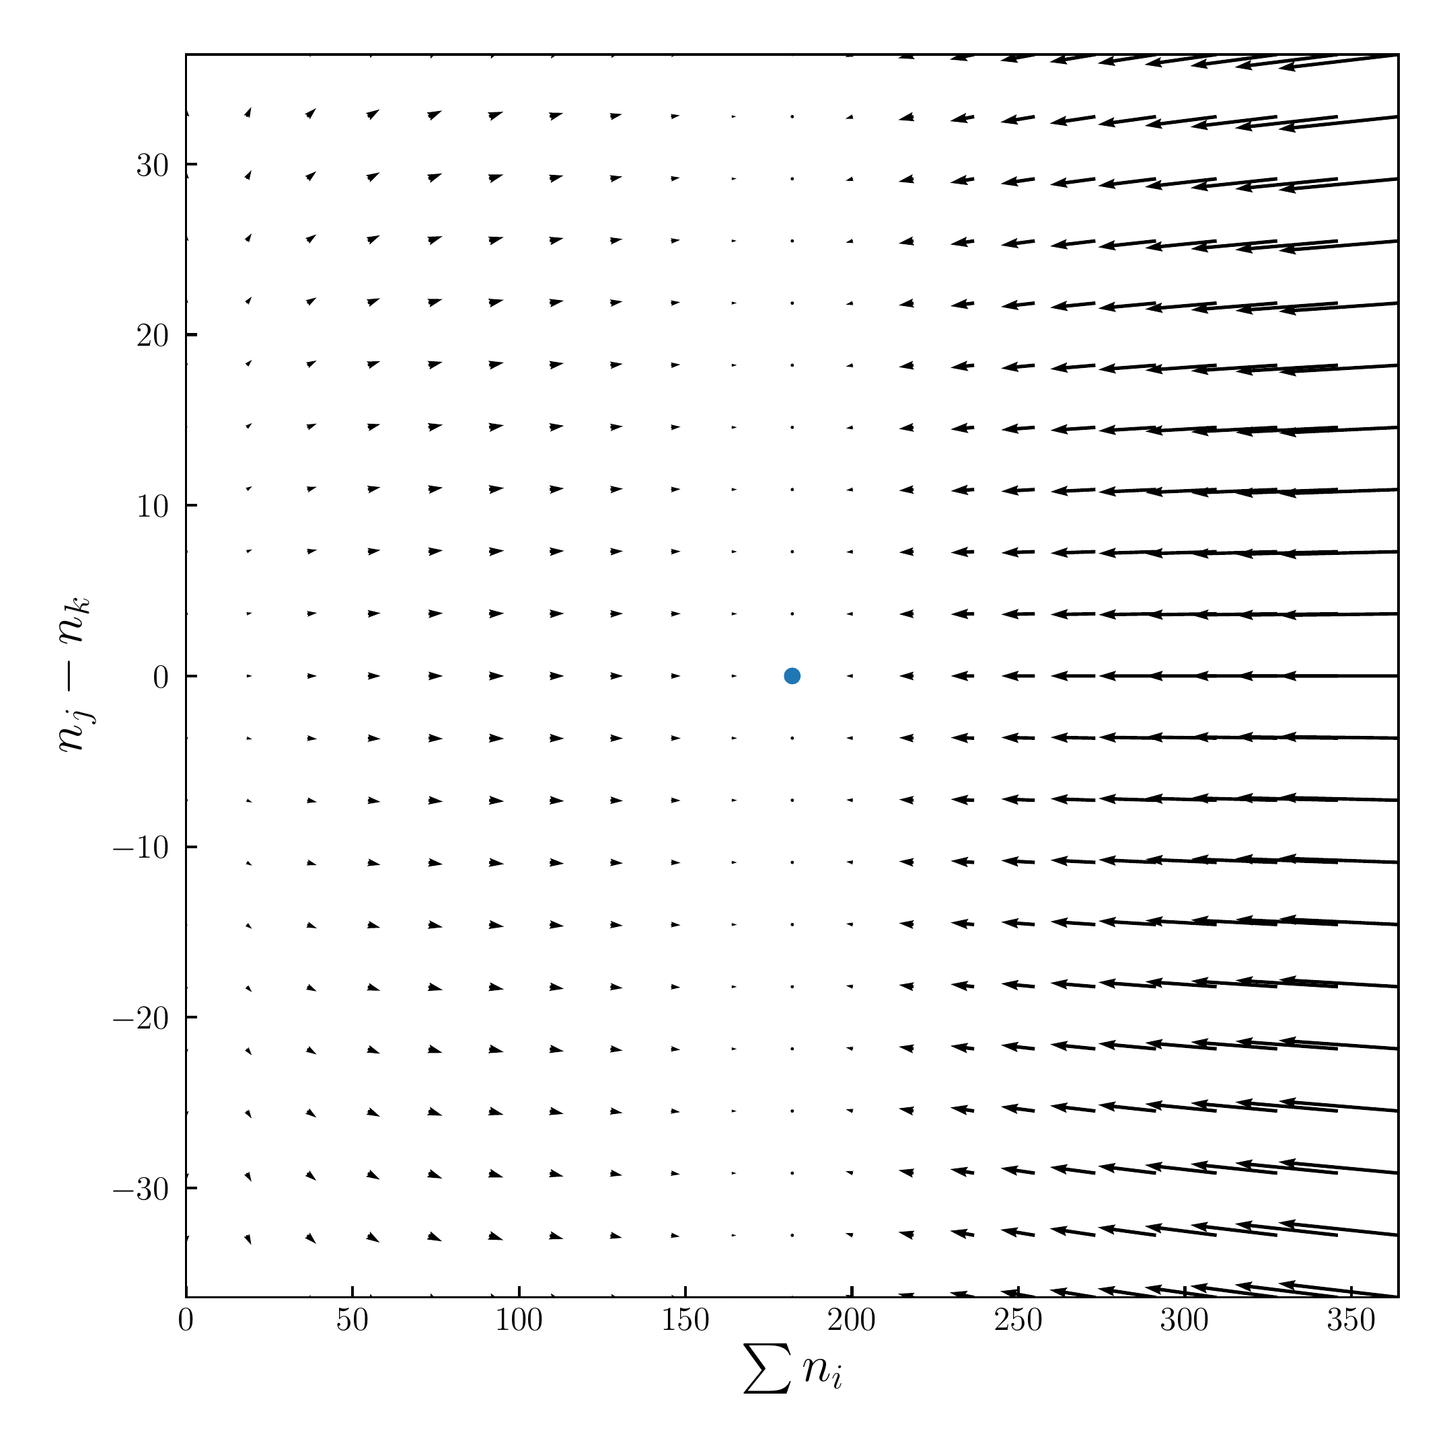
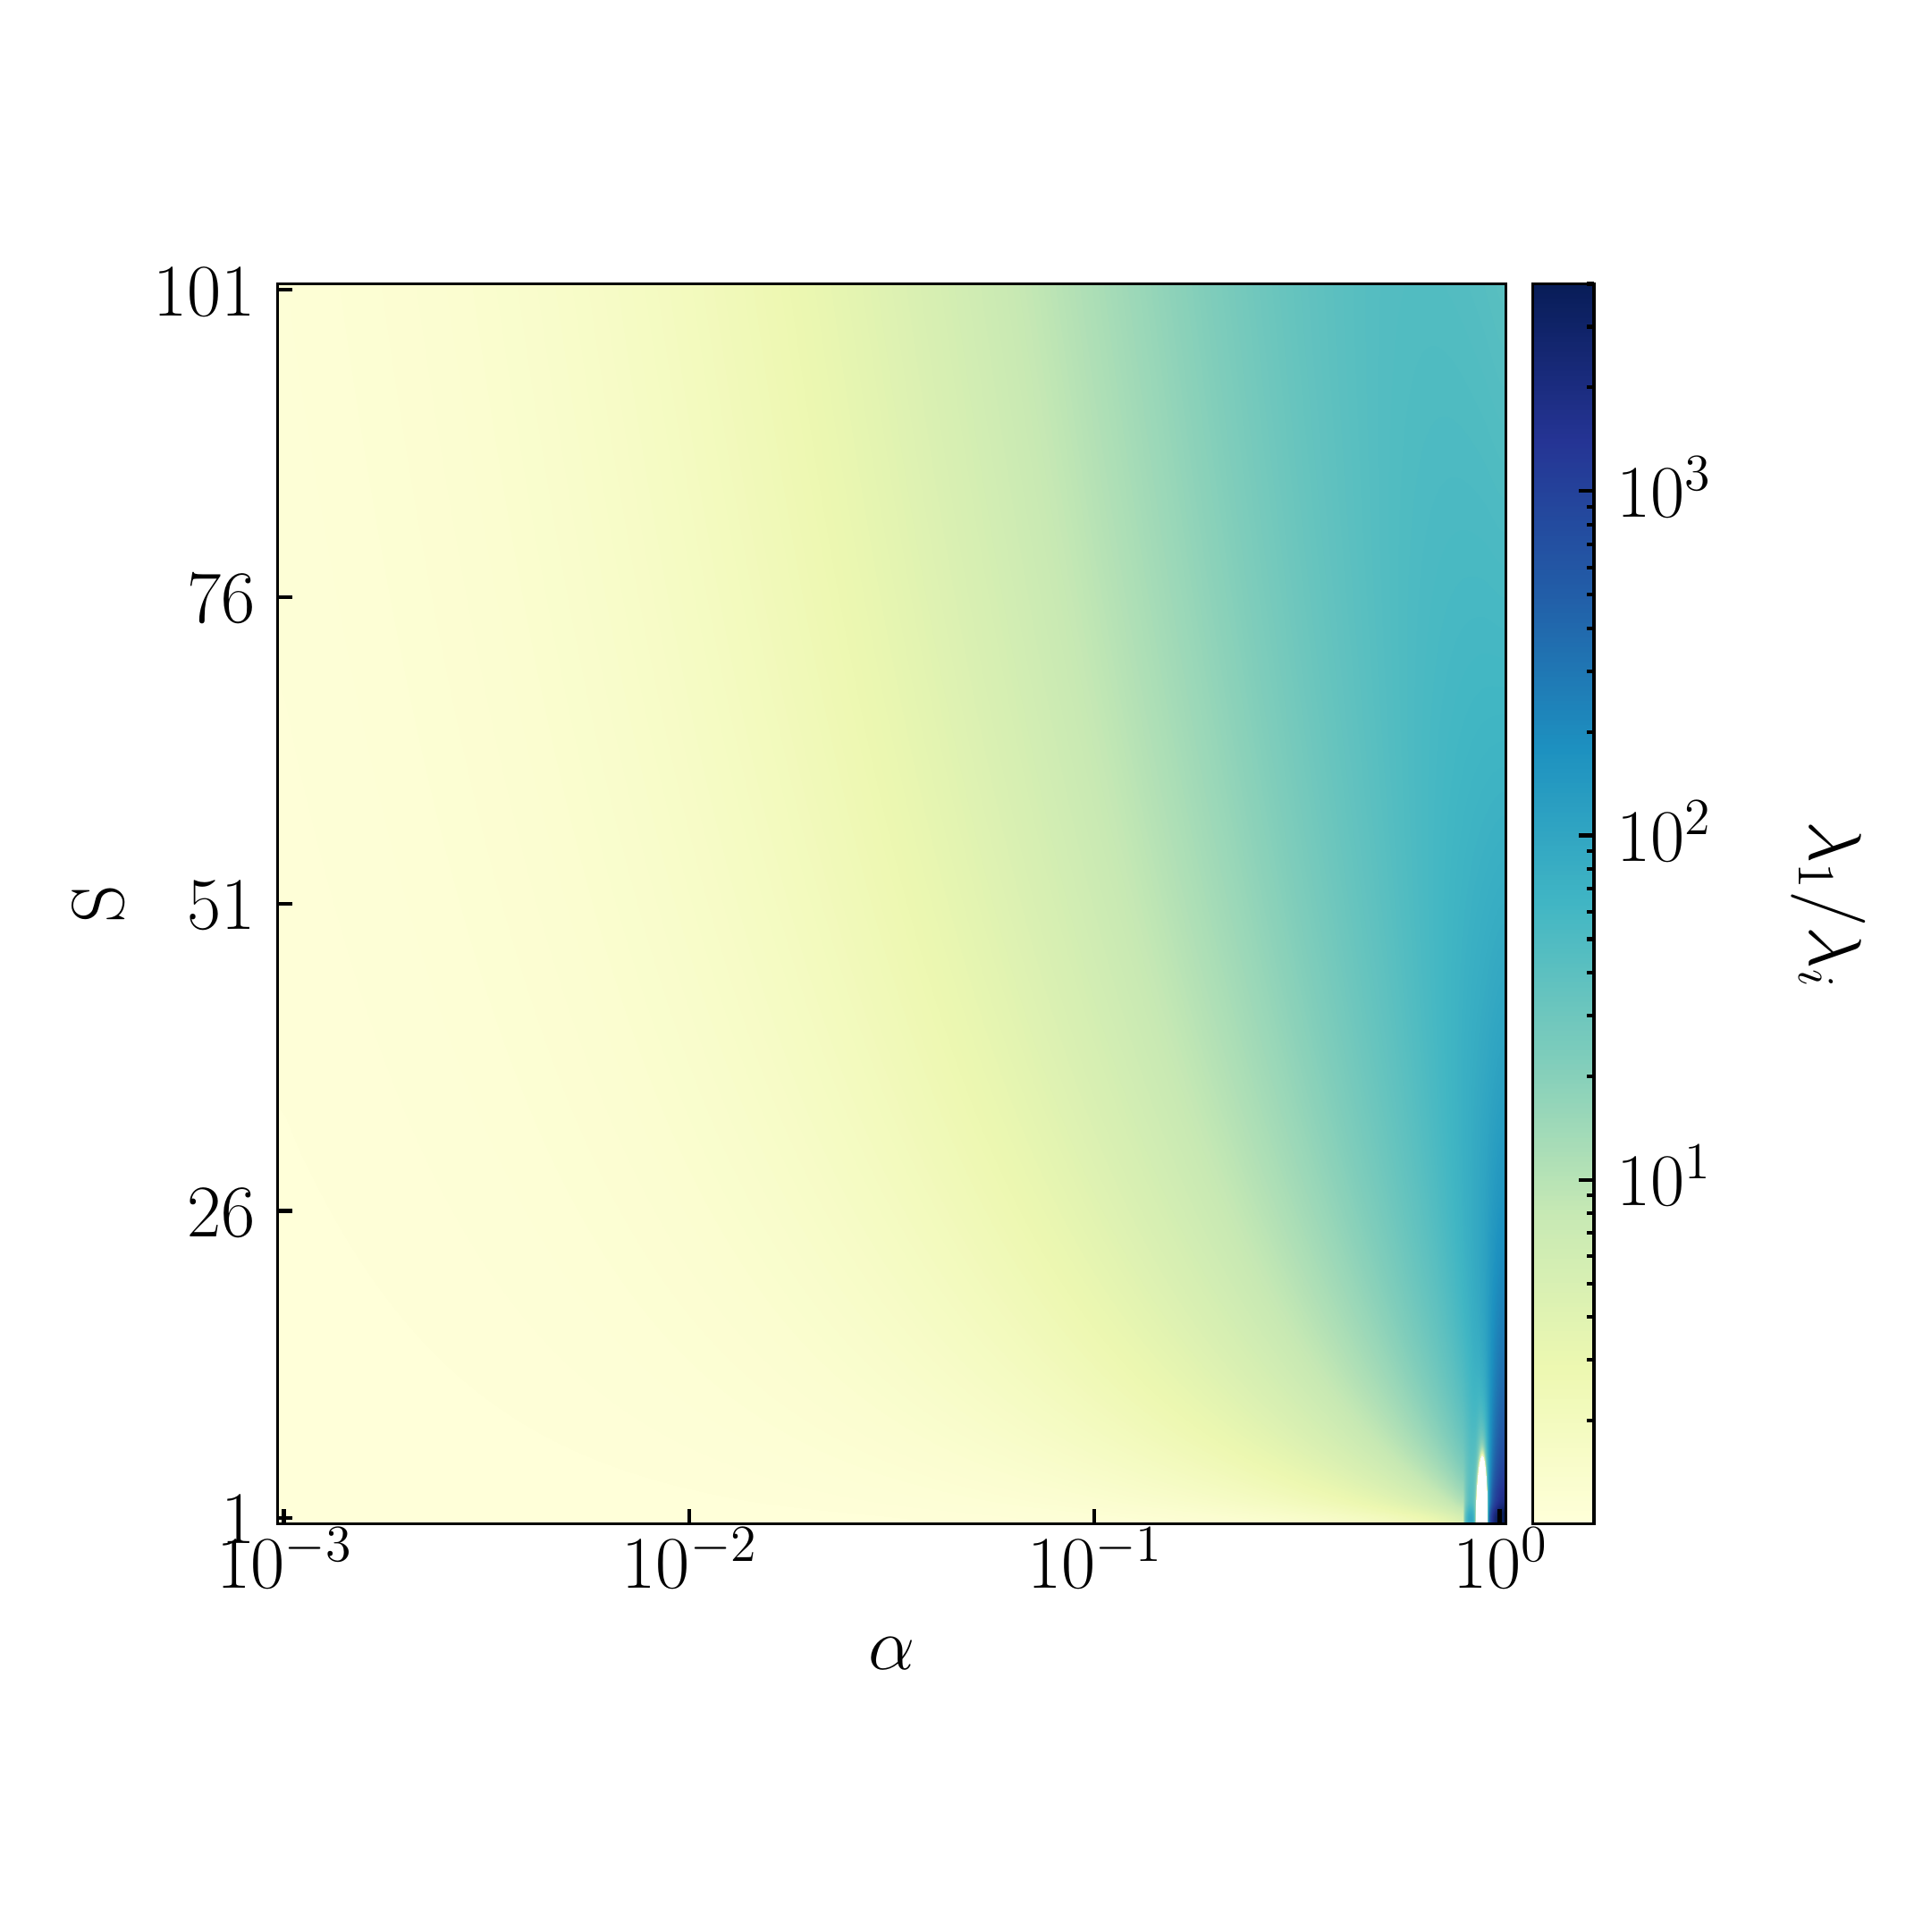
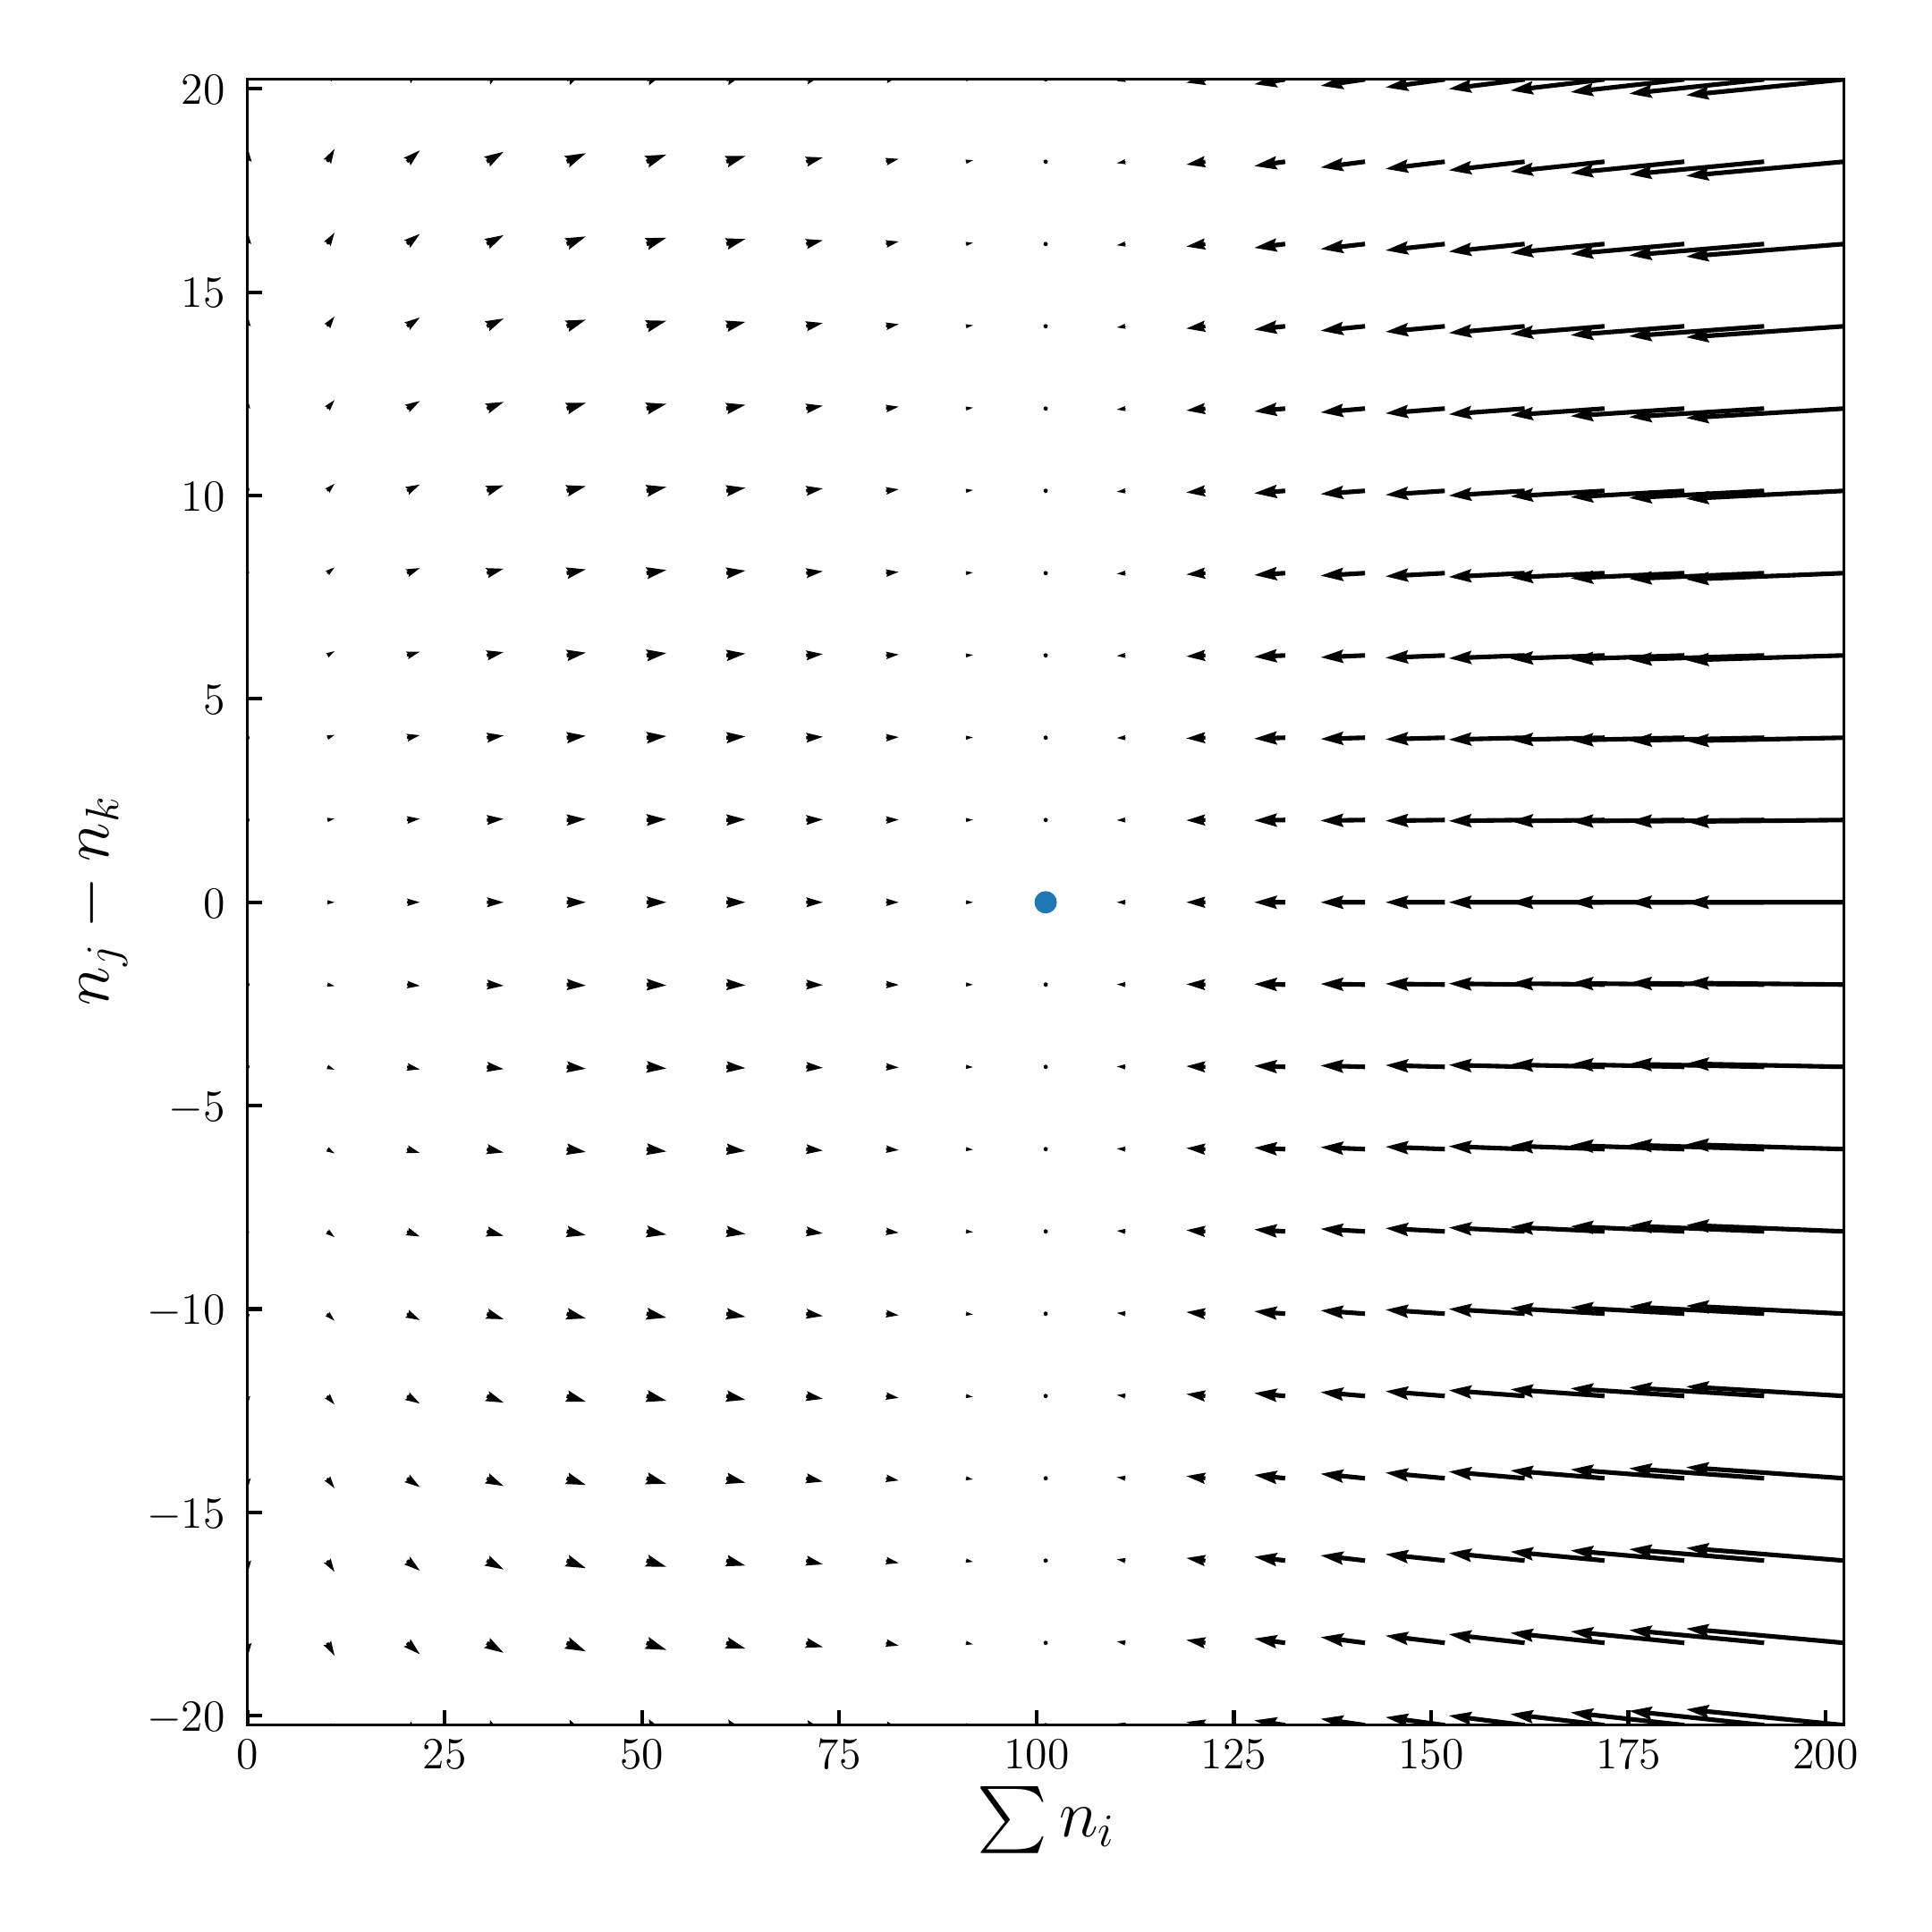

Slide 11


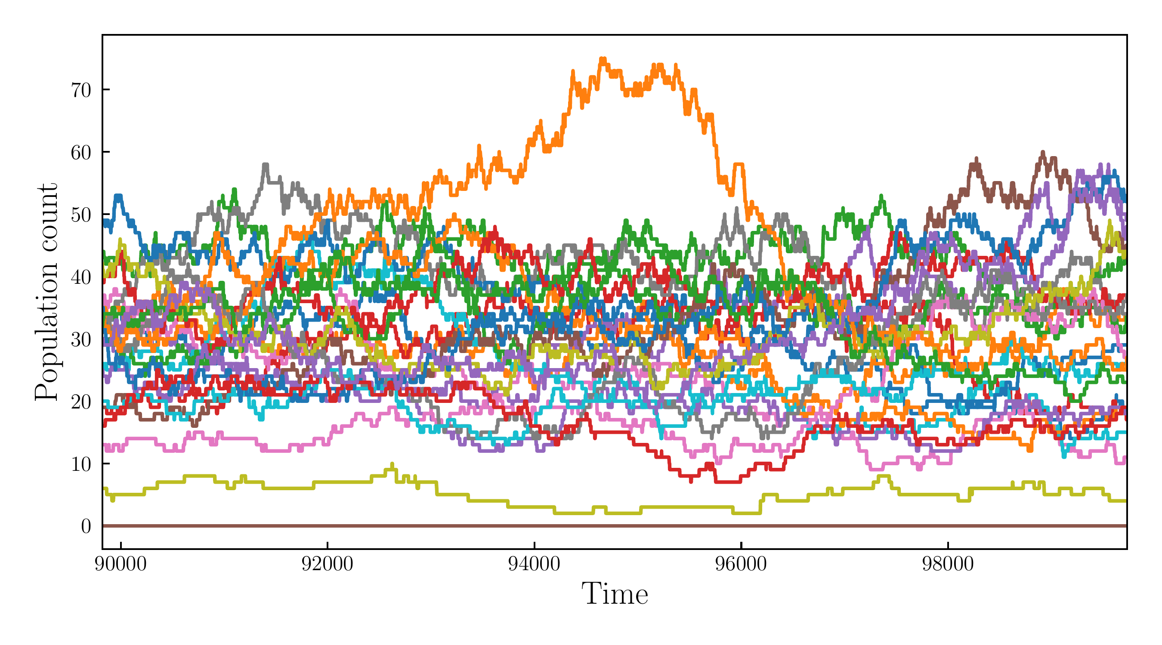
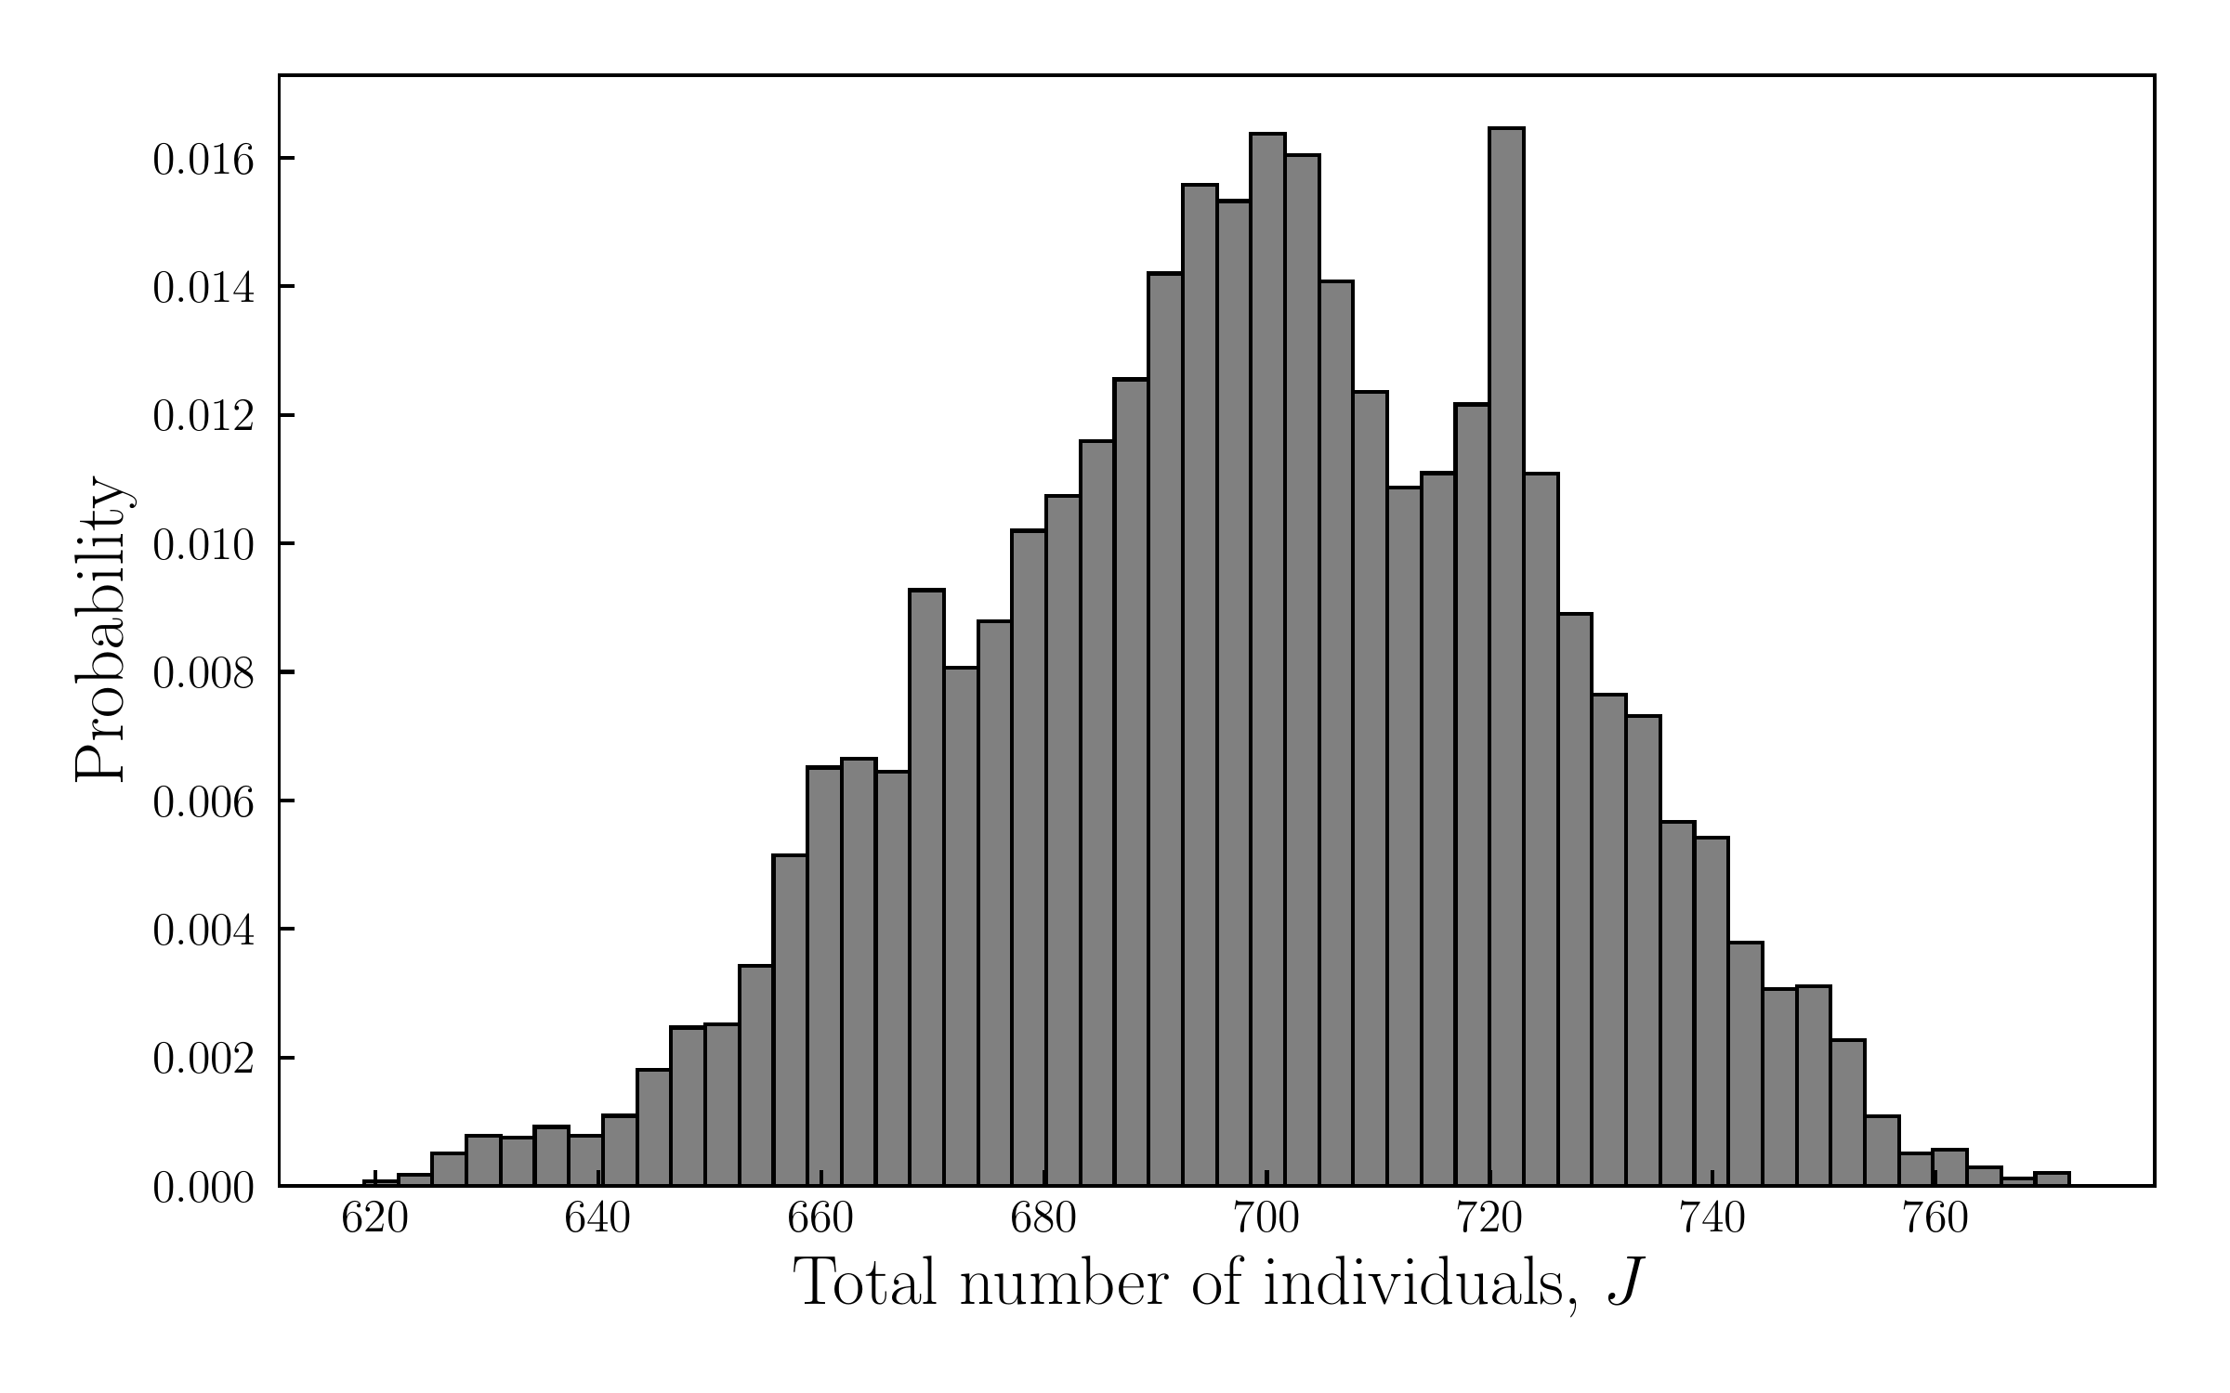

Slide 12



Moran Schemes
…
…
…
…

Slide 13



Immigration
…
Pool
…
…
…
…

Slide 14


Slide 15

Transition to Master Equations

Slide 16


Slide 17
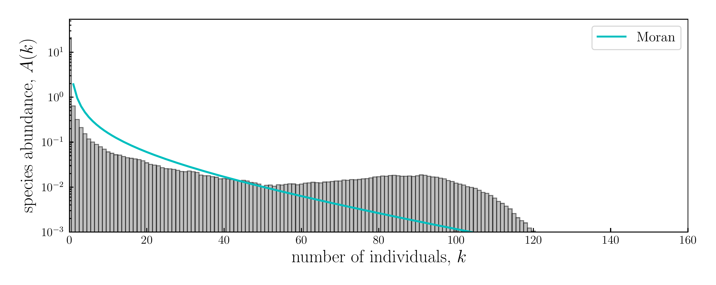
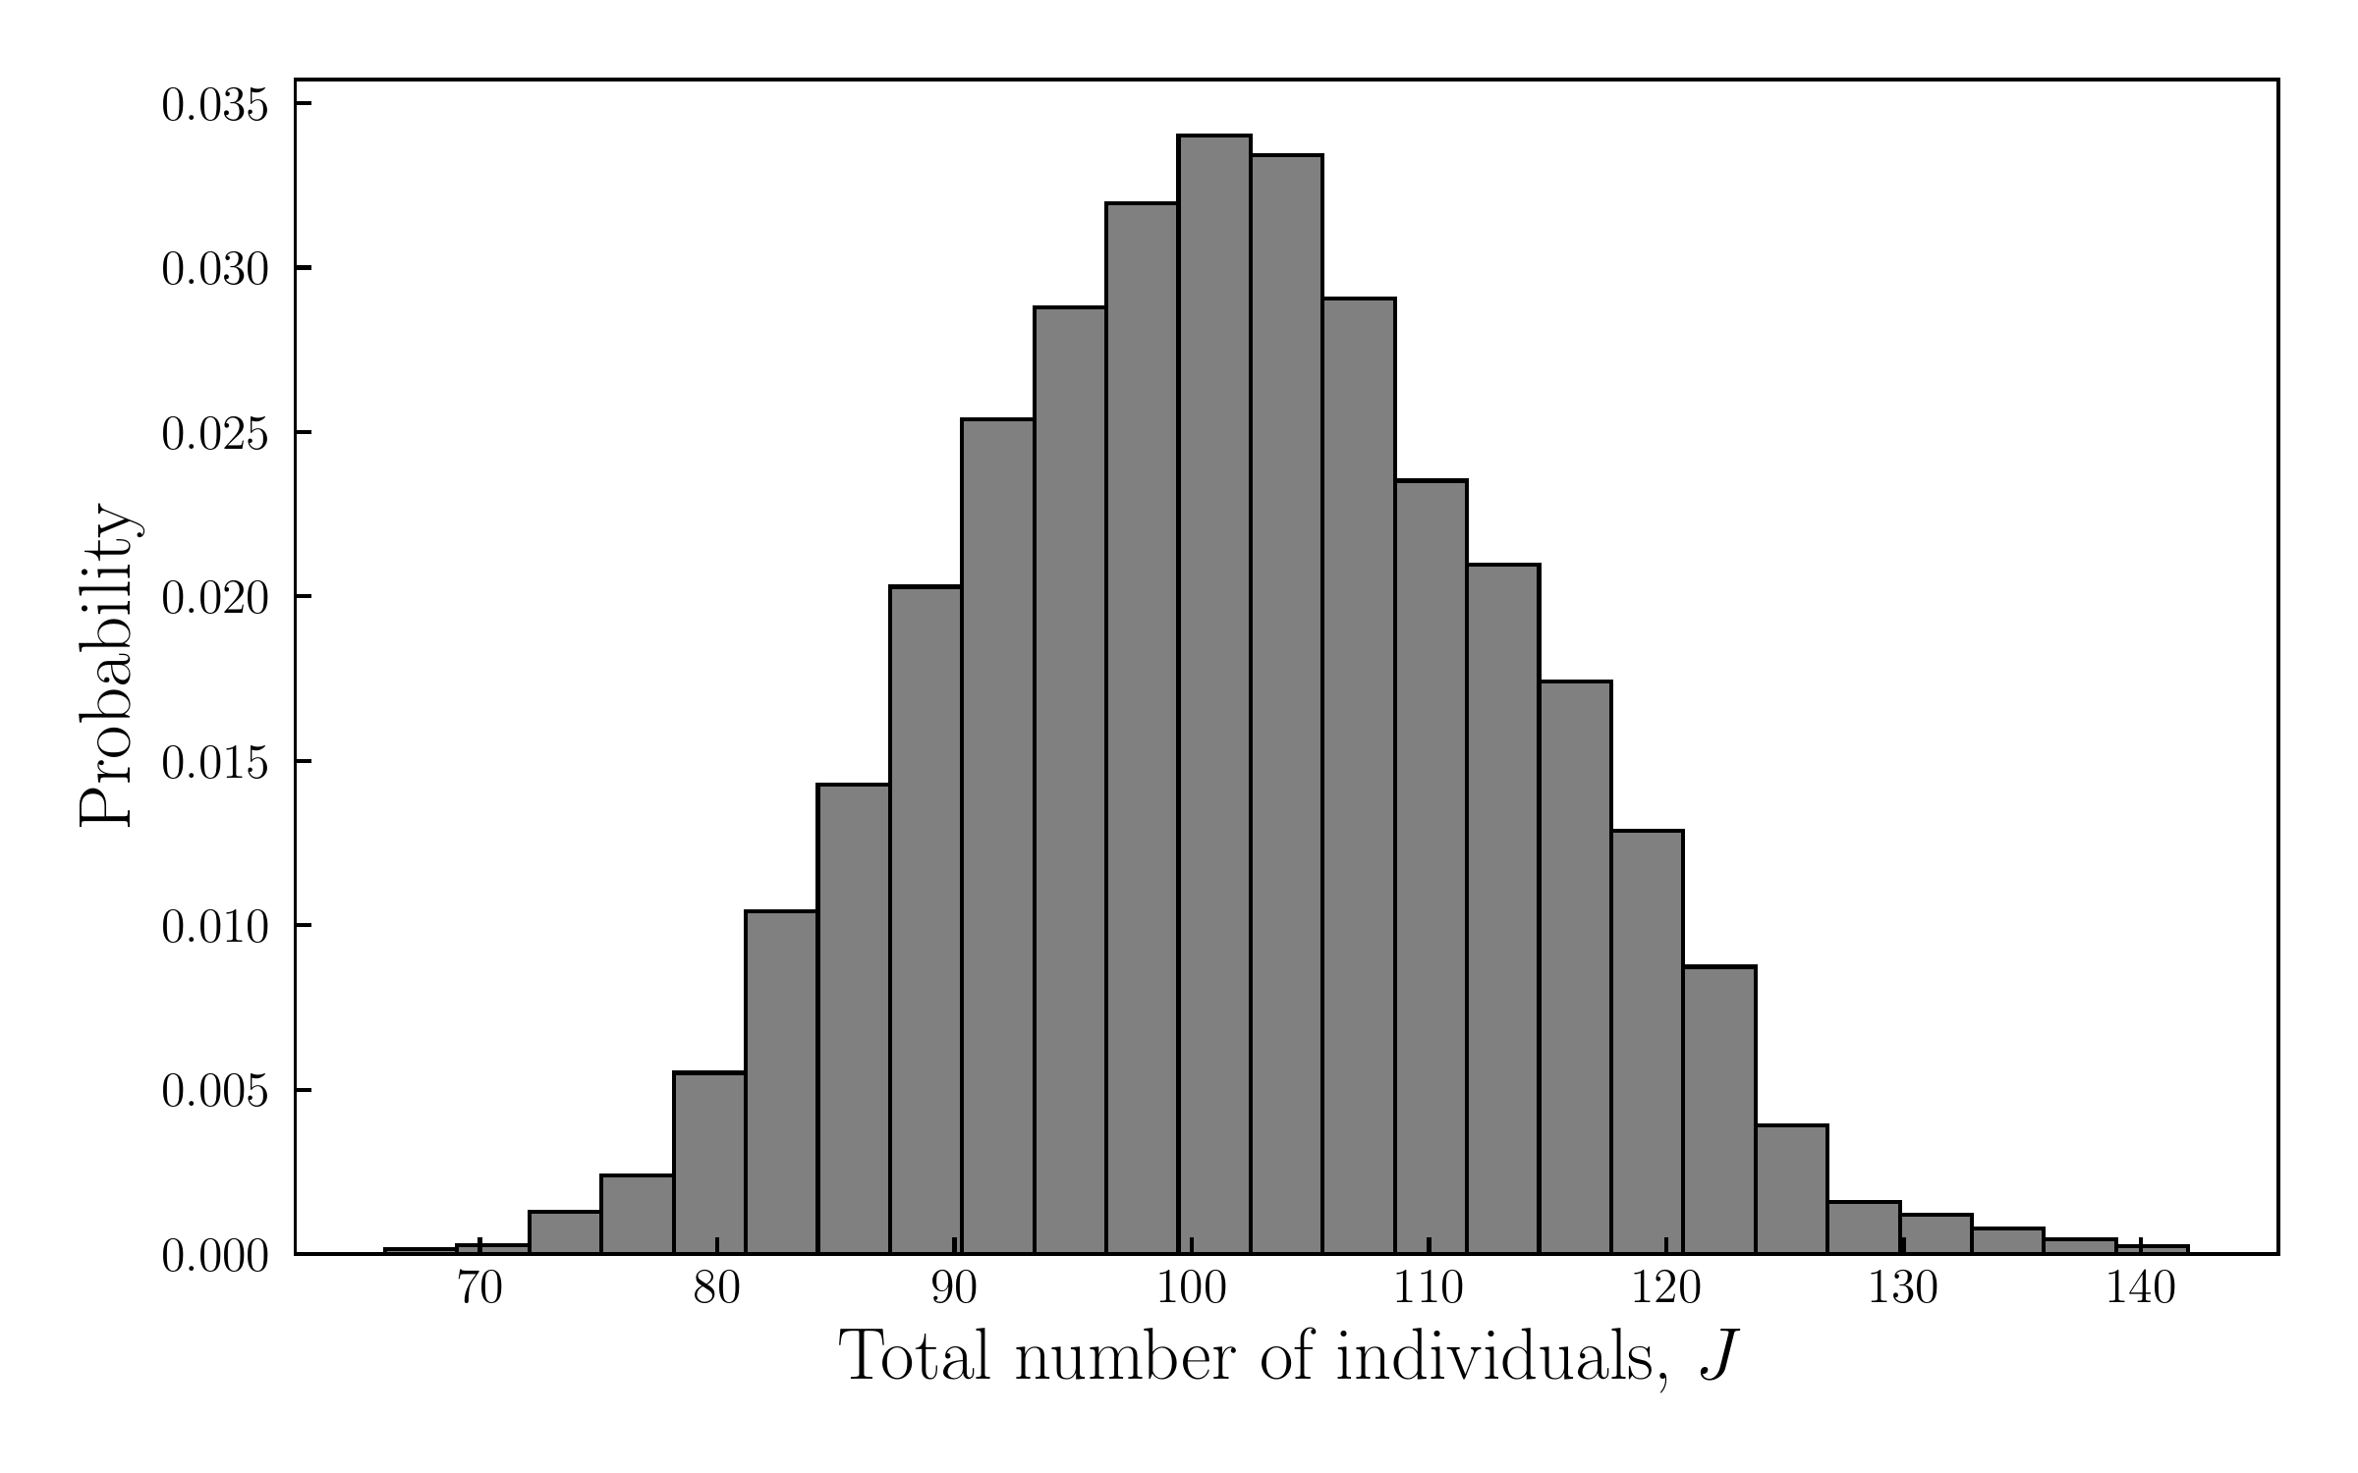

Slide 18


Slide 19
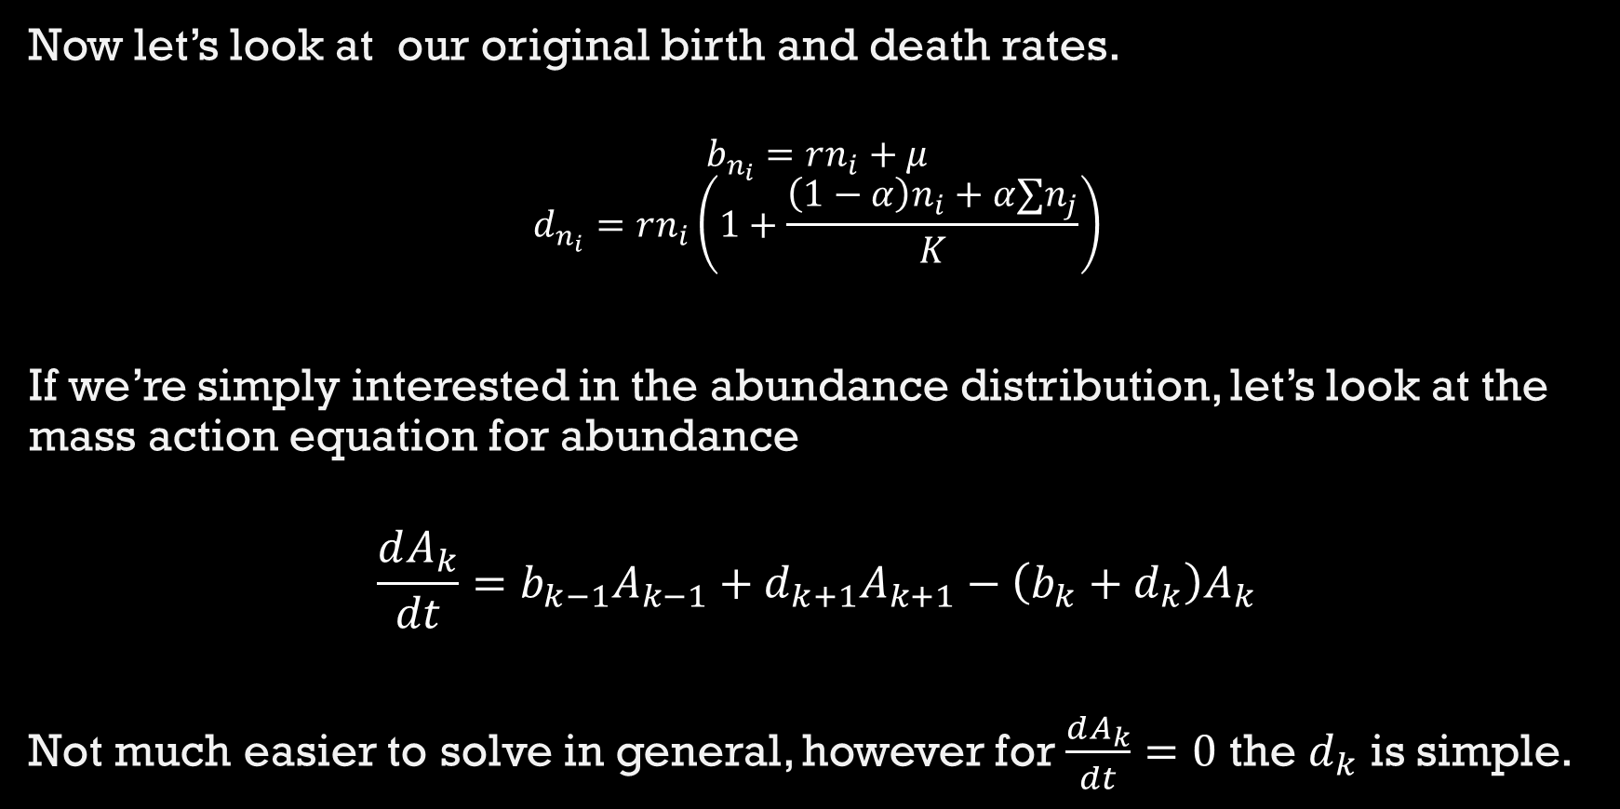

Slide 20

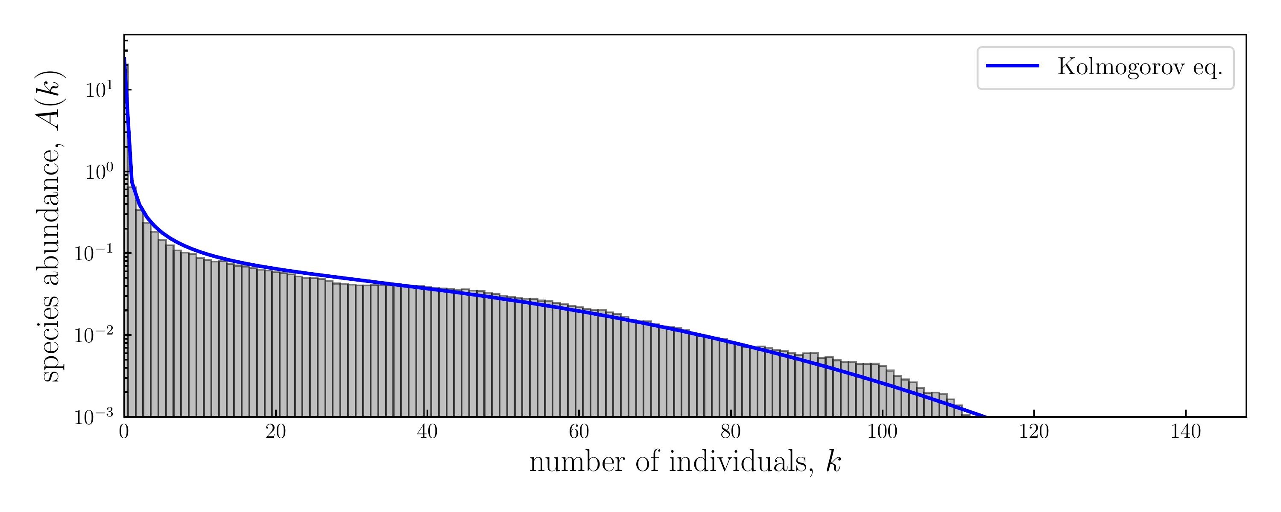
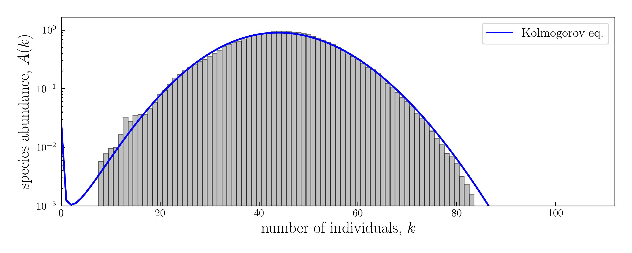

Slide 21
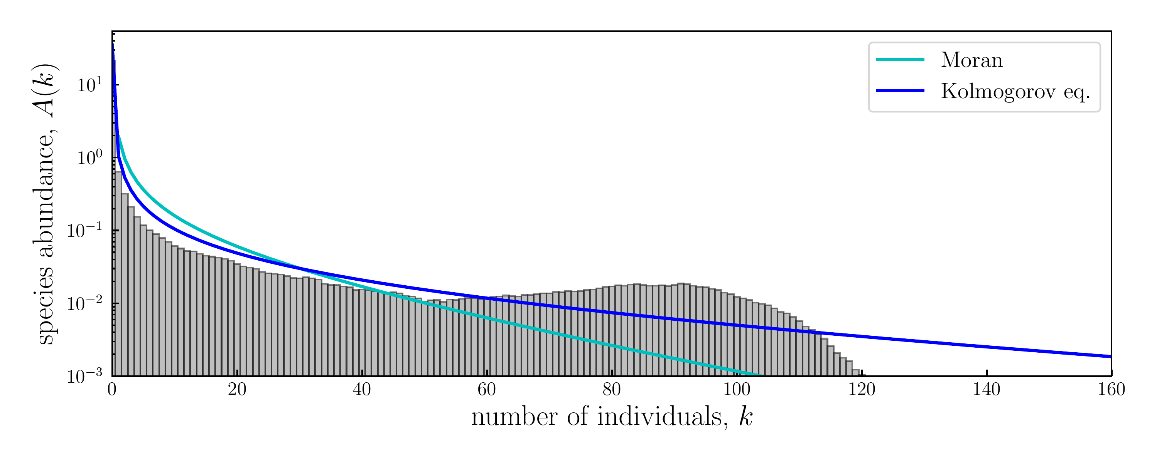

Compare to the Moran Abundance distribution to this distribution. What do we find?
.

Slide 22
Transitions between 2 states
Great, if we have abundance this is nice. However, notice a peak is forming around some n.
What is this peak?
Can we calculate the time it takes for a species to transition from the dominant phase to non dominant?

Slide 23
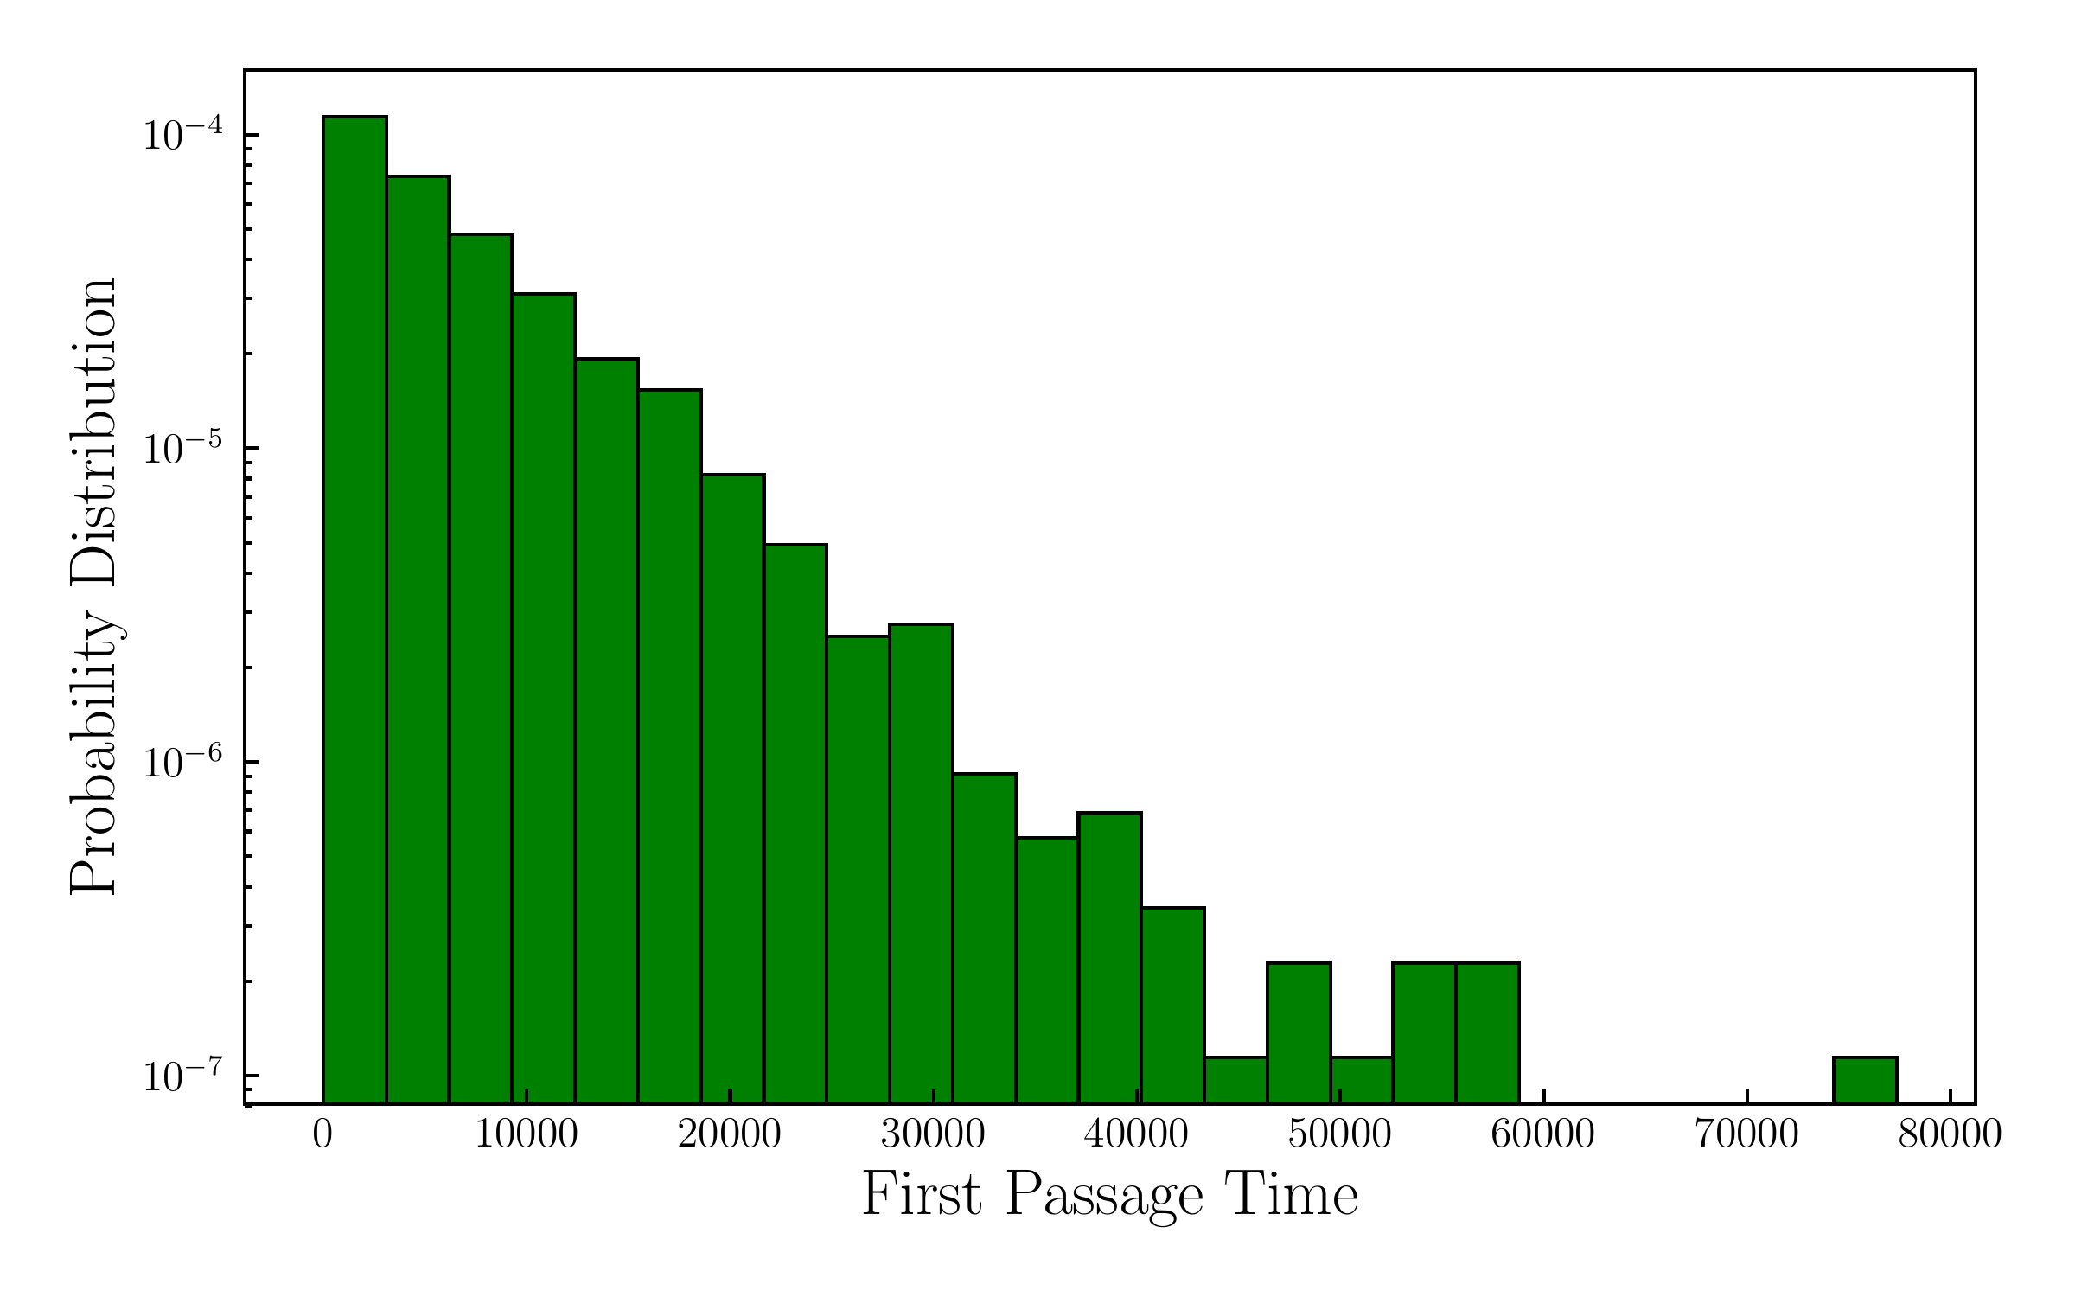
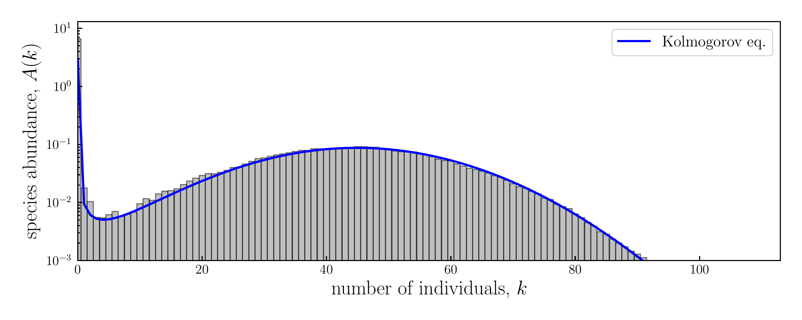
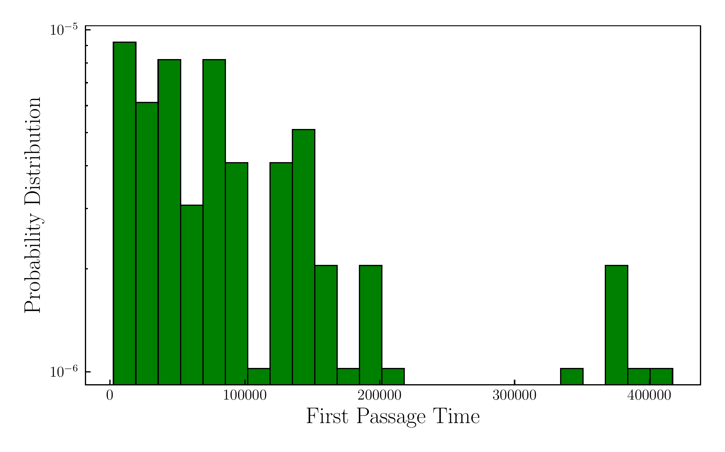
Transitions between 2 states

Slide 24
References
Blythe, Richard A., and Alan J. McKane. "Stochastic models of evolution in genetics, ecology and linguistics." Journal of Statistical Mechanics: Theory and Experiment 2007, no. 07 (2007): P07018.
Capitán, José A., Sara Cuenda, and David Alonso. "How similar can co-occurring species be in the presence of competition and ecological drift?." Journal of the Royal Society Interface 12, no. 110 (2015): 20150604.
Nåsell, Ingemar. "Extinction and quasi-stationarity in the Verhulst logistic model." Journal of Theoretical Biology 211, no. 1 (2001): 11-27.
Zomorrodi, Ali R., and Daniel Segrè. "Synthetic ecology of microbes: mathematical models and applications." Journal of molecular biology 428, no. 5 (2016): 837-861.
Foley, Patrick. "Extinction models for local populations." In Metapopulation biology, pp. 215-246. Academic Press, 1997.

Slide 25
EXTRA SLIDES

Slide 26
Why are we interested in Lotka-Volterra dynamics?
It’s a tractable description of simple pairwise interactions. Although multiple species might exhibit higher-order interactions, a lot can be captured by pairwise.
Can be easily extended to higher dimensional system (adding species)
Historical importance, it’s a model that’s been studied and used to explain data (caveat: when was it used appropriately?)

Slide 27

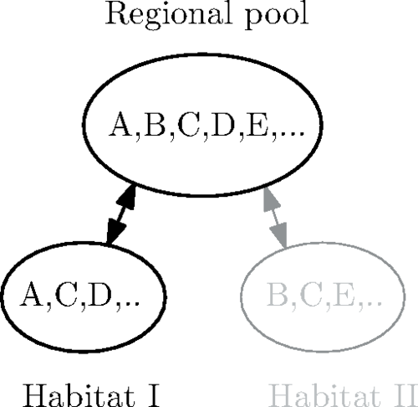
Ecological communities with Lotka-Volterra dynamics (Bunin 2017)
We investigate the dynamics in habitat 1:
However, assume the and are sampled from a regional pool wherein the interspecies interaction term are sampled independently (except for possible correlation ).
The sample rule is
Where
Notes: S is the total number of species in the regional pool. can be negative, represents predators needing prey.

Slide 28
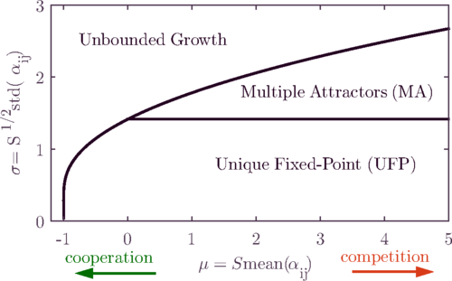

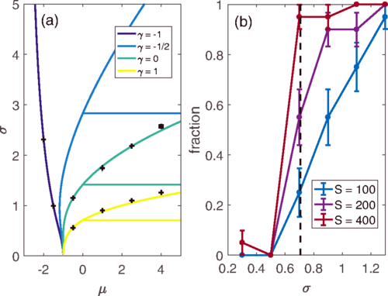
Phase Diagram
Can derive 4 different behaviours of our system at fixed points:
Unbounded growth: cooperation between different species means they continue growing indefinitely
Unique Fixed-Point: For the species present in the habitat, only one possible
Multiple Attractors: Various fixed points exist and whether the system is in one depends on the initial configuration
Dynamical ‘fixed’ points: , oscillations
Investigate the phase space by assuming there exists a Unique Fixed Point and then seeing whether invasions changes the properties of this fixed point (dynamical cavity method).

Slide 29


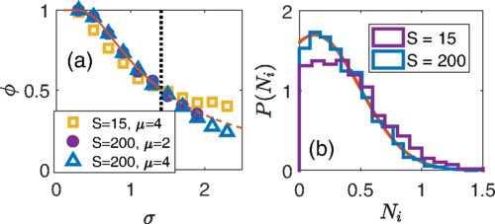
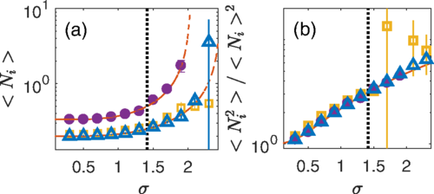
Surprisingly, we can find an analytical form for the abundance of the species (distribution of number of species of size n).
It is gaussian, exact for UFP and approximate for multiple attractors.

