Slide 1

Make Java Profilers Lie Less
Jaroslav Bachorík, Oracle
@yardus
Jaroslav Bachorík, 22nd October 2015

Slide 2

Safe Harbor Statement
The following is intended to outline our general product direction. It is intended for information purposes only, and may not be incorporated into any contract. It is not a commitment to deliver any material, code, or functionality, and should not be relied upon in making purchasing decisions. The development, release, and timing of any features or functionality described for Oracle’s products remains at the sole discretion of Oracle.
Copyright ©2015, Oracle and/or its affiliates. All rights reserved.
Jaroslav Bachorík Prague, 22nd October 2015

Slide 3
About Me
Present
  Member Of JVM Serviceability Group
  BTrace [1] Maintainer
Past
  VisualVM [2] Contributor
  NetBeans Profiler [3] Engineer
Jaroslav Bachorík Prague, 22nd October 2015

Slide 4
Agenda
Let's Define 'Java Profiler'
Types Of Java Profilers
Under The Hood Of Java Profiler
Show Me The Magic!
There Must Be A Better Way
Conclusion
Anything I Forgot To Mention? (Q&A)
Jaroslav Bachorík Prague, 22nd October 2015

Slide 5

1) Let's Define
Java Profiler
Jaroslav Bachorík Prague, 22nd October 2015

Slide 6
Profiling (Definition)
Profiling ("program profiling", "software profiling") is a form of dynamic program analysis that measures, for example
the space (memory) or time complexity of a program
the usage of particular instructions
or the frequency and duration of function calls.
Most commonly, profiling information serves to aid program optimization.
-Wikipedia
Jaroslav Bachorík Prague, 22nd October 2015

Slide 7
Java Runtime
Also „Java Virtual Machine” (JVM)
Intermediate Execution Form – JVM Bytecode
  Programming Language Agnostic
Dynamic In Nature
  Interpreted vs. Compiled
  Just In Time (JIT) Compilation
  Dynamic Optimizations
  Native Representation Of Bytecode Changes In Time
Jaroslav Bachorík Prague, 22nd October 2015

Slide 8
Profiling Java (JVM, In Fact)
CPU
  Utilization
  Frequency And Duration Of Method Calls
Memory
  Space Complexity
  Garbage Collection (GC) Issues
Jaroslav Bachorík Prague, 22nd October 2015

Slide 9
2) Types Of
Java Profilers
Jaroslav Bachorík Prague, 22nd October 2015

Slide 10
Java Profilers
Sampling Profilers
  Coarse Grained Data
  Low Overhead (Usually)
  Stack, Heap Histo
Instrumenting (Or Tracing) Profilers
  Fine Grained Data
  Injecting Bytecode
  Significant Overhead (Usually)
  Class Retransform (JVMTI, java.lang.instrument)
Jaroslav Bachorík Prague, 22nd October 2015

Slide 11
3) Under The Hood
Of Java Profiler
Jaroslav Bachorík Prague, 22nd October 2015

Slide 12
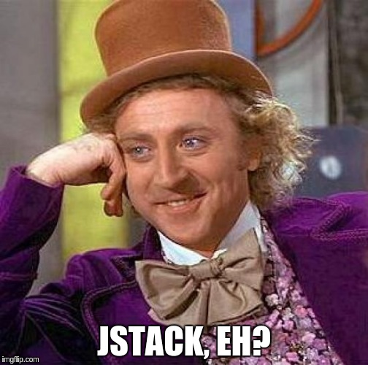
Sampling Profilers
Collecting Thread Stack Samples
  Thread.getAllStackTraces()
"AWT-XAWT" #19 daemon prio=6 os_prio=0 tid=0x00007f08a80ef800 nid=0x647b runnable [0x00007f08b67e5000]
java.lang.Thread.State: RUNNABLE
at sun.awt.X11.XToolkit.waitForEvents(Native Method)
at sun.awt.X11.XToolkit.run(XToolkit.java:568)
at sun.awt.X11.XToolkit.run(XToolkit.java:532)
at java.lang.Thread.run(Thread.java:745)
Locked ownable synchronizers:
- None
Jaroslav Bachorík Prague, 22nd October 2015

Slide 13
Sampling Profilers
Reconstruct Application Profile From Samples
  Approximation
Errors Due To
  Sampling Granularity
  Sampling Bias
Jaroslav Bachorík Prague, 22nd October 2015

Slide 14
Sampling Granularity
Grabbing Stacktrace With Certain Frequency
Might Miss Methods Shorter Than Sampling Period
Shortening Sampling Period Is Limited
  Timer Resolution
  Overhead
    fn(Number Of Threads, Stack Depth)
    Safepoints
Jaroslav Bachorík Prague, 22nd October 2015

Slide 15
Sampling Bias
Preferring Certain Methods
  Regular Execution
  Execution Frequency ~ Sampling Frequency)
Sampler
Timeline
3 Out Of 4 Samples Ended In The Same Method
Other Methods Are Neglected
Jaroslav Bachorík Prague, 22nd October 2015

Slide 16
Sampling Bias
Minimized By Irregular Sampling Period
  Offsetting Each Sampling Interval
    RND(-N, N)
  Maximize Random Interval Randomness
    Normal Distribution \w Big Variance
  Safepoints Are Problematic
Jaroslav Bachorík Prague, 22nd October 2015

Slide 17
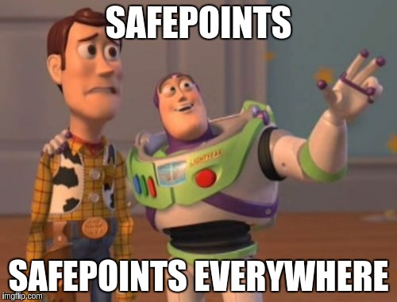
Safepoint
Signaling Known State Of JVM
Inserted By Interpreter
  After Each Bytecode
Arbitrarily Placed By JIT
  On Backedge Of
  Non-Counted Loops
  On Method Exit
  On JNI Call Exit
  May Be Omitted In Hot Code
Jaroslav Bachorík Prague, 22nd October 2015

Slide 18
Sampling And Safepoints
Thread A
Thread B
Thread C
Code Safepoint
Hot Code
Safepoint Reached
Invisible Code
Thread.getAllStackTraces()
Jaroslav Bachorík Prague, 22nd October 2015

Slide 19
Instrumenting Profilers
ByteCode Instrumentation (BCI)
Injecting Profiler Specific Bytecode Sequences
JVMTI Redefine/RetransformClasses
Additional Runtime Information
  Method Parameters Values
  Local Variables
Added Bytecode Will Affect JIT Compilers Decisions
Jaroslav Bachorík Prague, 22nd October 2015

Slide 20
BCI Example
0: sipush 3
3: invokestatic #96 // 'rootMethodEntry:(C)V'
6: nop
7: nop
8: iload_0
9: iload_1
20: iadd
11: sipush 3
14: invokestatic #90 // 'methodExit:(C)V'
17: nop
18: nop
19: ireturn
20: astore_1
21: sipush 3
24: invokestatic #90 // 'methodExit:(C)V'
27: aload_1
28: athrow
int add(int a, int b)
0: iload_0
1: iload_1
2: iadd
3: ireturn
Profile
Jaroslav Bachorík Prague, 22nd October 2015

Slide 21
BCI & JIT
JIT Decisions Affected By Injected Bytecode
  Inlining
    Inlined Method Size
    Caller Size
  Escape Analysis
    TLAB Allocation
    Stack Allocation
Jaroslav Bachorík Prague, 22nd October 2015

Slide 22
Inlining
Maximum Inline Size = 3
Method „y”
  Size = 1
  Will Be Inlined
Method „x”
  Size = 1
  After Inlining Size = 2
int x(int a, int b)
return a + y(b, a);
int y(int a, int b)
Inline!
return a - b;
int x(int a, int b)
int c = a - b;
return a + c;
Jaroslav Bachorík Prague, 22nd October 2015

Slide 23

Inlining \w BCI
Maximum Inline Size = 3
Maximum Caller Size Violated
int x(int a, int b)
int x(int a, int b)
return a + y(b, a);
Inline?
Profiler.entry();
int c = a - b;
int y(int a, int b)
Profiler.exit();
Profiler.entry();
return a + c;
return a - b;
Profiler.exit();
Jaroslav Bachorík Prague, 22nd October 2015

Slide 24
Inlining \w BCI
Maximum Inline Size = 2
Maximum Callee Size Violated
int x(int a, int b)
return a + y(b, a);
Inline?
int y(int a, int b)
Profiler.entry();
return a - b;
Profiler.exit();
Jaroslav Bachorík Prague, 22nd October 2015

Slide 25
Escape Analysis \w BCI
Original Code
Instrumented Code
void dummy()
void dummy()
MyInstance i = new Instance();
MyInstance i = new Instance();
i.doOperation();
Profiler.inspect(i);
i.doOperation();
Heap
Stack
Non-escaping instance allocated on stack
No GC involved
Profiler.inspect(i) makes 'i' to escape
Instance is allocated on heap
GC is involved
Jaroslav Bachorík Prague, 22nd October 2015

Slide 26
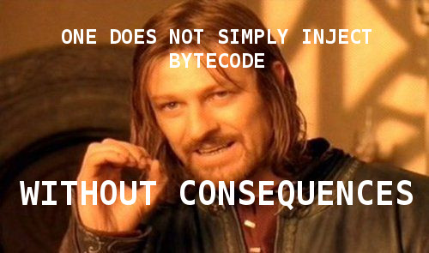
Unintended Consequences
JIT
  Optimization Decisions
  ReOpt/DeOpt
  Code Cache
Application Execution
  Timing
  Locking Order
  Additional Heap Allocations
Jaroslav Bachorík Prague, 22nd October 2015

Slide 27

Profiler Whopsies
Sampling Profilers
  Unexpected Overhead Due To Safepoints
  Unexpected Bias Due To Safepoints
Instrumenting Profilers
  BCI Affects JIT Optimization Decisions
  BCI Affects Memory Management
  BCI Affects Lock & Synchronization
Jaroslav Bachorík Prague, 22nd October 2015

Slide 28
4) Show Me
The Magic! (Demo)
Jaroslav Bachorík Prague, 22nd October 2015

Slide 29
Profiling Results (BCI)
Run Method
Profile Method
Inlining | Duration | Total | % | Duration | Total | %
Default | 0.44 | 6.81 | 6.46 | 8.2 | 660 | 1.24
3 | 0.44 | 6.98 | 6.3 | 9.5 | 684 | 1.39
40 | 0.44 | 6.03 | 7.3 | 7.4 | 653 | 1.13
200 | 0.44 | 9.58 | 4.59 | 15 | 680 | 2.21
1000 | 0.44 | 10.5 | 4.19 | 24 | 725 | 3.31
Jaroslav Bachorík Prague, 22nd October 2015

Slide 30
5) There Must Be
A Better Way
Jaroslav Bachorík Prague, 22nd October 2015

Slide 31
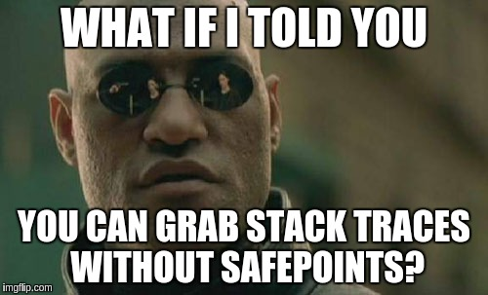
AsyncGetCallTrace
Internal API for Oracle Studio Performance Analyzer
Used by Java Flight Recorder (Oracle Commercial Feature)
Unsupported API
Despite That Used by 3rd Parties
  Honest Profiler [4]
Jaroslav Bachorík Prague, 22nd October 2015

Slide 32
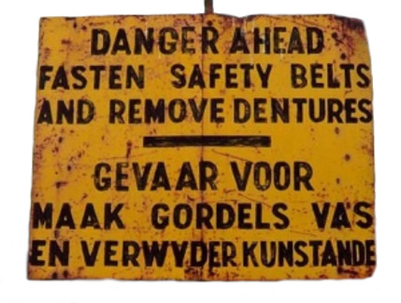
AsyncGetCallTrace
Interrupt Running Thread And Call Handler
Only Async-Safe Code In Handler
  See 'man 7 signal' For The List
Does Not Depend On Safepoints
Shows What Is Actually Being Scheduled
Does Not Guarantee Complete Data
  Missing Frames
  Incomplete Frames
  No Inlined Methods
Jaroslav Bachorík Prague, 22nd October 2015

Slide 33
Java Flight Recorder
Oracle Commercial Feature
Free To Use In Development
  -XX:+UnlockCommercialFeatures
  -XX:+FlightRecorder
Use Java Mission Control To Inspect Recording
  Available in JDK 8+ as 'jmc'
Use 'jcmd' To Initiate Recording
  jcmd <PID> JFR.start duration=60s filename=myreco.jfr
Jaroslav Bachorík Prague, 22nd October 2015

Slide 34
Java Flight Recorder
Very Low Overhead
Based On Events
  Many Events Built In JVM
    Reducing Need for BCI
  Application Specific Events (WLS, DMS, 3rd party)
Using AsyncGetCallTrace Internally
  Avoiding Safepoints Pitfalls
  All Limitations Of AsyncGetCallTrace
Jaroslav Bachorík Prague, 22nd October 2015

Slide 35
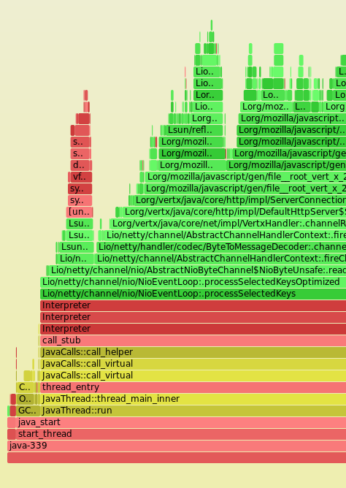
System Profiler
-XX:+PreserveFramePointer
  JDK 8u60, 9
Full Application Stack Available
Only Linux
  perf
Need To Map Symbols
  perf-map-agent [5]
Still Few Wrinkles To Iron
  Symbols Changing In Time
CPU Flame Graphs [6]
Jaroslav Bachorík Prague, 22nd October 2015

Slide 36
Microbenchmarks
Measure Performance In Controlled Environment
Stabilize JVM (JIT etc.) Before Measuring
Particulary Effective During Development
  Optimize Performance Single Method At A Time
  Guards Against Performance Regressions
Will Not Help Uncovering The Problems
Jaroslav Bachorík Prague, 22nd October 2015

Slide 37


Microbenchmarks
Hard To Do Properly
Require Intimate Knowledge of JVM
Java Microbenchmark Harness (JMH) [7]
  Abstract Away Gory Details
  Integrated Profilers (stack, perf, perfasm, gc, …)
  OpenJDK Project
Jaroslav Bachorík Prague, 22nd October 2015

Slide 38
JMH Profilers
JMH Can Profile Benchmarked Methods
  stack, gc, perf, perfnorm, perfasm
'perfasm' Profiler
  Using 'perf' To Collect Profile
  Shows Annotated Assembly Code
    Java Instruction
    Source Line Number
    Inlining
  Requires 'hsdis' [8]
Jaroslav Bachorík Prague, 22nd October 2015

Slide 39

BCI-Less JVMTI Profiler
JVMTI Method Entry/Exit Event
Does Not Affect JIT
Does Not Need Stack Traces
Once Enabled ALL Methods Are Tracked
  Huge Overhead
Jaroslav Bachorík Prague, 22nd October 2015

Slide 40
Improved BCI-Less Profiler
Half-Baked Idea So Far
  JVMTI Events With Reduced Overhead
Provide 'Slots' By Interpreter/Compiler
  NOPs At Method Entry/Exit
Enable Profiling Per Method
  Replace Slot By Handler Hook
Implementation At Interpreter/Compiler Level
Jaroslav Bachorík Prague, 22nd October 2015

Slide 41
6) Conclusion
Jaroslav Bachorík Prague, 22nd October 2015

Slide 42

Sampling And Instrumentation
Incomplete Or Skewed Data
Profiling Affects Application Execution
„Low Hanging Fruits” Almost Not Affected
Error Increasing With Detail Level
  „Heisenberg Uncertainity Principle”
Strive For Repeatable Measurements
Know Your „O”
Jaroslav Bachorík Prague, 22nd October 2015

Slide 43
Non Traditionals
AsyncGetCallTrace
  Not Supported
  Possibly Missing Frames
Java Flight Recorder
  Commercial Product
  → AsyncGetCallTrace
System Profiler
  Only Linux
  Still Missing Pieces
Microbenchmarks
  Won't Help To Identify Problems
Jaroslav Bachorík Prague, 22nd October 2015

Slide 44
Improving Situation
AsyncGetCallTrace
  Promote To Suported API
  -XX:+PreserveFramePointer Synergy
  Allow Unwinding Inlined Frames
Native Probe API
  Use Interpreter/Compiler 'Slots' For Easy Instrumentation
  Very Complicated Implementation
Jaroslav Bachorík Prague, 22nd October 2015

Slide 45
7) Did I Forget
Anything? (Q&A)
Jaroslav Bachorík Prague, 22nd October 2015

Slide 46
Resources
[1] https://github.com/jbachorik/btrace
[2] http://visualvm.java.net/
[3] https://profiler.netbeans.org/
[4] https://github.com/RichardWarburton/honest-profiler
[5] https://github.com/jrudolph/perf-map-agent
[6] http://techblog.netflix.com/2015/07/java-in-flames.html
[7] http://openjdk.java.net/projects/code-tools/jmh
[8] https://github.com/AdoptOpenJDK/jitwatch/wiki/Building-hsdis
Jaroslav Bachorík Prague, 22nd October 2015

Slide 47
THANK YOU!
jaroslav.bachorik@oracle.com, @yardus
Jaroslav Bachorík Prague, 22nd October 2015

