Slide 1
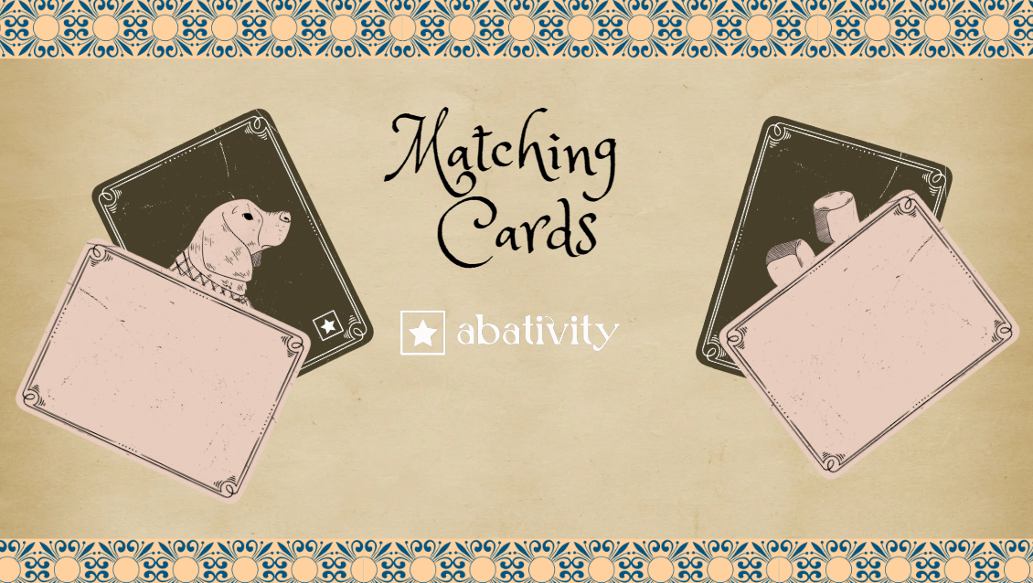

Slide 2

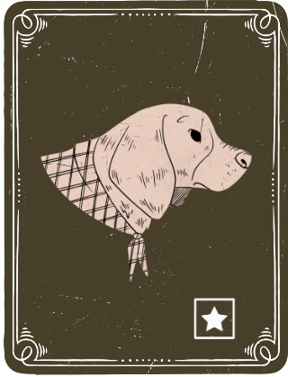



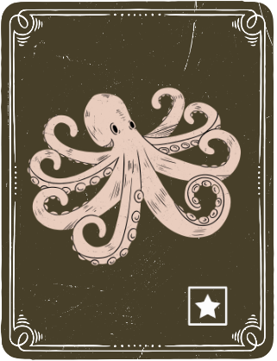
Card Station

Slide 3

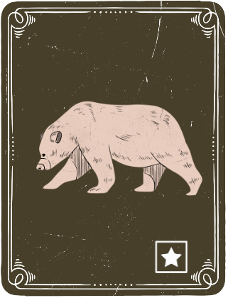
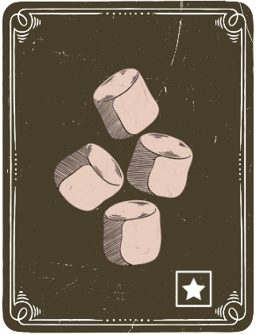
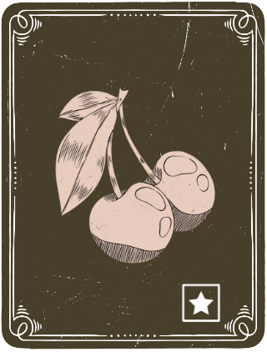

Card Station

Slide 4
Note to Clinicians:
You can change the size of the cards if needed.
You can also move each individual card around for different rounds of the game.
If you find a duplicate you can delete those cards off the board or move them to the card station.

