Slide 1


Slide 2


Slide 3
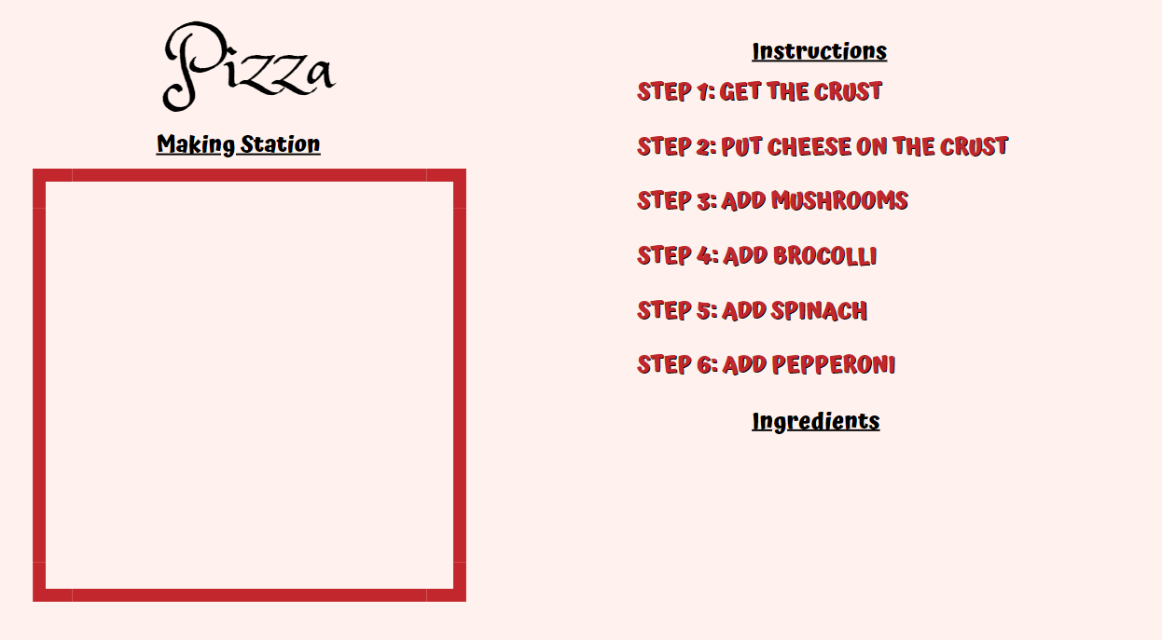







Slide 4






Slide 5
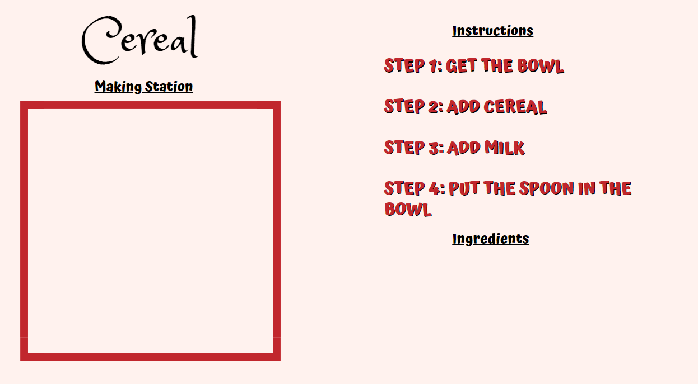





Slide 6
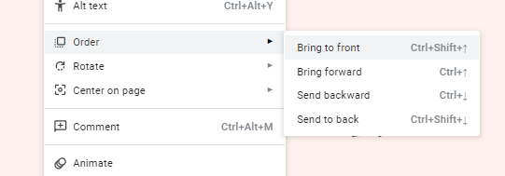
Note to clinicians:
If an image does not overlap properly onto another image, change the order of the images.
Right click on the image you want to bring forward
Click on Order
The click on Bring to front

