Slide 1

Matching Cards

Slide 2
Note to Clinicians
Use the “stage slides” - first three blank slides, to set up the cards you want to use for each trial prior to activity.
If you are using screen share and the client is able to request control, they can move the cards to the correct locations.
On the “stage slides” you can also adjust the size the the images if needed.

Slide 3


Example Stage Slide: Trial #

Slide 4
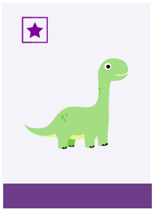



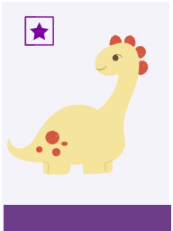

Example Stage Slide: Trial #

Slide 5
Example Stage Slide: Trial #

Slide 6

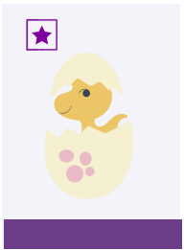



Slide 7









Slide 8







Slide 9


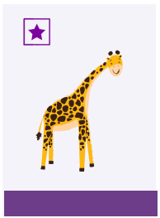






Slide 10







Slide 11



