Slide 1



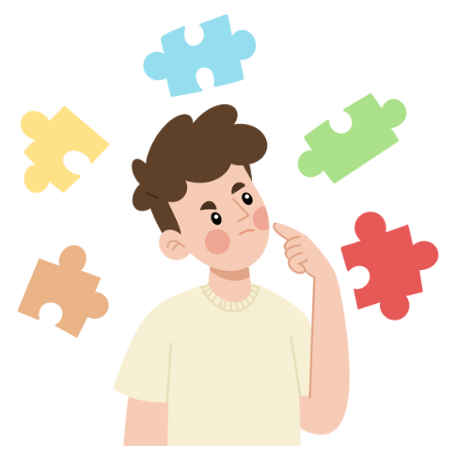

Slide 2
Note to Clinicians:
The images around the border can be moved
If screen control can be given to client, client can move the images onto the main picture for matching
There are two set of main pictures that are slightly different to help with generalization

Slide 3


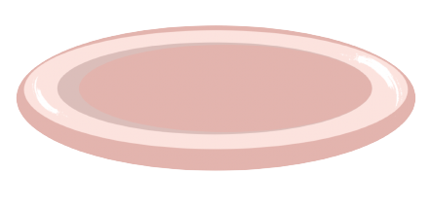

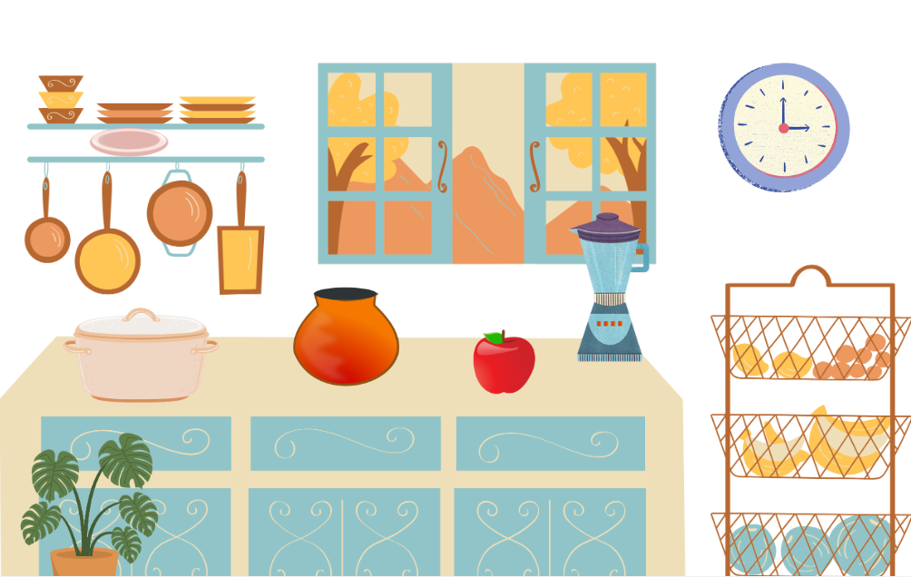
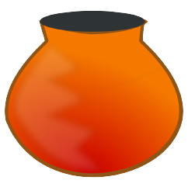
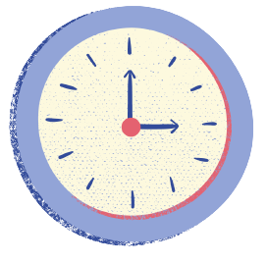


Slide 4


Slide 5



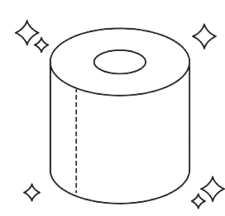




Slide 6


Slide 7



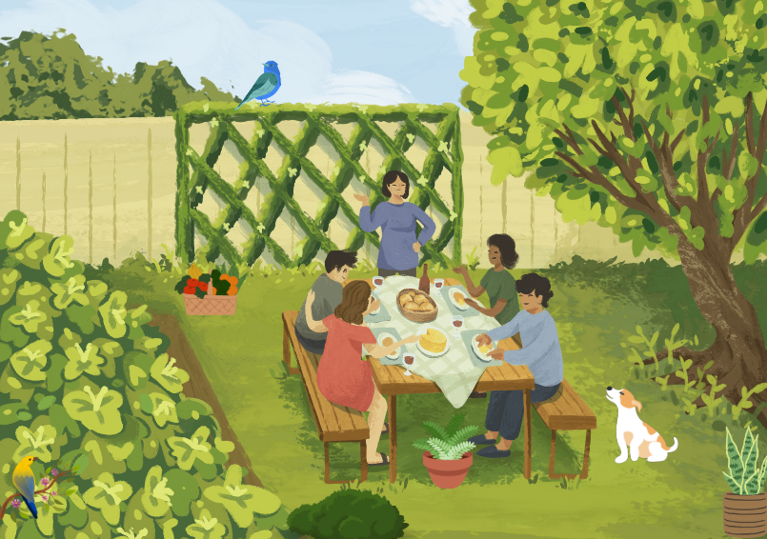





Slide 8
