Slide 1
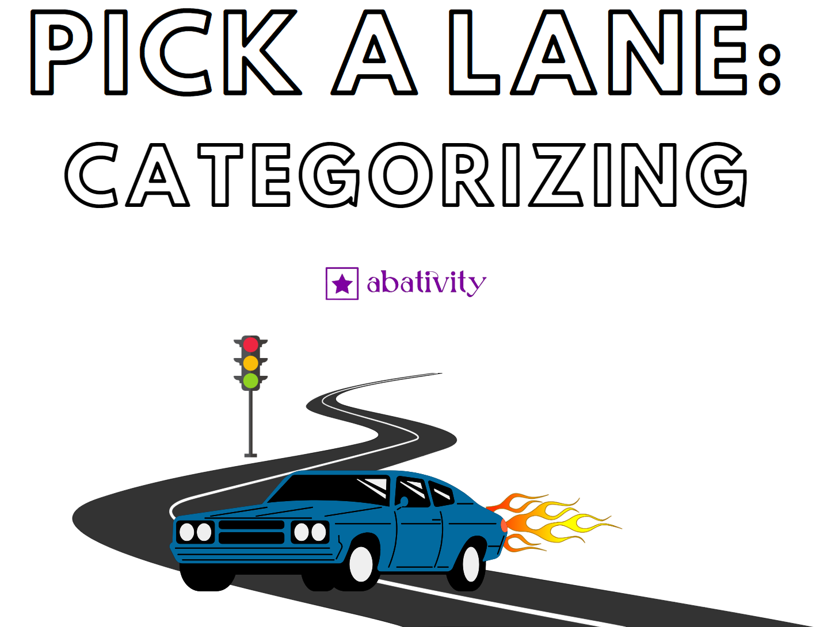

Slide 2












Categorize by: Type
Lane 1 | Lane 2 | Lane 3 | Lane 4

Slide 3

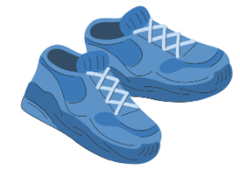
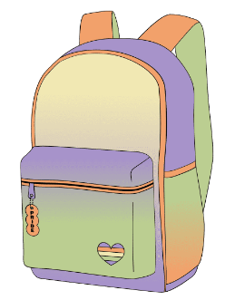









Categorize by: Function
Lane 1 | Lane 2 | Lane 3 | Lane 4

Slide 4














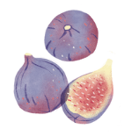

Categorize by: Color
Lane 1 | Lane 2 | Lane 3 | Lane 4

Slide 5








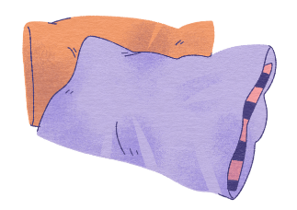
Categorize by: Texture/Feel
Lane 1 | Lane 2 | Lane 3

