Slide 1
Accelerating Design Exploration and Optimization with Surrogate Physics Models
Nico Quirante
Jack Bajcz

Slide 2


Our Background
Graduate research assistants in the Facility for Rare Isotope Beams (FRIB) cryogenics department
FRIB is a DOE-funded accelerator facility on the campus of Michigan State University
Notes:
Nico
To start off our presentation, we'd like to briefly introduce ourselves. We're graduate research assistants in the cryogenics department at the Facility for Rare Isotope Beams, or FRIB.
FRIB is a DOE-funded accelerator facility located on the campus of Michigan State University.

Slide 3
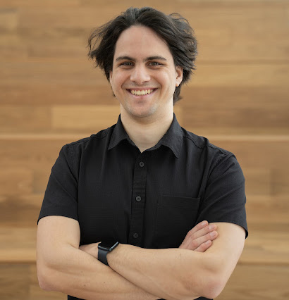
Jack Bajcz
BS in Mechanical Engineering
Concentration in Computational Design
Minors in Computer Science and German
MS in Mechanical Engineering
Working thesis title:
“Performance Characterization of a Helium Freeze-out Purifier”
Hobbies:
3D printing
Rowing
Notes:
Jack
My bachelor’s degree was in mechanical engineering with a concentration in computational design.
My master’s degree is also in mechanical engineering with a focus in large-scale cryogenic systems.
My current research is in cryogenic helium purification. Specifically, my thesis seeks to model frost deposition within fin-tube heat exchangers and how that affects system performance.

Slide 4
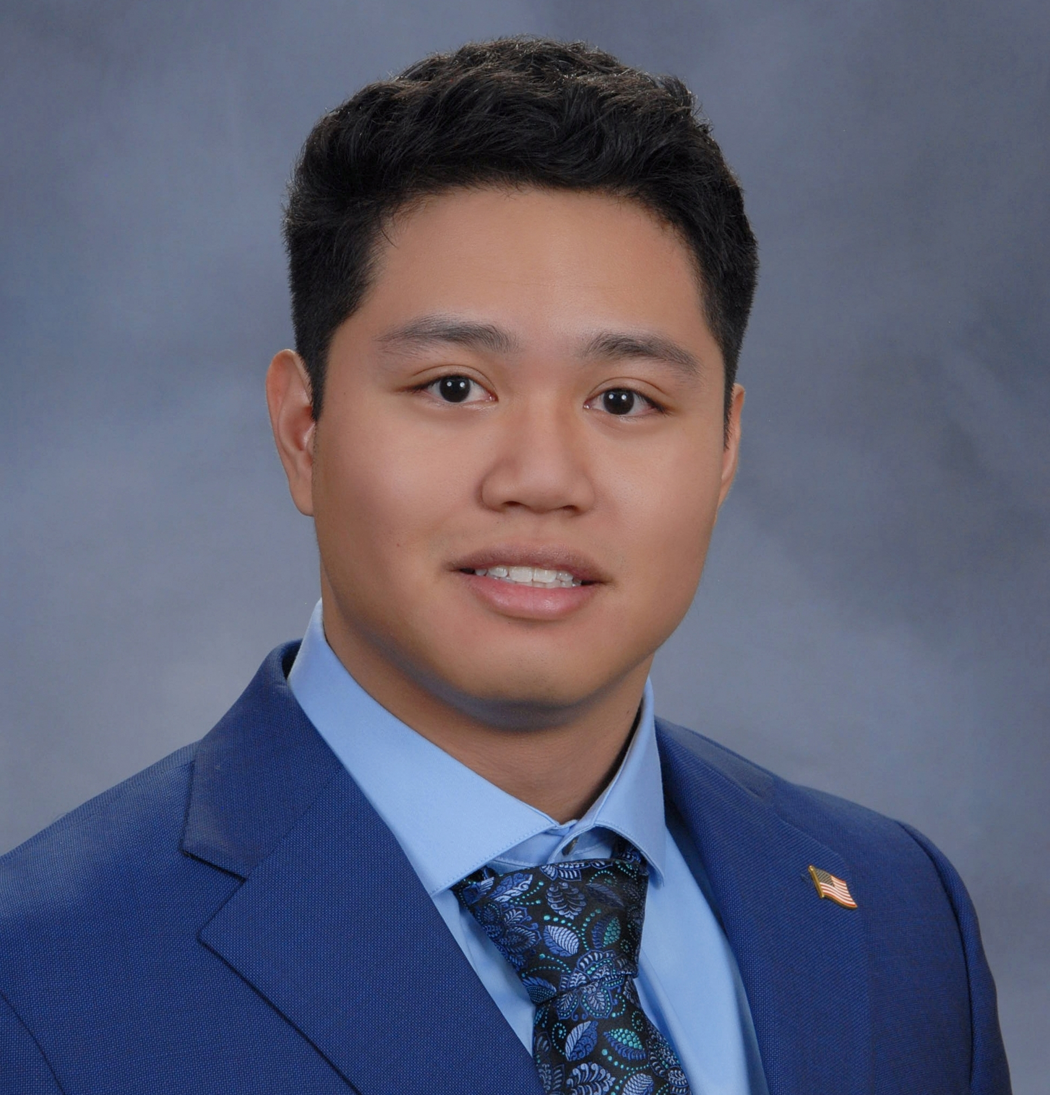
Nico Quirante
BS in Mechanical Engineering
Concentration in Cryogenics
PhD in Mechanical Engineering (First-year)
Hobbies:
Gym
Gaming
Notes:
Nico
My name is Nico Quirante and I earned my bachelor’s degree in mechanical engineering with a concentration in cryogenics.
I am currently starting my first year of my PhD in mechanical engineering.

Slide 5
Problem Introduction
Challenge: Predict performance metrics (Pressure Drop, Avg. Velocity, Surface Area, Mass) from design parameters
Goal: Train a surrogate model and use inverse design to maximize surface area while satisfying the following constraints:
Mass < 125 g
Pressure Drop < 8000 Pa
Avg. Velocity > 520 mm/s
Notes:
Jack
The challenge we chose to solve was training a machine learning model to predict heat exchanger performance metrics like pressure drop, average velocity, surface area, and mass from design parameters like cell size and inlet velocity.
From this trained model, we are tasked with using inverse design to optimize the input parameters for maximum surface area within the given constraints.

Slide 6
Why is this important?
A surrogate model is less costly than full CFD simulations
Setup & Calculation Time
Computational Power
Energy Consumption
Personnel & Training
We’ve seen this in our own work
Notes:
Nico
So why is this important?
Inference with a surrogate model is much less costly than full simulations, especially as a design is developing. FEA and CFD simulations can take a large amount of time, computational power, and energy as the resolution increases.
Within our own work at FRIB, we’ve seen these bottlenecks in action. As we go through the concept phase, there is input required from many parties, including the physics and accelerator group, controls, infrastructure, and other engineers. If a full simulation was required each time something changed in the concept, nothing would ever get made. Within our department, we have created our own processes to reduce that bottleneck, but a physics-informed surrogate model could be a middle ground to inform our decisions without as much computational overhead.

Slide 7
Dataset
Dataset Input Ranges:
10mm < Cell Size X < 25 mm
10mm < Cell Size Y/Z < 25 mm
2500 mm/s < Inlet Velocity < 3500 mm/s
Generated 1000 data points
Notes:
Jack
To begin, we were provided with an initial dataset.
After receiving poor results training on this initial dataset and after the scoring parameters were updated to no longer factor in time to run, we decided it would be beneficial to generate more data.
Using a modified version of the provided python script, we generated 1000 data points across the input ranges.
This was a significant time investment, but we felt it was worth the risk for the expected increase in model accuracy.
The data generation took a little more than 24 hours, but it paid dividends as we moved into the training phase.

Slide 8
Preprocessing
Features:
- X Cell Size
- Y/Z Cell size
- Inlet Velocity
Targets:
- Pressure Drop
- Avg. Velocity
- Surface Area
- Mass
Scaling:
MinMaxScaler applied to both inputs and outputs
Split:
90% training 10% validation
Notes:
Nico
Before training our model, we first prepared our dataset.
We started by defining our input features, including X cell size, Y/Z cell size, and inlet velocity, and our output targets, including pressure drop, average velocity, surface area, and mass.
To normalize the data, we tested both MinMaxScaler and StandardScaler. In this situation, MinMaxScaler gave us better loss during training, likely due to the fact that it preserves feature relationships within a bounded range.
We then randomly split the dataset into 90% training and 10% validation, giving the surrogate model a reliable foundation to generalize from.

Slide 9
Surrogate Model Approach
Framework: Tensorflow + Keras Tuner
Model Type: Multi-layer Perceptron (MLP)
Hyperparameter Tuning:
Layers: 2-6
Units/layer: 32-1024
Activations: ReLU, Tanh, ELU
Dropout: 0.0–0.5
Learning Rate: 1e-2 to 5e-5
Early Stopping: Prevent overfitting
Notes:
Jack
For our model architecture, we chose a Multi-Layer Perceptron model. We understood the basics of this model relatively well and it is well-implemented within several existing python libraries, like Tensorflow and Keras.
In our early training, we found that the hyperparameter tuning gave better results than our own trial-and-error but didn’t improve the quality of the predictions as much as we expected. To enhance the tuning, we increased the number and range of parameters to search. Specifically, we increased the ranges for number and density of the layers, as well as adding several activation function options. This significantly decreased the validation loss and our predictions improved considerably.
Due to our relatively limited dataset, overfitting was a big concern for us. To prevent this, the tuning was configured with an “early stopping” callback, which is well-described by the name. It stops training early after reaching a target value for the validation loss.

Slide 10
Inverse Design
Goal: Maximize surface area
Prediction Constraints:
Mass < 125 g
Pressure Drop < 8000 Pa
Avg. Velocity > 520 mm/s
Methods:
Random sampling
Multi-start optimization
Validation with nTop
Notes:
Nico
Moving on to the inverse design methodology.
To identify the optimal combination of the X cell size, Y/Z cell size and inlet velocity, we used a three-step inverse design strategy aimed at maximizing surface area while satisfying three constraints: the mass staying under 125 grams, pressure drop below 8000 pascals, and the average velocity above 520 millimeters per second.
We approached this using Random Sampling, Multi-Start Gradient Optimization, and then Validation with an nTop simulation.

Slide 11
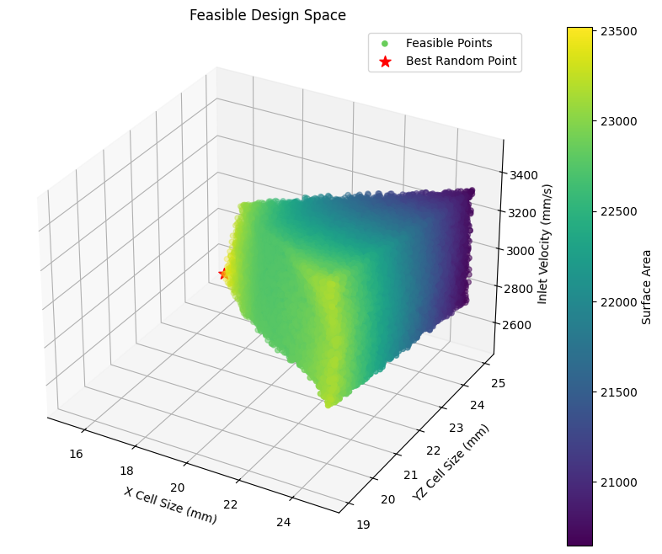
Random Sampling
Samples: 1 million random points within input constraints
Feasibility Check: Predict mass, pressure drop, and average velocity for each point and verify they are within constraints
Best Feasible Point: Highest surface area among feasible points
Figure 1
Notes:
Jack
To begin our inverse design, we performed large-scale random sampling.
Using the trained model, we predicted the surface area, mass, pressure drop, and average velocity for a million points within the design space.
In figure 1, you can see the colored points that fit the constraints. Add number
These valid points form a rough triangular prism (read the room: “if you squint your eyes a bit”)
The point shown with a red star is the design point with the highest surface area found during this random sampling.

Slide 12
Multi-Start Gradient Optimization
Used SLSQP optimizer with nonlinear constraints
Ran 50 trials from different starting points
centered around best random sample
within 10% of variable range
Notes:
Nico
After finding the best performing design from our initial random sampling, we improved it using a multi-start gradient optimization.
For this, we chose the Sequential Least Squares Programming Optimizer (or SLSQP for short), which supports nonlinear constraints.
We ran 50 optimization trials, each starting from a different point within 10% of the variable range, centered around the best-performing random sample found in the random sweep.
The most optimal point found across all trials was then passed to the next stage of our inverse design, the validation of our prediction using an nTop simulation.

Slide 13
Validation with nTop
Output | Model Prediction | nTop Simulation
Surface Area | 23365.6582 | 23709.2144
Pressure | 5610.0811 | 5734.4897
Avg Velocity | 529.4271 | 535.1234
Mass | 124.9252 | 124.8487
Purpose: Confirm surrogate prediction for optimal input parameters with nTop simulation
Example Optimum:
X Cell Size: 23.1363
Y/Z Cell Size: 21.0964
Inlet Velocity: 3290.8234
Notes:
Jack
When the predicted optimal parameters are found using the optimization function, we feed those back into the nTop simulation to ensure it is a valid design point. In the table, we show an example optimum we found.

Slide 14
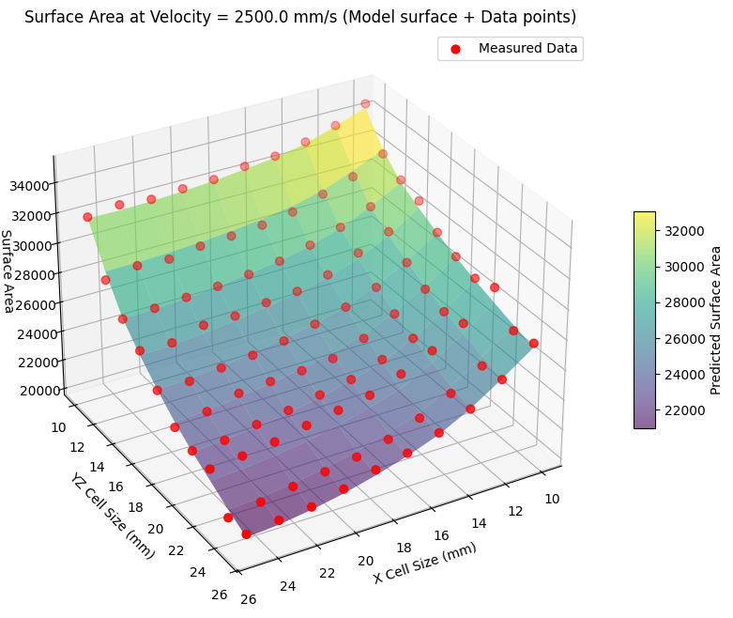
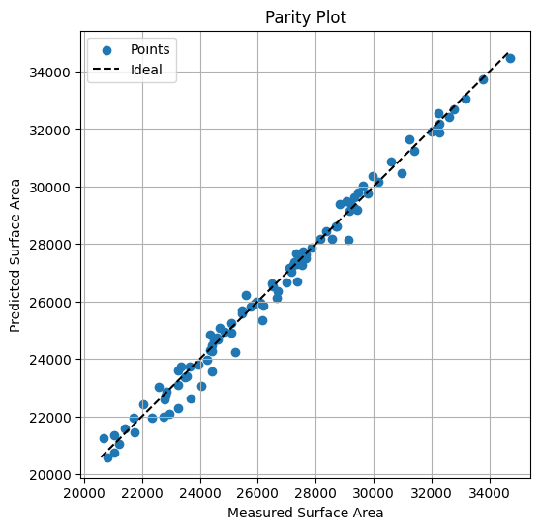
Model Performance Plots
Inlet velocity: 2500 mm/s
Points compared: 100
R²: 0.9878
RMSE: 373.95
Figure 2
Figure 3
Notes:
Nico
To measure our model's performance, we compared its surface area predictions across varying X and Y/Z cell sizes with the corresponding values from our generated dataset.
Figure 2 shows the predicted surface area distribution vs the dataset. The close alignment between the red points and the model surface indicates reliable predictions from our model.
Figure 3 shows the parity plot corresponding to the data in figure 2. The predicted and actual surface areas show a very close relation, with an R squared value of 0.9878 and an RMSE of 373.95. This confirms that our model can reliably predict the geometry-performance relationship.

Slide 15
Future improvements
Reducing required data
Could adequate results be obtained with less data?
Could adequate results be obtained with lower quality data?
Can we improve surrogate model trust?
Could the inverse design method be altered to prefer more stable optima?
Can a prediction tolerance be added?
Notes:
Jack
Here we outline some of the areas we wanted to explore if we had more time.
A big hurdle for us in the beginning was the large amount of data required to produce consistent and accurate results.
If we were to continue studying these surrogate models, this would be a major area of focus.
Can we use less data or even lower-fidelity data?
Can the accuracy of the model predictions be improved without generating mountains of additional data?
Next, we looked for ways to improve our confidence in the predictions we obtained from our model.
Could we do additional post-processing on the predictions to find stable maxima instead of points that require impossible manufacturing tolerances?
Or can we bake in a prediction tolerance to represent the range of uncertainty in the value?
This could inform the user about how much trust should be placed in the values the model predicts.

Slide 16
Thank you! Questions?
Notes:
Nico
Thank you for your time and attention.
Any questions?

