Slide 1
Graph Data Science with Titanic Dataset
Notes:
Hello everyone, Thank you very much for coming. Today we are going to talk about Graph Data Science using the Titanic Dataset.

Slide 2
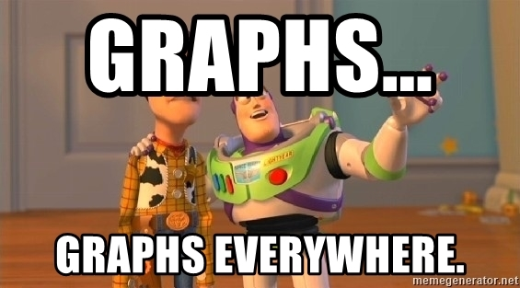
Notes:
My goal at the end of the presention is for you to say that you see graphs. Because, once you start seeing it, you cannot really unsee it. I am going to walk you through step by step explaining what is a graph and how we can use it in data science but let's first clarify what is not a graph.

Slide 3
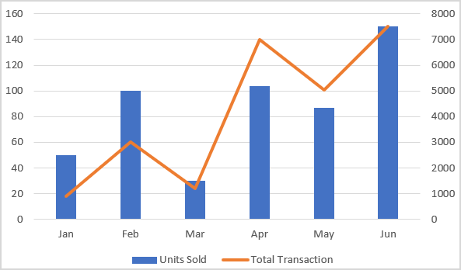
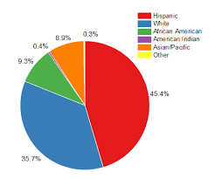
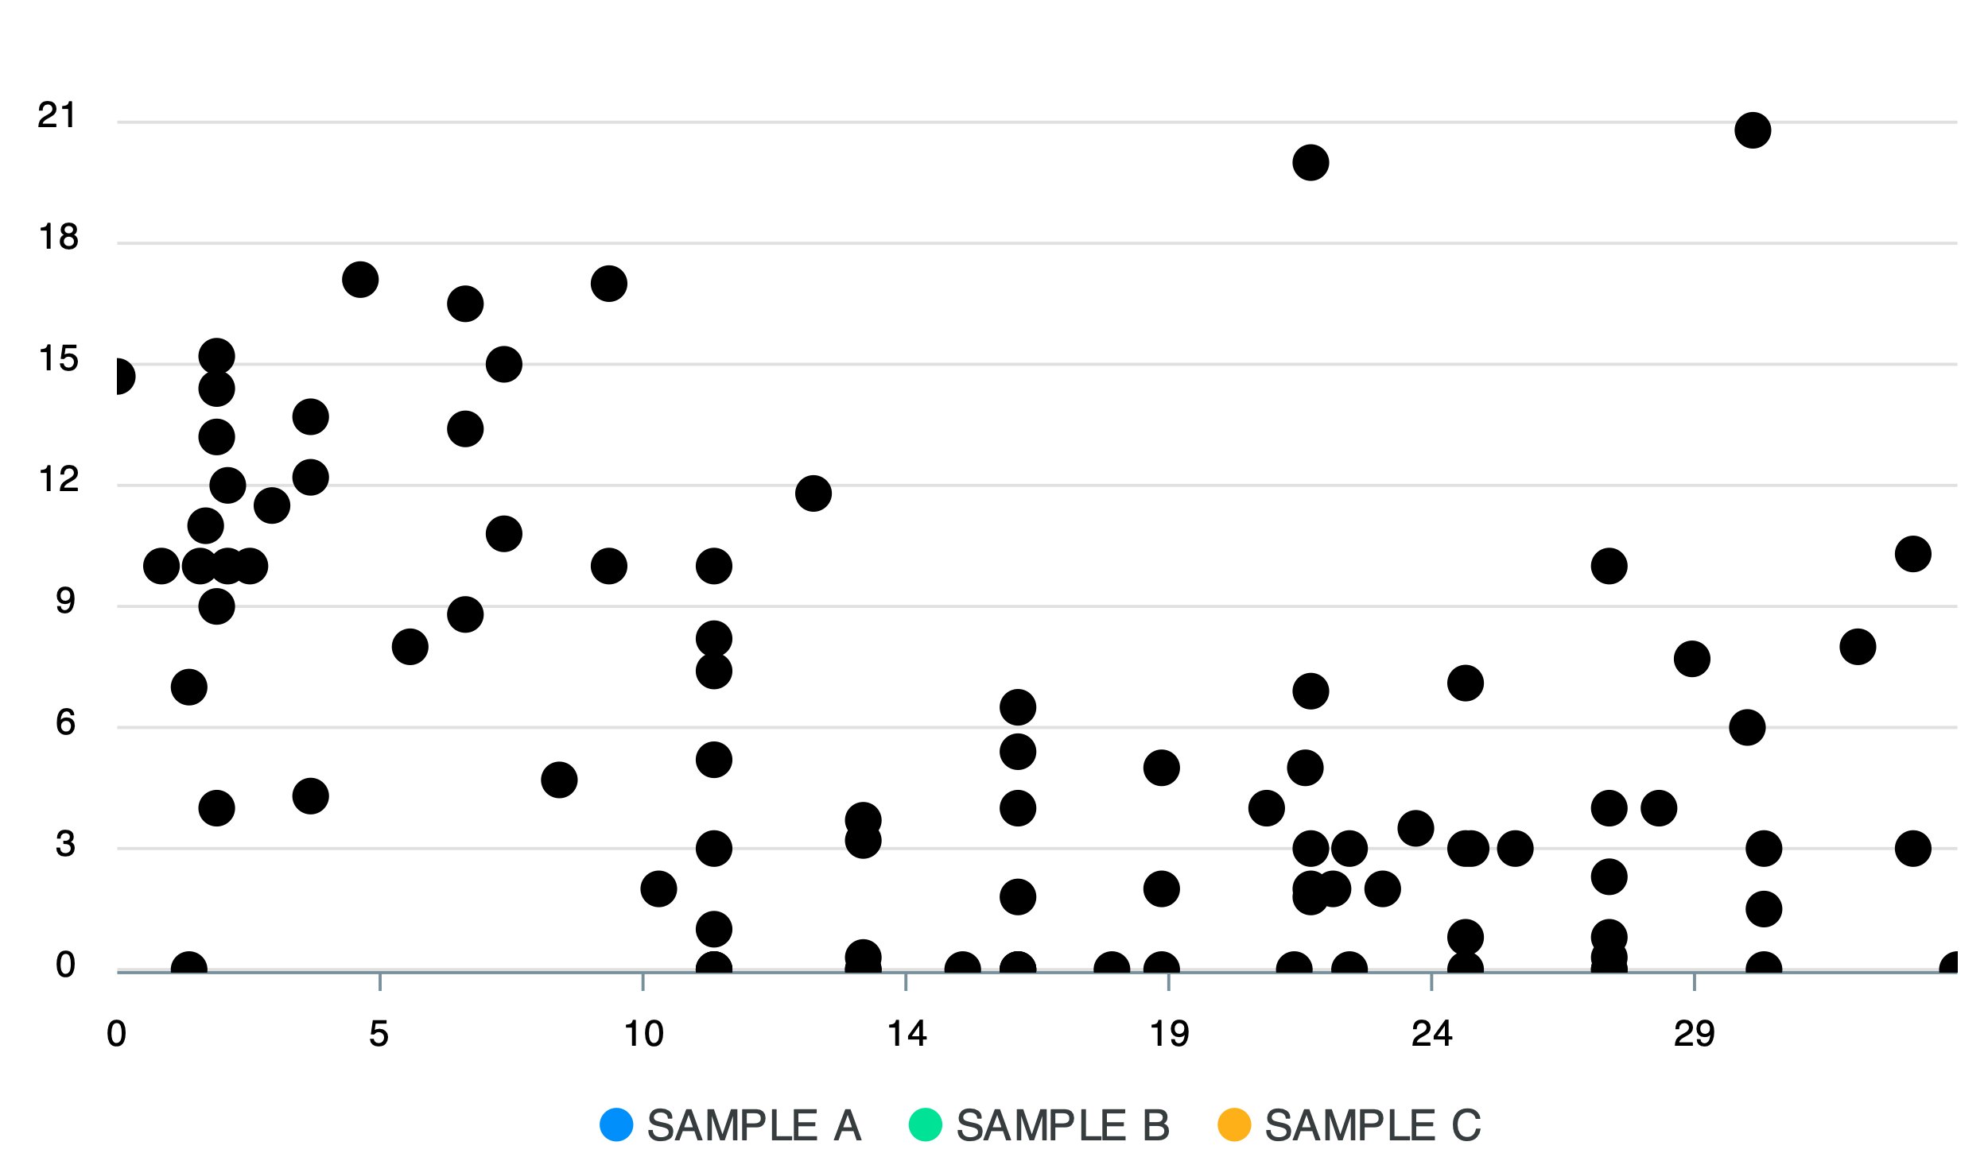




“Graph” is NOT
Notes:
What we mean by graph are not charts or some of visualization libraries such as seaborn or matplotlib or some of the visualization applications such as powerbi and tableau.
What we mean by graph is completely different.

Slide 4
”Graph” is a Database
Node
Node
Relationship
Person
Person
Car
Company
City
Movie
Book
CONNECTED
READ
MANUFACTURED_BY
LOCATED_IN
LOCATED_IN
WATCHED_BY
WRITTEN_BY
Person
Book
Company
City
State
Person
Author
Notes:
What we mean by graph is a database. It is very similar sql databases or nosql databases in terms of storing the data but the way graph databases store the information is completely different. Graphs are all about nodes and relationship. The data is stored either at the node level or the relationship level. Here the nodes and relationships could be anything. Here for example, Nodes could be person, car, company, city, movie etc. What is important is that there needs to be a logical relationship between the nodes.

Slide 5
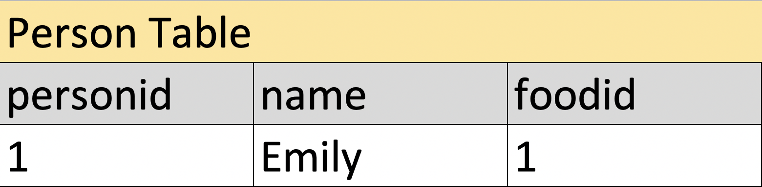
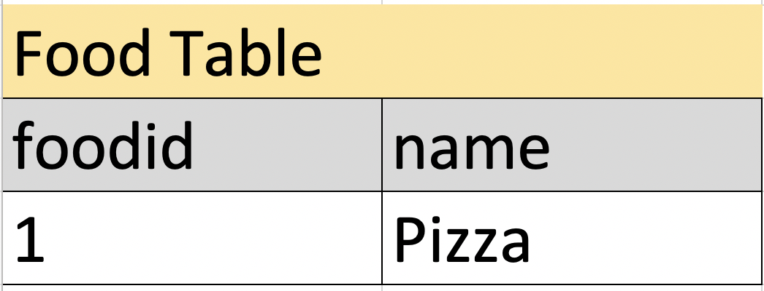
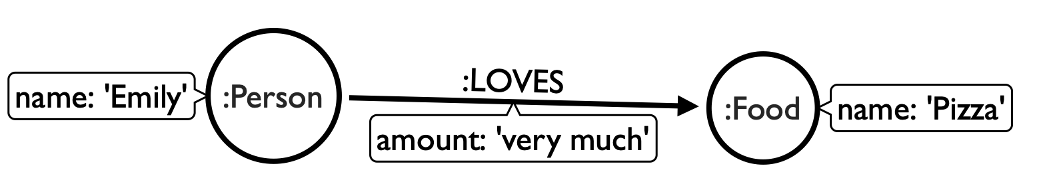
Simple Example
RDMS
loves?
very much?
“Emily loves pizza very much”
GRAPH
Notes:
Take this sentence for example.
If we had to store this information in a SQL database we would create a maybe
As you can see, there is no foreign key or primary key in Graph Databases. All the data is already connected so there is no need for that. Also, transitions between the nodes are really fast, since, again the data is already connected.
In the case of relational databases, you have to write join queries to connect the data.

Slide 6
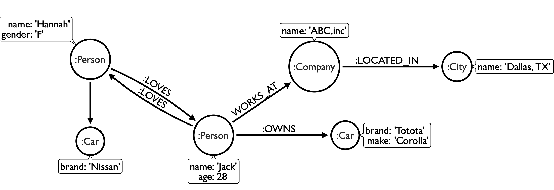
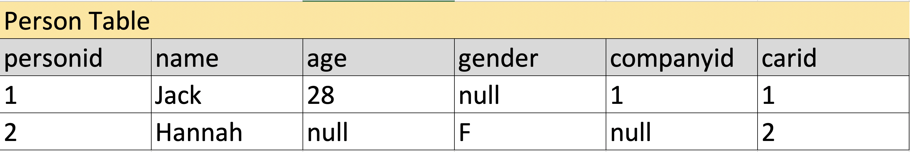
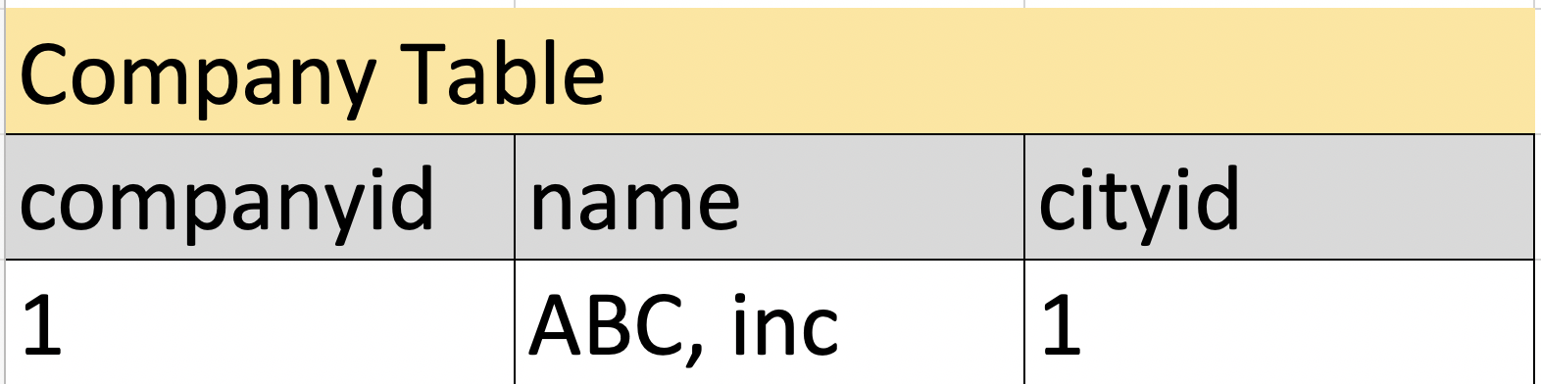
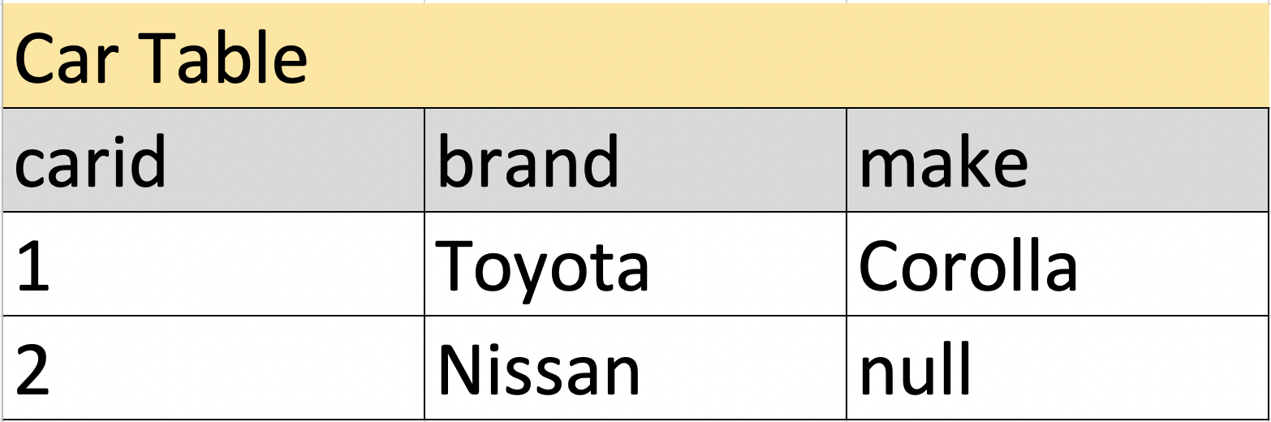
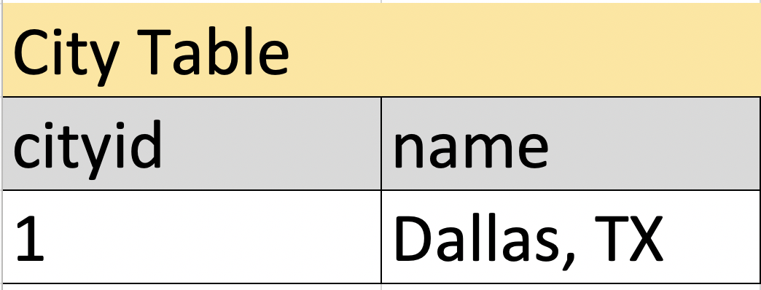
LOVES?
WORKS_AT?
OWNS?
LOCATED_IN?
Notes:
Here is another example. Even if you don't really know anything about the graph databases, you can look at the graph and understand what is going.
If we have to represent the same data in sql, we would have to create at least 4 tables. and we wouldn't still be able to capture all the information. We would also have a lot of missing values.

Slide 7
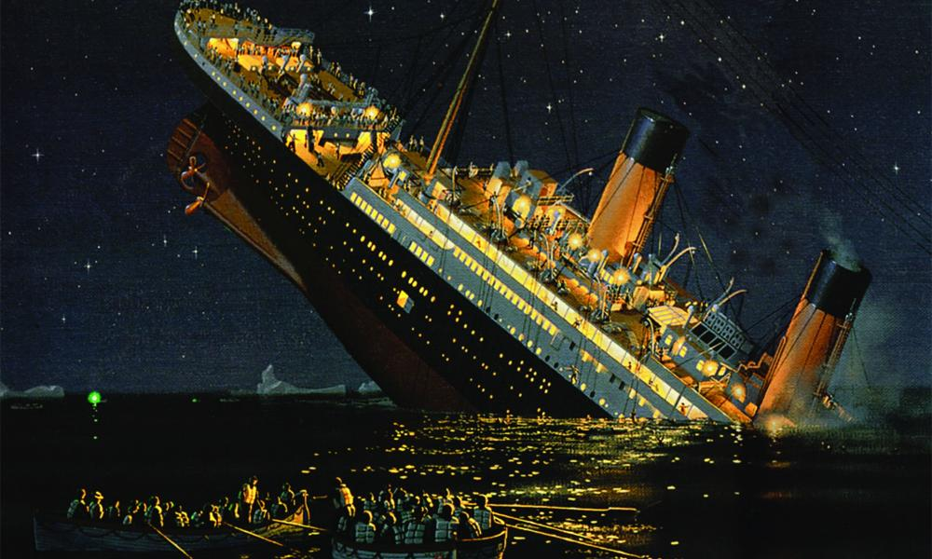
Dataset: Titanic Task: Predict Survival Relational vs. Graph Approach
Notes:
I am sure you heard about the Titanic dataset but for those who don’t know there is dataset associated with this tragic event.
The dataset constitutes the individual attributes such as passenger class, gender or age. and the label column is whether the passenger survived or not. So, the task is to predict who has survived this tragic event.
To solve this problem we will take Relational Database approach and Graph Approach

Slide 8
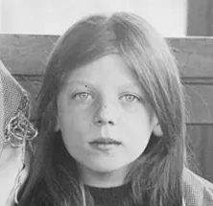
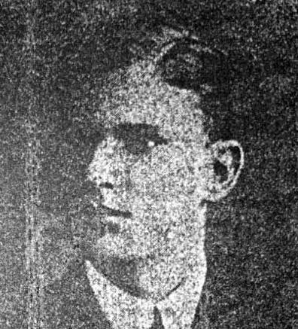
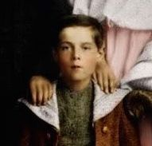
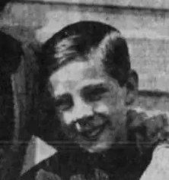
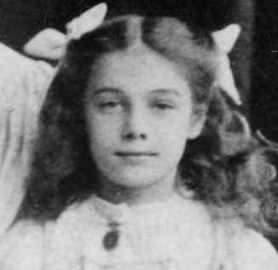
Survived?
Survived
Not Survived
Survived
Not Survived
Pclass | 2
Age | 8
SibSp | 0
Parch | 2
Ticket | C.A. 31921
Fare | 26.25
Cabin | NaN
Embarked | S
Pclass | 1
Age | 17
SibSp | 0
Parch | 0
Ticket | 113059
Fare | 47.1
Cabin | NaN
Embarked | S
Pclass | 3
Age | 9
SibSp | 5
Parch | 2
Ticket | CA 2144
Fare | 46.9
Cabin | NaN
Embarked | S
Pclass | 3
Age | 9
SibSp | 0
Parch | 2
Ticket | 363291
Fare | 20.525
Cabin | NaN
Embarked | S
Pclass | 3
Age | 10
SibSp | 5
Parch | 2
Ticket | CA 2144
Fare | 46.9
Cabin | NaN
Embarked | S
Miss Marjorie L. Collyer
Mr. Jose Pedro Carrau
Master. Harold V. Goodwin
Master Frank JW Goldsmith
Miss. Jessie A. Goodwin
Notes:
Let’ start with an example. Harold V. Goodwin was one of the passengers. Here, I am going to give all the data available about this boy and ask you to guess whether he survived or not? Just to give you some information about the data...
So, the question is Did you survive or not?
I know it is hard to guess but here is some more data coming from other passengers. Let's take a moment and see if we will catch a pattern.
We can keep looking but it is really hard to come with a pattern at this point. Passengers are very similar to each other, yet some survived while others have died. We need to have hundreds maybe thousands of cases to learn and more importantly we need a machine learning model. In either case, just a few cases won't help us. (next slide)
Traditional approach goes row by row and misses the relationship between these rows.

Slide 9
Is he alone?
Master. Sidney L. Goodwin
Master. William F. Goodwin
Miss. Jessie A. Goodwin
Miss. Lillian A. Goodwin
Mr. Charles E. Goodwin
Mr. Charles F. Goodwin
Mrs. Frederick (Augusta Tyler) Goodwin
Brother
Brother
Sister
Sister
Brother
Father
Mother
Master. Harold V. Goodwin
Notes:
In graph approach we start asking a different question. Is he alone?
I mean if you had seen this kid all alone on the deck, you wouldn’t help but wonder where his family is. If we go back to the previous slide we are going to realize that we have skipped a vital information. ‘Go back to the previous slide’

Slide 10
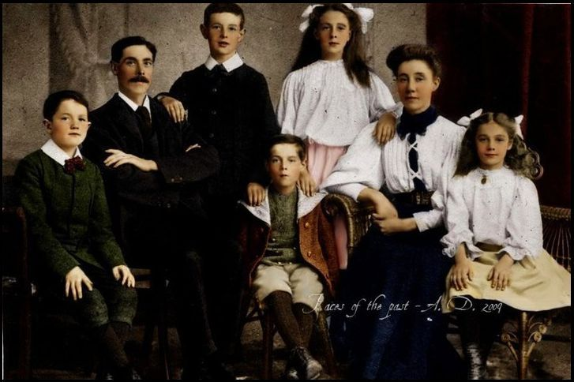
Died
Died
Died
Died
Died
Died
Died
Notes:
Let’s go back to the same picture and see if we are missing the picture.
Here as you can see these two kids are posing for the same picture.
Now, I am going to display whether each of these family members survived or not.
So, if we ask the original question again, whether the kid survived or not, I think the answer is easy. In making this prediction we didn't have to look at any individual attributes but the connections.
This is certainly a tragic event but we can learn from it. So, the next time we have to predict whether a person has survived we need to also consider the person's connections.

Slide 11
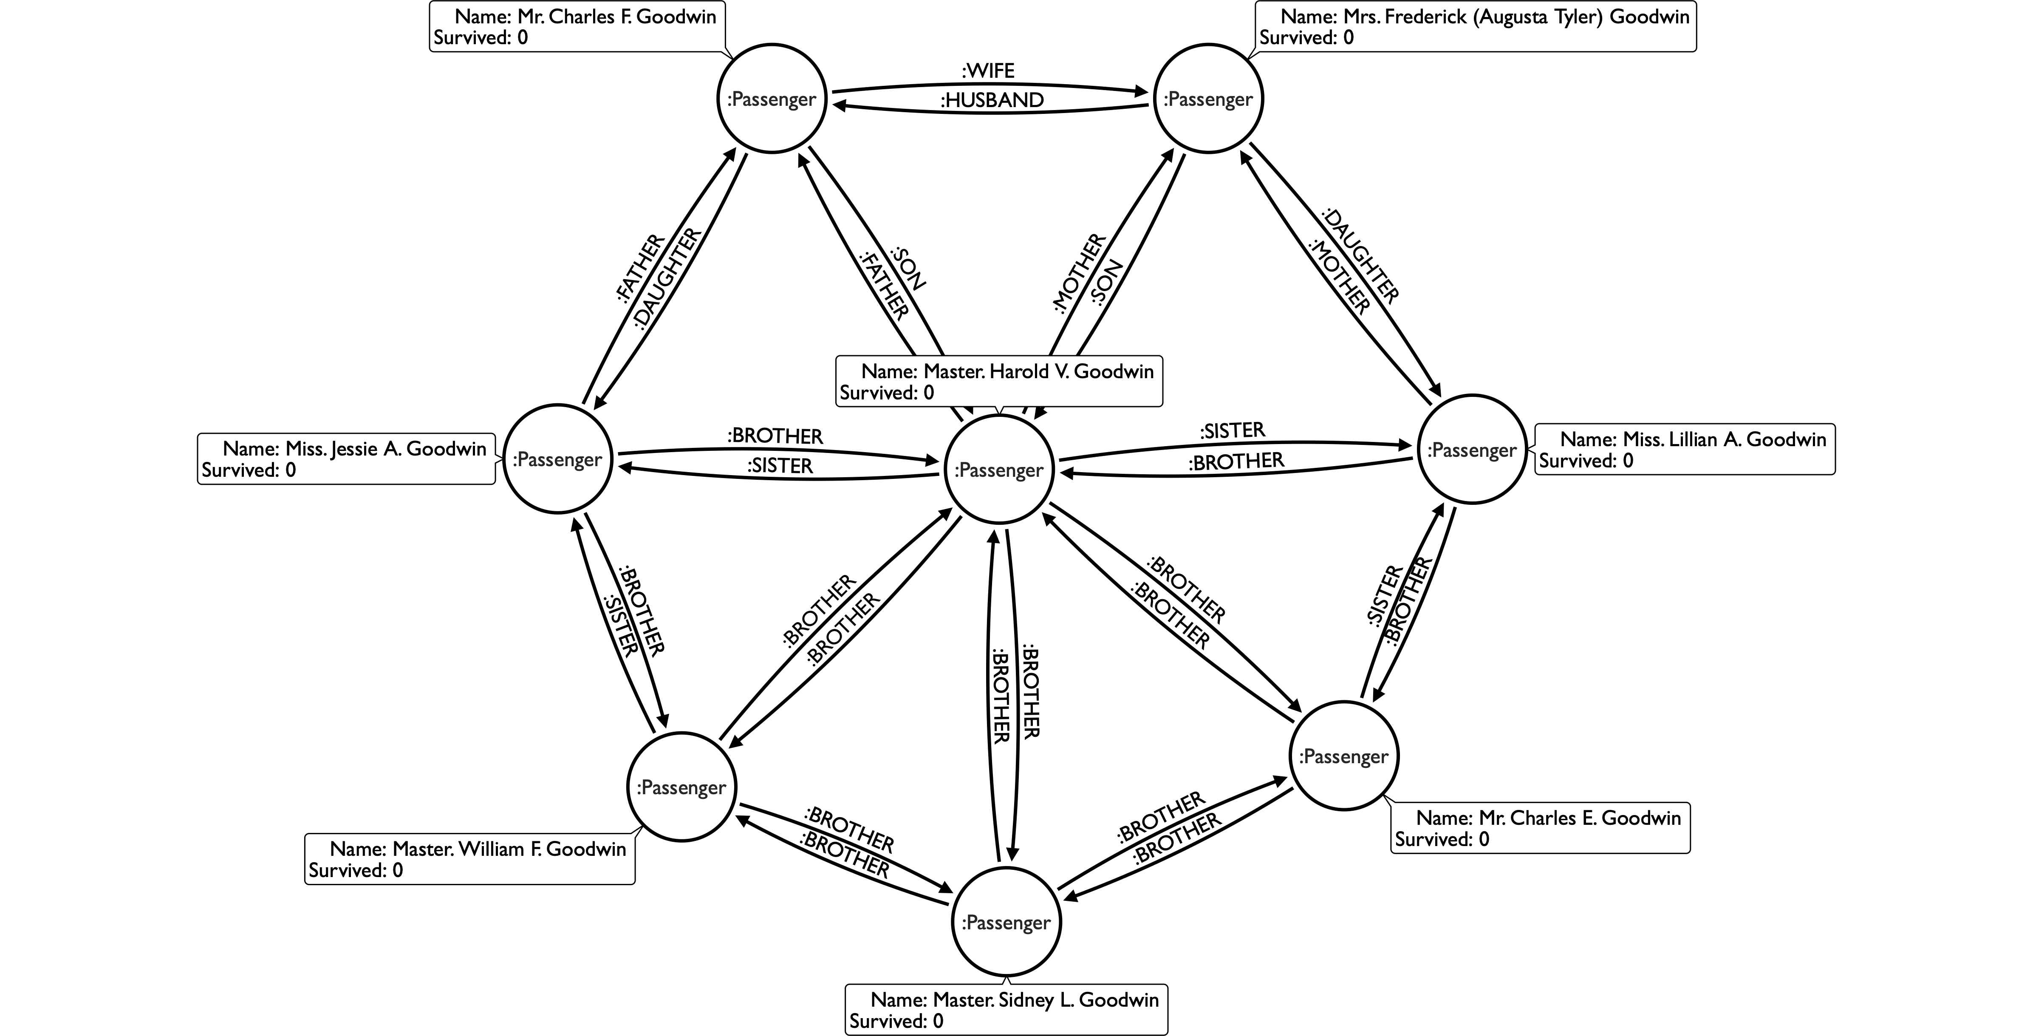
Notes:
Here we represent the family in a graph. It may look complicated at first but it is really not. Let me explain.

Slide 12
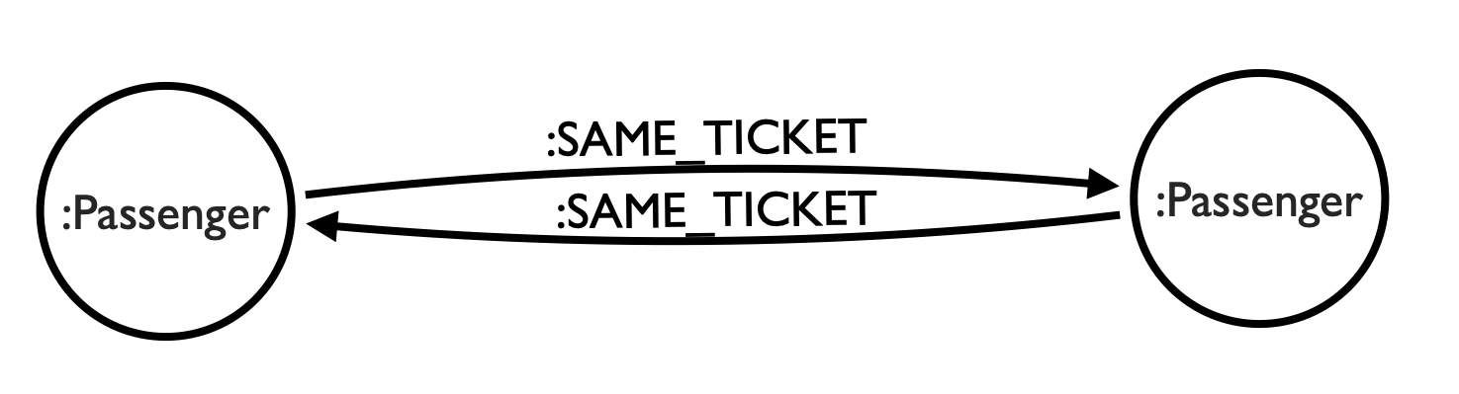
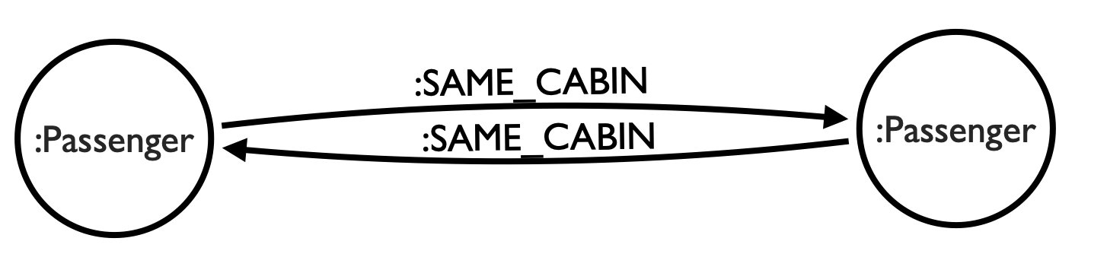
What about non-families?
Ticket | Cabin
364856 | NaN
113780 | C51
C.A. 2673 | NaN
348125 | NaN
P/PP 3381 | NaN
Out of 1309 passengers:
-929 distinct Tickets
-187 distinct Cabins, 78% missing value
-Additional data comes from https://www.encyclopedia-titanica.org/
-Will be opensourced.
Notes:
We can learn about non-family connections from two columns. Ticket and Cabin. These tables are not usable as is in a traditional model but we can use them in graph. For of the passengers in the database with similar Ticket and Cabin information, we can link them using either as SAME_TICKET and SAME_CABIN.

Slide 13
Let’s build the models
Notes:
For this task, we are going to build two models. One being the base model, and the other one being the graph enriched model.

Slide 14
Base Model
Features
Sex
Age
SibSp
Parch
Fare
Survived
Pclass3
Pclass2
Pclass1
Embarked_Q
Embarked_C
Embarked_S
Model:
Random Forest Classifier
Notes:
For the base model we are the following features and the following model. We are going to use the same model for the graph enriched model as well.

Slide 15
Create Graph
PassengerId | Name | ...
481 | Goodwin, Master. Harold Victor | ...
1032 | Goodwin, Miss. Jessie Allis | ...
... | ... | ...
Nodes
nodes_df = train.csv + test.csv
iterate rows and create nodes
G.add_node()
Ex: G.add_node(481, {name: 'Goodwin, Master. Harold Victor',...})
Relationships
iterate rows and create relationships
G.add_edge()
Ex: G.add_edge(481, 1032, type='SISTER')
u_id | v_id | type
481 | 1032 | SISTER
... | ... | ...
Notes:
As for the Graph Enriched model, we are going to have to create the graph first. If you remember when we first talked about the graphs we had talked about the Nodes and Relationships. We are going to create them now.
As for the nodes, we are going to train and test sets provided by Kaggle and we are going to iterate through each row and add them to the graph. For this task, we are going to use nxneo4j which is a networkX api for Neo4j. So, if you are used to writing NetworkX codes, yyou can use them here as well.

Slide 16
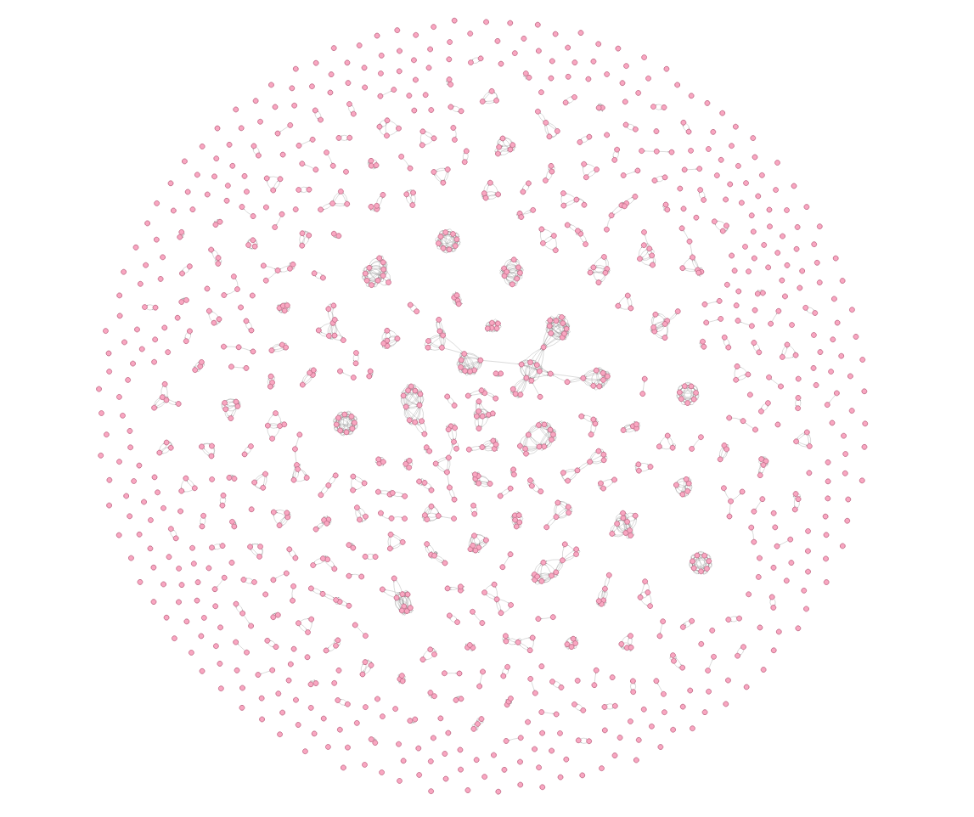
Titanic Graph:
nx.draw(G)
Neo4j Browser
2306 relationships
815 nodes are connected
494 nodes are not connected
Notes:
And, there what the graph looks like. We can create this graph either using Neo4j browser or nxneo4j.
Here we are representing 2306 relationships
815 nodes are connected while others are not connected.

Slide 17
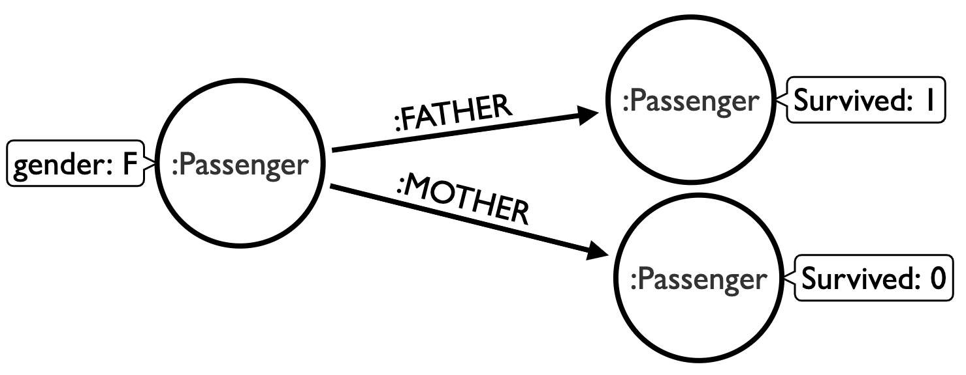
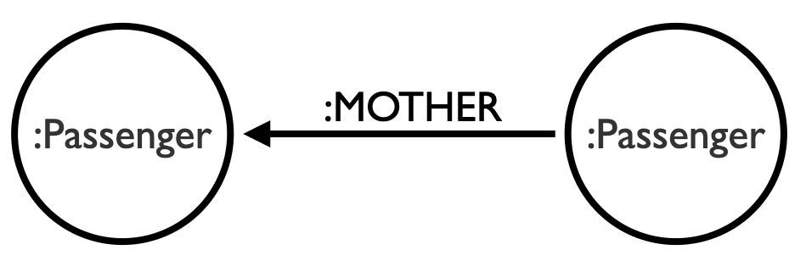
Graph Features
Features with Graph Data Science library and nxneo4j*:
nx.node2vec(G) (relationship similarity)
Ex: Same family members have similar scores
nx.graphsage(G) (attribute and relationship similarity)
Ex: kids in families will have similar scores
nx.degree_centrality(G) (number of connections)
Ex: number of friends or number of family members
Cypher (upcoming workshop)
Survival rates in the network:
average survived in the connections
mother survived
father survived
same gender survived in the connections
similar age survived in the connections.
Titles (incoming relationship type)
Father
Mother
Son
Daughter
*upcoming release
Notes:
This is the last slide before the model results. So, let’s take a moment and understand graph generated features.

Slide 18
Graph Enriched Model
Base Model
76% Accuracy
81% Accuracy
Rank | Feature
1 | Sex
2 | Age
3 | SibSp
4 | Parch
5 | Fare
6 | Pclass3
7 | Pclass2
8 | Pclass1
9 | Embarked_Q
10 | Embarked_C
Rank | Feature
1 | Sex
2 | Age
3 | Fare
4 | Pclass3
5 | connection_size
6 | avg_survived
7 | same_gender_survived
8 | graphsage1
9 | graphsage3
10 | graphsage4

