Slide 1
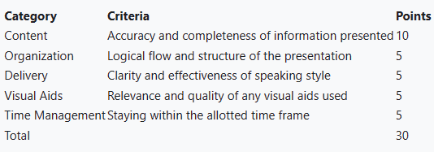
Python Dictionaries
CS-150-01: Computer Programming
Professor Sayani Sarkar
By Juan Ballas
Friday, December 1st 2023

Slide 2
What are Dictionaries?
A dictionary is a collection of key-value pairs.
You use the key to access the value associated to that key.
A key can be a number, string, list, or another dictionary.
It is changeable but does not allow duplicates.
Dictionaries are not sequences – data is not stored in order.
Dictionary representation {}

Slide 3
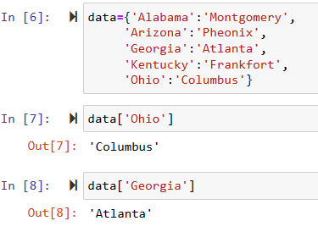
Examples of how it works

Slide 4
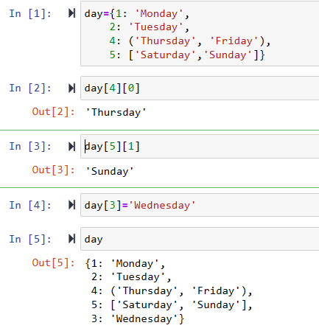
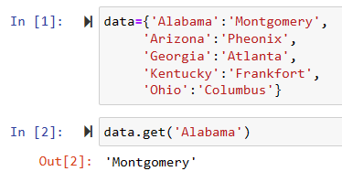
Calling a Dictionary
Add a dictionary
Get a dictionary

Slide 5
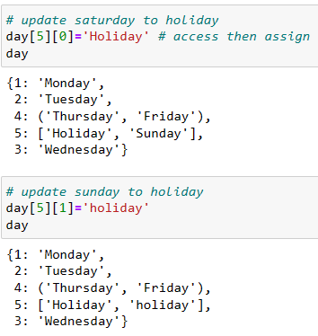
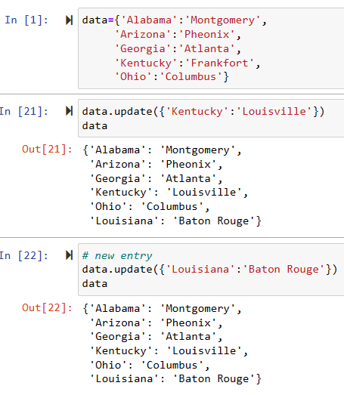
Updating a Dictionary
Updating a Dictionary
Update method

Slide 6
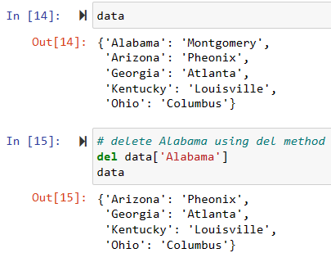
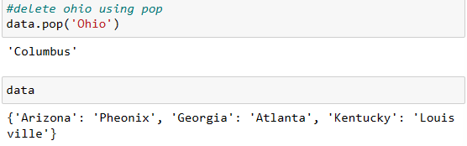
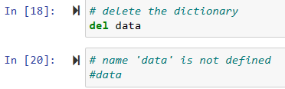
Deleting a Dictionary
del method
pop method
Deleting whole dictionary

Slide 7
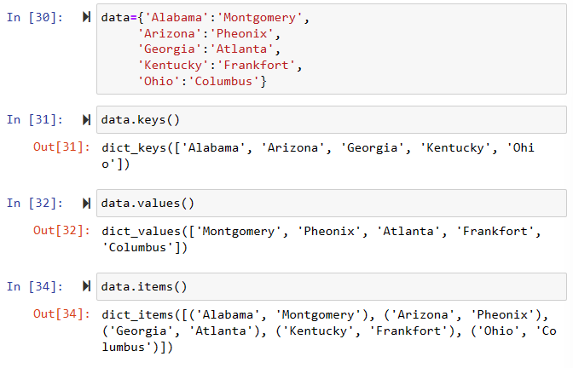
Keys(), Values(), Items()

Slide 8
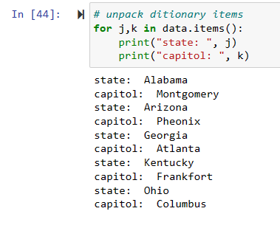
Unpack dictionary with loop

Slide 9
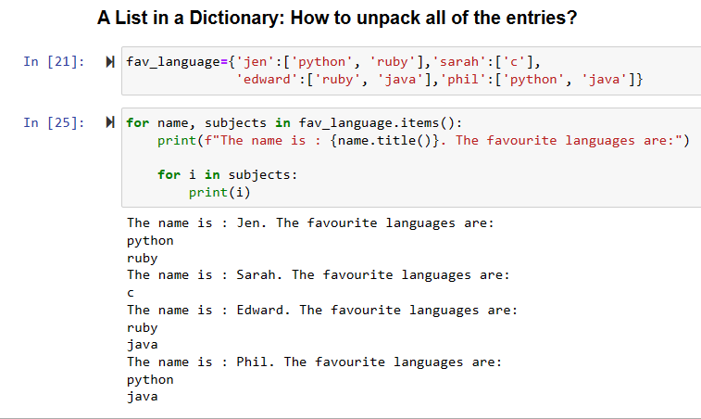
How to deal with a List in a Dictionary

Slide 10
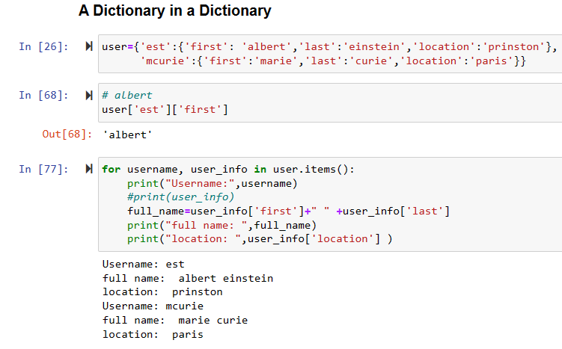
How to deal with a Dictionary in a Dictionary

Slide 11
Conclusion
A dictionary is a collection of key-value pairs.
Dictionaries are not sequences – data is not stored in order.
Dictionaries can be changed, updated, and deleted.
Keys and Values make up an Item.
Lists and Dictionaries can be found in a Dictionary.
Uses?
When we want to find something.
To associate data to a single key. Easier to find it.

Slide 12


