Slide 1

Magist: A reliable partner to explore the Brazilian market
Notes:
We welcome everyone and especially our CEO to today's presentation. As you all know our company is looking to expand into the brazilian market with Magist as a connecting partner. Today we will show you that this strategy provides chances but also high risks that need to be considered

Slide 2
Eniac
We offer high-value Apple-compatible accessories
Our company adopts a policy of fast shipping and quick return to customer demands by keeping customer satisfaction at the highest level.
We constantly strive to meet our customers' expectations and provide them with an excellent shopping experience.
Notes:
Our analysis and recommendation is based on those company's core values.

Slide 3
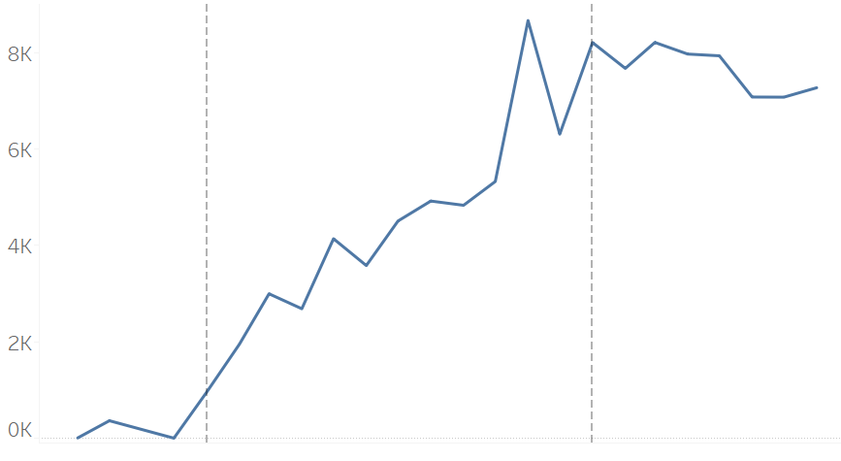
Magist’s sales numbers increased strongly in 2017
2016
2017
2018
Notes:
But is Magist a reliable partner for us? As you can see the overall sales increased strongly in 2017, suggesting a platform growth.
While sales in 2018 did not increase as of yet, the data do not include the important last quarter including the christmas time

Slide 4
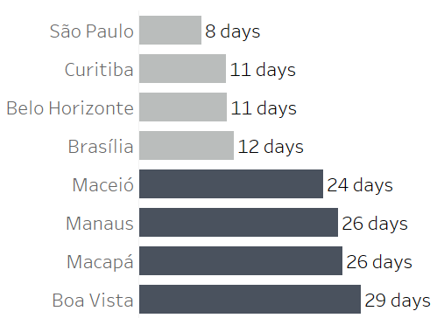
Delivery times within Brazilian ecommerce standard
Amazon Brazil standard delivery: 8 - 12 days
Mercado Libre standard: within 15 working days
Notes:
As our core value is a timely and reliable delivery, we analysed Magist’s average delivery times. While they vary considerably between hot-spot and remote states, they are within the industries standard for Brazil

Slide 5
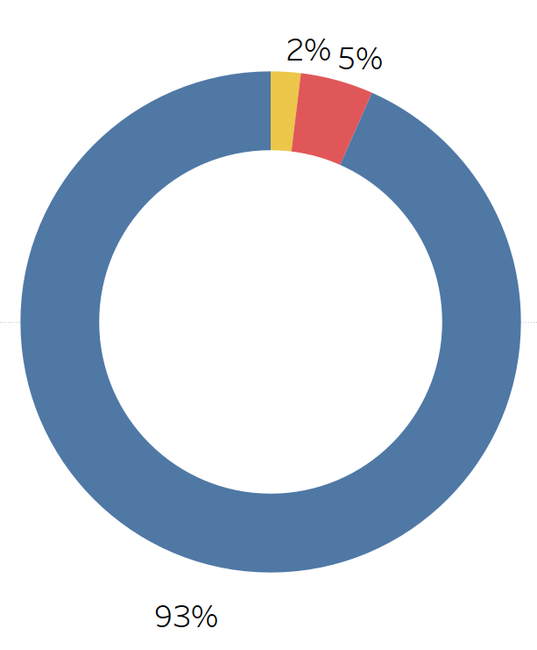

The majority of deliveries arrive in time

Slide 6
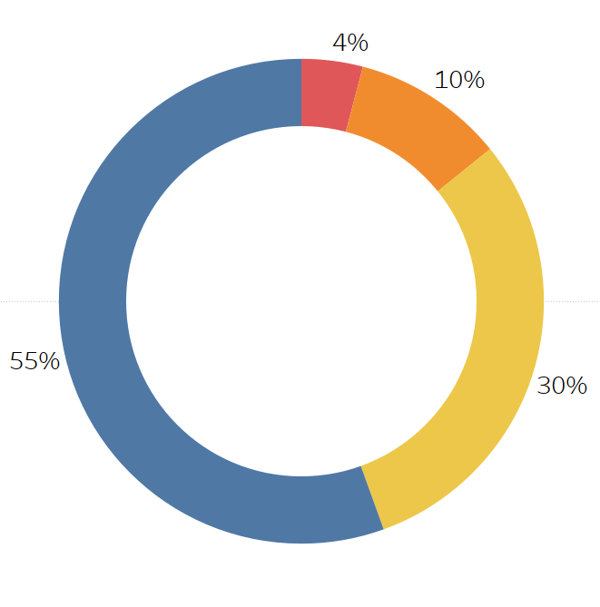
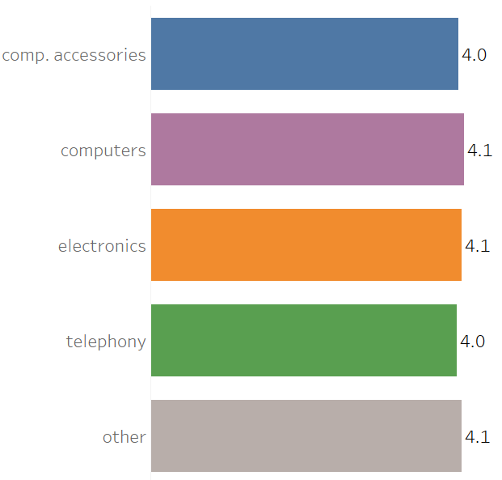
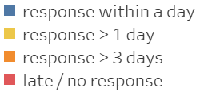
Positive customer reviews - fast customer support
Notes:
The platform has high customer review in all sectors and their response times to requests ar very fast in general - 85% of review were answered within three days and 55% even within a day

Slide 7
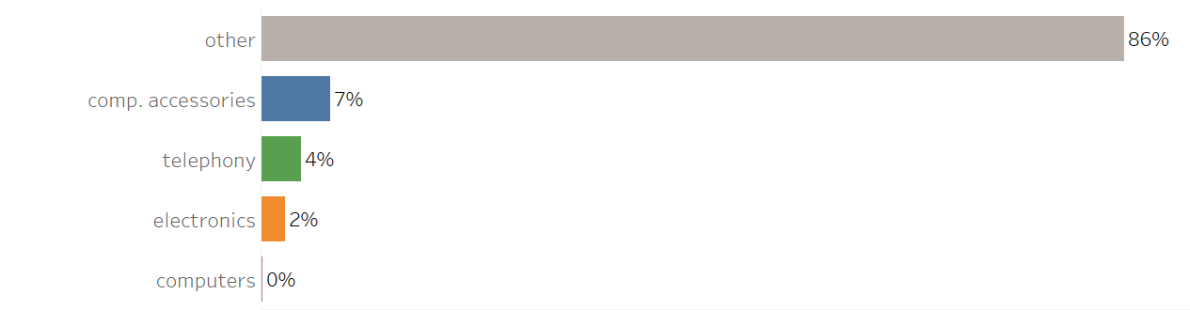
Magist is not specialized on selling tech-products
Notes:
But let us now specifically look at the tech-sector of Magist’s wide product range:
We can see that tech products made around 14 % of all sales and are not Magist’s core business

Slide 8
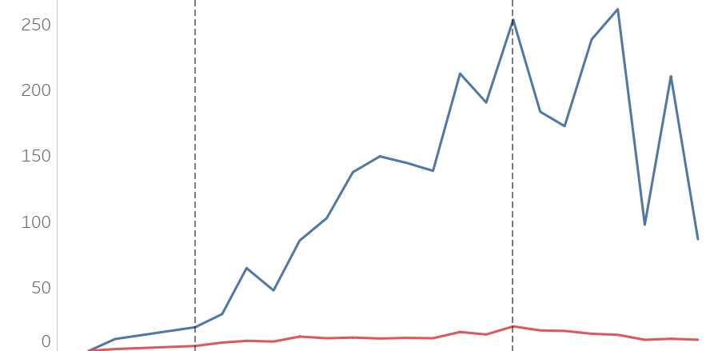
Low average sales per store in the technology sector
2016
2017
2018
max. sales
avg. sales
Notes:
There is a number of tech sellers on the platform however the monthly sales volume per seller is very low on average. Even the highest individual sales numbers ranged only between 50 and 200 sales

Slide 9
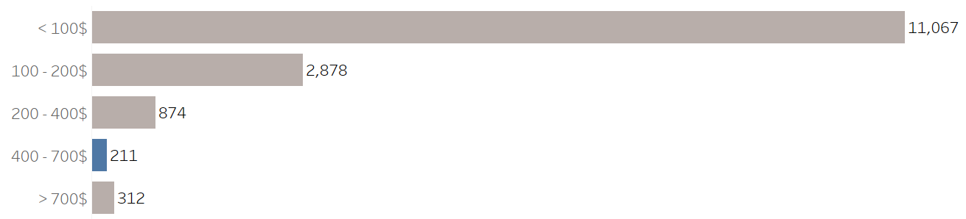
Low sales volume of high-value technology products
Price range of most Eniac products
Notes:
Even more prominent: sales numbers in the higher price segments, which are Eniacs core business, are very low compared to the lower-priced products

Slide 10
Sales numbers suggest a small customer base for Eniac’s high-value technology products
but
Magist provides a growing platform, reliable deliveries and responsive customer service
Notes:
In conclusion we think that Magist is a reliable partner for us in the Brazilian market in terms of growth and delivery, however the strategy comes with some risks due to the low customer base for high-value tech products. Alternative ways to go forward would be negotiating a shorter contract to have a test phase

Slide 11
Additional Slides

Slide 12
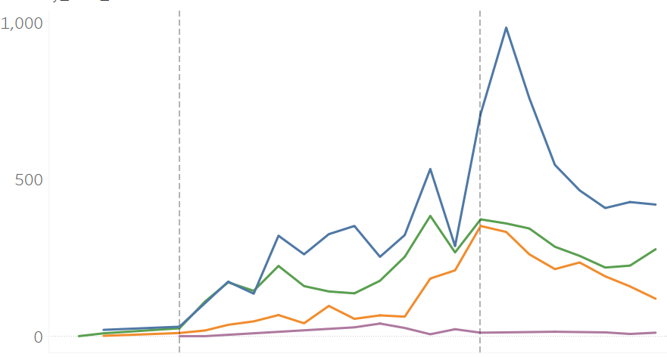
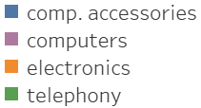
Sales numbers in the technology sector
2016
2017
2018
Notes:
Furthermore, sales numbers in the tech sector were fluctuating, annual growth was observed but not as prominent (steep decline in Q2 2018)

Slide 13
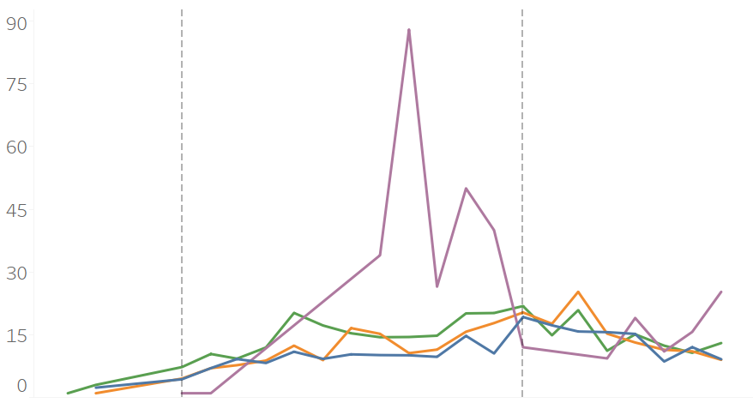
Low average sales per store
2016
2017
2018

Slide 14
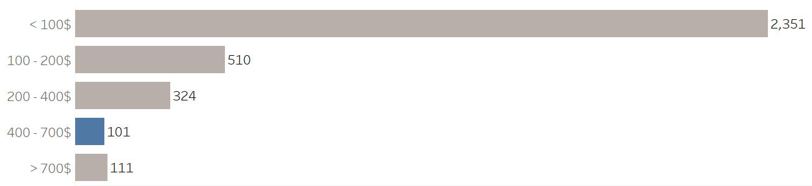
Small number of tech-products in higher price segments
Price range of most Eniac products

Slide 15
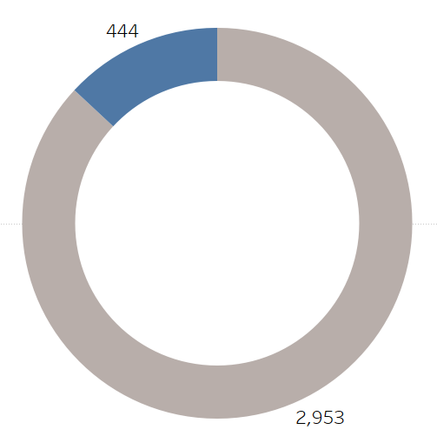

Number of stores on the Magist platform

