Slide 1
Discounts as a marketing strategy: Data driven approach

Slide 2
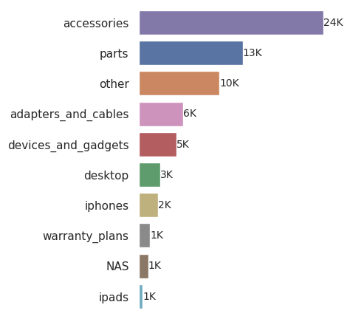
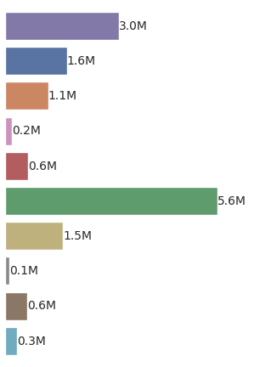
Analyzed Data: Overview
Product Categories
Sales
Revenue
Timeframe: 01/2017 - 03/2018
Sold Products: 59,001
Total Revenue: ~ 14.7 M
Number of Orders: 44,812
Notes:
Here we show an overview of products categories.
Accessories with 24k sales gives lesser revenue
Desktop with 3k sales gives highest revenue.

Slide 3
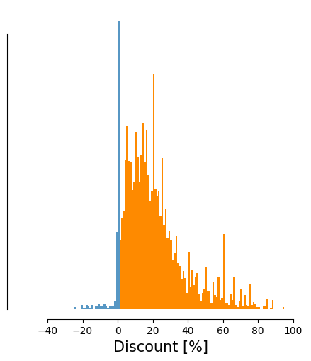
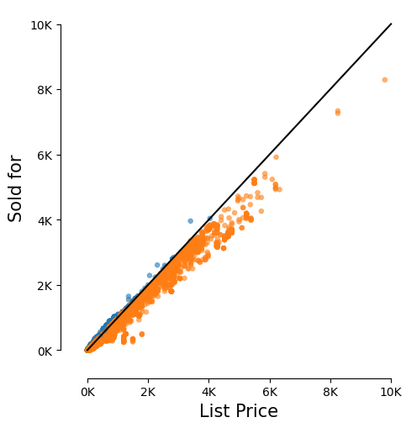
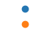
A majority of items was sold at a discount between 5 - 30%
Not Discounted
Discounted
Notes:
discount was estimated by comparing list price with order price
most products were sold at a discount between 5 - 30 %

Slide 4
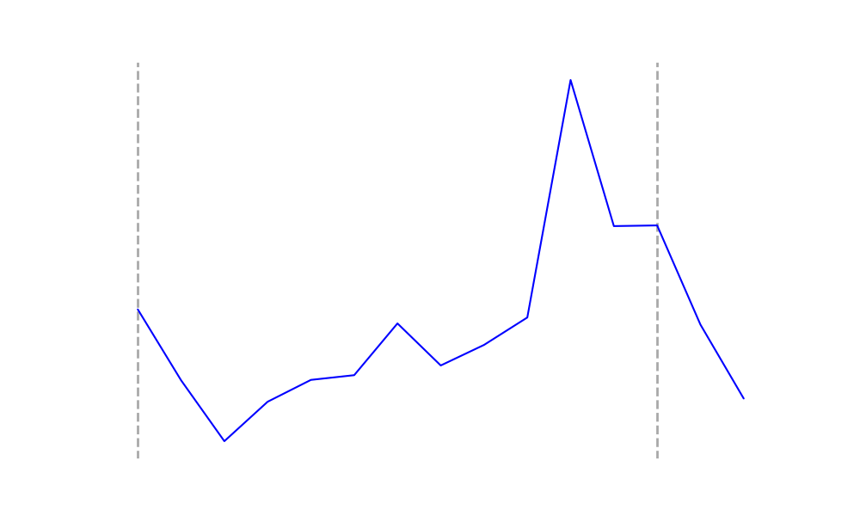
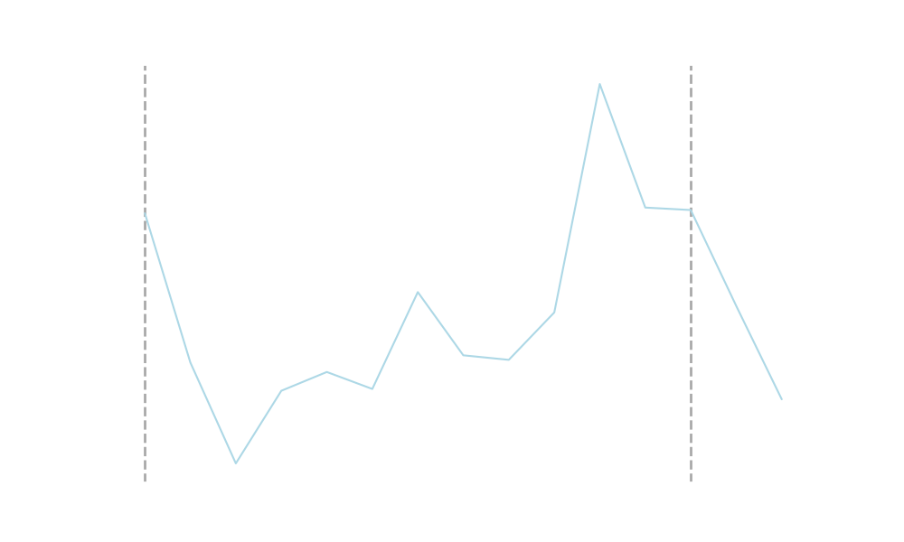
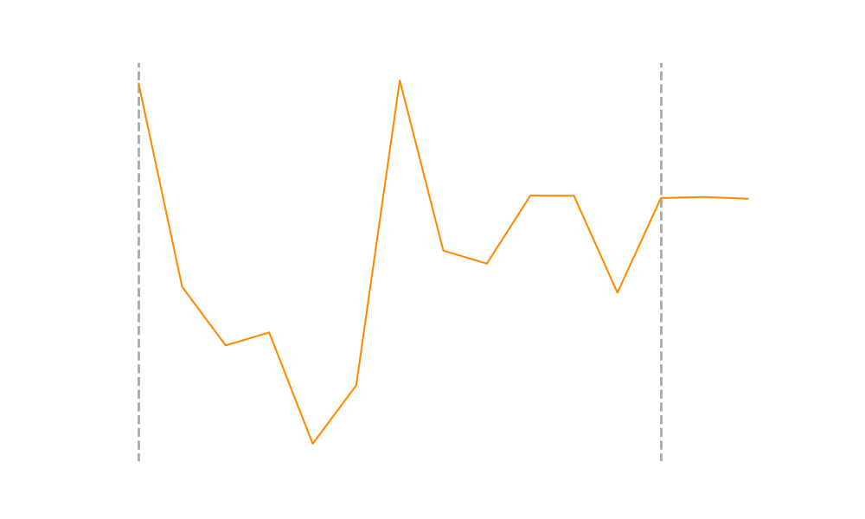
Strong Seasonal Variation in Sales and Revenue
Avg. Discount
Sales
Revenue
2017
2018
Notes:
We observed two peak periods during the timeframe which influenced sales.
In summer 2017, high discounting enhanced sales while in the Fall 2017 sales were influenced by christmas holidays.
peak in summer can be explained by high discounts
discount did not affect sales/revenue in the christmas time
discounts also affect sales and revenue differently

Slide 5
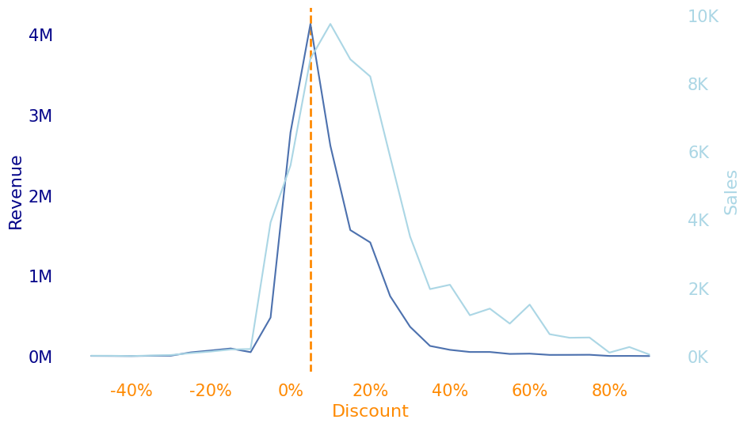
High Sales but lower Revenue at higher Discounts
Notes:
revenue was highest at low discount around 5 %
higher discounts did not improve sales further and additionally reduced revenue

Slide 6
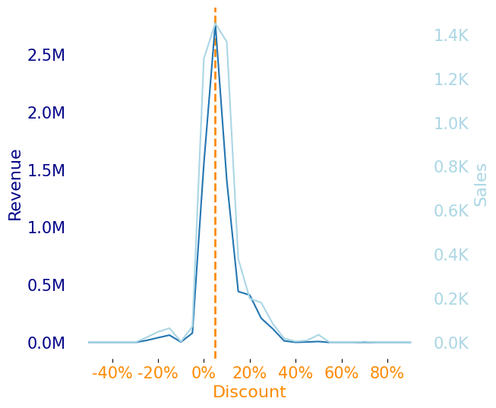
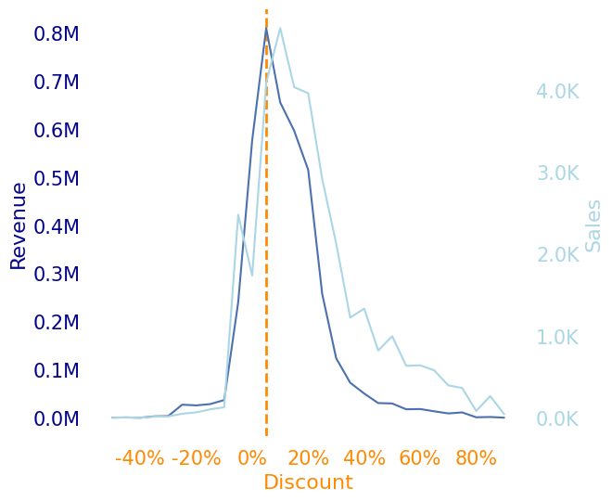
Discount Effect on High-Selling product types
Accessories & Other
iPhones and Desktop
Notes:
the pattern was similar for most product categories
but the effect was especially strong in categories with high sales and lower revenue

Slide 7
Our analysis suggests:
Seasonal variation (especially Christmas-Business) was the strongest driver for sales and revenue
Discounts can improve sales in low-selling seasons
Discounts > 5-10 % lower the revenue and did not seem to improve sales further
In general discount offers >10 % should be reduced and kept at a 5 - 10% level
Other factors (release of new phone models) should be considered

Slide 8
Room for Improvement: Data Quality and Completeness
Quality control and verification of data type at data entry must be improved to prevent data loss in the future
Additional data should be collected to gain valuable insights:
Including product manufacturer/ supply costs will enable us to estimate profit
Products should be classified in easy to understand, hierarchical categories
Records (e.g. monthly) should be kept which products where offered in the shop at what price

