Slide 1

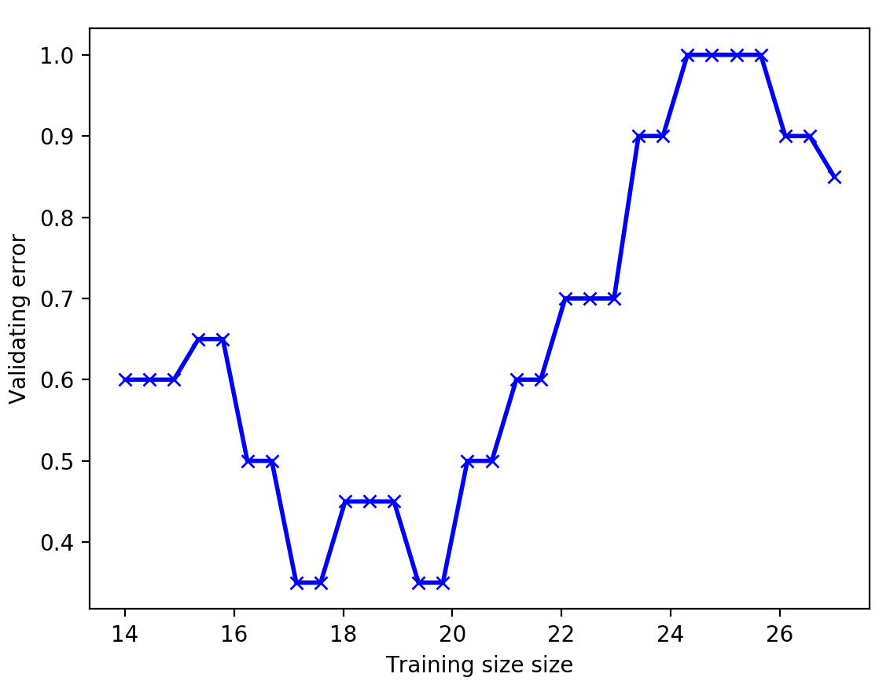
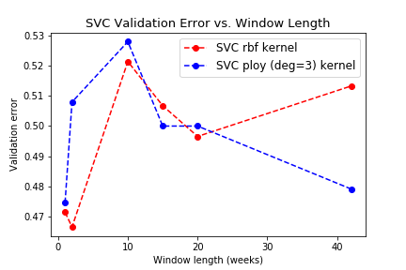
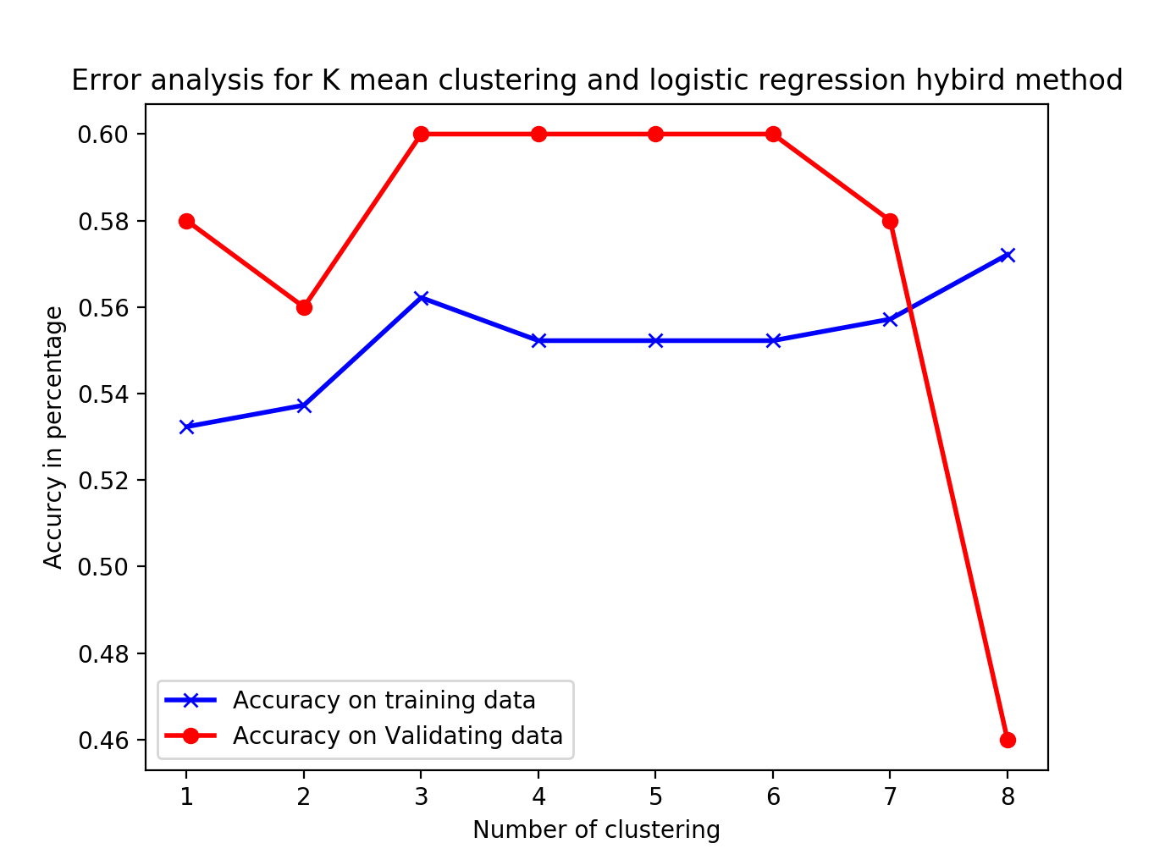
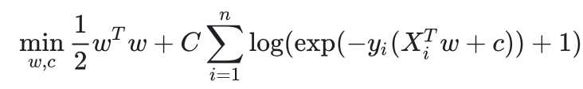
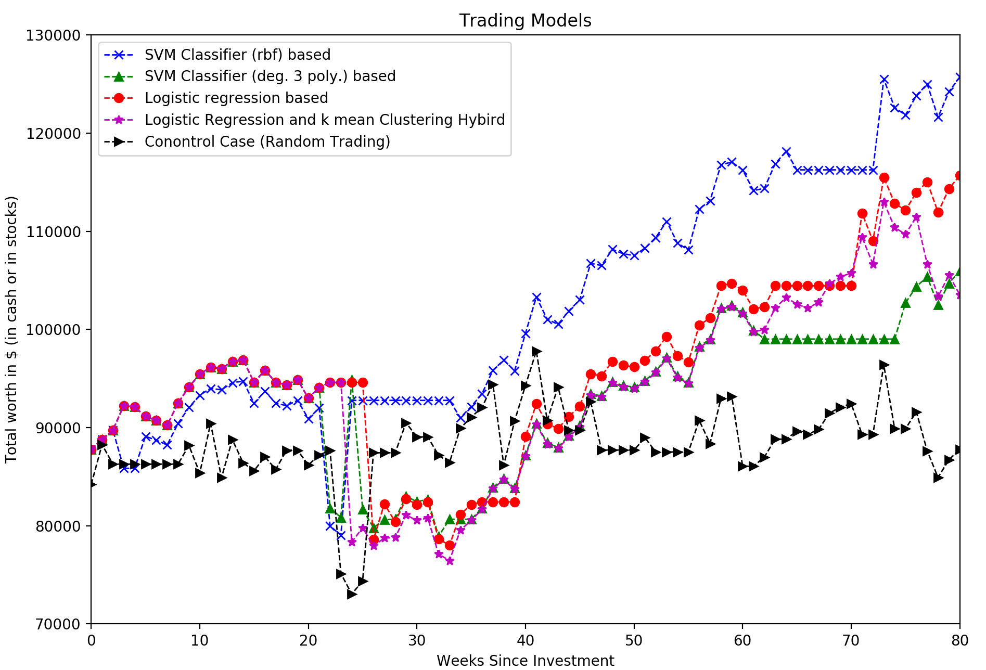
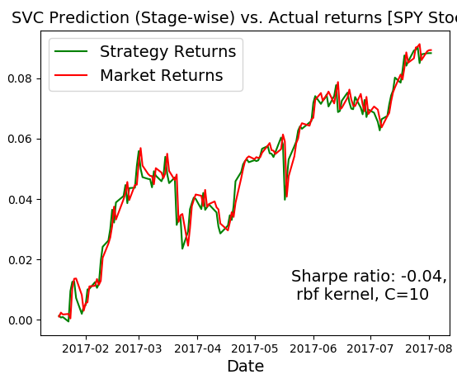
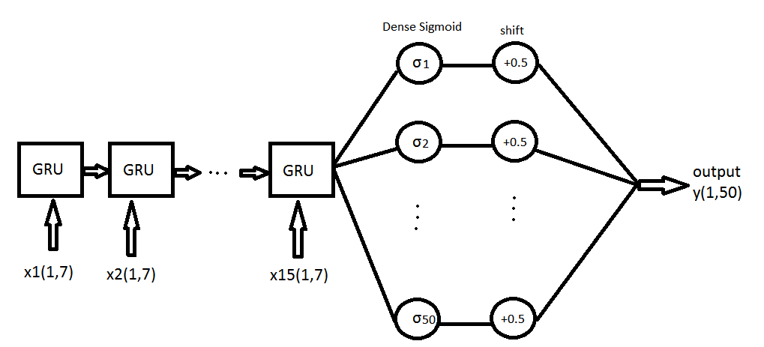
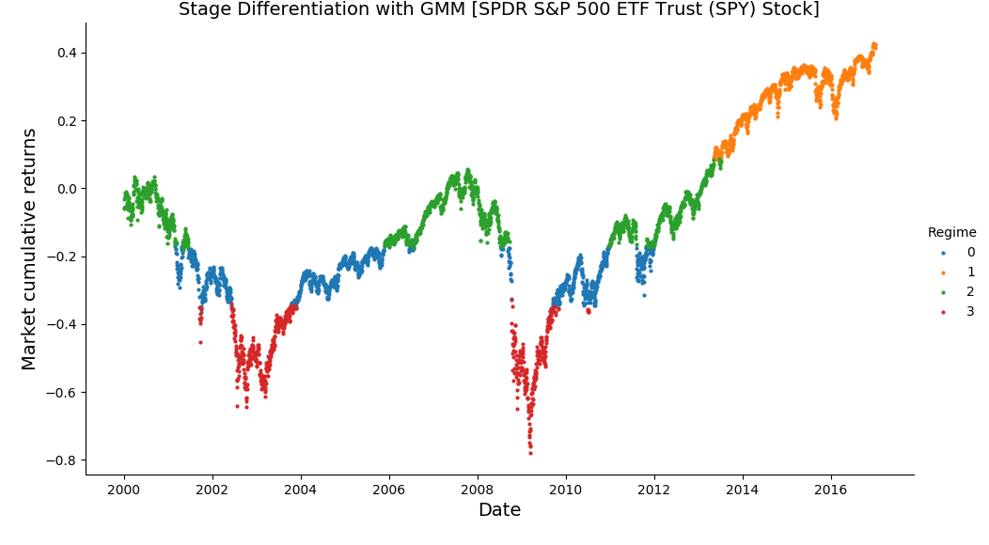
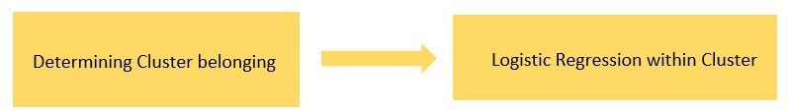
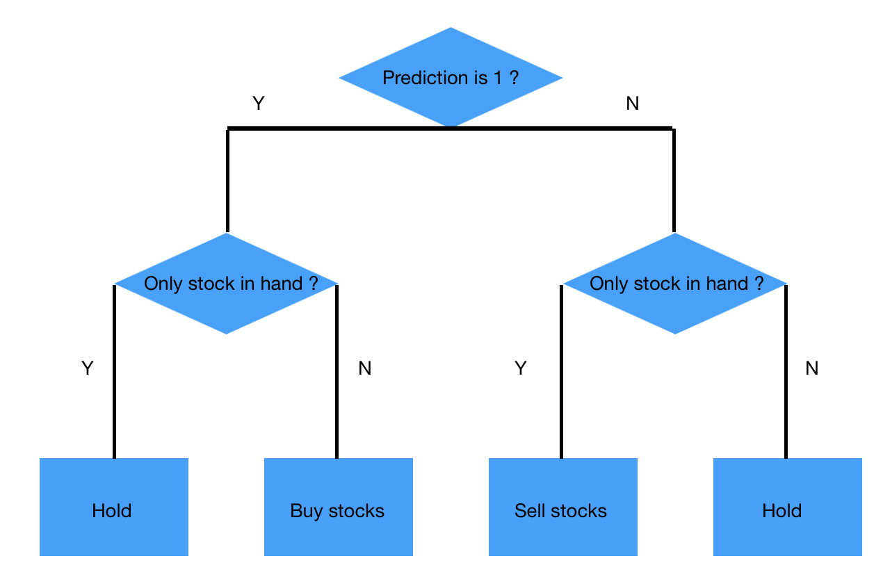
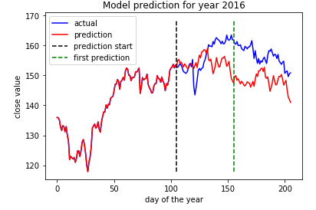
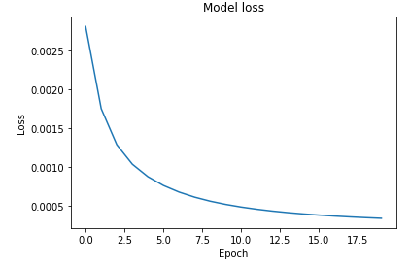
Data Driven Approach for Predicting Stock index movement
Saksham Gakhar, Lei Fang, Joseph Ballouz
{sakshamg,lfang2,jballouz}@Stanford.edu
Motivation
Build a wide range of models and algorithms to assist financial analysts in making predictions about the direction and value of future stock prices. Besides, we look for underlying trends in years of training data
Data set and Features
Data Source
We get time series of stocks for different companies and trusts from S&P 500 [daily data]. The columns vector features in the raw data are – for each stock: opening price, closing price, high and low values of the day and the volume of stocks traded. The rows are the data for each company for each date.
Some of the derived features [for different tasks] are: Percent change in price over week, percent change volume, Smooth Moving Average, log return based on opening price for current to previous date, stock differentiation stage [one of the 4 clusters], Relative Strength Index (RSI), average directional index
Results and Discussion
Trading (SVC and logistic regression)
Time series of stock price is not iid. Experiments have shown that 20 most resent weeks will give best results.
Stage differentiation & Stage dependent SVC: Used GMM for stage identification in stock cycle. Regimes successfully correspond to established breakout, sideways & panic zones. Trained regime dependent SVC Classifier for to predict the current day’s trend at the opening of the market based on parameters: stage, RSI, SMA, Correlation, log-return of 1- day.
Neural Nets: 2016 closing value predictions IBM
Machine Learning Model
Linear Regression
Support Vector Machine
Neural Network
Hybrid K-mean clustering & Linear regression
Financial stage differentiation using GMM
Prediction of log return using stage depended SV classifier
Future Work
Working more on visualization of K mean clustering logistic regression hybrid model.
Work on more sophisticated trading strategy. Example can be reinforcement learning on trading strategy.
Improve SVC training on the differentiated data after running PCA to recognize the most relevant parameters
Incorporate more features (and scaling them accordingly) in the input for the recurrent neural network. Besides, we would like to also try CNN
Stage | 0 | 1 | 2 | 3
Color | Blue (Sideways zone or low volatility) | Orange (breakout zone) | Green zone | Red (panic zone or high volatility)
Characteristic | Moderate mean, Low Co-var | High mean, High Co-var. | High mean, Moderate Co-var | Low mean, Low Co-var
Mean ($) | 115.44 | 197.24 | 138.70 | 92.01
Covar | 29.91 | 251.15 | 75.02 | 57.47
Trading Model
References
- Scikit-learn: Machine Learning in Python, Pedregosa et al., JMLR 12, pp. 2825-2830, 2011.
- Quantinsiti.com, Trading Using Machine Learning in Python
- Keras library, Sci-kit, Pandas and other common libraries.
Our used simple rule and we call it “Buy-everything Sell-every thing model”. If the model predicts that stock will increases price, we try to get as much as stocks. We try to sell all the stocks if prediction is that stock price will decrease.

