Slide 1
Physical Structure of CMOS ICs
Lecture# 05
VLSI Design

Slide 2
Physical Structure of CMOS Integrated Circuits
A CMOS IC is a electronic switching network
  Created in a small area
  Using complex physical and chemical processes
In the design hierarchy the last task is to
  Translate circuit schematics in to silicon form
  Called physical design
In this chapter we will examine the structure of CMOS IC
  At the microscopic level

Slide 3
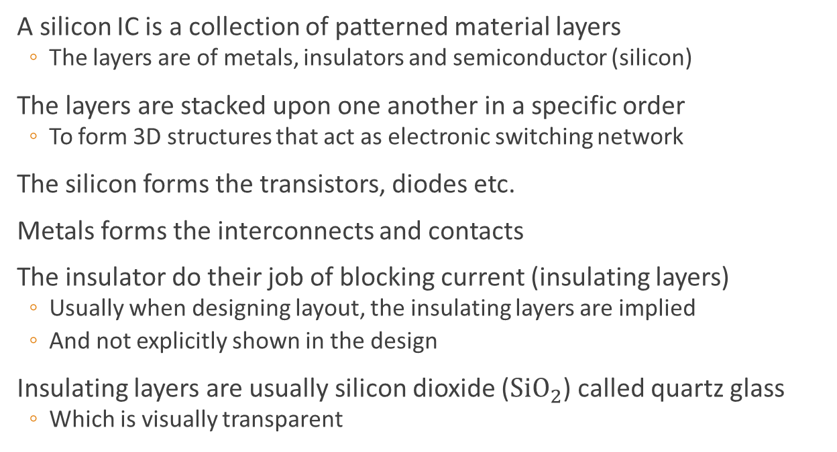
Integrated Circuit Layers
A silicon IC is a collection of patterned material layers
  The layers are of metals, insulators and semiconductor (silicon)
The layers are stacked upon one another in a specific order
  To form 3D structures that act as electronic switching network
The silicon forms the transistors, diodes etc.
Metals forms the interconnects and contacts
The insulator do their job of blocking current (insulating layers)
  Usually when designing layout, the insulating layers are implied
  And not explicitly shown in the design
Insulating layers are usually silicon dioxide ($SiO_{2}$) called quartz glass
  Which is visually transparent

Slide 4
Integrated Circuit Layers cont.
Metal 1
Consider an example
  With two layers
  As shown in figure
Metal 1 and Substrate
  Is electrically isolated by insulator
Insulator
Substrate
Side view
Top view

Slide 5
Integrated Circuit Layers
Adding more layers
The metal 1 layer is filled/coated
  with insulator
Then it is subjected to CMP
  Chemical Mechanical Planarization
  In which the surface is etched and sanded
  To flat the surface for next layer
Next, the surface is coated with
  Metal 2 layer,
  As shown in figure
Side view shows, order of stacking
Top view shows, pattern of each layer
Metal 2
Metal 1
Insulator
Side view
Substrate
Top view

Slide 6
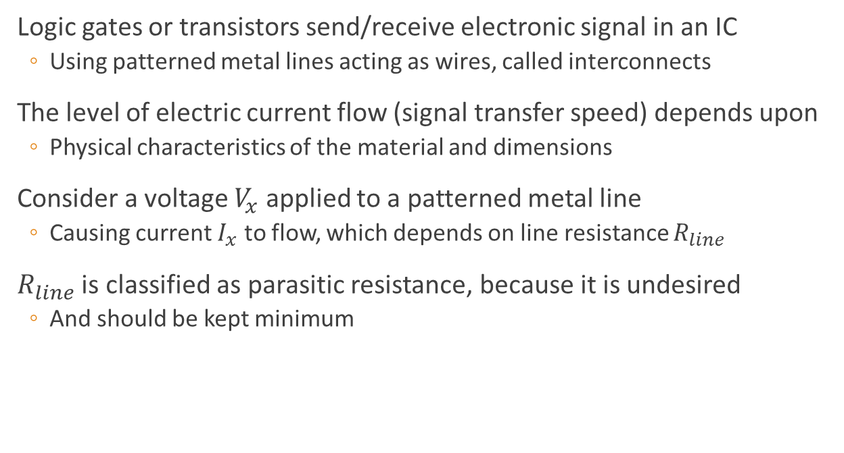
IC Layers – Interconnect Resistance & Capacitance
Logic gates or transistors send/receive electronic signal in an IC
  Using patterned metal lines acting as wires, called interconnects
The level of electric current flow (signal transfer speed) depends upon
  Physical characteristics of the material and dimensions
Consider a voltage $V_{x}$ applied to a patterned metal line
  Causing current $I_{x}$ to flow, which depends on line resistance $R_{line}$
$R_{line}$ is classified as parasitic resistance, because it is undesired
  And should be kept minimum

Slide 7
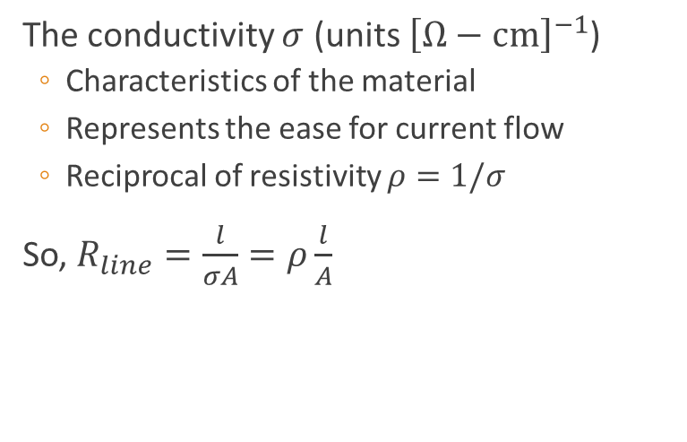
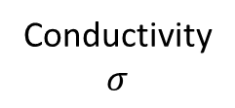
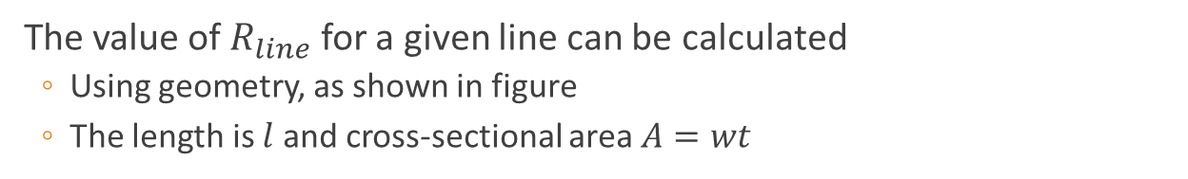



IC Layers
Interconnect Resistance
The value of $R_{line}$ for a given line can be calculated
  Using geometry, as shown in figure
  The length is $l$ and cross-sectional area $A=wt$
The conductivity $σ$ (units ${\left[Ω−cm\right]}^{−1}$)
  Characteristics of the material
  Represents the ease for current flow
  Reciprocal of resistivity $ρ=1/σ$
So, $R_{line}=\frac{l}{σA}=ρ\frac{l}{A}$
$$t$$
$$l$$
Conductivity
$$σ$$
$$w$$

Slide 8
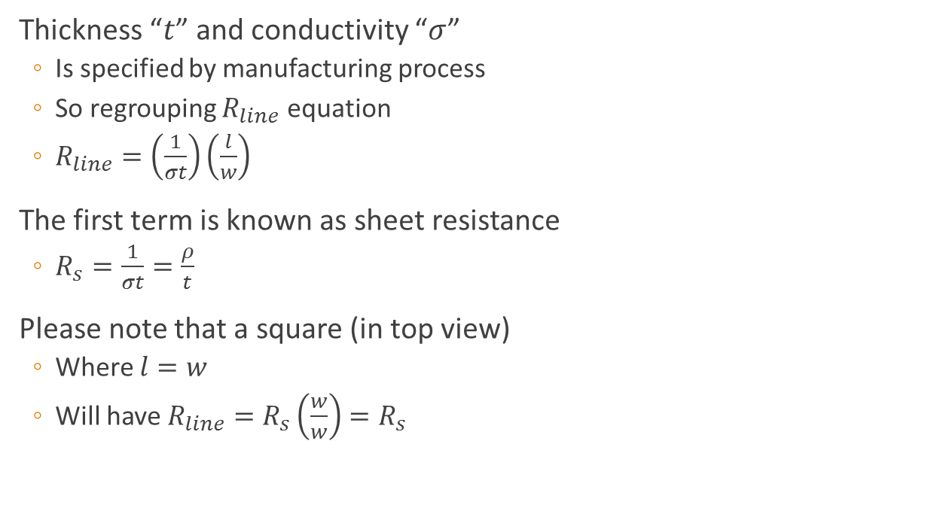
IC Layers
Interconnect Resistance cont.
Thickness “$t$” and conductivity “$σ$”
  Is specified by manufacturing process
  So regrouping $R_{line}$ equation
  $R_{line}=\left(\frac{1}{σt}\right)\left(\frac{l}{w}\right)$
The first term is known as sheet resistance
  $R_{s}=\frac{1}{σt}=\frac{ρ}{t}$
Please note that a square (in top view)
  Where $l=w$
  Will have $R_{line}=R_{s}\left(\frac{w}{w}\right)=R_{s}$
$$t$$
$$l$$
Conductivity
$$σ$$
$$w$$

Slide 9

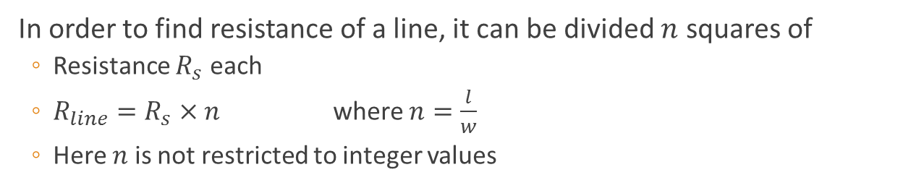


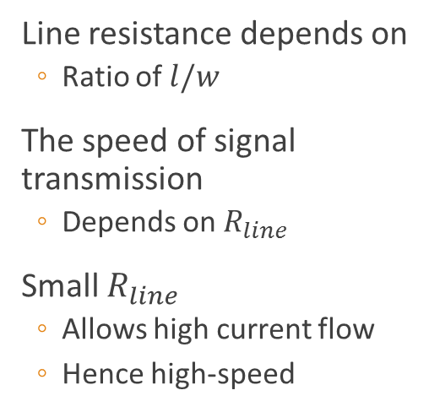


IC Layers
Interconnect Resistance cont.
In order to find resistance of a line, it can be divided $n$ squares of
  Resistance $R_{s}$ each
  $R_{line}=R_{s}×n$ where $n=\frac{l}{w}$
  Here $n$ is not restricted to integer values
Line resistance depends on
  Ratio of $l/w$
The speed of signal transmission
  Depends on $R_{line}$
Small $R_{line}$
  Allows high current flow
  Hence high-speed
X
Y
$$t$$
$$w$$
1 square (with resistance $R_{s}$)
X
Y
All these resistances are $R_{s}$
Fraction of $R_{s}$

Slide 10
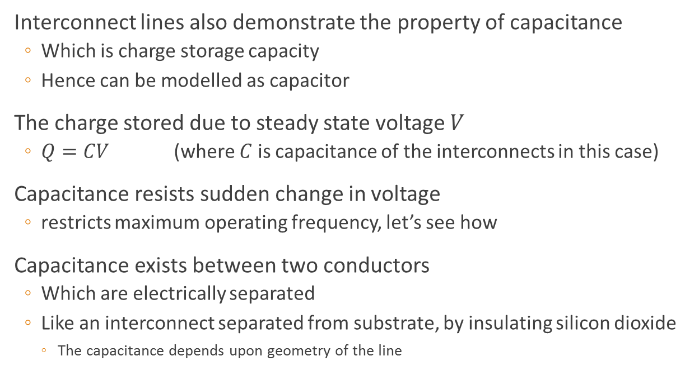
IC Layers
Interconnect Capacitance
Interconnect lines also demonstrate the property of capacitance
  Which is charge storage capacity
  Hence can be modelled as capacitor
The charge stored due to steady state voltage $V$
  $Q=CV$ (where $C$ is capacitance of the interconnects in this case)
Capacitance resists sudden change in voltage
  restricts maximum operating frequency, let’s see how
Capacitance exists between two conductors
  Which are electrically separated
  Like an interconnect separated from substrate, by insulating silicon dioxide
    The capacitance depends upon geometry of the line

Slide 11

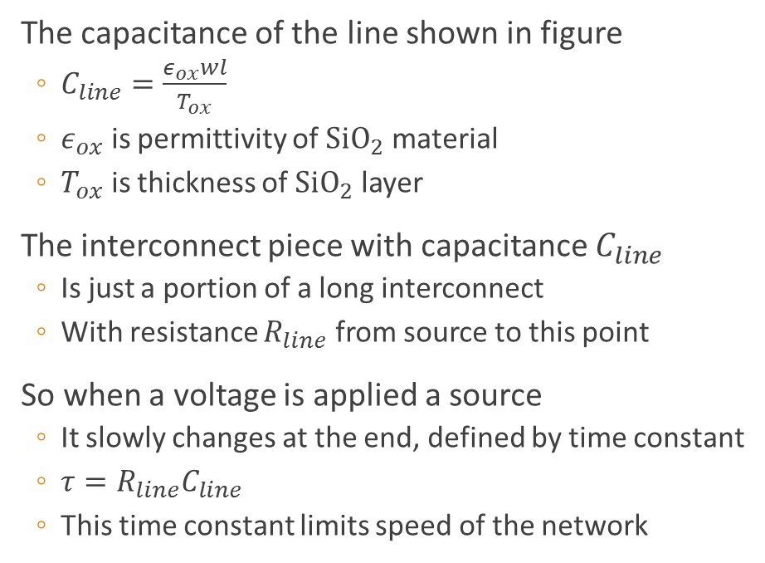


IC Layers
Interconnect Capacitance cont.
$$w$$
The capacitance of the line shown in figure
  $C_{line}=\frac{ε_{ox}wl}{T_{ox}}$
  $ε_{ox}$ is permittivity of $SiO_{2}$ material
  $T_{ox}$ is thickness of $SiO_{2}$ layer
The interconnect piece with capacitance $C_{line}$
  Is just a portion of a long interconnect
  With resistance $R_{line}$ from source to this point
So when a voltage is applied a source
  It slowly changes at the end, defined by time constant
  $τ=R_{line}C_{line}$
  This time constant limits speed of the network
$$T_{ox}$$
$$l$$

Slide 12


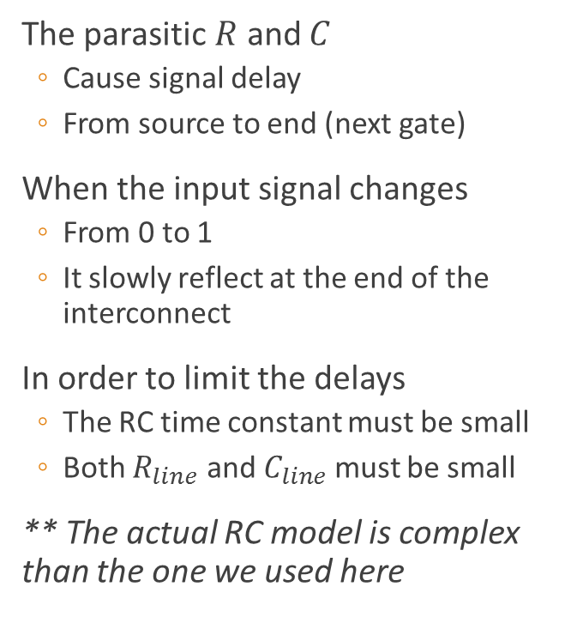





IC Layers
Interconnect Time Constant
The parasitic $R$ and $C$
  Cause signal delay
  From source to end (next gate)
When the input signal changes
  From 0 to 1
  It slowly reflect at the end of the interconnect
In order to limit the delays
  The RC time constant must be small
  Both $R_{line}$ and $C_{line}$ must be small
** The actual RC model is complex than the one we used here
$$R_{line}$$
$$v_{s}\left(t\right)$$
$$C_{line}$$
$$v_{c}\left(t\right)$$
$$v_{s}\left(t\right)$$
$$v_{c}\left(t\right)$$
$$Voltage (V)$$
$$τ$$
$$Time (s)$$

Slide 13
IC layers of a MOSFET
CMOS gates are made of complementary MOSFETs
  It is important to understand MOSFET at physical level
To start with, consider an nMOS with
  Two set of patterned layers
The gate electrode acts as control terminal
  When voltage is applied to gate, the switch is closed
  and vice versa
The voltage at gate controls current flow
  between source and drain terminals
Consider a signal G applied at gate terminal

Slide 14
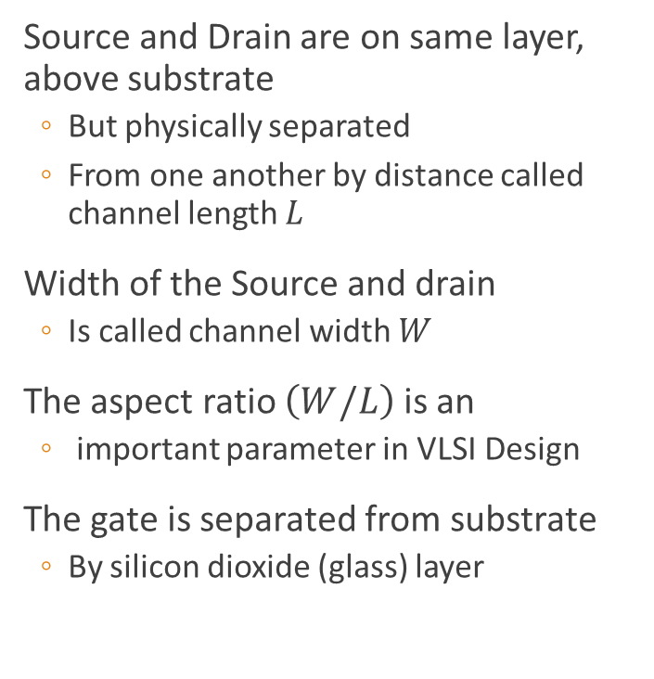


Physical Structure of a MOSFET
Various Layers
Source and Drain are on same layer, above substrate
  But physically separated
  From one another by distance called channel length $L$
Width of the Source and drain
  Is called channel width $W$
The aspect ratio $\left(W/L\right)$ is an
  important parameter in VLSI Design
The gate is separated from substrate
  By silicon dioxide (glass) layer
Silicon dioxide insulator
Gate
Source
$$L$$
Drain
$$W$$

Slide 15
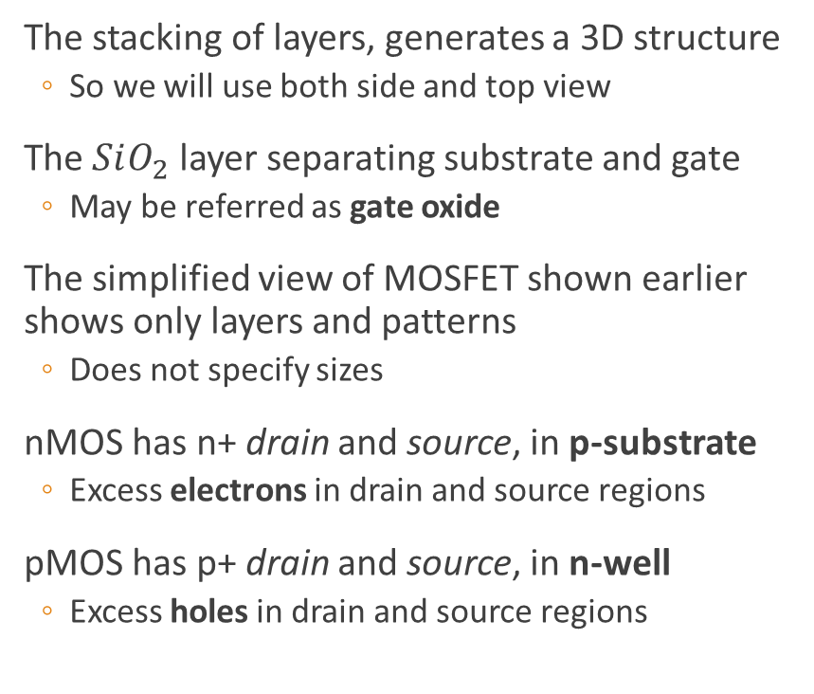


Physical Structure of a MOSFET
Various Layers cont.
The stacking of layers, generates a 3D structure
  So we will use both side and top view
The $SiO_{2}$ layer separating substrate and gate
  May be referred as gate oxide
The simplified view of MOSFET shown earlier shows only layers and patterns
  Does not specify sizes
nMOS has n+ drain and source, in p-substrate
  Excess electrons in drain and source regions
pMOS has p+ drain and source, in n-well
  Excess holes in drain and source regions
Source
Gate
Gate Oxide
$$L$$
Drain
Side View
Gate
$$W$$
Source
Drain
Top View

Slide 16
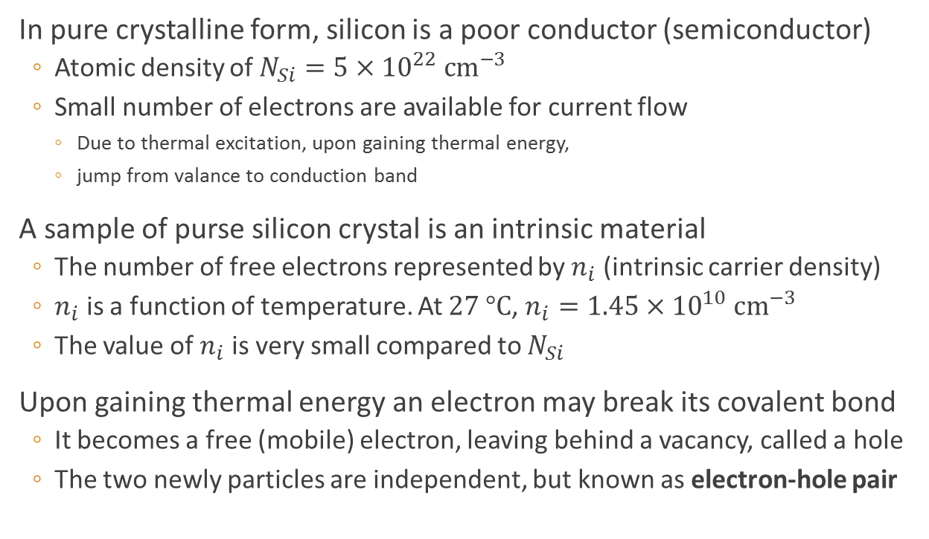
Electrical Conduction in Silicon
Intrinsic Semiconductor
In pure crystalline form, silicon is a poor conductor (semiconductor)
  Atomic density of $N_{Si}=5×{10}^{22} cm^{−3}$
  Small number of electrons are available for current flow
    Due to thermal excitation, upon gaining thermal energy,
    jump from valance to conduction band
A sample of purse silicon crystal is an intrinsic material
  The number of free electrons represented by $n_{i}$ (intrinsic carrier density)
  $n_{i}$ is a function of temperature. At $27 °C$, $n_{i}=1.45×{10}^{10} cm^{−3}$
  The value of $n_{i}$ is very small compared to $N_{Si}$
Upon gaining thermal energy an electron may break its covalent bond
  It becomes a free (mobile) electron, leaving behind a vacancy, called a hole
  The two newly particles are independent, but known as electron-hole pair

Slide 17
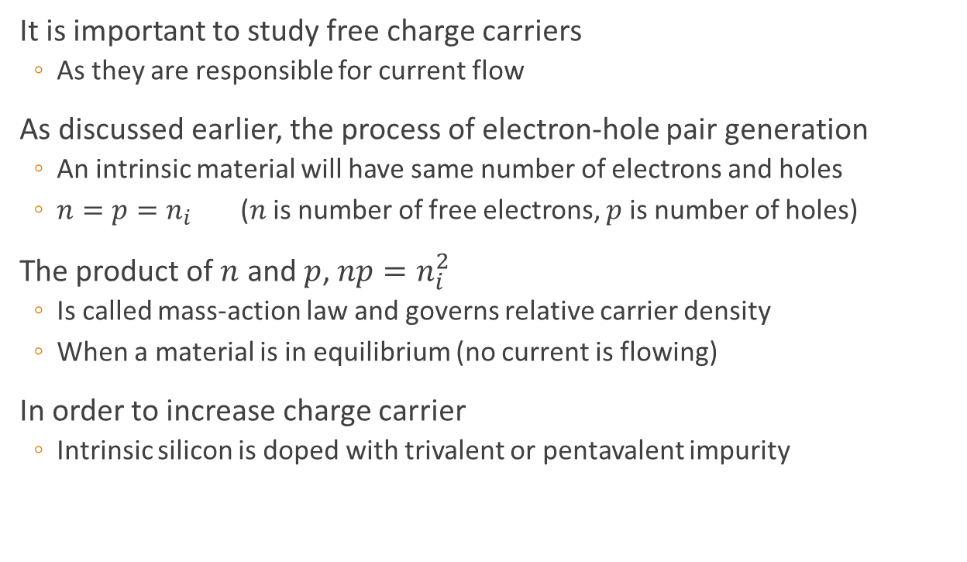
Electrical Conduction in Silicon Charge Carriers
It is important to study free charge carriers
  As they are responsible for current flow
As discussed earlier, the process of electron-hole pair generation
  An intrinsic material will have same number of electrons and holes
  $n=p=n_{i}$ ($n$ is number of free electrons, $p$ is number of holes)
The product of $n$ and $p$, $np=n_{i}^{2}$
  Is called mass-action law and governs relative carrier density
  When a material is in equilibrium (no current is flowing)
In order to increase charge carrier
  Intrinsic silicon is doped with trivalent or pentavalent impurity

Slide 18
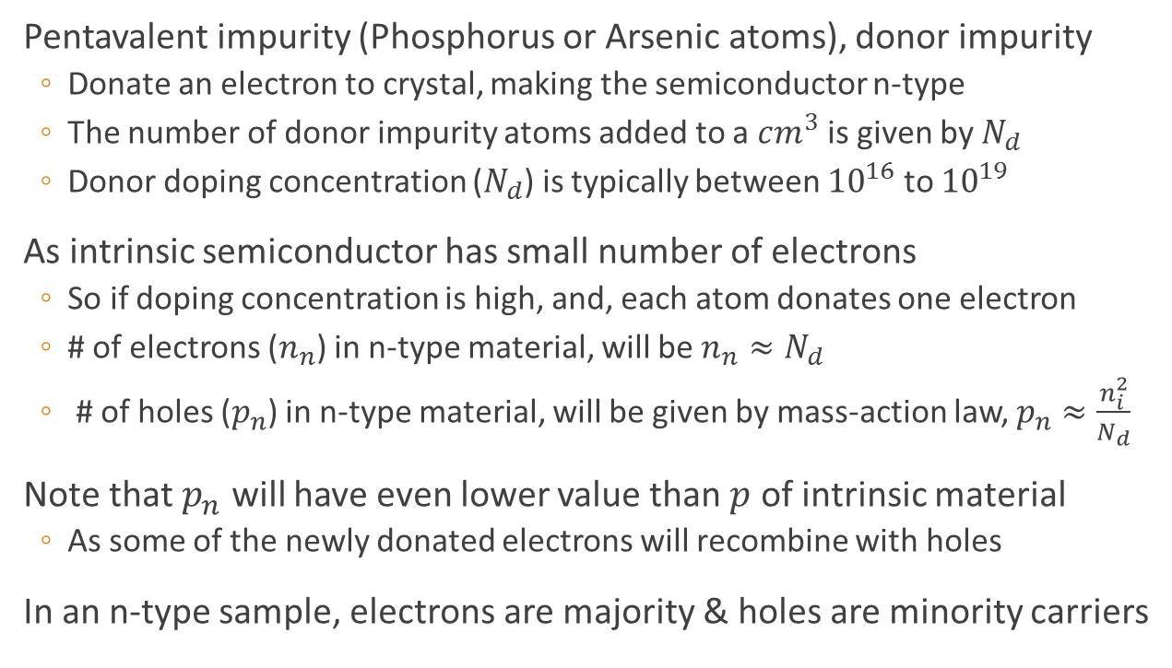
Electrical Conduction in Silicon Donor Doping
Pentavalent impurity (Phosphorus or Arsenic atoms), donor impurity
  Donate an electron to crystal, making the semiconductor n-type
  The number of donor impurity atoms added to a $cm^{3}$ is given by $N_{d}$
  Donor doping concentration ($N_{d}$) is typically between ${10}^{16}$ to ${10}^{19}$
As intrinsic semiconductor has small number of electrons
  So if doping concentration is high, and, each atom donates one electron
  # of electrons ($n_{n}$) in n-type material, will be $n_{n}≈N_{d}$
  # of holes ($p_{n}$) in n-type material, will be given by mass-action law, $p_{n}≈\frac{n_{i}^{2}}{N_{d}}$
Note that $p_{n}$ will have even lower value than $p$ of intrinsic material
  As some of the newly donated electrons will recombine with holes
In an n-type sample, electrons are majority & holes are minority carriers

Slide 19
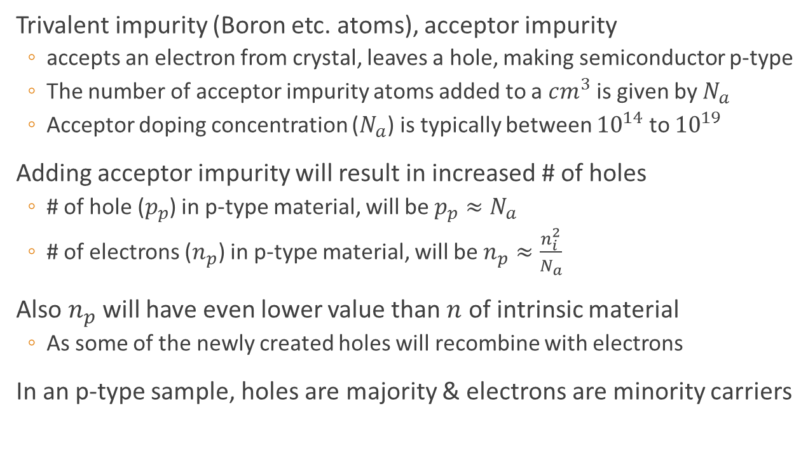
Electrical Conduction in Silicon Acceptor Doping
Trivalent impurity (Boron etc. atoms), acceptor impurity
  accepts an electron from crystal, leaves a hole, making semiconductor p-type
  The number of acceptor impurity atoms added to a $cm^{3}$ is given by $N_{a}$
  Acceptor doping concentration ($N_{a}$) is typically between ${10}^{14}$ to ${10}^{19}$
Adding acceptor impurity will result in increased # of holes
  # of hole ($p_{p}$) in p-type material, will be $p_{p}≈N_{a}$
  # of electrons ($n_{p}$) in p-type material, will be $n_{p}≈\frac{n_{i}^{2}}{N_{a}}$
Also $n_{p}$ will have even lower value than $n$ of intrinsic material
  As some of the newly created holes will recombine with electrons
In an p-type sample, holes are majority & electrons are minority carriers

