Slide 1
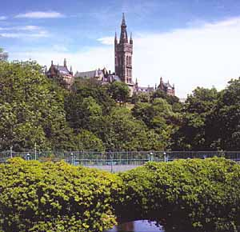

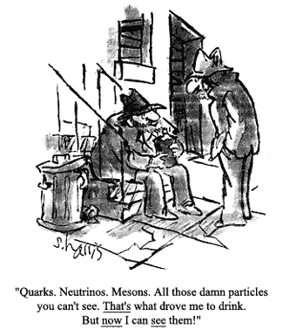
Particle Physics
3rd Handout
Experimental QCD
Kinematics
Deep Inelastic Scattering
  Structure Functions
  Observation of Partons
  Scaling Violations
Jets – quarks & gluons
Measurement of R
http://ppewww.ph.gla.ac.uk/~parkes/teaching/PP/PP.html
Chris Parkes

Slide 2

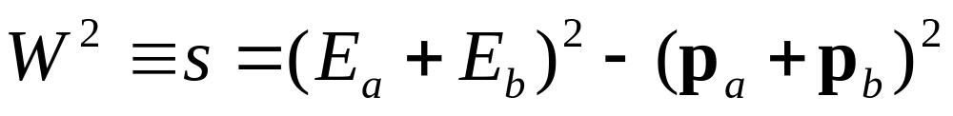
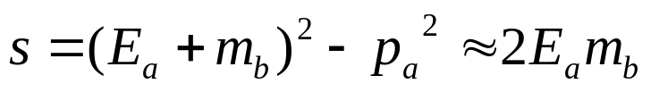

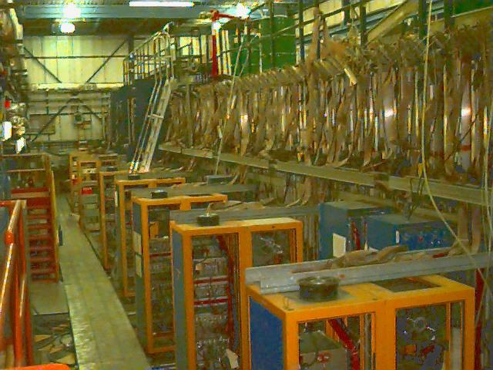
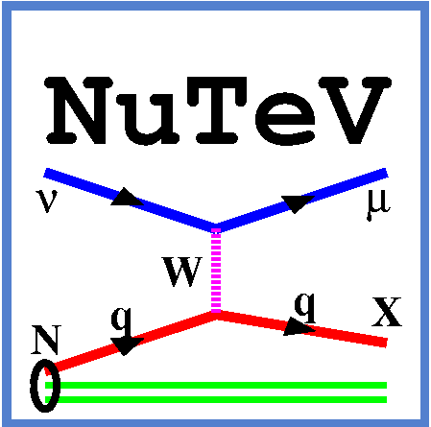
Fixed Target Experiment
Interaction Kinematics
See Appendix A
Martin&Shaw
consider
with four momenta (E_{a},p_{a}) etc..
Total CM energy, a frame invariant [show this]
b at rest:E_{b}=m_{b}
for
e.g. NuTeV
Scatter neutrinos
off nucleons
(iron target)
Measure sin²θ_{W}
Why does this have
to be fixed target?

Slide 3


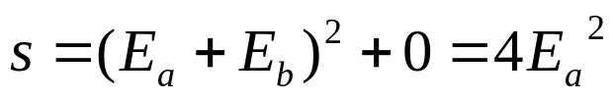

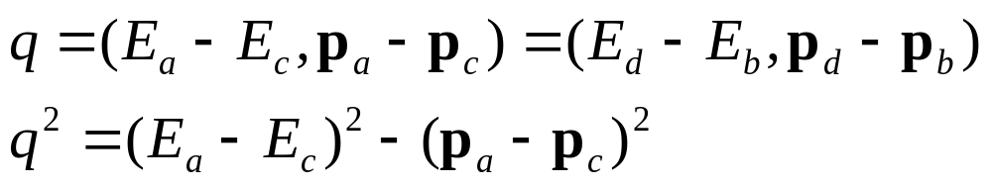

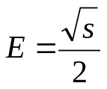

Colliding Beam
LEP,Tevatron, LHC – synchotrons.
SLC – 1990s e+e- 90GeV Linear Collider
ILC – International Linear Collider, 500GeV e⁺e⁻?
Symmetric beams – lab frame =CM frame
Particle & anti-particle collision
a
c
Four Momentum Transfer
θ*
Defined as
b
d
where
Scattered through angle (in CM)
θ*
When particles are not changed in the interaction i.e. a=c, b=d
– elastic scattering process, magnitudes of momenta unchanged
[Here * indicates CM frame]
Hence q^{2→}0, when θ* →0, forward scattering, otherwise negative
[Q²=t=-q²]
For large momenta in CM, can neglect masses, all momenta same

Slide 4
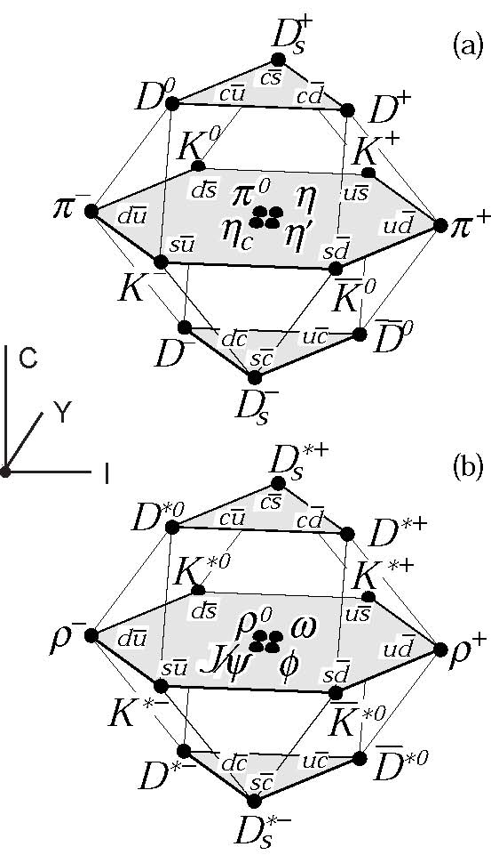
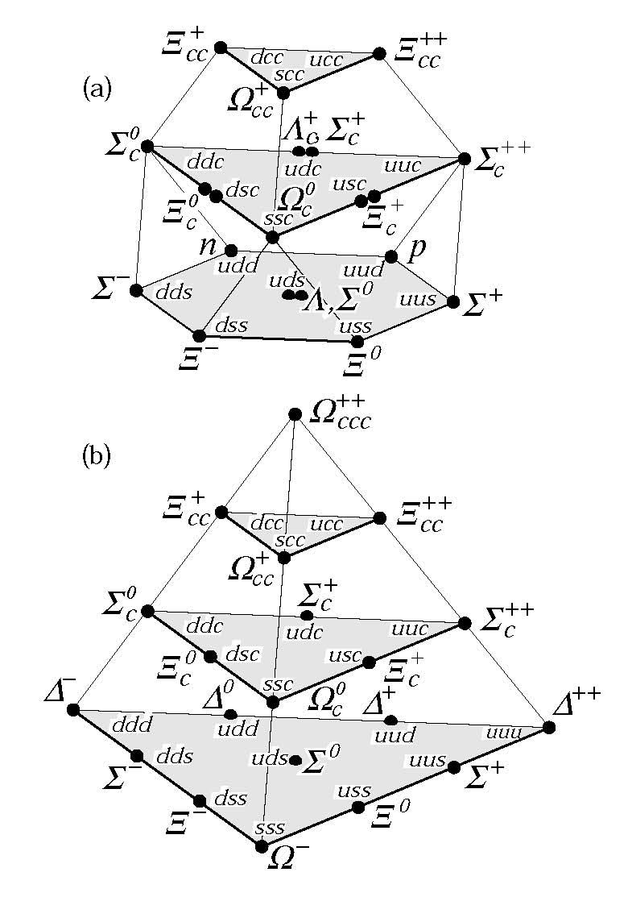
Evidence for Quarks
1) Quark Parton Model
Static quark model that
describes the observed
Hadrons.
c.f. Periodic table of elements
Instead of Atomic number we have various
quantum numbers:
  Isospin
  Strangeness
  Charm
  Beauty
But..
2) Deep Inelastic Scattering

Slide 5
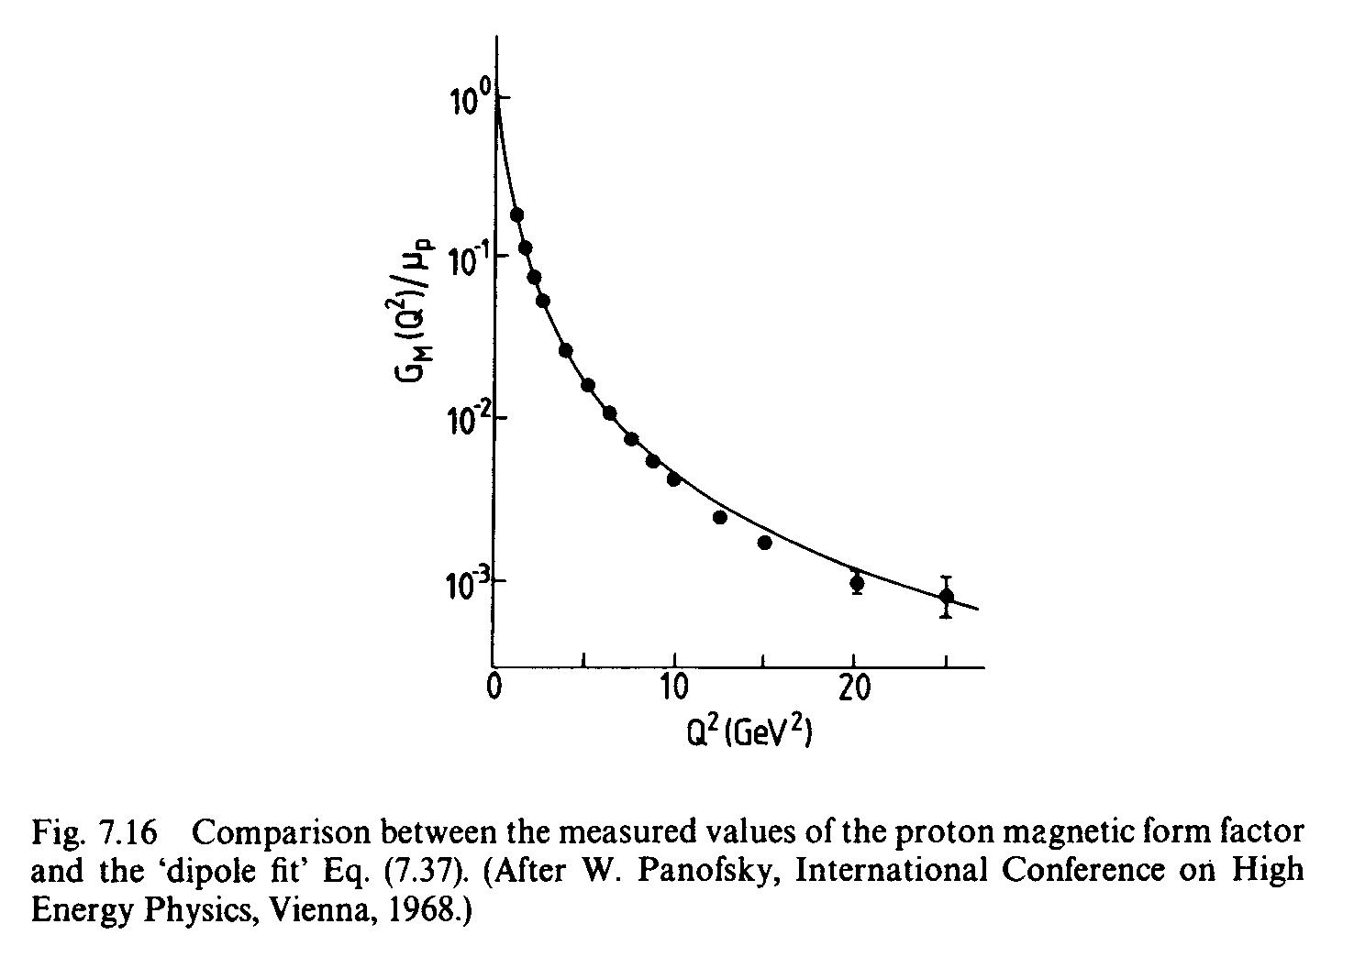
Elastic Scattering
Resolving structure within proton requires photon λ << proton size
Scattering of electrons off protons to determine charge distribution of proton
point-like particle
proton
Form Factor –
ratio of measured cross-section to that for a point-like particle
Point-like particle would have form factor=1& independent of Q²
From this can determine the size (rms charge radius) of the proton
r_{E}=0.85fm

Slide 6
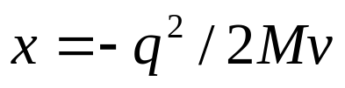
Deep Inelastic Scattering
The proton is broken-up into hadrons
Quarks confined inside proton
Quarks have momentum distribution, each one carries a
Varying fraction of the protons E,p call this fraction x
At high q², small wavelength, scatter off quarks inside proton
E’,p’
electron
E,p
γ
v=E-E` (in proton rest frame)
q=p`-p
Proton
Mass M
m
quark
It can be shown that (M&S Q7.6)
i.e. can tell momentum of quark by looking only at electron!
Where q is 4-vector v,q

Slide 7
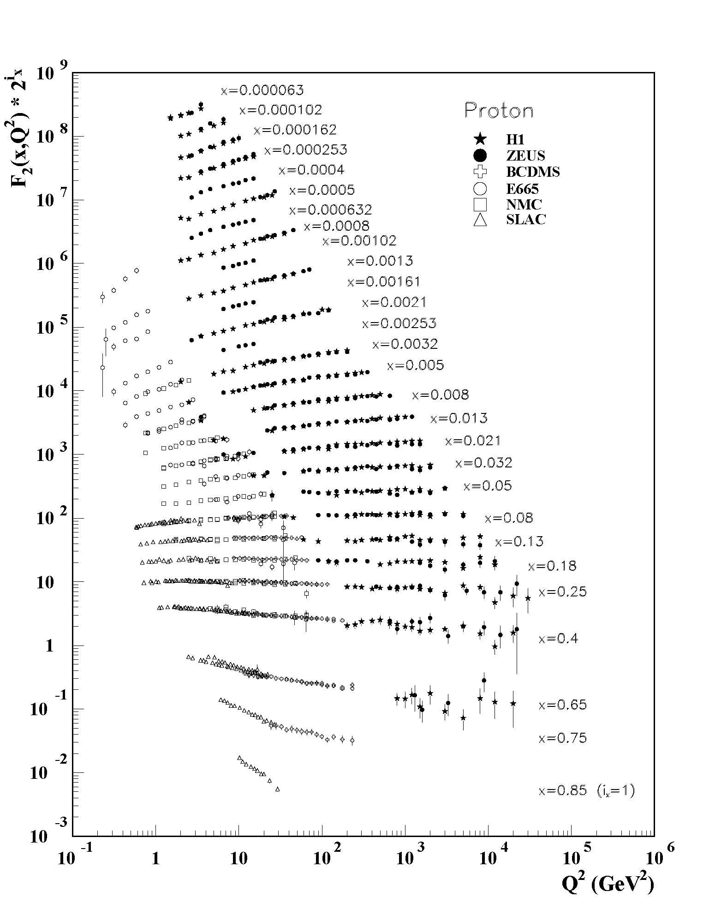
F₂ Structure Function
Equivalent role of form factor in elastic collisions
is generalised to structure functions for inelastic collisions
Measure DIS cross-section
Find structure function for DIS (F₂) is roughly flat with Q² for given values of x
Measures probability of finding a parton with given fraction of proton momentum, x
i.e. same structure over large range of photon energy
Scattering from point-like constituents of the proton - quarks

Slide 8
Scaling Violations
Indirect evidence
for gluon
However, F₂ not quite flat
Parton= valence quark
+quark-anti-quark pairs
Parton= proton
Parton= valence quark
λ=1/q
λ
λ
High q² probe gluon splitting to quark anti-quark pairs
At high q² and large x (>0.3) quarks are less likely, as emitted gluons
F2 decreases
At high q2 and small x quarks more likely, as extra q qbar
        F2 increases

Slide 9
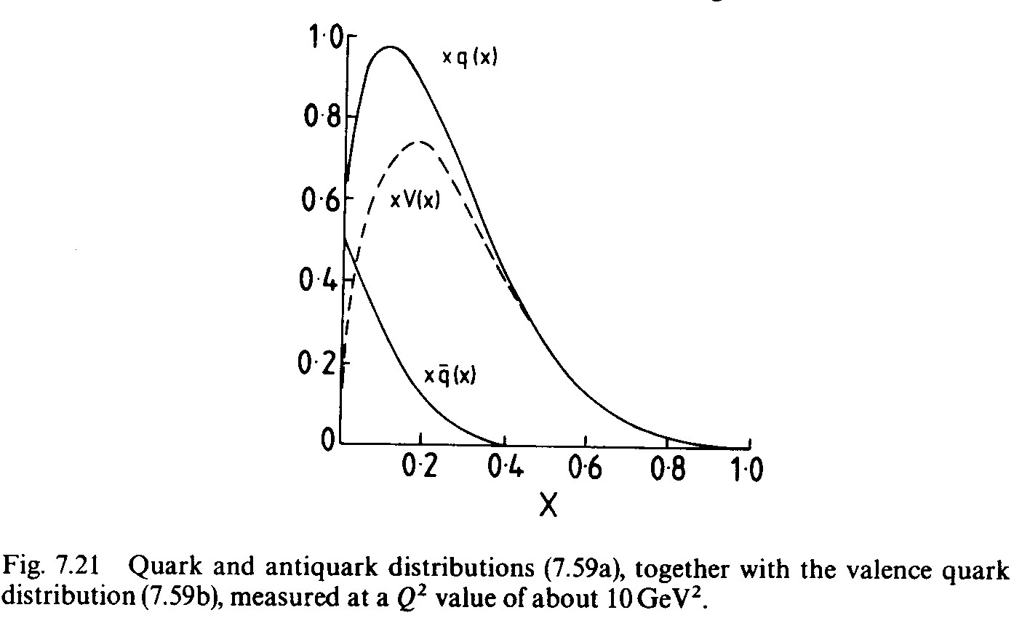
Momentum Distribution
F2 is also sensitive to
The sum of the squares of the quark charges (i.e. 1/9 and 4/9)
The momentum of the quarks – valence quarks / sea quarks
While electron-proton has same q and q bar interactions
Neutrino-proton scattering allows to separate
What about the momentum ?
Quark,
Antiquark
Difference V
= valence quarks
Integrate up and down quark component
i.e. total of sea and valence quarks
only 54% of momentum
rest is in gluons

Slide 10
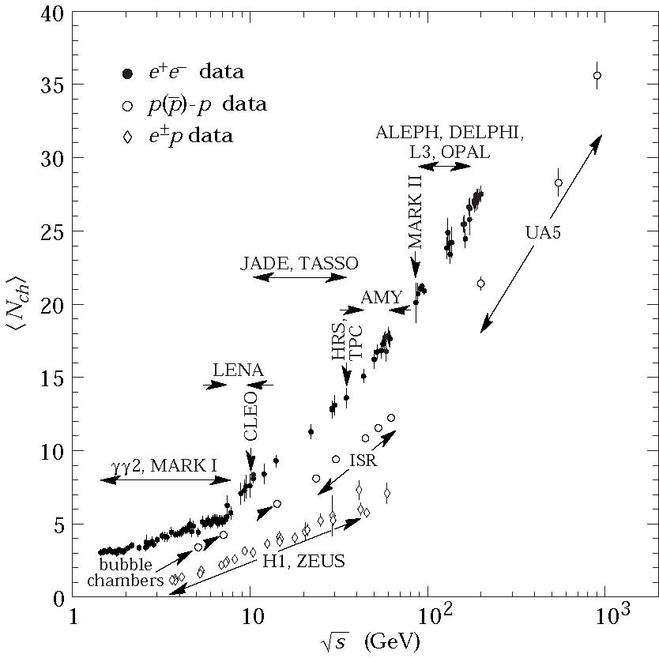

Observation of quark jets
Jet – collimated spray of hadrons from quark or gluon production
To see jets need quarks to have sufficient
longitudinal momentum
transverse momentum set by confinement →Example
At low energy study how spherical event is.
At high energy
structure is clear.
Average charged particle multiplicity

Slide 11
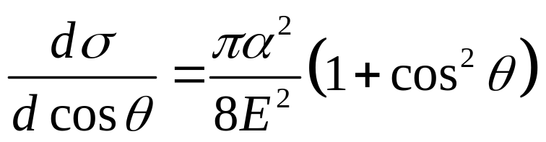
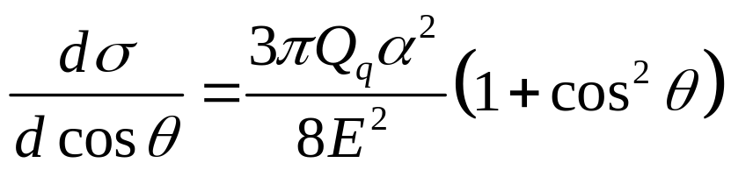
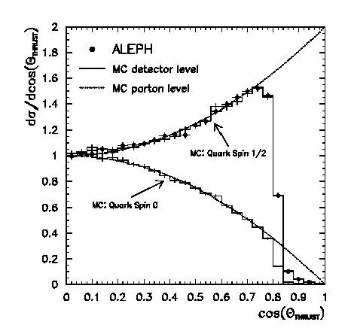
Angular Distribution of Jets
e+
μ+
For
e-
μ-
q
Extra factors - 3 for colour, and charge
So, for
e+
2
e-
qbar
Angular distribution sensitive to spin, and shows quarks are spin 1/2

Slide 12
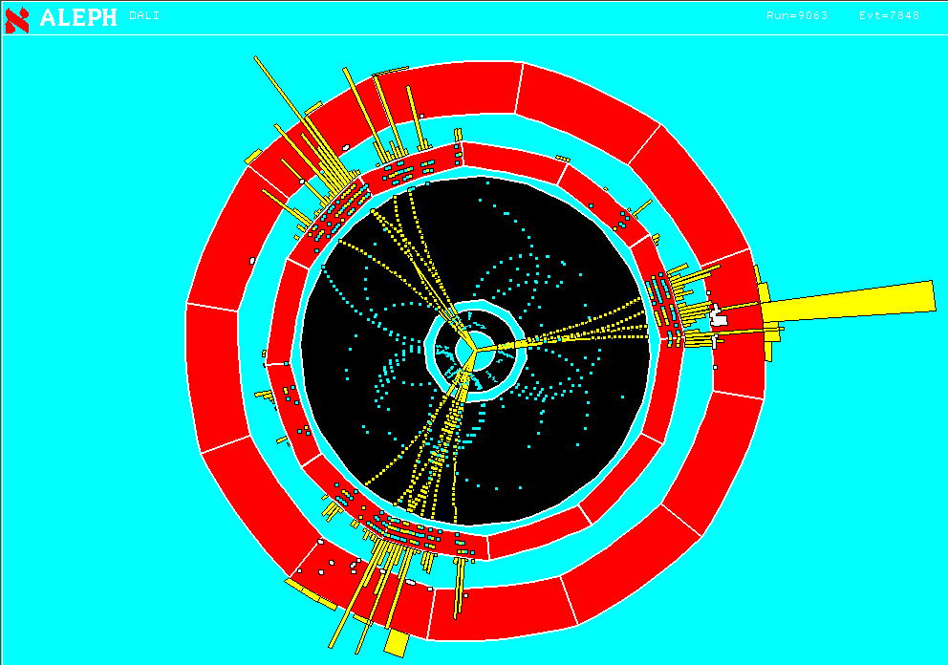
Observation of Gluon Jets
e+
Events also with three jets
Angular distribution
shows that gluon has spin 1
q
γ/Z
g
e-
qbar
‘Mercedes’ star Event !
Probability of gluon emission from α_{S}
Can use to measure α_{S}
Cross-check value from running coupling constant

Slide 13
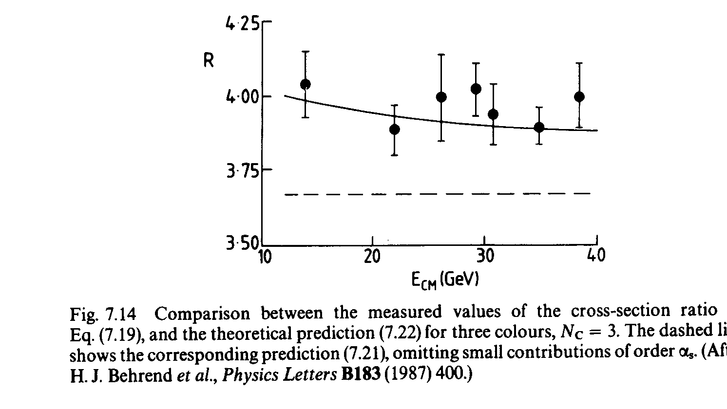
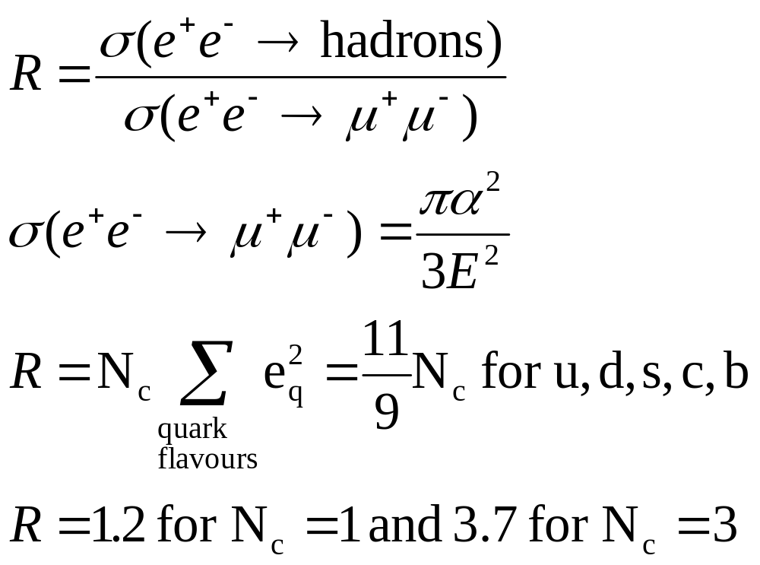
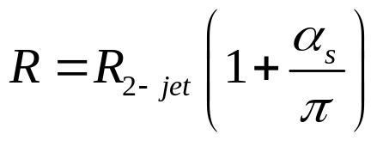
R measurement
Simple measurement
  identify final states in detector
R measured >3 why ?
Neglected 3 jet events –
gluon emission

Slide 14
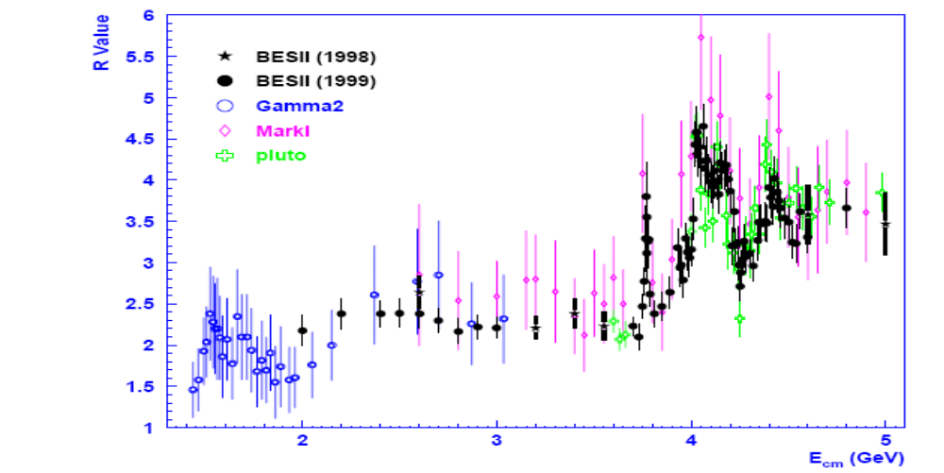
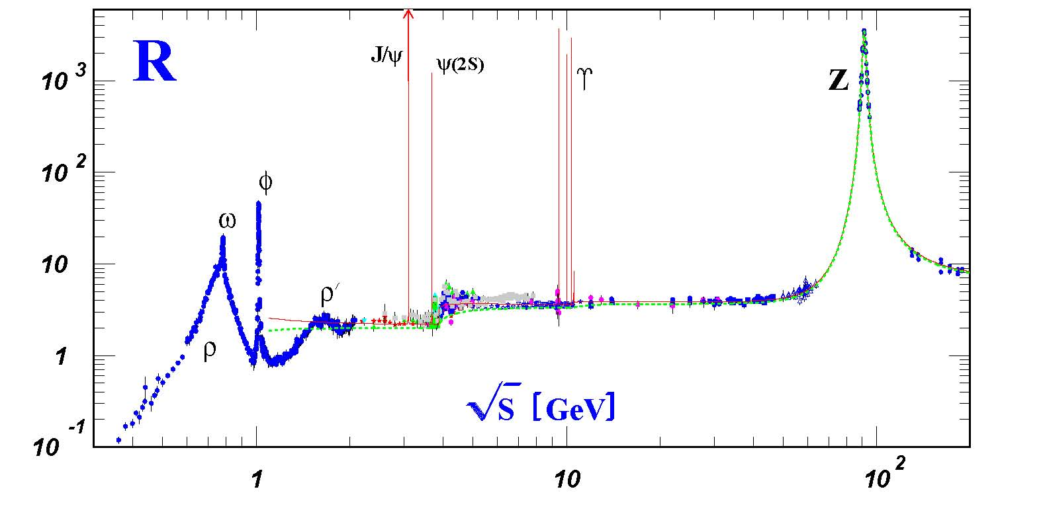
R measurements
R Value has:
Spikes for resonance
particle production
Increase in level when energy to produce next quark type is reached
+c
u,d,s

Slide 15
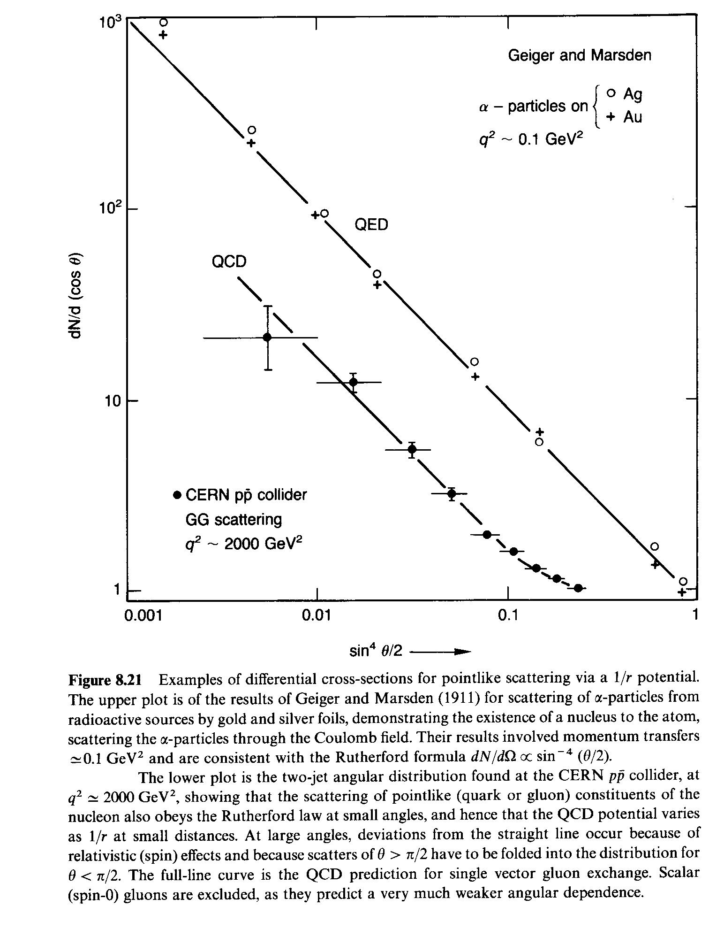

Slide 16
Summary
e-,p Elastic Scattering – proton not point like
Deep Inelastic Scattering
  F₂ flat-ish, proton same structure (quarks) at all scales
  F₂ scaling variation explained by
  gluon splitting to virtual q qbar
Observation of Jets
  Quark and gluon, determine spin
R Ratio: ratio hadron events to muon events
  Check Quark Charges
  Determine 3 Colours

