Slide 1

By – Jagannath Banerjee

Slide 2
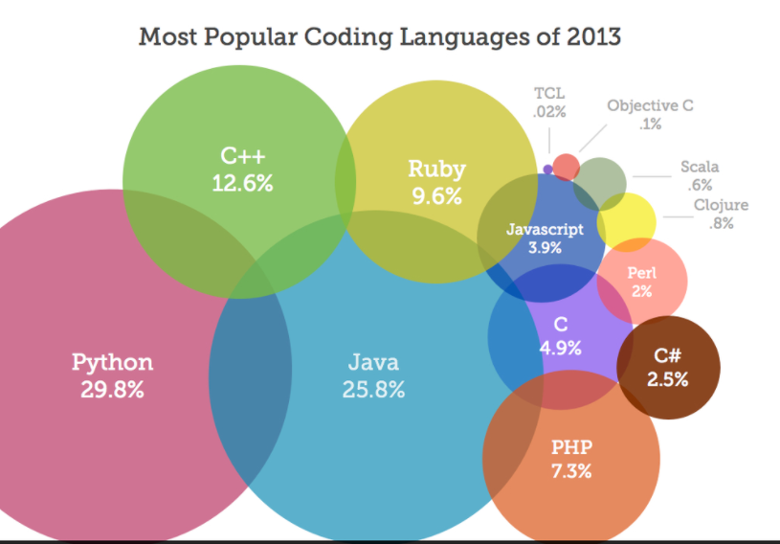
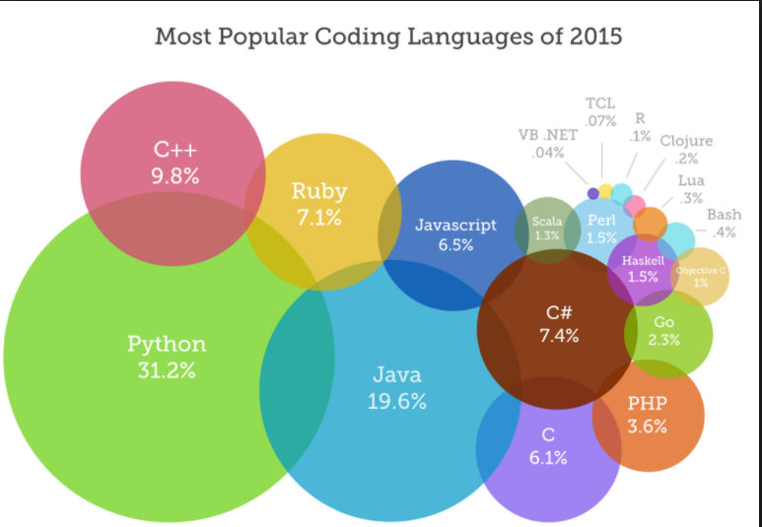
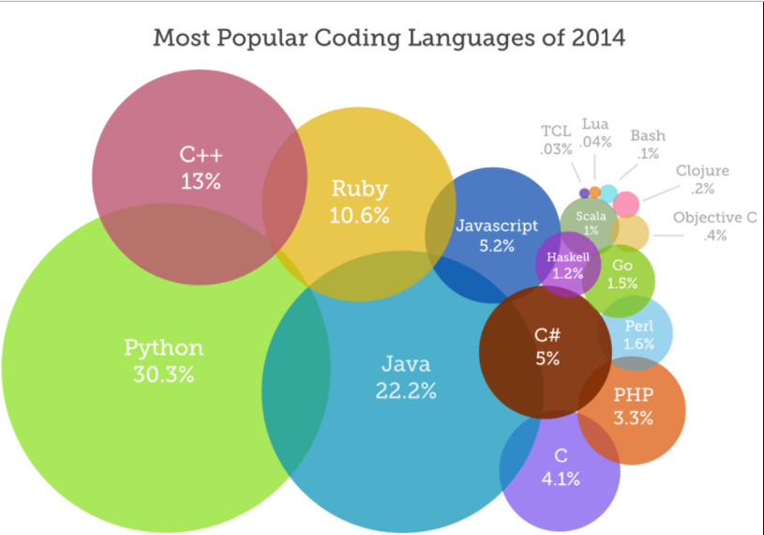
Most Popular Language

Slide 3
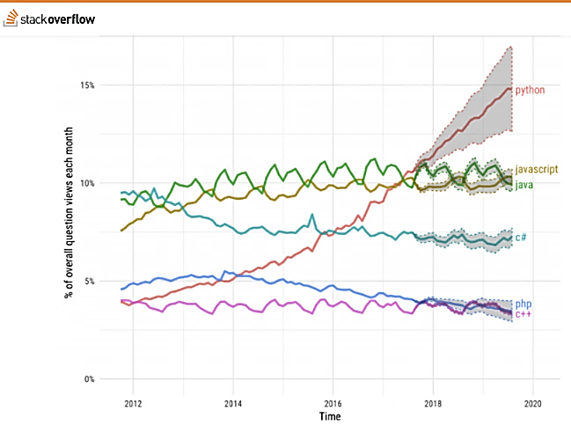
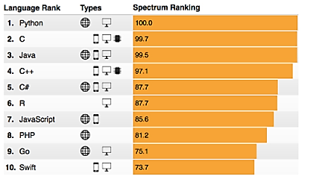
Growth of Python

Slide 4
Python - Contents
What is Python ?
Why Python ?
Installing IDEs for Python
Writing First Program in Python
Data Structure – List, Tuple, Dictionary
Decision making – If, Else, Else-If
Loops
Functions
Importing Libraries
Object Oriented Programming – Basics
Importing Library Modules
Data Science Package – Numpy , Matplotlib, Pandas

Slide 5
Self Study Material
Programming Basics - http://www.expert3p.com/programming-basics/
Python Tutorial - https://docs.python.org/3/tutorial/index.html

Slide 6
What is Python ?
Python is a widely used high-level programming language created by Guido van Rossum . It’s used to :
Automate manual task
Perform a complex mathematical/statistical calculations
Create GUI application
Create Games
Build Websites
Robotics
Machine Learning/Data Science
Its widely used across – Banks, Insurance , Manufacturing , Retail , Automobile , Robotics , Space
High-level, general-purpose, interpreted, dynamic programming language
Emphasizes code readability , express concepts in fewer lines of code than C++ or Java

Slide 7
Why Python ?
Its simple and easy to learn - Elegant Syntax, Readability, Maintenance
Python IDE (Integrated Development Environment) is freely available
Efficient high-level data structures - Simple approach to OOP
Python supports modules and packages, which encourages program modularity and code reuse.
Wide variety of Use – Website , Gaming, Big Data, Automation, Mobile Platforms

Slide 8
Which Python ?
Python 2.x | Python 3.x
Python 2.7 released in 2010 . No major release after that | Python 3.x is in active development. Python 3.6 came out in 2016
current Linux distributions and Macs still use 2.x as default | Python 3.x can be downloaded into Mac & Linux
Only if you require specific version | This should be first choice
Specific third party package not made for Python 3. | All best packages are readily available
 | Improvements are done in 3.x that will not be backported directly to Python 2 strings are Unicode by default clean Unicode/bytes separation exception chaining function annotations syntax for keyword-only arguments extended tuple unpacking non-local variable declarations

Slide 9
Python IDE - Regular Scripting
IDE - Integrated Development Environment
An integrated development environment (IDE) is a software application that provides comprehensive facilities to computer programmers for software development. An IDE normally consists of a source code editor, build automation tools and a debugger. Most modern IDEs have intelligent code completion.
IDE for Python – IDLE
https://www.python.org/downloads/

Slide 10
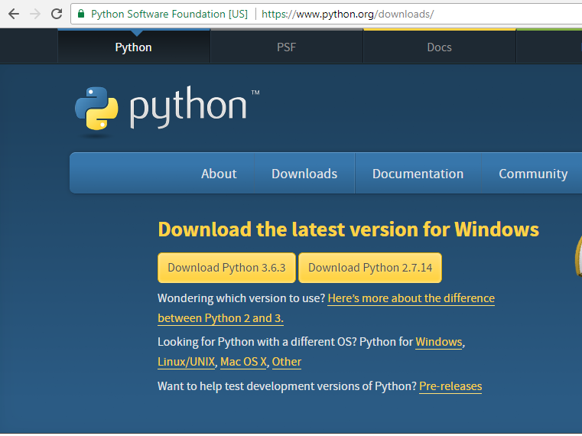
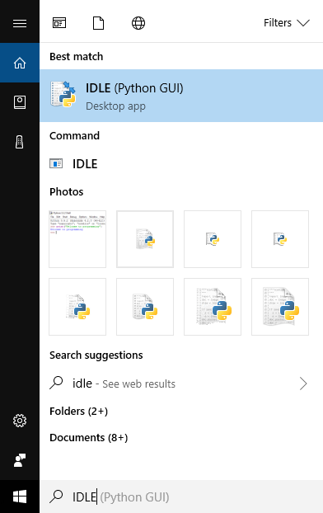
Python IDE - Regular Scripting

Slide 11
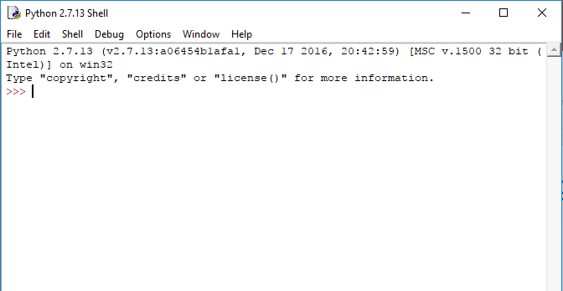
Python IDE - Regular Scripting - IDLE

Slide 12
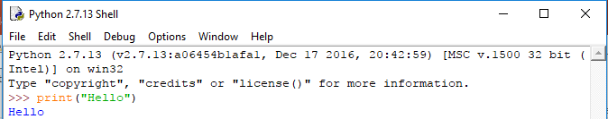
Python - TEST IDLE
1. Write - print(“hello”)
2. Press Enter
3. You should get a “hello” as output

Slide 13
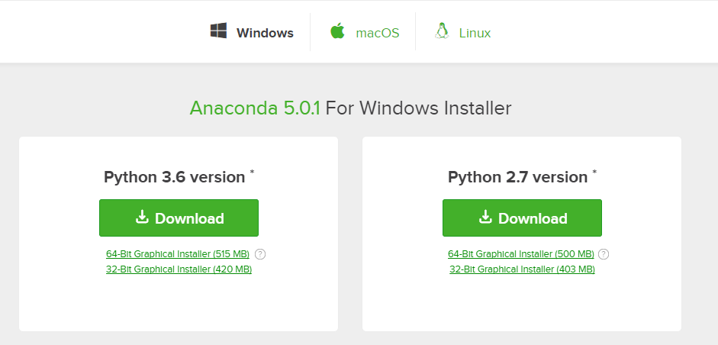
Python IDE - Data Science & Machine Learning
https://www.anaconda.com/download/
Choose OS
Install Anaconda from the downloads

Slide 14
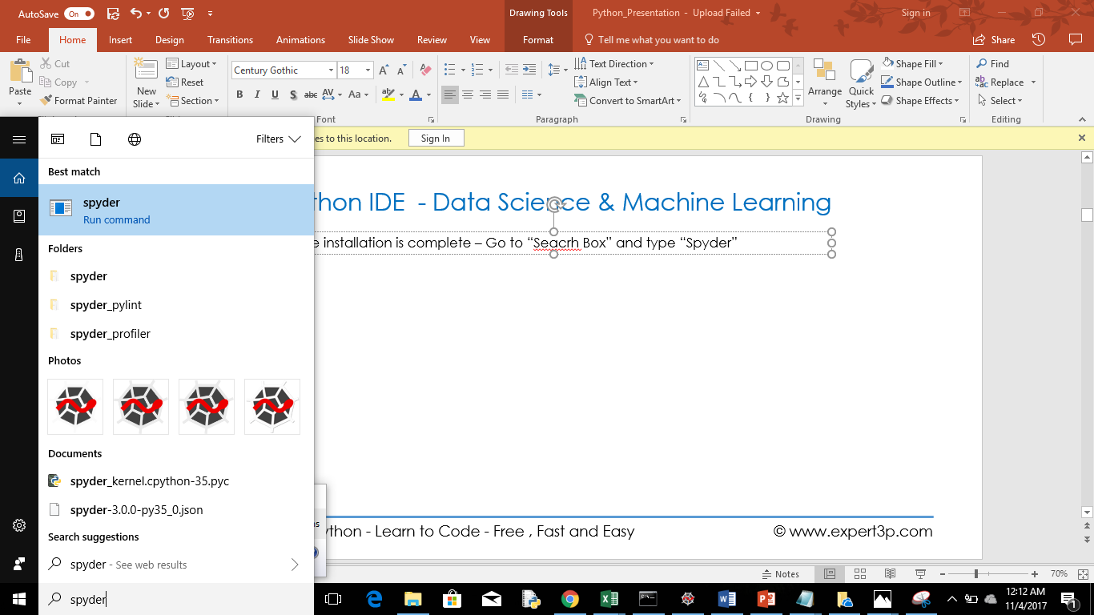
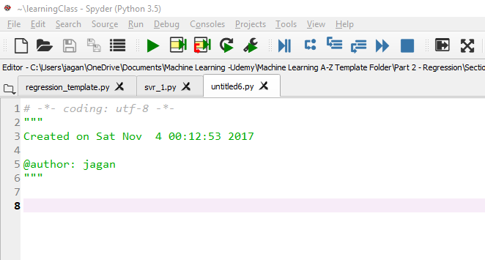
Python IDE - Data Science & Machine Learning
Once installation is complete – Go to “Search Box” and type “Spyder”

Slide 15
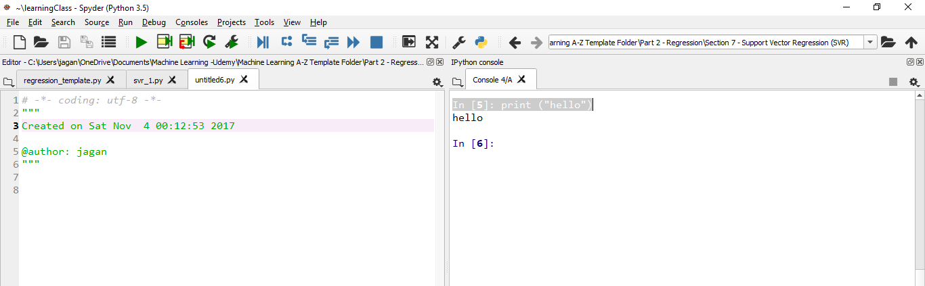
Python IDE - Test you installation
print(“hello”)

Slide 16
Python - My First Program – “Hello Python”
print("Hello Python")
input_user = input("Enter you name:")
print(input_user)

Slide 17
Python - Comment
Single Line Comment – “#”
Multiline Comment – “”” “””

Slide 18
Python - Displaying Text
print('The capybara is the worlds largest rodent')
print("The capybara can swim")
print("the capybara lives in \nSouth America")
print("""This is the strangest
way to print over multiple lines I know""")
print('here is a double quote "' + " here is a single quote '")
print("or you can just do this \" does that work")
print("can I just print a \ on the screen?")
print("But what if I want \\news ")

Slide 19
Variables and Constants
Constants : Have fixed value . Such as pi = 3.14
Variables : Used to manipulate values and perform calculations throught the program .
Data Types :
Numeric : Integer, Float and Complex
String: Group of characters in quotes .
Boolean: True or False
4. Container
List
Set
Tuple
Dictionary

Slide 20
Python – Numeric Data Type
Integer -
Float -
Complex -
Examples:
Operation | Result
x + y | sum of x and y
x - y | difference of x and y
x * y | product of x and y
x / y | quotient of x and y
x // y | floored quotient of x and y
x % y | remainder of x / y
-x | x negated
+x | x unchanged
abs(x) | absolute value or magnitude of x
int(x) | x converted to integer
float(x) | x converted to floating point
complex(re, im) | a complex number with real part re, imaginary part im. imdefaults to zero.
c.conjugate() | conjugate of the complex number c
divmod(x, y) | the pair (x // y, x % y)
pow(x, y) | x to the power y
x ** y | x to the power y

Slide 21
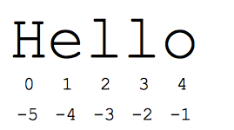
Python Strings
Strings are contiguous set of characters represented in single or double quotes.
Subsets of strings - slice operator ([ ] and [:] )
Python index count starts at 0 in the beginning or -1 from the end.
Examples:
Syntax | Meaning
print(str) | Prints complete string
print(str[0]) | Prints first character of the string
print(str[2:5]) | Prints characters starting from 3rd to 5th
print(str[2:]) | Prints string starting from 3rd character
print(str*2) | Prints string two times
print(str+"TEST“) | Prints concatenated string
print( 'I\'m single') | Strings in single quotes.
Print("I'm double double“) | Strings in double quotes.
"e" in "hello“ | Searching a character in the string
len(str) | Length of string

Slide 22
Python - List
Lists are the most versatile of Python's compound data types.
A list contains items separated by commas and enclosed within square brackets ([]).
Subsets of list - slice operator ([ ] and [:] )
Python index count starts at 0 in the beginning or -1 from the end.
Examples−
list = [ 'abcd', 786 , 2.23, 'john', 70.2 ]
Syntax | Meaning
print(test_list) | Prints complete list
print(test_list[0]) | Prints first element of the list
print(test_list[2:5]) | Prints elements starting from 3rd to 5th
print(test_list[2:]) | Prints list starting from 3rd element
print(test_list*2) | Prints list two times
print(test_list+test_list_1) | Prints concatenated list
if ("apple" in test_list) | Searching a element in the list
len(test_list) | Length of list

Slide 23
Python List – Function
Function | Description | Example
all() | Return True if all elements of the list are true (or if the list is empty).
any() | Return True if any element of the list is true. If the list is empty, return False.
enumerate() | Return an enumerate object. It contains the index and value of all the items of list as a tuple.
len() | Return the length (the number of items) in the list.
list() | Convert an iterable (tuple, string, set, dictionary) to a list.
max() | Return the largest item in the list.
min() | Return the smallest item in the list
sorted() | Return a new sorted list (does not sort the list itself).
sum() | Return the sum of all elements in the list.

Slide 24
Python List – Method
Methods | Explanation | Example
append() | Add an element to the end of the list
extend() | Add all elements of a list to the another list
insert() | Insert an item at the defined index
remove() | Removes an item from the list
pop() | Removes and returns an element at the given index
clear() | Removes all items from the list
index() | Returns the index of the first matched item
count() | Returns the count of number of items passed as an argument
sort() | Sort items in a list in ascending order
reverse() | Reverse the order of items in the list
copy() | Returns a shallow copy of the list

Slide 25
Python - Tuples
Tuple is a set of immutable Python Object.
Elements are represented within () braces. Eg- fruits=(‘apple’,’orange’,’banana’)
test_list = ( ‘banana’,’apple’ , 2.23, 'john', 70.2,100 )
Syntax | Meaning
print(test_list) | Prints complete list
print(test_list[0]) | Prints first element of the list
print(test_list[2:5]) | Prints elements starting from 3rd to 5th
print(test_list[2:]) | Prints list starting from 3rd element
print(test_list*2) | Prints list two times
print(test_list+test_list_1) | Prints concatenated list
if ("apple" in test_list) | Searching a element in the list
len(test_list) | Length of list

Slide 26
Python – Tuples - Functions
Function | Description
all() | Return True if all elements of the tuple are true (or if the tuple is empty).
any() | Return True if any element of the tuple is true. If the tuple is empty, return False.
enumerate() | Return an enumerate object. It contains the index and value of all the items of tuple as pairs.
len() | Return the length (the number of items) in the tuple.
max() | Return the largest item in the tuple.
min() | Return the smallest item in the tuple
sorted() | Take elements in the tuple and return a new sorted list (does not sort the tuple itself).
sum() | Retrun the sum of all elements in the tuple.
tuple() | Convert an iterable (list, string, set, dictionary) to a tuple.

Slide 27
Python – Tuples - Methods
Method | Description
count(x) | Return the number of items that is equal to x
index(x) | Return index of first item that is equal to x

Slide 28
Python - Set
A set is an unordered collection with no duplicate elements.
Used for membership testing and eliminating duplicate entries.
Supports mathematical operations like union, intersection, difference, and symmetric difference.
Elements are represented within {} braces. Eg- fruits={“apple”,”orange”,”banana”}
a={'a','b','c','d','e’}
b={'c','e','f’}
Syntax | Output | Explanation
a-b | {'a', 'b', 'd'} | letters in a but not in b
b-a | {'f'} | letters in b but not in a
a | b | {'a', 'b', 'c', 'd', 'e', 'f'} | letters in a or b or both
a & b | {'c', 'e'} | letters in both a and b
a ^ b | {'a', 'b', 'd', 'f'} | letters in a or b but not both

Slide 29
Python – Set - Functions
Function | Description
all() | Return True if all elements of the set are true (or if the set is empty).
any() | Return True if any element of the set is true. If the set is empty, return False.
enumerate() | Return an enumerate object. It contains the index and value of all the items of set as a pair.
len() | Return the length (the number of items) in the set.
max() | Return the largest item in the set.
min() | Return the smallest item in the set.
sorted() | Return a new sorted list from elements in the set(does not sort the set itself).
sum() | Retrun the sum of all elements in the set.

Slide 30
Python – Set - Methods
Method | Description
add() | Add an element to a set
clear() | Remove all elements form a set
copy() | Return a shallow copy of a set
difference() | Return the difference of two or more sets as a new set
difference_update() | Remove all elements of another set from this set
discard() | Remove an element from set if it is a member. (Do nothing if the element is not in set)
intersection() | Return the intersection of two sets as a new set
intersection_update() | Update the set with the intersection of itself and another
isdisjoint() | Return True if two sets have a null intersection
issubset() | Return True if another set contains this set
issuperset() | Return True if this set contains another set
pop() | Remove and return an arbitary set element. Raise KeyErrorif the set is empty
remove() | Remove an element from a set. If the element is not a member, raise a KeyError
symmetric_difference() | Return the symmetric difference of two sets as a new set
symmetric_difference_update() | Update a set with the symmetric difference of itself and another
union() | Return the union of sets in a new set
update() | Update a set with the union of itself and others

Slide 31
Python - Dictionary
Dictionary as an unordered set of key: value pairs
Keys are unique within one dictionary
Elements are represented within {} braces. employee={'Jack': 111, 'John': 222,'Andy':333}
Syntax | Output | Explanation
employee[‘Dan’]=444 | {'Andy': 333, 'Dan': 444, 'Jack': 111, 'John': 222} | Add a key/value pair in dictionary
del employee['Andy'] | {'Dan': 444, 'Jack': 111, 'John': 222} | Delete a key/value pair in dictionary
employee['Dan'] | 444 | Provides value against the key
my_dict = dict({1:'apple', 2:'ball'}) | {1: 'apple', 2: 'ball'} | Creating Dictionary using “dict”

Slide 32
Python – Dictionary - Function
Function | Description
all() | Return True if all keys of the dictionary are true (or if the dictionary is empty).
any() | Return True if any key of the dictionary is true. If the dictionary is empty, return False.
len() | Return the length (the number of items) in the dictionary.
cmp() | Compares items of two dictionaries.
sorted() | Return a new sorted list of keys in the dictionary.

Slide 33
Python – Dictionary - Method
Method | Description
clear() | Remove all items form the dictionary.
copy() | Return a shallow copy of the dictionary.
fromkeys(seq[, v]) | Return a new dictionary with keys from seq and value equal to v(defaults to None).
get(key[,d]) | Return the value of key. If key doesnot exit, return d (defaults to None).
items() | Return a new view of the dictionary's items (key, value).
keys() | Return a new view of the dictionary's keys.
pop(key[,d]) | Remove the item with key and return its value or d if key is not found. If d is not provided and key is not found, raises KeyError.
popitem() | Remove and return an arbitary item (key, value). Raises KeyError if the dictionary is empty.
setdefault(key[,d]) | If key is in the dictionary, return its value. If not, insert key with a value of d and return d (defaults to None).
update([other]) | Update the dictionary with the key/value pairs from other, overwriting existing keys.
values() | Return a new view of the dictionary's values

Slide 34
Programs for Practice
Print Hello World
Sum 2 numbers
Subtract 2 numbers
Input Color and Print
Area of Circle
Area of rectangle
Area of Square
Find Square Root
Km to Miles
Centigrade to Fahrenheit
String Operation
String Concatenate

Slide 35
Python - Operators
Operators | Example
Arithmetic Operator | a+b ; a-b ; a*b ; b/a ; b%a ; a**b ; a//b (floor division)
Comparison Operator | ==; != ; > ; < ; = ; >= ; <=
Logical operators | A & B ; A|B
Membership Operator | in ; not in

Slide 36
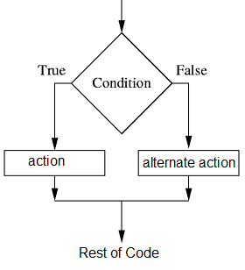
Python - Decision Making
if(a==100) :
print(“Number is 100")
if (a==100):
print (“I am in if condition. Value 100“)
else:
print (“I am in else condition. Value not100“)
if (a==100):
print (“I am in if condition. Value 100“)
elif (a < 100):
print (“I am in elif condition. Value less than 100“)
else:
print (“I am in else condition. Value greater than 100“)

Slide 37
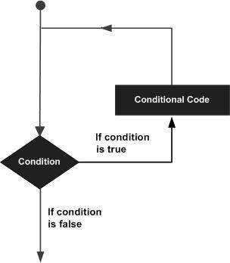
Python - Loops
Loop :
A loop is a sequence of instruction s that is continually repeated until a certain condition is reached
Initialize or Provide starting point
Check Condition
Break condition/Boundary Condition
For Loop:
fruits = ['banana', 'apple', 'mango']
for fruit in fruits:
print('Current fruit :',fruit)
While Loop
count=0
while (count < 9):
print ('The count is:', count)
count = count + 1

Slide 38
Python - For Loops
For Loop Syntax | Solution
for x in range(10): print (x) | 0,1,2,3,4,5,6,7,8,9
for x in range(1,10): print (x) | 1,2,3,4,5,6,7,8,9
for x in range(1,10,2): print (x) | 1,3,5,7,9
fruits = ['banana', 'apple', 'mango'] for fruit in fruits: print('Current fruit :',fruit) | Current fruit : banana Current fruit : apple Current fruit : mango

Slide 39
Python - Break & Continue
Break : Break the loop or come out of the loop
Continue : The continue statement is used to skip the rest of the code inside a loop
Break:
test_list = ['apple','orange','banana','grapes']
counter=1
for fruit in test_list:
if(fruit=='apple'):
print(counter,':apple found')
break
else:
print(counter,':still searching')
counter = counter + 1
Output -
1 :apple found
#Program came out of the loop the moment it found apple. It will not run the loop any more
Continue:
test_list = ['apple','orange','banana','grapes']
counter=1
for fruit in test_list:
if(fruit=='apple'):
print(counter,':apple found')
continue
else:
print(counter,':still searching')
counter = counter + 1
Output -
1 :apple found
1 :still searching
2 :still searching
3 :still searching
#Program will keep running even it found apple.

Slide 40
Python - Function
A function is a block of code that performs certain task and re-used over and over throughout the lifecycle of a code.
Functions helps in providing e better modularity for our code
#Defining the function
def sum(a,b):
print("Sum:",a+b)
return
#Calling the function
sum(2,3)
sum(10,5)
sum(10,10)
#Defining the function
def sum(a,b):
#print("Sum:",a+b)
return(a+b)
#Calling the function
result=sum(2,3)
print("Sum:", result)
#Defining the function
def calc(a,b):
#print("Sum:",a+b)
return(a+b,a-b,a*b,a/b)
#Calling the function
add,sub,mul,div=calc(2,3)
print("add:", add,"\n","sub:", sub)
print("mul:", mul)
print("div:", div)

Slide 41
Python - *args & **kwargs
*args and **kwargs in function definitions is used to pass a variable number of arguments to a function
Single asterisk form (*args) - used to pass a non-keyworded, variable-length argument list
Double asterisk form (**kwargs) - used to pass a keyworded, variable-length argument list
*args
def normal_funtion_arg_only(*arg):
for item in arg:
print("Rest of the data:",item)
normal_funtion_arg_only('hello','python','jagan','iot','mobile','ML')
**kwargs
def learn_kwarg_function_1(**kwargs):
for key,value in kwargs.items():
print("The value of ",key,"is ",value)
learn_kwarg_function_1(kwarg_1="Tuna",kwarg_2="Talapia",kwarg_3="Salmon")
def normal_funtion_two_var(var1,var2,*arg):
print("var1:",var1)
print("var2:",var2)
for item in arg:
print("Rest of the data:",item)
normal_funtion_two_var('hello','python','jagan','iot','mobile','ML')

Slide 42
Python - Try / Except

Slide 43
Python - Raising Exception

Slide 44
Python - Object Oriented Programming

Slide 45
Python - File Handling

Slide 46
Python - Importing Libraries

Slide 47
Python - installing Libraries

Slide 48
Python - Regex

Slide 49
Thank You!

