Slide 1

By – Jagannath Banerjee

Slide 2
Python - Contents
What is Python ?
Why Python ?
Installing IDEs for Python
Writing First Program in Python
Data Structure – List, Tuple, Dictionary
Decision making – If, Else, Else-If
Loops
Functions
Importing Libraries
Object Oriented Programming – Basics
Importing Library Modules
Data Science Package – Numpy , Matplotlib, Pandas

Slide 3
What is Python ?
Python is a widely used high-level programming language created by Guido van Rossum . It’s used to :
Automate manual task
Perform a complex mathematical/statistical calculations
Create GUI application
Create Games
Build Websites
Robotics
Machine Learning/Data Science
Its widely used across – Banks, Insurance , Manufacturing , Retail , Automobile , Robotics , Space
High-level, general-purpose, interpreted, dynamic programming language
Emphasizes code readability , express concepts in fewer lines of code than C++ or Java

Slide 4
Why Python ?
Its simple and easy to learn - Elegant Syntax, Readability, Maintenance
Python IDE (Integrated Development Environment) is freely available
Efficient high-level data structures - Simple approach to OOP
Python supports modules and packages, which encourages program modularity and code reuse.
Wide variety of Use – Website , Gaming, Big Data, Automation, Mobile Platforms

Slide 5
Python IDE - Regular Scripting
IDE - Integrated Development Environment
An integrated development environment (IDE) is a software application that provides comprehensive facilities to computer programmers for software development. An IDE normally consists of a source code editor, build automation tools and a debugger. Most modern IDEs have intelligent code completion.
IDE for Python – IDLE
https://www.python.org/downloads/

Slide 6
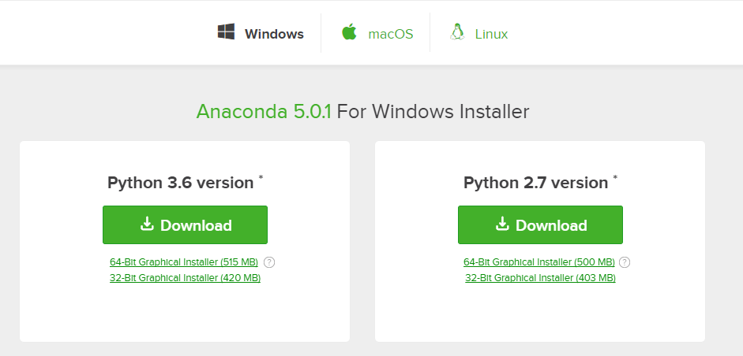
Python IDE - Data Science & Machine Learning
https://www.anaconda.com/download/
Choose OS
Install Anaconda from the downloads

Slide 7
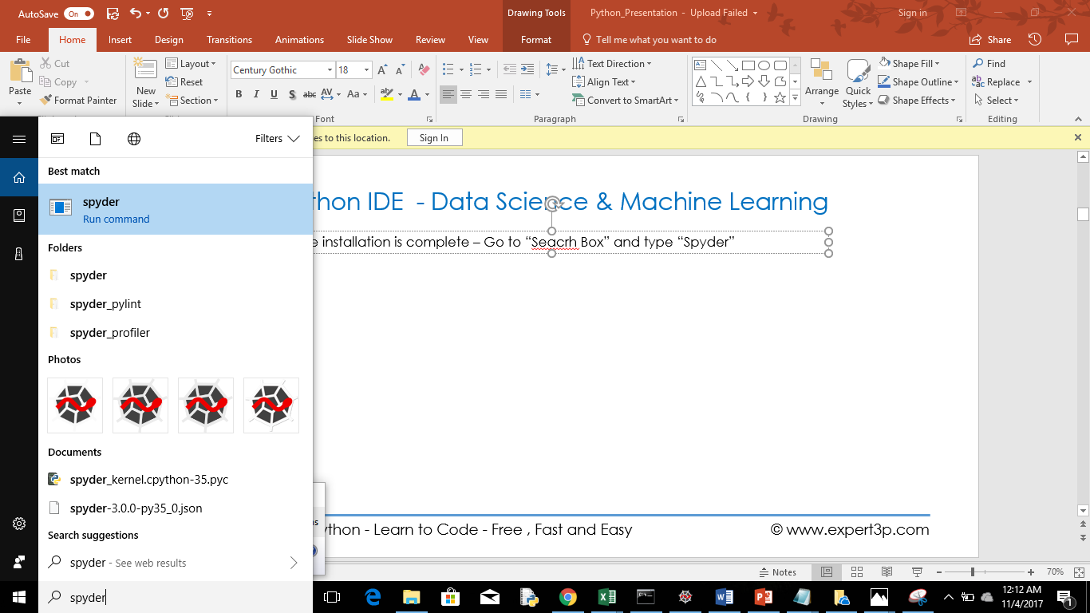
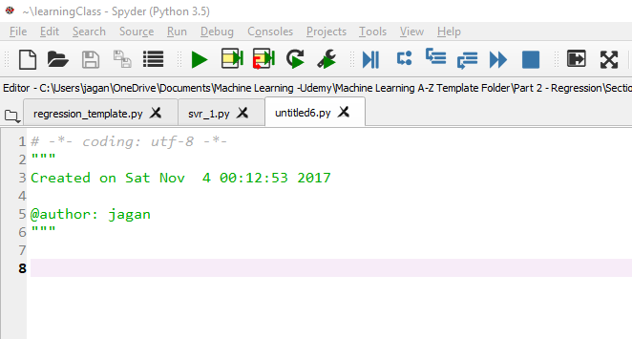
Python IDE - Data Science & Machine Learning
Once installation is complete – Go to “Search Box” and type “Spyder”

Slide 8
Python - My First Program – “Hello Python”
print("Hello Python")

Slide 9
Python - Taking User Input
print("Hello Python")

Slide 10
Python - Constants & Variables

Slide 11
Python - Basic Operators

Slide 12
Python - Decision Making

Slide 13
Python - Loops

Slide 14
Python - Data structure

Slide 15
Python - Data Structure - List

Slide 16
Python - Data Structure - Tuples

Slide 17
Python - Data Structure - Dictionary

Slide 18
Python - Data Structure - Set

Slide 19
Python - Functions

Slide 20
Python - File Handling

Slide 21
Python - Error Handling

Slide 22
Python - String Formatting

Slide 23
Python - Object Oriented Programming

Slide 24
Python - Best Practices

Slide 25
Python - Projects
Web Scrapping
Sending Text Message
Search Walmart
Personal Bot
Connecting Python with Database
Speech to Text
Pulling Stock Market Data

Slide 26
Getting into Python
Installing Python 3.5 in windows
Overview of IDLE editor
Interactive Python Shell
Writing my First Program – “Hello World”
Basic parts of programming:
Input . Eg : radius = int(input(“Please enter the radius:”))
Calculation . Eg: Area = pi * radius * radius
Output. Eg : print(“Area of Circle-”,Area)

Slide 27
Variables and Constants
Constants : Have fixed value . Such as pi = 3.14
Variables : Used to manipulate values and perform calculations throught the program .
Basic Types of Variables
Numeric or Integer : +ve or –ve value without decimals . Eg:counter = 100
Float : Fractions in decimal points . Eg : miles = 1000.0
Character : 1 byte in quotes . Eg : “a” , “b”
String: Group of characters in quotes . Eg : “Hello world”
Default everything is string in Python
To convert from String to Integer : int(variable)
To convert from String to Decimal point(float) : float(variable)
List
Tuple
Dictionary

Slide 28
Programs for Practice
Print Hello World
Sum 2 numbers
Subtract 2 numbers
Input Color and Print
Area of Circle
Area of rectangle
Area of Square
Find Square Root
Km to Miles
Centigrade to Fahrenheit
String Operation
String Concatenate

Slide 29
Python Strings
Strings in Python are identified as a contiguous set of characters represented in the quotation marks.
Python allows for either pairs of single or double quotes. Subsets of strings can be taken using the slice operator ([ ] and [:] ) with indexes starting at 0 in the beginning of the string and working their way from -1 at the end.
Plus (+) sign is the string concatenation operator
Asterisk (*) is the repetition operator.
Examples:
print(str) # Prints complete string print(str[0]) # Prints first character of the string print(str[2:5]) # Prints characters starting from 3rd to 5th print(str[2:]) # Prints string starting from 3rd character print(str * 2) # Prints string two times print(str + "TEST“) # Prints concatenated string
print( 'I\'m single') # Strings in single quotes. Print("I'm double double“) # Strings in double quotes.

Slide 30
Python List
Lists are the most versatile of Python's compound data types.
A list contains items separated by commas and enclosed within square brackets ([]).
all the items belonging to a list can be of different data type.
The values stored in a list can be accessed using the slice operator ([ ] and [:]) with indexes starting at 0 in the beginning of the list and working their way to end -1.
The plus (+) sign is the list concatenation operator, and the asterisk (*) is the repetition operator.
Examples−
list = [ 'abcd', 786 , 2.23, 'john', 70.2 ] tinylist = [123, 'john']
print list # Prints complete list print list[0] # Prints first element of the list print list[1:3] # Prints elements starting from 2nd till 3rd print list[2:] # Prints elements starting from 3rd element print tinylist * 2 # Prints list two times print list + tinylist # Prints concatenated lists

Slide 31
List – Functions & Methods
Basic functions:
len(list)
max(list)
min(list)
type(list)

Slide 32
List – Methods
L.append(object) -> None -- append object to end
L.clear() -> None -- remove all items from L
L.copy() -> list -- a shallow copy of L
L.count(value) -> integer -- return number of occurrences of value
L.index(value, [start, [stop]]) -> integer -- return first index of value.Raises ValueError if the value is not present.
L.insert(index, object) -- insert object before index
L.pop([index]) -> item -- remove and return item at index (default last).Raises IndexError if list is empty or index is out of range.
L.remove(value) -> None -- remove first occurrence of value.Raises ValueError if the value is not present.
L.reverse() -- reverse *IN PLACE*
L.sort(key=None, reverse=False) -> None -- stable sort *IN PLACE*

Slide 33
Python Tuples
A tuple is another sequence data type that is similar to the list. A tuple consists of a number of values separated by commas. Unlike lists, however, tuples are enclosed within parentheses.
The main differences between lists and tuples are:
Lists are enclosed in brackets “[ ]” while tuples are enclosed in parentheses “()”
List elements and size can be changed while tuple cannot be updated. Tuples can be thought of as read-only lists.
Add/Remove/append/pop cannot be done
You can't find elements in a tuple. Tuples have no index method
Advantages of Tuples:
Tuples are faster than lists. If you're defining a constant set of values and all you're ever going to do with it is iterate through it, use a tuple instead of a list.
It makes your code safer if you “write-protect” data that does not need to be changed.

Slide 34
Examples of Tuples:
tuple = ( 'abcd', 786 , 2.23, 'john', 70.2 ) tinytuple = (123, 'john')
print tuple # Prints complete list print tuple[0] # Prints first element of the list print tuple[1:3] # Prints elements starting from 2nd till 3rd print tuple[2:] # Prints elements starting from 3rd element print tinytuple * 2 # Prints list two times print tuple + tinytuple # Prints concatenated lists
Del tup # Delete Tuple
Basic Tuples Operations
Python Expression | Results | Description
len((1, 2, 3)) | 3 | Length
(1, 2, 3) + (4, 5, 6) | (1, 2, 3, 4, 5, 6) | Concatenation
('Hi!',) * 4 | ('Hi!', 'Hi!', 'Hi!', 'Hi!') | Repetition
3 in (1, 2, 3) | True | Membership
for x in (1, 2, 3): print x, | 1 2 3 | Iteration

Slide 35
Tuples Function:
Command | Description
cmp(tuple1, tuple2) | Compares elements of both tuples.
len(tuple) | Gives the total length of the tuple.
max(tuple) | Returns item from the tuple with max value.
min(tuple) | Returns item from the tuple with min value.
Tuples Method:
T.count(value) -> integer -- return number of occurrences of value

Slide 36
Practice Session-2:
Write a Python program which accepts the user's first and last name and print them in reverse order with a space between them
Perform using normal string print operations
Perform using list – list1.reverse() function
Perform using tuple
2. Write a Python program which accepts a sequence of comma-separated numbers from user and generate a list and a tuple with those numbers. Sample data : 3, 5, 7, 23 Output : List : ['3', ' 5', ' 7', ' 23'] Tuple : ('3', ' 5', ' 7', ' 23')
3. Write a Python program to display the first and last colors from the following list. color_list = ["Red","Green","White" ,"Black"]
4. Write a Python program to calculate the sum of three given numbers
values = input("Input some comma seprated numbers : ")
list = values.split(",")
tuple = tuple(list)
print('List : ',list)
print('Tuple : ',tuple)

Slide 37
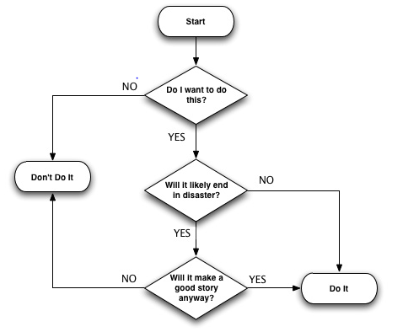
Python – Decision making
Decision making is anticipation of conditions occurring while execution of the program and specifying actions taken according to the conditions.
Decision structures evaluate multiple expressions which produce TRUE or FALSE as outcome. You need to determine which action to take and which statements to execute if outcome is TRUE or FALSE otherwise.

Slide 38
Python – Decision making
Statement | Description
if statements | An if statement consists of a boolean expression followed by one or more statements. | if a==10: print('great')
if...else statements | An if statement can be followed by an optional else statement, which executes when the boolean expression is FALSE. | if a==10: print("Correct") else: print("Incorrect")
nested if statements | You can use one if or else if statement inside another if or else if statement(s). | var = 100 if var < 200: print ("Expression value is less than 200" ) if var == 150: print ("Which is 150" ) elif var == 100: print ("Which is 100") elif var == 50: print ("Which is 50") elif var < 50: print ("Expression value is less than 50") else: print ("Could not find true expression") print ("Good bye!")

Slide 39
http://www.w3resource.com/python-exercises/python-basic-exercises.php

