Slide 1
OSTC1 Simulator Seat Redux
March 30, 2016

Slide 2
Project Goals
Requirements:
Improve ruggedness of simulator seat design (stable and strong).
User ingress/egress handles.
Realistic seat height and petal position.
Exchange seat / steering wheel / cluster.
Adjustable steering angle and height.
Adjustable seat to pedal distance.
Steering and eye tracking support equipment mounting and protection.
Bonus:
Maintain electric adjustment in seat (and support equipment).
Integrated retractable casters

Slide 3
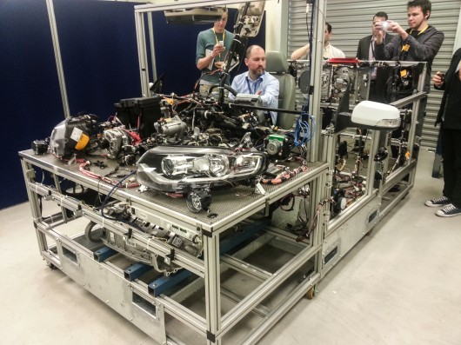
Project Style
The seat will be designed to resemble industry standard mock-ups.

Slide 4
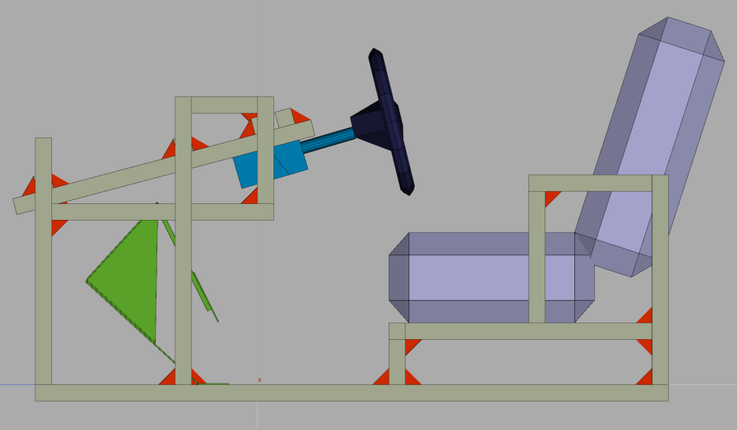
Sizing and Layout
Sizing and placement of components based on L405 driver seat.
200mm
650mm
430mm
370mm
150mm

Slide 5
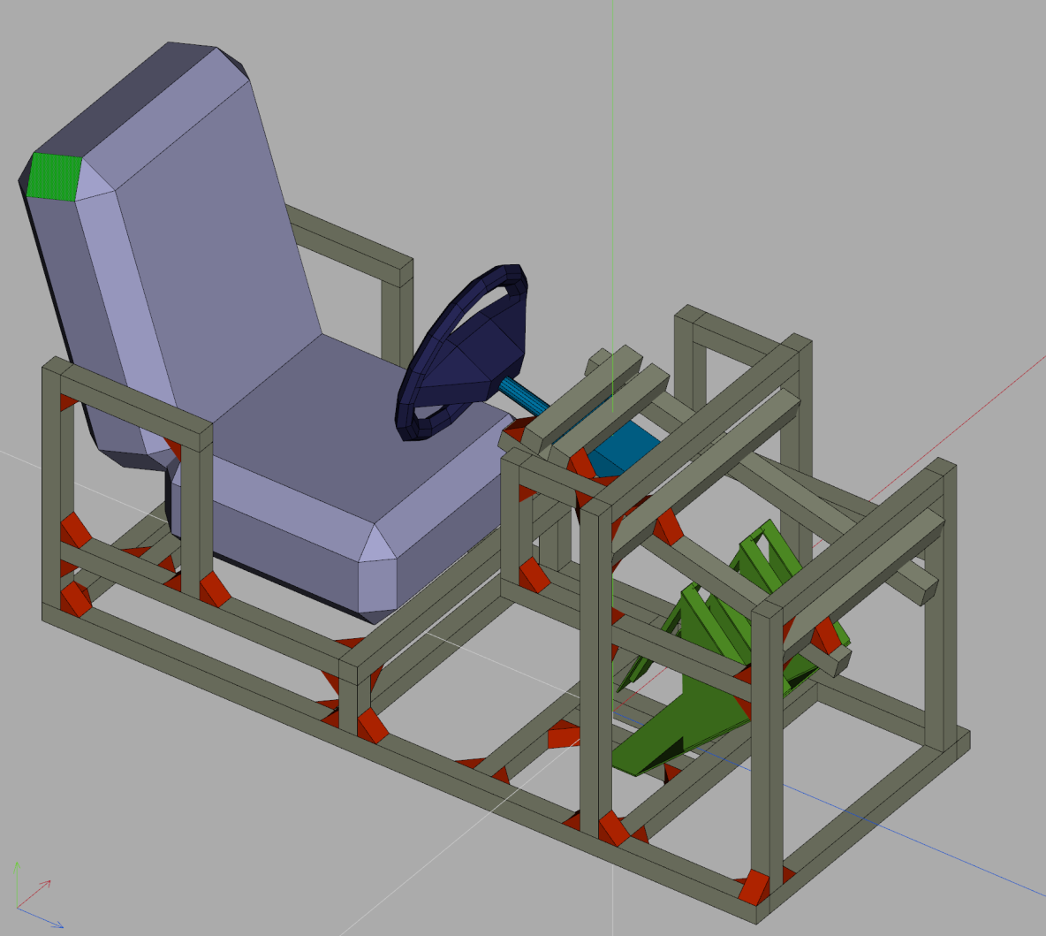
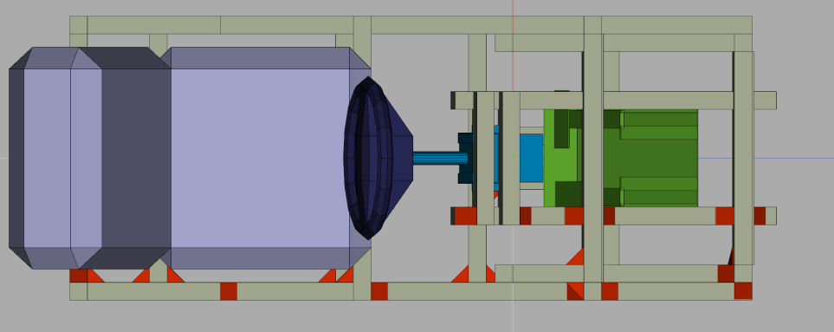
Proposed Design

Slide 6
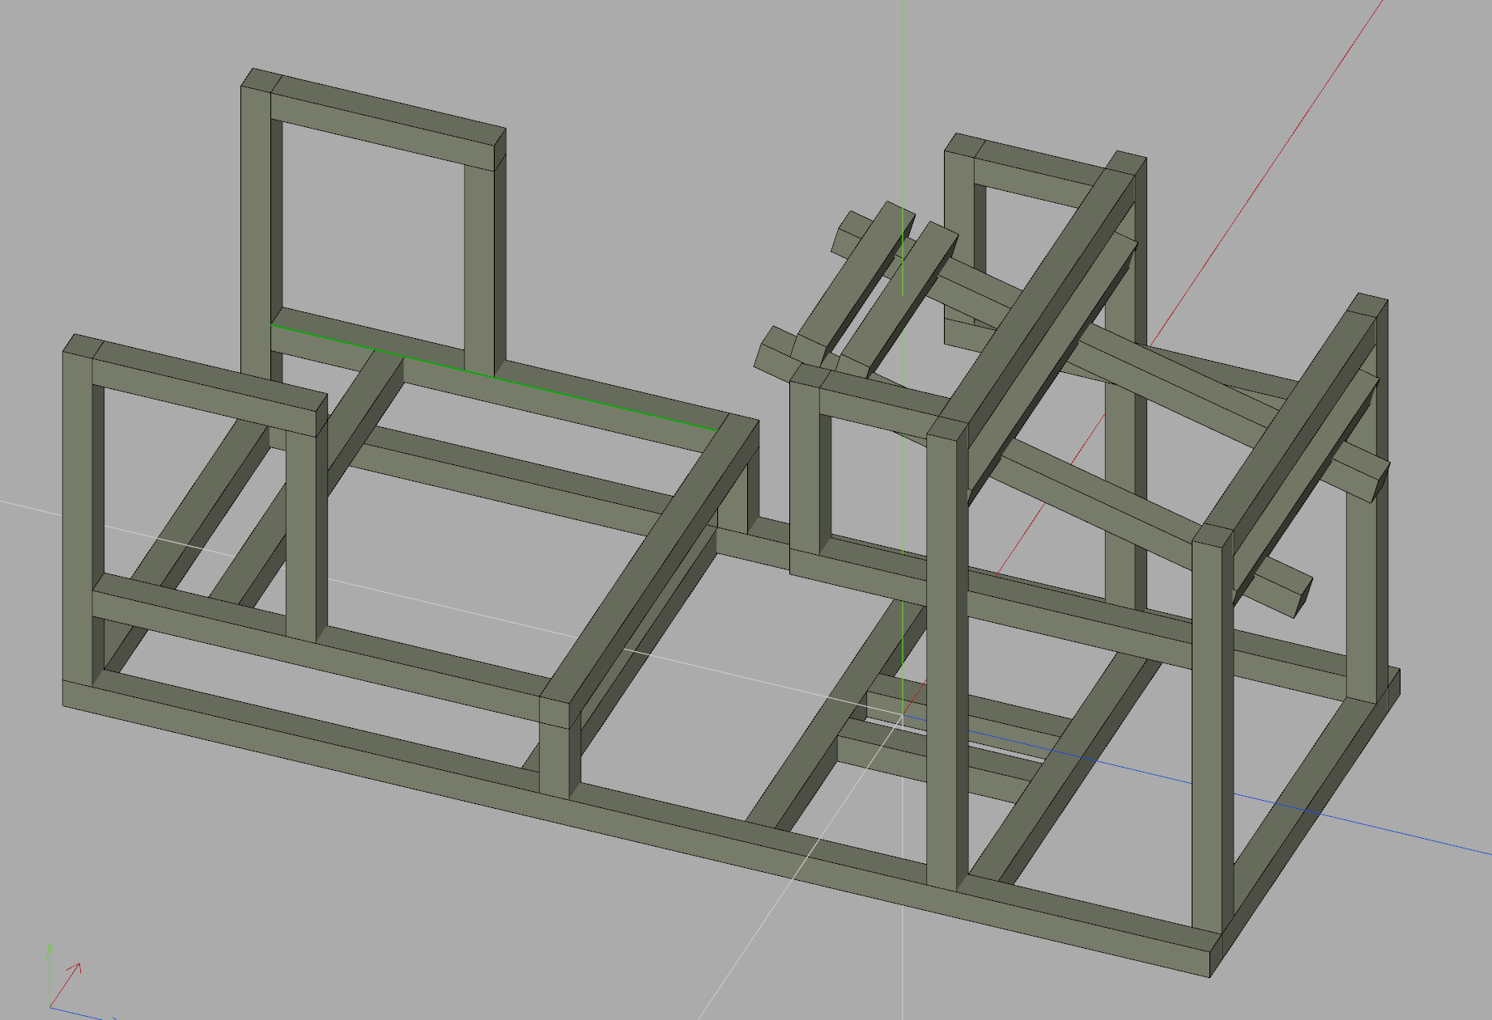
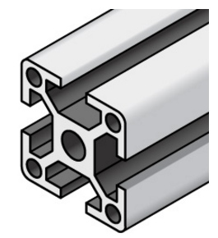
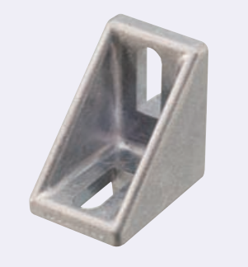
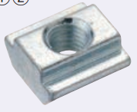
Frame Materials
The frame is made of Misumi 8 Series, Base 40, Four-Side Slots, aluminum extrusion. It is assembled using track nuts, bots and brackets. The martial was chosen for:
Assembly speed
Strength
Adjustability
Dimension: H470 x W600 x D1600mm
29” (740mm)
63” (1600mm)
24” (600mm)

Slide 7
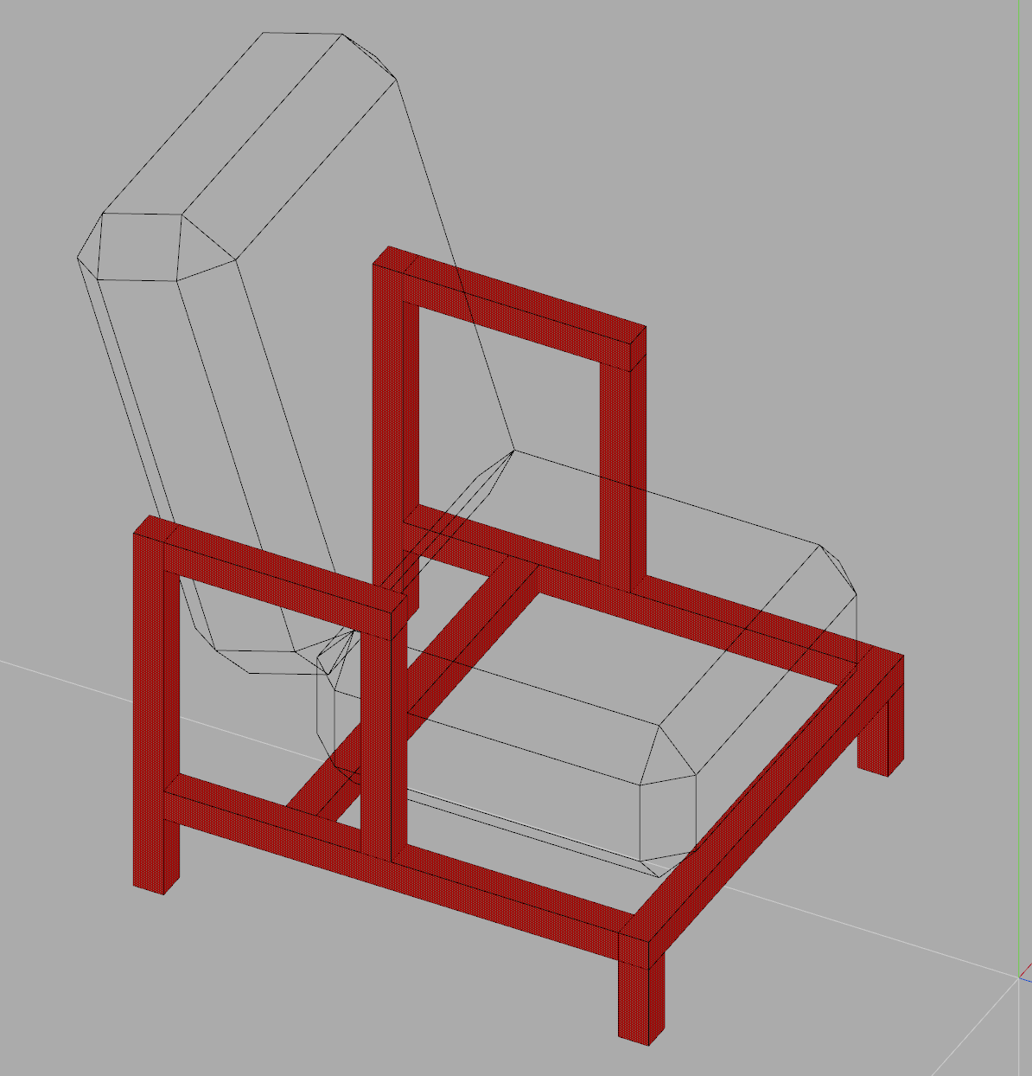
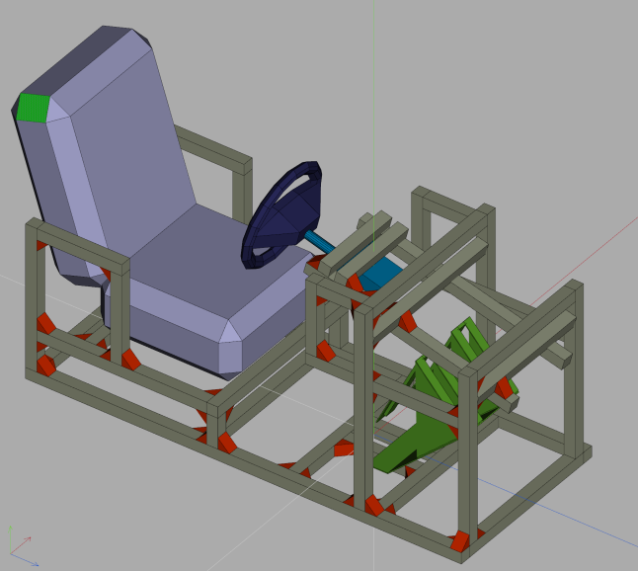
Seat Design
The seat frame can accommodate any Jaguar or Land Rover seat (< 560mm wide, 22 inch).
User is provided handles for ingress/egress.
Seat frame mounting height mimics L405.
Should allow support equipment for seat motion in cavity under seat.
The seat mounting rails will bolt ( ) into the frame directly using track nuts.
The rear frame rail can be adjusted ( ) for any mounting depth.

Slide 8
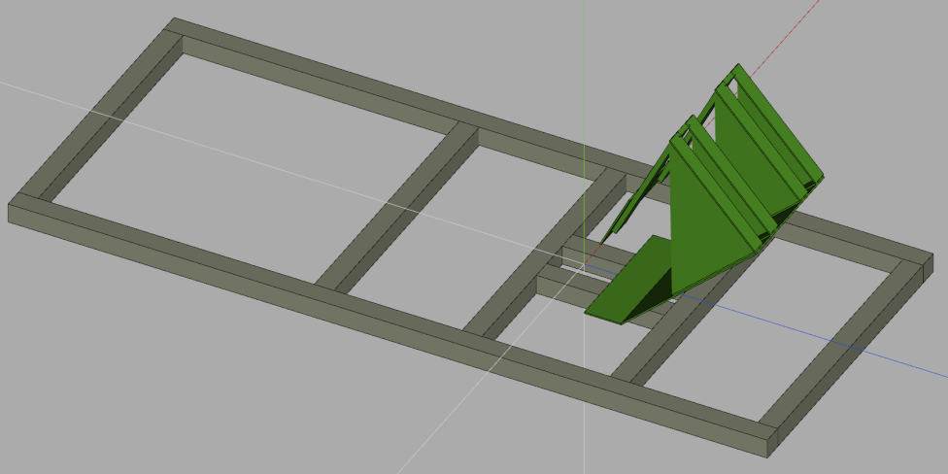
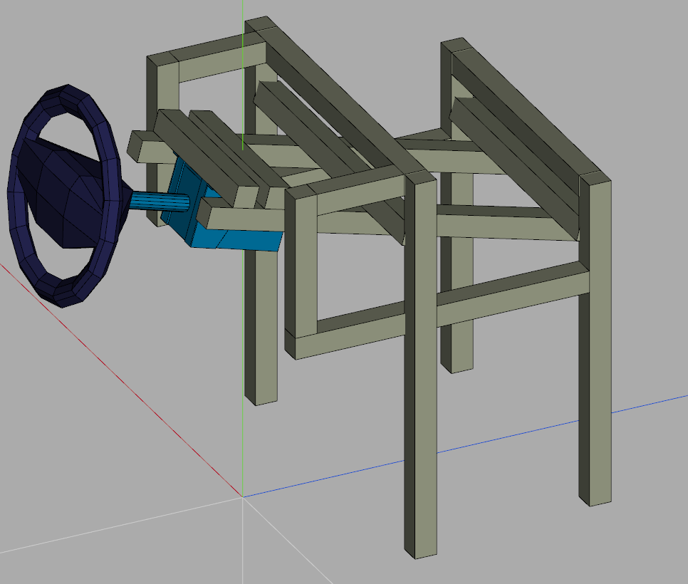
Pedal and Steering Design
The frame is designed to accommodate the existing force feedback steering wheel and racing pedals.
Petal alignment is adjustable F/R and L/R.
A floorboard plate will be added between seat and pedals for safety and comfort.
Steering wheel can be height, depth and angle adjusted.
User is provided handles for ingress/egress either side of the steering wheel.
Cluster can attach to rails above steering box.

Slide 9
Next Steps
After go-ahead approval:
Any size or scale adjustments to design. (unk)
Deployable caster design (if needed). (1 day)
Cut list and bill of materials. (2 days)
Ordering/shipping. (2-4 wks)
Fabrication. (3 days)
Testing. (1 day)

Slide 10
Project Name
Oct Jan 2015 Feb Mar Apr May June Timeline 2014/15
1
Project Timeline Milestones completion dates Current timeline marker |  |  |  |  | Team Members Manager: Project Lead:
Project Brief Overall RAG status
Construction of simulator seat capable of handling public use.
Summary
The previous simulator seat was easily damage
Achievements
Blocker (B) / Escalation (E) / Decision (D) necessary
Target for Next Week
31 March 2016

