Slide 1
Replication Study for “Comparing deep learning and concept extraction based methods for patient phenotyping from clinical narratives”
By Jeremy Bao and Luke Freitag

Slide 2
Background
Goal = determine patient characteristics from natural language clinical notes
Past methods labor intensive
Paper proposes CNNs
Data = discharge summaries from MIMIC-III
1,610 used in paper, 1,341 by us
Investigated 10 conditions
Condition: | Count:
Adv. Cancer | 147
Adv. Heart Disease | 221
Adv. Lung Disease | 141
Chronic Neuro | 308
Chronic Pain | 277
Alcohol Abuse | 172
Substance Abuse | 139
Obesity | 99
Psychiatric disorders | 248
Depression | 388

Slide 3
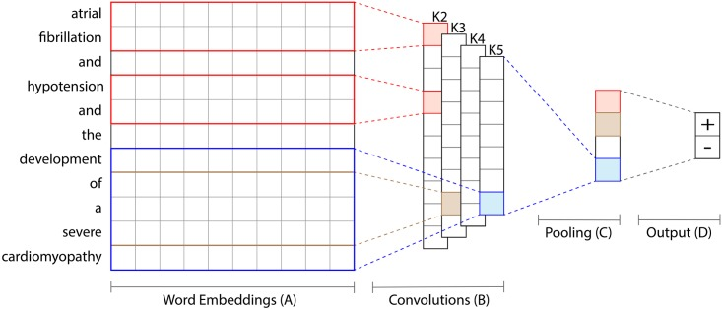
Architecture
Convolutional Layer
ReLU
Global Max Pooling
Fully-Connected Layer
Log Softmax

Slide 4
 | 1 | 1, 2 | 1, 2, 3 | 1, 2, 3, 4 | 1, 2, 3, 4, 5 | 2, 3, 4, 5
Advanced Cancer | P: 0.88 R: 0.42 F1: 0.57 AUC: 0.95 | P: 0.83 R: 0.61 F1: 0.70 AUC: 0.94 | P: 0.79 R: 0.58 F1: 0.67 AUC: 0.93 | P: 0.88 R: 0.21 F1: 0.34 AUC: 0.92 | P: 0.78 R: 0.42 F1: 0.55 AUC: 0.93 | P: 0.91 R: 0.30 F1: 0.45 AUC: 0.91
Advanced Heart Disease | P: 0.55 R: 0.16 F1: 0.25 AUC: 0.91 | P: 0.56 R: 0.62 F1: 0.59 AUC: 0.91 | P: 0.78 R: 0.38 F1: 0.51 AUC: 0.93 | P: 0.75 R: 0.24 F1: 0.37 AUC: 0.93 | P: 0.71 R: 0.41 F1: 0.52 AUC: 0.90 | P: 0.86 R: 0.32 F1: 0.47 AUC: 0.92
Advanced Lung Disease | P: 0.00 R: 0.00 F1: 0.00 AUC: 0.84 | P: 0.00 R: 0.00 F1: 0.00 AUC: 0.90 | P: 0.00 R: 0.00 F1: 0.00 AUC: 0.91 | P: 1.00 R: 0.03 F1: 0.06 AUC: 0.88 | P: 0.42 R: 0.85 F1: 0.57 AUC: 0.90 | P: 0.65 R: 0.39 F1: 0.49 AUC: 0.93
Chronic Neurologic Dystrophies | P: 0.59 R: 0.69 F1: 0.63 AUC: 0.81 | P: 0.60 R: 0.63 F1: 0.61 AUC: 0.82 | P: 0.56 R: 0.52 F1: 0.54 AUC: 0.79 | P: 1.00 R: 0.09 F1: 0.17 AUC: 0.80 | P: 0.77 R: 0.16 F1: 0.26 AUC: 0.80 | P: 0.77 R: 0.36 F1: 0.49 AUC: 0.82

Slide 5
 | 1 | 1, 2 | 1, 2, 3 | 1, 2, 3, 4 | 1, 2, 3, 4, 5 | 2, 3, 4, 5
Chronic Pain | P: 0.00 R: 0.00 F1: 0.00 AUC: 0.58 | P: 0.28 R: 0.76 F1: 0.41 AUC: 0.70 | P: 1.00 R: 0.02 F1: 0.04 AUC: 0.73 | P: 0.00 R: 0.00 F1: 0.00 AUC: 0.71 | P: 0.53 R: 0.34 F1: 0.41 AUC: 0.74 | P: 1.00 R: 0.02 F1: 0.04 AUC: 0.77
Alcohol Abuse | P: 1.00 R: 0.35 F1: 0.52 AUC: 0.92 | P: 1.00 R: 0.42 F1: 0.59 AUC: 0.92 | P: 1.0 R: 0.26 F1: 0.41 AUC: 0.94 | P: 1.00 R: 0.60 F1: 0.75 AUC: 0.95 | P: 1.00 R: 0.58 F1: 0.74 AUC: 0.94 | P: 1.00 R: 0.49 F1: 0.66 AUC: 0.92
Substance Abuse | P: 0.00 R: 0.00 F1: 0.00 AUC: 0.86 | P: 0.60 R: 0.25 F1: 0.35 AUC: 0.88 | P: 0.63 R: 0.21 F1: 0.31 AUC: 0.90 | P: 0.64 R: 0.38 F1: 0.47 AUC: 0.89 | P: 0.6 R: 0.25 F1: 0.35 AUC: 0.87 | P: 0.68 R: 0.54 F1: 0.60 AUC: 0.88

Slide 6
 | 1 | 1, 2 | 1, 2, 3 | 1, 2, 3, 4 | 1, 2, 3, 4, 5 | 2, 3, 4, 5
Obesity | P: 0.00 R: 0.00 F1: 0.00 AUC: 0.74 | P: 0.00 R: 0.00 F1: 0.00 AUC: 0.69 | P: 0.00 R: 0.00 F1: 0.00 AUC: 0.70 | P: 0.00 R: 0.00 F1: 0.00 AUC: 0.69 | P: 0.00 R: 0.00 F1: 0.00 AUC: 0.68 | P: 0.67 R: 0.08 F1: 0.14 AUC: 0.75
Psychiatric Disorders | P: 1.00 R: 0.04 F1: 0.08 AUC: 0.79 | P: 0.79 R: 0.29 F1: 0.43 AUC: 0.85 | P: 0.90 R: 0.35 F1: 0.51 AUC: 0.82 | P: 1.00 R: 0.06 F1: 0.11 AUC: 0.75 | P: 1.00 R: 0.02 F1: 0.04 AUC: 0.75 | P: 1.00 R: 0.02 F1: 0.04 AUC: 0.79
Depression | P: 0.68 R: 0.85 F1: 0.76 AUC: 0.88 | P: 0.83 R: 0.32 F1: 0.47 AUC: 0.90 | P: 0.89 R: 0.22 F1: 0.35 AUC: 0.85 | P: 0.90 R: 0.36 F1: 0.52 AUC: 0.88 | P: 1.00 R: 0.01 F1: 0.03 AUC: 0.75 | P: 0.83 R: 0.07 F1: 0.13 AUC: 0.79

Slide 7
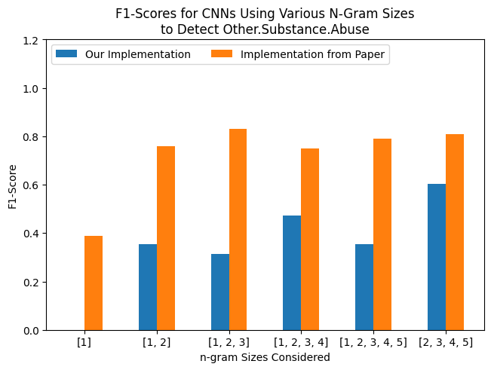
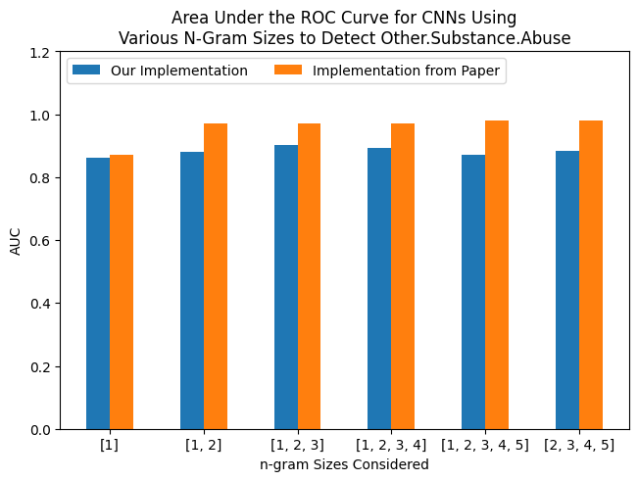
Results

Slide 8
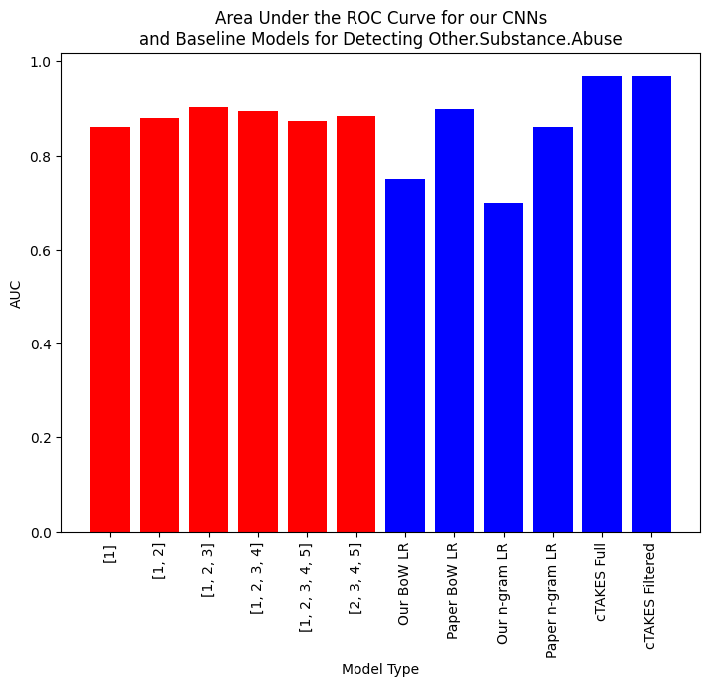
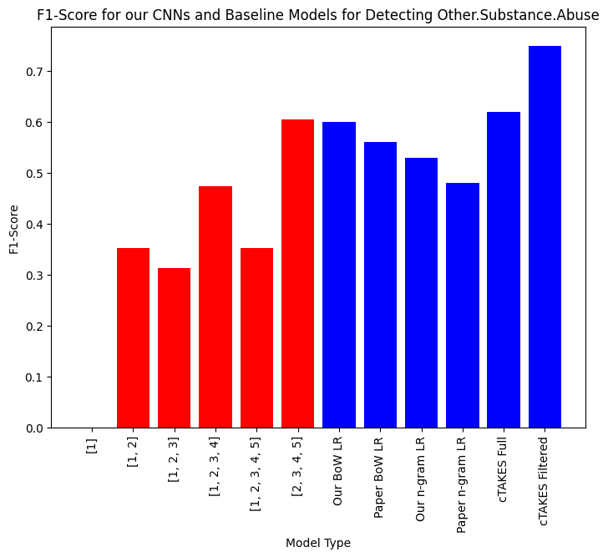
Results

Slide 9
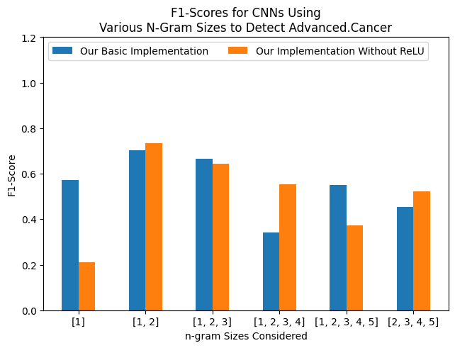
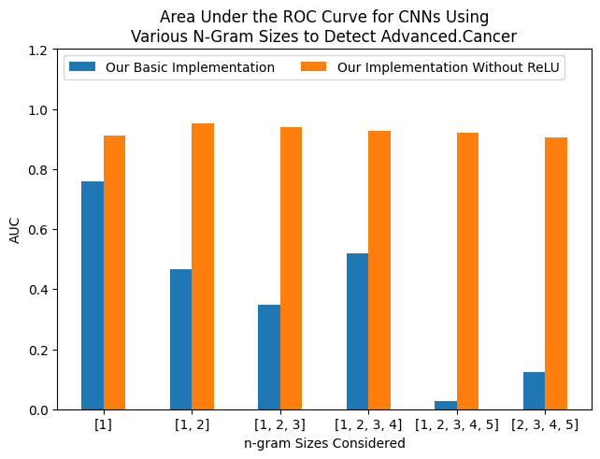
First Ablation

Slide 10
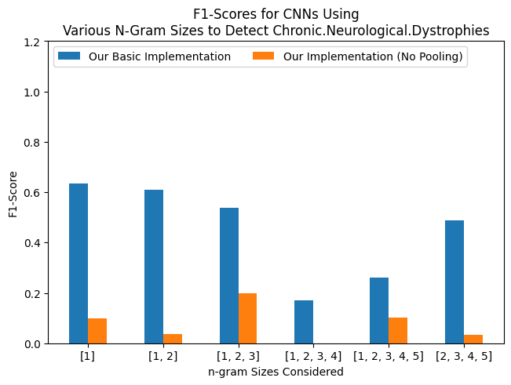
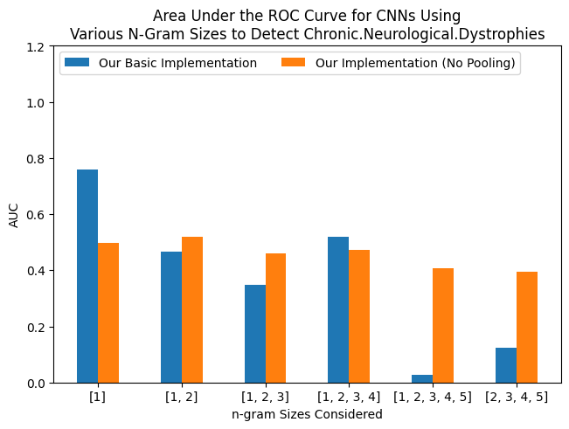
Second Ablation

