Slide 1
Detection of unbounded memory accesses using dynamic taint analysis
Master's Thesis
By Zhani Baramidze
Supervisors:
Prof. Dr.-Ing. Wolfgang Kunz &: M.Sc M. Ammar Ben Khadra
Notes:
Hello, thanks for coming. Welcome to presentation of my thesis project, titled “detection of unbounded memory accesses using dynamic taint analysis”

Slide 2
Table of contents
Motivation
State of the art
Theory
Tool architecture
Results
Notes:
First we’ll talk about motivation, to have better understanding of where we are, what are current problems and what is the motivation behind our project
Then we’ll talk about state of the art, what are the modern tools that do similar thing as the tool we have developed does and what we have improved
Then we’ll talk about theoretical part of our project,KATU. KATU is the name of the tool that we have developed. We’ll discuss what is the idea behind our tool and how does it work
Then we’ll talk about Architecture of the tool, technical part of of how we have implemented it
And at the end we’ll talk about the results achieved

Slide 3
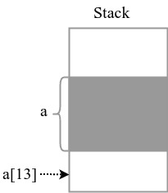
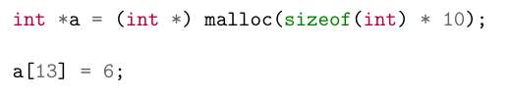
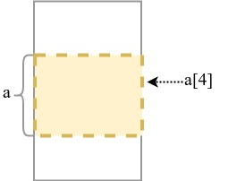
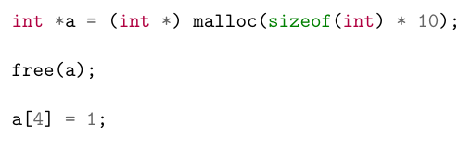
Memory safety
Memory safety is needed for correctness and security
Errors can be spatial or temporal
Spatial:
Temporal:
Notes:
Since our project is related to memory safety, first we’ll have to explain what is it and why is it important. Memory safety is feature of application or a programming language that guarantees that memory access errors won’t happen.
And it’s important because memory safety is the key to applications correct behavior. If we don’t have memory safety we may have memory corruption which can lead to invalid execution of the application, which makes memory safety important from correctness perspective. and in some cases can even be exploited, which makes it important from security perspective as well.
Memory access errors are divided into two categories: spatial and temporal memory errors. Spatial memory errors are errors that happen when we are accessing memory, e.g dereferencing pointer that points outside bounds (e.g. buffer overflow, use of uninitialized pointer). Temporal errors are errors that happen when we are accessing memory that was valid at some point but is not valid anymore, because it was deallocated, like use-after-free errors. As the title suggests, our tool is hunting for spatial errors and thus we’ll concentrate mostly on spatial errors from now on.

Slide 4
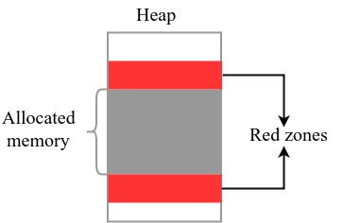
State of the art
AddressSanitizer
  Compile-time transformation, supported by GCC/Clang/Xcode
  Detection by Red Zones via Shadow memory
  Check before every dereference
  The average slowdown is 2x
Valgrind
  Dynamic Binary Instrumentation (DBI)
  Memory checking tool: Memcheck
  Detection via Shadow memory
  Slowdown factor can range from 5 – 100
Notes:
Since those mechanisms cannot protect against lot of kinds of memory errors, some tools were made to do the error checking in the applications. We’ll discuss two very commonly used tools here.
First one, called AddressSanitizer, is a compile-time transformation that is supported by GCC/Clang and Xcode. It works by transforming the code on compile time by inserting instructions that will check every memory access for correctness. It works by placing so-called red zones between every allocation. Then, on every memory access it checks if it’s accessing red zone. If it does, it warns about found memory error.
Red zones are implemented by so called shadow memory. Shadow memory is an object that keeps metadata for every byte in data section of the application. Thus, every byte in data section is mapped to a single bit or byte in shadow memory (in ASAN case it’s one bit). ASAN sets the bit in shadow memory if corresponding byte is red zone. Then, on every memory access it does quick lookup in shadow memory. Lookup is fast, and ASAN has only 2x slowdown on average.
Valgrind, on the other hand, does runtime transformation. It used Dynamic Binary instrumentation method, which means it injects the instrumentation code to analyze the runtime behaviour of the application.
Memcheck is memory checking tool that is built on top of Valgrind’s framework. The idea how it works Is the same: it surrounds objects returned by malloc with red zones and used shadow memory to keep track of them

Slide 5
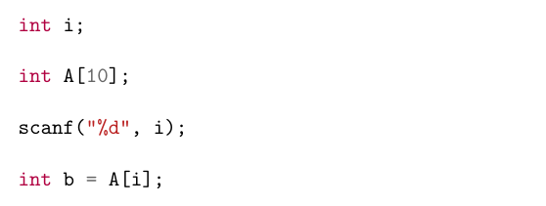
Scope of our contribution
Both tools are dynamic memory checkers that depend on given input.
Our tool goes one step beyond this.
None of the tools will complain, if i is 5!
Notes:
So, what we saw as potential improvement in those tools is that they cannot detect memory vulnerability before corresponding memory error happens. For example, in this case If scanf reads 5, the tools won’t produce any warning because memory error doesn’t happen, even though we have a memory access vulnerability.
The bug here is that we are missing bounds check, and thus the access is unbounded. This is what we decided to improve on: to detect unbounded memory accesses.

Slide 6
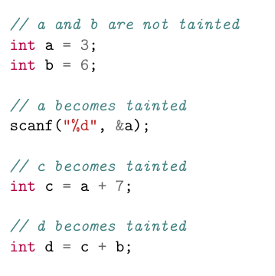
KATU
Dynamic Binary Instrumentation (DBI) method
  DynamoRIO platform
Dynamic Taint Analysis (DTA) technique
Notes:
Our tool also uses already-described DBI technique. As a framework for DBI, we use DynamoRIO, open source DBI tool. It works by splitting code in basic blocks, puttng them and executing them from code cache. Basic block is sequence of instructions that terminates with control transfer instruction. Thus, when application running under DynamoRIO jumps to some function, first DynamoRIO checks if corresponding basic block exists in code cache. If it doesn’t, it asks the clients to instrument it, then places it in code cache and executes from there. Our tool, KATU, is DynamoRIO client
We use Dynamic Taint Analysis (DTA) method. Idea of DTA technique is that every variable that is read from external world and can be modified from outside user poses a potential security risk. Variables that are derived from it also pose security risk. We call those variables tainted and use already-explained shadow memory to keep track of taint data. When read from external memory gets detected, DTA tools mark corresponding bytes as tainted. When the data gets propagated, DTA tool propagates corresponding taint information as well. Then, for example when memory access happens, DTA tool checks if the pointer address is tainted.

Slide 7
KATU
Idea:
Follow the execution
Remember all the constraints applied
Check if memory accesses are bounded
Notes:
Our idea is to use DTA technique, but with each tainted byte it also keeps track of what are the constraints that got applied to this tainted data, for example if it compared less then some number in some if statement. Then, when memory access happens, we check if pointer is tainted it’s also bounded. If not, we say that we have found a read/write primitive which is a memory access vulnerability.

Slide 8
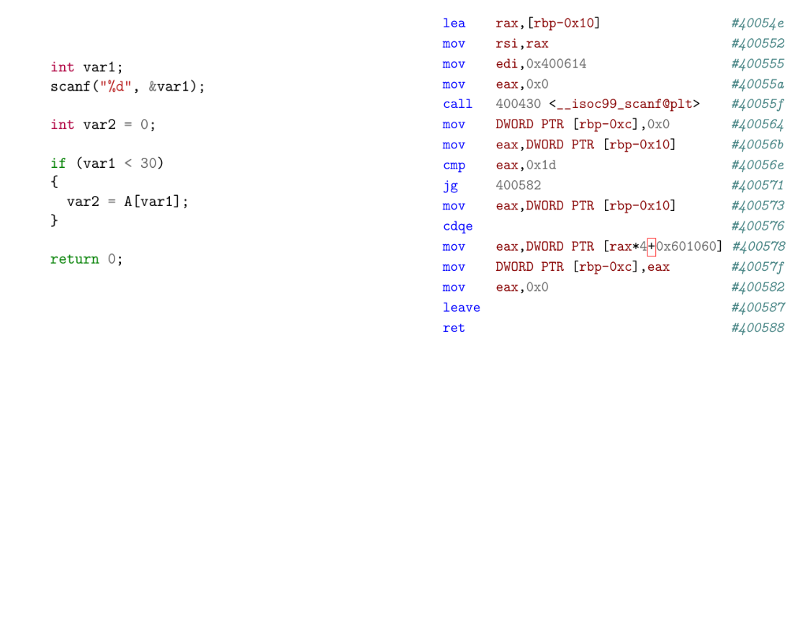
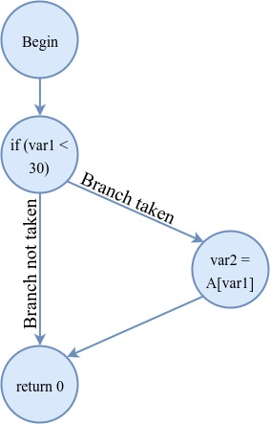
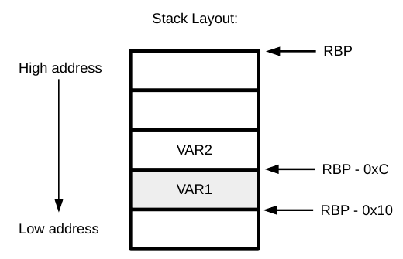
Illustrating example:
Notes:
To better illustrate our idea, we have here an illustrating example. On the left side we have a code that has memory access vulnerability, because we don’t check lower bound of var1. Thus, user can input any negative value, like -100 and var2 will become value that is outside A’s bounds. To better explain how our tool can detect this vulnerability, on the left side we have corresponding assembly code. Let’s proceed instruction by instruction.
…….
Note that in order for our tool to be able to detect the vulnerability, we have to provide it with inputs that will take the application on the same path in control-flow graph that it would go on if the input was making the memory error happen.
That is, if the entered value was more then 30, the tool wouldn’t be able to detect anything then.
So, this is the idea behind KATU. Now let’s take a look at how we can implement it.

Slide 9
Illustrating example:
Notes:
To better illustrate our idea, we have here an illustrating example. On the left side we have a code that has memory access vulnerability, because we don’t check lower bound of var1. Thus, user can input any negative value, like -100 and var2 will become value that is outside A’s bounds. To better explain how our tool can detect this vulnerability, on the left side we have corresponding assembly code. Let’s proceed instruction by instruction.
…….
Note that in order for our tool to be able to detect the vulnerability, we have to provide it with inputs that will take the application on the same path in control-flow graph that it would go on if the input was making the memory error happen.
That is, if the entered value was more then 30, the tool wouldn’t be able to detect anything then.
So, this is the idea behind KATU. Now let’s take a look at how we can implement it.

Slide 10
Illustrating example:
Notes:
To better illustrate our idea, we have here an illustrating example. On the left side we have a code that has memory access vulnerability, because we don’t check lower bound of var1. Thus, user can input any negative value, like -100 and var2 will become value that is outside A’s bounds. To better explain how our tool can detect this vulnerability, on the left side we have corresponding assembly code. Let’s proceed instruction by instruction.
…….
Note that in order for our tool to be able to detect the vulnerability, we have to provide it with inputs that will take the application on the same path in control-flow graph that it would go on if the input was making the memory error happen.
That is, if the entered value was more then 30, the tool wouldn’t be able to detect anything then.
So, this is the idea behind KATU. Now let’s take a look at how we can implement it.

Slide 11
Illustrating example:
Notes:
To better illustrate our idea, we have here an illustrating example. On the left side we have a code that has memory access vulnerability, because we don’t check lower bound of var1. Thus, user can input any negative value, like -100 and var2 will become value that is outside A’s bounds. To better explain how our tool can detect this vulnerability, on the left side we have corresponding assembly code. Let’s proceed instruction by instruction.
…….
Note that in order for our tool to be able to detect the vulnerability, we have to provide it with inputs that will take the application on the same path in control-flow graph that it would go on if the input was making the memory error happen.
That is, if the entered value was more then 30, the tool wouldn’t be able to detect anything then.
So, this is the idea behind KATU. Now let’s take a look at how we can implement it.

Slide 12
Illustrating example:
Notes:
To better illustrate our idea, we have here an illustrating example. On the left side we have a code that has memory access vulnerability, because we don’t check lower bound of var1. Thus, user can input any negative value, like -100 and var2 will become value that is outside A’s bounds. To better explain how our tool can detect this vulnerability, on the left side we have corresponding assembly code. Let’s proceed instruction by instruction.
…….
Note that in order for our tool to be able to detect the vulnerability, we have to provide it with inputs that will take the application on the same path in control-flow graph that it would go on if the input was making the memory error happen.
That is, if the entered value was more then 30, the tool wouldn’t be able to detect anything then.
So, this is the idea behind KATU. Now let’s take a look at how we can implement it.

Slide 13
Illustrating example:
Notes:
To better illustrate our idea, we have here an illustrating example. On the left side we have a code that has memory access vulnerability, because we don’t check lower bound of var1. Thus, user can input any negative value, like -100 and var2 will become value that is outside A’s bounds. To better explain how our tool can detect this vulnerability, on the left side we have corresponding assembly code. Let’s proceed instruction by instruction.
…….
Note that in order for our tool to be able to detect the vulnerability, we have to provide it with inputs that will take the application on the same path in control-flow graph that it would go on if the input was making the memory error happen.
That is, if the entered value was more then 30, the tool wouldn’t be able to detect anything then.
So, this is the idea behind KATU. Now let’s take a look at how we can implement it.

Slide 14
Illustrating example:
Notes:
To better illustrate our idea, we have here an illustrating example. On the left side we have a code that has memory access vulnerability, because we don’t check lower bound of var1. Thus, user can input any negative value, like -100 and var2 will become value that is outside A’s bounds. To better explain how our tool can detect this vulnerability, on the left side we have corresponding assembly code. Let’s proceed instruction by instruction.
…….
Note that in order for our tool to be able to detect the vulnerability, we have to provide it with inputs that will take the application on the same path in control-flow graph that it would go on if the input was making the memory error happen.
That is, if the entered value was more then 30, the tool wouldn’t be able to detect anything then.
So, this is the idea behind KATU. Now let’s take a look at how we can implement it.

Slide 15
Illustrating example:
Notes:
To better illustrate our idea, we have here an illustrating example. On the left side we have a code that has memory access vulnerability, because we don’t check lower bound of var1. Thus, user can input any negative value, like -100 and var2 will become value that is outside A’s bounds. To better explain how our tool can detect this vulnerability, on the left side we have corresponding assembly code. Let’s proceed instruction by instruction.
…….
Note that in order for our tool to be able to detect the vulnerability, we have to provide it with inputs that will take the application on the same path in control-flow graph that it would go on if the input was making the memory error happen.
That is, if the entered value was more then 30, the tool wouldn’t be able to detect anything then.
So, this is the idea behind KATU. Now let’s take a look at how we can implement it.

Slide 16
Illustrating example:
Notes:
To better illustrate our idea, we have here an illustrating example. On the left side we have a code that has memory access vulnerability, because we don’t check lower bound of var1. Thus, user can input any negative value, like -100 and var2 will become value that is outside A’s bounds. To better explain how our tool can detect this vulnerability, on the left side we have corresponding assembly code. Let’s proceed instruction by instruction.
…….
Note that in order for our tool to be able to detect the vulnerability, we have to provide it with inputs that will take the application on the same path in control-flow graph that it would go on if the input was making the memory error happen.
That is, if the entered value was more then 30, the tool wouldn’t be able to detect anything then.
So, this is the idea behind KATU. Now let’s take a look at how we can implement it.

Slide 17
Illustrating example:
Notes:
To better illustrate our idea, we have here an illustrating example. On the left side we have a code that has memory access vulnerability, because we don’t check lower bound of var1. Thus, user can input any negative value, like -100 and var2 will become value that is outside A’s bounds. To better explain how our tool can detect this vulnerability, on the left side we have corresponding assembly code. Let’s proceed instruction by instruction.
…….
Note that in order for our tool to be able to detect the vulnerability, we have to provide it with inputs that will take the application on the same path in control-flow graph that it would go on if the input was making the memory error happen.
That is, if the entered value was more then 30, the tool wouldn’t be able to detect anything then.
So, this is the idea behind KATU. Now let’s take a look at how we can implement it.

Slide 18
Illustrating example:
Notes:
To better illustrate our idea, we have here an illustrating example. On the left side we have a code that has memory access vulnerability, because we don’t check lower bound of var1. Thus, user can input any negative value, like -100 and var2 will become value that is outside A’s bounds. To better explain how our tool can detect this vulnerability, on the left side we have corresponding assembly code. Let’s proceed instruction by instruction.
…….
Note that in order for our tool to be able to detect the vulnerability, we have to provide it with inputs that will take the application on the same path in control-flow graph that it would go on if the input was making the memory error happen.
That is, if the entered value was more then 30, the tool wouldn’t be able to detect anything then.
So, this is the idea behind KATU. Now let’s take a look at how we can implement it.

Slide 19
Illustrating example:
Notes:
To better illustrate our idea, we have here an illustrating example. On the left side we have a code that has memory access vulnerability, because we don’t check lower bound of var1. Thus, user can input any negative value, like -100 and var2 will become value that is outside A’s bounds. To better explain how our tool can detect this vulnerability, on the left side we have corresponding assembly code. Let’s proceed instruction by instruction.
…….
Note that in order for our tool to be able to detect the vulnerability, we have to provide it with inputs that will take the application on the same path in control-flow graph that it would go on if the input was making the memory error happen.
That is, if the entered value was more then 30, the tool wouldn’t be able to detect anything then.
So, this is the idea behind KATU. Now let’s take a look at how we can implement it.

Slide 20
Illustrating example:
Notes:
To better illustrate our idea, we have here an illustrating example. On the left side we have a code that has memory access vulnerability, because we don’t check lower bound of var1. Thus, user can input any negative value, like -100 and var2 will become value that is outside A’s bounds. To better explain how our tool can detect this vulnerability, on the left side we have corresponding assembly code. Let’s proceed instruction by instruction.
…….
Note that in order for our tool to be able to detect the vulnerability, we have to provide it with inputs that will take the application on the same path in control-flow graph that it would go on if the input was making the memory error happen.
That is, if the entered value was more then 30, the tool wouldn’t be able to detect anything then.
So, this is the idea behind KATU. Now let’s take a look at how we can implement it.

Slide 21
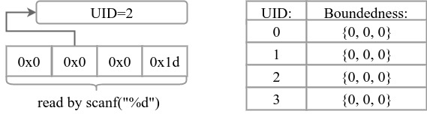
How to achieve it? First attempt
Associate Unique ID (UID) to every tainted byte
Keep boundedness info for each UID
When used in memory access, do the check
Notes:
Easiest way to implement it is to associate some ID, let’s call it Unique ID (UID) to every tainted byte and for each UID keep track of boundedness information. Here, let’s say we read an integer with scanf. As you can see, each byte will have separate UID and each UID, in some other table, will have 3 bits: bounded from below, bounded from up and fixed. Fixed is the case when tainted variable compares equal to some constant or untainted data.
So, then, whenever we want to check boundedness of the variable we just check corresponding UIDs.
Simple, but it doesn’t work.

Slide 22
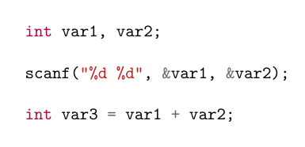
Problems with first attempt
What can we do in this case?
Notes:
What can we do in this case? What do we associate with var3? We cannot associate some new UID with it because boundednesses of var3 and var1 and var2 are dependent. If var1 and var2 are tainted, var3 is also tainted. We cannot also associate new UID and calculate the boundedness of this new uid at assignment time because var1 and var2 can be unbounded at assignment time but become bounded later.

Slide 23
How to achieve it? Second attempt
Associate Taint ID (TID) to every tainted byte.
For each TID, keep track of UID’s and operations it’s composed of.
Keep boundedness info for each UID.
Notes:
To fix it, we came up with concept of Taint ID (TID). We associate for each tainted byte TID and for each TID we remember what are the UIDs that its made from. When we read data, together with creating UIDs we create corresponding TIDs that are made with only this UID.
So in our example, for var1 and var2 we will have TID’s that are made by only one UID, and for var3, corresponding TID will be made of 2 UID’s. As you can see on the picture, TID 10 corresponds to UID 2, and one operation +6. We call such TID’s composed TIDs.
Now we can keep track of dependencies of UIDs, but what if composed TID gets constrained?
Note that boundedness information we still keep with UIDs.

Slide 24
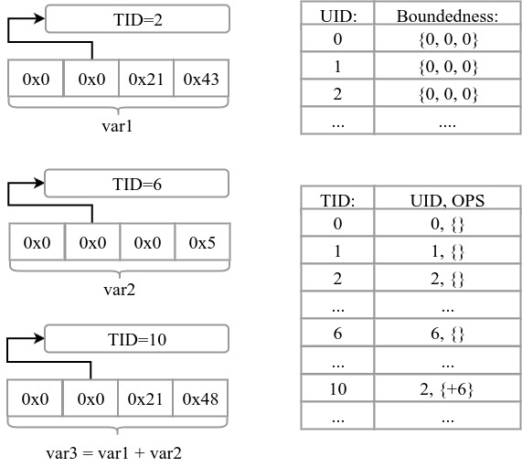
Example:

Slide 25
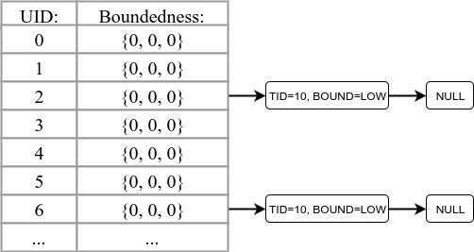
What if var3 gets constrained now?
Affects all UIDs that var3’s TID is connected to
Create Group Restriction (GR)
Associate GR with all UID’s it’s related to
Notes:
Constrainting var3 affects all UIDs that it is related to. To keep track of it, whenever a composed TID gets restricted we create a special object, called Group Restriction (GR) for each related UID. This GR consists of which TID got constrained and what was the constraint type (from below, from top or equal). Then, for each UID we keep linked list of all related GR’s. In this case, GR with TID 10 would get associated with UIDs 2 and 6 because TID 10 is made by UIDs 2 and 6.

Slide 26
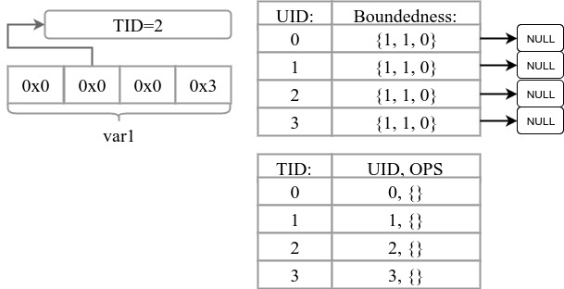
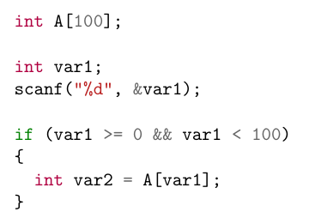
Solving boundedness
How can we check boundedness of variable?
  Simple case:
How about more general case?
Notes:
…
But what about the more general case, where we want to check boundedness of composed TID?

Slide 27
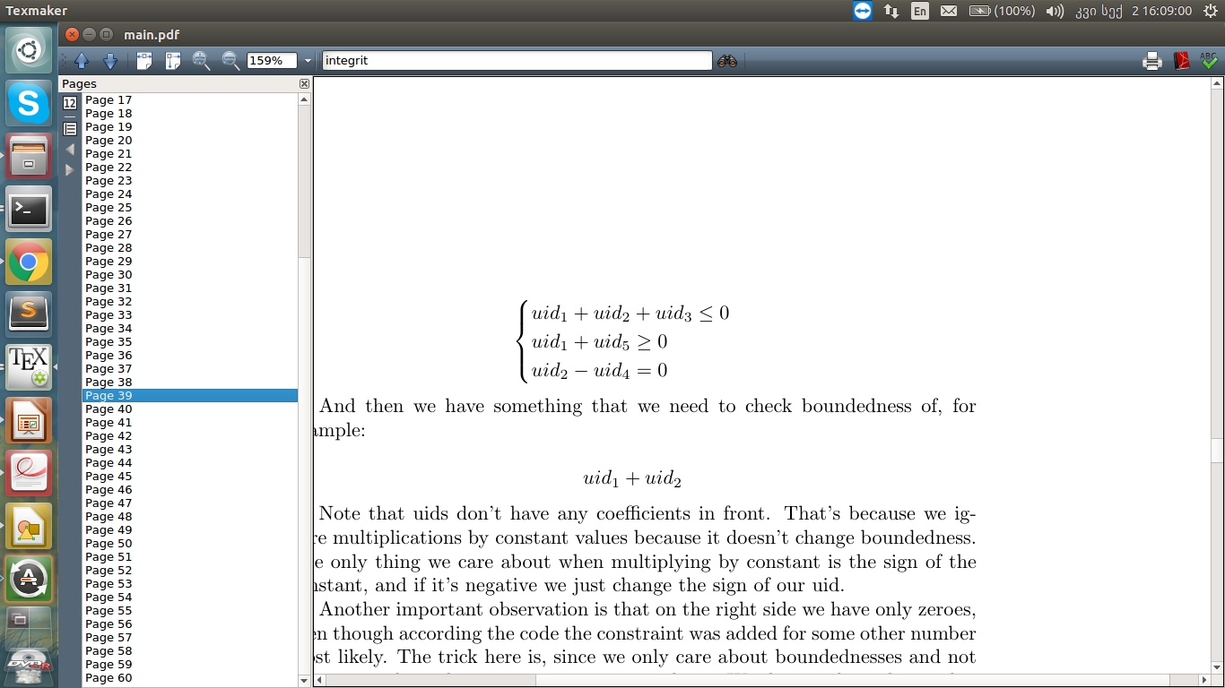
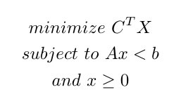
Solving boundedness
We have per-UID boundednesses and GR’s:
Trying to check boundedness of:
It is a Linear programming problem!
Notes:
Boundednesses of UIDs are inequalities of those UIDs. GR’s correspond to inequalities of sums of UIDs, like here on the picture. The TID that we are trying to check boundedness of is also sum of several UIDs. Thus, we have following picture, which fits in a template of a linear programming problem as we see here! So, we have imported a linear programming solver lp_solve and ask it to solve boundednesses in KATU. It works.

Slide 28
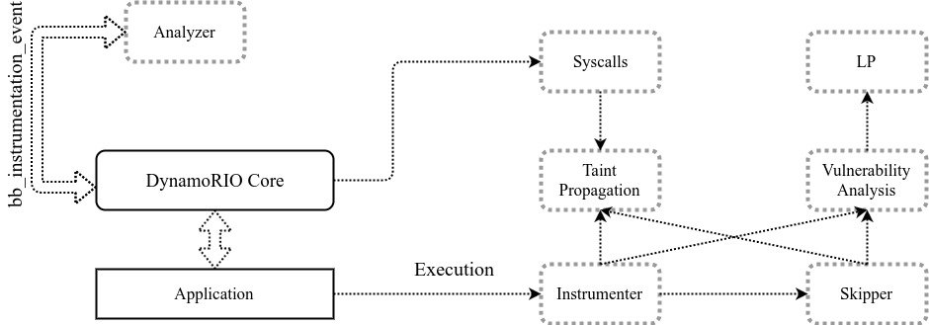
Architecture of KATU
Notes:
Now it’s time to talk about the architecture. KATU is split into several modules as you can see here. For instrumenting, DynamoRIO gives basic blocks to Analyer module. This module iterates over all instructions in basic block, fetches opcodes and decodes variants of the instruction (exampe….) and depending on it inserts a corresponding clean call. Clean call is a mechanism in DynamoRIO to insert call to some function from any point in the stream of instructions.
Functions called via clean-call are instruction dendent routines that reside in Instrumented. Some of them do just taint propagation, for which it asks TP module to do corresponding changes to shadow memory.
Some of them are conditional operations, in which case Instrumenter updates bound informations of corresponding UIDs (or creates Grs)
Some of them are potentially vulnerable operations, like jumps or memory accesses. For those, Instrumenter asks VA tool to check for the boundedness of jump target or memory address. VA uses LP module whenever it needs to.
Skipper is something we haven’t yet talked about. Since we are analyzing programs written in C programming language, all of them are linked to and use routines from libc. The idea of the skipper is, since libc routines are simple and well-defined, we can skip instrumenting them instruction by instruction. Instead, we can manually do the corresponding changes to shadow memory, that will summarize the execution of libc function. For example, instead instrumenting memcpy instruciton by instruciton we can manually copy taint information from source to the destination. This is, on one hand perf. Improvement since summary functions are way faster then ins-by-ins analysis, and on the other hand functions in libc are highly optimized and thus highly complicated. Thus, it can be tricky to analyze them for our tool, which can lead to false positive or negative. Skipper also solves this problem for us.

Slide 29
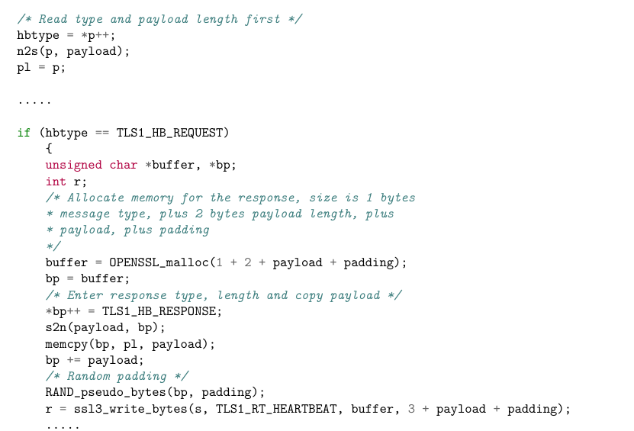
Results
Heartbleed: Detected!
Notes:
Our primary goal was to detect a heartbleed vulnerability. Heartbleed is a vulnerability in OpenSSL, open source implementation of TLS/SSL protocols that was found in 2014. It is a bug caused by missing bounds check, exactly the kind of problem our tool is hunting on. Bug happens in heartbeat extension, which is used to check if the connection is still alive. To check if we would be able to detect it, we implemented small server and client applications that would establish OpenSSL encrypted connection and exchange heartbeat requests. KATU detected the vulnerability!
Apart from that, we wanted to check if our tool would find some new vulnerability in existing and well-known libraries as well. Thus, we ran regression tests of libjpeg, binutils and libxml with our tool. As you can see from the statistics table below, in some cases our tool incurs slowdown of up to 5200 times. Such a huge slowdown can be explained by following factors:
...

Slide 30
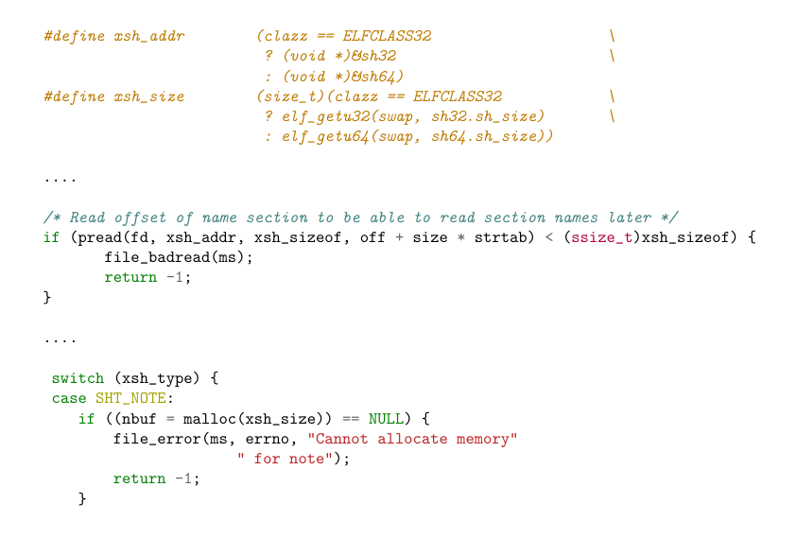
Results
Unbounded malloc() in file(1) version 5.22
In readelf.c:

Slide 31
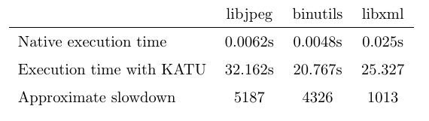
Tool performance
Regression tests of: libjpeg, binutils, libxml
Slowdown reasons:
  Clean call for each instruction
  Byte-level processing

Slide 32
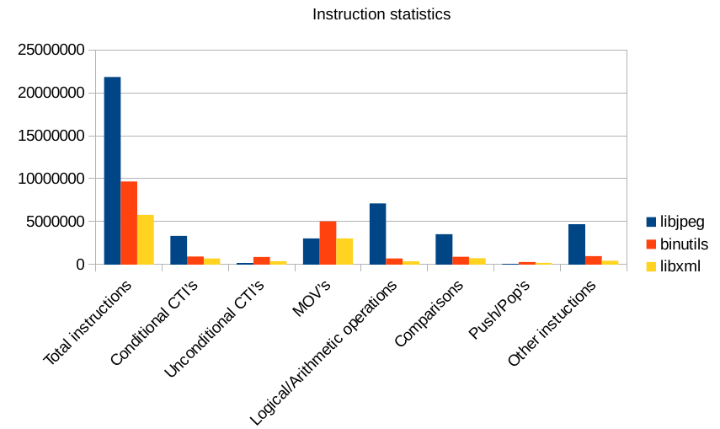
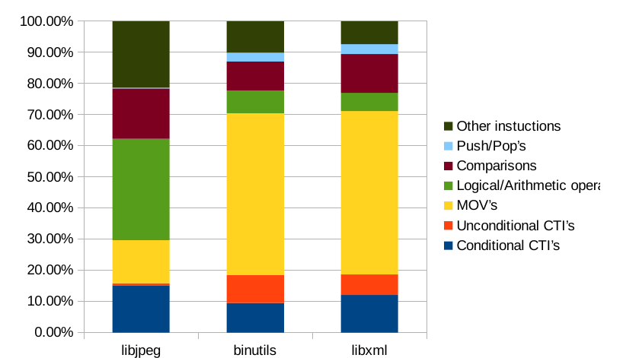
Statistics
Notes:
Even though we couldn’t find any vulnerability in those libraries, but we have collected and visualised some useful statistics. Here you can see the statistics about the instruction usage inside regression tests. First one shows total number of instructions, then split into categories and the second one is made from same data but shows distribution of types of instructions withing the regression tests.

Slide 33
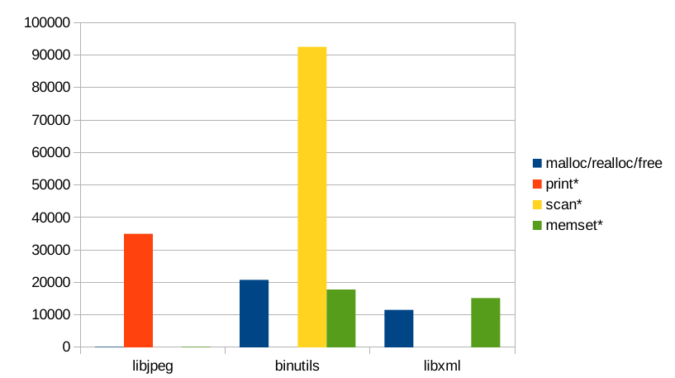
Statistics
Notes:
And here we have also dumped statistics of libc usage of regression tests.

Slide 34
Thank you!
Questions?

