Slide 1


Ecommerce Data Dashboard
Sirus Baladi & Jimmy Baranello

Slide 2
Presentation Outline
User-case
Database Design
E-R Model
Participation and key constraints
Queries
UI
User interaction
Queries output
Attention to details

Slide 3

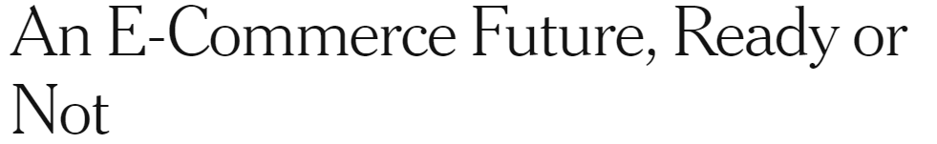

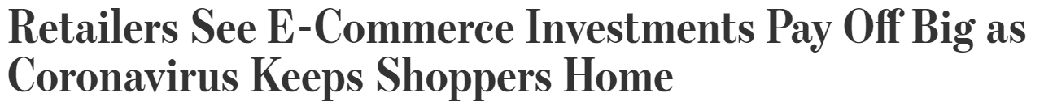
User Case
Establish a link between the legalization of abortion and future crime
Centralized dashboard for quick data overview
For Ecommerce owners
Notes:
Career choices agents can make if they are forward looking / anticipate a future driven by Automation

Slide 4
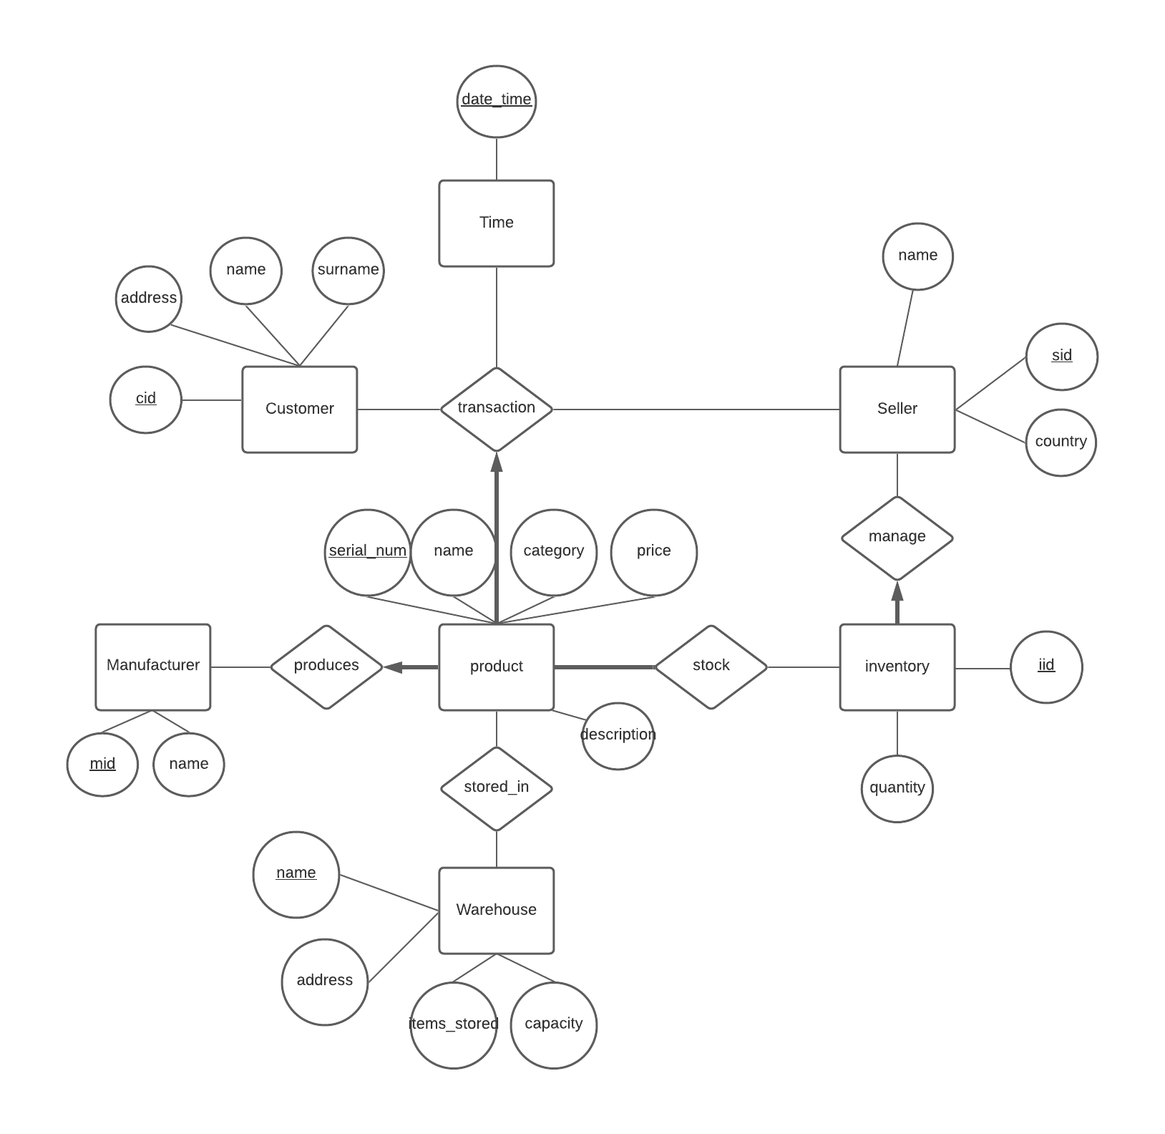
Database Design
ER-Model
7 entity sets
5 relationship sets
20 attributes
Notes:
Proditble in the longterm, they can’t afford it

Slide 5
Database Design
Participation &
Key Constraints
Product - produces - transaction
Inventory - Manage
Stock - Product
Notes:
A customer and a seller transact a product at a specific timestamp. We want to record every time they transact and the specific price they transact the product at.
The customer has an address, a unique cid, a name and surname.
The seller has a name, distinct sid, and country.
The product has a serial number, name, description and category. It is produced by one manufacturer with a unique mid and name. Each product, having a unique serial number, must have only one seller and one customer. A product has to be listed by a seller to be recorded in our database.
A seller manages an inventory that has an iid and tracks the product quantity. Sellers store the product they want to sell in warehouses. The warehouses have a distinct name, and they also have an address, capacity and number of items stored.

Slide 6
Queries
Use of joins and GROUP BY
16 Tables Joined & 2 Group By
Examples
Total Sales By Date & Seller
2 tables joined and a GROUP BY
Best Selling Products
4 joined a group by
Notes:
Proditble in the longterm, they can’t afford it

Slide 7
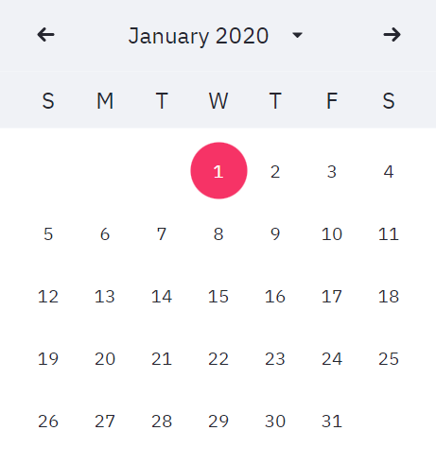
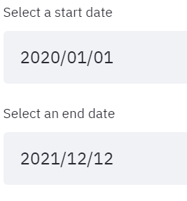
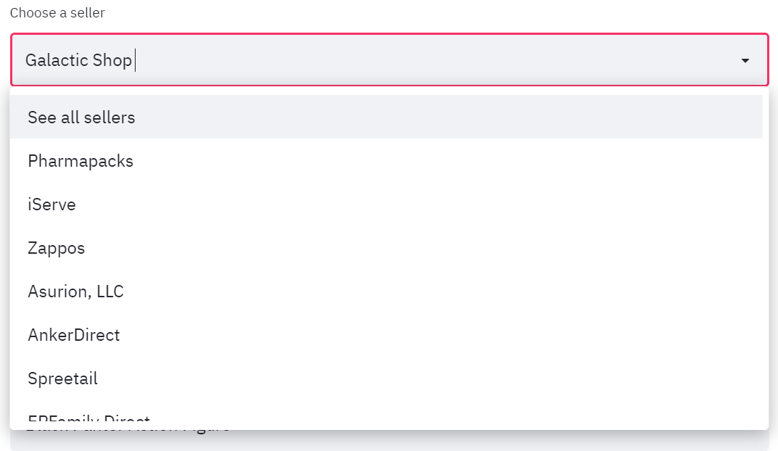
User interaction
Date selection
Drop downs
Notes:
Proditble in the longterm, they can’t afford it

Slide 8
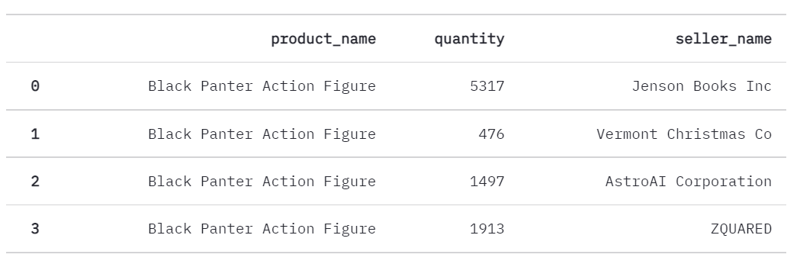
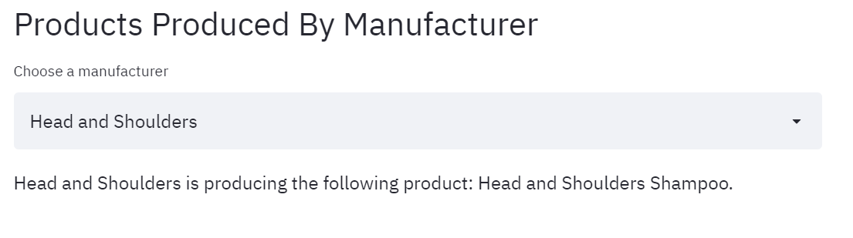
Queries Output
Tables
Text
Notes:
Proditble in the longterm, they can’t afford it

Slide 9
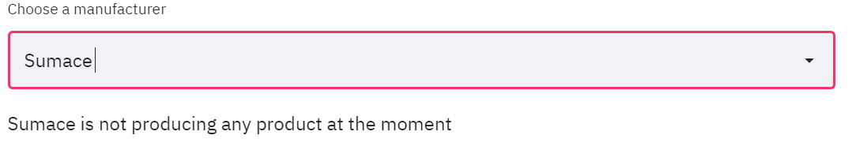
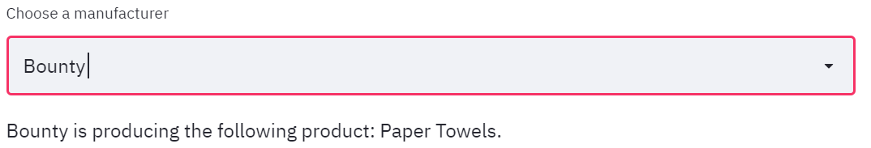
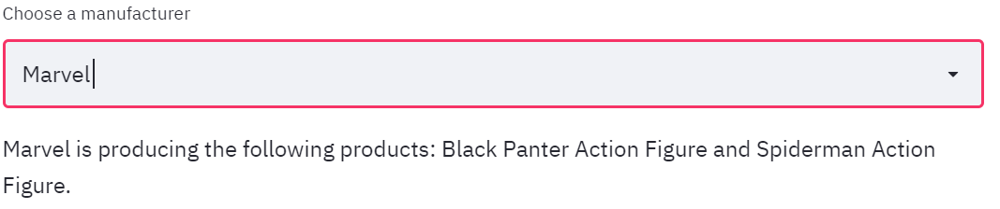
Attention to details
Example
Notes:
Proditble in the longterm, they can’t afford it

Slide 10
Thank you

