Slide 1


In-Memory Performance
Durability of Disk

Slide 2

Distributed Database DevOps Dilemmas?
Kubernetes to the Rescue
Denis Magda
Ignite PMC Chair
GridGain Director of Product Management

Slide 3
Agenda
Apache Ignite
Clustering and Deployment
Orchestration Specificities
Kubernetes Deployment
Scaling the Cluster
Demo

Slide 4
Apache Ignite In-Memory Computing Platform
Financial
Services
Telco
Travel &
Logistics
E-Commerce
Pharma &
Healthcare
IoT
SQL
Key/Value
Transactions
Compute
Services
Streaming
ML
Memory-Centric Database
Ignite Native Persistence
(Flash, SSD, Intel 3D XPoint)
Third-Party Persistence
(RDBMS, HDFS, NoSQL)
Notes:
The Apache Ignite Platform
Apache Ignite is a memory-centric data platform that is used to build fast, scalable & resilient solutions.
At the heart of the Apache Ignite platform lies a distributed memory-centric data storage platform with ACID semantics, and powerful processing APIs including SQL, Compute, Key/Value and transactions. Built with a memory-centric approach, this enables Apache Ignite to leverage memory for high throughput and low latency whilst utilising local disk or SSD to provide durability and fast recovery.
The main difference between the memory-centric approach and the traditional disk-centric approach is that the memory is treated as a fully functional storage, not just as a caching layer, like most databases do. For example, Apache Ignite can function in a pure in-memory mode, in which case it can be treated as an In-Memory Database (IMDB) and In-Memory Data Grid (IMDG) in one.
On the other hand, when persistence is turned on, Ignite begins to function as a memory-centric system where most of the processing happens in memory, but the data and indexes get persisted to disk. The main difference here from the traditional disk-centric RDBMS or NoSQL system is that Ignite is strongly consistent, horizontally scalable, and supports both SQL and key-value processing APIs.
Apache Ignite platform can be integrated with third-party databases and external storage mediums and can be deployed on any infrastructure. It provides linear scalability, built-in fault tolerance, comprehensive security and auditing alongside advanced monitoring & management.
The Apache Ignite platform caters for a range of use cases including: Core banking services, Real-time product pricing, reconciliation and risk calculation engines, analytics and machine learning.

Slide 5
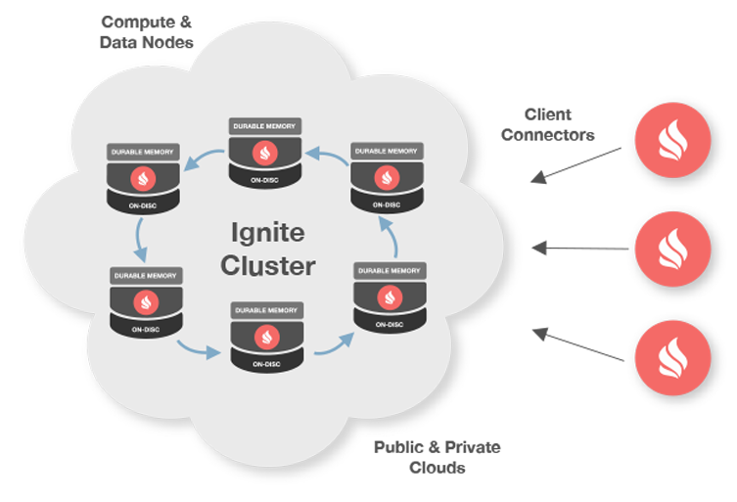
Clustering
Server Nodes
Act as containers for data and computations
Generally started as standalone processes
Client Nodes
Provide a cluster entry point to run operations
Embedded in applications code

Slide 6
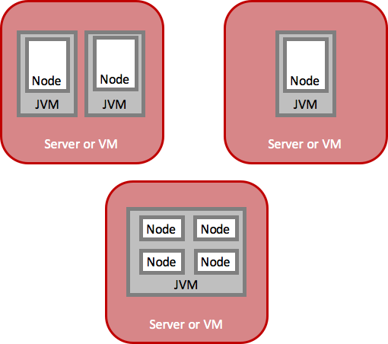
Deployment
Nodes are logical entities
Runs in a JVM process
Many nodes in a single JVM process
On-Premise and Cloud
Physical server or VM
AWS, Azure, Google Compute Engine
Kubernetes, Mesos, YARN

Slide 7
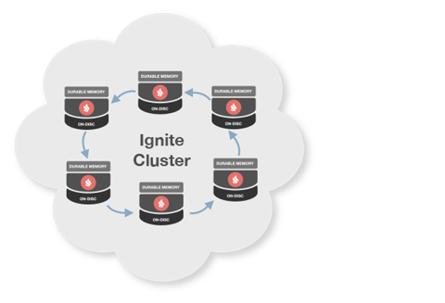
IP Finder
Networking subsystem component
Knows IP addresses of cluster members
Multiple Implementation
Multicast
Static (predefined IPs)
Cloud (AWS, Azure, etc.)
Kubernetes!

Slide 8
Orchestration Specificities
Cluster Discovery
Nodes IP addresses are unknown
IP addresses change after restarts
Kubernetes to the rescue!
In-Cluster Communication
Peer-to-peer
Self-Healing
Self-Contained
Based on Ignite facilities
+

Slide 9
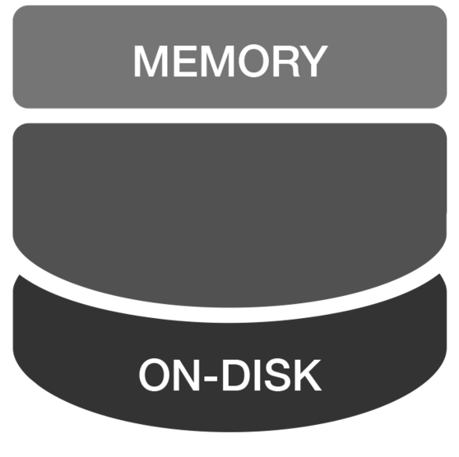

Kubernetes Deployment
Kubernetes
Lookup Service
Kubernetes Lookup Service
Maintains a list of the Ignite IPs
Kubernetes IP Finder
Communicates to the service
Ignite pod obtains existing addresses
The pod joins the cluster using an address
1
Server Node
2
ON-DISK

Slide 10

Create the Lookup Service
apiVersion: v1
kind: Service
metadata:
name: ignite
spec:
clusterIP: None
ports:
- port: 9042 # custom value.
selector:
app: ignite
kubectl create -f ignite-service.yaml

Slide 11

Deploy Apache Ignite Cluster
apiVersion: extensions/v1beta1
kind: Deployment
metadata:
name: ignite-cluster
spec:
# Start two Ignite nodes by default.
replicas: 2
template:
metadata:
labels:
app: ignite
spec:
containers:
# Custom Ignite pod name.
- name: ignite-node
image: apacheignite/ignite:2.3.0
env:
- name: OPTION_LIBS
value: ignite-kubernetes
- name: CONFIG_URI
value: https://raw.githubusercontent.com/apache/ignite/master/modules/kubernetes/config/example-kube.xml
kubectl create -f ignite-deployment.yaml

Slide 12
Scaling the Cluster
From:
To:
kubectl scale --replicas=5 -f ignite-deployment.yaml

Slide 13
Demo

Slide 14
Any Questions?
Thank you for joining us. Follow the conversation.
http://ignite.apache.org
#apacheignite
#denismagda

