Slide 1
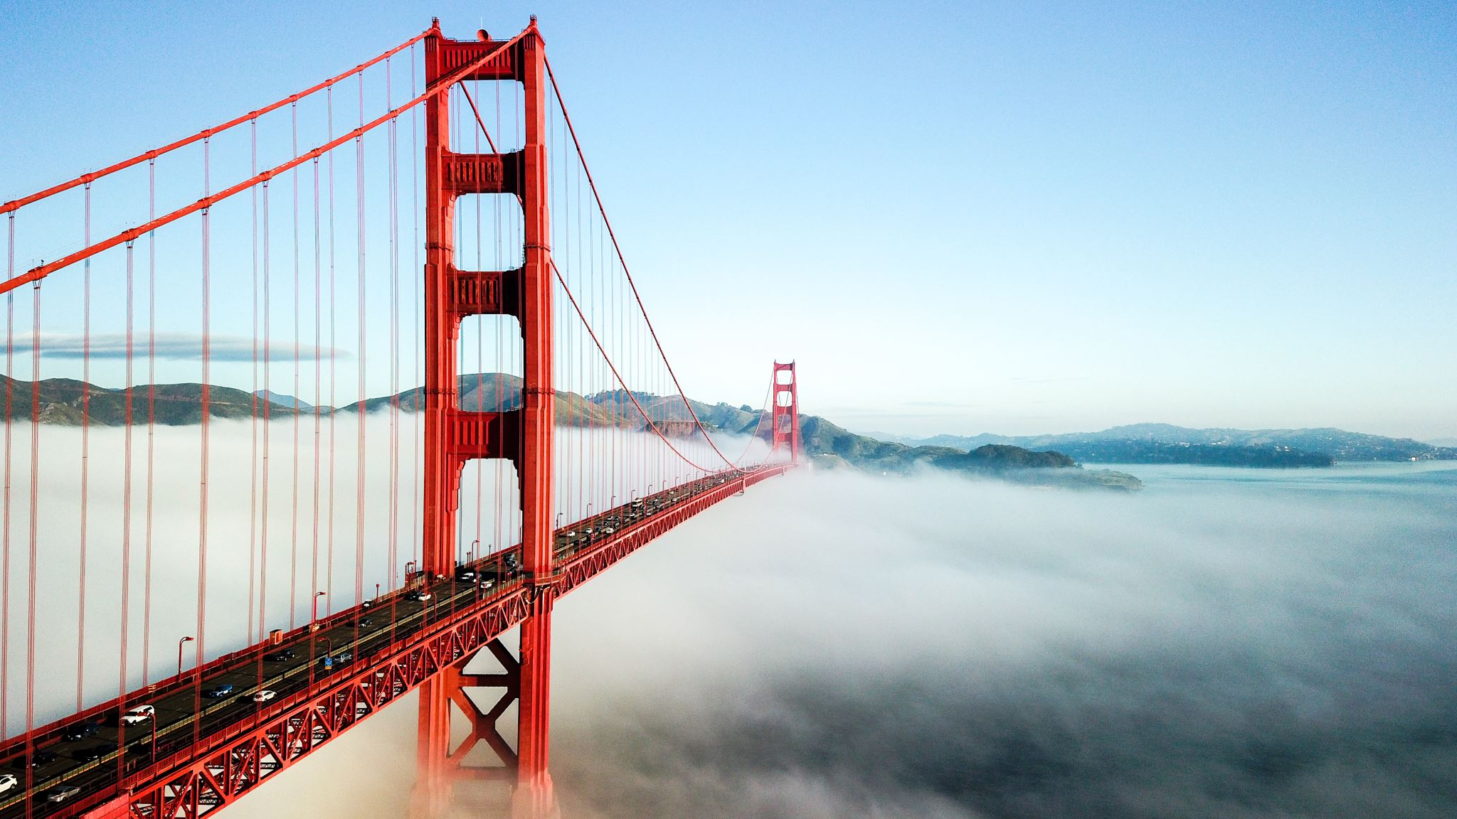
Start-up Location in San Francisco
by
Joseph Barjis

Slide 2

Content
Problem Description
Data Description
Data Collection
Methodology
Results
Discussion and Conclusion

Slide 3

PROBLEM DESCRIPTION
We (a team of 6 people) want to set up our office in an area with a rich concentration of Fortune 500 companies
The choice is California, where most of the Fortune 500 companies are located
Our hypothesis is that would be in Bay Area, between San Francisco and San Jose.
In this project, the aim is to:
Create a list of major companies (Fortune 500) in the US
Reduce the list to only the ones with headquarter in California
In CA, find out an area with most concentration of Fortune 500 headquarters
This insight already will help to decide on a suitable location for our start-up company.

Slide 4
DATA DESCRIPTION
The data used in this project were acquired from two sources
Based on these data, I will draw a map of locations that are favorable to other big companies (Fortune 500).
This exploration of locations should help me to recommend the right location for our start-up Data Science company.
DATA SOURCES
https://en.wikipedia.org/wiki/List_of_largest_companies_in_the_United_States_by_revenue
https://www.latlong.net/category/cities-236-15.html

Slide 5
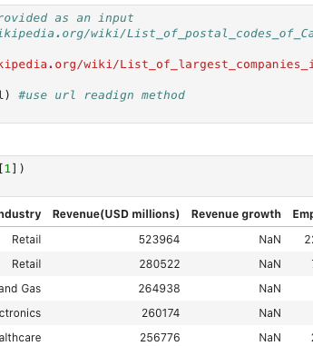
Methodology
Data Collection
The project used a Wiki page with a list of largest companies in the US. The web page processing resulted in three dataframes. The second one was the one with data I needed, i.e., name of the companies and their headquarter location.

Slide 6
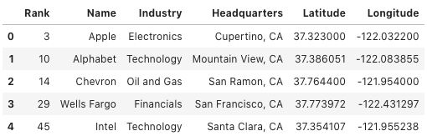
Results
First of all, finally, I was able to create one dataframe that contains the list of all Fortune 500 companies headquartered in California and added to each company their Long and Lat coordinates. I will also build a few visual reports that shows the final results.

Slide 7
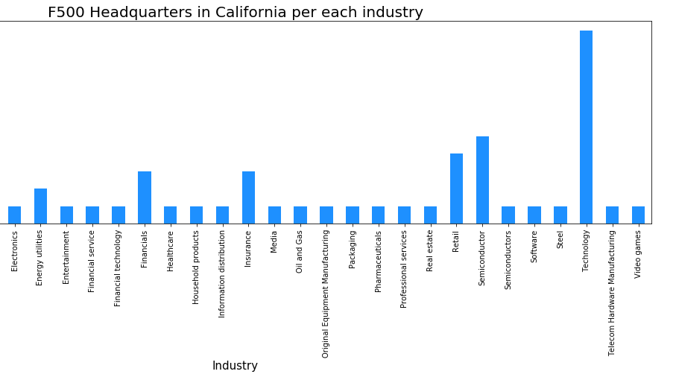
Data Visualization
Lest have a look what industry represents most of the Fortune 500 companies in CA. As seen below, it is Technology and second one is Semiconductor

Slide 8
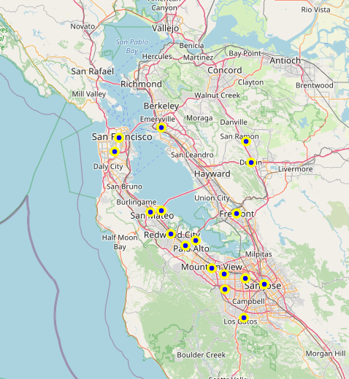
Superimpose Fortune 500 Headquarters onto the Map of Bay Area
As a final step, now we superimpose the headquarter of Fortune 500 companies that are located in the Bay Area, which was our primary goal for this project.

Slide 9
Discussion
This capstone project allowed to dive much deeper than any previous courses. It revealed that Data Science as much hard and technical skill as it is soft skill, imagination, and creativity. While of course accurate data collection and availability is crucial, but the many ways of presenting and visualizing it is even more important.
For me, it is a start of a new career. I took these courses to shift my career from Agile Development of Complex Enterprise Solutions to Data Science or a hybrid of the two.

Slide 10

Conclusion
This project is rather a start of much longer journey, in which I want to collect and visualize all type of data about Fortune 500 companies. They year by year performance, relocation of headquarters and their reasons, moving up and down the list of ranking, changes in industry, etc. However, here, I focused on California and specifically on Bay Area as we have vested interest in it.
One special thanks to the fellow leaner for grading this humble work!

