Slide 1
Sign Language Recognition
IVU Practicals (710.241)
WS 2024/2025
Jules Barreaux
jules.barreaux.student@tugraz.at

Slide 2
Project Objectives
Translate sign language gestures into text in real time using a webcam
Incorporate visual computing and deep learning methods
Focus on ASL Sign Language

Slide 3
Data Used
Data developed by a research team from Microsoft
More than 200 signers (different individuals)
Vocabulary of 1,000 distinct signs
Wide variability in the proposed videos
Data sets for training, validating, and testing the model

Slide 4
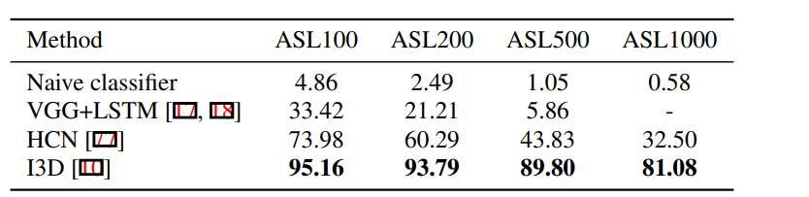
Using a CNN or RNN
LSTM (Long Short-Term Memory)
- Landmark detection
- An inconclusive approach
I3D (3D CNN)
- Based on the article by the research team that developed the MS-ASL database
- Use of raw images
- Promising results for real-time use

Slide 5
LSTM Data preparation
Extraction of hand landmarks from the different frames of each video with mediapipe
Landmark Normalization
Verification of the number of detected landmarks, and adjustment if necessary, to achieve a fixed length (truncation, padding)
Ensure a uniform vector for each frame
As a result, we obtain one file per video, containing vector of landmarks for each frame within it
Creation of fixed-length frame sequences from this data associated with their label

Slide 6
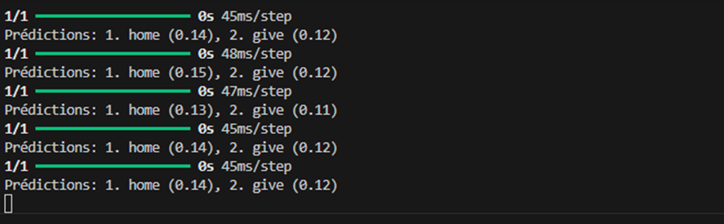
Recurrent Neural Network RNN (LSTM)
Usage of an LSTM model for sequence classification
Training the model while considering label underrepresentation or overrepresentation using class weights
Various errors were made

Slide 7
Data preparation I3D
Focus on 10 classes of words
20 to 30 videos for each sign
Increasing the amount of data to train the model:
- Contrast
- Cropping
- Brightness
- Horizontal flip
Creation of files containing a fixed number of frames representative of each video

Slide 8
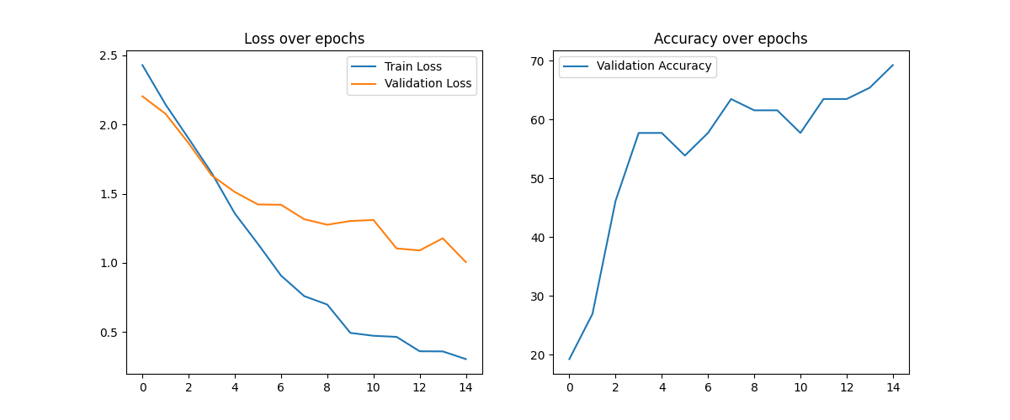
Training the I3D model
In the model, one of the four variations created during augmentation is passed for each class in each iteration
Between 15 and 20 data samples are passed through the model
At each iteration, the model's accuracy is measured using the validation data

Slide 9
Result with I3D Model
With the test data, an accuracy of approximately 70% to 80% on average
Better results obtained after data augmentation
The next steps will be:
- Creating more diverse data: different cropping, contrast, and noise
- Testing in real time
- With more classes

Slide 10
References
A Large-Scale Data Set and Benchmark for Understanding American Sign Language
What is LSTM? Introduction to Long Short-Term Memory
Long Short-Term Memory Networks
MS-ASL American Sign Language Dataset
MS-ASL: A Large-Scale Data Set and Benchmark for Understanding American Sign Language

